Slide 1
The Savvy Business Officer
School / Business Office Calendar
Palmer D. Ball Palmer D. Ball
Business Manager Palmer Ball Consulting, LLC
Spartanburg Day School palmerballconsulting@gmail.com
864-582-7539 864-266-8175

Slide 2
Calendar Dynamics
Schools are busy, a lot of events get squeezed into a short period of time
Flow of the business office doesn’t line up perfectly with the rest of the school
How do you manage the flow of meetings?
What data do you need, when and from who?
Who do you need to meet with regularly?
Controller, Facilities, Security, School store?
There are always surprises!

Slide 3
Business Officer Role / The Calendar
It’s Alumni Weekend and you have a 25th Reunion reception is scheduled in the building
There is terrible storm and it knocks out the HVAC to the room.
The school-wide fire alarm goes off due to smoke from a motor overheating during a power surge
And the Chair of the Finance Committee just asked you to revise the dashboard with five new pieces of information for the board meeting tomorrow morning.

Slide 4
Business Officer Role / The Calendar
There’s never a dull moment….
But you don’t panic!
You are organized and have planned for the many things that happen concurrently in the life of the school and the life of the Business Office!

Slide 5
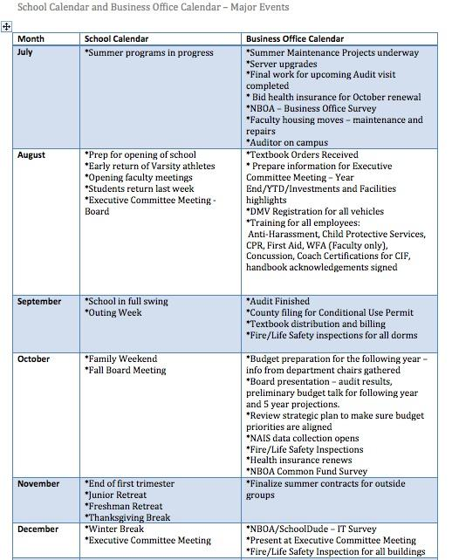
Business Officer Role – The Calendar July – Dec

Slide 6
Business Officer Role – The Calendar Jan-June

Slide 7
Business Officer Role / The Calendar
 | Business Office Calendar
Quarterly +/- | *Trustee Committee meetings – Finance, Investment, Human Resources, Buildings & Grounds, Long Range Planning *Sales tax reporting *Property and Sales taxes paid *Fire/Life safety inspections *Fire/Weather/Lockdown drills *Safety Meetings
Annual | *Backflow preventers certified *ERISA filings *990 *Audit for retirement plans

Slide 8
Business Officer Role / The Calendar
Also see calendar I use at Spartanburg Day School to populate my calendar each month (located in BOI 2016 Community).
I have included firm dates (Form 990 Due Date), as well as reminders to meet monthly with on site Food Service Manager and quarterly with Food Service Regional Manager and Vice President.
These dates are loaded on my calendar and pop up each month.

Slide 9
Any questions or suggestions? The End Go ‘Dores

