Slide 2
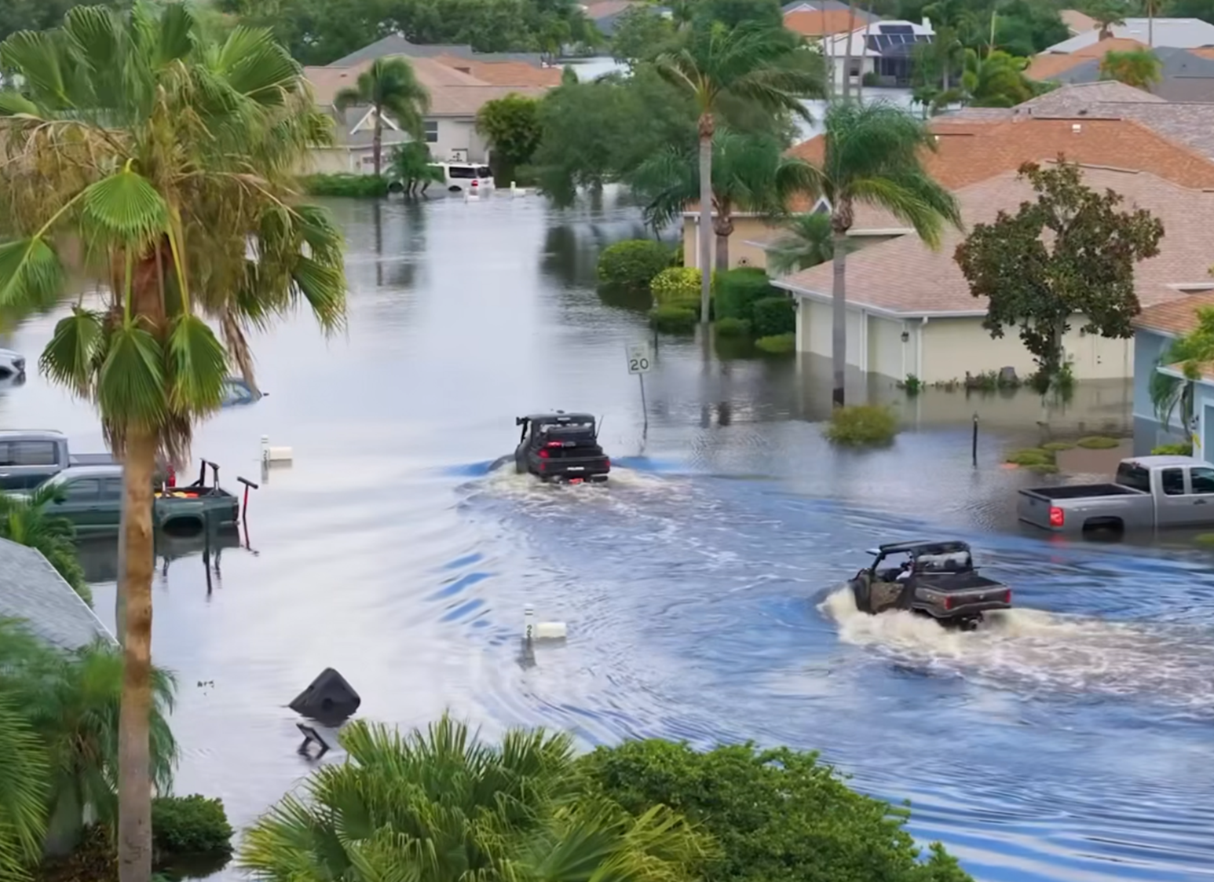
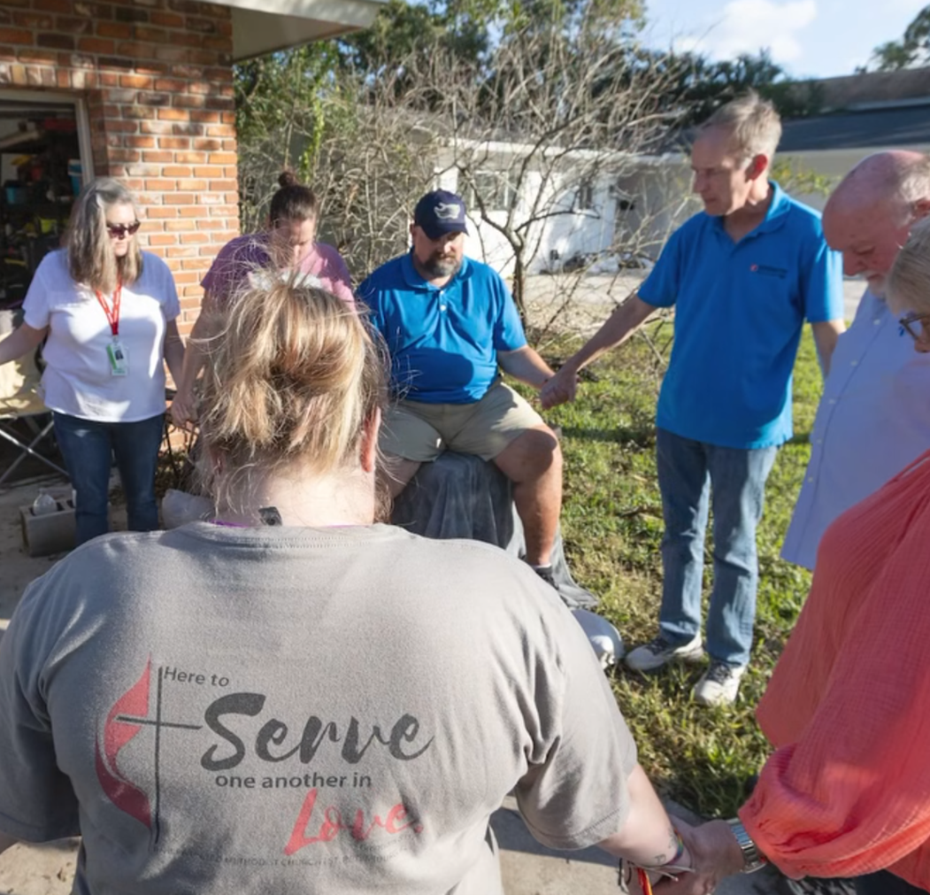
Pray for
Hurricane
Victims

Slide 3
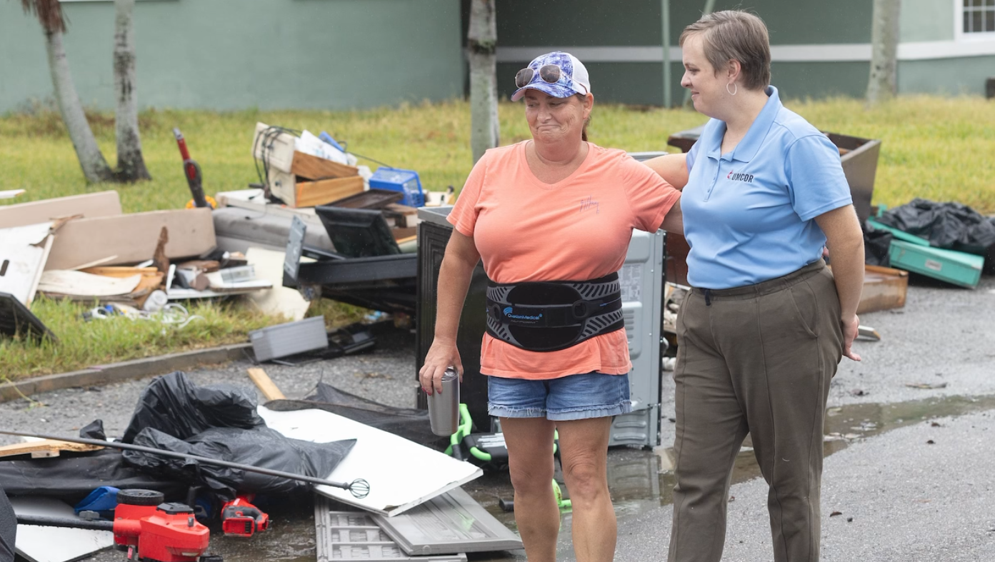

Slide 5
Job deals with Suffering
Psalms deal with Prayer
Proverbs deal with Daily Life
Ecclesiastes deals with Doubt
Song of Songs deals with Love

Slide 7
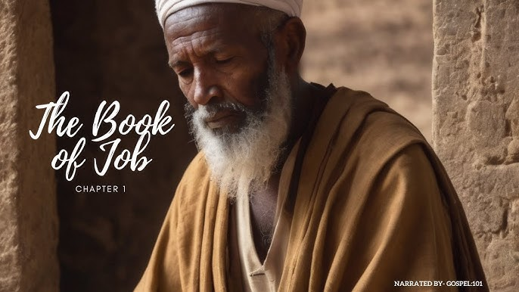

Slide 8
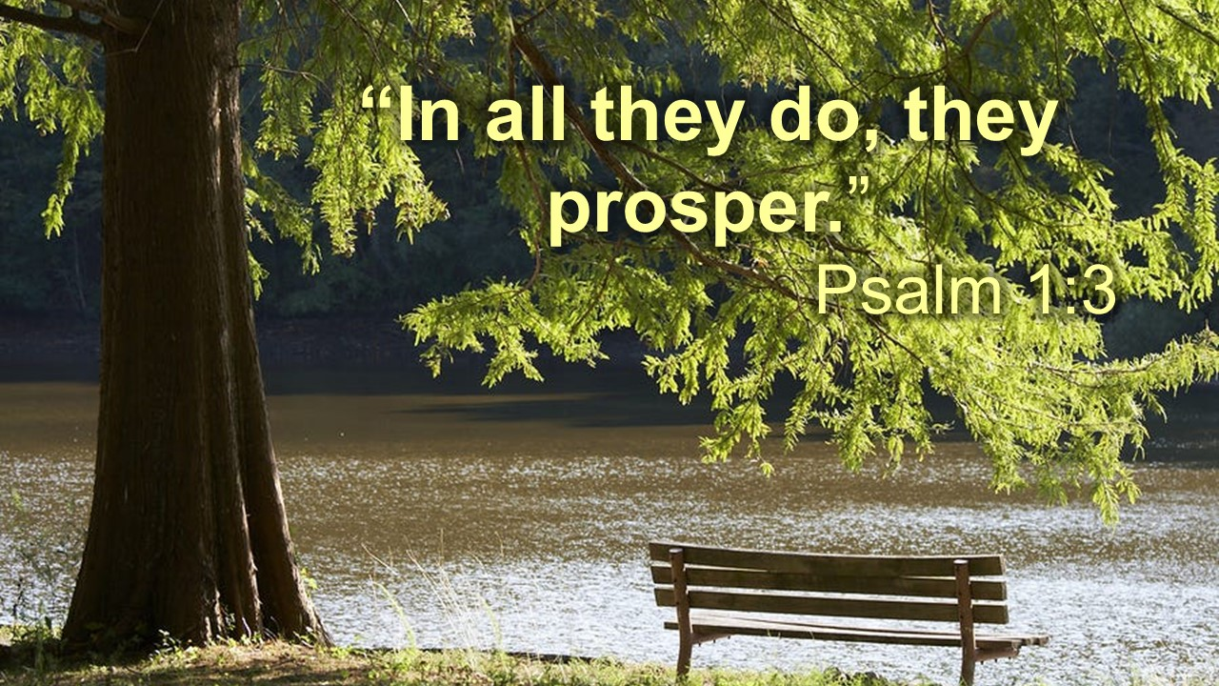

Slide 10
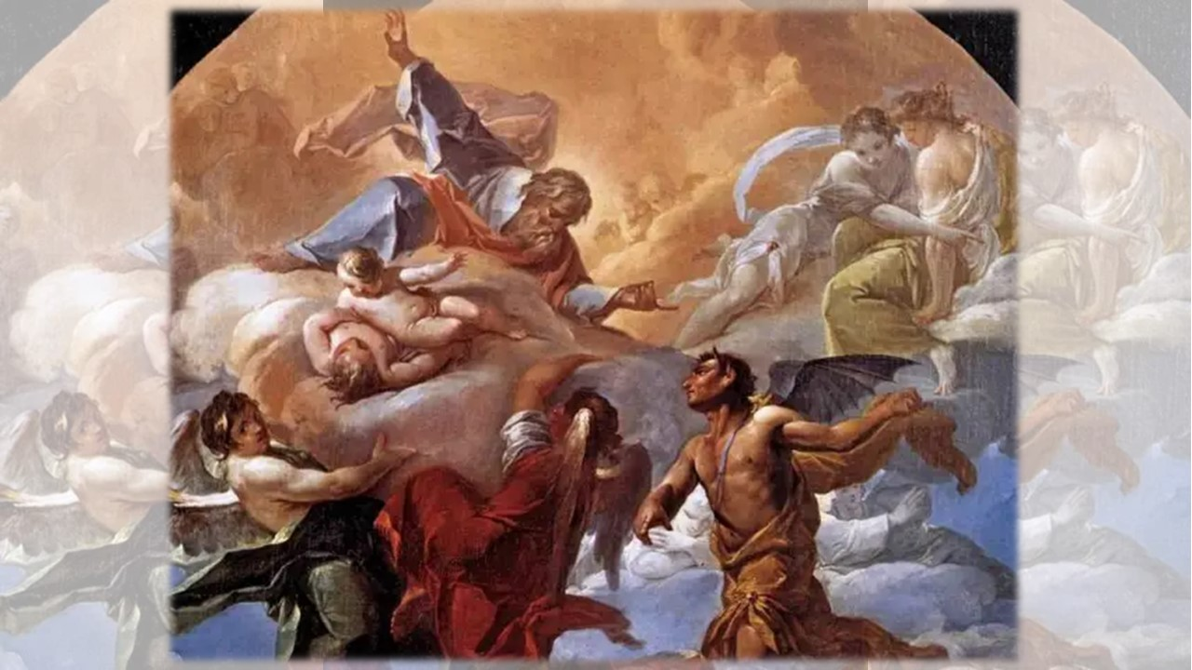

Slide 11
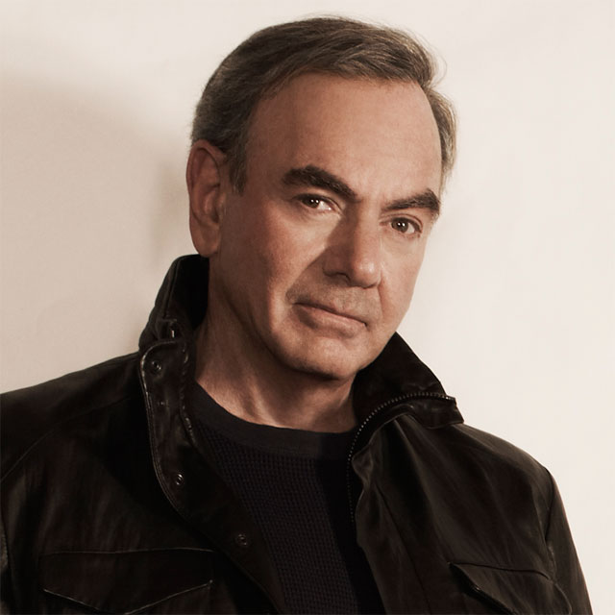
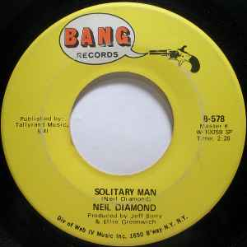
SOLITA
RY MAN

Slide 12
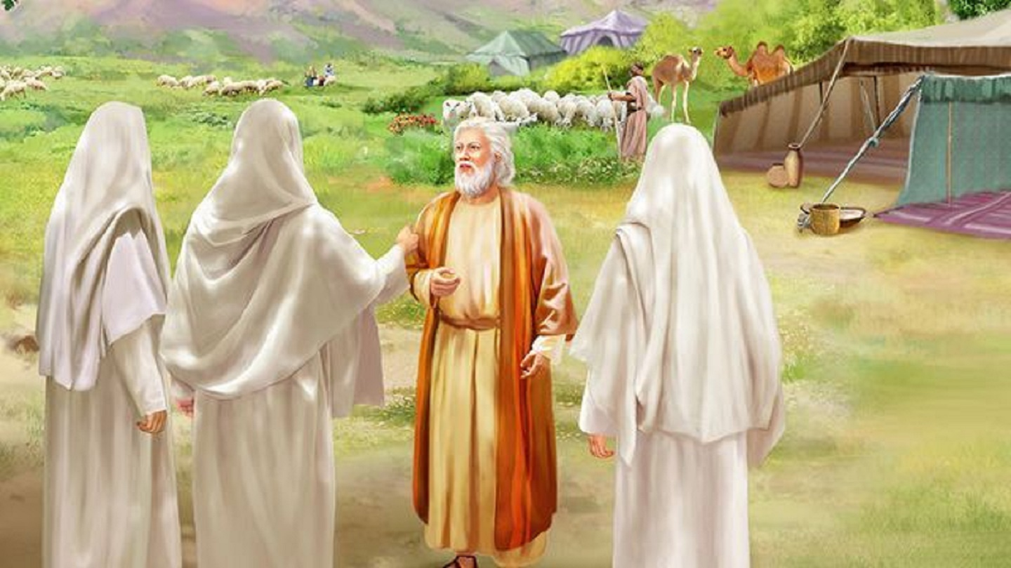
Abraham intercedes for Sodom & Gomorrah

Slide 13
God is willing to be swayed by my prayers

Slide 14
