Slide 1
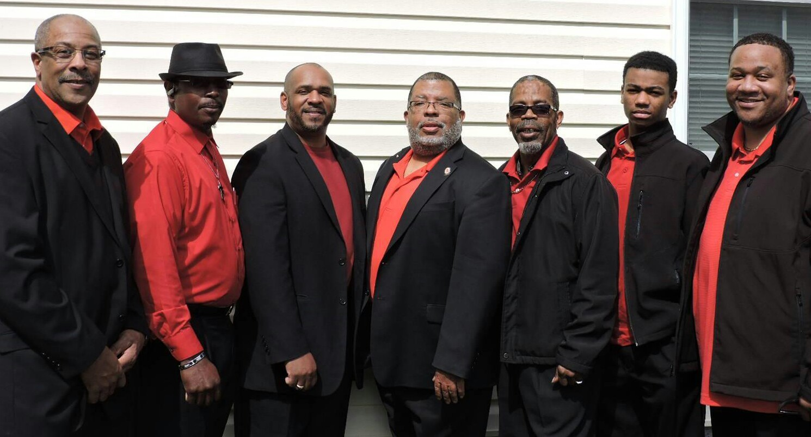
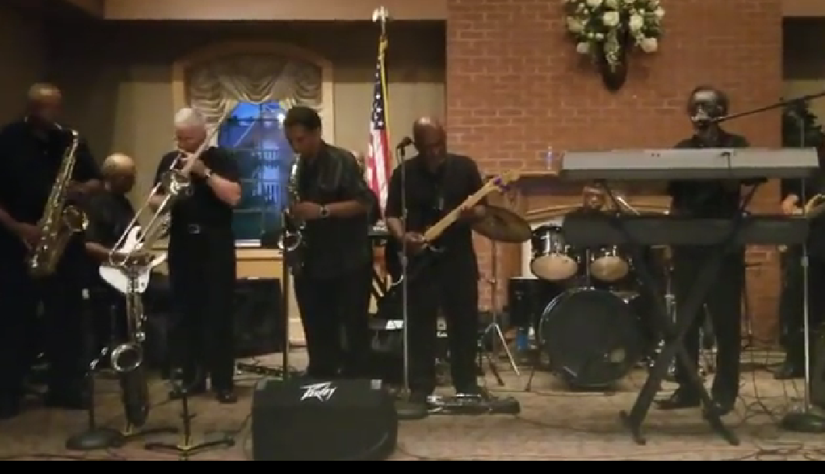
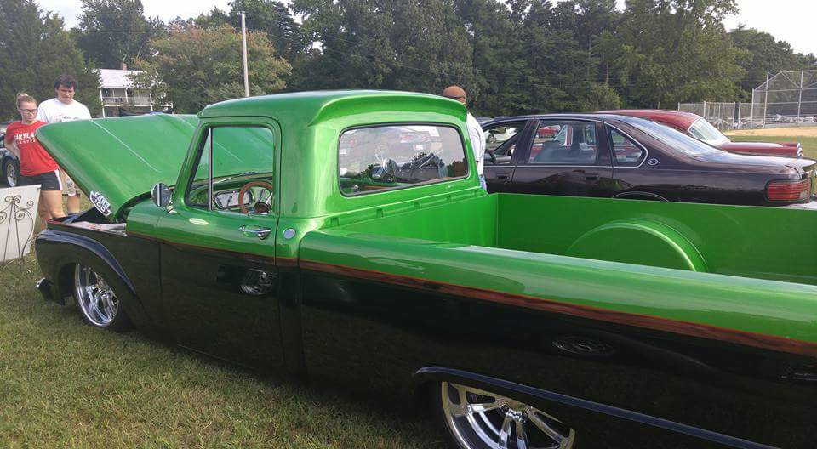
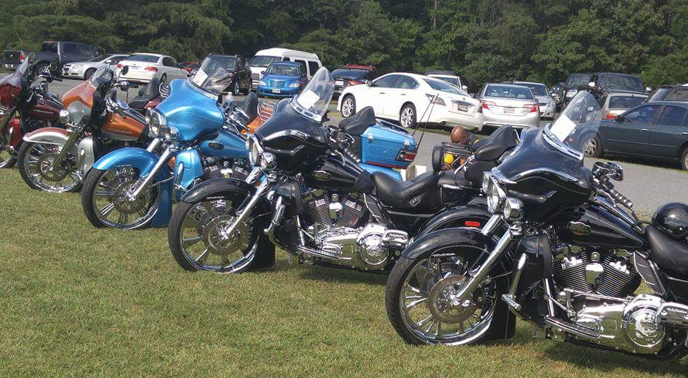
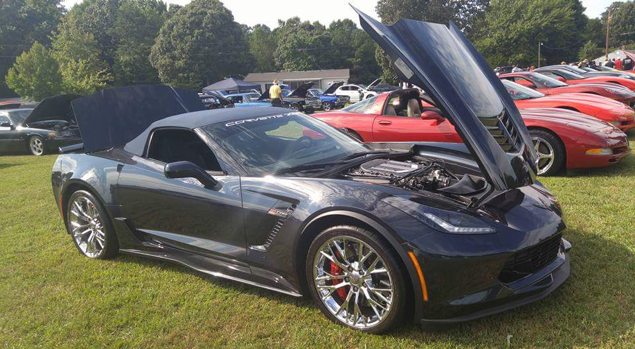
ST. PETER CLAVER CATHOLIC CHURCH ANNUAL PRE-LABOR DAY DINNER & FESTIVAL
SUNDAY, SEPTEMBER 02, 2018
CHURCH SERVICE (MASS) @ 10:00 A.M. FATHER SCOTT WOODS, PASTOR Our location is 16922 St. Peter Claver Road P.O. Box 240, St. Inigoes, MD 20684 For more information: Call 301-872-5460 *********************************************************************************************
THEME: “IT’S A FAMILY AFFAIR”
DINNERS WILL BE ON SALE STARTING @ 12:30 P.M. Meal catered by: “SCRUMPTIOUS ENTRÉE & CAKES”
Dinners - $22.00 (In Advance) ends 8-26-18 $25.00 (At The Door)
CRAB CAKE* FRIED OR BAKED CHICKEN * FRIED FISH * HAM * PARSLEY POTATOES *
GREEN BEANS * CORN * BEETS * ROLLS * ICED TEA
ALL DAY ENTERTAINMENT & ACTIVITIES FOR THE ENTIRE FAMILY!!!
SPC DANCE MINISTRY * SOUTHERN MD COMMUNITY CHOIR * ZUMBA PARTY * ST. PHILLIP’S LINE DANCERS *
ANTIQUE CAR / BIKE SHOW * PAUL WILLS BAND, W/ SPECIAL GUEST ALAN BLAIR * HARMONIES OF FAITH GOSPEL
GROUP * VENDORS * SILENT AUCTION * ACTIVITIES FOR CHILDREN * FACE PAINTING * BINGO * AND MUCH MORE
NO OUTSIDE COOLERS, PLS. VISIT OUR SPIRITS BOOTH!
Harmonies of Faith
ANNUAL CLASSIC ANTIQUE CAR & BIKE SHOW
Paul Wills Band w/ Alan Blair

