Slide 1
2011 Can Am Challenge
By: Austin Springer

Slide 2
2011 Can Am Team Chalengers

Slide 3
2011 Can Am Challenge
The Can Am Challenge was an eight day basketball tour of Ottawa and Toronto, Canada. The team was coached by Dave Springer of Shippensburg University and consisted of six college players from the US east coast. It was my responsibility to serve as team manager, statistician, and sports information director.

Slide 4
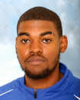
Team Roster
6 – Jaron Moore
- Class: Sophomore - Height / Weight: 6-6 / 210
-Hometown: Elizabeth City, NC - Position: Forward
- High School: Pasquotank - College: Elizabeth City State
- Class: Senior - Height / Weight:6-7 / 230
Hometown: Plainfield, NJ - Position: Forward
College: Elizabeth City State
8 – Rondy Tucker

Slide 5
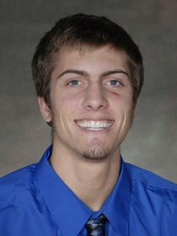
Team Roster
4-Dylan Edger
Class: Sophomore -Height: 6-10
Hometown: Shiremanstown, PA -Position: Center/Forward
High School: Mechanicsburg -College: Shippensburg University
3- Ryan Corrigan
-Class: Sophomore -Height: 6-2
-Hometown: Harrisburg -Position: Guard
-High School: Bishop McDevitt -College: Shippensburg University

Slide 6
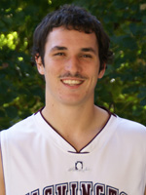
Team Roster
7 – Alex Herzing
-Class: Sophmore -Height/Weight: 7-0/250
-Hometown: Lynchburg, VA -Position: Center
-High school: The Hill School -College: Bryant University
2 – Kevin Breslin
-Class: Senior -Height/Weight: 6-1/195
-Hometown: Hagerstown, MD -Position: Guard
-High school: St. Maria Goretti -College: Washington College

Slide 7
Coaching Staff

Slide 8
Coaching Staff
Coach Springer and Coach Raulhauser of Shippensburg University and the Sheridan University Coaches.
Coach Heidecker, Austin Springer, and Coach Raulhauser

Slide 9
Ottawa, Ontario
The Can Am Challengers spent the first part of the tour in Ottawa. Here we participated in the 8th Annual Basketball at the Capitol Tournament. This tournament had several excellent teams from around the Ottawa area. Some of the teams were college teams and others were alumni teams with players who play professionally in Europe. While in Ottawa we were able to see various interesting sites such as the changing of the guard at the Parliament.

Slide 10
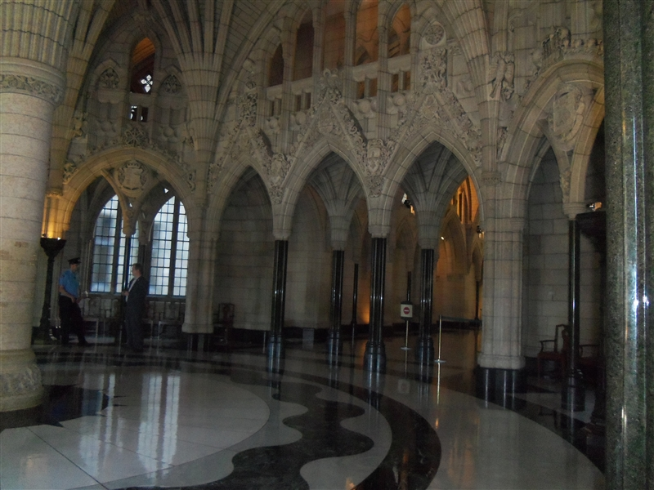
Ottawa, Ontario
Changing of the Guard.
Inside of the Parliament.

Slide 11
Basketball at the Capitol Tournament - Game 1
For the first game of the Basketball at the Capitol Tournament the Can Am Challengers played SYBL. The Can Am team defeated SYBL with a score of 94-86. Alex Herzing played well the first half leading the team with 11 points shooting 5-5 from the field. At half SYBL was winning 49 to 40. Can Am played exceptionally well the second half, quickly taking a lead. Dylan Edger led the team with 22 points and 10 rebounds. Jaron Moore hit the boards hard with 13 rebounds and 19 points. Ryan Corrigon had 9 assists to lead the team. Kevin Brelsin had 8 defensive rebounds. Rondy Tucker played good defense and had 11 rebounds.

Slide 12
Game 1 Stats

Slide 13
Game 1
Jaron Moore jumping for the tip.
Jaron Moore blocking a shot.

Slide 14
Basketball at the Capitol Tournament - Game 2
For the second game of the tournament the Can Am Challengers played the Guardsmen . The Guardsmen have won the tournament the last 6 out of 7 years. They have 2 players who played professionally in Europe. The Guardsmen took a quick lead to be up 9 at half. Dylan Edger hit the boards hard to lead the Can Am team with 15 rebounds. Rondy Tucker led the team with 16 points and 9 rebounds while Kevin Brelsin added 7 assists. Ryan Corrigon had 2 from beyond the arc. The final score was Gaurdsmen 64 Can Am 53.

Slide 15
Game 2 Stats

Slide 16
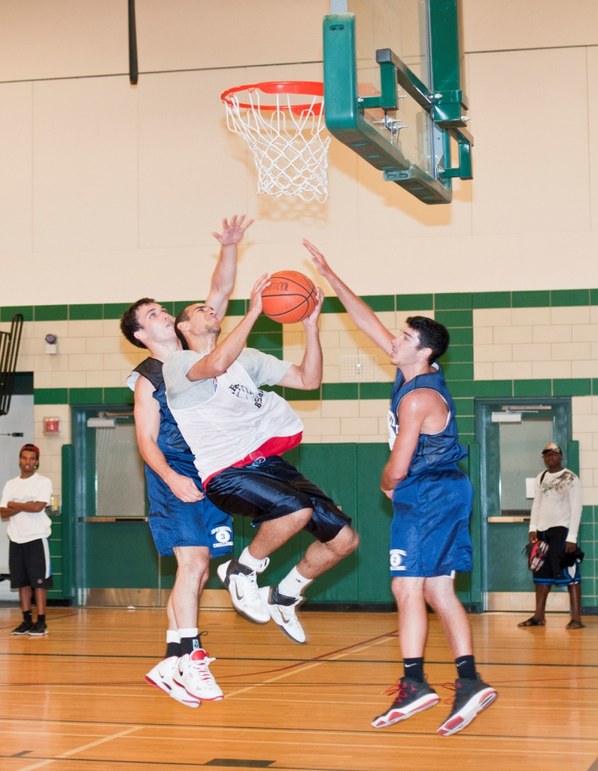
Game 2
Dylan Edger plays defense.
Kevin Breslin plays tough defense.

Slide 17
Basketball at the Capitol - Game 3
The third game of the tournament was an elimination game for the Can Am Challengers. Their opponent was the University of Ottawa, the best university team in Canada. From the start the University of Ottawa shot lights out connecting on 9 first half three pointers. The score at half time was 53-40 Ottawa. The great shooting from the University of Ottawa didn’t stop at half as they went on to hit 14 threes in the game. Kevin Breslin led the Can Am team with 17 points and 7 assists although it was not enough as the University of Ottawa won the game with a final score of 90 to 68. Rondy Tucker had 7 rebounds to go along with 14 points. The Can Am team finished the tournament with a record of 1-2.

Slide 18
Game 3 Stats

Slide 19
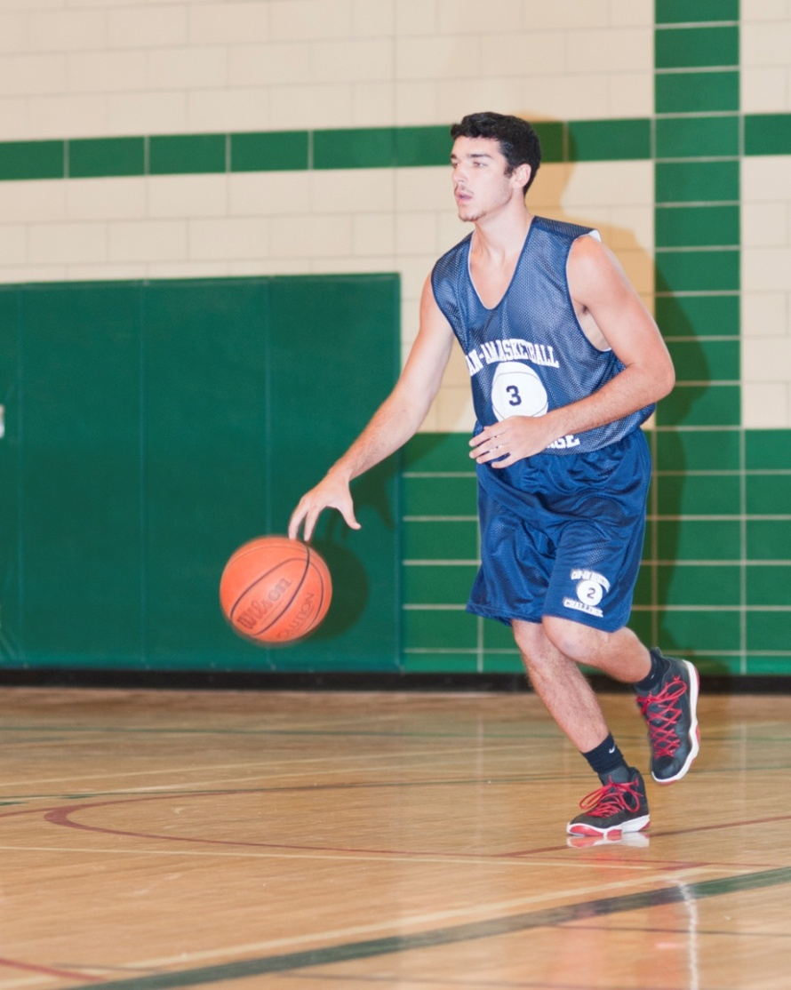
Game 3
Ryan Corigan brings the ball up the court.

Slide 20
Toronto
After playing the 3 games in Ottawa the Can Am Challengers traveled to Brampton, a suburb of Toronto. While there we played Sheridan University and an alumni team from Sheridan University. We also were able to tour Toronto and see the Blue Jays Stadium (Minute Maid Park) and the CN Tower.

Slide 21
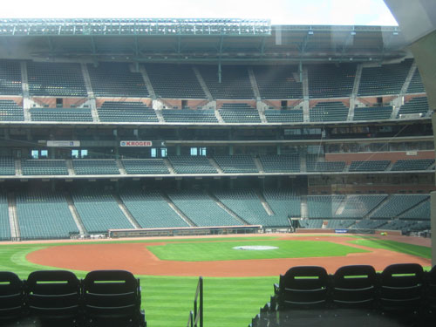
Toronto
Minute Maid Park

Slide 22
Toronto

Slide 23
Game 4
The fourth game of the Can Am tour was Can Am Challengers versus Quasar. Both teams played extremely well. At half time the score was 43 to 35 Quasar. The Can Am Challengers made a run to cut the game to 2 points but couldn’t make a final run to get the win. The final score was 80 to 72. The Can Am Challengers were led by Rondy Tucker with 20 points and 11 rebounds. Ryan Corrigon had 18 points knocking down 4 from beyond the arc.

Slide 24
Game 4 Stats

Slide 25
Game 5
For the final game of the Can Am tour the Cam Am Challengers played Sheridan College. Sheridan came out on fire and played great defense. The Can Am team came back and the score at half was 50 to 47 Sheridan. Sheridan continued to play very good defense but the Can Am team made a run to go up 3 with 12 minutes to go but couldn’t hold on. The final score was 98 to 93 Sheridan. Rondy Tucker led the team with 37 points and 27 rebounds. Jaron Moore also played very well with 15 points and 10 rebounds.

Slide 26
Game 5 Stats

Slide 27
Conclusion
Although the Can Am Challengers ended with a 1-4 record the tour was a wonderful experience for everyone. The players had the opportunity to participate in great competition. The coaches were able to work with skilled athletes and help prepare them for their upcoming seasons. I had the opportunity to experience what it is going to be like to become a college coach.

