Slide 1
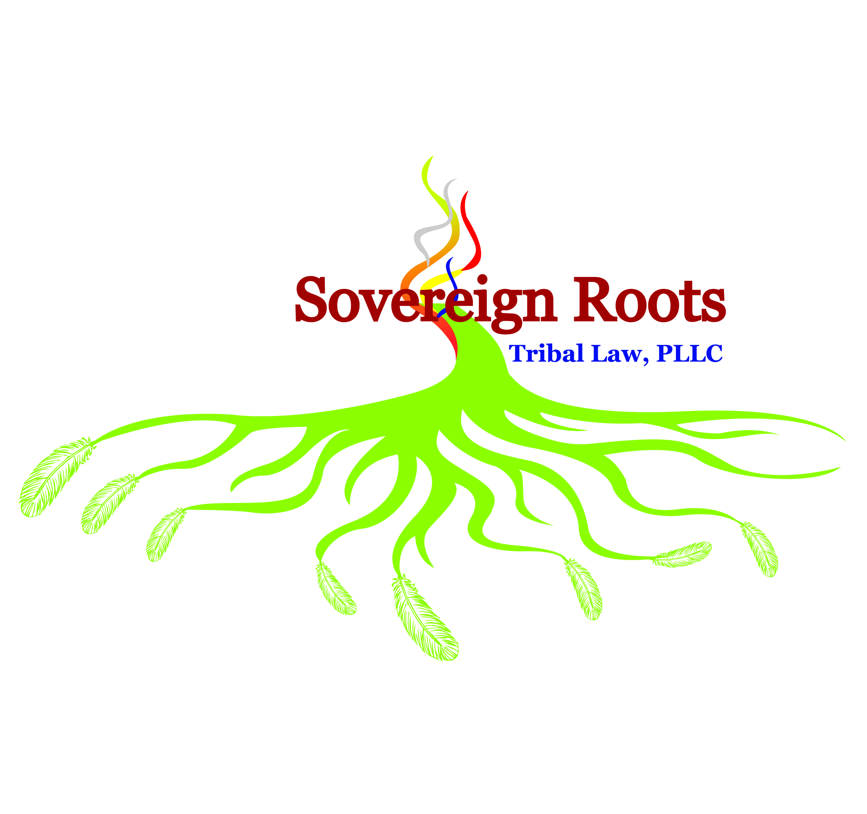
Indian Treaties, Taxes and Reservations: Effective Representation of North American Indian Tribes and Nations

Slide 2
Many Issues
Status of Indian Treaties; Status of Tribes Under Federal Law
Treaty Abrogation
Reservation Diminishment
Sovereignty Infringement
State-Law Preemption

Slide 3
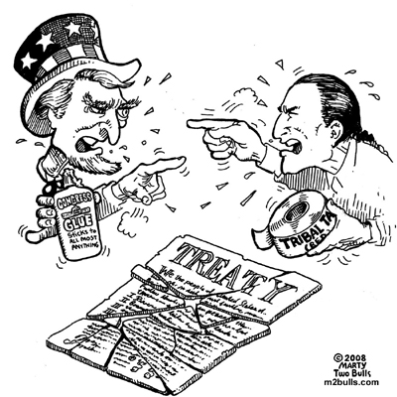
Treaty Abrogation
The Supreme Court established that Congress may unilaterally abrogate a treaty with an Indian tribe using its ‘plenary power’. Lone Wolf v. Hitchcock (1903)

Slide 4
Treaty Abrogation
Origins of the modern test date back to Menominee v. United States (1968) – Justice Douglas writing for the majority:
“While the power to abrogate [hunting and fishing] rights exists
(see Lone Wolf v. Hitchcock) the intent to abrogate or modify a
treaty is not to be lightly imputed to Congress… We find it difficult
to believe that Congress, without explicit statement, would subject
the United States to a claim for compensation by destroying property
rights conferred by treaty”

Slide 5
Treaty Abrogation
After Menominee – Courts, including the Supreme Court, generally followed the
requirement that to abrogate an Indian treaty required “a clear and explicit statement
by Congress – in a statute or reliable legislative history – before finding an intent to
extinguish treaty rights”
Washington v. Commercial Passenger Fishing Vessel Ass’n (1979) – the absence of an explicit statement supports construing treaty rights in Indian’s favor.
County of Oneida v. Oneida Indian Nation (1985) – Intent to extinguish Indian title must be “plain and unambiguous”
Dion, 1986.

Slide 6
Treaty Abrogation
The Court loosened the test in United State v. Dion (1986)
“What is essential is clear evidence that Congress actually considered the conflict between its intended action on the one hand and Indian treaty rights on the other, and chose to resolve the conflict by abrogating the treaty”
What is “clear evidence”?

Slide 7
Treaty Abrogation
Clear Evidence:
Clear Evidence exists when Congress issues an “express declaration of its intent to abrogate treaty rights” and an “[e]xplicit statement by Congress is preferable for the purpose of ensuring legislative accountability” BUT
It may exist absent an “express declaration” – “where the evidence of congressional intent to abrogate is sufficiently compelling, the weight of authority indicates that such an intent can also be found by a reviewing court from clear and reliable evidence in the legislative history of a statute”

Slide 8
Treaty Abrogation
After Dion the Court has decided more treaty abrogation cases but always applied the
‘clear evidence’ test from Dion.
South Dakota v. Bourland (1993)
Justice Thomas (Majority): “the sum paid by the Government to the
Tribe for former trust lands taken for the Oahe Dam… shall be in final and complete settlement of all claims, rights, and demands of the Tribe or its allottees”
Justice Blackmun (Dissenting): Majority cannot demonstrate that Congress
actually considered the possibility that the taking would deprive the
tribe of its ability to regulate non-Indian hunting and fishing on the land.

Slide 9
Treaty Abrogation
After Dion the Court has decided more treaty abrogation cases but always applied the ‘clear evidence’ test from Dion.
Minnesota v. Mille Lacs Band of Chippewa Indians (1999)
The 1855 Treaty “is devoid of any language expressly mentioning – much less abrogating usufructury rights… There is no such ‘clear evidence’ of Congressional intent to abrogate the Chippewa treaty rights here. The relevant statute… makes no mention of Indian treaty rights; it provides no clue that Congress considered the reserved rights of the Chippewa and decided to abrogate those rights when it passed the act… the State does not point to any legislative history describing the effect of the Act on Indian treaty rights”

Slide 10
Treaty Abrogation
After Dion the Court has decided more treaty abrogation cases but always applied the ‘clear evidence’ test from Dion.
Herrera v. Wyoming (2019)
Like the Act discussed in Mille Lacs , the Wyoming Statehood Act "makes no mention of Indian treaty rights" and "provides no clue that Congress considered the reserved rights of the [Crow Tribe] and decided to abrogate those rights when it passed the Act."

Slide 11
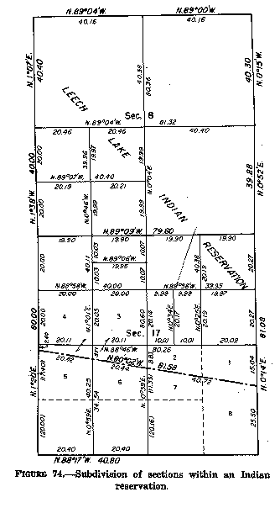
Reservation Diminishment
Between 1887 and 1934 many Indian reservations were allotted by Congress.
Some allotment acts diminished or disestablished Indian reservations

Slide 12
Reservation Diminishment
There are more than 40 Supreme Court cases dealing with diminishment of allotted reservations going back to the Nineteenth Century
The modern test for diminishment goes back to Solem v. Bartlett (1984)
“only Congress can divest a reservation of its land and diminish its boundaries… Diminishment moreover, will not be lightly inferred. Our analysis… requires Congress clearly evince an ‘intent’… to change… boundaries before diminishment will be found.”
To determine if an Allotment Act diminished a reservation Solem looked at 3-factors

Slide 13
Reservation Diminishment
The modern test for diminishment goes back to Solem v. Bartlett (1984)
Statutory Language: “The most probative evidence of Congressional intent is the statutory language used to open the Indian lands. Explicit reference to cession… buttressed by an unconditional commitment from Congress to compensate the Indian tribe for its open land, there is an almost insurmountable presumption that Congress meant for the tribe’s reservation to be diminished”
Events Surrounding Passage: “Congress’s own treatment of the affected areas, particularly in the years immediately following the opening, has some evidentiary value, as does the manner which the Bureau of Indian Affairs and local judicial authorities dealt with unallocated open lands”
Indian Character: “we have also recognized that who actually moved onto opened reservation lands is also relevant to deciding whether a surplus land act diminished a reservation. Where non-Indian settlers flooded into the opened portion of a reservation and the area has long since lost its Indian character, we have acknowledged de facto if not de jure diminishment”

Slide 14
Reservation Diminishment
The Supreme Court just decided McGirt v. Oklahoma (2020) which arguably modified the test.
“On the far end of the Trail of Tears was a promise. *** Today we are asked whether the land these treaties promised remains an Indian reservation for purposes of federal criminal law. Because Congress has not said otherwise, we hold the government to its word.”
“[C]ourts have no proper role in the adjustment of reservation borders. Mustering the broad social consensus required to pass new legislation is a deliberately hard business under our Constitution. Faced with this daunting task, Congress sometimes might wish an inconvenient reservation would simply disappear. *** But wishes don’t make for laws, and saving the political branches the embarrassment of disestablishing a reservation is not one of our constitutionally assigned prerogatives.”

Slide 15
Reservation Diminishment
The Supreme Court just decided McGirt v. Oklahoma (2020) which arguably modified the test.
“When interpreting Congress’s work in this arena, no less than any other, our charge is usually to ascertain and follow the original meaning of the law before us. *** That is the only “step” proper for a court of law. To be sure, if during the course of our work an ambiguous statutory term or phrase emerges, we will sometimes consult contemporaneous usages, customs, and practices to the extent they shed light on the meaning of the language in question at the time of enactment. . . . But Oklahoma does not point to any ambiguous language in any of the relevant statutes that could plausibly be read as an Act of disestablishment. Nor may a court favor contemporaneous or later practices instead of the laws Congress passed.”

Slide 16
Reservation Diminishment
The Cases
Mattz v. Arnett (1973) – Past tense reference to the Klamath Reservation did not diminish the reservation when legislative history suggests otherwise.
DeCoteau v. District Court (1975) - Relinquishment of ‘all’ of the tribe’s ‘claim, right, title, and interest’ coupled with a sum certain per acre was enough to constitute diminishment
Rosebud Sioux Tribe v. Kneip (1977) – “return to the public domain” along with legislative history resulted in diminishment even though there was no sum certain.
Solem v. Bartlett (1984) – The government acted as a sales agent, no cession language or sum certain payment meant no diminishment of Cheyenne River Reservation.

Slide 17
Diminishment
The Cases
Hagen v. Utah (1994) – “return to the public domain” is clear cession language resulting in diminishment of the Uintah Reservation.
South Dakota v. Yankton Sioux (1998) – “cede” plus payment of sum certain was textbook presumption of congressional diminishment.
Nebraska v. Parker (2016) – When acting like a sales agent, it doesn’t matter that just 1% of the opened area retains its Indian character, and statements by single legislators do not establish congressional intent.
McGirt v. Oklahoma (2020) – The intent of Congress not to diminish the Muscogee Reservation was clear from the text of the Allotment Act

Slide 18
Sovereignty Infringement
Infringement is based on tribal sovereignty
“[A]bsent governing Acts of Congress”, the question is “whether the state action infringed” on the right of “Indians to make their own laws and be ruled by them” –Williams v. Lee (1959)

Slide 19
Sovereignty Infringement
Generally, the doctrine of Infringement applies when the legal incidence of the tax falls
directly upon the tribe, but does not apply when the tax is imposed on non-Indians.
Moe v. Salish & Kootenai Tribes of the Flathead Reservation (1976): state can
assert its tax over cigarettes sold by a tribal member to non-members on the
reservation, and tribe can be forced to collect and remit those taxes.
Washington v. Confederated Tribes of the Colville Reservation (1980): state can still assert its tax over cigarettes sold by the tribes themselves to non-members.
Oklahoma Tax Commission v. Citizen Band Potawatomi (1991): “Indian retailers on an Indian reservation may be required to collect all state taxes applicable to sales to non-Indians”

Slide 20
Sovereignty Infringement
The location of the activity also effects the application of infringement.
McClanahan v. Arizona State Tax Comm’n (1973) – A state cannot tax income earned by a tribal member who lives on the reservation and who earns his or her income from the reservation. However, the state can tax activity outside the reservation and tribal members who live outside of the reservation.

Slide 21
Sovereignty Infringement
Infringement is more likely to apply to bar state activity on the reservation when the tribal
activity has added value.
California v. Cabazon Band of Mission Indians (1987) – State regulation of tribal card club would
infringe on the tribal government’s right to make its own laws in part because the tribe had built the
club and created new economic value instead of marketing an exemption.
Wagnon v. Prairie Band Potawatomi (2005) – State could impose its tax on wholesale fuel distribution
received by tribal gas station because the incidence of the tax was off the reservation despite the station
serving a market created by the tribe’s casino.

Slide 22
State-Law Preemption
Indian Preemption is distinguished from than other Constitutional doctrines of preemption
Balance the tribal, state, and federal interests against each other to determine if the state authority is preempted.

Slide 23
State-Law Preemption
“Under certain circumstances a State may validly assert authority over the activities of nonmembers on a reservation, and… in exceptional circumstances a State may assert jurisdiction over on-reservation activities of tribal members” - California v. Cabazon Band of Mission Indians (1987)
An individualized analysis is required which balanced the state, federal, and tribal interests.

Slide 24
State-Law Preemption
Cabazon - gaming
Federal Interest
Tribal Economic Development
Indian Sovereignty
Tribal Interest
Sole source of revenue
Significant employment
State Interest
Prevent organized crime from operating in a state

Slide 25
State-Law Preemption
The Court has decided many Preemption cases
Warren Trading Post v. Arizona Tax Comm’n (1965) – the federal Indian Trader scheme was so comprehensive it preempted 2% state sales tax
Central Machinery v. Arizona Tax Comm’n (1979) – Non-Indians off a reservation do not have to pay a Transaction Privileges Tax because, even though they are not licensed Indian Traders, the federal interests preempted the tax
White Mountain Apache Tribe v. Bracker (1980) – Federal statutes regulating timber preempt a state fuel tax with a general state interest in raising money for roads

Slide 26
State-Law Preemption
The Court has decided many Preemption cases
Ramah Navajo School Bd. v. New Mexico Bd. of Revenue (1982) – Federal statutes related to schools and Indian education preempt a NM gross receipts tax on a non-Indian construction company building a school on the reservation.
Arizona Dept of Revenue v. Blaze Construction (1999) – Arizona could impose its Transaction Privileges Tax on a construction company’s profits for work done on an Indian reservation when the contract was with the BIA.

Slide 27
Questions?
Contact Gregory Arnold
GregArnold@sovereign-roots.org
(509) 212-5311

