Slide 1
Chapter 15
Section 2

Slide 2
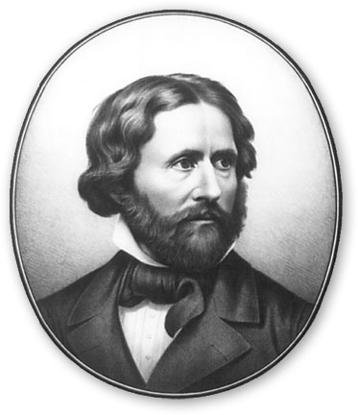
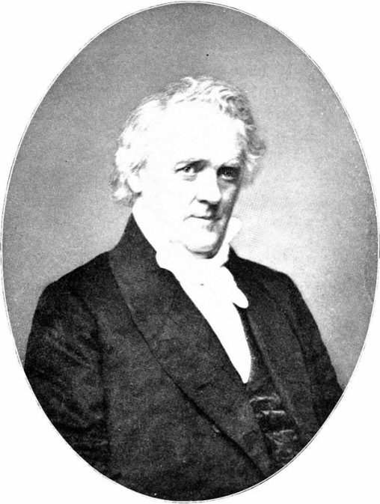
Slavery and Political Division
Republican Party forms
Antislavery
Sought to protect the interests of the North
Election of 1856
Republican Candidate: James Fremont
Won 11 states in the North
Democratic Candidate: James Buchanan
Won all slaves states but one and 2 free states
Buchanan became president
Proved Republican Party was a major force in the North

Slide 3
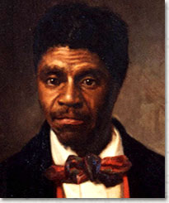
The Dred Scott Decision
Dred Scott
Black slave
Sued for his freedom and the freedom of his family
Case went to the Supreme Court
1857- Court ruled against Scott
Slaves were property not citizens
Slaves did not have rights; could not sue
Congress could not limit slavery

Slide 4
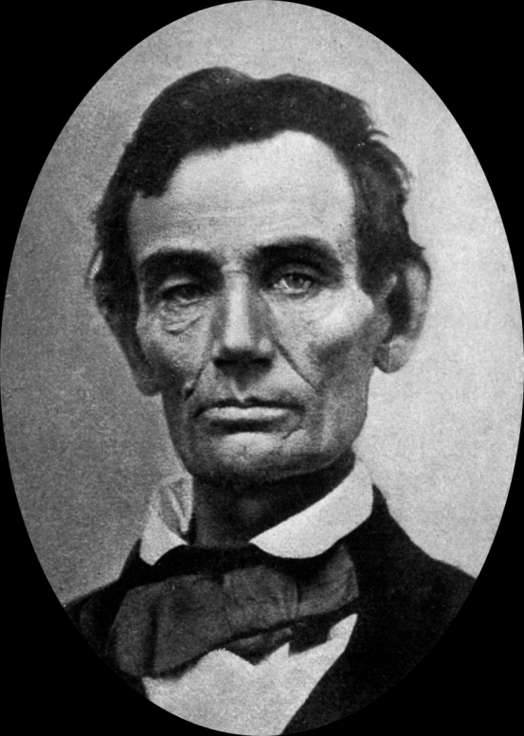
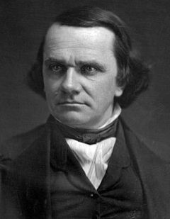
Abraham Lincoln
Republican
1858- Lincoln runs against Stephen Douglas for the U.S. Senate
Lincoln and Douglas debated over slavery
Neither wanted slavery to expand
Lincoln lost election
Became a national figure and leader of Republican party

Slide 5
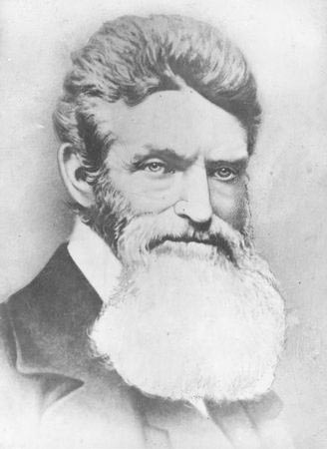
John Brown’s Raid
John Brown wanted to provoke a slave uprising
1859- Brown and 18 followers captured U.S. arsenal
Harpers Ferry, Virginia
No slaves joined the revolt
Brown was captured, tried, and hung for treason

