Slide 1
Print Management Implementation
Danny Edwards – Rockingham Community College
Michael Capps – Wake Tech Community College

Slide 2
Managed Print Services
~125 users
  118 Staff
  7 Faculty
3 month implementation
4 printer models
Direct Printing vs Secure Release
Datatel Printing

Slide 3
Managed Print Services
Select Queue
Print Job
Swipe ID/Enter Credentials
Release Job
Charge Department
Secure Release Printing
Direct Printing
Datatel Printing
Select Queue
Print Job
Select Cost Center
Release Job
Charge Department
Select Alias
Print Job
Charge Department
$0.03/b&w page
$0.08/color page

Slide 4
Papercut-Rockingham CC
Implemented in Fall 2012. Test pilot was run in Summer 2012.
Considered other solutions. Chose Papercut as it was the most cost effective for the size of our college.
Currently used for curriculum students only.
3 printer models (2 for B/W and 1 for color printing)
Students begin each semester with a balance of $5.00.
Current cost of printing is set at 5 cents for B/W and 25 cents for color printing.
Patron accounts are set up for use in the Library for the public.
Instructors can request free printing with 48 hour notice.
System has led to cost savings for the college.

Slide 5
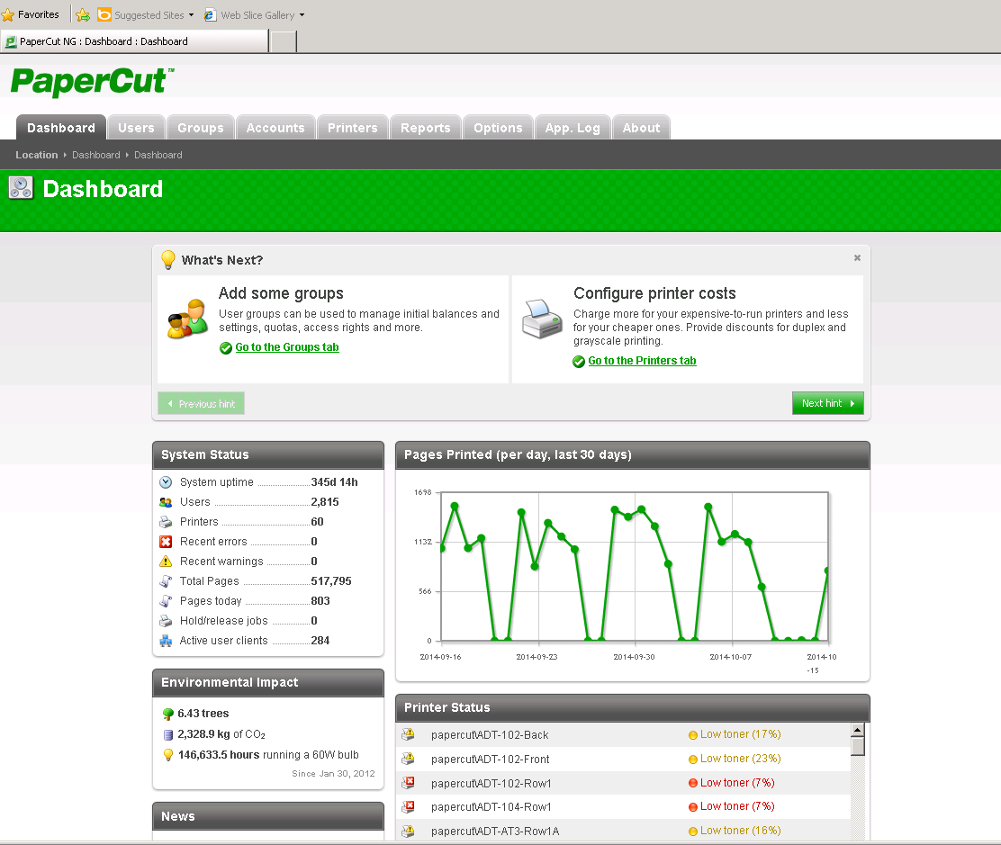
PaperCut Dashboard

