Slide 1
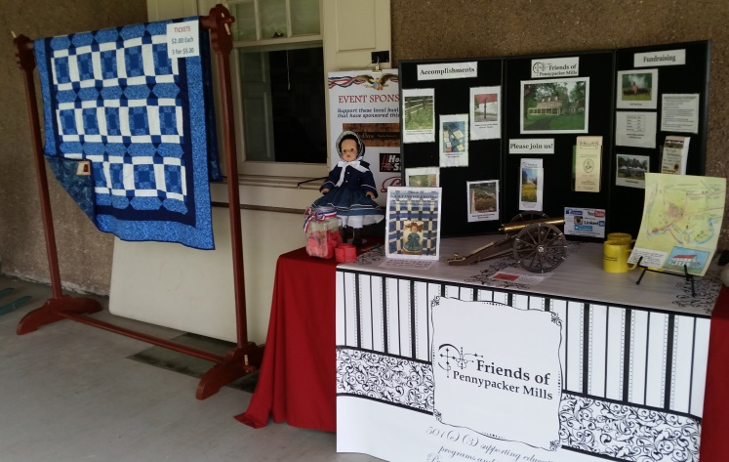
Annual Report 2016

Slide 2
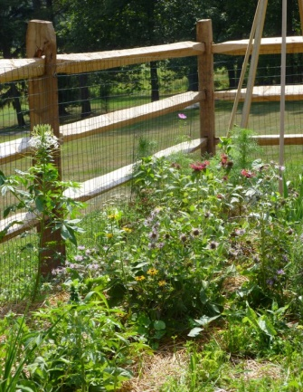
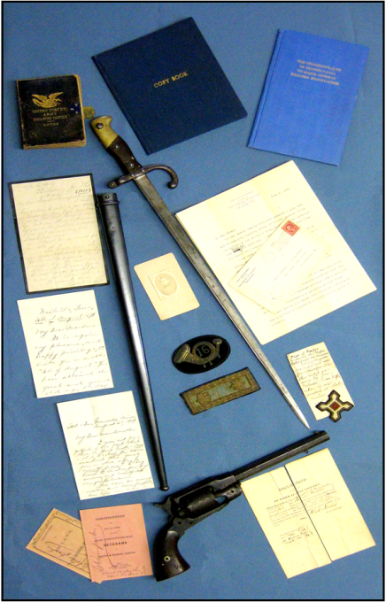
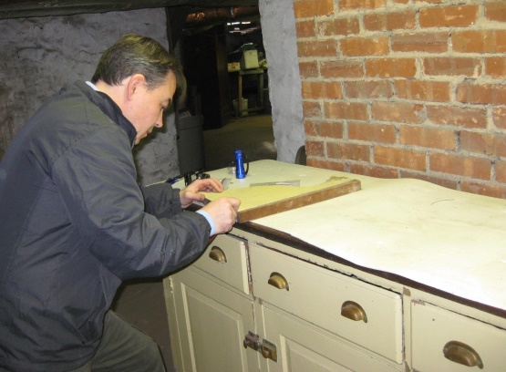
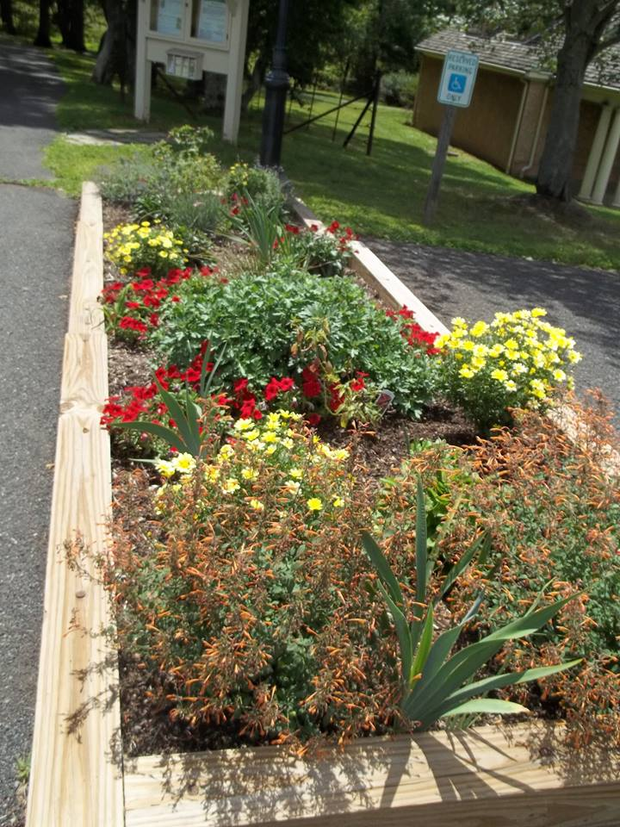
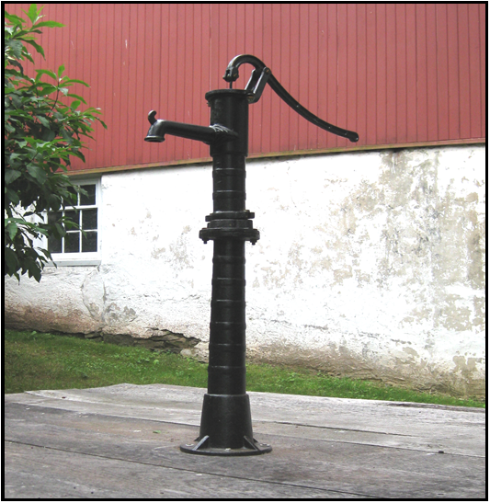
Past Accomplishments
2010
2012
2013
2015
2010

Slide 3
2016 Strategic Plan Objectives and Outcomes
Individual Membership

Slide 4
2016 Strategic Plan Objectives and Outcomes
Corporate Membership

Slide 5
2016 Strategic Plan Objectives and Outcomes
Fundraising – Civil War Event
Fully funded!!

Slide 6
2016 Strategic Plan Objectives and Outcomes
Fundraising – Craft Marketplace

Slide 7
2016 Strategic Plan Objectives and Outcomes
Fundraising – Craft Marketplace

Slide 8
2016 Strategic Plan Objectives and Outcomes
Fundraising – Craft Marketplace Cost of Fundraising

Slide 9
2016 Strategic Plan Objectives and Outcomes
Fundraising – Interpretive Signs Campaign

Slide 10
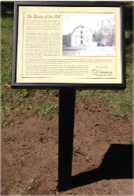
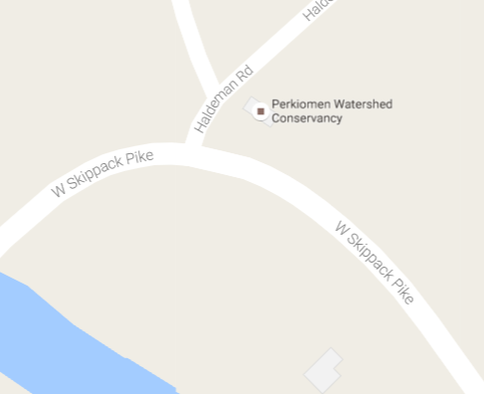
Interpretive Sign No. 1
Installed June 2016
Sign No. 1

Slide 11
Interpretive Sign No. 2 – Side 1

Slide 12
Interpretive Sign No. 2 – Side 2

Slide 13
Interpretive Sign No. 2 – Location
Sign No. 2

Slide 14
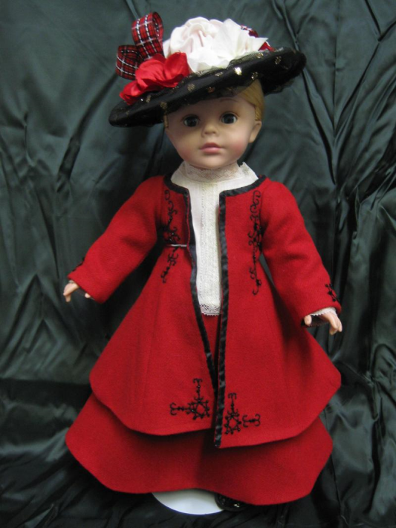
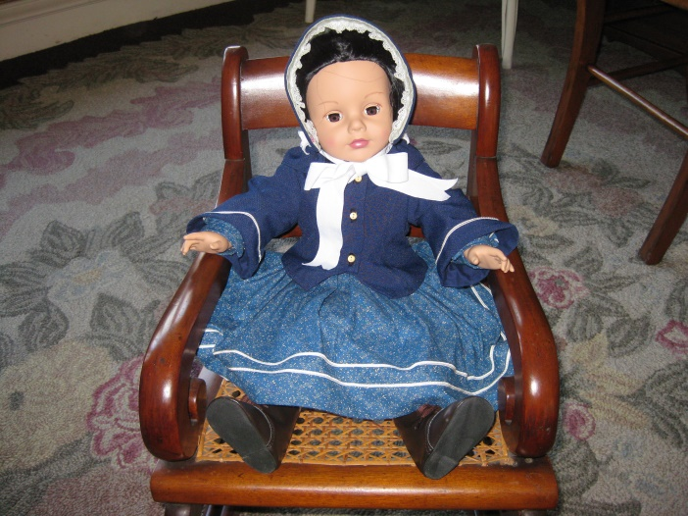
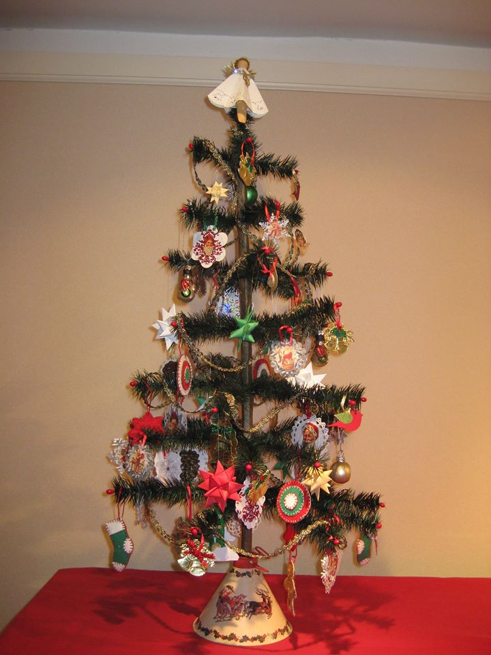
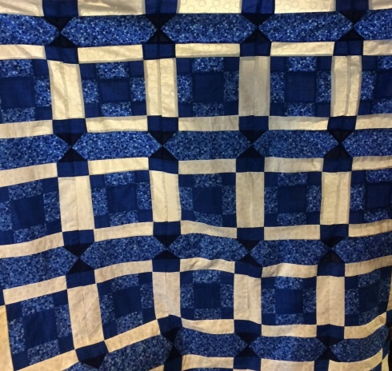
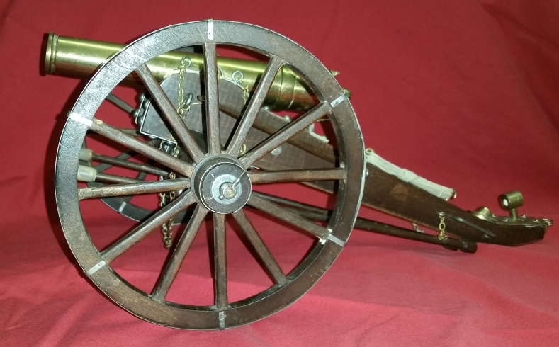
Fundraising - Raffles

Slide 15
2016 Marketing
Leveraged free and low cost opportunities.

Slide 16
2016 Networking
Directly resulted in sponsorships and memberships.

Slide 17
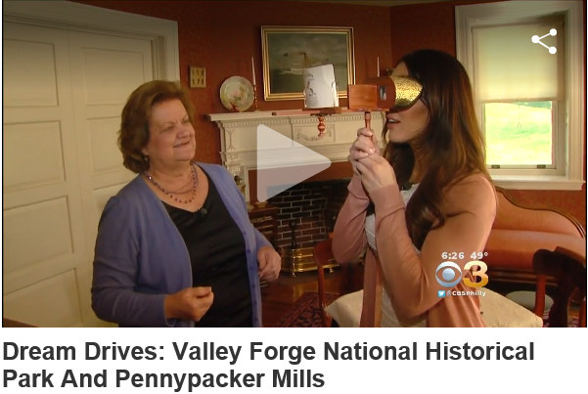
2016 Networking
Outreach resulted in a spot on CBS3 Dream Drives

Slide 18
2016 Financials
2016 Net Income $2,381.01

Slide 19
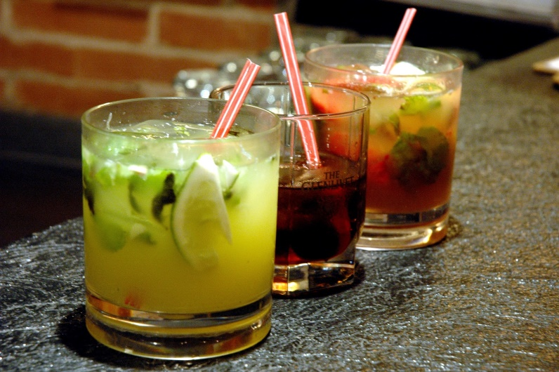
Exciting News!
New County Alcoholic Beverages Policy!

Slide 20
Ahead for 2017
Exciting and fun events for the public and for members.
Completion of sign campaign (3 more signs).
Assist with needs related to new visitors building/ museum shop.

Slide 21
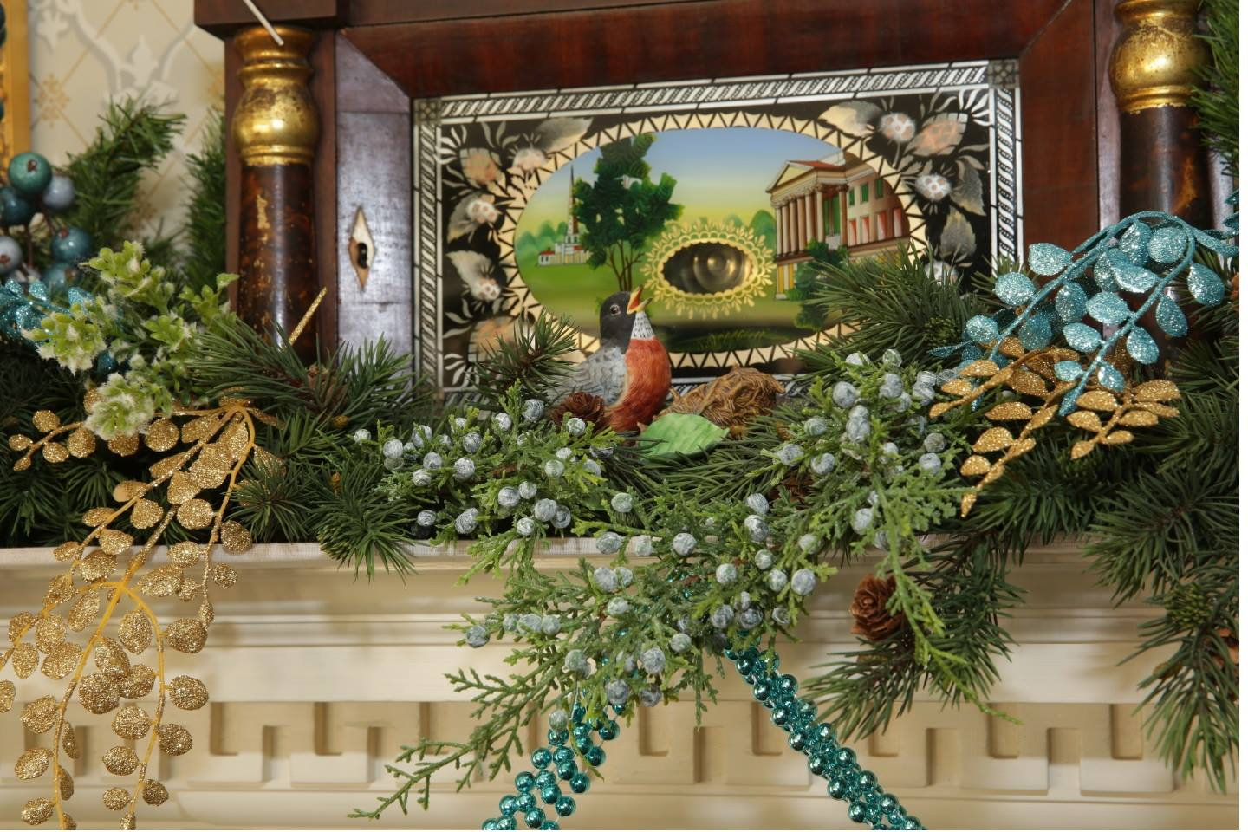
Thank you!

