Slide 1
Bridging Mathematics
and the Home

Slide 2
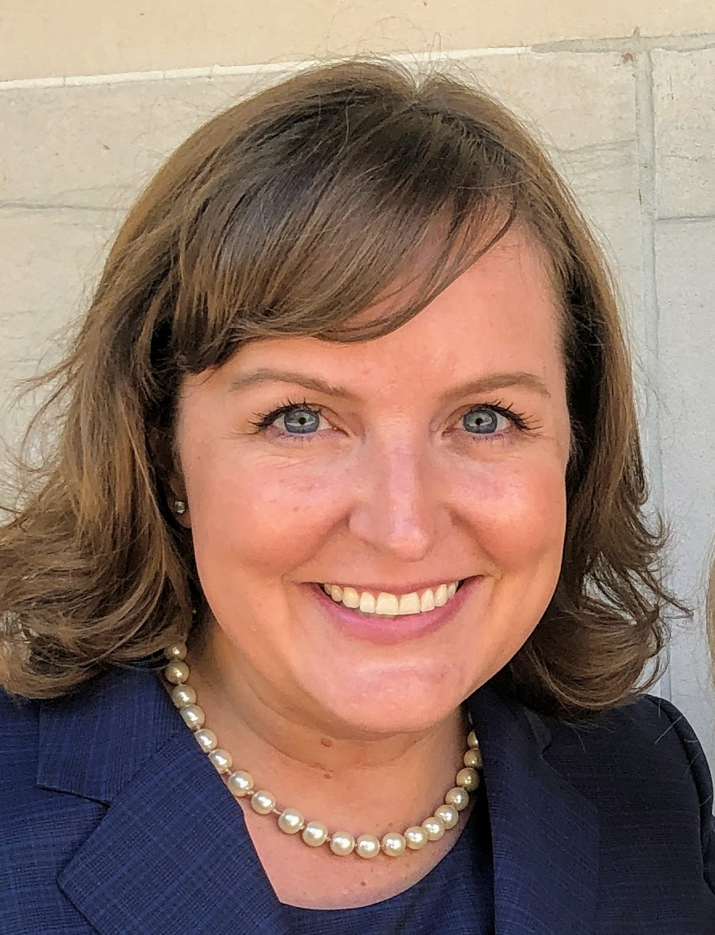
Sarah R. Powell, Ph.D.
Associate Professor
The University of Texas at Austin
www.sarahpowellphd.com
srpowell@utexas.edu
@sarahpowellphd

Slide 3
Introduce yourself.
Describe the math you work on with your child/children.
Share fun things from tonight and tag @sarahpowellphd!

Slide 4
Math Vocabulary

Slide 5
Powell, Bos, & Lin (2019)

Slide 6
Listening
Speaking
Reading
Writing
Vocabulary
Which of these is easiest for your child? Most difficult?

Slide 7
Math Vocabulary
Why is math vocabulary difficult for children?

Slide 8
1. Some math terms are shared with English but have different meanings
right
base
degree
Rubenstein & Thompson (2002)

Slide 9
1. Some math terms are shared with English but have different meanings
2. Some math words are shared with English with similar meanings
(but a more precise math meaning)
difference
even
Rubenstein & Thompson (2002)

Slide 10
1. Some math terms are shared with English but have different meanings
2. Some math words are shared with English with similar meanings
(but a more precise math meaning)
3. Some math terms are only used in math
numerator
trapezoid
parallelogram
Rubenstein & Thompson (2002)

Slide 11
1. Some math terms are shared with English but have different meanings
2. Some math words are shared with English with similar meanings
(but a more precise math meaning)
3. Some math terms are only used in math
4. Some math terms have more than one meaning
square
round
base
second
Rubenstein & Thompson (2002)

Slide 12
1. Some math terms are shared with English but have different meanings
2. Some math words are shared with English with similar meanings
(but a more precise math meaning)
3. Some math terms are only used in math
4. Some math terms have more than one meaning
5. Some math terms are similar to other content-area terms with different meanings
variable vs. variably cloudy
divide vs. Continental Divide
Rubenstein & Thompson (2002)

Slide 13
1. Some math terms are shared with English but have different meanings
2. Some math words are shared with English with similar meanings
(but a more precise math meaning)
3. Some math terms are only used in math
4. Some math terms have more than one meaning
5. Some math terms are similar to other content-area terms with different meanings
6. Some math terms are homographs
sum vs. some
eight vs. ate
base vs. bass
rows vs. rose
Rubenstein & Thompson (2002)

Slide 14
1. Some math terms are shared with English but have different meanings
2. Some math words are shared with English with similar meanings
(but a more precise math meaning)
3. Some math terms are only used in math
4. Some math terms have more than one meaning
5. Some math terms are similar to other content-area terms with different meanings
6. Some math terms are homographs
7. Some math terms are related but have distinct meanings
hundreds vs. hundredths
factor vs. multiple
numerators vs. denominator
Rubenstein & Thompson (2002)

Slide 15
1. Some math terms are shared with English but have different meanings
2. Some math words are shared with English with similar meanings
(but a more precise math meaning)
3. Some math terms are only used in math
4. Some math terms have more than one meaning
5. Some math terms are similar to other content-area terms with different meanings
6. Some math terms are homographs
7. Some math terms are related but have distinct meanings
8. An English math term may translate into another language with different meanings
mesa vs. tabla
Rubenstein & Thompson (2002)

Slide 16
1. Some math terms are shared with English but have different meanings
2. Some math words are shared with English with similar meanings
(but a more precise math meaning)
3. Some math terms are only used in math
4. Some math terms have more than one meaning
5. Some math terms are similar to other content-area terms with different meanings
6. Some math terms are homographs
7. Some math terms are related but have distinct meanings
8. An English math term may translate into another language with different meanings
9. English spelling and usage may have irregularities
four vs. forty
Rubenstein & Thompson (2002)

Slide 17
1. Some math terms are shared with English but have different meanings
2. Some math words are shared with English with similar meanings
(but a more precise math meaning)
3. Some math terms are only used in math
4. Some math terms have more than one meaning
5. Some math terms are similar to other content-area terms with different meanings
6. Some math terms are homographs
7. Some math terms are related but have distinct meanings
skip count vs. multiples
8. An English math term may translate into another language with different meanings
9. English spelling and usage may have irregularities
one-fourth vs. one quarter
10. Some math concepts are verbalized in more than one way

Slide 18
1. Some math terms are shared with English but have different meanings
2. Some math words are shared with English with similar meanings
(but a more precise math meaning)
3. Some math terms are only used in math
4. Some math terms have more than one meaning
5. Some math terms are similar to other content-area terms with different meanings
6. Some math terms are homographs
7. Some math terms are related but have distinct meanings
8. An English math term may translate into another language with different meanings
rhombus vs. diamond
9. English spelling and usage may have irregularities
10. Some math concepts are verbalized in more than one way
vertex vs. corner
11. Informal terms may be used for formal math terms

Slide 19
Math Vocabulary
What are ways you can use math language appropriately?

Slide 28
What are examples of,
“Instead of ___, Say ___?”

Slide 29
Math Vocabulary
What are ways you can help your child with math language in the home?

Slide 30
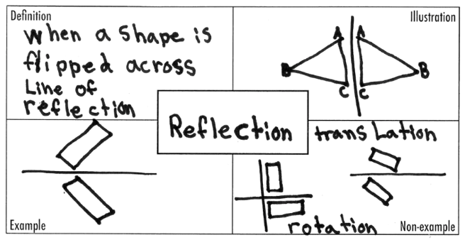
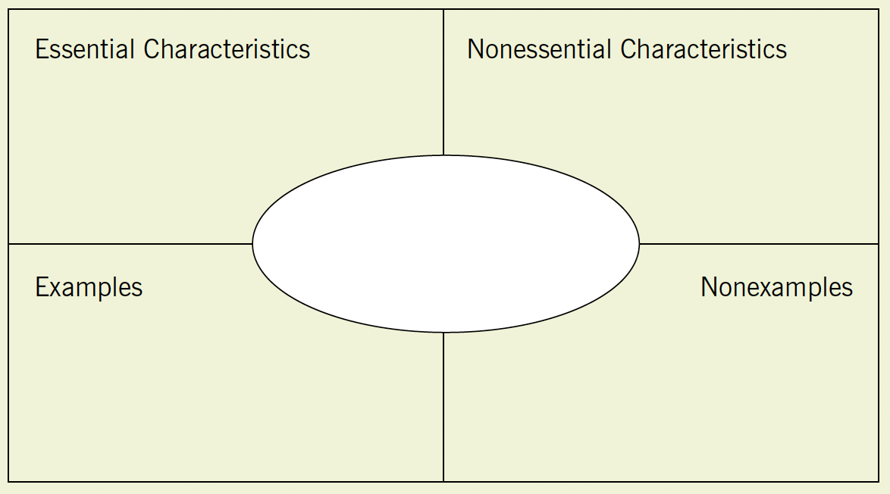
Use graphic organizers
Dunston & Tyminski (2013)

Slide 31
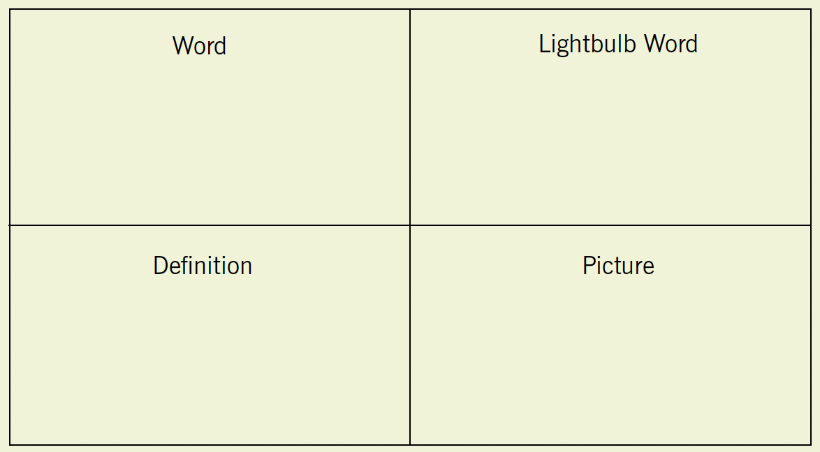
Use graphic organizers
Dunston & Tyminski (2013)

Slide 32
Have students create vocabulary cards

Slide 33
Have students create glossaries

Slide 34
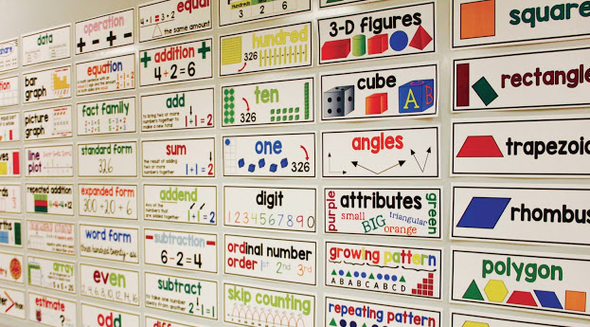
Create a word wall

Slide 35
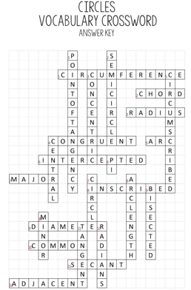
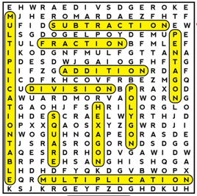
Do word games

Slide 36
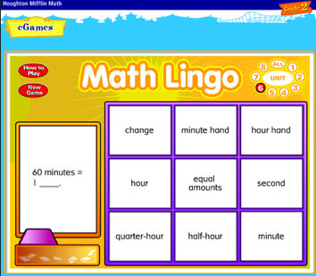
Use technology
Math Learning Center
Math Lingo

Slide 37
Math Vocabulary

Slide 38
Math Word Problems

Slide 39
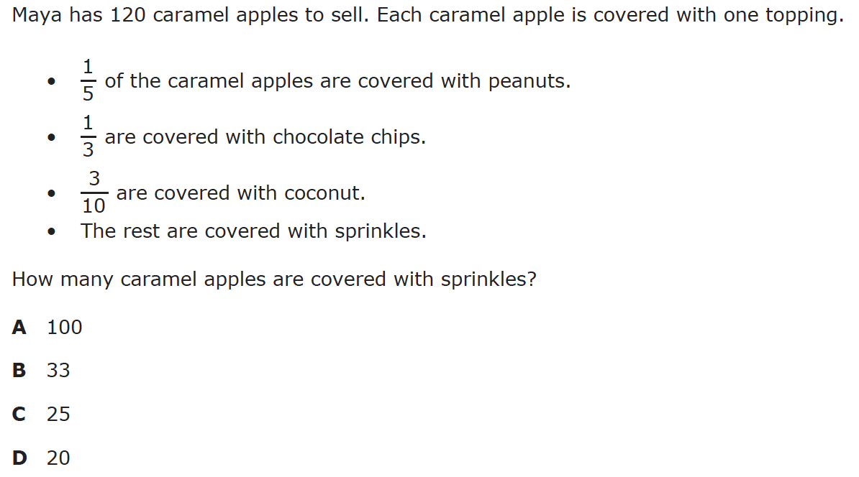

Slide 40
Reading the problem
Understanding the vocabulary
Identifying important information
Ignoring irrelevant information
Reading charts and graphs
Selecting operation(s)
Doing the computation(s)

Slide 41
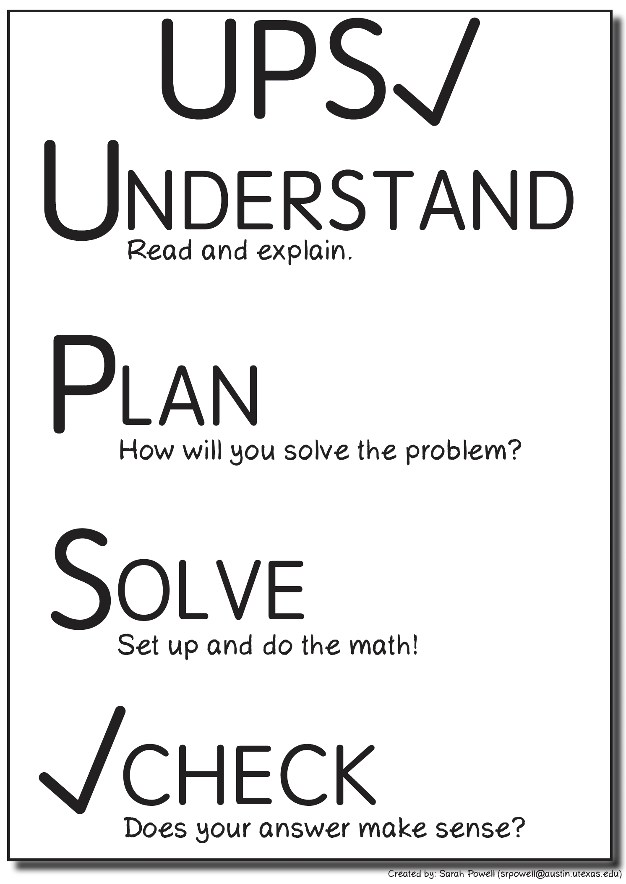
Have an attack strategy

Slide 42
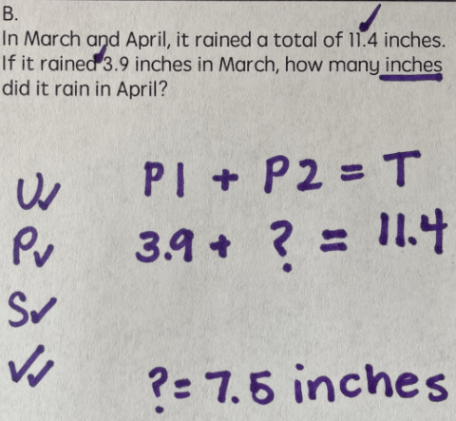
Total

Slide 43
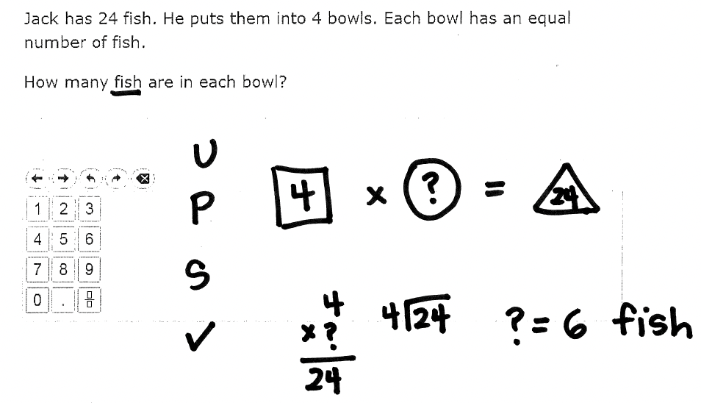
Equal Groups

Slide 44
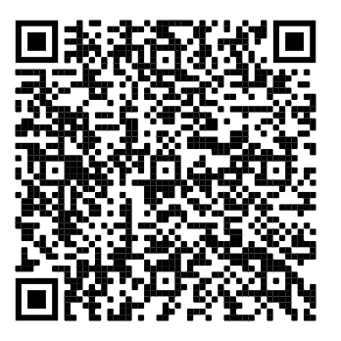

Slide 45
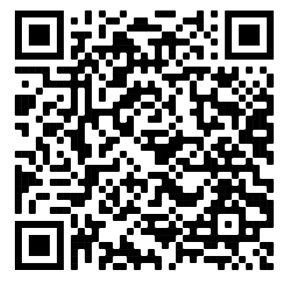
https://intensiveintervention.org/intensive-intervention-math-course

Slide 46
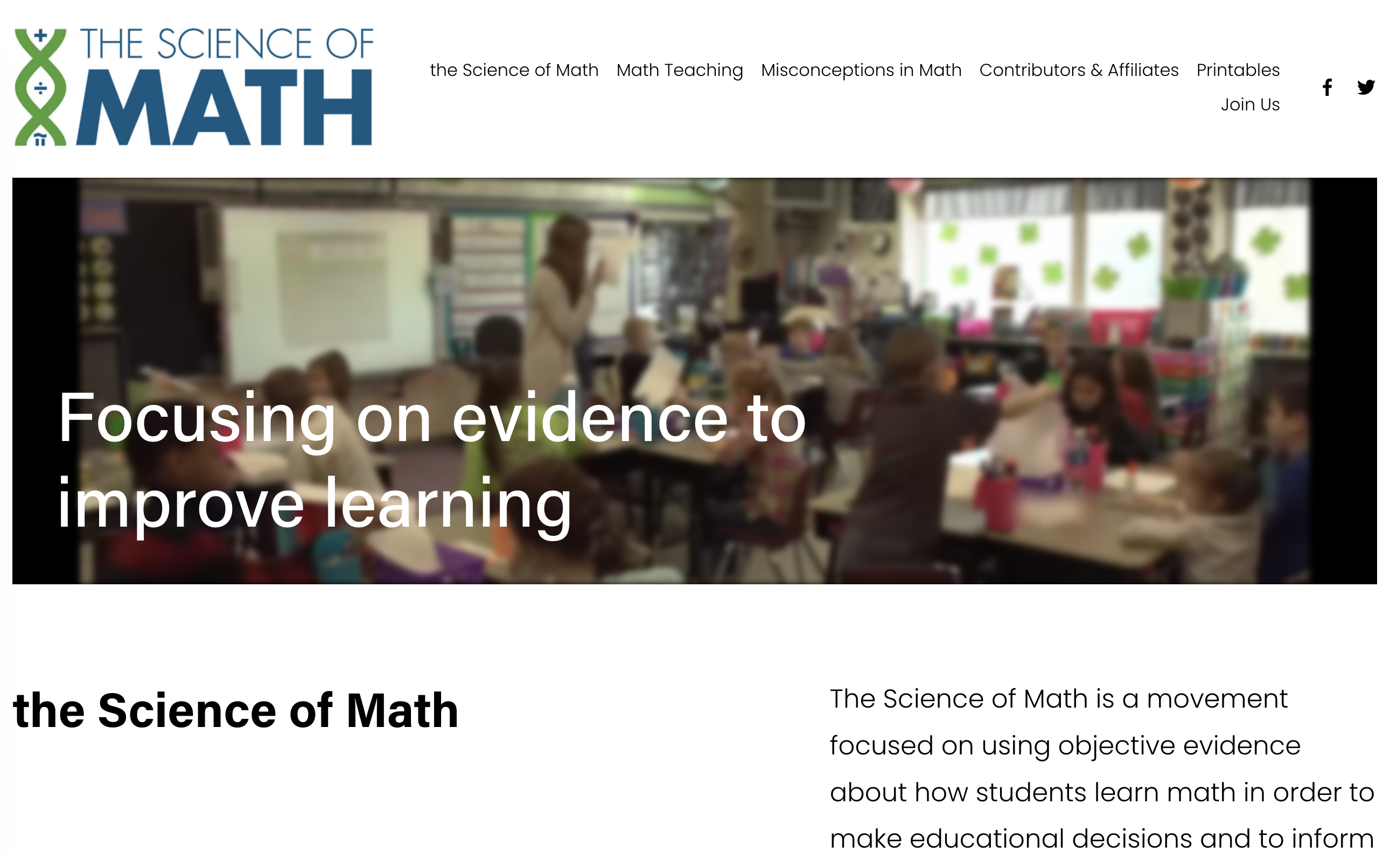
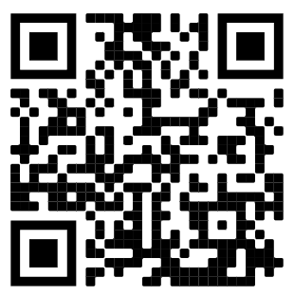
https://www.thescienceofmath.com/

Slide 47
Sarah R. Powell, Ph.D.
Associate Professor
The University of Texas at Austin
www.sarahpowellphd.com
srpowell@utexas.edu
@sarahpowellphd
119

