Slide 1
Lincoln Place / Amber Vista Survey Responses
7/10/23

Slide 2
Purpose
Gain an understanding of what neighbors think of HOA duties
Social events
Entrance maintenance
Covenant enforcement
Dues
Drive the agenda to today’s meeting
Notes:
Secondary purpose: based on social media posts, I think there are some neighbors who don’t know what the HOA does, and is responsible for. Hopefully the survey helped clarify that.

Slide 3
Responses
Invited via email on June 28
We have email addresses for about half of HOA owners
67 responses
Following meeting, anonymized responses will be available on HOA website
http://www.lincolnplace.org/
Notes:
Ask Mark if OK to host!

Slide 4
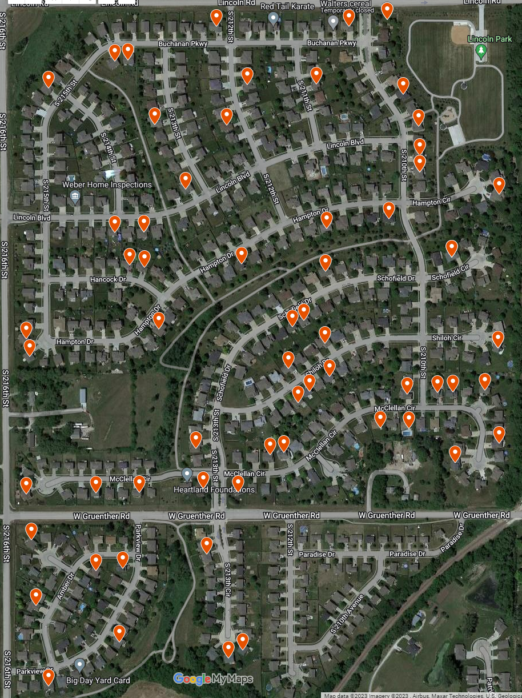
Map of responses
Notes:
I put them all on a map to verify that people were where they said they were. One neighbor had a typo in their address, so quickly corrected that. If you took the survey, you should see your house marked here. I think we got a pretty good geographic distribution of neighbors who helped with this, so thanks to those of you who participated.

Slide 5
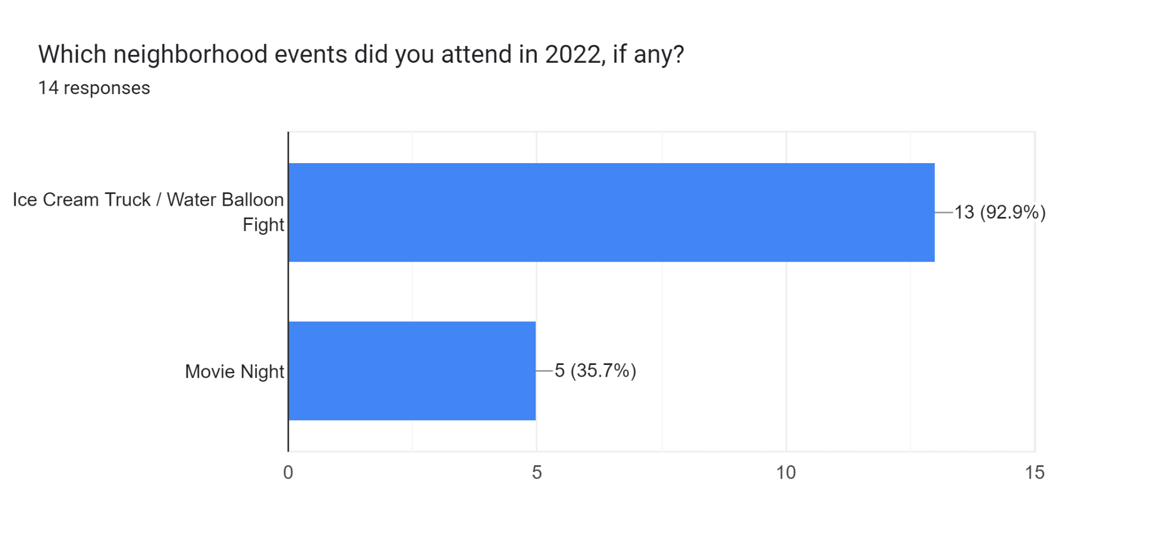
Notes:
We had over 100 people on the first event, not sure how many families that would work out to.

Slide 6
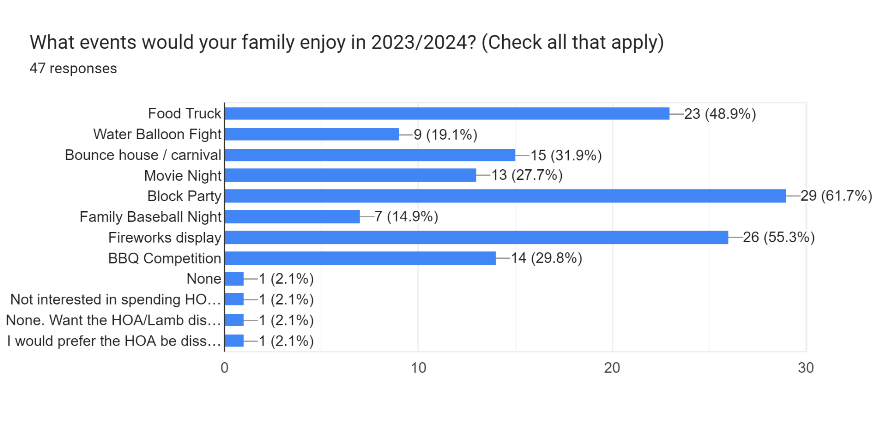
Notes:
Lots of interest in doing something here. Block party, fireworks and food truck all the most popular. Some of these could be combined if we wanted. 4 people wanted nothing, or the HOA dissolved, the other 43 thought their family would enjoy an event.

Slide 7
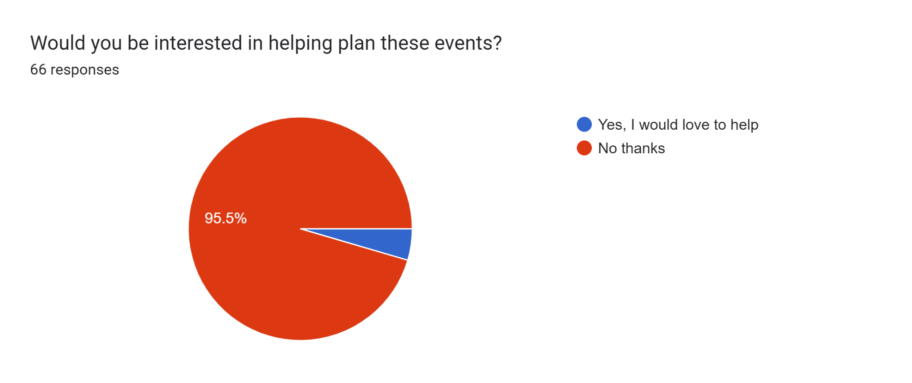
Notes:
3 people marked ‘yes’ here. Great to see.

Slide 8
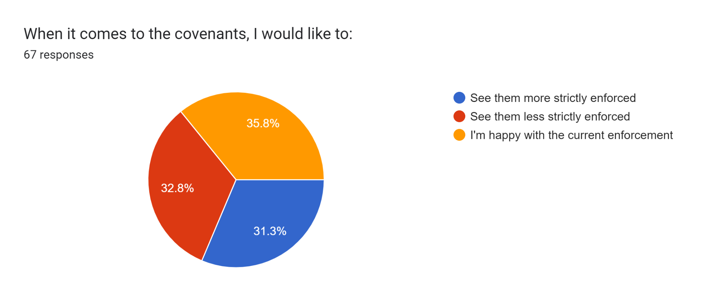
Notes:
Most interesting chart. One vote difference between “more” and “less” (21 vs 22), and only two-vote difference between “less” and “happy.” No clear consensus to make changes in either direction here.

Slide 9
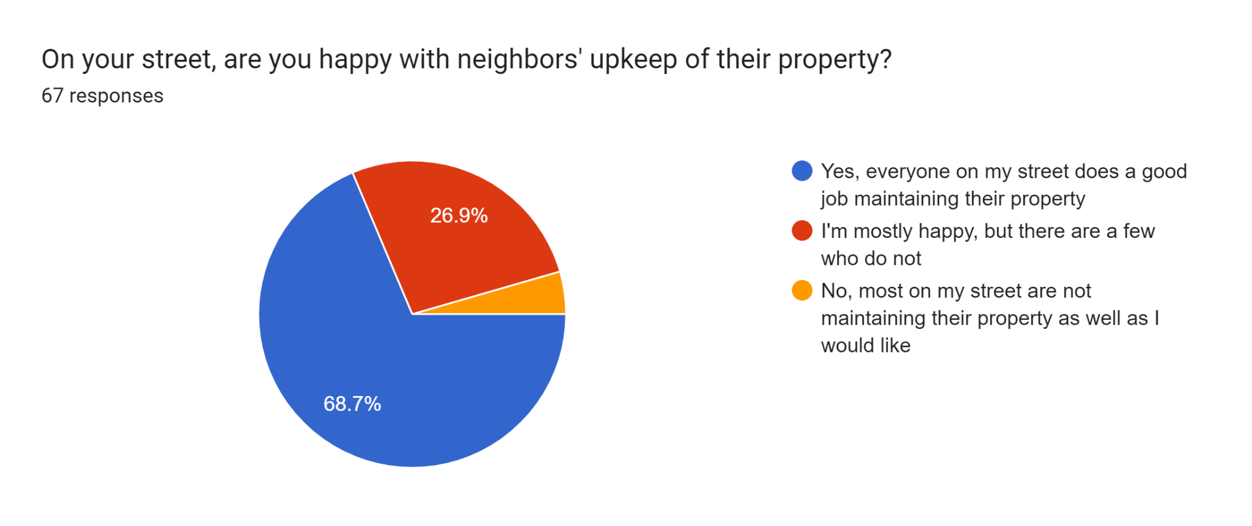

Slide 10
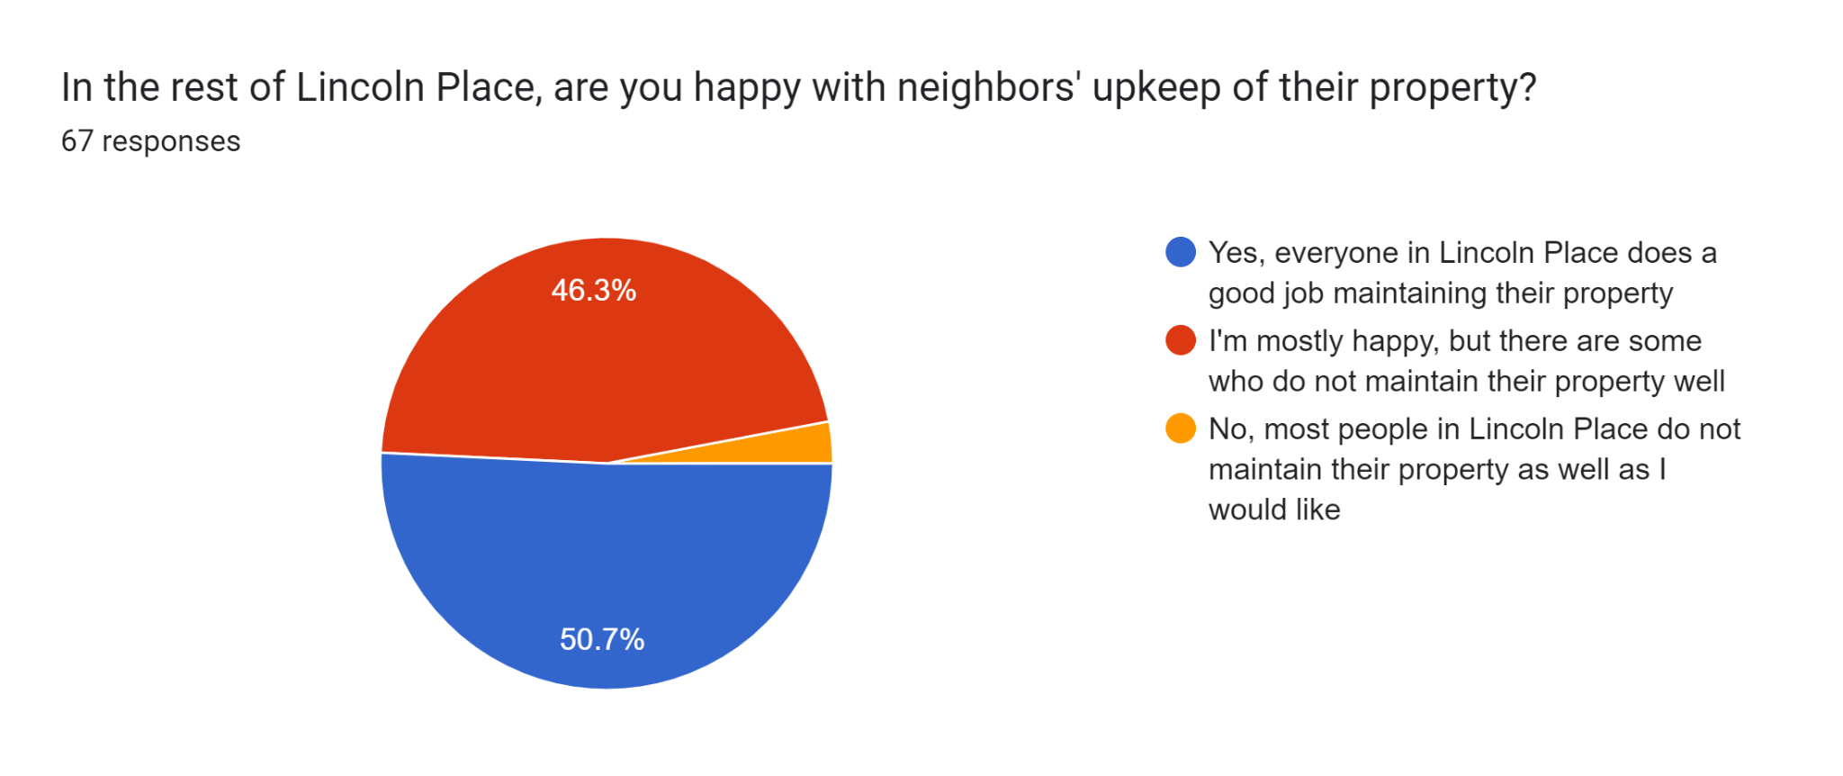

Slide 11
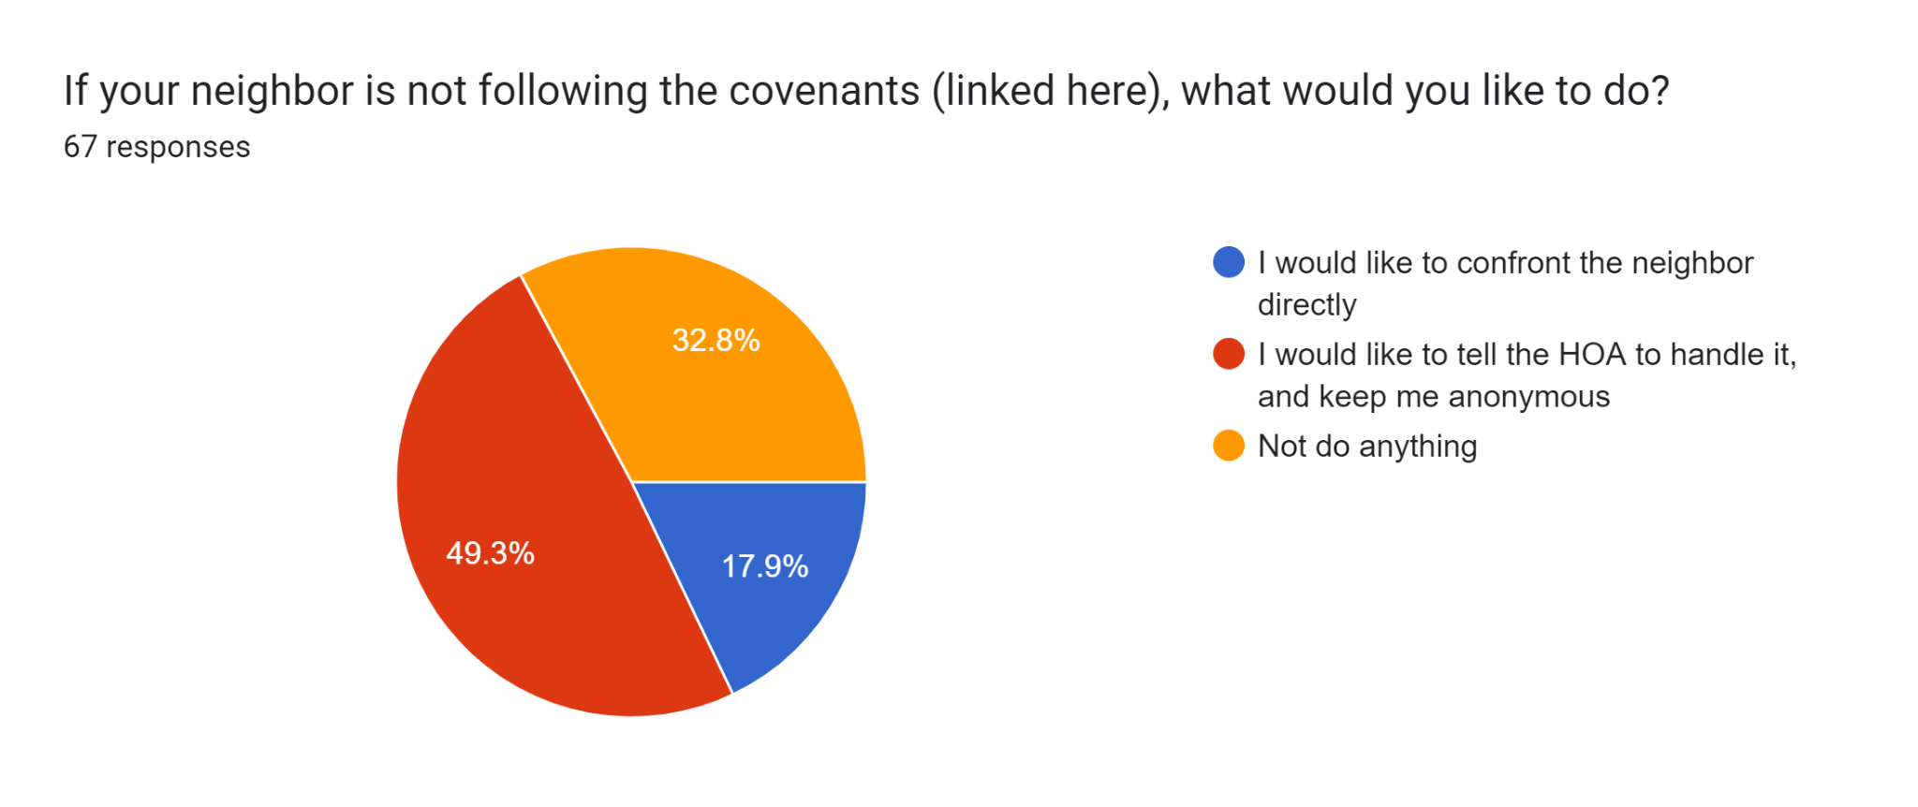

Slide 12
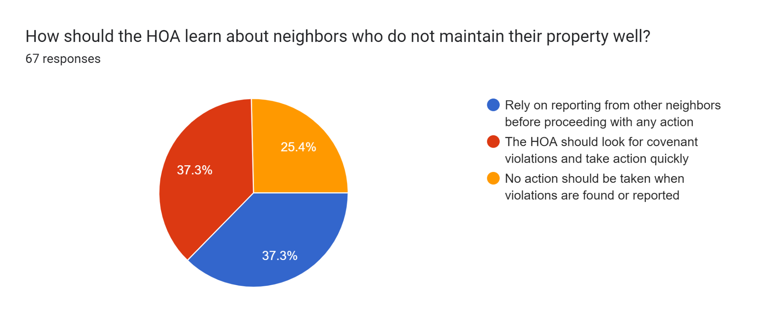
Notes:
75% of neighbors would like the HOA to take some sort of action when a neighbor isn’t maintaining their property.

Slide 13
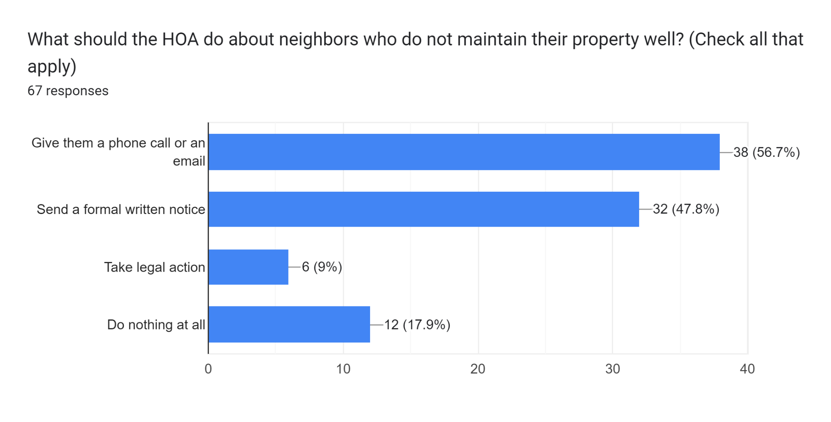
Notes:
On this chart, 80% of neighbors want the HOA to take some sort of action. So now we have two charts with a clear consensus that covenants need to be enforced. Very few people want them legally enforced by the HOA, however.

Slide 14
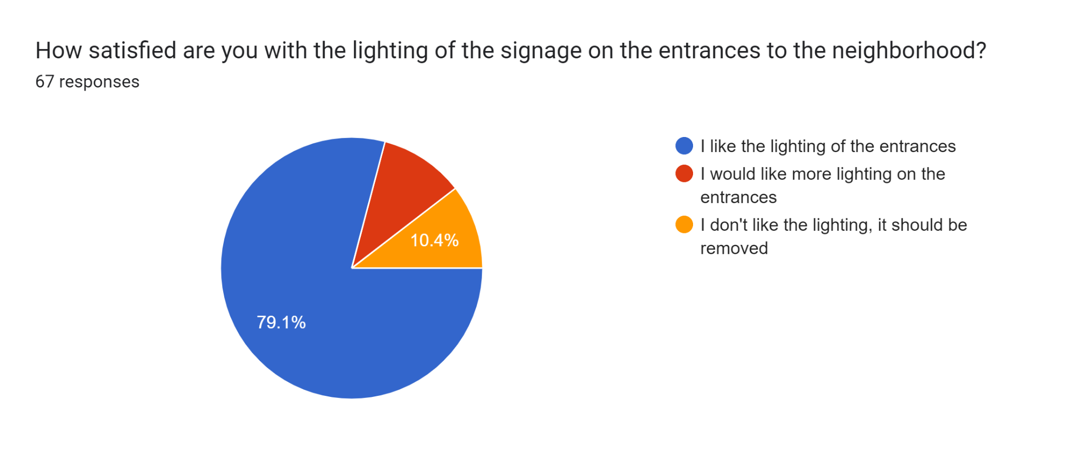
Notes:
Lighting of the entrances is popular.

Slide 15
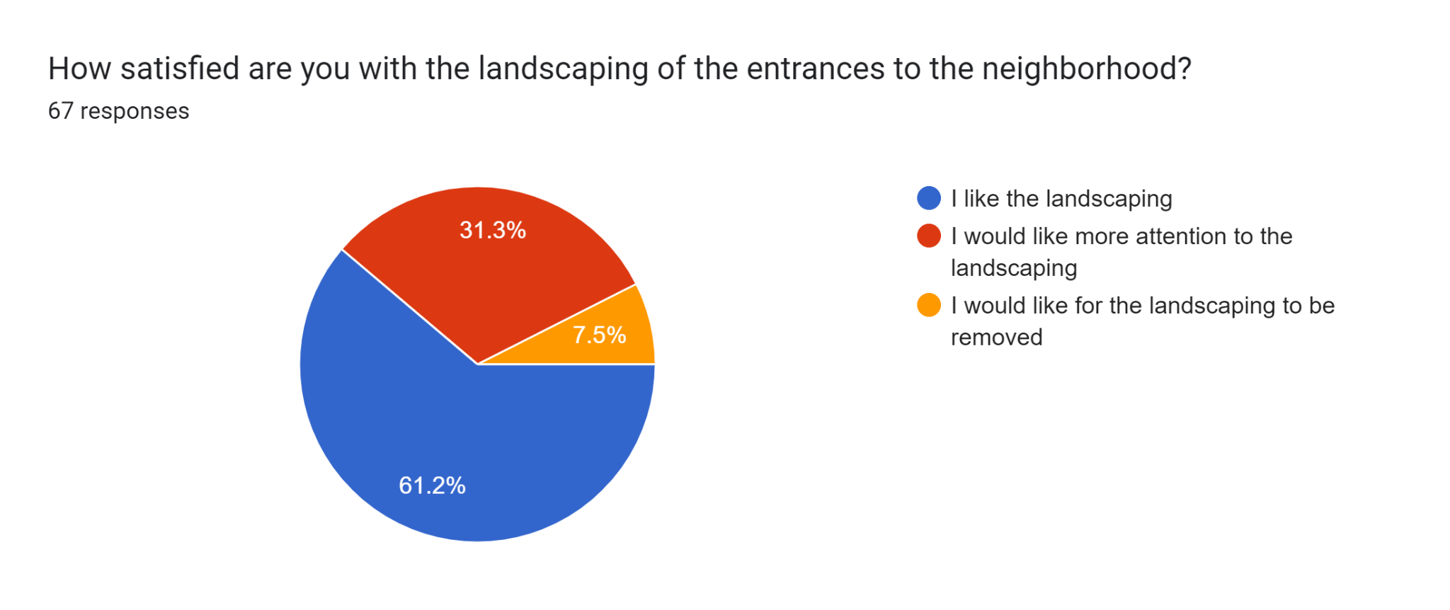
Notes:
Landscaping of the entrances is popular.

Slide 16
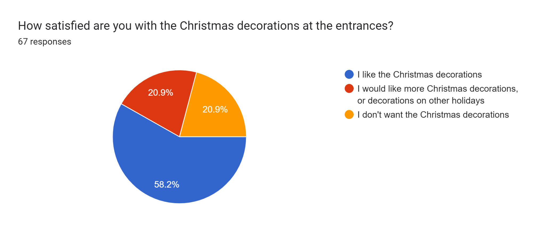
Notes:
Christmas decorations are popular. Kudos to Mark for starting to do that a couple of years ago.

Slide 17
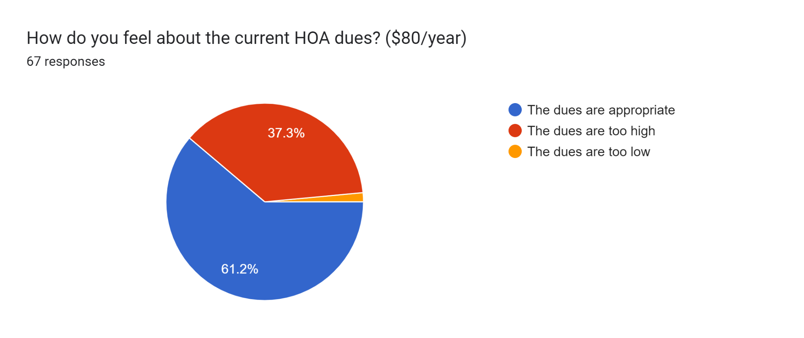
Notes:
Most people think the dues are appropriate.

Slide 18
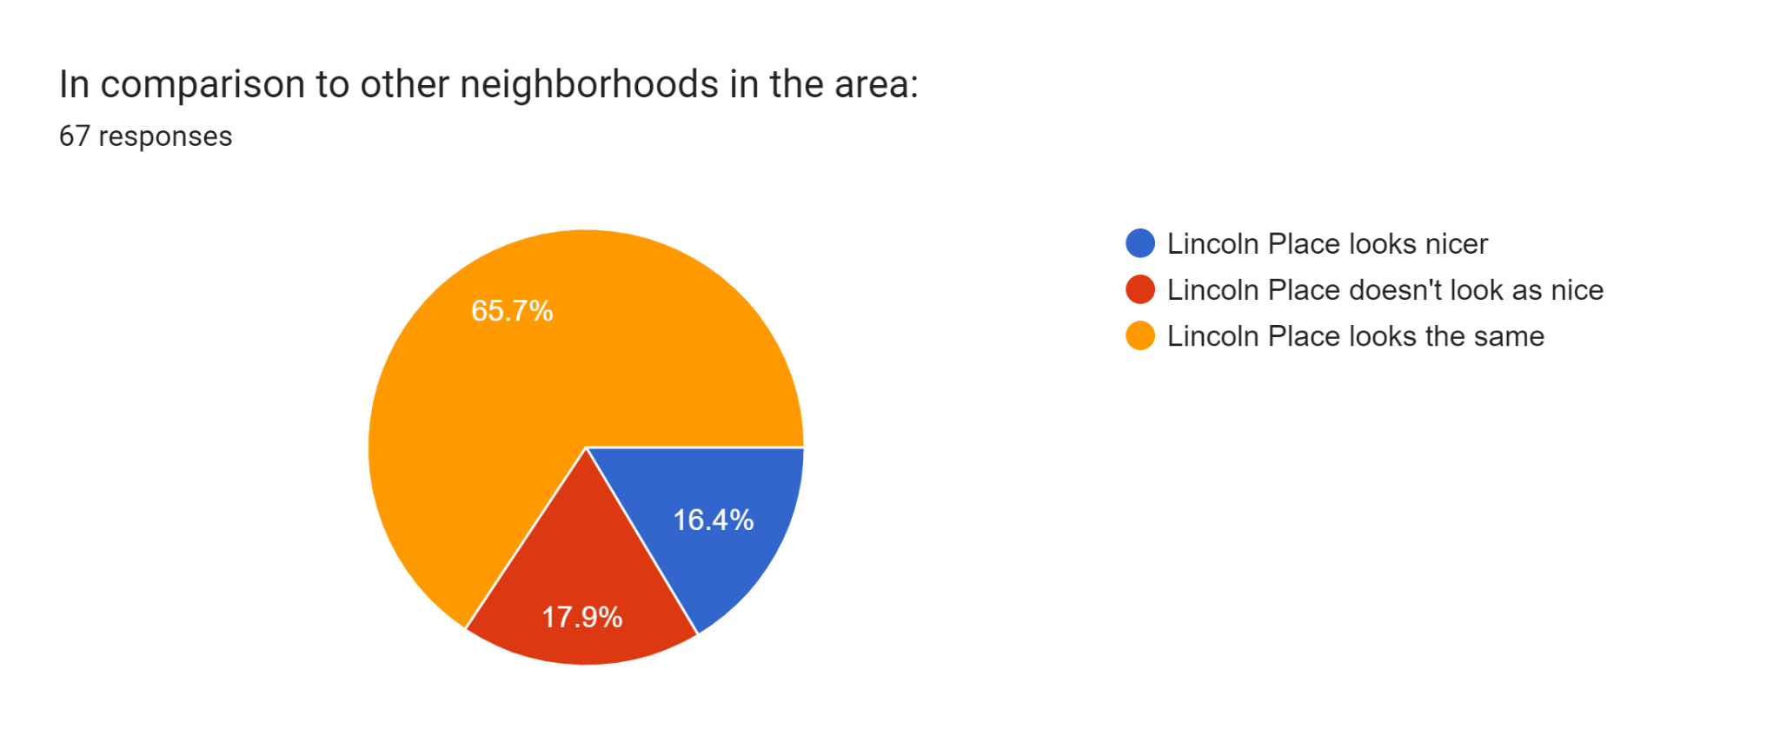

Slide 19
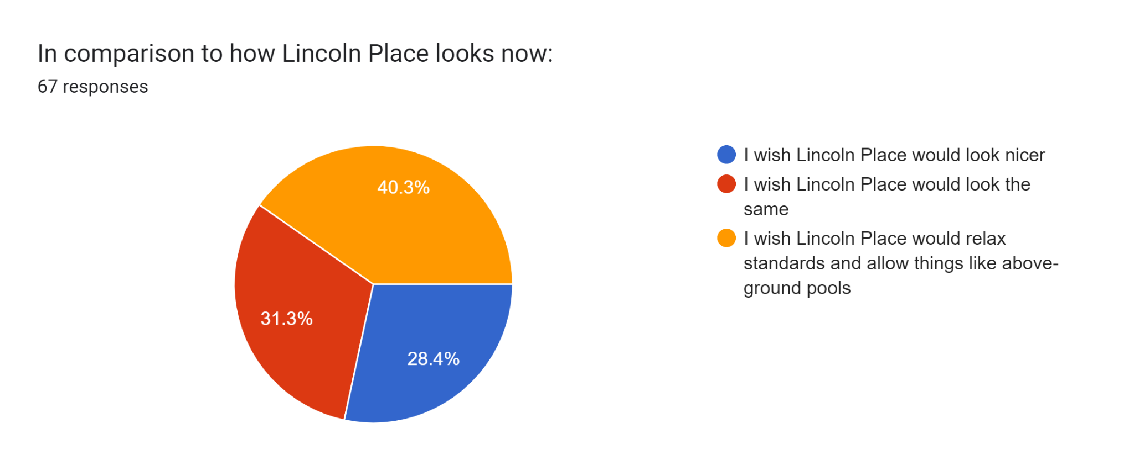
Notes:
40% think we should relax standards, the other 60% think standards should be kept the same or increased. Tells me there’s no clear consensus to make a change overall. Because if we did relax standards, 60% of neighbors would have a problem with that.

Slide 20
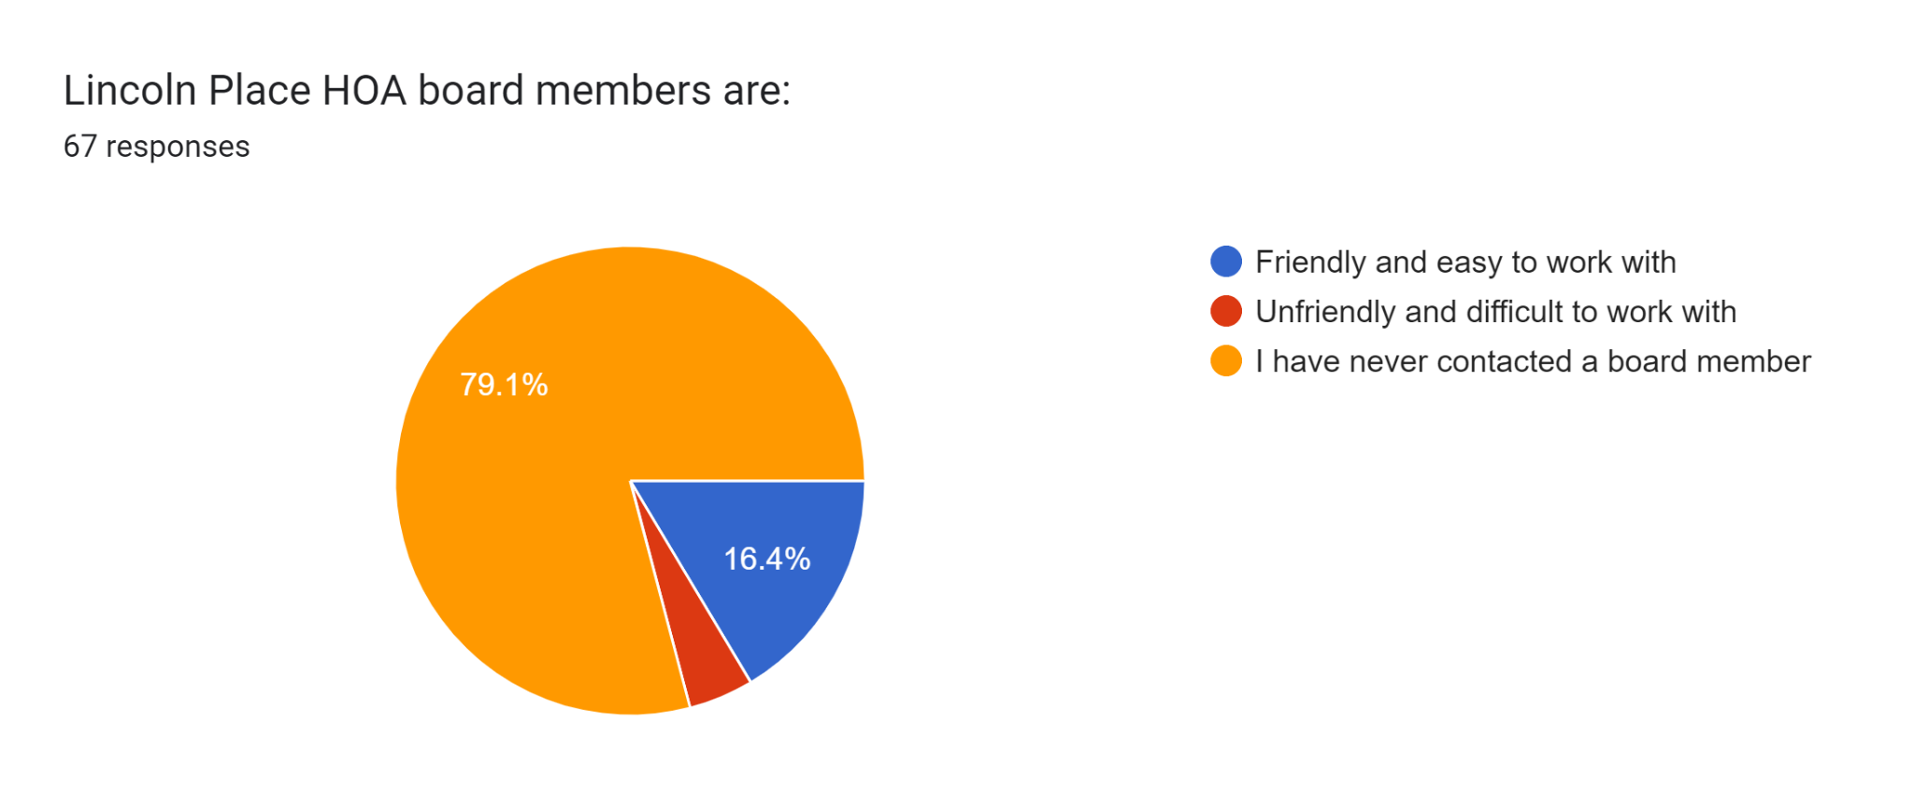
Notes:
3 people think we’re unfriendly and difficult. 11 think we’re friendly. The rest have never contacted us.

Slide 21
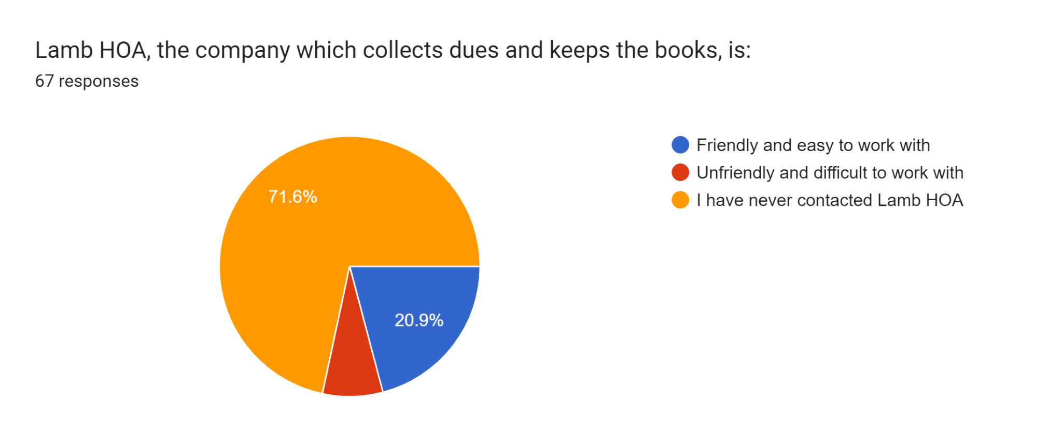
Notes:
5 people think the folks at Lamb are unfriendly and difficult. 14 think they’re friendly. The rest have never contacted them.

Slide 22
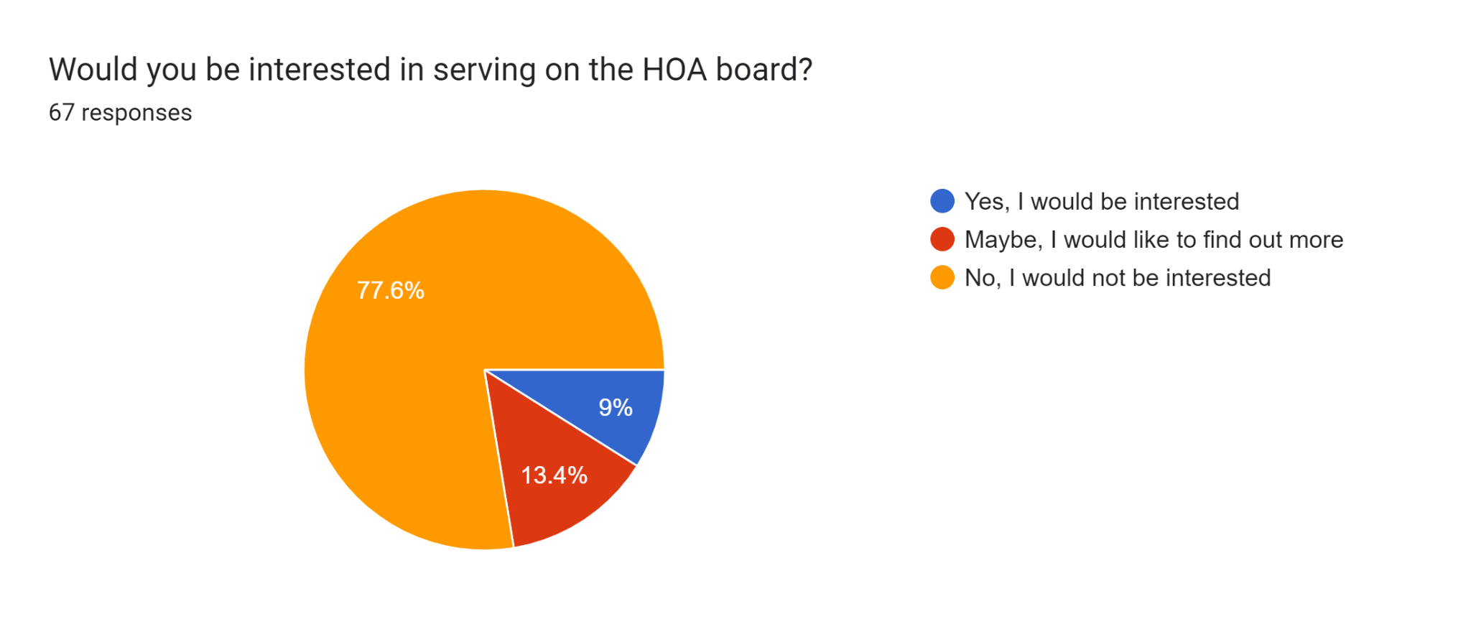
Notes:
6 interested, 9 maybe. Great news for next year, as mine and Mark’s seats are both up. Mark was the sole member for a couple of years, we had an additional open seat the year after I joined. So great to see the interest level.

