Slide 1
Creating & Presenting Academic Research Posters
Rob Mayes
University of North Texas

Slide 2

What is an Academic
Research PosTER?

Slide 3
Why Academic Research PosTERS?
Market or Share your research ideas
Acquire advice and encouragement from seasoned researchers
Showcase your creative talents.
Enter and enjoy the competition.

Slide 4
How to Create an
Academic Research Poster
Create you research document.
Start a Power Point presentation with ONE slide the size of the POSTER
Add the title block and authors section
Import text Blocks
Import Graphs/Charts and Tables
Import Images
Import University Logos
as per Branding and
Trademark rules.

Slide 5
Consider this….
Printing Costs
Poster Size
Carrying Case (Tube)
Display Easel
Attachment Pins or Clips
Handouts and Business Cards

Slide 6

Examples
Reference: http://cleo.uwindsor.ca/oakland/2009/info-posterprize-winner.php

Slide 7

Examples

Slide 8

Examples

Slide 9

Examples

Slide 10

Examples
Reference: http://ichams.org/presentations-2

Slide 11

Examples

Slide 12
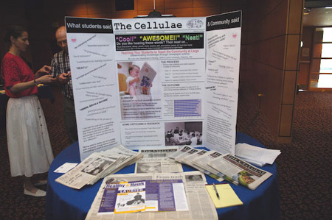
Examples

Slide 13
Poster References
https://www.scientificposterdesigns.com/scientific_poster_examples

