Slide 1
GP CPCS: Initial Engagement for General Practice teams

Slide 2
What is GP CPCS?
Background
The NHS CPCS (Community Pharmacist Consultation Service) is a nationally commissioned & funded service that was launched in community pharmacies across England in October 2019
Electronic referrals from NHS 111 were made to community pharmacies for patients with a minor illness or those needing an urgent supply of a medicine
A pathway to expand this to general practice patients with a minor illness was piloted by NHSE&I in 2019-20 and the decision to expand the service to include referrals from general practice to community pharmacy was agreed from 1st November 2020
What is GP CPCS?
GP CPCS is a pathway that general practices use to refer patients with minor illness or low acuity conditions to a community pharmacist
A patient referred electronically through GP CPCS will receive a consultation with a pharmacist (in the consultation room or remotely) where the pharmacist will clinically assess the patient, referring to SCR and NICE CKS as appropriate – this is not a conversation over the counter (e.g., Minor Ailments Service)
Only patients electronically referred from general practice or NHS 111 can be included in this service

Slide 3
NHS 111 CPCS:
10,500 patients referred per week in England
NHS 111 CPCS:
332,000 patients referred in first 9 months of service from October 2019
GP CPCS:
88% of patients referred had their concern resolved by the pharmacist
GP referral pathway introduced following pilot success and evaluation
GP CPCS:
£20 million potential savings if 6% appointments which could be safely referred to community pharmacy, were
Evidence & Impact

Slide 4
Benefits
As general practices continue to deliver the COVID-19 vaccination programme, this greater use of pharmacists’ expertise can help ensure patients are provided with the right care by the right person at a time most convenient to them. This will increase capacity within general practice for the treatment of patients with higher acuity needs, both now and post pandemic
This service aims to support the local NHS system and improve access to primary care through more effective use of existing resource, capacity, and expertise within the system
Patients | Accessible & professional clinical service from the pharmacist of their choice Re-educate patients to go to the most appropriate healthcare professional for their needs
General Practice | Create capacity – more GP appointments available as those with minor illnesses/low acuity conditions have been referred to pharmacy Patients seen by the right healthcare professional at the right time Build on and enhance local relationships between primary care providers
Pharmacy | Allows community pharmacy to demonstrate its place within the NHS to manage patients with minor illnesses/low acuity conditions Build on and enhance local relationships between primary care providers
NHS | Cost-effective use of NHS resources to support patients with minor illnesses/low acuity conditions

Slide 5
GM Referral Process

Slide 6
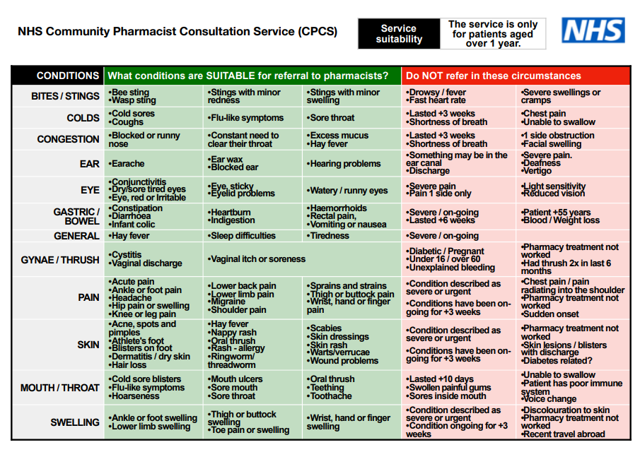
1. Identifying a Referral: Receptionist or Care Navigator
The process begins in the general practice and should be considered as part of the total triage process
The patient contacts the general practice via telephone or online triage system
Care navigator or receptionist assesses the patient’s issue against a list of conditions which are suitable for referral under CPCS
Please see Appendix B in the GP CPCS Toolkit for GP and PCN Teams for the full list of NHS CPCS symptom groups for determination by general practice.

Slide 7
2. Making a Referral: Receptionist or Care Navigator
Care navigator or receptionist makes an electronic referral to the community pharmacy of the patient’s choice.
The referral details are sent through to the pharmacy as an electronic message using the electronic tool.
Patient Access Connect Template (EMIS)
This is a tool integrated into EMIS-web which includes the condition list and some triage questions to help to identify appropriate referrals. The tool pre-populates with patient demographic information and sends it directly from the EMIS to the community pharmacy system (PharmOutcomes) via ITK link.
[Please note patients are not required to sign up to the Patient Access app to utilise this referral mechanism.]
PharmRefer (non-EMIS)
For non-EMIS practices, there is a web-based referral tool called PharmRefer, for which practices will have a login and which captures the same patient demographic information and sends it directly to the community pharmacy system (PharmOutcomes.)
[There are currently no integrated tools on the market for non-EMIS practices.]
Please see Appendix C in the GP CPCS Toolkit for GP and PCN Teams for further information.
Funding for the IT referral mechanism has been sourced by GMHSCP.
There is a helpful 4-minute video for general practice teams to see the EMIS tool in practice.
Further information about PharmRefer can be found here.

Slide 8
3. Pharmacist Conducts the Consultation
Pharmacy contacts the patient
Within 2-3 hours
Consultation to be completed within 12 hours pending patient circumstances
Consultation
Pharmacist
Presenting symptoms, relevant medical history & medication taken
Outcome
Safety Netting advice
Consultation notes sent as pdf by NHS mail to the referring general practice
Remote or face to face
NICE CKS
Red flags
SCR
Managed in the pharmacy or escalated
If escalated, Pharmacist makes the call
Patient should only contact the pharmacy themselves if they have not had contact within 3 hours
Clinical assessment

Slide 9
4. Consultation Outcomes
Advice Only
Advice & OTC sale
Advice & referral into local MAS
Advice & non-urgent signposting to another service / GP
Advice & urgent escalation to GP (pharmacist makes contact)
Advice & urgent escalation to urgent care e.g. A&E or 999
Patient Reassurance. May also include provision of written information, or recommendation to use products the patient has at home
Patient is encouraged to purchase a medicine OTC.
Pilot feedback shows this was not a barrier for patients even in deprived areas
To another hcp e.g. optometrist
Or to the GP for a routine appt.
e.g. dermatitis / eczema which was previously treated with OTC steroid cream but is no longer effective
Where the pharmacist considers the patient should be seen by their GP the same day – Pharmacist will contact the practice themselves
A minority of cases where a patient is urgently escalated to A&E
Where the MAS is commissioned and where the presenting symptoms and patient are included in the service eligibility criteria

Slide 10
GP CPCS vs. Minor Ailments Service (MAS)
GP CPCS
If the reception staff are :
not confident in the patient's self-diagnosis
OR feel that the patient would benefit from a clinical consultation with the pharmacist
OR feel that a red flag discussion and a review of patient's medicines and relevant medical history is appropriate
then they should refer under GP CPCS.
Key points:
An electronic referral ensures that the patient is assessed by the pharmacist and that the pharmacy will get paid for the consultation
Patients referred via GP CPCS will receive a personal consultation with the pharmacist either remotely or in person
Consultation outcomes and any product supplied will be sent back to practice
If patient requires a referral back to the practice this will be formally handled by the pharmacist ensuring that risk is managed across primary care
MAS
If the reception staff are:
confident in patient's self-diagnosis
AND do not feel there is need for a clinical consultation with the pharmacist to exclude red flags e.g. sepsis
then they can continue to signpost and NOT use GP CPCS to make a referral.
Key points:
MAS patient assessment is carried out by any member of the healthcare team under the supervision of a responsible pharmacist
Only patients who fit the eligibility criteria for the MAS then they can be treated under the MAS and receive a medicine supply free of charge
Details of the interaction will not be shared with the GP
Contact has been made with all pharmacies in Greater Manchester in preparation for GP CPCS deployment and conversations around Minor Ailment Scheme have been had where appropriate.

Slide 11
GM Deployment Overview
Governance
GMHSCP Head of Primary Care is SRO for programme
PID completed
Working group set up to inc. LPCs, GMHSCP & GP reps
Funding for IT referral mechanism by GM agreed for 21/22 and 22/23 by Primary Care Digital Board
Scoping
All GM general practices in scope
Initial targets of 50% deployment by March 2022 revised following announcements in October 2021 regarding IIF incentives for general practice
Planning
Deployment blueprint & plan prepared to provide standard process & activity tracking
Engagement
Procurement managed by GMSS
GM-specific processes & escalations agreed
Virtual Outcomes training secured for general practice & community pharmacy
First practices live May 2021
101 practices live as of end November 2021
Monthly stakeholder reports shared inc. KPIs & activity data
Reporting to GM system is being reviewed in November 2021
GM system: DMOG, Primary Care Board, Community Pharmacy provider Board, GP Provider Board, PCN Clinical directors, community pharmacies, CCGs, Practice-based pharmacists & Practice managers
GMHSCP comms sent out late November 2021 referencing WPAF & IIF – deployment reviewed & streamlined to inc. increased activity from Jan 2022

Slide 12
Next Steps
Training
Book all appropriate reception / admin / care navigator staff onto a training session
See link shared separately
Date
Your GP CPCS WG lead will allocate a go live date once training has been booked
Date will be confirmed to you by email
Prep for go live
GP staff attend training session
GP CPCS working group contact all pharmacies who dispense majority of prescriptions from your practice to confirm go live date & share supporting information inc. contact info for non-urgent and urgent escalations
Go Live
Practice team start to make referrals
Target referrals are 0.65 referrals per week per 1000 patient list size
Your GP CPCS lead is available should you require any information or support*
* For any issues which require formal escalation, please see GP FAQs for process

Slide 13
To confirm
It is vital that practices attend a GP CPCS training session and does not commence making referrals until the go live date confirmed by the GP CPCS working group lead.
If a practice starts to make referrals without completing these vital steps, there is as risk that:
Practice staff will not receive training and so may make inappropriate referrals, leading to a higher rate of escalations and a negative patient experience
Referrals sent via NHSmail are not visible to the commissioner – they can only be seen when the pharmacy completes the consultation in PharmOutcomes, meaning no audit trail of missed or dropped referrals
Escalation information has not been collated from the practices & shared with pharmacies – GM processes will not be followed as pharmacies will not have the escalation information we are collating as part of deployment
Pharmacies are not informed of a practice going live – they may miss referrals leading to a negative patient experience and potential damage to relationships

Slide 14
Resources
GP CPCS Tools | Link
NHS CPCS Toolkit for GP and PCN teams | Report template - NHSI website (england.nhs.uk)
NHS GP Briefing Note | https://www.england.nhs.uk/primary-care/pharmacy/community-pharmacist-consultation-service/referring-minor-illness-patients-to-a-community-pharmacist/
Advanced Service Specification NHS CPCS | https://www.england.nhs.uk/wp-content/uploads/2019/10/CPCS-Advanced-Service-Specification.pdf
Patient Access Patient Signposting Video | https://www.youtube.com/watch?v=pyQUfUR2lz0
PharmRefer Video | https://media.pharmoutcomes.org/video.php?name=PharmRefer-2021_Update
NHSBSA GP CPCS Page | General Practice Community Pharmacist Consultation Service (GP CPCS) | NHSBSA
PSNC GP CPCS Page including GP CPCS Animation | CPCS – GP referral pathway : PSNC Main site
GP CPCS Pilot - Bristol, North Somerset and South Gloucestershire pilot | NHS England » GP Referral to NHS Community Pharmacist Consultation Service – Bristol, North Somerset and South Gloucestershire pilot
Frequently Asked Questions (FAQ’s) | Frequently Asked Questions (primarily for general practice teams)

