Slide 1
2018 Field Efforts
Arctic Waterways Safety Committee
December 5, 2017
BOEM Environmental Sciences
https://www.boem.gov/akstudies/
Contact: Catherine.Coon@boem.gov

Slide 2
Field Efforts in 2018
PLANNED NEW FIELD EFFORTS (FY 2018)
AK-17-01 | Wave and Hydrodynamic Modeling in the Nearshore Beaufort Sea | Beaufort | 2017 | UAF/USGS/AOOS

Slide 3
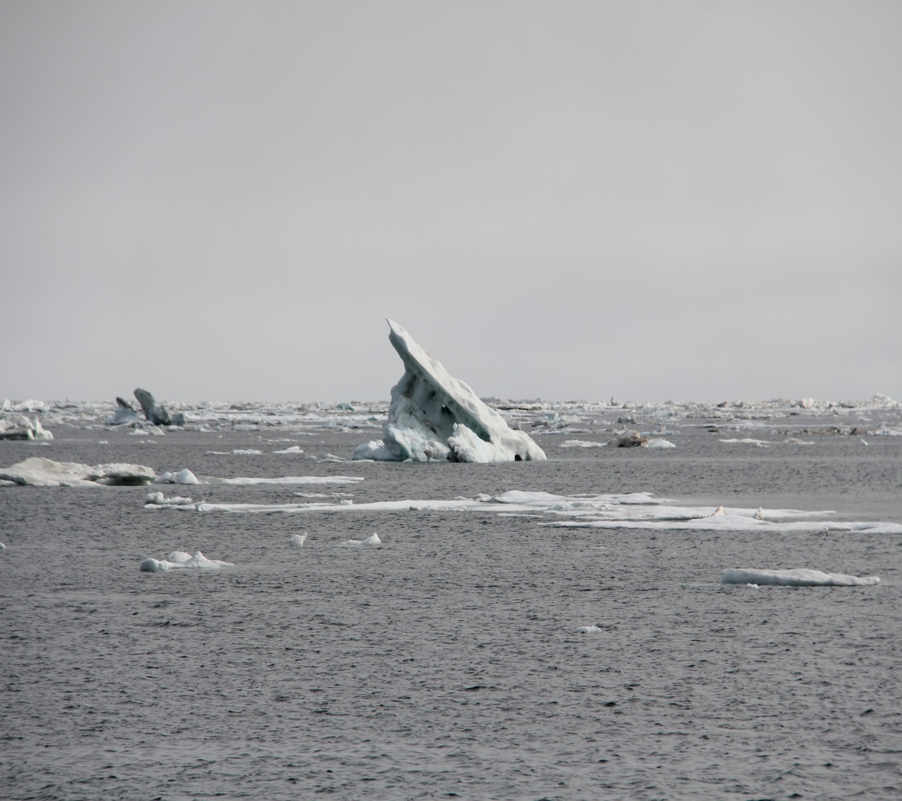
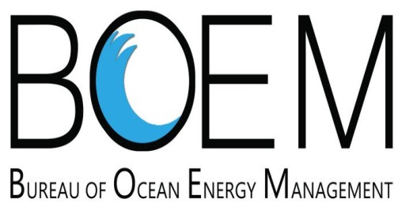
Central Beaufort Sea Wave and Sediment Transport Study

Slide 4
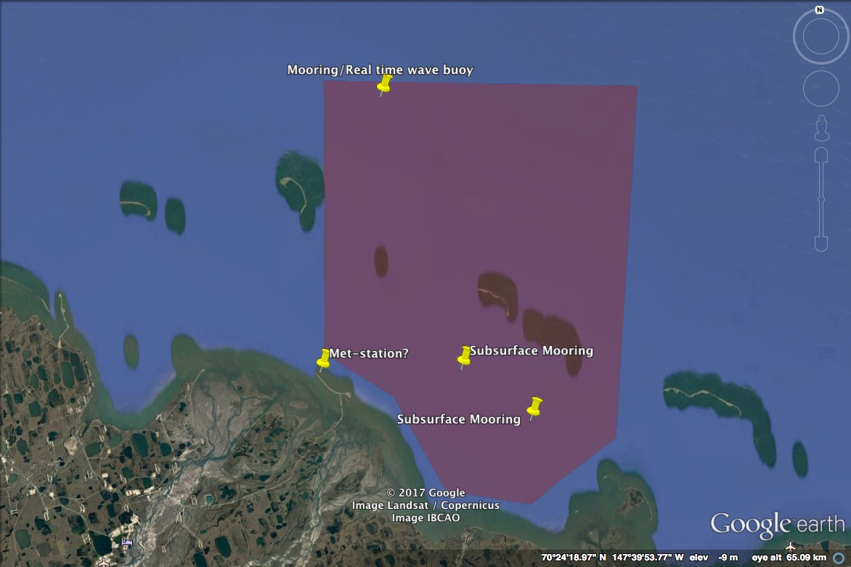
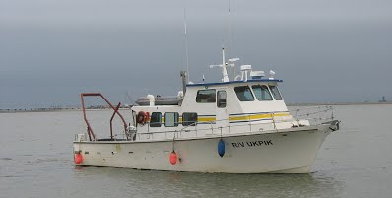
Tentative Schedule
Cross Island
Field work in Summer 2018, 2019, 2020 (July)
~9 days of CTD, multibeam sonar surveys and mooring deployments in 2018, 2019 from the R/V Ukpik.
Most of the vessel-based work concentrated in- and around- Foggy Island Bay (red shaded area)
Final mooring recoveries in 2020
Real-time wave data from a buoy off NE of Narwhal Island in Summer/Fall 2018 and 2019
Real-time met station (location TBD)
Field work will be scheduled to avoid whaling activities
Field work will be scheduled to avoid whaling activities
Wave buoy is 20+ miles from miles from Cross Island to nearest mooring, ~64 miles as-the-crow-flies to Nuiqsut, ~14 miles to Deadhorse airport
Prudhoe Bay
Foggy Island Bay

Slide 5
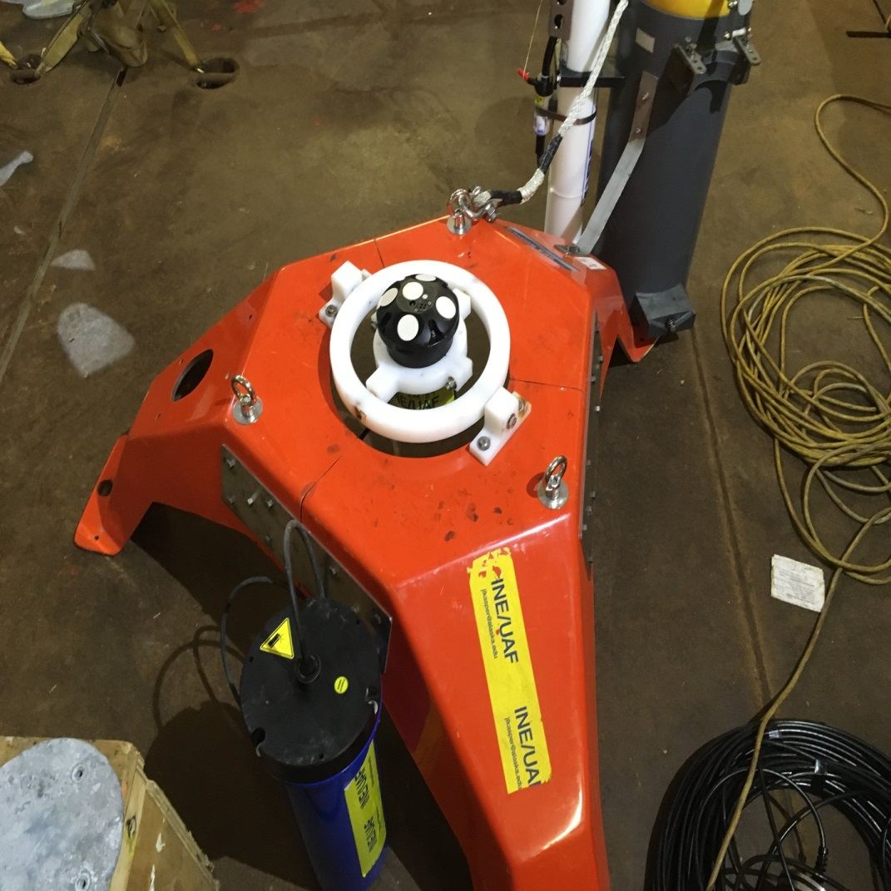
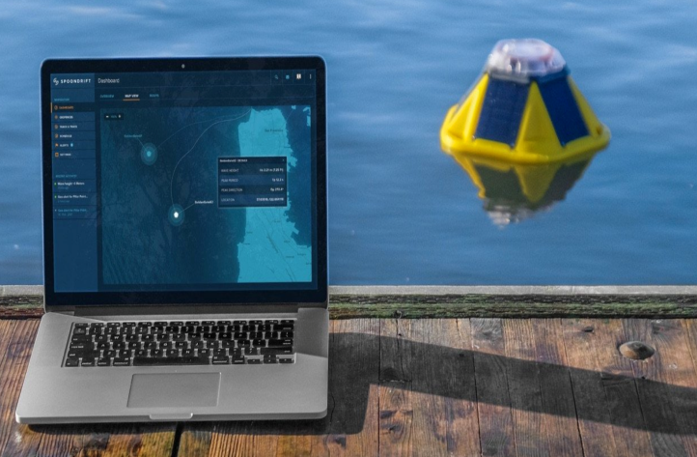
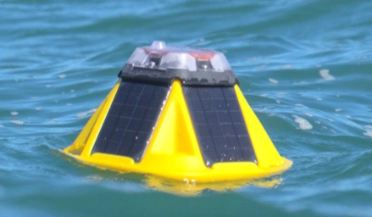
Moorings, Real time wave buoy
Moorings
Compact frames that sit on the bottom, deployed year-round
Instruments
Conductivity/Temperature/Pressure logger
Acoustic Doppler Current Profiler (frequencies of 600 kHz or 1 MHz, well outside marine mammal hearing ranges)
Acoustic Doppler Velocimeter (frequency of 2 MHz or greater, well outside marine mammal hearing range)
Real-time wave buoy
~15” buoy with satellite telemetry
Data publically available via AOOS website
Deployed for several months at a time in Fall 2018 and 2019.

Slide 6
Summary
Outreach
AOOS (C. Janzen) will lead outreach (locations & method, TBD, Nuiqsut is the closest community)
Project website on AOOS page will be widely advertised by AOOS and UAF
UAF will participate in Kaktovik Youth Oceanography Program (UT, USGS, USFWS, BOEM).
Field Work/Sensors
~1.5 weeks of vessel surveys in 2018, 2019
Survey work will avoid subsistence whaling periods
Oceanographic moorings deployed from Summer 2018-2020
Instruments are quiet and/or outside marine mammals’ hearing range
Real-time wave information (height, direction, period) will be publically accessible during periods when sensor is deployed (~Aug.-Oct. 2018, 2019).
Questions/Concerns?
Outreach: Carol Janzen (janzen@aoos.org)
Science Lead: Jeremy Kasper (jlkasper@alaska.edu), 907 888-2534
Program Officer: Warren Horowitz (warren.horowitz@boem.gov)

Slide 7
2018 Beaufort Sea Boulder Patch, Nearshore Fish
Field work,
July 12-18th access with the R/V Proteus (Small Boston Whaler) in the Stefansson Sound Boulder Patch.
July 18-30th USGS will be conducting fisheries sampling with fyke nets in Steffanson Sound and Simpson lagoon.
July 30-August 11th LTER Allison Lagoon, Steffanson Sound, vicinity of Barter Island
Also the Kakotvik Oceanography Program will be the 3rd week of August
This is a week-long K-12 Oceanography Program for the youth
daily field activities alongside scientists using a variety of instrumentation and gear. We engage the adult community through the kids through afternoon or evening K-12 student-led presentations, exhibits, and activities.
t.
Questions/Concerns?
Ken Dunton (ken.dunton@utexas.edu)

Slide 8
Marine Arctic Ecosystems Study (MARES):

