Slide 2
Todays Schedule
Q&A
Level 4 Basics
Lunch 12:00 – Reading Resources Update
Level 4 Wrap-up
Psychology of Success

Slide 3
Q & A
Classroom setting
Level 1-3 Questions

Slide 4
Open Syllables
Only 1 vowel - vowel at the end – vowel says it’s own name
Long-U makes 2 sounds Few / ee-oo/
Flu /00/
Y is a vowel at the end of words
Long I at the end of one syllable words (sky)
American words don’t end in I. Spell the Long-I sound with a Y

Slide 5
Syllable Division Rule #1
2 vowels not next to each other – two syllables
Separate the vowels
Move letter between to back…if it’s a real word – you’re done. If not – move the other way
New procedures for multi-syllable words
Y at the end says /ee/ like Baby
No FLOSS rule
C switches to /s/ if the watch-out vowel is long OR short

Slide 6
Syllable Division Rule #2
If the word has 2 letters between the vowels, split them
Never split digraphs or blends
Rotten Letters – if the second letter is an L or R – you usually don’t split those letters – send both to the end

Slide 7
Lesson 4 – Brick Wall

Slide 8
Strategies
Movement ideas…
Excersize balls
Standing/white board
Rock/paper/scissors
Connect 4
Fiddle objects
“Buy In” strategies…
Pokemon?
Lego
Oobi eyes
Youtube

Slide 9
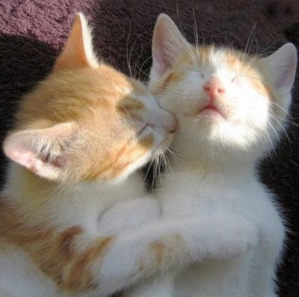
Spelling /k/ in the Middle
Music Trick Spelling Rule:
Use Milk Truck Rule in multi-syllable words unless the last sound is /ic/
In multi-syllable words spell /ic/ as ic
Kiss the Cat Spelling Rule:
Applies to /k/ at the beginning of multi-syllable words

Slide 10
Spelling /K/ in the Middle
Picnic Chicken Basket Spelling Rule:
In the middle of a multi-syllable word – spell /k/ with a C whenever you can
If a C won’t work – use CK if /k/ is right after a short vowel
Otherwise, use a K

Slide 11
Spelling Double Letters
Happy Spelling Rule:
A vowel can only be short in a closed syllable
If you can hear anything closing it off, double the next sound you can hear
Campus Confess Spelling Rule:
FLOSS rule only applies to words with one vowel
S at the end of a multi-syllable words is doubled if the last syllable is accented
No E-X-S (extent)
The /s/ sound is part of the X.
No E-G-S (exact)
EX followed by a vowel says /egz/

Slide 12
Spelling: Schwa
Accenting
In most two syllable words, the first one is accented
Schwa
The vowel in an unaccented syllable says /uh/ instead of its sound. This allows us to talk faster.
Reading Schwa
An A or O in a closed unaccented syllable end will make the schwa sound
Spelling Schwa
If you hear /uh/ in the unaccented syllable – use Franklin Spelling Ace to determine which vowel is making that sound

Slide 13
Syllable Division Rule #3
3 Letters between vowels
1-2 split
Never split digraph or units
If it’s a compound word – just pull the two words apart
Spelling Rule – if two small words mean one thing, run them together as a Compound word

Slide 14
Syllable Division Rule #4
First Check for a Compound word. Just pull the two words apart
Otherwise do a 1-3 split so the three letter blend(that begins with an s) can stay together
There are only four three letter blends…
SCR, SPR, STR, SPL

Slide 15
Three-Syllable Words
To divide long words into syllables…Start at the beginning
Find the first two vowels and move them into syllables
Divide the blue tiles according to the rule
Find the next set of vowels and repeat process
Pronounce each syllable – say it fast like a word
Be careful when there is only on letter between the vowels
Move it to the end first
If it doesn’t create a real word, move it the other way

Slide 16
Spelling: The Banana Rule
Every unaccented Open-A syllable with change to Schwa
In three-syllable words, the last syllable is never accented
Only 1 syllable in a word is accented
Usually the 1st syllable is accented, but sometimes it’s the second syllable
Banana spelling rule reminds students that if they hear /uh/ at the end of an unaccented syllable, spell it with an A

Slide 17
Confident Rule
In the middle syllable, Open –I’s and Open – E’s make their short sound
To be in the middle syllable, a word has to have 3 syllables or more
A word can follow both the Confident rule and the Banana rule

Slide 18
Spelling Long A,E and I at the End
Vowel Team syllable
Page # 387

Slide 19
Spelling: Long O and U at the End

Slide 20
Vowel Teams in the Middle

Slide 21
Level 4 – coaching support
DVD’s
Bright Solutions website
Reading Resources

