Slide 1
Online Assessment Readiness and Other Technology Updates
September 15, 2017
Cliff Lloyd, Chief Information Officer

Slide 2
State of the Art in 1998...

Slide 3
Progress in 2017…

Slide 4
Introducing the TN Education Data System
TEDS is our opportunity to
re-imagine from scratch what a powerful and truly functional data system might be and set us up for the next decade!
Over the span of two years, TEDS will incrementally replace EIS along with every application, data interface, and reporting system currently connected to EIS.
TEDS is being designed with consideration to state-of-the-art technologies and design paradigms that support big-data, analytics, and on-demand decision making.

Slide 5
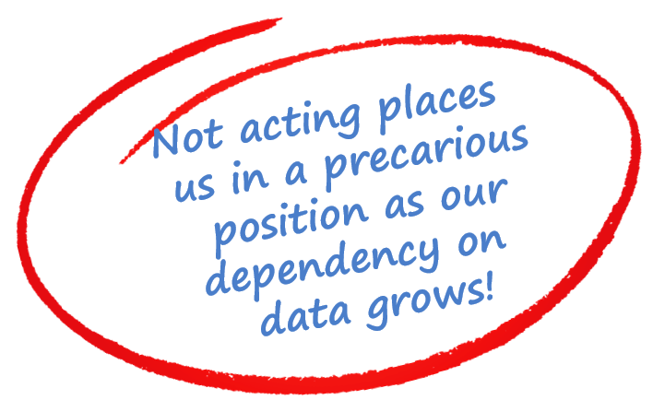
Why do we need to do this?
Accurate, timely, and complete data is now essential to more than 75 percent of all projects defined in the department’s strategic plan.
The “1998-era” capabilities of EIS are becoming exponentially disproportionate to the “2017-era” importance of data in education.

Slide 6
Scope of TEDS
Creation of a single data repository
Real-time data integration of every SIS
Simple “on demand” data
Redevelopment of all 22 state apps
Integration of all 9 SaaS vendor apps
Simplified data sharing with partners
Deep data analytics
Enhanced security and performance
Substantially reduced operational cost

Slide 7
Partnering for Success
Platinum
Partners:
Gold Partners:
Silver Partners:

Slide 8
Student Information Systems
All SIS contracts, hosting options, and subsidies remain unchanged for the 2017-18 school year.
Existing contracts expire at the end of 2017-18. The department will attempt to renew ALL current contracts.
The state will continue to offer a free hosting service in 2018-19.
Further information will be published in late fall.

Slide 9
Ready for TNReady
Ready for TNReady is a program designed to help ensure every district has attained the level of technical and operational readiness needed to maximize success with online assessment.
The specific objectives of the program are:
Give districts confidence that their schools are ready for online testing
Provide technical and testing staff with tools and checklists to help verify local infrastructure and processes
Promote statewide best practices for online testing readiness
Online testing is mandatory for high school students in 2017-18.

Slide 10
Ready for TNReady
Ready for TNReady provides readiness guidance tools across three key areas of online assessment:
1
Devices
2
Infrastructure
3
Operations
Make and model compatibility
Operating system version and patch
Quantity of devices
Broadband speed
Local network speed (including wireless)
Wireless ratios
Performance tool
Student training and practice
Administrator guides and training
Staff regional assessment training
Districts who complete the Ready for TNReady program
receive a certificate of completion.

Slide 11
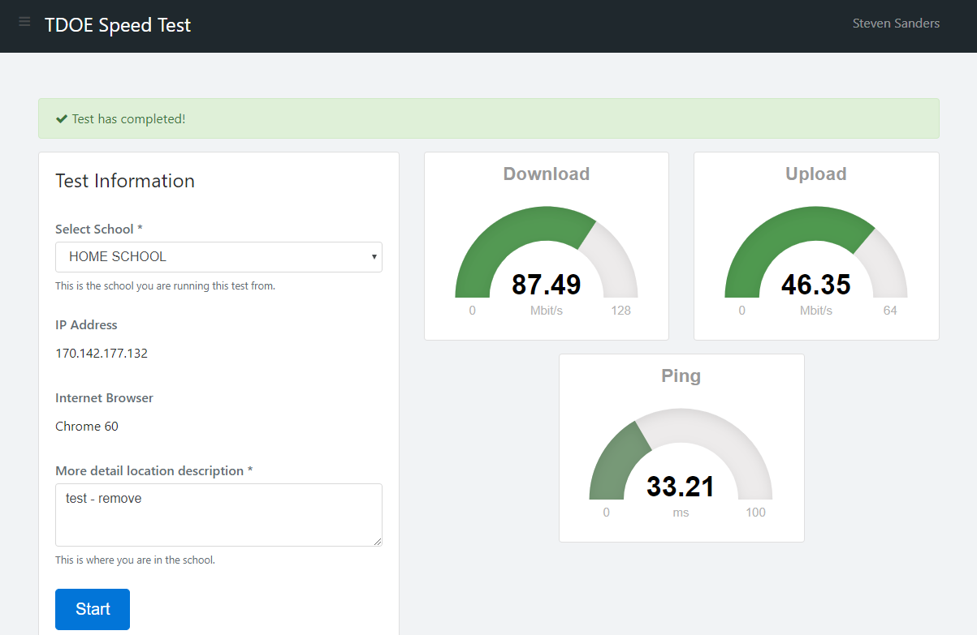
Ready for TNReady – Speed Test Tool

Slide 12
Single Sign On
Single Sign On (SSO) is a program that provides everyone in districts with a single set of credentials that provide access to every state system. The goal is to make it simpler to interact with state systems while improving overall security.
Every director of schools now has an SSO account.
Sixty-three districts have been provisioned, and we are ready to provision any district who requests it.
23,604 staff have been provisioned.
The system has been used 5,985 times.
For more information, contact Chris.Voss@tn.gov.

Slide 13
Increasing Security Threats
72 percent of public sector organizations hit with security incidents
Nearly three out of four public sector organizations experienced a security issue last year according to a 2017 IT Risks in Government survey released recently. The survey also found that only 14 percent of public sector organizations believe that they are well prepared to defend against IT risks.
Ransomware Attacks on Education Industry
Education has historically been fairly safe from financial cyber attacks, but with the recent increase of ransomware, such as WannaCry and CryptoLocker, education has become a new target for these attacks.

Slide 14
What we are doing top shore up EIS
The office of district technology within the department’s information systems division offers several direct services to help districts manage these increased security threats.
Emergency response to a security or data breach
Guidance around IT policy and procedures
Guidance around IT contracts relating to technical requirements
For more information, contact Steven.Sanders@tn.gov.

Slide 15
Pre-ID and SDDV Simplification
Fully Enrolled Students in SIS
Nightly Data Transfer to EIS
New Tool for Data Review of EIS Demo Stats
Automatic Ordering of Student Tests
Automatic Rostering in Teacher Student Connection
Ongoing SIS Updates and EIS Data Transfer

Slide 16
More Time to Enter, Better Data!
OLD PROCESS | NEW PROCESS
Pre-ID data pulled once – in October and January – for test ordering | Continuous EIS data transfer through two days before admin window opens (in November and April) for online test ordering in Nextera
Demographic data clean-up 2-3 weeks after testing window closed | Demographic data review and updates for 2 – 3 months - from first EIS data transfer through the last day of the testing window
Teacher Student Connection open only after testing window closed | Teacher Student Connection (TSC) open and available for editing from first EIS data transfer through last day of testing window
Duplicate data entry in both EdTools and SIS | Single data entry in SIS with data transfer to EIS, Nextera, and TSC
No reconciliation between EdTools and EIS resulting in data conflicts and errors | EIS Data Visibility Tool ensures accuracy of data for assessment, accountability, and other reporting/finance functions

Slide 17
What’s in it for you?
One time data entry for all enrollment and demographic data – no more need to use EdTools to duplicate work already done in the SIS
More time to enter enrollment data – right up to the start of the testing window
Even more time to enter demographic data – through to the end of the testing window
Way more time to undertake TSC - no longer a post assessment function
No need to place orders or online or paper assessment – we just use your enrollment data!
Notes:
Cliff

Slide 18
What are we doing to “Shore Up” EIS
EIS help desk increased by three people to handle district support calls
EIS engineering team increased by three people to help troubleshoot any issues
New proactive monitoring of extract processing to spot problems before they get to the district
Doubling down on clearing all current support tickets
Improved communication portal with daily status to give districts visibility to extract processing queues
New data visibility portal
For more information, contact Steven.Sanders@tn.gov.

