Slide 1
Ware Shoals High - TailCATE
Learning, Serving, Leading in Careers and Technology Education

Slide 2
Greenwood School District 51
Introductions:
Ryan Gambrell
Julie Madden
Daniel Crockett

Slide 4
Serves Grades 9-12
Fewer than 300 students
CATE Offerings:
Horticulture
Environmental and Natural Resource Management
Business Information Management

Slide 5
Traditional Indicator Struggles
1S1: Academic Attainment – Reading / Language Arts
6S1: Nontraditional Participation

Slide 6
THREE GOALS
Desire students to be able to TRANSFER knowledge into real world situations.
PROMOTE great things taking place in our CATE programs and RECOGNIZE the accomplishments of students.
Generate more parent and community involvement. (Parents are busy…Work, ball games, other commitments).
Have FUN!

Slide 7
TRANSFERENCE
Capacity to apply acquired knowledge and skills to new (real world) situations.

Slide 8
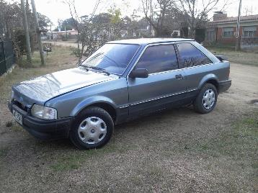
TRANSFERENCE (continued) Gradual Release of Responsibility
I do it, you watch
We do it together
You do it, I’ll watch
You do it alone

Slide 9
THREE GOALS
Desire students to be able to TRANSFER knowledge into real world situations.
PROMOTE great things taking place in our CATE programs and RECOGNIZE the accomplishments of students.
Generate more parent and community involvement. (Parents are busy…Work, ball games, other commitments).
Have FUN!

Slide 11
“BRING CATE TO THEM!”
TailCATE

Slide 13
Pre-game TailCATE
Recruit non-traditional participation
Bring awareness to next year’s course offerings
Have fun!
-Students attending the event got into the baseball game free.
-This created a larger crowd and concession sales increased.

Slide 14
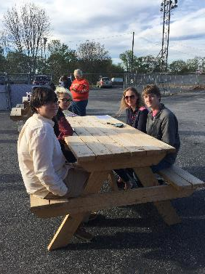
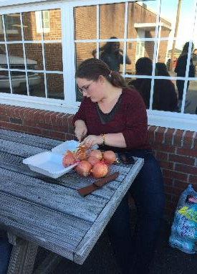
TailCATEing - Pregame

Slide 15
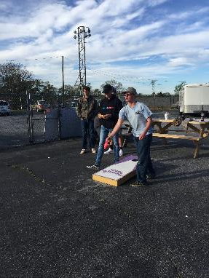
TailCATE

Slide 16
During the Game

Slide 17
FFA President threw first pitch
FFA & FBLA Officers recognized
Drawings for ferns, plants, corn hole boards etc.
Live Stats
Tractor equipment displayed outside stadium

Slide 18
TailCATE

Slide 19
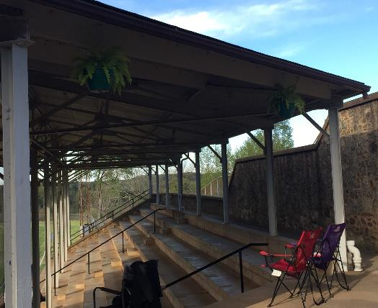
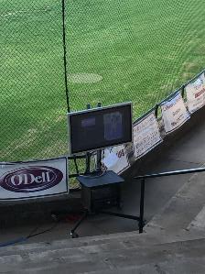
TailCATE

Slide 20
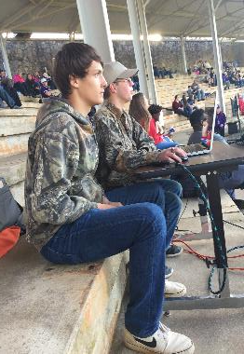
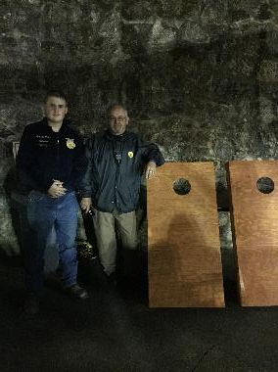
TailCATE

Slide 21
CATE Programs

Slide 22
Digital Desktop Publishing
Students created flyers advertising the event
Each student came up with their own design
Student Competition
A group of students also created the game program

Slide 24
Image Editing
Students created baseball cards for senior baseball players
Must include certain elements
Student Competition

Slide 25
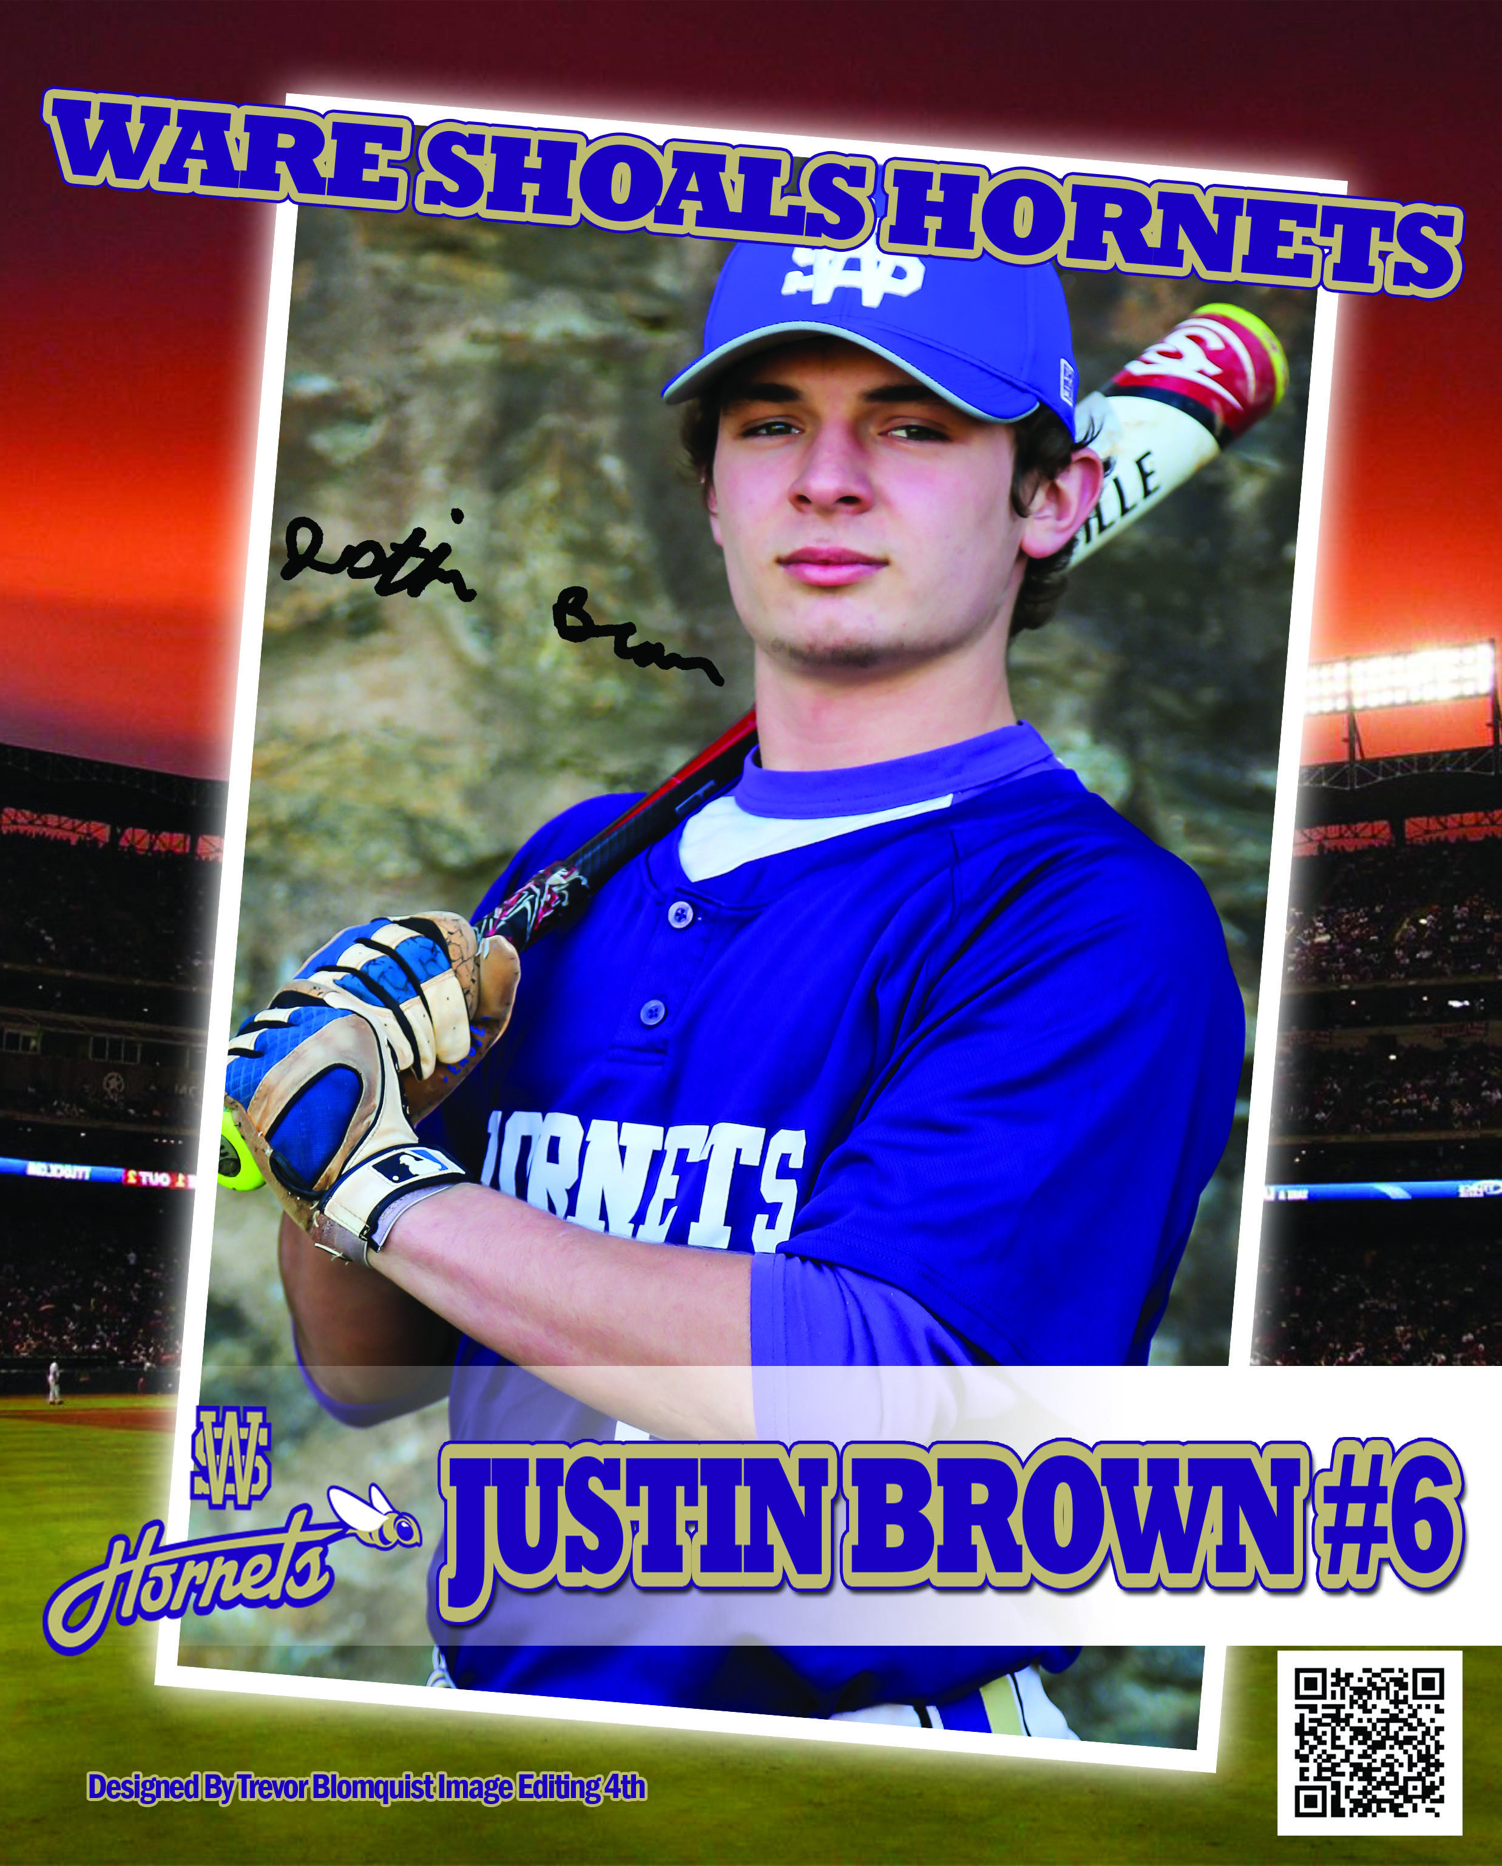
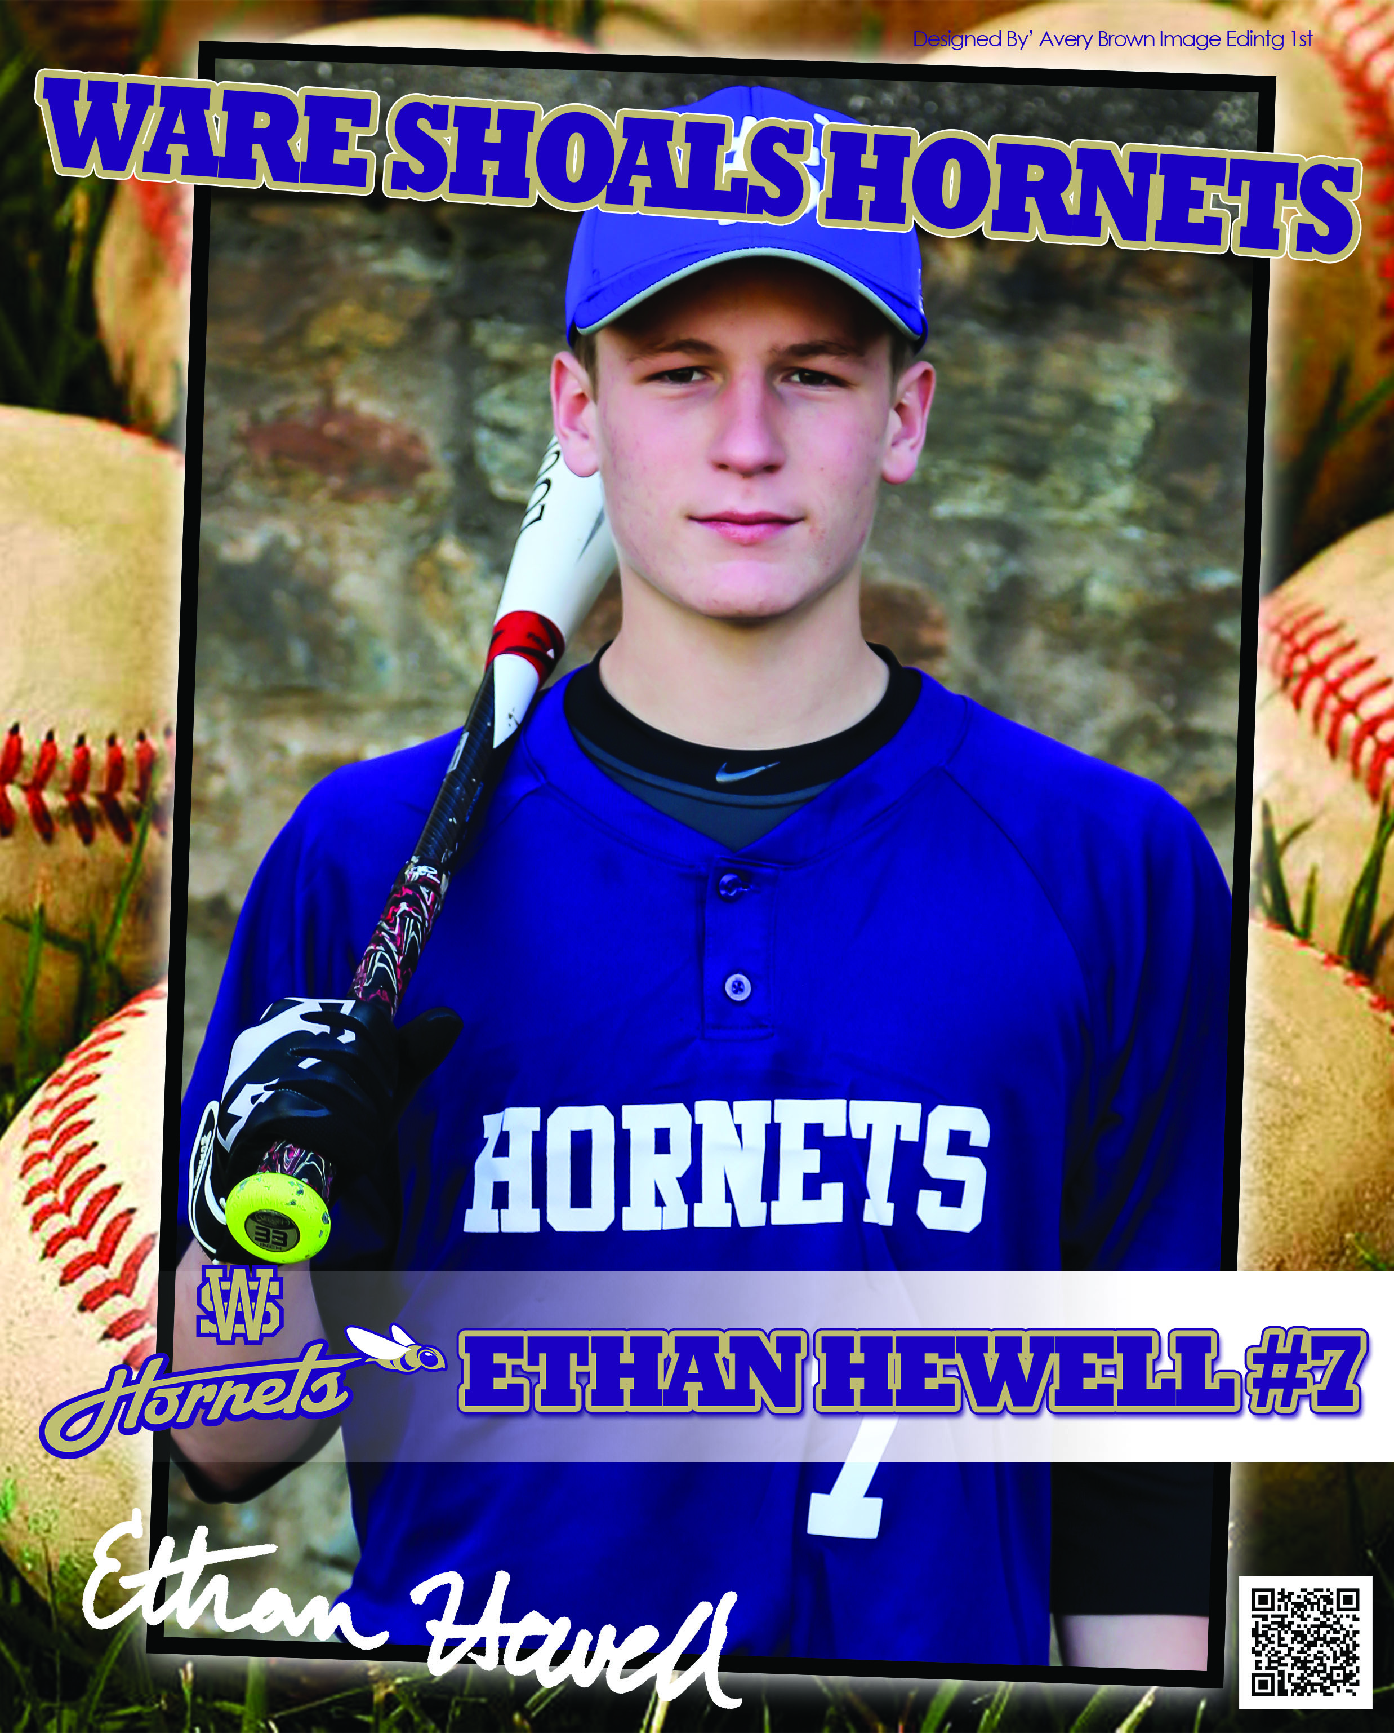
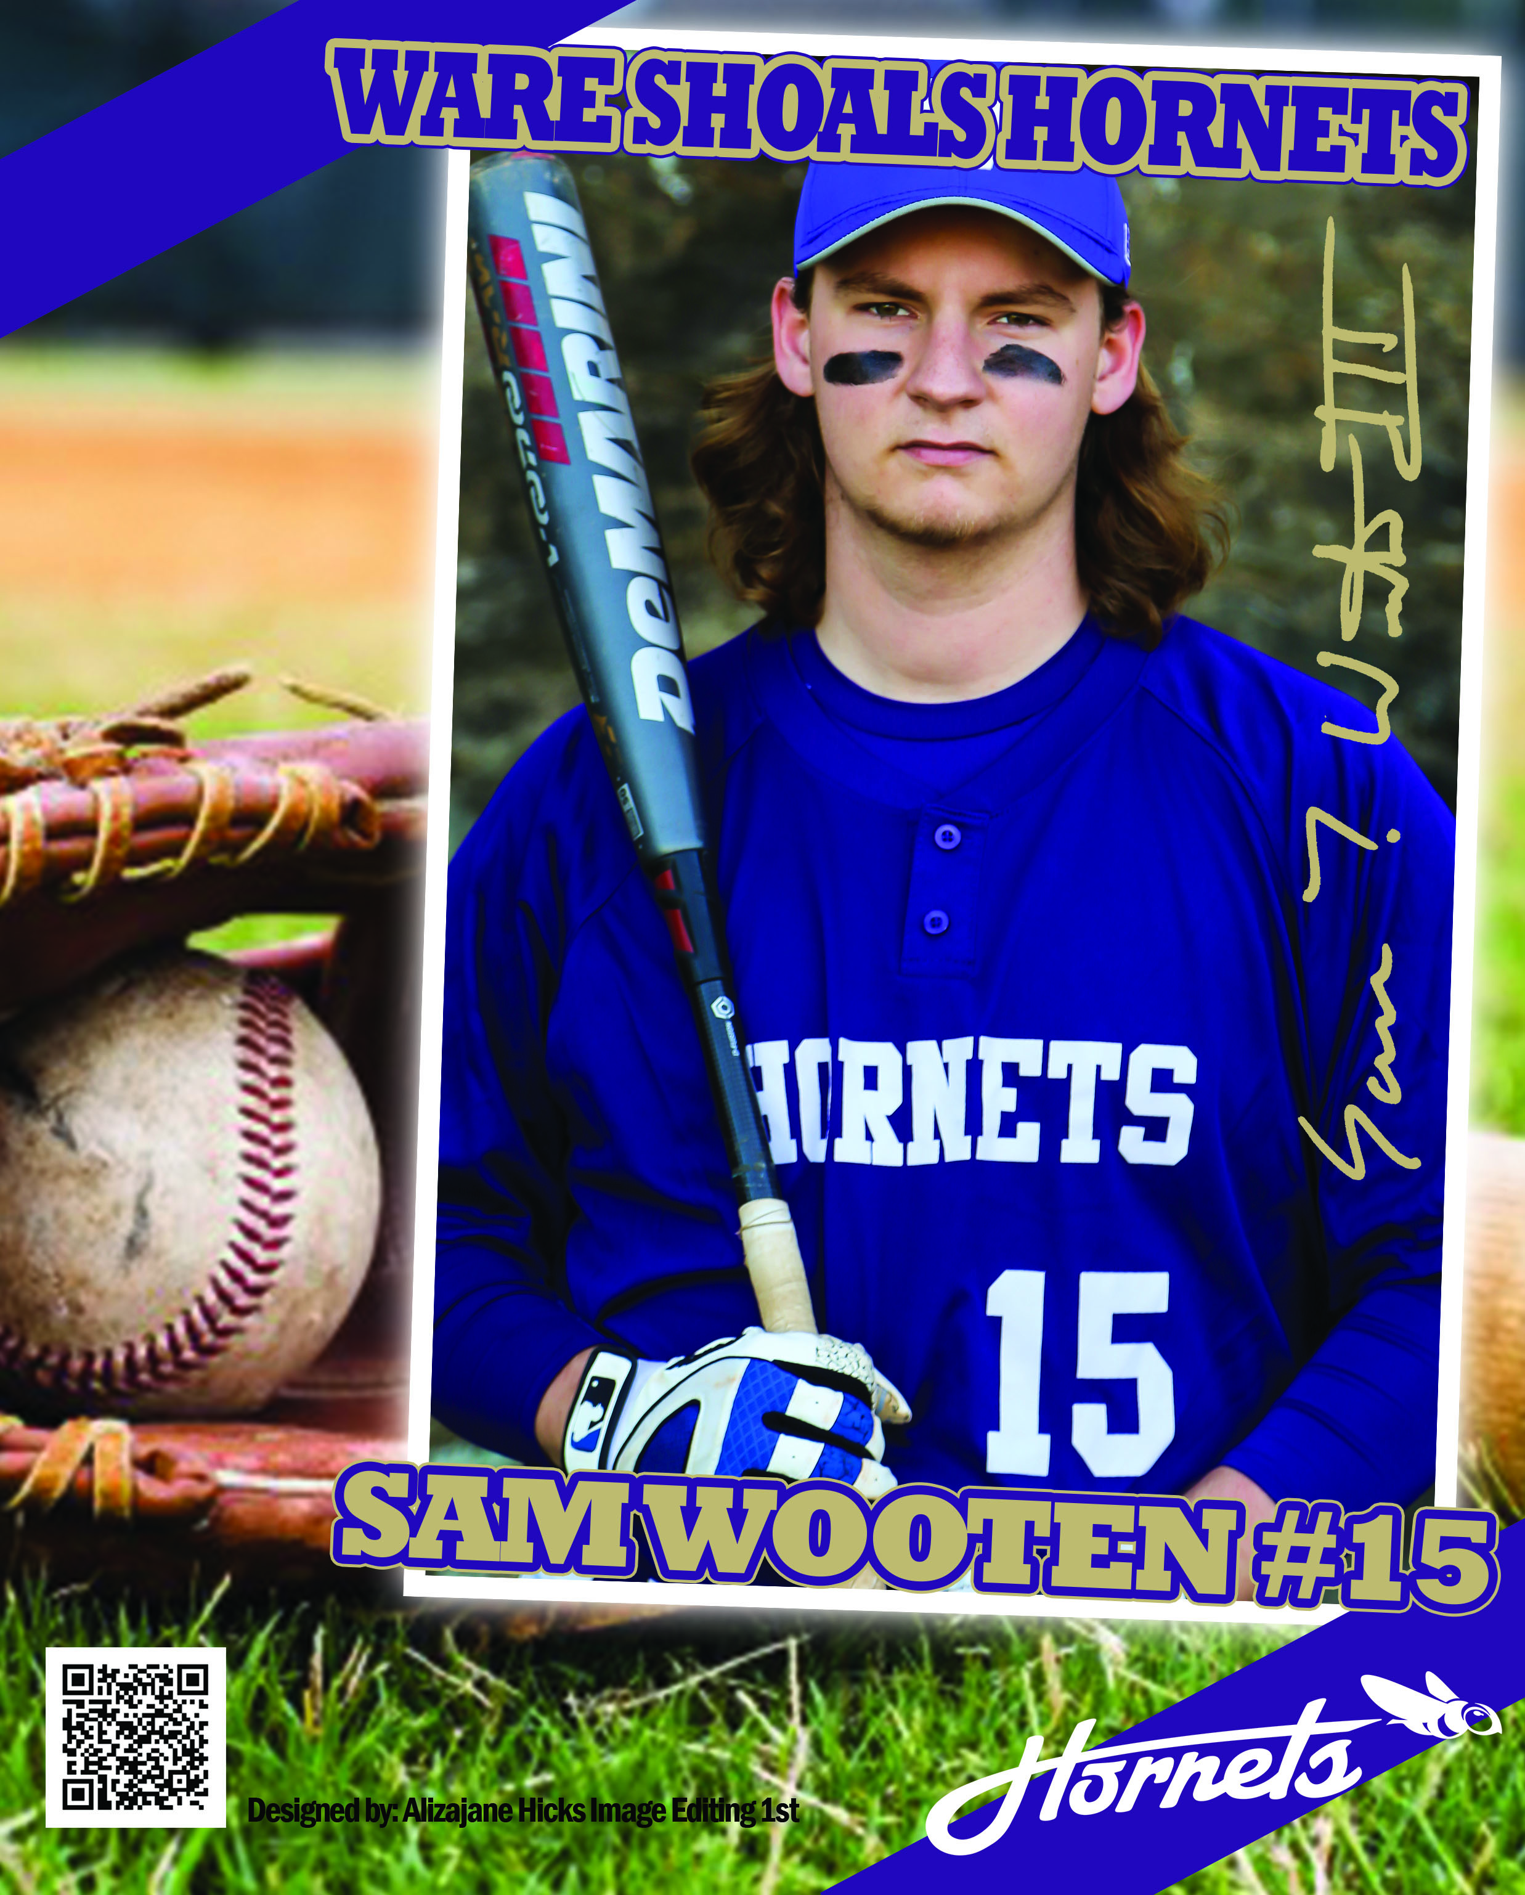

Slide 26
Other Ideas…
WebPage Design Class
Create team website that includes profiles, stats, etc.

Slide 27
Integrated Business Applications
Responsible for the Live Stats
Created the player stat sheets
Photographed the players
Created the PowerPoint
Set-up and managed the laptop and monitors during the game

Slide 28
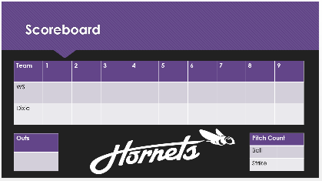
Integrated Business Applications

Slide 29
Google Applications
Responsible for showcasing our CATE Programs
Designed and created posters using Google Drawings
Displayed the posters around TailCATE

Slide 30
Google Applications

Slide 31
Quotes
“That was fun. Can we do it every home game?” – William McClellan (student)
“Shout out to WSH FBLA and FFA you were awesome tonight. Great job!” – April Bostic
“Thanks to all who worked on this project they turned out great!” – April Wooten

Slide 32
What did we learn?
Typically 90-120 seconds between innings (be ready and brief).
Winning ticket numbers should be displayed on projection screen.
Choose a game earlier in the season – not so high stakes.
Having students get into the game free was a good motivator (concession sales also increased).
Strong relationships with Athletic Directors and Head Coaches are very helpful!
Next year ideas: VIP seating for advisory council, business classes market Flower Sales, etc.

Slide 33
Curse of Knowledge
Notes:
New ideas: Have VIP Seating for our Advisory Committee Members, Have our Business Management classes market and manage our Ag. Flower sale. etc

Slide 34
Questions

Slide 35
Thank You!

