Slide 1
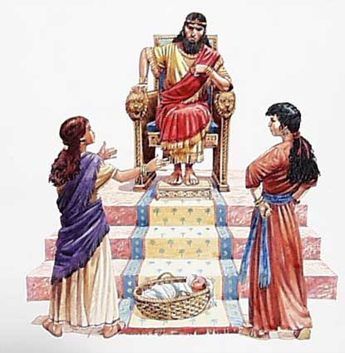
Ecclesiastes

Slide 2
Discovering a Life of Fullness in an Empty World
Ecclesiastes
Hebrew – Koheleth – Preacher
Greek – Ecclesia - Gathering
Frustration
Faith
The
Preacher
Fatalism
Ascending towards faith 7-11
Descending to fatalism 2-6
Folly
Fear
12:1-14
Cynicism
Wisdom
Experiment
Emptiness of Exploration Exasperation of Mystery Exaltation
Vs.1:1-18
Preacher
Precept
Poem
Problem
Explore everything under the sun
Mystery of Suffering 7:1-14
Mystery of Wickedness & righteousness 7:15-22
Mystery of Wisdom 7:23-8:1
Mystery of Authority 8:2-9
Mystery of Mortality 8:10-9:12
Mystery of Folly 10:1-20
Mystery of Sowing & Reaping 11:1-6
Mystery of Life’s Brevity 11:7-10
12:1-14
Remember
Creator
Remember Time
Remember
Commands
Remember
Fear God
Pleasure 2:1-3
Possessions 2:4-11
Madness/Folly 2:12-26
Time 3:1-5
Justice 3:16-4:3
Labor 4:4-16
Religion 5:1-7
Riches 5:10-6:9
Refrain 6:10-12
12:13 The conclusion when all has been heard is fear God and keep His commandments because this applies to every person.

Slide 3
Ecc. 2 – Pleasure and Work
Solomon gives us three insights about work.
Solomon tells us why work won’t work as the way of meaning and satisfaction. 18-19
He then tells us why work alone, apart from a relationship with God brings despair. (20-13)
Finally, he tells us that work with a relationship with God brings satisfaction and joy. (24-26)

Slide 4
Ecc. 2 – Pleasure and Work
Work won’t bring satisfaction (18-19)
All of our work will be left to a successor.
There is no guarantee the successor will be wise. He may be a fool and squander the fruit of our labor.
There is no guarantee that your work will be used to benefit the next generation. (Harvard, Yale, YMCA, etc.)

Slide 5
Ecc. 2 – Pleasure and Work
Work apart from a relationship with God brings despair. (20-23)
Giving an inheritance to someone who has not toiled for it causes despair because they will not have the same appreciation for the hard work required to gain the inheritance.
Work which results in success is lost when one dies. The success can’t be taken past the grave therefore it is vanity.

Slide 6
Ecc. 2 – Pleasure and Work
Work with a relationship with God brings satisfaction and joy. (24-26)
Recognizing that everything we have is from God allows us to eat, drink and see labor as being good.
God is the source of our enjoyment and sustenance.
A relationship with God brings wisdom, knowledge and joy. (moth and rust can’t destroy these)
The sinner gathers and collects only to have it taken by God and (bestowed, granted, entrusted) to the righteous. Vs. 26 ??(Prov. 13:22; 28:8; Matt. 13:12)

Slide 7
Ecc. 2 – Pleasure and Work
Proverbs 13:22 - A good person leaves an inheritance for their children’s children, but a sinner’s wealth is stored up for the righteous.
The irony for the wicked person is that God may give his possession to the righteous. Just like the righteous, his inheritance might be squandered by children who are wicked or foolish so the wicked face the reversal and the good person might inherit it.

Slide 8
Take Aways
Work and pleasure must be tempered by Godly perspective.
Christians resist hedonism because God is left out of the equation and pleasure becomes an end in itself.
Christians overcome pain and suffering not by seeking pleasure or work to dull the pain but by seeking a deeper relationship with Christ.

Slide 9
Take Aways
The pursuit of pleasure or happiness is healthy when it recognizes that all good gifts come from our heavenly Father above.
Christians should be wise in determining how their inheritance is distributed and trust the Lord for the future.
Work that contributes to the advancement of the Kingdom of God has eternal reward.

Slide 10
Facing Life’s Cycles Forces us to Fear the God of Eternity
Ecc. 3
Beginnings & Endings
Emotions & Relationships
Value & Possessions
Action & Convictions
Life & Death
Planting/Harvesting
Kill/Heal
Tear Down/Build Up
Weeping/Laughing
Mourning/Dancing
Throw/Gather Stones
Embrace/Shun
Search/Give Up
Keep/Cast
Tear/Sew
Silent/Speak
Love/Hate
War/Peace
He gives tasks to occupy our time
He makes everything beautiful in its time (Rom. 8:28)
He places eternity in your hearts
He has hidden is purposes from us
He desires us to rejoice and trust His purposes
He desires us to do good
His works remain forever
We cannot add anything to the works of God
We cannot take anything away from the works of God
He desires that we should fear Him
The Sovereign God

Slide 12
Ecc. 3 – Mystery of Time
See notes and recopy

Slide 13
Ecc. 3 – Mystery of Time

Slide 14
Ecc. 3 – Mystery of Time

Slide 15
Ecc. 3 – Mystery of Time

Slide 16
Ecc. 3 – Mystery of Time

Slide 17
Ecc. 3 – Mystery of Time

