Slide 1
Introduction to
Intensive Intervention
National Center on Intensive Intervention
Sarah Powell & Sarah Benz

Slide 2


Contact Information
Sarah Powell
  University of Texas at Austin
  srpowell@austin.utexas.edu
  @sarahpowellphd
Sarah Benz
  University of Texas at Austin
119

Slide 3
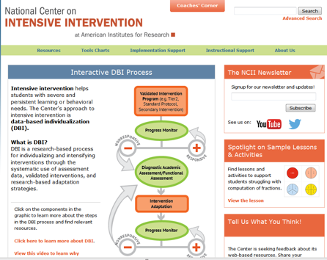
National Center on
Intensive Intervention (NCII)
To build capacity of state and local educational agencies, universities, practitioners, and other stakeholders to support implementation of intensive intervention in reading, mathematics, and behavior for students with severe and persistent learning and/or behavioral needs.

Slide 4

States
Cohort 1:
Colorado
Michigan
Oregon
Washington
Cohort 2:
Rhode Island
South Carolina
Texas
Other:
Can potentially take one more state
Started preliminary work in Texas for 2018-2019
Recruiting Districts
Notes:
Currently we are working with 7 states to help them build capacity at the State Education Agency to support the work at the local level. We have already started the ground work for the state of Texas for 2018-2019 and are working with TEA and Pam Bell from Meadows Center. We are currently recruiting pilot districts to begin this work starting next year. If your district is interested in this work, connect with someone at TEA.

Slide 5
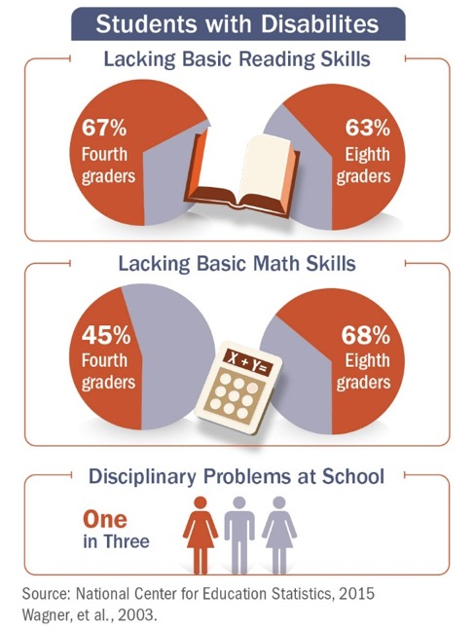
Why Intensive Intervention?
Too many students, especially those with disabilities, lack basic skills for reading and mathematics or have serious discipline problems in school

Slide 6
Why Intensive Intervention?
  The school completion rate for youth with emotional disturbances (56%) is lower than the rate for all other categories, with the exception of youth with multiple disabilities or intellectual disabilities
  More than one-third of students with disabilities who dropout have spent a night in jail
    Dropouts are 10% more likely to have been arrested than youth with disabilities who finished high school
(Wagner et al., 2005)

Slide 7


Why Intensive Intervention?
More Help
Validated programs are not universally effective programs with 3 to 5% of students need more help (Fuchs et al., 2008; NCII, 2013).
More Practice
Students with intensive needs often require 10–30 times more practice than peers to learn new information (Gersten et al., 2008).
Notes:
Not all students respond to standardized, evidence-based interventions…
Analysis of student response data from controlled studies suggests that approximately 3-5 percent of students or 20 percent of at-risk students do not respond to standard, evidence-based intervention programs (Fuchs et al., 2012; Wanzek & Vaughn, 2009; Conduct Prevention Problems Research Group, 2002).
Despite interventions being generally effective for students demonstrating difficulty
These students may demonstrate BOTH related academic and behavioral needs

Slide 8
What is Intensive Intervention?
Driven by data
Increased intensity and individualization
8

Slide 9

NCII’s Approach
Data-Based Individualization (DBI) is a systematic method for using data to determine when and how to provide more intensive intervention
It is a process not a single intervention program or strategy
It is not a one-time fix but an ongoing process comprising intervention and assessment adjusted over time

Slide 10
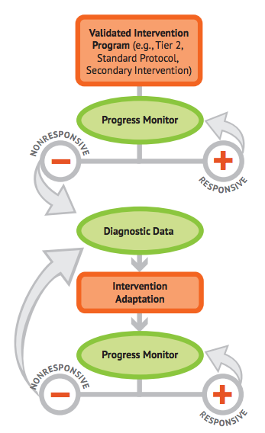
NCII’s Approach
DBI: Integrating data-based decision making across academics and social behavior

Slide 11
Mathematics
and Intensive Intervention
11

Slide 12
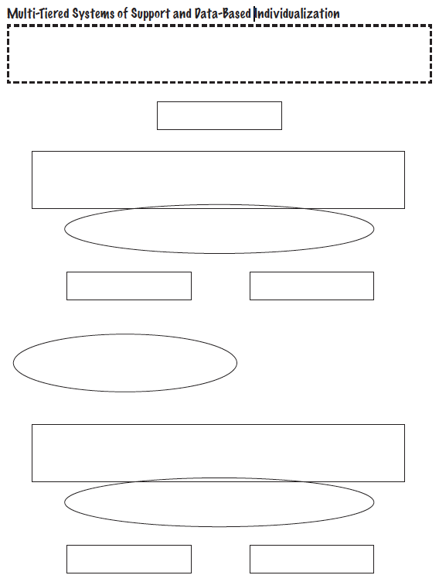
Multi-tiered Systems of Support
12

Slide 13
Tier 1
13

Slide 14
Tier 1
Core instruction utilizes evidence-based programs or strategies
All students screened
Students scoring below a cut-score are suspected at risk for math difficulties
Suspected at-risk students monitored for 6 to 10 weeks during primary prevention using progress monitoring
14

Slide 15
Evidence-based instruction
All students screened
At-risk students progress monitored for 6-10 weeks
NON-RESPONSIVE
15

Slide 16
Think-Pair-Share
  What is the current landscape for Tier 1 in your school?
  What evidence-based mathematics interventions?
  How is fidelity monitored?
  What is the screening?
  What is the progress monitoring?
  Who makes decisions?
16

Slide 17
MTSS or RTI
DBI
17

Slide 18
DBI
Students in a tiered intervention program who have not responded to evidence-based secondary interventions
Students with very low academic achievement who are not making adequate progress in their current intervention program
Students with disabilities who are consistently not making adequate progress in meeting their IEP goals

Slide 19
Tier 2
This may be the start of DBI
Students are tutored in small groups using evidence-based practices
Tutoring takes place 3 to 4 times a week
Each tutoring session lasts 30 to 60 minutes
Tutoring lasts 10 to 20 weeks
Tutoring is conducted by resource personnel or paraprofessionals (not usually the classroom teacher)
PM continues weekly

Slide 20
Tier 2
If student response to secondary prevention is inadequate:
  In some RTI versions:
    Student participates in more small-group tutoring while weekly PM continues
  In other RTI versions:
    Student moves to Tier 3 (tertiary prevention)
    Comprehensive evaluation answers questions, determines disability, and suggests if special education services are appropriate
20

Slide 21
Evidence-based instruction provided in small groups
Progress monitoring for 10-20 weeks
NON-RESPONSIVE
RESPONSIVE

Slide 22
Think-Pair-Share
What is the current landscape for Tier 2 in your school?
  What evidence-based mathematics interventions?
  Who implements?
  How is fidelity monitored?
  What is the progress monitoring?
  Who makes decisions?
22

Slide 23
Evidence-based instruction provided in small groups
Progress monitoring for 10-20 weeks
NON-RESPONSIVE
RESPONSIVE

Slide 24
Evidence-based instruction provided in small groups
Progress monitoring for 10-20 weeks
NON-RESPONSIVE
RESPONSIVE

Slide 25
Evidence-based instruction provided in small groups
Progress monitoring for 10-20 weeks
NON-RESPONSIVE
RESPONSIVE
Diagnostic Assessment

Slide 26
Tier 3
This is part of DBI
Adaptations are made to the student’s intervention
Student progress is monitored weekly
  With adequate slopes or end levels, students return to secondary or primary prevention
26

Slide 27
Diagnostic Assessment
Evidence-based instruction provided individually
Progress monitoring for 10-20 weeks
NON-RESPONSIVE
RESPONSIVE

Slide 28
Diagnostic Assessment
Evidence-based instruction provided individually
Progress monitoring for 10-20 weeks
NON-RESPONSIVE
RESPONSIVE

Slide 29
Diagnostic Assessment
Evidence-based instruction provided individually
Progress monitoring for 10-20 weeks
NON-RESPONSIVE
RESPONSIVE

Slide 30
Think-Pair-Share
What is the current landscape for Tier 3 in your school?
  What evidence-based mathematics interventions?
  Who implements?
  How is fidelity monitored?
  What is the progress monitoring?
  Who makes decisions?
30

Slide 31
Intervention: Occurs frequently and with intensity
Assessment: Formative
Assessment: Diagnostic
Intervention adaptation: Content, dosage, explicit instruction, attention to transfer
Assessment: Formative

Slide 32
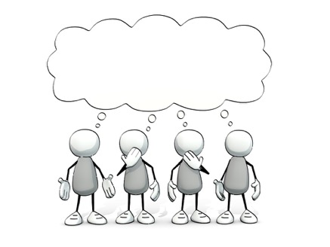
Let’s Think About
Designing Interventions…

Slide 33
Intervention: Occurs frequently and with intensity
Intervention adaptation: Content, dosage, explicit instruction, attention to transfer

Slide 34
Where student NEEDS TO BE
Where student IS

Slide 35
Intervention: Occurs frequently and with intensity
Needs to focus on foundational mathematics necessary across grade levels

Slide 36
Fluency

Slide 37
Fluently add and subtract within 5.
continuum of mathematics learning

Slide 38
Fluently add and subtract within 5.
Add and subtract within 20, demonstrating fluency for addition and subtraction within 10.

Slide 39
Fluently add and subtract within 5.
Add and subtract within 20, demonstrating fluency for addition and subtraction within 10.
Fluently add and subtract within 100 using strategies based on place value, properties of operations, and/or relationships.
continuum of mathematics learning

Slide 40
Fluently add and subtract within 5.
Add and subtract within 20, demonstrating fluency for addition and subtraction within 10.
Fluently add and subtract within 100 using strategies based on place value, properties of operations, and/or relationships.
Fluently multiply and divide within 100, using strategies such as the relationship between multiplication and division…

Slide 41
Fluently add and subtract within 5.
Add and subtract within 20, demonstrating fluency for addition and subtraction within 10.
Fluently add and subtract within 100 using strategies based on place value, properties of operations, and/or relationships.
Fluently multiply and divide within 100, using strategies such as the relationship between multiplication and division…
Fluently add and subtract multi-digit whole numbers using the standard algorithm.

Slide 42
Fluently add and subtract within 5.
Add and subtract within 20, demonstrating fluency for addition and subtraction within 10.
Fluently add and subtract within 100 using strategies based on place value, properties of operations, and/or relationships.
Fluently multiply and divide within 100, using strategies such as the relationship between multiplication and division…
Fluently add and subtract multi-digit whole numbers using the standard algorithm.
Fluently multiply multi-digit whole numbers using the standard algorithm.
continuum of mathematics learning

Slide 43
Fluently add and subtract within 5.
Add and subtract within 20, demonstrating fluency for addition and subtraction within 10.
Fluently add and subtract within 100 using strategies based on place value, properties of operations, and/or relationships.
Fluently multiply and divide within 100, using strategies such as the relationship between multiplication and division…
Fluently add and subtract multi-digit whole numbers using the standard algorithm.
Fluently multiply multi-digit whole numbers using the standard algorithm.
Fluently add, subtract, multiply, and divide multi-digit decimals using the standard algorithm.

Slide 44
Where student NEEDS TO BE
Fluently add and subtract within 5.
Add and subtract within 20, demonstrating fluency for addition and subtraction within 10.
Fluently add and subtract within 100 using strategies based on place value, properties of operations, and/or relationships.
Fluently multiply and divide within 100, using strategies such as the relationship between multiplication and division…
Fluently add and subtract multi-digit whole numbers using the standard algorithm.
Fluently multiply multi-digit whole numbers using the standard algorithm.
Fluently add, subtract, multiply, and divide multi-digit decimals using the standard algorithm.
continuum of mathematics learning

Slide 45
Where student IS
Where student NEEDS TO BE
Fluently add and subtract within 5.
Add and subtract within 20, demonstrating fluency for addition and subtraction within 10.
Fluently add and subtract within 100 using strategies based on place value, properties of operations, and/or relationships.
Fluently multiply and divide within 100, using strategies such as the relationship between multiplication and division…
Fluently add and subtract multi-digit whole numbers using the standard algorithm.
Fluently multiply multi-digit whole numbers using the standard algorithm.
Fluently add, subtract, multiply, and divide multi-digit decimals using the standard algorithm.
continuum of mathematics learning

Slide 46

Where student IS
Where student NEEDS TO BE
Fluently add and subtract within 5.
Add and subtract within 20, demonstrating fluency for addition and subtraction within 10.
Fluently add and subtract within 100 using strategies based on place value, properties of operations, and/or relationships.
Fluently multiply and divide within 100, using strategies such as the relationship between multiplication and division…
Fluently add and subtract multi-digit whole numbers using the standard algorithm.
Fluently multiply multi-digit whole numbers using the standard algorithm.
Fluently add, subtract, multiply, and divide multi-digit decimals using the standard algorithm.
continuum of mathematics learning

Slide 47
Where student IS
Where student NEEDS TO BE
Explain why addition and subtraction strategies work, using place value and the properties of operations.
Understand that the two digits of a two-digit number represent amounts of tens and ones.
Use addition and subtraction within 100 to solve one- and two-step word problems…
Fluently add and subtract within 100 using strategies based on place value, properties of operations, and/or relationships.
Apply properties of operations as strategies to multiply and divide….
Fluently multiply and divide within 100, using strategies such as the relationship between multiplication and division…
Use multiplication and division within 100 to solve word problems…
Fluently add and subtract multi-digit whole numbers using the standard algorithm.
Find whole number quotients and remainders with up to four-digit dividends and one-digit divisors, using strategies based on place value, the properties of operations, and/or the relationship between multiplication and division.
Solve multi-step word problems posed with whole numbers and having whole-number answers using the four operations…
Understand that the three digits of a three-digit number represent amounts of hundreds, tens, and ones.
Fluently multiply multi-digit whole numbers using the standard algorithm.
continuum of mathematics learning

Slide 48
Instruction Within the Platform

Slide 49
Instructional Platform
INSTRUCTIONAL DELIVERY
Explicit instruction
Multiple representations
Concise language
INSTRUCTIONAL STRATEGIES
Fluency building
Problem solving instruction
Motivation component

Slide 50
Explicit Instruction
I Do
Modeling
Practice
Clear Explanation
Guided
Practice
We Do
Planned
Examples
Independent Practice
You Do
Supporting Practices
Asking the right questions
Eliciting frequent responses
Providing immediate specific feedback
Maintaining a brisk pace

Slide 51
How do you use explicit instruction within intensive intervention?
Model steps using concise language
Provide guided practice opportunities
Provide independent practice opportunities
Use supporting practices during modeling and practice
  Ask the right questions
  Elicit frequent responses
  Provide feedback
  Be planned and organized

Slide 52
Multiple Representations
Abstract
Representational
Concrete

Slide 53
How should multiple representations be used within intensive intervention?
Use three-dimensional concrete materials to teach concepts and procedures
Use two-dimensional representations to teach concepts and procedures
Ensure students understand mathematics with numbers and symbols (i.e., the abstract)

Slide 54
Focus on Language
precise
concise

Slide 55
How do you attend to language within intensive intervention?
Understand why formal mathematical language is important
Plan for mathematical language to be precise
Plan for mathematical language to be concise

Slide 56
Fluency
Addition
Subtraction
Multiplication
Division
Students must understand the concepts
Students should learn and use strategies to solve the facts
Students should develop fluency with facts

Slide 57
How to build fact fluency within intensive intervention?
Teach the concepts of the operations (see Module 6)
Teach strategies to understand how facts fit together
Practice building fluency with a variety of activities and games

Slide 58
Problem Solving
SIGNS
  Survey questions
  Identify key words
  Graphically draw problem
  Note operations
  Solve and check
SOLVE
Study the problem.
Organize the facts.
Line up the plan.
Verify the plan with computation.
Examine the answer.

Slide 59
Problem Solving
When teaching about word problems, students should learn the schema of the word problem.
Additive
Multiplicative
Jitendra & Star (2011); Riley & Greeno (1988); Van de Walle, Karp, & Bay-Williams (2010)
Total
Equal Groups
Difference
Comparison
Change
Ratios/
Proportions

Slide 60
How do you incorporate effective problem-solving strategies within intensive intervention?
Don’t use key words tied to operations
Do teach students an attack strategy
Do teach students schemas
Do explicitly teach problem solving
Do provide problem-solving instruction regularly (i.e., several times a week)
Do practice schemas that students will encounter regularly

Slide 61
Motivation Component
on task
keep attention
regulate behavior

Slide 62
How do you incorporate a motivational component within intensive intervention?
Utilize a motivational component, when necessary

Slide 63

Instructional Platform
Abstract
Representational
Concrete
Modeling
Practice
Clear Explanation
Guided
Practice
Planned
Examples
Independent Practice
Supporting Practices
Asking the right questions
Eliciting frequent responses
Providing immediate specific feedback
Maintaining a brisk pace

Slide 64
Instructional Platform
INSTRUCTIONAL DELIVERY
Explicit instruction
Multiple representations
Concise language
INSTRUCTIONAL STRATEGIES
Fluency building
Problem solving instruction
Motivation component

Slide 65
How Do You Intensify
(Adapt) Interventions?

Slide 66
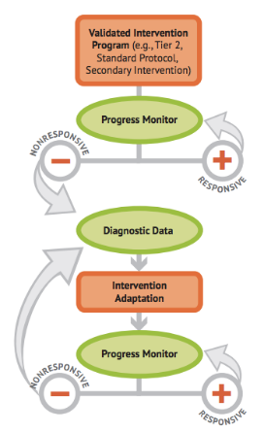
Intervention: Occurs frequently and with intensity
Intervention adaptation: Content, dosage, explicit instruction, attention to transfer

Slide 67
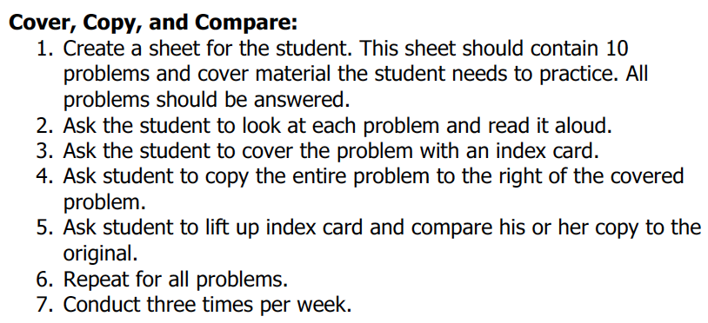
Implement with greater fidelity
Adaptation
Ensure that you are implementing the intervention or strategy with fidelity

Slide 68
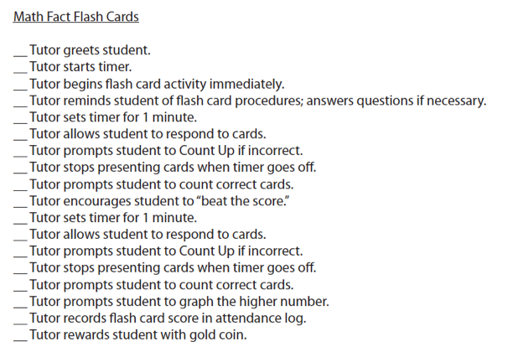
Implement with greater fidelity
Adaptation
Ensure that you are implementing the intervention or strategy with fidelity

Slide 69
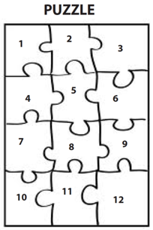
Implement with greater fidelity
Adaptation
Embed behavioral supports
May want to incorporate strategies to improve self-regulation and minimize nonproductive behavior

Slide 70
Implement with greater fidelity
Adaptation
Embed behavioral supports
May want to incorporate strategies to improve self-regulation and minimize nonproductive behavior
UPSCheck
  Understand
  Plan
  Solve
  Check

Slide 71
Implement with greater fidelity
Adaptation
Embed behavioral supports
Increase dosage
Conduct longer sessions, more sessions per week, or more weeks within DBI

Slide 72
Implement with greater fidelity
Adaptation
Embed behavioral supports
Increase dosage
Conduct longer sessions, more sessions per week, or more weeks within DBI

Slide 73
Implement with greater fidelity
Adaptation
Embed behavioral supports
Increase dosage
Conduct longer sessions, more sessions per week, or more weeks within DBI
Number of weeks left in intervention

Slide 74
Implement with greater fidelity
Adaptation
Embed behavioral supports
Increase dosage
Adapt mathematics content
Where student IS
Where student NEEDS TO BE
Alter the scope and sequence
Explain why addition and subtraction strategies work, using place value and the properties of operations.
Use addition and subtraction within 100 to solve one- and two-step word problems…
Fluently add and subtract within 100 using strategies based on place value, properties of operations, and/or relationships.
Apply properties of operations as strategies to multiply and divide….
Fluently multiply and divide within 100, using strategies such as the relationship between multiplication and division…
Understand that the three digits of a three-digit number represent amounts of hundreds, tens, and ones.
Find whole number quotients and remainders with up to four-digit dividends and one-digit divisors, using strategies based on place value, …
Solve multi-step word problems posed with whole numbers and having whole-number answers using the four operations…
Understand that the two digits of a two-digit number represent amounts of tens and ones.
Use multiplication and division within 100 to solve word problems…
Fluently add and subtract multi-digit whole numbers using the standard algorithm.
Fluently multiply multi-digit whole numbers using the standard algorithm.
continuum of mathematics learning

Slide 75
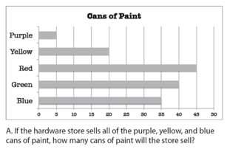
Implement with greater fidelity
Adaptation
Embed behavioral supports
Increase dosage
Solve
Adapt mathematics content
Write equation
Break down problems into smaller steps
Draw picture
Identify schema
Label graph
Underline labels
Read the problem

Slide 76
Implement with greater fidelity
Adaptation
Embed behavioral supports
Increase dosage
Adapt mathematics content
precise
Focus on the language of mathematics
concise

Slide 77
Implement with greater fidelity
Adaptation
Embed behavioral supports
Increase dosage
Adapt mathematics content
Focus on the language of mathematics
MATH JOURNAL

Slide 78
Implement with greater fidelity
Adaptation
Embed behavioral supports
Increase dosage
Adapt mathematics content
Define: | Characteristics:
Example: | Non-example:
Focus on the language of mathematics

Slide 79
Implement with greater fidelity
Adaptation
Embed behavioral supports
Increase dosage
“Tell me how you solved this problem.”
Adapt mathematics content
“What were you thinking about when you regrouped?”
Engage student in more discourse
“How would you teach this problem to another student?”
“Describe the word problem in 10 words or less.”

Slide 80
Implement with greater fidelity
Adaptation
Embed behavioral supports
Increase dosage
“Talk through this problem with me.”
Adapt mathematics content
Provide worked examples
405
+ 16
405
+ 16
411
521

Slide 81
Implement with greater fidelity
Adaptation
Embed behavioral supports
Increase dosage
Adapt mathematics content
Utilize more three-dimensional representations
Abstract
Representational
Concrete

Slide 82
Implement with greater fidelity
Adaptation
Embed behavioral supports
Increase dosage
Adapt mathematics content
Utilize more two-dimensional representations
Abstract
Representational
Concrete

Slide 83
Implement with greater fidelity
Adaptation
Embed behavioral supports
Increase dosage
Adapt mathematics content
Ensure student understand the abstract
Abstract
Representational
Concrete

Slide 84
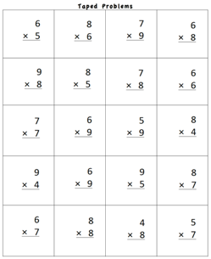
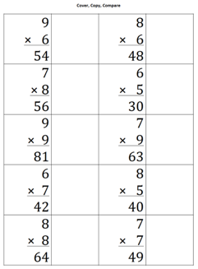

Implement with greater fidelity
Adaptation
Embed behavioral supports
Increase dosage
Adapt mathematics content
Focus on fact fluency

Slide 85
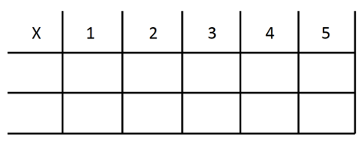
Implement with greater fidelity
Adaptation
Embed behavioral supports
Increase dosage
Adapt mathematics content
Focus on other types of fluency
-3 + (-4) = ___ 5 – (-6) = ___

Slide 86
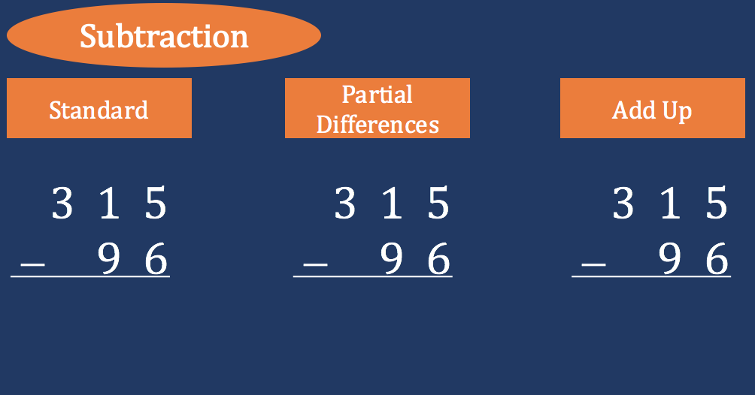
Implement with greater fidelity
Adaptation
Embed behavioral supports
Increase dosage
Adapt mathematics content
Teach alternate algorithms

Slide 87
Implement with greater fidelity
Adaptation
Embed behavioral supports
Increase dosage
Adapt mathematics content
Explicitly teach problem solving
Additive
Multiplicative
Total
Equal Groups
Difference
Comparison
Change
Ratios/
Proportions

Slide 88
Implement with greater fidelity
Adaptation
Embed behavioral supports
Increase dosage
Adapt mathematics content
Encourage alternate methods and solutions
405
+ 16
405
+ 16
500
10
+ 11
521
521

Slide 89
Implement with greater fidelity
Adaptation
Embed behavioral supports
Increase dosage
Adapt mathematics content
Modeling
Practice
Utilize explicit instruction
Clear Explanation
Guided
Practice
Make sure you’re doing it! And do it well!
Planned
Examples
Independent Practice
Supporting Practices
Asking the right questions
Eliciting frequent responses
Providing immediate specific feedback
Maintaining a brisk pace

Slide 90
Implement with greater fidelity
Adaptation
Embed behavioral supports
Increase dosage
405
+ 16
4305
+ 216
Adapt mathematics content
Utilize explicit instruction
Explicitly teach transfer
Marney baked 89 cookies and sold 40 cookies at the bake sale. How many cookies does Marney have left?
Explicitly teach how current learning relates to other learning
Marney had $89 and spent $40 on shoes. How many much does Marney have left?
Marney had $89 and spent $40 on shoes. How much money will Marney have after buying the shoes?

Slide 91
Implement with greater fidelity
Adaptation
Embed behavioral supports
Increase dosage
Adapt mathematics content
Utilize explicit instruction
Explicitly teach transfer

Slide 92
Intervention: Occurs frequently and with intensity
Intervention adaptation: Content, dosage, explicit instruction, attention to transfer

Slide 93
Think-Pair-Share
Which adaptations do you plan to use?
What adaptations do you see or suggest for the classroom?
93

Slide 94
Case Study
94

Slide 95
Case Study: Lindsay
Lindsay is a sixth-grade student with an individualized education program.
Lindsay struggles with mathematics and has recently begun struggling with fluency, preforming on timed tests, and consistency on mastery assessments.

Slide 96
Intervention History: Lindsay
Lindsay receives Corrective Mathematics in a small group setting with 3 other students, 5x a week, 50 minutes each session.
No current behavioral interventions

Slide 97
Lindsay’s Scores:
Baseline Data FAST Math
Lindsay’s FAST Mathematics benchmarks are shown on this graph.
Progress is monitored weekly.
Goal line is based on fourth-grade scores.
Goal line

Slide 98
DBI for Lindsay
Data indicate Lindsay is at risk of not meeting her academic goals.
Lindsay’s teachers are becoming increasingly concerned with her inconsistency and distractibility.

Slide 99
DBI for Lindsay
The next steps in the DBI process are as follows:
  Diagnostic assessment
    Error analysis to glean further understanding of Lindsay’s mathematical skills
  Implementation of an intervention adaptation
  Continued progress monitoring

Slide 100
Lindsay’s Current Performance
Initial data collection and analysis revealed the following:
  An error analysis revealed that Lindsay was making errors on mathematics concepts she had previously demonstrated mastery with including long division skills.
  Teachers predicted Lindsay was struggling with the increased length and intensity of mathematics assessments in sixth grade.

Slide 101
Lindsay’s Current Performance
  Lindsay demonstrated off-task behaviors and high levels of distractibility
    in the late afternoon and final periods of the day.
    during unstructured time and when she was not provided with regular, explicit feedback on her performance.

Slide 102
Intervention Adaptation 1
The intervention team met and made the following decisions about Lindsay’s intervention
  Break lengthy mathematics assignments and assessments into smaller chunks to avoid issues with stamina and distractibility
  Move Lindsay into a mathematics intervention period earlier in the school day to help with distractibility
  Provide increased feedback and opportunities to practice, especially with long division problems

Slide 103
FAST Math Data
Baseline
Intervention Adaptation 1
Goal Line

Slide 104
DBI for Lindsay
Lindsay continues to have multiple scores that fall below the goal line.
Staff are concerned Lindsay continues to exhibit high levels of distractibility, even during morning period of intervention.

Slide 105
Intervention Adaptation 2
Lindsay’s teachers met and decided to:
  Continue her intensified math intervention
    Adapt instruction to include fluency practice
  Make the following adaptations to include a behavioral component:
    Add a self-regulation or behavior monitoring component to the intervention to be tracked by Lindsay.
    Add weekly check-ins with Lindsay and her intervention teacher to assess behavior progress monitoring data.

Slide 106
Lindsay’s Self-Regulation Strategy
Self-regulation consisted of:
Self-monitoring “I was paying attention” at 5-minute intervals
Planning and setting goals for behavior
  Initially at 50% engagement
Monitoring progress toward goal
Notes:
Self-regulation is a learners ability to take ownership of his/her learning. (paraphrase or read slide)
Self-regulation comprises:
Planning and setting goals for learning
Monitoring learning and progress toward goals
Regulation of language and memory to support learning (e.g., self-talk, use of strategies)
Attention

Slide 107
Poor Self-Regulation and Executive Function Impede Academic Learning
Students with deficits in these areas:
  Demonstrate minimal use of self-directed strategies
  Often exhibit behavior problems due to inattention and poor impulse control.
  Have difficulty taking in new information
  Lack the ability to monitor their learning
Notes:
Why does poor self-regulation and executive function impede academic learning? Because students with deficits in these areas demonstrate minimal use of self-directed strategies—They need to be explicitly taught. Students also, often exhibit behavior problems due to inattention and poor impulse control. Their inattention makes intake of new information difficult, and their lack of monitoring of learning makes it difficult for students to be aware of what they do and do not know, and when they should request help.

Slide 108
FAST Math Data
Intervention Adaptation 1
Goal Line
Baseline
Intervention Adaptation 2

Slide 109
DBI for Lindsay
Lindsay began to show progress after her intervention teachers integrated individualized supports for both her academic and behavioral needs.
Although Lindsay is making progress, she continues to perform below grade level and will need continued observation, intervention, and individualized adaptations.

Slide 110
In Summary
DBI is an ongoing process that comprises ongoing assessment, intervention, evaluation, and adjustment to maximize student outcomes.
Students with the most severe and persistent needs often demonstrate integrated academic and behavioral difficulties
While Lindsay’s scores on her mathematics assessments have begun to increase staff will want to continually monitor her levels of distractibility and individualize her interventions as needed
110
Notes:
Read slide.

Slide 111

For More Information…

Slide 112
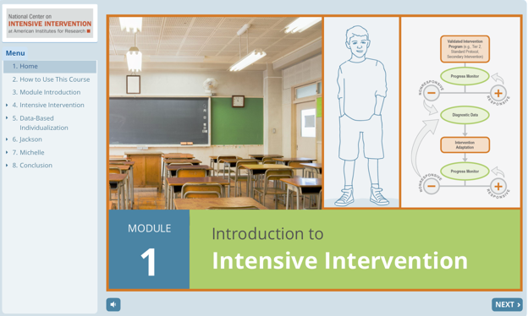
Supporting Self-Directed Training and Learning
New interactive online learning module
  Self-paced
  Apply learning to two case examples
  Test knowledge
http://www.intensiveintervention.org/resource/introduction-intensive-intervention
Notes:
Sarah- you can go to the internet and click around on the NCII website if that’s easier than going through all of these slides.
On the NCII website, there are several self paced modules about the foundational parts of DBI. This module is about 30 minutes depending on how often you stop and work through the activities.

Slide 113
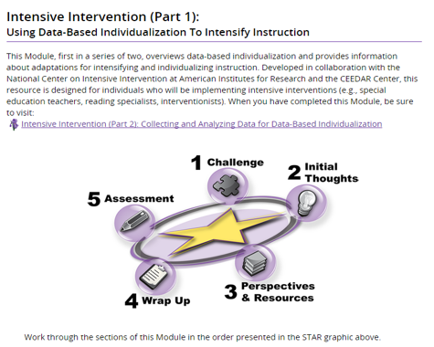
Supporting Self-Directed Training and Learning: IRIS Modules
Intensive Intervention (Part 1):Using Data-Based Individualization To Intensify Instruction http://iris.peabody.vanderbilt.edu/module/dbi1/#content
Intensive Intervention (Part 2):Collecting and Analyzing Data for Data-Based Individualization http://iris.peabody.vanderbilt.edu/module/dbi2/#content
Notes:
Other self-directed learning modules are available through the IRIS center. Much of the content was taken from the NCII website and Sarah Arden helped to develop these.

Slide 114
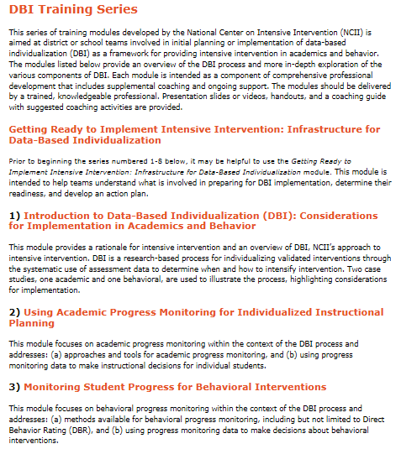
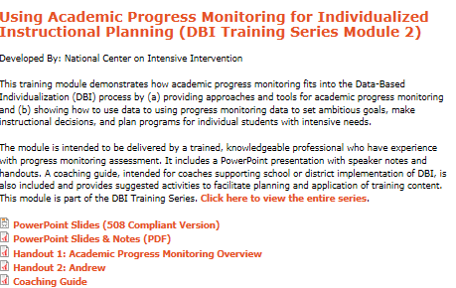
Supporting Training & Coaching Efforts: DBI Training Series
http://www.intensiveintervention.org/content/dbi-training-series
Notes:
There is specifically a DBI training series available on the NCII website.

Slide 115

Introductions to Intensive Intervention
This document provides an overarching description of DBI. Additional resources that provide an overview include
Videos
Modules
Webinars
http://www.intensiveintervention.org/resource/data-based-individualization-framework-intensive-intervention
Notes:
Other resources to help support in implementing intensive intervention.

Slide 116
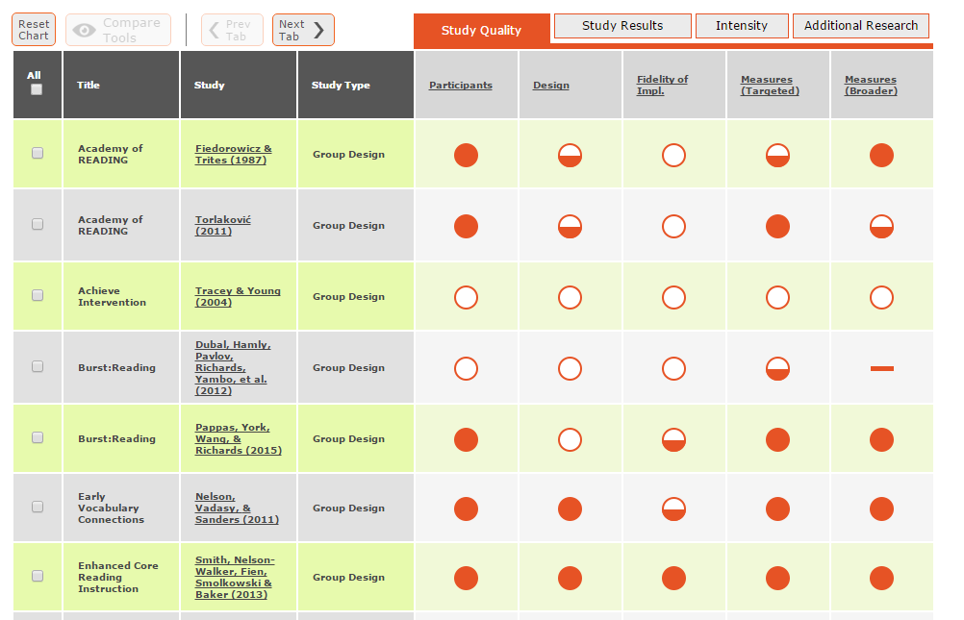
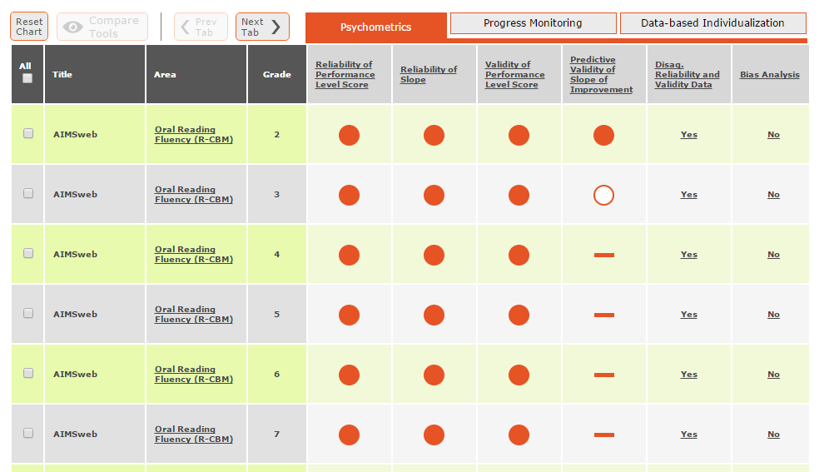
Identifying Evidenced-Based Interventions and Assessments
http://www.intensiveintervention.org/chart/instructional-intervention-tools & http://www.intensiveintervention.org/chart/progress-monitoring
http://www.intensiveintervention.org/chart/behavioral-progress-monitoring-tools
http://www.intensiveintervention.org/chart/behavioral-intervention-chart

Slide 117
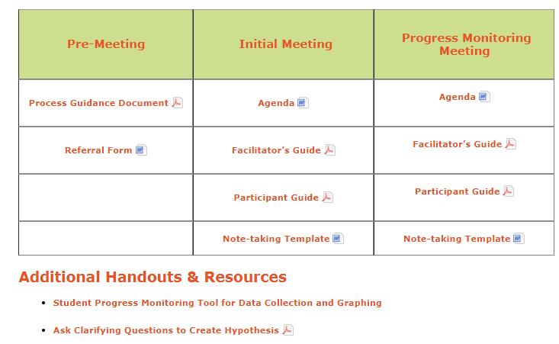
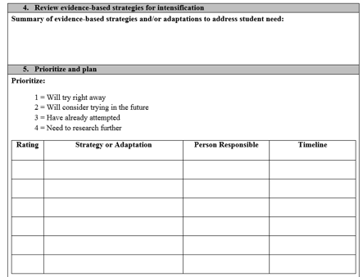
Supporting Meeting Facilitation and Planning
http://www.intensiveintervention.org/tools-support-intensive-intervention-data-meetings

Slide 118
Supporting Instruction: Sample Lessons and Activities
Includes Lesson Plans, Worksheets, Materials
Content areas:
  Reading
  Mathematics
    Includes video examples
  Behavior

Slide 119
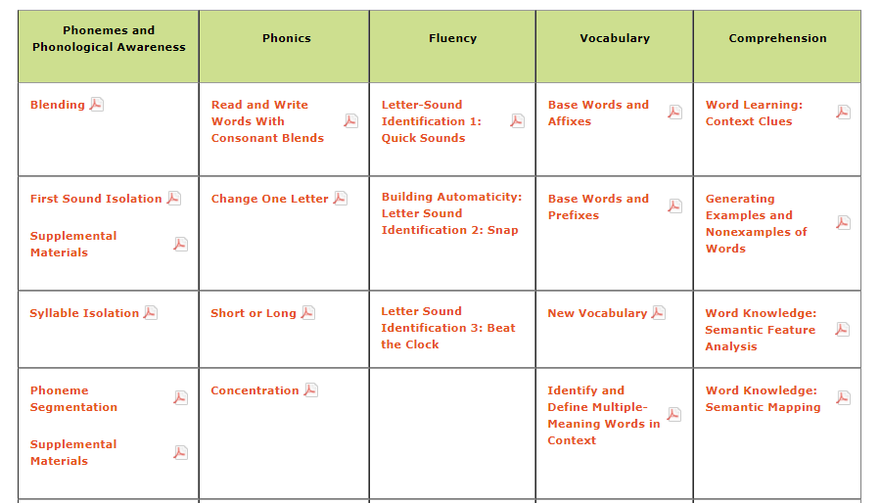
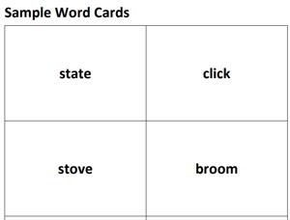
Sample Lessons Reading

Slide 120
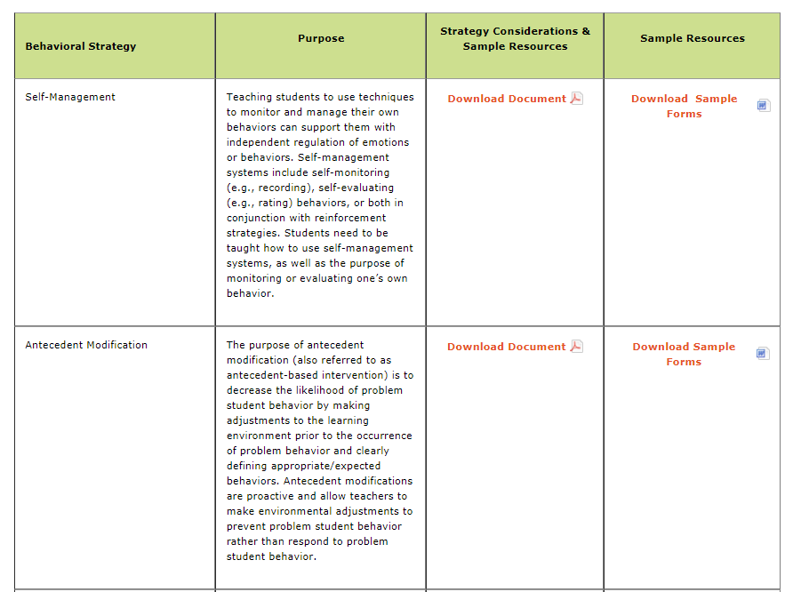
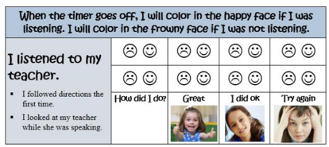
Sample Resources Behavior
http://www.intensiveintervention.org/implementing-behavioral-strategies-considerations-and-sample-resources

Slide 121
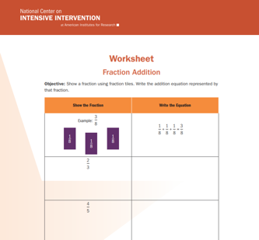
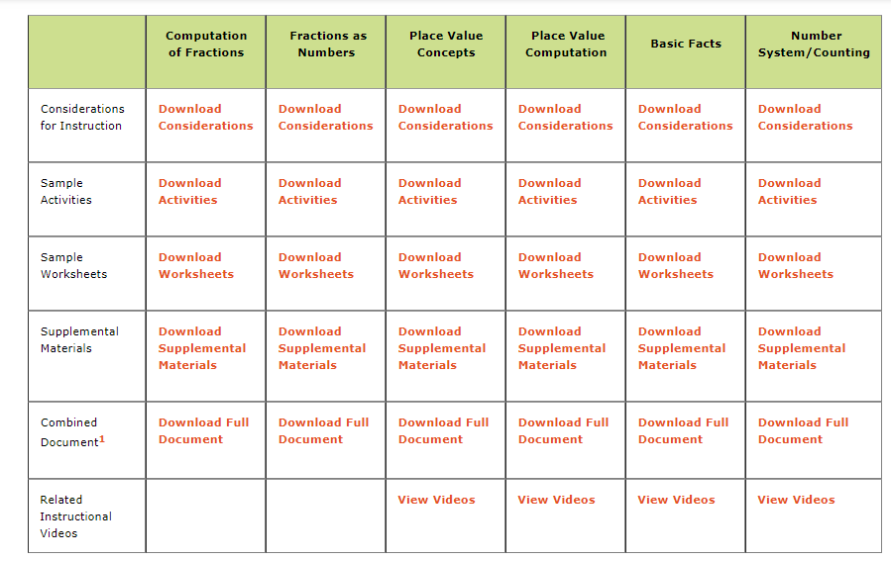
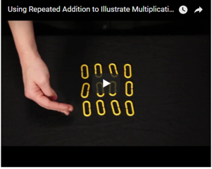
Sample Lessons Math
http://www.intensiveintervention.org/resources/sample-lessons-activities/mathematics

Slide 122
Multiple Tools To Measure Fidelity
Schoolwide Implementation
Data Meeting Process Implementation
Intervention Implementation

Slide 123
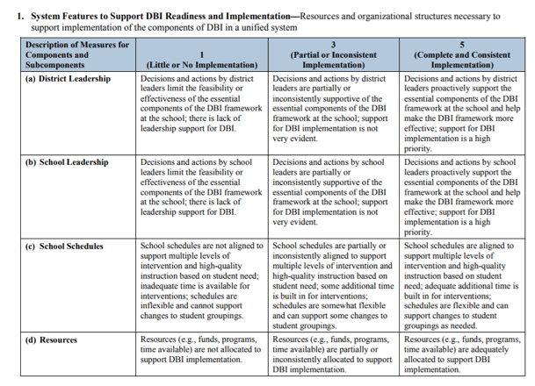
School Wide DBI Implementation: Rubric and Interview
http://www.intensiveintervention.org/resource/dbi-implementation-rubric-and-interview

Slide 124
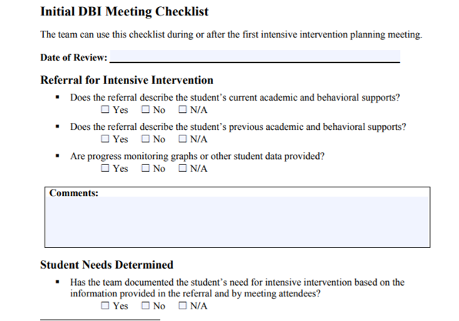
Meeting Process Checklist
http://www.intensiveintervention.org/resource/student-level-data-based-individualization-implementation-checklists

Slide 125
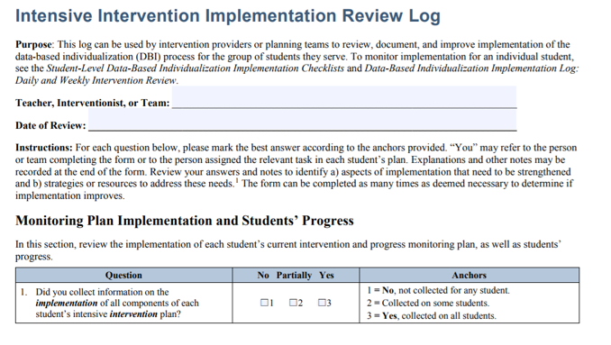
Intervention Review Log for Multiple Students
http://www.intensiveintervention.org/resource/intensive-intervention-implementation-review-log

Slide 126
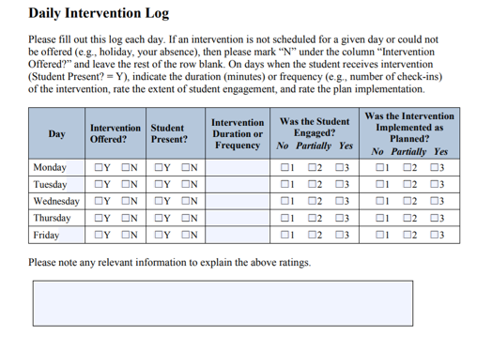
Intervention Log Tracking for Individual Student
http://www.intensiveintervention.org/resource/data-based-individualization-implementation-log-daily-and-weekly-intervention-review

Slide 127
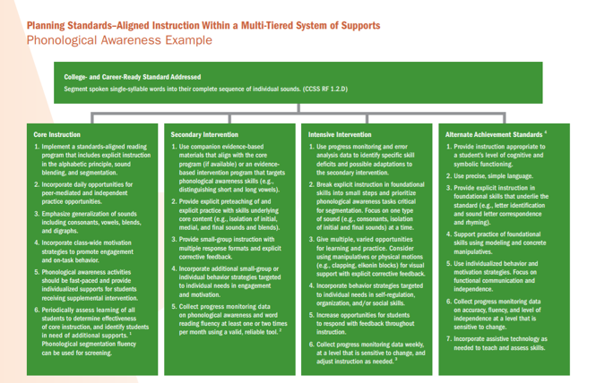
Considering Standards Aligned Instruction Across MTSS Framework

Slide 128
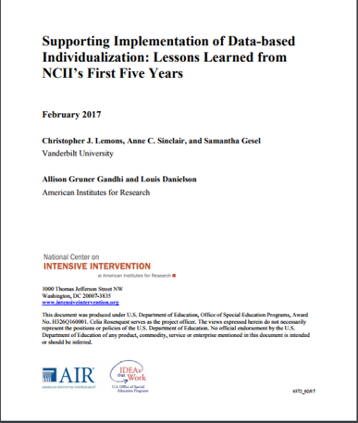
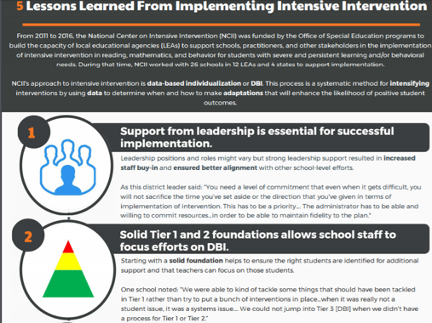
Lessons Learned
http://www.intensiveintervention.org/content/implementation-examples-field

Slide 129

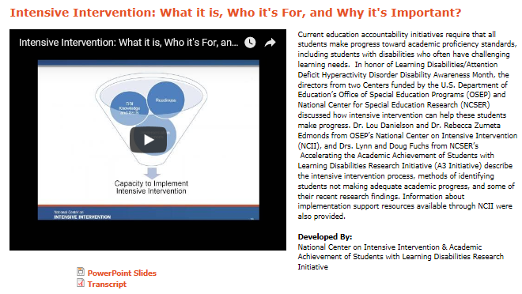
Other Resources
Webinars: http://www.intensiveintervention.org/resources/webinars
Ask the Expert Videos: http://www.intensiveintervention.org/resources/ask-the-expert

Slide 130

Stay Up to Date: Twitter
Follow NCII on Twitter at @TheNCII
Join our mailing list and receive updates and newsletters

Slide 131

Stay Up to Date: YouTube
Follow our YouTube Channel to view archived webinars and ask the expert videos

Slide 132


Stay Up to Date: Newsletter
Sign up for our Newsletter and email list to receive regular updates

Slide 133

Making Improvements
We are working to improve the website and access and will relaunch with the same resources but a different look and feel.
Notes:
Relaunching of the new website is March / April 2018.

Slide 134


Slide 135

Contact Information
Sarah Powell
  University of Texas at Austin
  srpowell@austin.utexas.edu
  @sarahpowellphd
119

