Slide 1
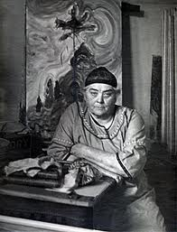
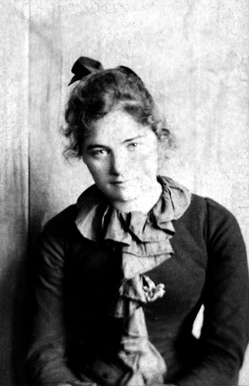
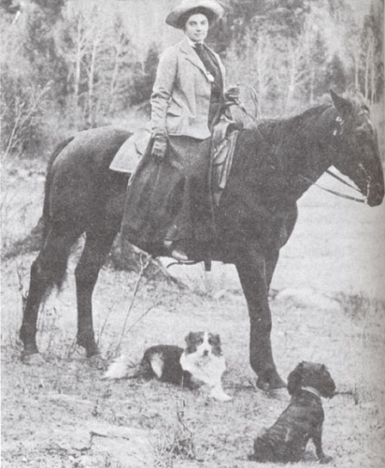
EMILY CARR – 1871-1945

Slide 2
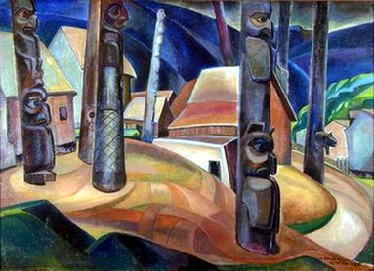
Kisplox Village, 1929

Slide 3
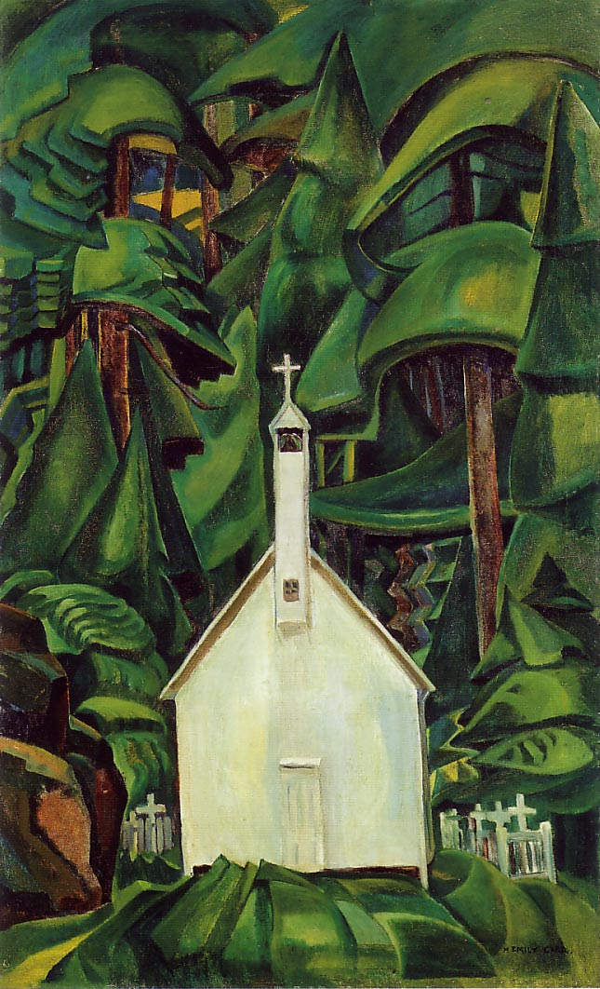
Indian Church, 1929

Slide 4
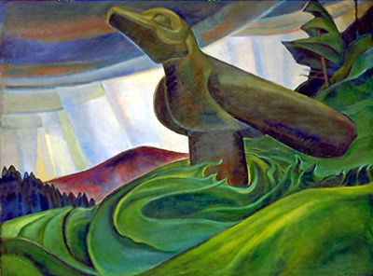
Big Raven, 1931

Slide 5
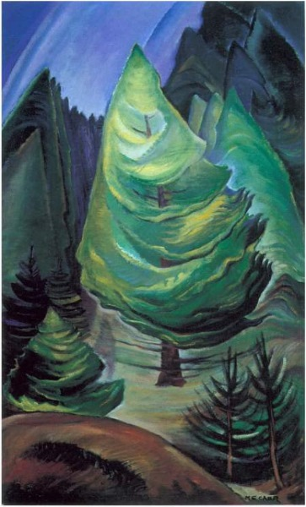
The Little Pine, 1931

Slide 6
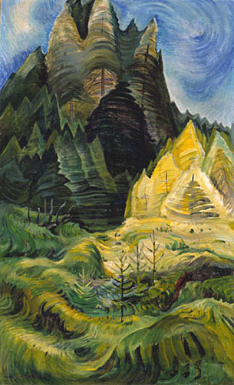
Reforestation, 1936

Slide 7
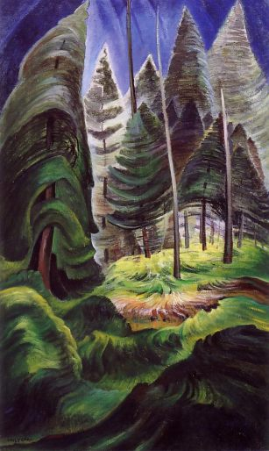
Rushing Sea of Undergrowth, 1932-35

Slide 8
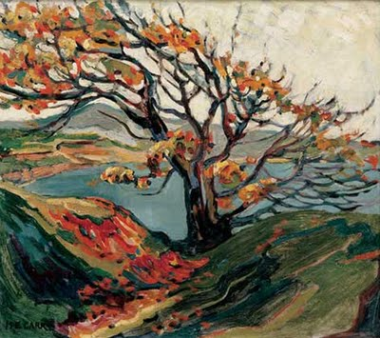
Tree in Autumn

Slide 9
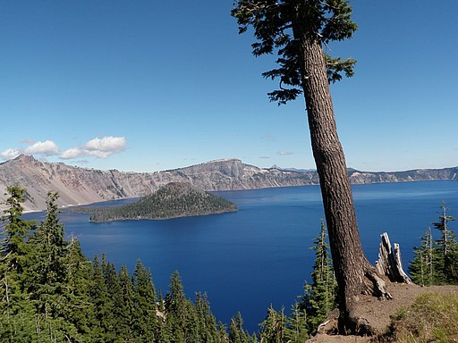
Crater Lake National Park

Slide 10
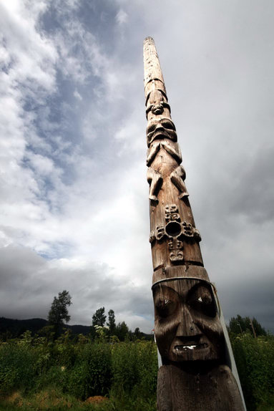
How would you paint this image?

Slide 11
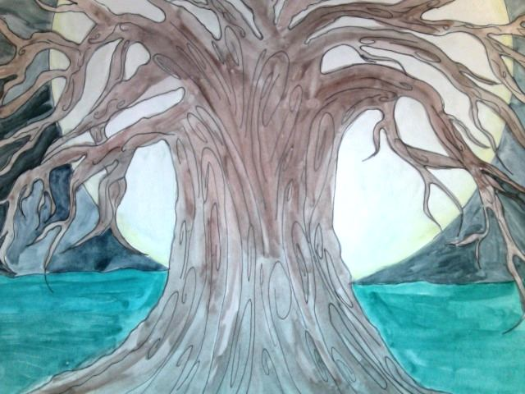
Student Sample – Inspired by Emily Carr

Slide 12
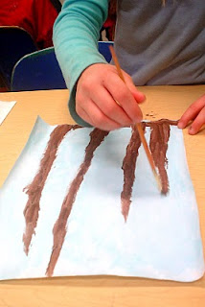
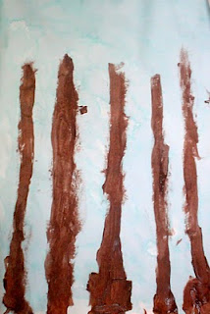
Third Grade Students Inspired by Emily Carr & the Manistee National Forest

Slide 13
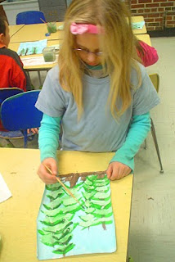
Inspired by Emily Carr

Slide 14
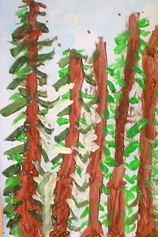
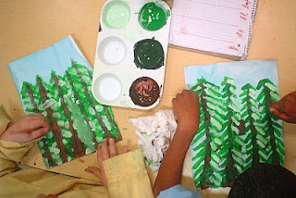
Do these look like an Emily Carr forest?

