Slide 1
Inventory Management High Risk Assets - TrackIt

Slide 2
Project Scope: To determine a solution for inventory management that also includes help desk, change management, licensing, and any additional access.

Slide 3
Software Comparison: TrackIt by Numara Service Desk Plus by ManageEngine WiseTrack by WiseTrack Freeware used before: OneorZero

Slide 4
Inventory Management

Slide 5
Inventory Home Screen

Slide 6
Add New Asset

Slide 7
Add New Asset-Properties

Slide 8
Asset with Data

Slide 9
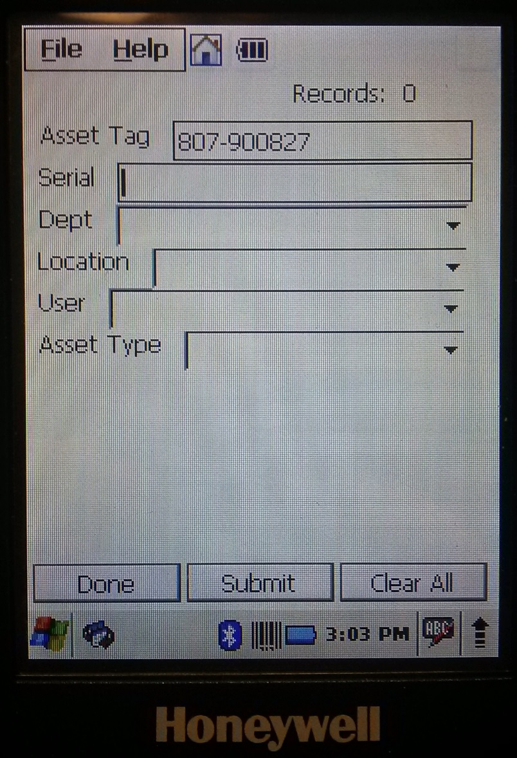
Scan Assets

Slide 10
Asset List ACE

Slide 11
Asset Screen

Slide 12
Asset iPad List (High Risk)

Slide 13
Asset iPad (High Risk)

Slide 14
Asset Audit Trail

Slide 15
Asset with Software

Slide 16
Asset with IP Data

Slide 17
TrackIt – Full Software

Slide 18
Help Desk – Task List

Slide 19
Solutions Library

Slide 20
Purchasing

Slide 21
Professional Development

Slide 22
Loan Library

Slide 23
Departments

Slide 24
Dashboard

Slide 25
Change Mgmt.

Slide 26
Vendor List

Slide 27
User List

Slide 28
Technicians

Slide 29
Questions?

