Slide 1
Law and Creation Order
Craig Vincent Mitchell
Assistant Professor of Christian Ethics
Southwestern Baptist Theological Seminary

Slide 2
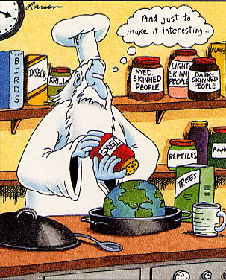
Hebrew Creation Ethics
God (Yahweh) is the Creator
In the beginning He created everything to reflect his will, His power, and His purpose
Everything that He created is “good”
Good- appropriate to purpose, function, or genre. Beautiful, orderly, fitting
The Created Order reflects justice and righteousness

Slide 3
Hebrew Creation Ethics
Throughout the Old Testament we see the word pair or phrase “justice and righteousness” over and over
Tsideqa- (Hebrew-righteous) the state of being right, according to the natural or created order, appropriate. Can be applied to inanimate things like scales.
Mishpat- (Hebrew- justice) righteousness in the social order

Slide 4
Hebrew Creation Ethics
There is an order to creation because it reflects God’s nature
There are two aspects to the created order
One aspect of the created order is the natural order
The other aspect of the created order is the social order
God assigned angelic powers to operate both aspects of the created order

Slide 5
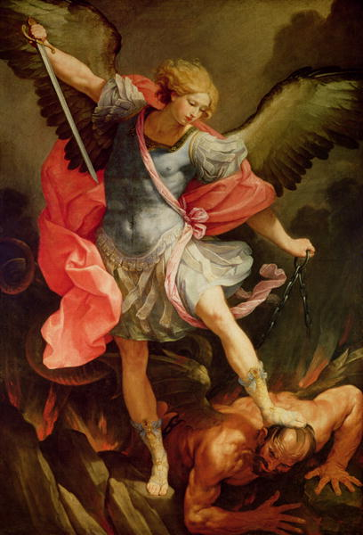
Hebrew Creation Ethics
God has assigned a hierarchy of angelic powers to control the natural order
God has also assigned angelic powers to control the social order
There is a hierarchy of angelic powers (kosmos)
Fallen angels are demons

Slide 6
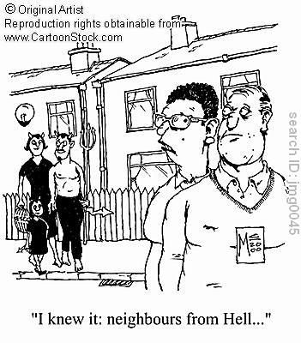
Hebrew Creation Ethics
Demons or fallen angels can employ the natural forces to destroy men and the social order.
Demons are factors in law, politics and economics
Demons also employ false religion to enslave men
They desire to destroy Christians and the church.

Slide 7
Hebrew Creation Ethics
Spiritual warfare involves demonic powers actually attacking the followers of Christ.
Demonic powers are also responsible for the propagation of false philosophical ideas and false theology. Which can be manifested in unjust law.
Christians are involved in spiritual warfare when they preach, evangelize, and pray
It also involves Christians standing up for what is true and right

Slide 8
The Created Order: The Natural Order
The natural order is composed of every physical aspect of reality
The natural order includes the laws of physics and chemistry
The natural order also includes the realm of plants and animals (biology)
Scripture shows angels controlling the wind, lightning, fire and other forces of the natural order.

Slide 9
The Created Order: The Social Order
The social order is another part of the created order
The social order is concerned with the world of men
The social order includes the family, the state and the church
The social order is the realm of morality, politics, economics and law
Scripture shows angels over every part of the social order

Slide 10
Hebrew Creation Ethics
In the Fall some of the angelic powers rebelled and everything is subjected to futility
Sin is anything that is contrary to God’s will, purpose or law
Sin can be equated with bad, evil, chaos, disorder, and rebellion
Evil is nothing in itself, it is merely the lack of good or the corruption of the good

Slide 11
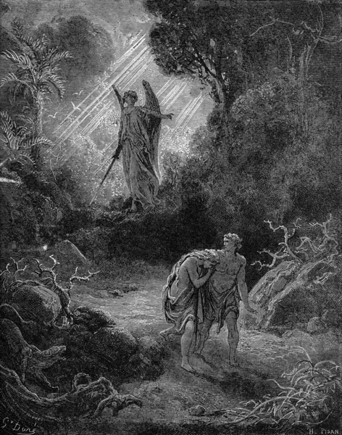
Hebrew Creation Ethics
In the Fall, man and the rest of creation is damaged and things are not the way that they are supposed to be.
Men love the wrong things and hate the wrong things
Men become hostile to the truth

Slide 12
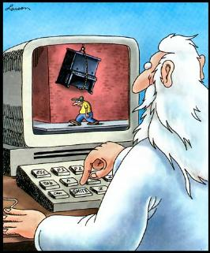
Hebrew Creation Ethics
After the Fall, man is at war with God.
Man has rebelled against God
Because of man’s sin, the wrath of God is coming upon the world
Man is helpless, and only God can make things right.

Slide 13
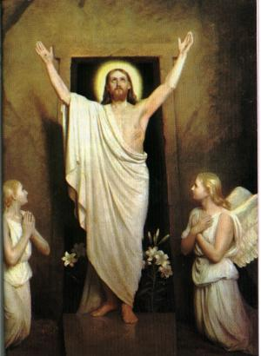
Jesus Christ and Salvation History
Jesus Christ came to reconcile God to man.
He came to redeem creation and to restore justice and righteousness
It is in the life, death, burial and resurrection of Jesus Christ than man is justified (made righteous)

Slide 14
The Created Order
God established (ordained) every part of this social order
All authority comes from God (Romans 13)
God ordained the family
God ordained the state
God ordained the church
These ordinations include a structure and a purpose
Morality is operating in accordance with the order

Slide 15
The Social Order: Authority
All authority is given by God to execute justice and righteousness
In every relationship there is a super- ordinate and a subordinate (there are also equals)
God created all men equal
God created the social order to operate properly with His structure and authority
The social order should act in accordance with moral order

Slide 16
The Social Order: Authority
For individuals to execute justice and righteousness, they should act accordingly
When the individual is a sub-ordinate he should submit to his super-ordinates and show proper respect. Insubordination happens when he fails to do so.
When the individual is the super-ordinate he should not abuse his authority and give proper respect to the sub-ordinate
God is always the Super-ordinate

Slide 17
The Social Order: The Family
God ordained marriage and family
The purpose of the family is to fulfill the command to be fruitful and multiply and to teach children justice and righteousness
The family has a God –given structure (Ephesians 5-6)
Father
Loves his wife and children
Has responsibility for mother and children
Mother
Submits to father/ husband
Has responsibility
for children
Children
Submits to mother
and father
Children learn justice and righteousness

Slide 18
The Social Order: The State
The Purpose of the state is to execute justice and righteousness in the social order by rewarding the good and punishing the wicked
No particular form of government is mandated in scripture
Rulers
Executes justice and righteousness
Has responsibility for officials and people
Officials
Submits to rulers
Rewards the good and punishes the wicked
Citizens
Submits to officials and respects rulers
Families are the building block of society

Slide 19

The Social Order: The State
The state should pass laws to protect the family
The state should also protect the rights of the individual
The state should spend only on public works, a legal /justice system, and national defense

Slide 20

The Social Order: The State
The state has the responsibility to ensure justice and righteousness
Consequently, the state has the right to:
  charge taxes
  Declare and conduct war
  Perform capital punishment
  Make and enforce just laws

Slide 21
The Social Order: The Church
The church is a new part of the social order
The church is a manifestation of the kingdom of God
The Great Commission (Matthew 28: ) is the purpose of the Church: to evangelize the lost and to disciple the saved so that Jesus Christ may be glorified
The Church has a God- ordained structure
Pastor/ Elders
The pastor is the head elder
The elders are responsible to lead the local congregation
Deacons
The deacons must submit to the pastor and elders
The deacons offer a limited form of authority and leadership
Laity
The laity must submit to the pastor and elders
The people are ambassadors
for Christ

Slide 22
The Created Order
Social Order
Law
Politics
Economics

Slide 23
Law and the Individual
Law, impacting the integrated dynamics of the community should be :
A balance of mercy and discipline for the individual
An ordinance of reason serving the common good (rational)
A purposeful guide through life or lived experience (goal directed)

Slide 24
Law and Morality
The existence of unjust laws proves that law and morality are not identical.
The existence of laws that serve to defend basic values prove that the two can work together. (i.e., laws against murder, rape, etc.)
Laws can state what overt offenses count as wrong and therefore punishable.
Laws govern conduct at least partly through fear of punishment.

Slide 25
Law and Morality
Morality can influence the law in the sense that it can provide the rational understanding of the “common good” by which whole groups of immoral actions can be deemed illegal.
Law can be a public expression of morality which codifies in a public way the basic principles of conduct which a society accepts. In that way it can guide the educators of the next generation by giving them a clear outline of the values society wants taught to its children.

Slide 26
Law and the Market
Markets can limit freedom and virtue if there is (socialist) central planning
The market can limit virtue by eliminating the choice for the good by planning or malevolence
The market can limit virtue when non-market structures eliminate charity, inspiration or aspiration.

Slide 27
Natural Law
The created order has a natural law
In the social order, the natural law unites morality, politics and economics and civil law.
Civil law should rest on the natural law
Angelic powers are involved in each of these
Politics/
Economics
Civil law
Morality

Slide 28
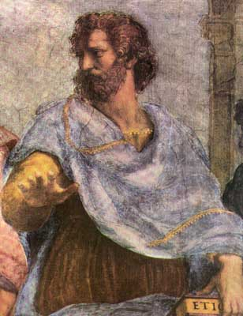
Natural Law
Aristotle argued that there is a natural law that affects all men everywhere. (Nicomachean Ethics)
We know this natural law through reason.
To be virtuous is to act in accordance with this law. To be vicious is to act contrary to it.

Slide 29
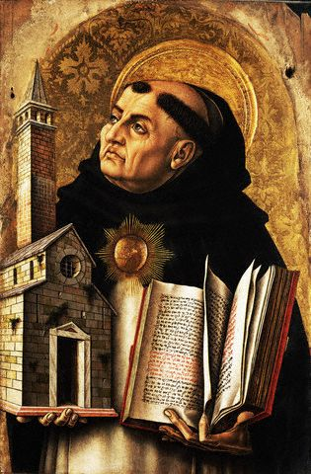
Natural Law
St Thomas Aquinas combined the theology of Augustine with the philosophy of Aristotle
He argued that the natural law is in accordance with the 10 commandments
He also argued that civil law should be based on natural law

Slide 30
Thomas Aquinas
Law is an ordinance of reason from the leader of the community promulgated for the sake of the common good (Summa Theologiaie I-II, 90A
The purpose of human law is to lead men to virtue, not suddenly, but gradually.” Summa Theologiaei II, I, Q. 96, Art 2, ad 2.

Slide 31
Natural Law
Natural law is part of the eternal law of God
Civil law is only temporal and established by man
Thomas Aquinas believed that there should be little difference between morality and the law
Aquinas also believed that not every moral precept should be put into law because then law would become a tyrant

Slide 32
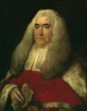
Natural Law
William Blackstone argued for natural law in his Commentaries on the Law of England volume 1, section 2.
He argued that law and morality rests upon a God who set everything in order.

Slide 33
Natural Law
As man depends absolutely upon his maker for everything, it is necessary that he should in all points conform to his maker’s will. This will of his maker is called the law of nature. For as God, when he created matter, and endued it with a principle of mobility, established certain rules for the perpetual direction of that motion; so , when he created man, and endued him with freewill to conduct himself in all parts of life, he laid down certain immutable laws of human nature, whereby that freewill is in some degree regulated and restrained, and gave him also the faculty of reason to discover the purpose of those laws.

Slide 34
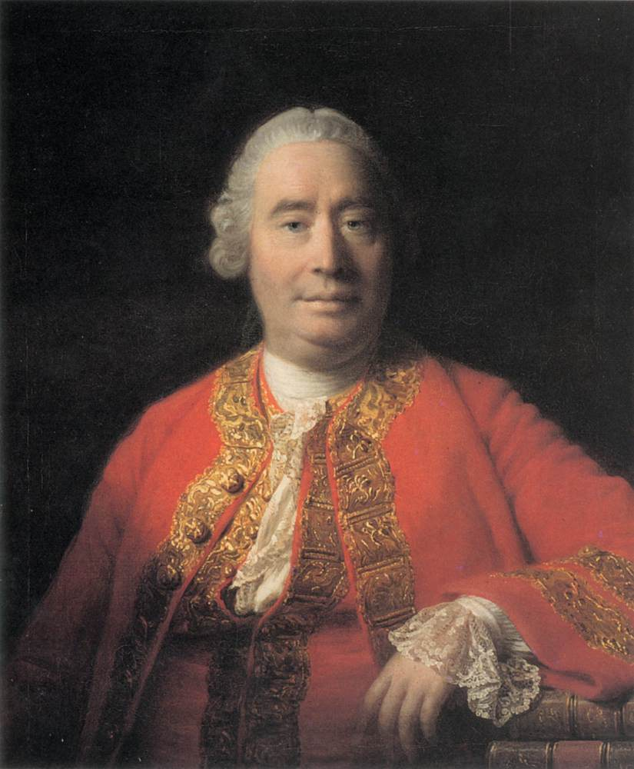
Natural Law
David Hume argued against the natural law with his fact/ value dichotomy
This dichotomy teaches that morality is based on the passions while facts are judged by reason
This resulted in positivism

Slide 35
Positivism
Positivism separates law from morality
Positivism separates morality from politics
Positivism separates morality from economics
Positivism results in increased confusion about how men should live
Positivism is contrary to God’s design, it argues that everything is meaningless
Positivism is just one tool, among many, employed by fallen angels to destroy the world of men

Slide 36
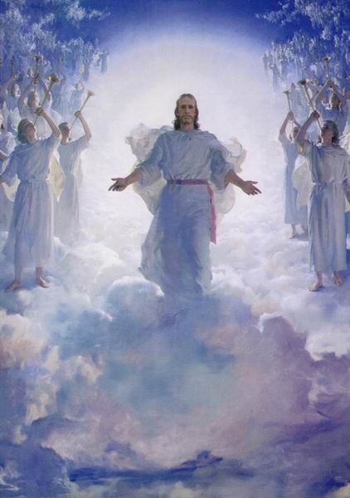
Jesus Christ and Salvation History
When Christ returns justice and righteousness will be completely restored
Until Christ returns sin will run its course
Until Christ returns disorder and rebellion will continue to infect the created order

Slide 37
Conclusion
Until Christ returns, Christians must strive to being about justice and righteousness
The primary way to bring about justice and righteousness comes through evangelism and discipleship.
Secondarily, we can bring about justice and righteousness by affecting the social order in the legal system, the political system and the economic system.
Christian Lawyers are God’s representative to the legal system. They should be concerned about justice and righteousness.

