Slide 1
Copyright Issues
Brian Prior
University Of Illinois Springfield Campus
Rob Mayes
University of North Texas

Slide 2
Copyright Law?
Copyright are used to project the copyright holder from unauthorized use of their copyrighted materials.
This is a civil matter where the courts can decide to award the plaintiff lost revenues, court costs and attorney fees/expenses.

Slide 3
Copyright What?
Academic Research Publication Manuscripts
Poetry
Movies
CD-ROMs
Video games
Videos
Plays
Paintings
Sheet music
Recorded music performances
Novels
Software code
Sculptures
Photographs
Choreography
Architectural designs

Slide 4
Qualifying for Copyright
“Fixed in a tangible medium of expression.“
Physical form for at least some period of time.
Independently created by the author
Some creative effort on the part of its author
Creative Ideas---DON’T COUNT!!!!!

Slide 5
Copyright Life
Before 1923: in Public Domain
After 1923 to 1977: (50 years after publication or 70 years after Author’s death if not published.
1978-Currrent: 70 years after Death of Author or 95/125 years from Publication Date (authorless pub)
Other Exceptions

Slide 6
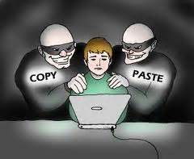
Fair Use or Plagiarism?
Quotes
Citations
NON-verbatim copies
What out for Images on websites!!

Slide 7
Registering a Copyright
U.S. Copyright Office
Online Forms or Attorney
Slow Process (Months)

Slide 8
Similarity Detection
TurnItIn Web Based Software
Finds Similarities in a document with previously published documents.
High Levels of similarities indicate evidence of plagiarism.
Cannot not check
for book references.

