Slide 1
Improving Attendance

Slide 2
School Year 2014-15
Attendance was becoming a major issue
Schools were Slow to take action or provide intervention
The juvenile judge had several hoops the school system must go through before a petition could be filed for truancy
There was no way one person could handle the issues
Saw a major need for change or a focus in a different direction
Principal placing blame
Director asked the principal “what have you done?”

Slide 3
2015-16 District wide Effort
Director impressed upon the administrators that the school it the frontline of defense to address attendance
Teachers should take an active part by contacting the parent
Be proactive rather than reactive
Schools and Central Office Show a united front of support
Develop of team approach - referrals to support services within the schools (counselors, nurse, psychologist, family resource etc.)
Get medical release signed to communicate with physicians

Slide 4
Spring Attendance Conference 2016
Attendance Works Presentation
Went back to district fired up and Ready to take our efforts to a new level
We were already doing a lot of the things discussed
Thought of ways to turn it up a notch

Slide 5
Action Plan For 2016-17
End of 2015-16 I provided each school their chronic attendance percentage with a list of the student who made up that percentage
During the summer a Community Meeting of all agencies involved was scheduled with Chuck Cagle Presenting
Revised our attendance procedures manual incorporating suggestions and documents from the attendance Works Website
Sent the administrators the url for the Attendance Works website
gave guidance for the administrators to become familiar with all the resources on the website
Mailed letters to the parents of every student on the list prior to the 2016-17 school year

Slide 6
Director challenged all administrators to improve their overall annual attendance percentage by 1.5%
Each school put in place a plan of action to design the appropriate intervention plan for each student on the list. ( personal calls, meetings with parent/student, or assigned a mentor per say)
Effort was made to identify specific issues or barriers impacting their school attendance
Attendance Teams – Home visits
The need to improve attendance integrated in all aspects of learning and academic success

Slide 7
Community Wide Slogan - Strive for less than 5 Absences
Challenge presented and explained To the students at all schools
All schools signed on the Attendance Works showing their support and efforts
When Registration Day Rolled around, the Needs of 401 students were met in several areas through our FRC…..Clothes, food, school supplies, rent, and parent finding work.

Slide 8
Developed CEO (Community Education Opportunities)
Presentation at the local chamber
Local Chamber identified two areas of weakness in the workforce - soft skills and attendance
Partnered with the schools to focus on these two areas
Business partners are welcoming students to school in the morning and speaking to the students about the importance of attending school on a regular bases to grow academically and achieve in the future.
They also impress how important attendance is as an adult in the workforce
Promote our Slogan of Strive for Less than 5 Absences across the county

Slide 9
September Awareness Month
Major Kick-off Activities
Proclamation presented to all schools from Board of Education, Director of Schools, Director of Attendance
Bulletin Boards at the schools for children to see Their individual progress
Bulletin Boards showing the school's daily/weekly progress
Parties to celebrate success at various times

Slide 10
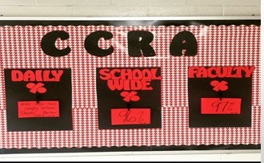

Slide 11
If student reached their goal they signed the “A” and they received a prize.

Slide 12
SUPER ATTENDANCE SPIRIT WEEK
SEPT. 6 –
SUPER HEROES SAVE THE DAY – DRESS UP AS YOUR FAVORITE SUPER HERO AND SAVE THE DAY WITH GREAT ATTENDANCE!
SEPT. 7 –
DISGUISE DAY – DON’T LET ABSENCES “SNEAK UP” ON YOU!
SEPT. 8 –
CAPE DAY! – WE ARE ALL CAPABLE” TO COME TO SCHOOL ON TIME EVERY DAY!
SEPT. 9 –
TACKY TIGHTS AND SOCK DAY! – WEARING TACKY TIGHTS AND SOCKS IS OKAY! WHEN YOU’RE ON TIME TODAY.

Slide 13
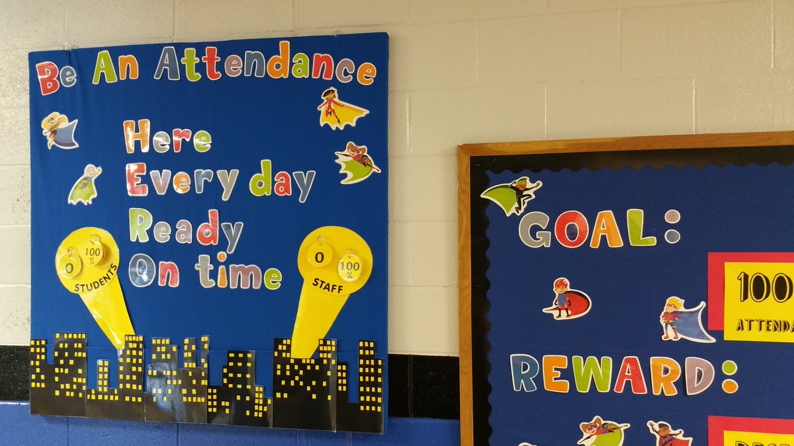

Slide 14
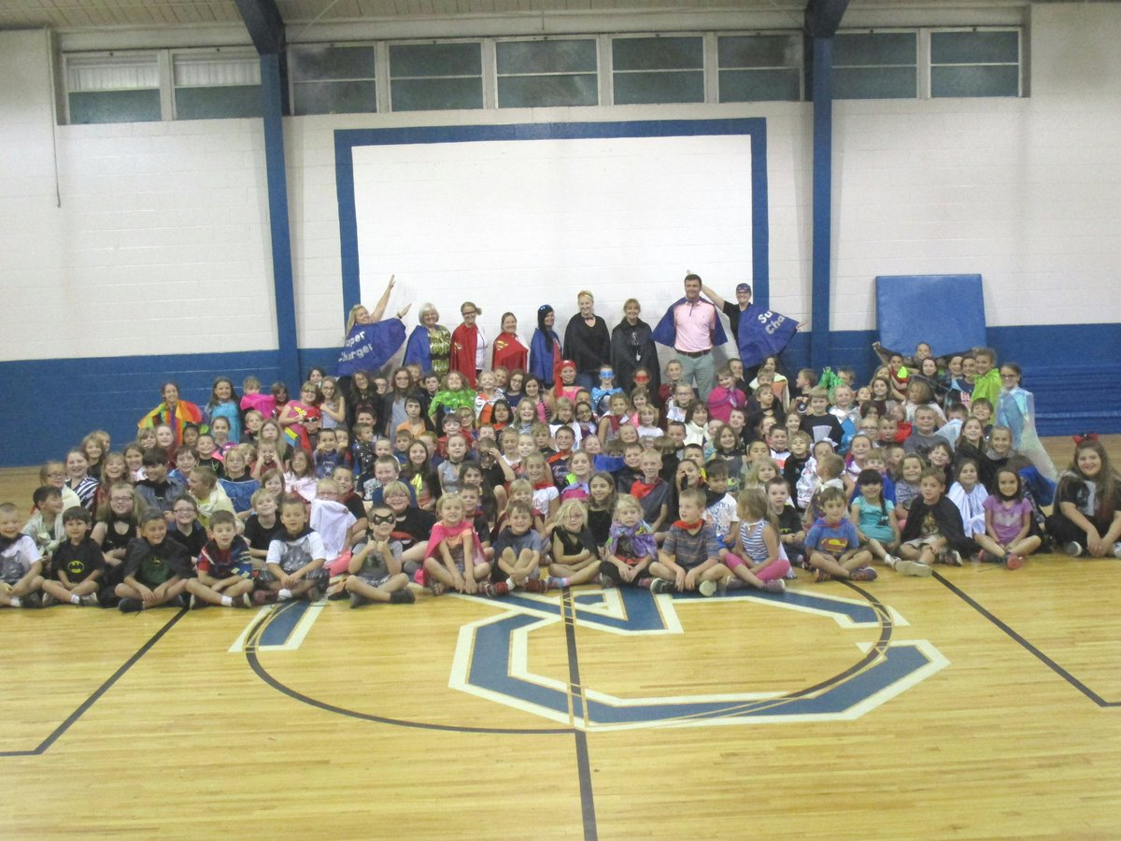
We are CAPE-able to be here & on time today

Slide 15
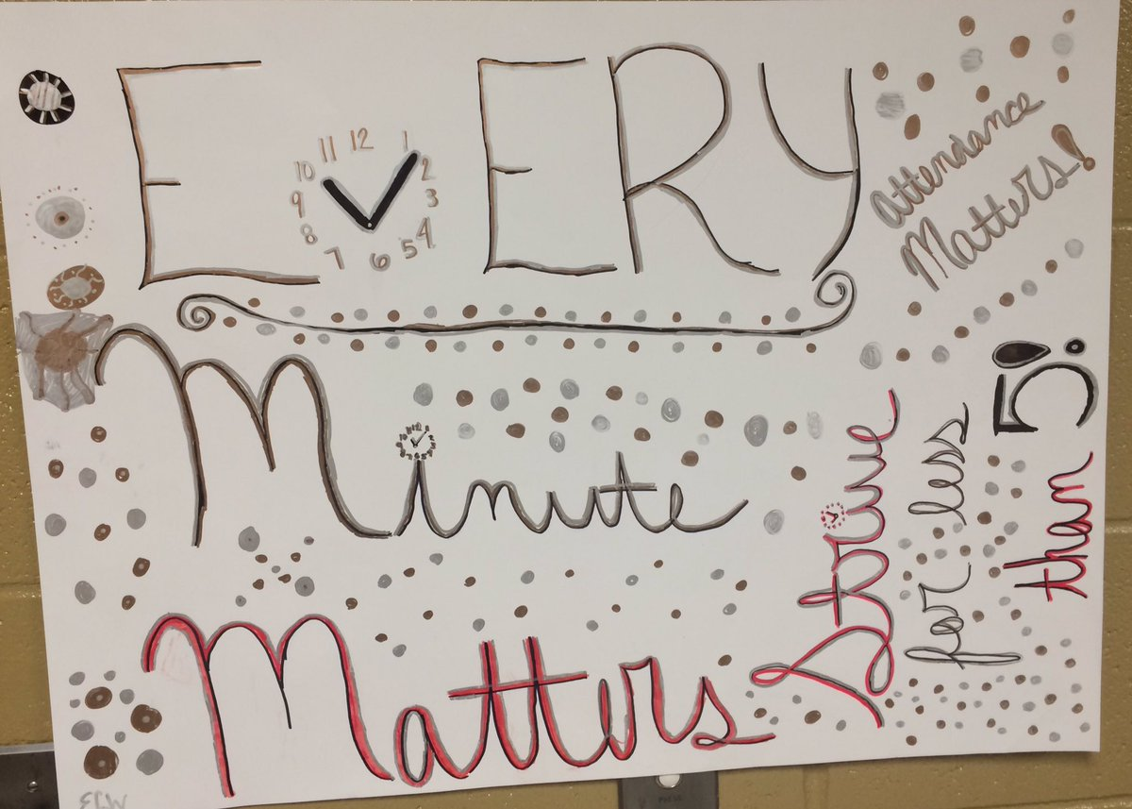
Kid Designed Posters with Messages

Slide 16
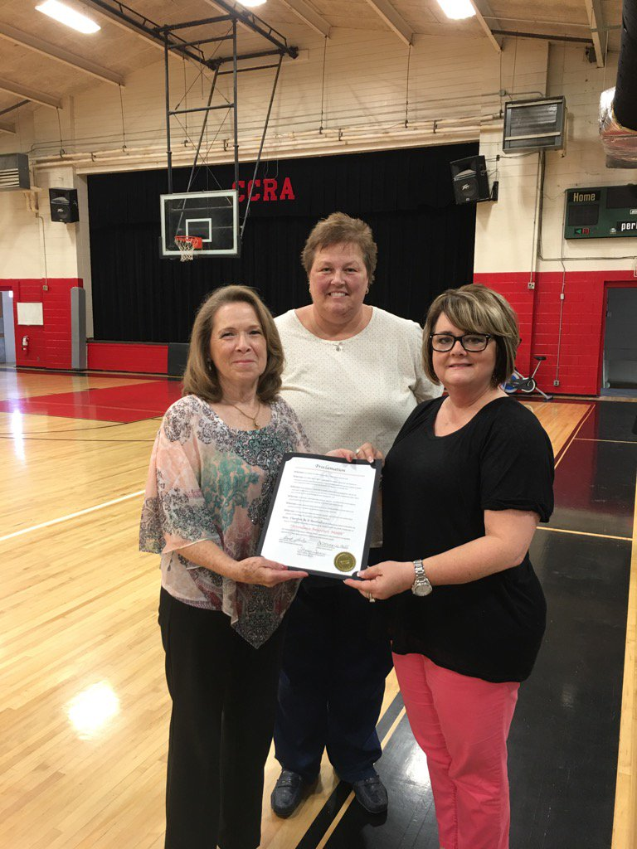
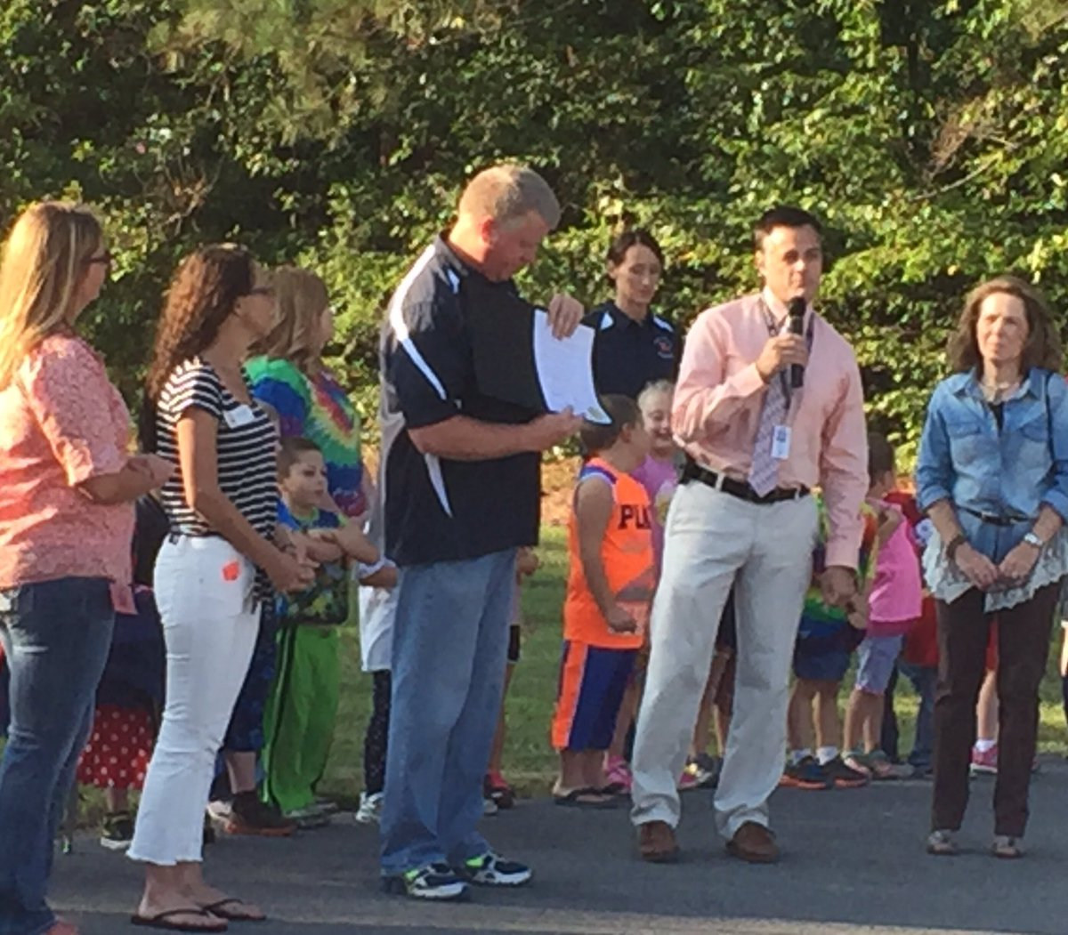
PROCLAMATION PRESENTED TO EACH SCHOOL BY BOARD MEMBERS AND SUPERVISORS

Slide 17
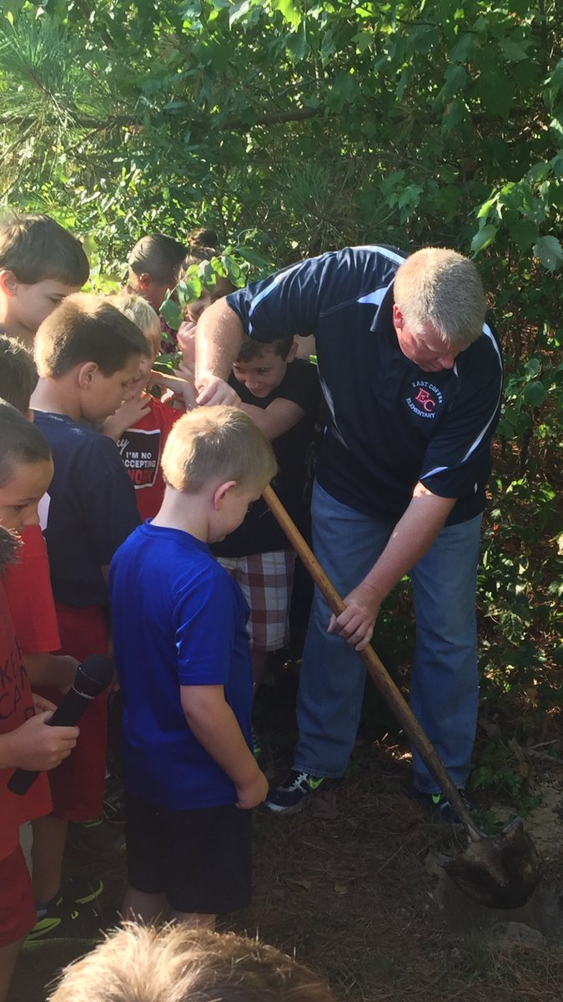
STUDENTS SET AN ATTENDANCE GOAL FOR THEMSELVES. THEY WROTE THE GOAL ON SLIPS OF PAPER THAT WAS PLACED IN A TIME CAPSULE THAT WAS BURIED. THE TIME CAPSULE WILL BE DUG UP AT THE END OF THE SCHOOL YEAR FOR THE STUDENTS TO PROVE THEY MET THEIR GOAL.

Slide 18
East Coffee – Droid Arial Photo of the percentage they are striving to achieve

Slide 19
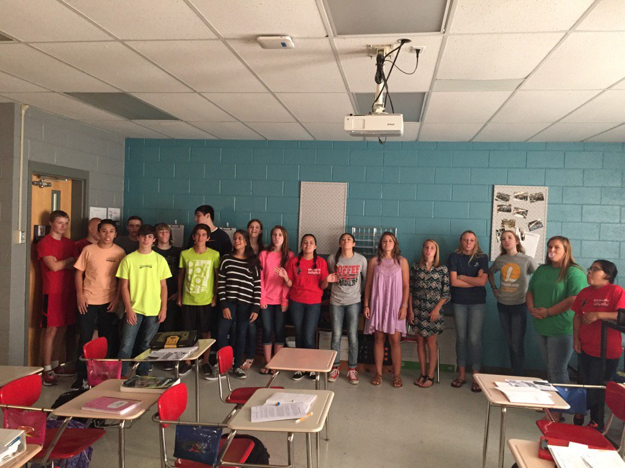
Blowing Attendance Awareness out of the Water

Slide 20
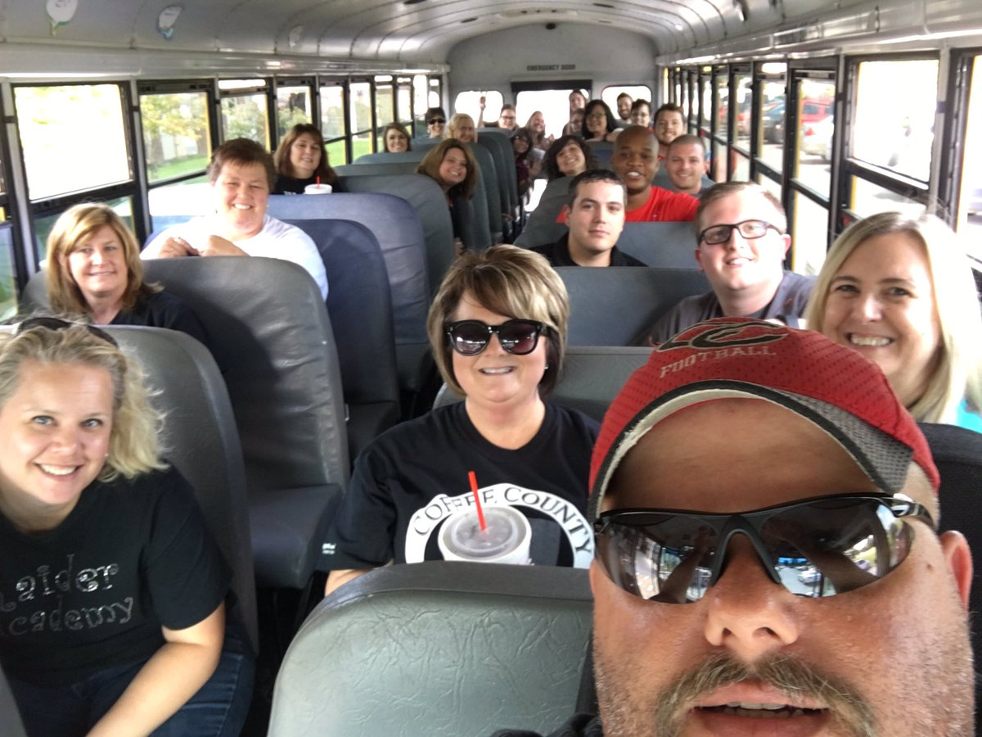
RoadTrip
ROAD TRIP
LEARNING BARRIERS THAT IMPACT KIDS

Slide 21
Road to Success is Good Attendance
STUDENTS DRESS IN COLLEGE COLORS OF THEY UNIVERSITY THEY HOPE TO ATTEND IN THE FUTURE.

Slide 22
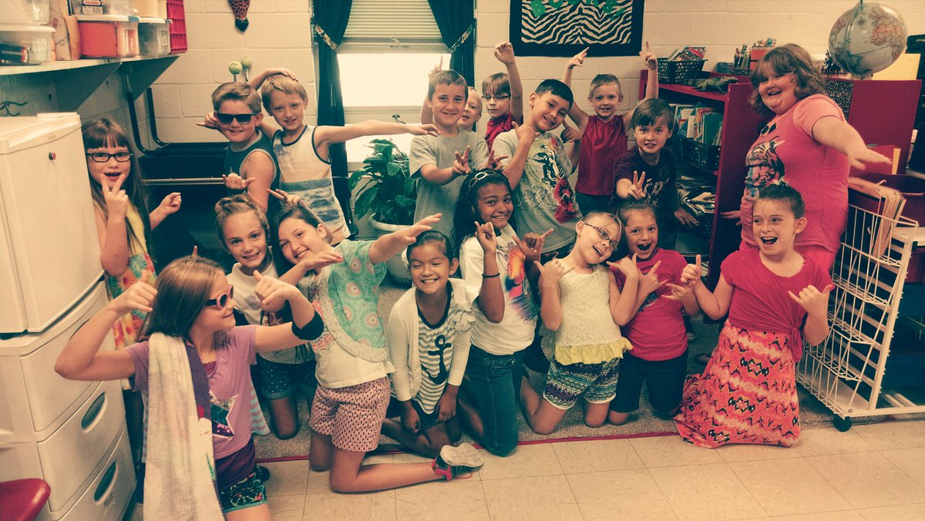
Cool to Attend School

Slide 23
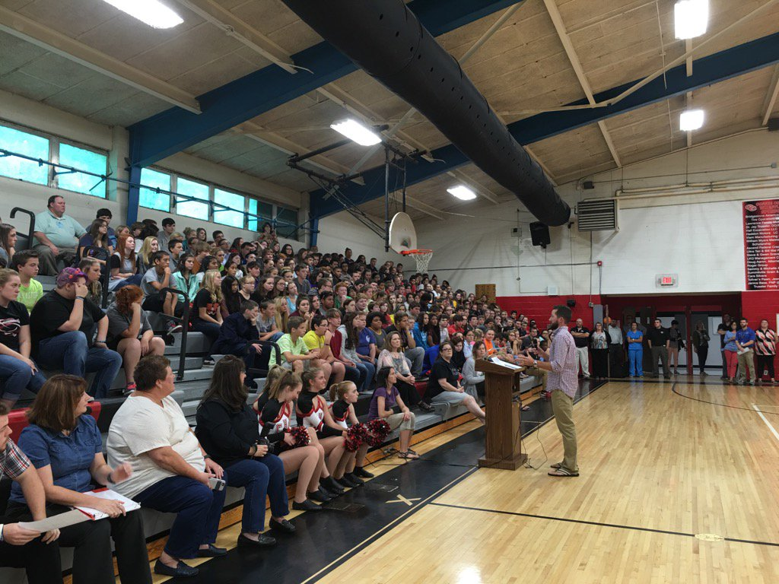

Slide 24
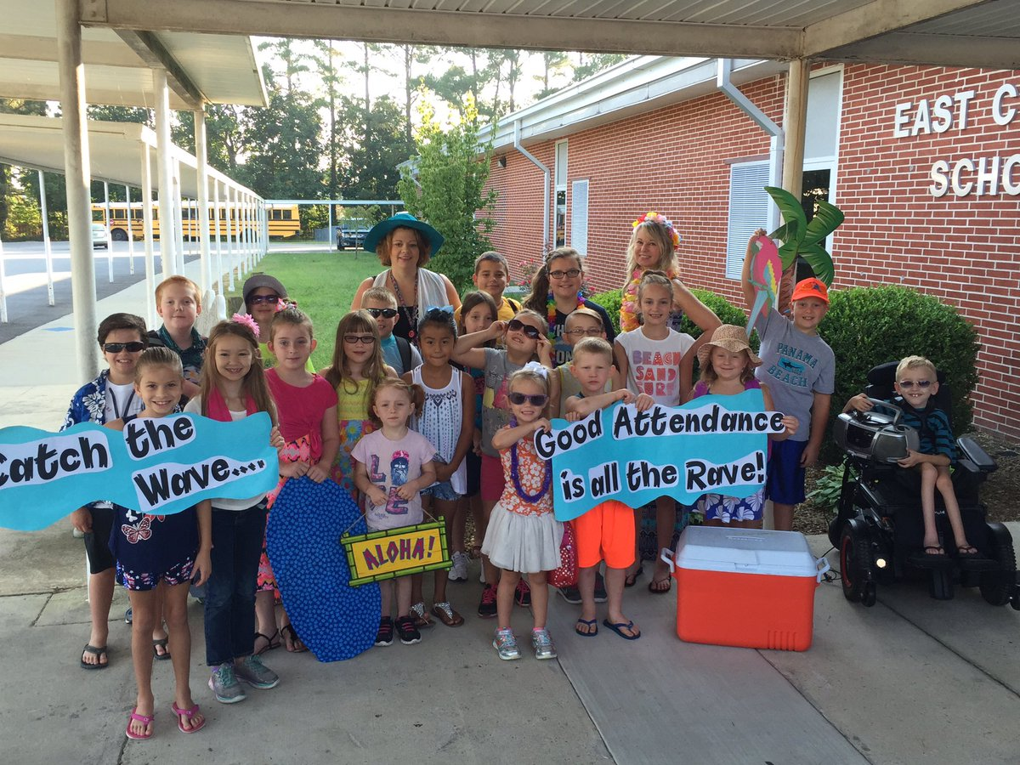
POOL DAYS ARE COOL BUT SO IS SCHOOL

Slide 25
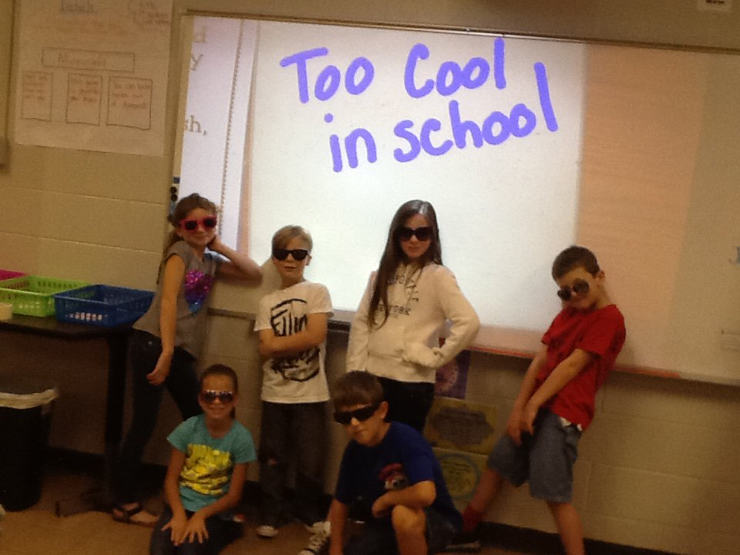
TOO COOL IN SCHOOL

Slide 26
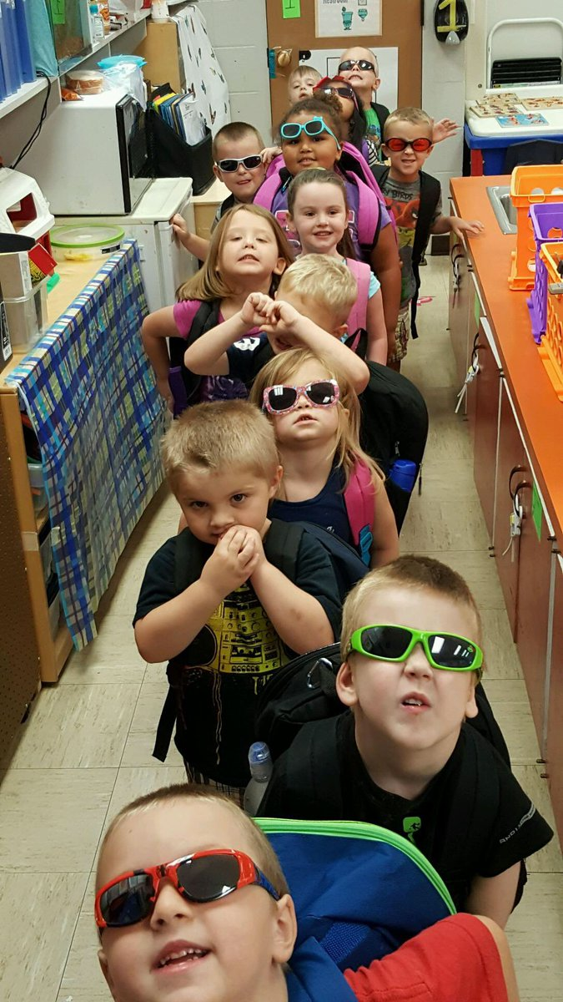
Attending school is SO BRIGHT that we need our shades.

Slide 27
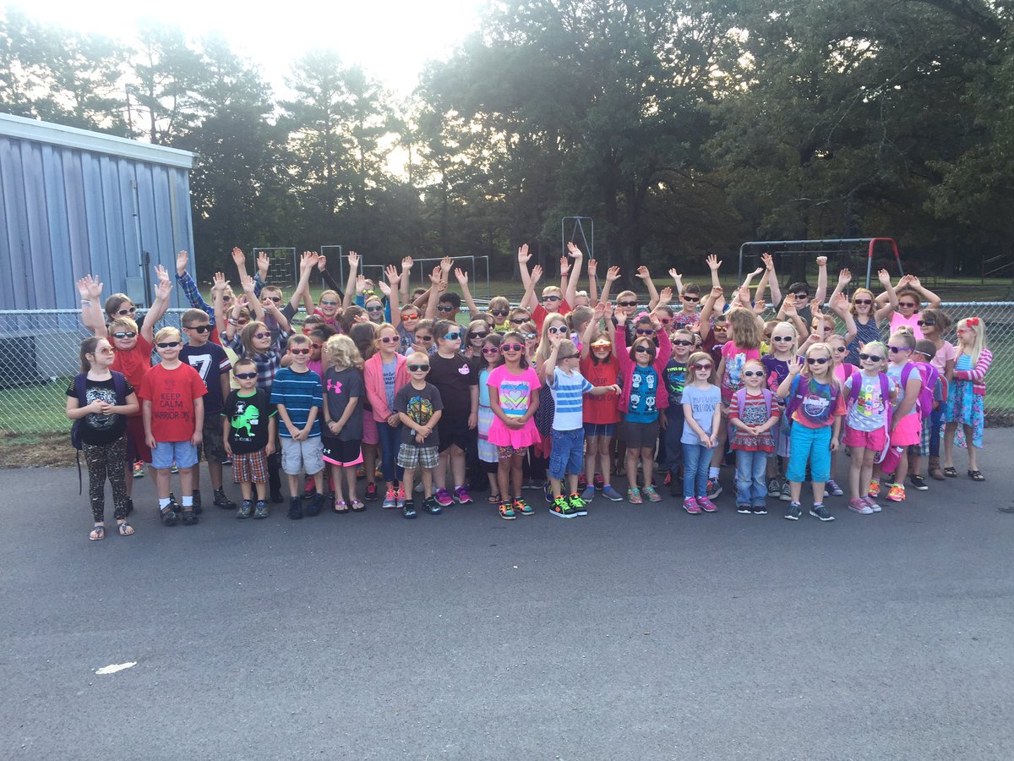

Slide 28
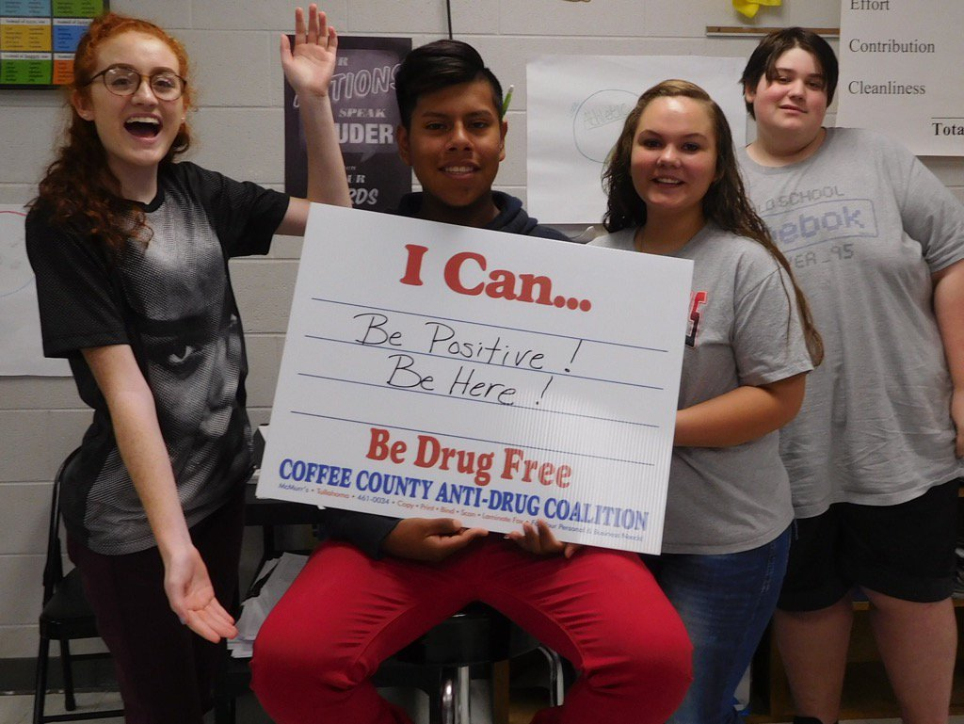
Signs for Attendance Pep-Rally

Slide 29
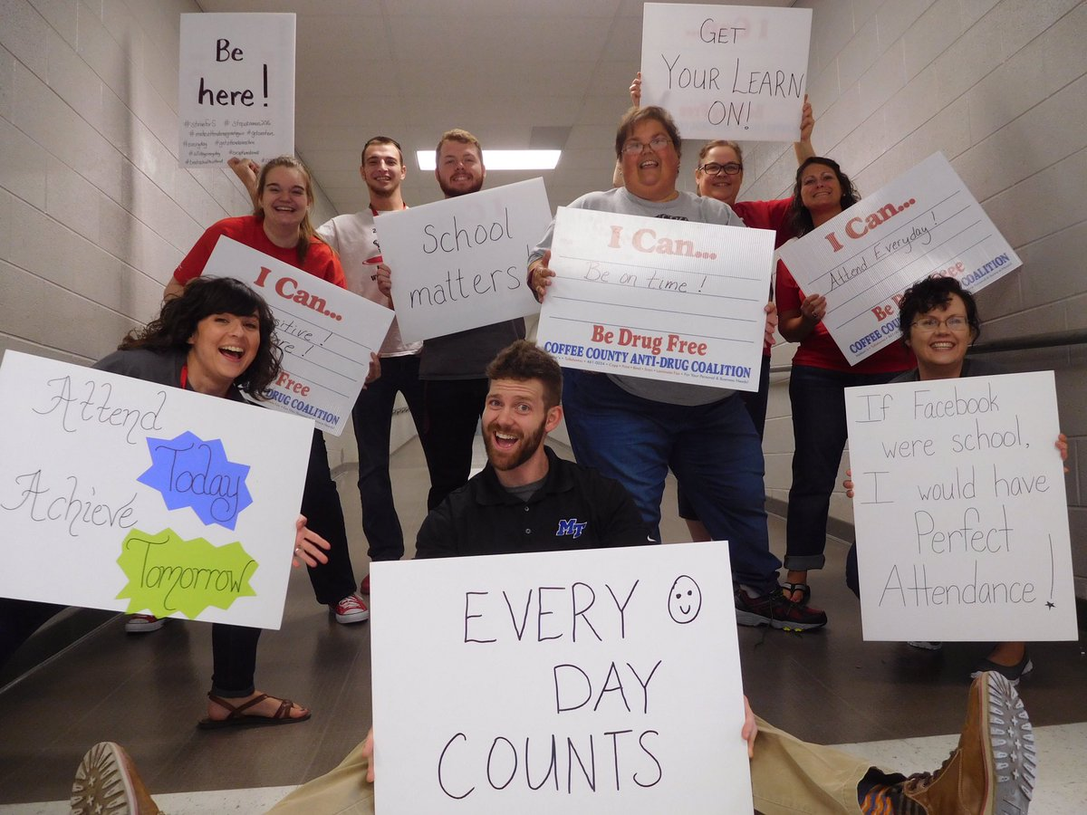

Slide 30
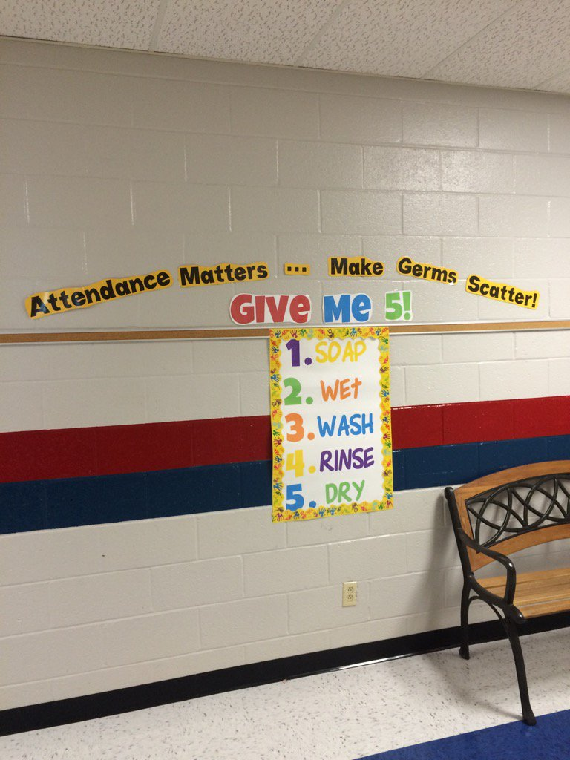
THE HEALTH CARE DEPARTMENT IN THE SCHOOLS ARE PROMOTING GOOD ATTENDANCE IN THEIR MESSAGE TO START OFF THE YEAR.

Slide 31
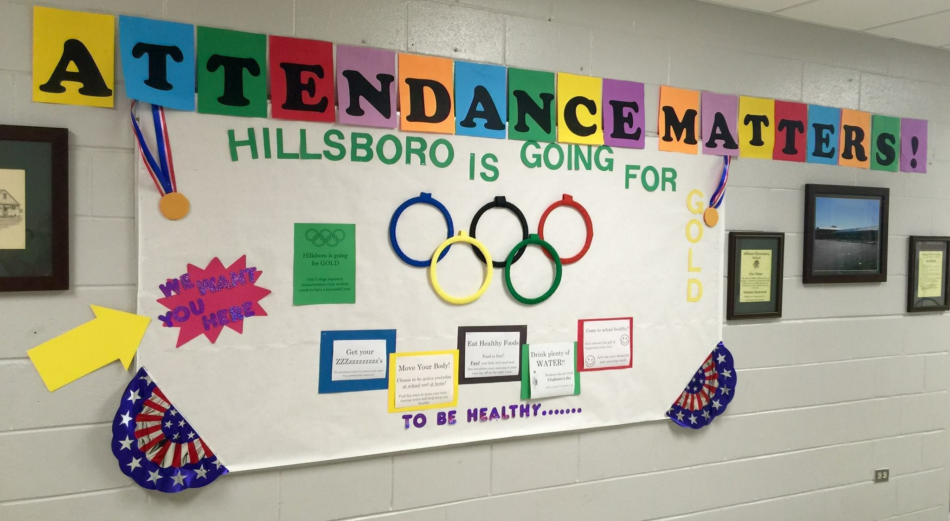

Slide 32
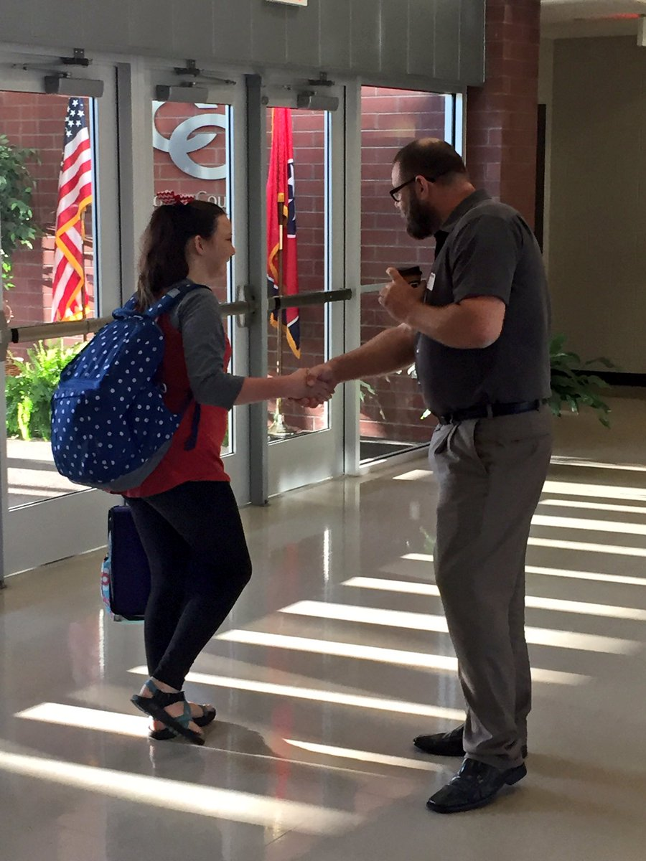
CEO Partners Welcome Students to School
Their Focus is on soft skills and
The importance of attendance

Slide 33
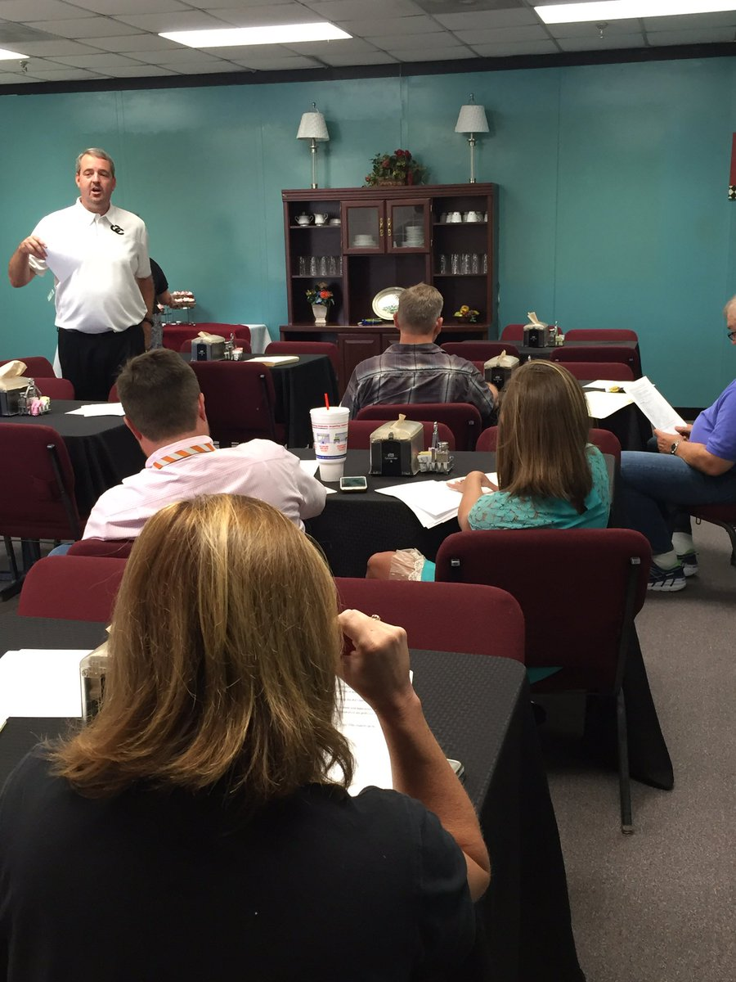
TOP 100
The top 100 are students at the high school who have been identified as potential dropouts. These students are assigned a mentor from our CEO partners.

Slide 34
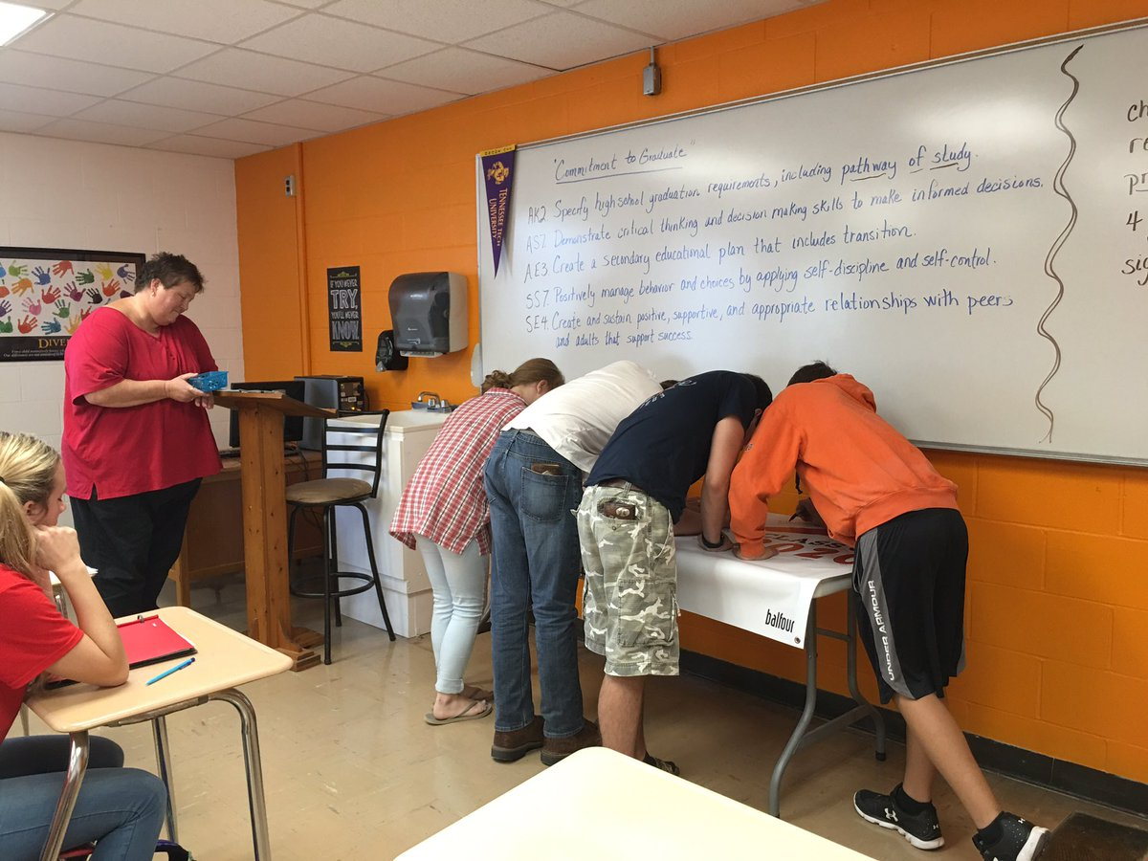
Improving or Achieving Your Goals
Signing Contract of
Commitment to
Graduate

