Slide 1
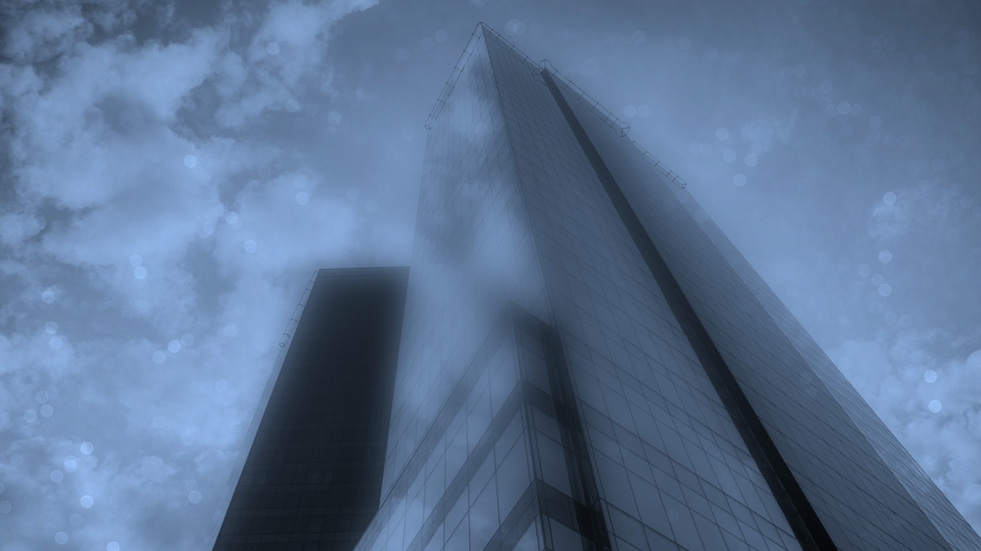
Create Trusted Transformative Partnerships
www.dchem.com

Slide 2
DCT Capabilities
Create Trusted Transformative Partnerships
Diversified Chemical Technologies (DCT)
Institutional & Quick-Serve
Food & Beverage
HealthCare
Custom Product Development
Private Label & Co-Branded
Proprietary Cleaners for Food Prep & Serve Environments & Applications
Heavy Duty Degreasers, Floor & Hard Surface Cleaners, to Cutting Board Restorers, etc.
COP / CIP Cleaners & Sanitizers for Food & Beverage Manufacturers
Cleaning & Sanitizing products from Clean-in-Place to Clean-out-of-Place Applications
Disinfectants & Sanitizers
EPA registered & FDA Approved, Non-Toxic, Non-Flammable, Biodegradable Applications
Custom R&D for Unique or Specialty Applications
Proven Track Record:
+30 Yrs of success designing & building custom solutions
Flexible Supply Chain for Customer Focused Alignment
Ability to Mfg., Package, & Brand to Customer Needs
And, the DCT “Jan-San” Portfolio of Products
CONFIDENTIAL

Slide 3
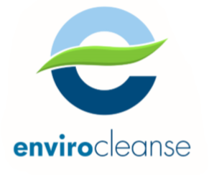
Multi-Purpose Disinfectant / Sanitizer
Envirocleanse is the Natural evolution of Disinfectant / Sanitizer, based on the science of Hypochlorous Acid (HOCL)
Powerful
Safe
Stable
Versatile
100x more effective than household bleach
FDA Approved &
EPA Registered
Supplied RTU (Ready To Use)
Fit for Use in Disinfection / Sanitization of:
EPA “List N” cited Disinfectants for Use Against SARS-CoV-2, the coronavirus that causes COVID-19
Green Innovation
Neutral pH
Non-Toxic
Non-Flammable
Bio-degradable
6-month Shelf Life for Disinfection
vs.
Industry Standard of 30 days
Hard Surfaces
Water Treatment
Food Prep
Wound Care
CONFIDENTIAL

Slide 4
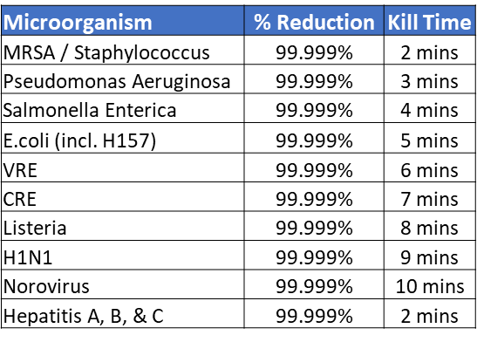
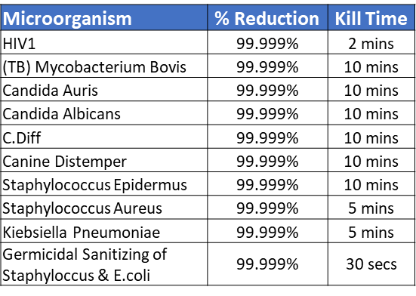
Envirocleanse - A
Multi-Purpose Disinfectant / Sanitizer
In hospitals, clinics, nursing homes and other medical facilities, Envirocleanse-A is an effective tool to eliminate bio-films, bacteria, viruses and fungi:
Powerful
Hard surface disinfection for beds, wheelchairs, restrooms, and medical equipment
Apply to disinfect as part of deep cleaning protocols or for rapid decontamination
Non-Corrosive & Highly Compatibility with Hard Surfaces to be cleaned: metals, plastics, & more.
100x more effective than household bleach
EPA “List N” cited: Disinfectants for Use Against SARS-CoV-2, the coronavirus that causes COVID-19
CONFIDENTIAL
Notes:
Powerful: A Bactericide, Virucide, and Fungicide that is 100x more effective than Bleach at killing pathogens
Kills SARS-CoV-2 (COVID-19), C.Diff, Norovirus, E-Coli, Listeria, Salmonella, HIV, MRSA, Hepatitis, H1N1, and others

Slide 5
Envirocleanse - A
Multi-Purpose Disinfectant / Sanitizer
 |  | Envirocleanse A | Traditional Disinfectant
Efficacy | Broad-Spectrum Killing: | ✓ | ✓
 | Efficacy Residence Time: Killing Power after Application & Drying |  | ✰ 
People | Non-Toxic to People & Animals | ✓ | -
 | Neutral pH | ✓ | -
 | Naturally Occurring in the body | ✓ | -
 | No PPE required for use | ✓ | -
Surfaces | Non-Corrosive |  | 
 | Food Contact Surfaces | ✓ | -
Handling | Non-Hazardous Shipping & In-House Handling | ✓ | -
Safe
Bleach
Quat.
“EPA rated nontoxic and organic, making it safe to use around kids and pets without the need for Personal Protective Equipment”
FDA Approved &
EPA Registered
Green Innovation: Neutral pH
Non-Toxic
Non-Flammable
Bio-degradable
CONFIDENTIAL
Notes:
Safe: HOCl is produced naturally in our bodies by our white blood cells to fight infections
Non-Toxic: FDA Approved & EPA Registered
Neutral pH: High Compatibility with a broad range of Hard Surfaces to be cleaned
Non-Flammable, Bio-Degradable: Non-Hazmat shipping

Slide 6
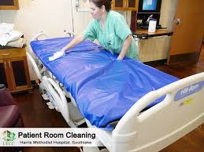
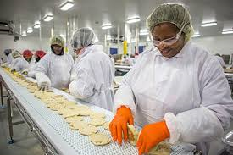
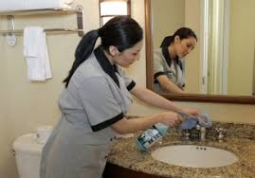
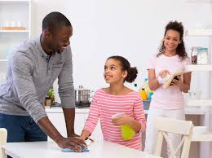
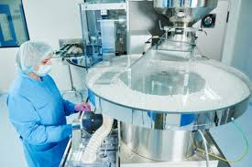
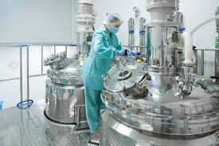
Envirocleanse - A
Multi-Purpose Disinfectant / Sanitizer
Versatile
Fit for Use in Disinfection / Sanitization of:
Healthcare
Food & Bev Mfg.
Hospitality
Hard Surfaces
Food Prep & Food Contact Surfaces
Water Treatment
Food Prep & Service
Residential
Pharma
CONFIDENTIAL
Notes:
Versatile: Fit for use in Healthcare, Pharma, Food & Mfg., Prep & Service, Hospitality, or Residential use
to Disinfectant, Sanitize, & Deodorize. Versatile application from spray to electrostatic mist.

