Slide 1
Richard Fiesta
Executive Director
RFiesta@retiredamericans.org
202-637-5271
815 16th Street, NW, Washington, DC 20006
www.retiredamericans.org

Slide 2
What Is The Alliance
4.4 million members and growing
1600+ local chapters in all states
Union retirees and community members
Notes:
The Alliance for Retired Americans works to ensure social and economic justice and full civil rights for all citizens so that they may enjoy lives of dignity, personal and family fulfillment and security.
The Alliance believes that all older and retired persons have a responsibility to strive to create a society that incorporates these goals and rights and that retirement provides them with opportunities to pursue new and expanded activities with their unions, civic organizations and their communities.
The Alliance enrolls and mobilizes retired union members and other senior and community activists into a nationwide grassroots movement advocating a progressive political and social agenda-one that respects work and strengthens families.
The Alliance was launched in 2001
We have 4.3 million members and are growing
We have over 1600 local chapters and participation by unions and community groups

Slide 3
Across the States
Members in every state
34 State Alliance Affiliates and growing
Notes:
The Alliance has members in all 50 states and many territories, and we have 34 state affiliates
Affiliated states indicates elected leadership and, in most cases, staff presence

Slide 4
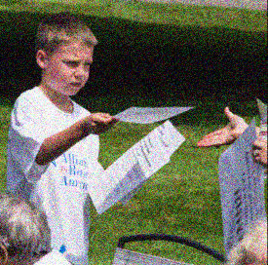
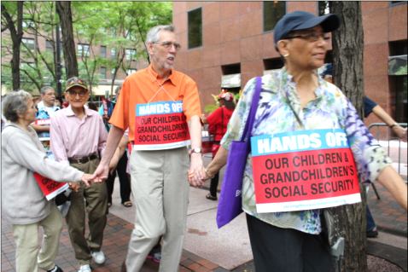
What We Do
Grassroots advocacy and actions
Legislative advocacy
Educate
Empower
Mobilize
We fight for retirement security and economic fairness for all Americans
Notes:
We fight for retirement security and economic fairness for all Americans through:
Grassroots advocacy and actions
Town halls, presentations, protests, earned media events/press conferences
Legislative advocacy
Online and offline actions and advocacy
Educate, Empower, Mobilize
Through our grassroots advocacy and action, we educate our members and the public
Through our trainings and advocacy work, we empower and mobilize activists to make a difference on the issues that matter in their lives

Slide 5
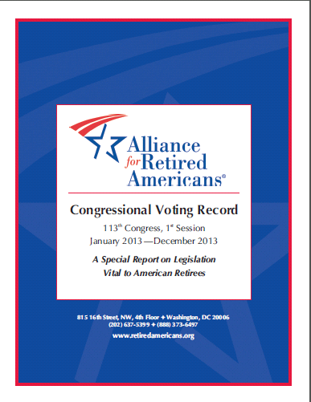
Resources
Annual Congressional Voting Record
Friday Alert newsletter weekly
Spanish-language materials
Fact sheets and reports
State leaders
Advocacy training
Notes:
Congressional Voting Record comes out each year to rate the past Congressional year on senior-relevant issues. All members of Congress receive a score for the past year and a lifetime score. This resource is great for education and advocacy. We are the only group that puts out a voting record on senior issues and it is reported on widely and used by Congressional offices.
Our Friday Alert email newsletter keeps members and supporters informed about Alliance news and retirement security issues. You can sign up to receive it at www.retiredamericans.org/signup. You will see that link on a future slide.
Alerta Semanal is our new Spanish-language translation of the Friday Alert. It comes out every Monday to summarize the past week’s news and make news about the Alliance and retirement security available to our Spanish-speaking members and supporters.
Fact sheets and reports may be found on the Alliance website www.retiredamericans.org. They cover a wide variety of topics, but focus on Social Security, Medicare and Medicaid. These fact sheets are translated into Spanish and posted on the Spanish language page www.alianzadejubilados.org.
Many of the Alliance’s chartered states have field organizers who cross the state organizing retirees.
The Alliance holds advocacy trainings on various issues at local state meetings, state conventions and of course at their national annual conventions.

Slide 6
False Promises: Candidate Trump Said
No cuts to Social Security
No cuts to Medicare or Medicaid
Allow Medicare to negotiate lower prescription drug prices

Slide 7
Donald Trump Since Election
Silent on Social Security
Trumpcare – disaster for seniors
Partnering with PhRma
Budget cuts Medicaid and programs that support seniors

Slide 8
Trump Admin Targets Older Americans
Block Fidiciary Rule – costs retirees $17 billion per year
Drastic cuts to housing, employment and nutrition programs for seniors
Billions in cuts to Medicaid

Slide 9
President’s FY 2018 Budget
$5.5T in tax breaks for wealthy & corps.
Cuts $600B in Medicaid
Eliminates LIHEAP funding
Cuts Meals-on-Wheels
Zeros out senior employment program
Cuts Legal Services that fights elder abuse
Notes:
On May 23, 2017, the President released his full budget for FY 2018. His budget is irresponsible and cruel. It would add $5 trillion to the debt by giving $5.5 trillion in tax breaks to the wealthy and corporations. At the same time, his budget cuts $600 billion from Medicaid. This is on top of the $834 billion cut in the Republican health care bill, making a total cut of $1.4 trillion. The budget also cuts $5.8 billion from NIH, at a time when 10,000 baby boomers turn 65 every day and will need medical research to help combat Alzheimer’s and other diseases. Eliminates LIHEAP funding, which provides heating and cooling for seniors. It eliminates the Community Development Block Grant, which helps local communities fund home-delivered meals. It zeroes out SCSEP funding, which provides up to 20 hours of pay to help seniors supplement their income. It cuts funding for Legal Services funding, which help protect seniors from neglect, abuse and exploitation. It cuts funding the State Health Insurance Program (SHIP), which provides assistance to seniors signing up for Medicare, Med Advantage, Megigap and Part D prescription drugs. Finally, it eliminates the Community Services Block Grant, which funds programs that allows seniors to remain self-sufficient.

Slide 10
House Black Budget
Cuts Medicare by $487B, increases age of eligibility and voucherizes program
Cuts Medicaid by $1T
Cuts SSDI by $5.4B
Cuts $893B in non-defense discretionary spending
Increases defense by $72Billion

Slide 11
GOP Still Wants to Repeal ACA
Tax Breaks for Millionaires & Corporations
Keeps tax on Workers’ Health Care
16-23 million people lose insurance
$700 Billion in Medicaid cuts
Insurance premiums would increase $1,700-$14,600 per year for people aged 50-64
Notes:
Repeals 3.8% tax on unearned income as well as the Medicare 0.9% tax on individuals with incomes above $200,000 and couples with incomes above $250,000. This will be a loss of $223 billion over 10 years and is a huge windfall for the wealthy. The repeal of the tax on insurers, drug makers and medical device manufacturers is also windfall to those industries. Millionaires will get a $50,000 tax breaks and the top 1% (incomes above $3.8 million) will get almost a tax break of about $195,000 tax break.
The repeal bill keeps the excise tax on worker’s health benefits. This is referred to as the Cadillac tax, which is a tax on high cost employer-sponsored health plans. This would hit plans with more ill, disabled or older works, as well as those in regions with high health-care costs. (Originally, Republican wanted to get rid of the tax exclusion on health. This would have taxed the health care of millions of workers and raised $200 million in revenue, while providing tax breaks for millionaires. The average middle income family would have gotten taxed nearly $4,000 for their health benefits. While this is not in the current version, it could be included at some point).

Slide 12
Alliance Efforts to Protect Retiree Health Care
161 District Office meetings
30,000+ constituent calls to 300+ Capitol Hill offices
Gathered 1,000,000+ petition signatures
Protests in key districts
Highlighted the effects of ACA repeal and cuts to Medicaid on seniors

Slide 13
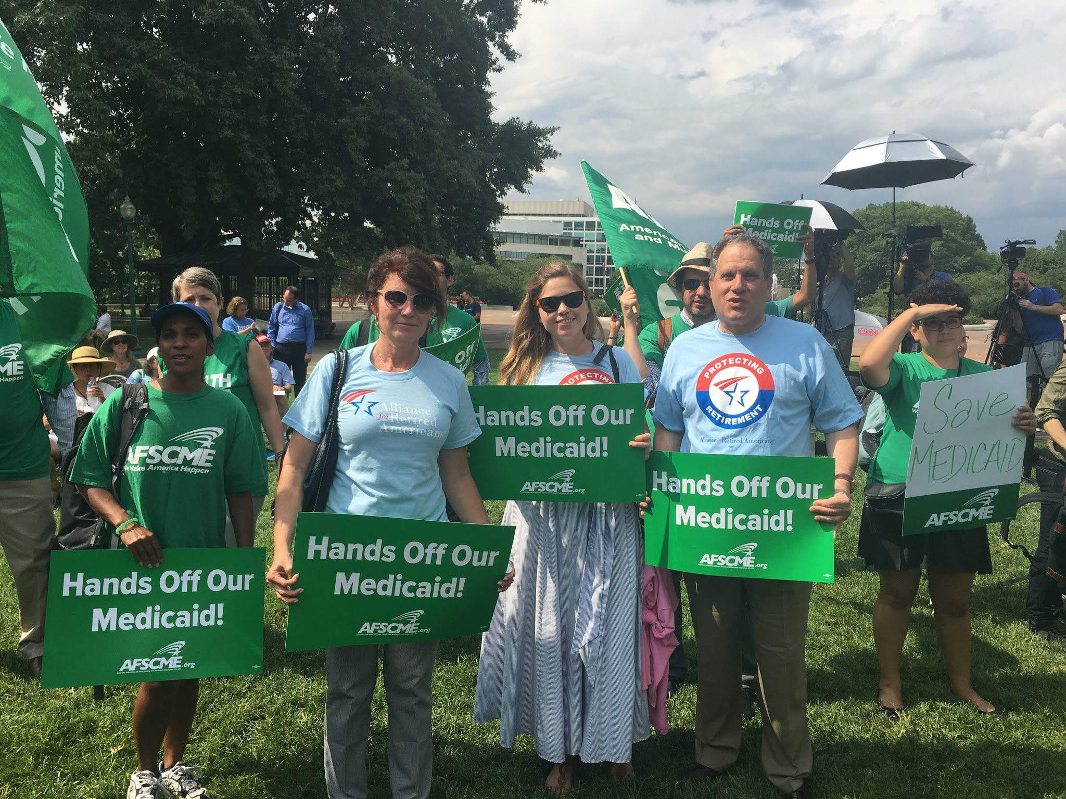
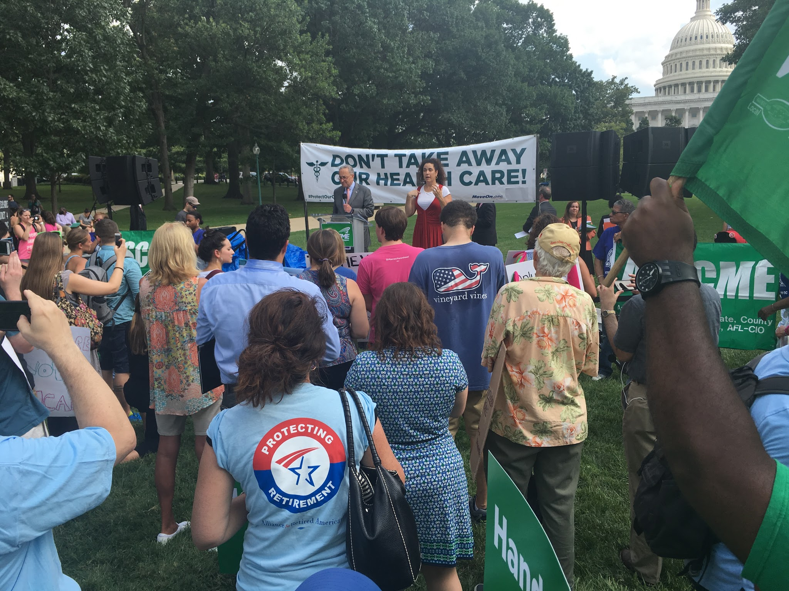
Trumpcare Protests

Slide 14
New Assault on Voting Rights
Presidential Advisory Commission on Voting Integrity
Led by Vice Chair Kris Kobach, Kansas Secretary of State
Experts expect effort to disenfranchise millions through a push for nationwide strict Voter ID

Slide 15
Voter ID Hurts Seniors
5 to 7% of all Americans don’t have passport or birth certificate
Many older Americans lack driver’s licenses
State IDs – expensive and difficult for seniors with limited transportation
www.866ourvote.org

Slide 16
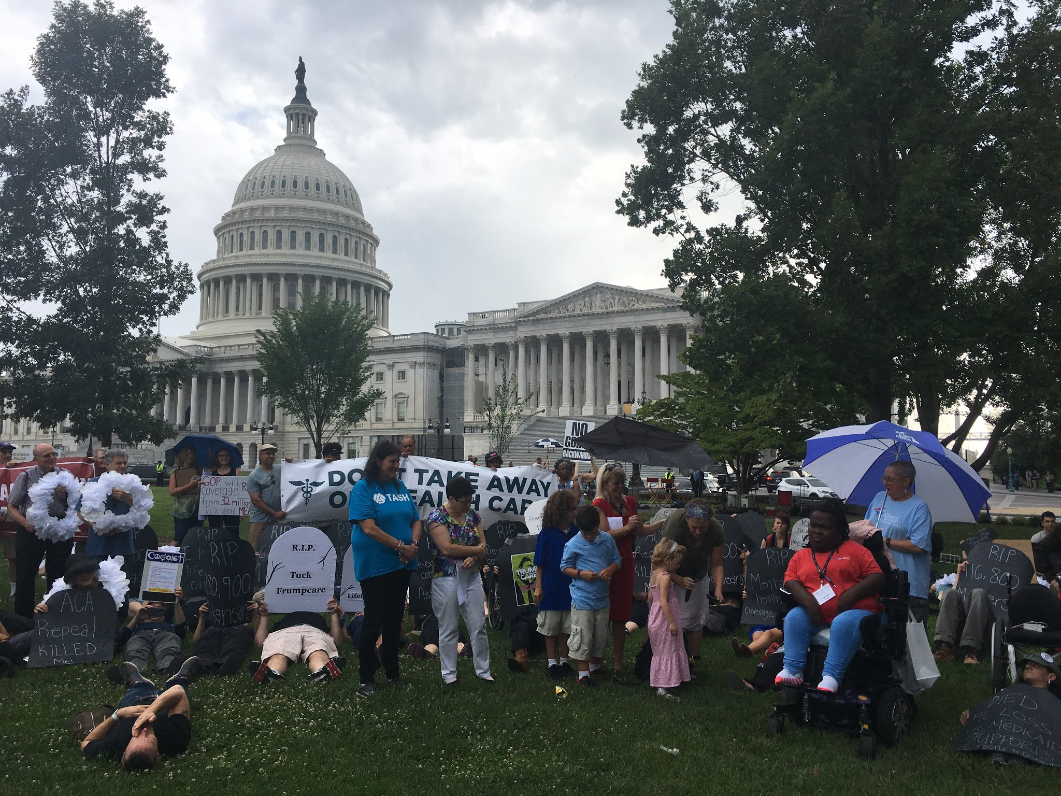
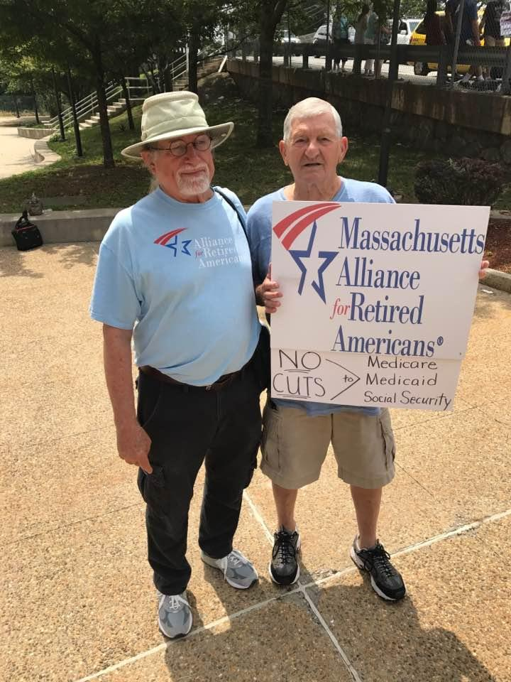
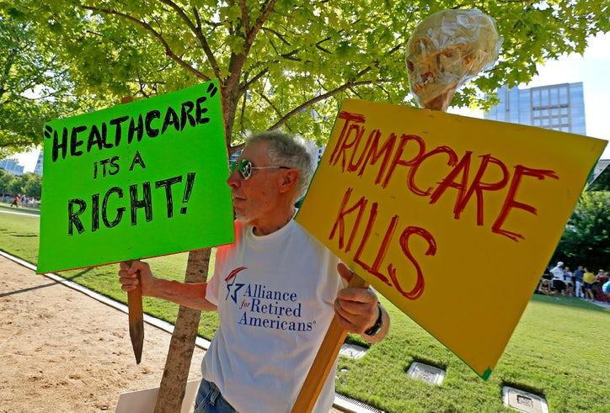
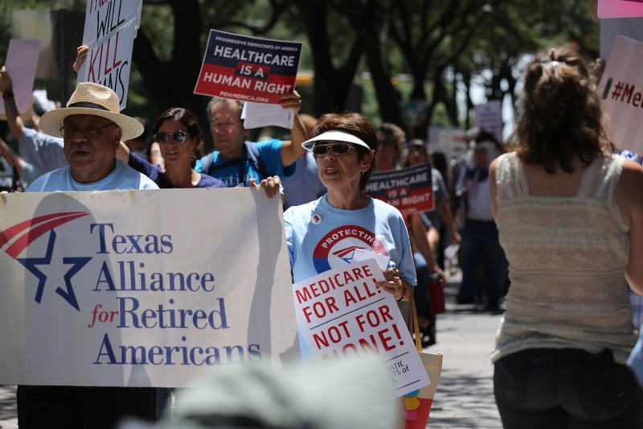

Slide 17
How to Resist Trump and GOP Congress?
Educate
Organize
Mobilize
Voter Protection – 33 states now have Voter ID laws (18 require a photo ID)

Slide 18
Follow Online, Spread the Word
www.retiredamericans.org
Facebook.com/retiredamericans
@activeretirees and @RFiestaARA
Youtube.com/retiredamericans
*Sign up for email updates: www.retiredamericans.org/signup
Notes:
Please visit and use resources from our website.
We are active on Facebook and Twitter. Be sure to follow us there.
If you want to check out videos and photos, see our YouTube and Flickr streams.
*SIGN UP FOR EMAIL UPDATES AT WWW.RETIREDAMERICANS.ORG/SIGNUP*

