Slide 1
Kennewick Man & Woman of the Year Banquet
Title Sponsor:
Presented by:
Soroptimist International of Pasco-Kennewick
and the
Kennewick Past Men of the Year Club

Slide 2
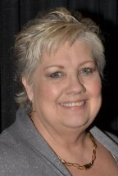
Woman of the Year 2014
René Pepiot Norman

Slide 3
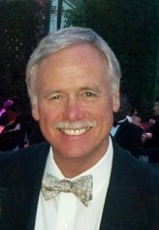
Man of the Year 2014
Glen Marshall

Slide 4
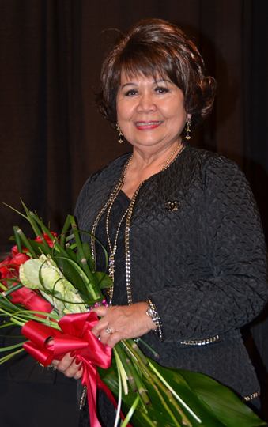
Woman of the Year 2013
Josie
Wannarachue

Slide 5
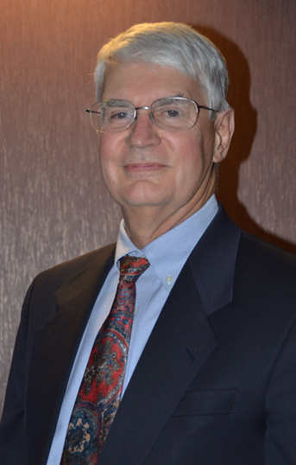
Man of the Year 2013
Art King

Slide 6
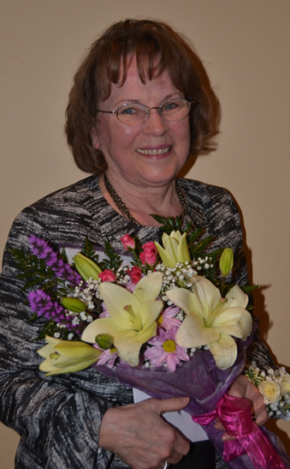
Woman of the Year 2012
Donna Vance

Slide 7
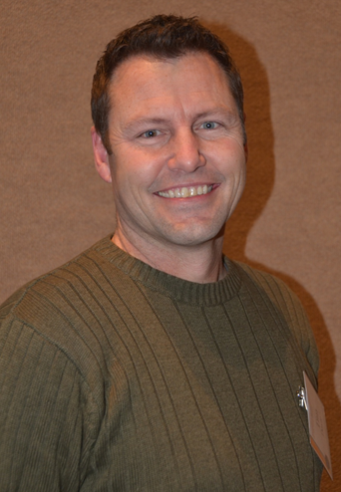
Man of the Year 2012
Tim Doyle

Slide 8
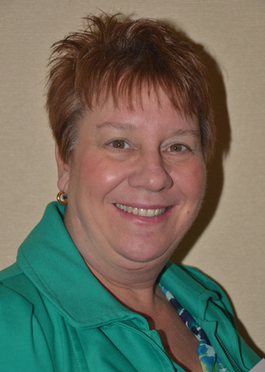
Woman of the Year 2011
Barbara Johnson

Slide 9
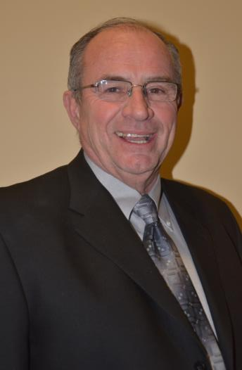
Man of the Year 2011
Dennis Poland

Slide 10
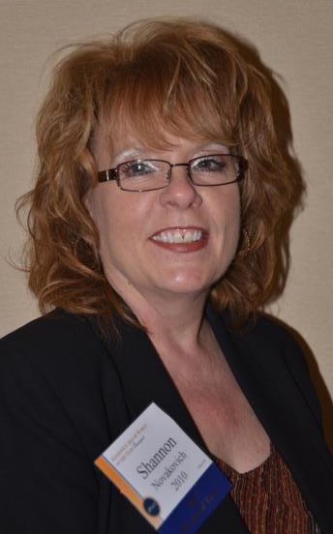
Woman of the Year 2010
Shannon
Novakovich

Slide 11
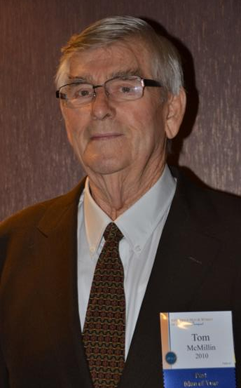
In Memoriam Man of the Year 2010
Tom McMillin

Slide 12
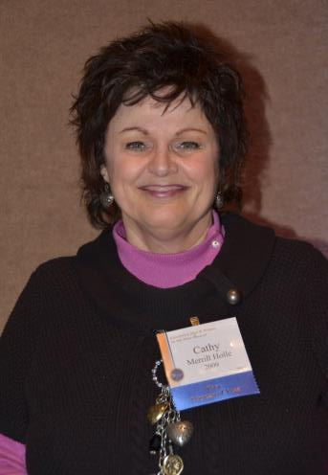
Woman of the Year 2009
Cathy Holle

Slide 13
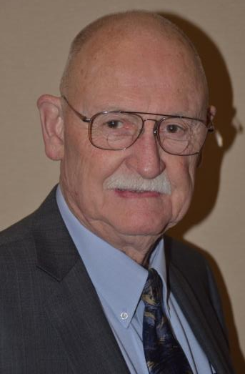
Man of the Year 2009
Paul Parish

Slide 14
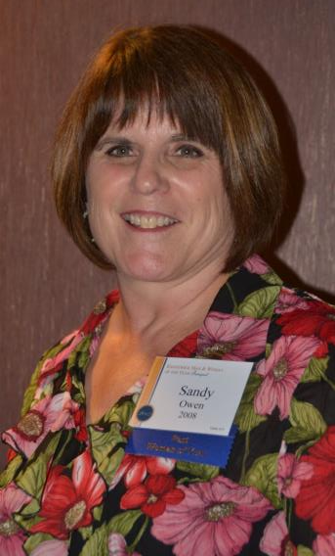
Woman of the Year 2008
Sandy Owen

Slide 15
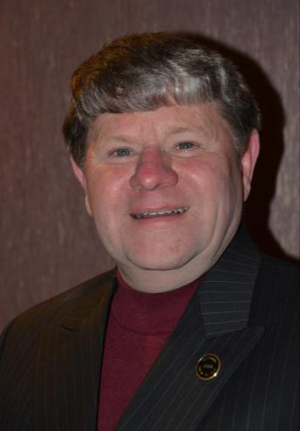
Man of the Year 2008
Hank Sauer

Slide 16
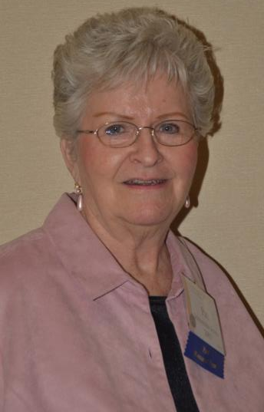
Woman of the Year 2007
Pat Johnstone
Jones

Slide 17
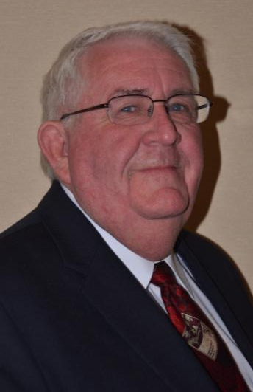
Man of the Year 2007
John Givens

Slide 18
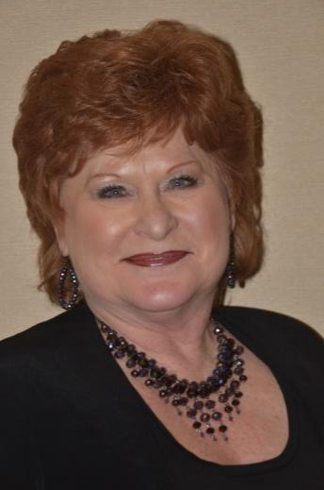
Woman of the Year 2006
Sandi Strawn

Slide 19
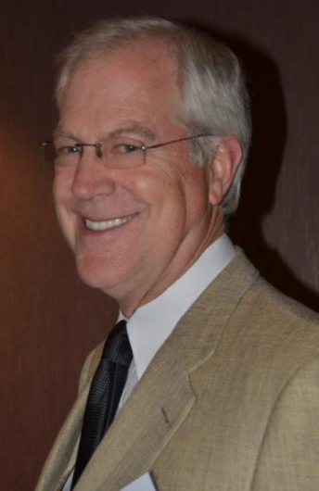
Man of the Year 2006
Craig Eerkes

Slide 20
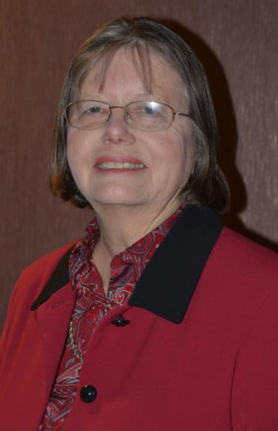
Woman of the Year 2005
Bonnie Taylor

Slide 21
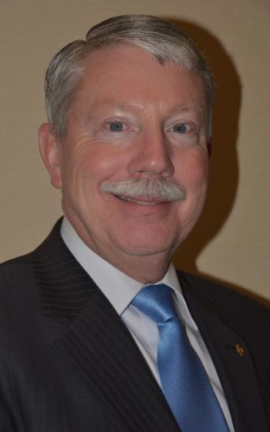
Man of the Year 2005
Ken Hohenberg

Slide 22
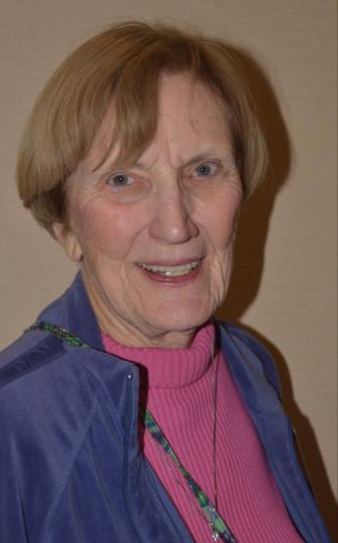
Woman of the Year 2004
Audrey
Simmelink

Slide 23
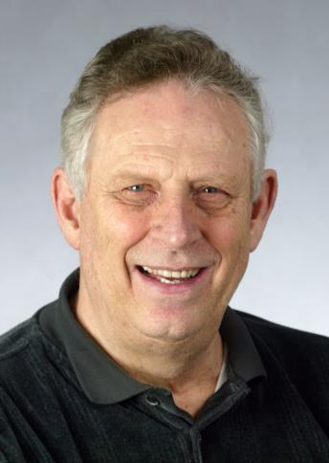
In Memoriam Man of the Year 2004
Bob Woehler
Photo courtesy Tri-City Herald

Slide 24
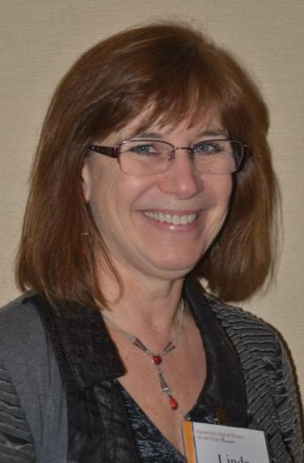
Woman of the Year 2003
Linda Boomer
Esparza

Slide 25
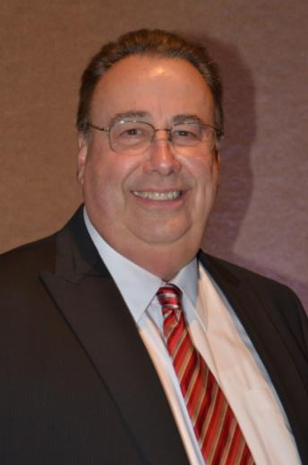
Man of the Year 2003
Ken
Johanning

Slide 26
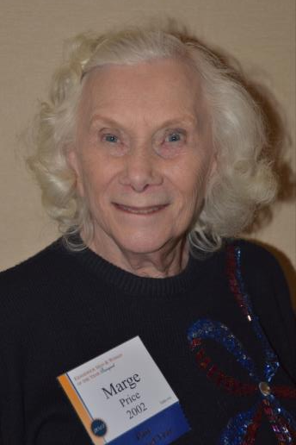
Woman of the Year 2002
Marge Price

Slide 27
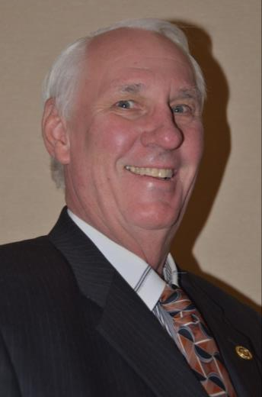
Man of the Year 2002
Ed Allen

Slide 28
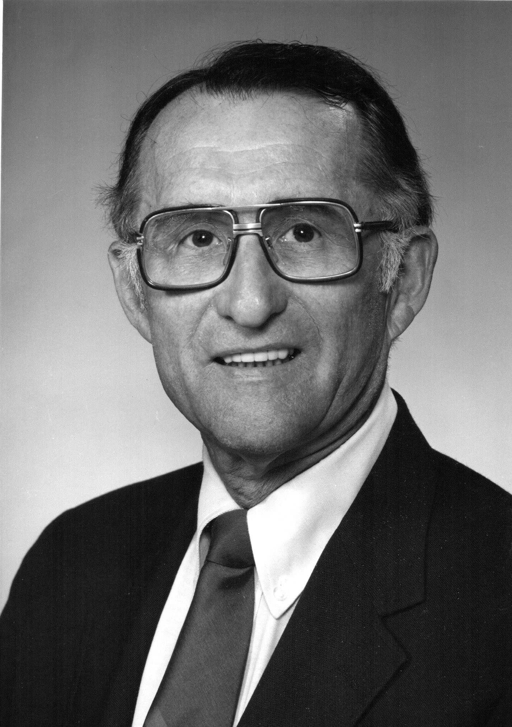
In Memoriam Lifetime Achievement 2002
Jim Mokler

Slide 29
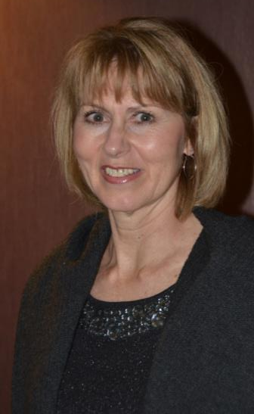
Woman of the Year 2001
Beverly
Abersfeller

Slide 30
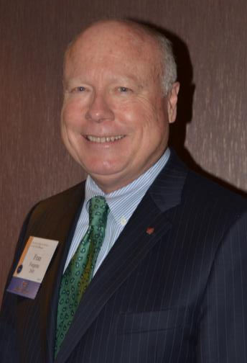
Man of the Year 2001
Fran Forgette

Slide 31
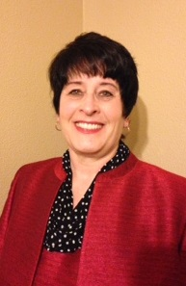
Woman of the Year 2000
Vickie Bergum

Slide 32
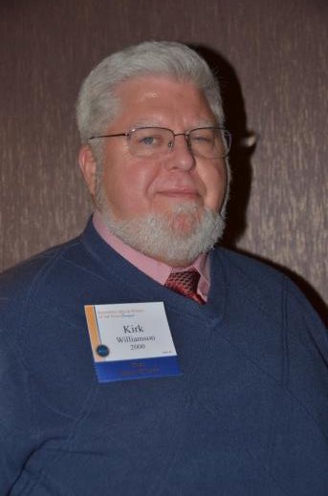
Man of the Year 2000
Kirk Williamson

Slide 33
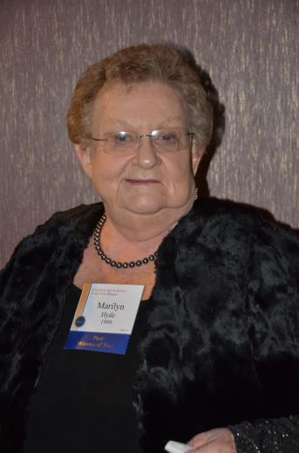
Woman of the Year 1999
Marilyn Hyde

Slide 34
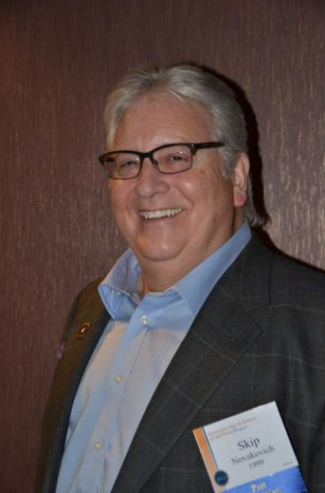
Man of the Year 1999
Skip Novakovich

Slide 35
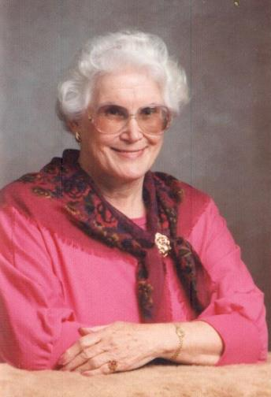
In Memoriam Woman of the Year 1998
Jean Carol Davis
Photo courtesy Tri-City Herald

Slide 36
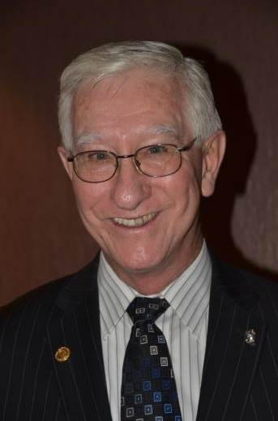
Man of the Year 1998
Dean Strawn

Slide 37
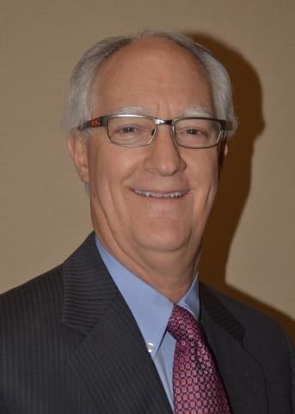
Man of the Year 1997
Gerald Berges, OD

Slide 38
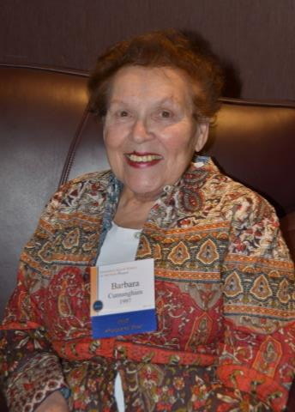
Woman of the Year 1997
Barbara “BC”
Cunningham

Slide 39
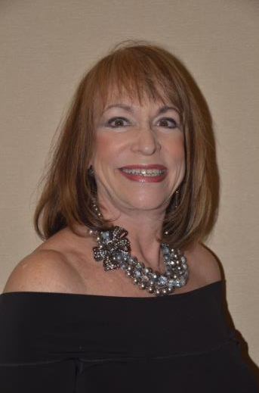
Woman of the Year 1996
Sondra Wilson

Slide 40
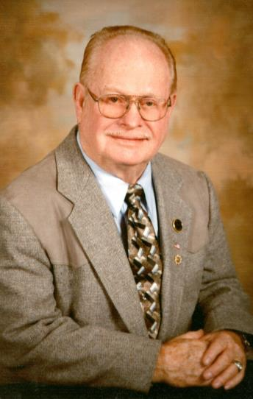
In Memoriam Man of the Year 1996
Victor “Red” Rutherford

Slide 41
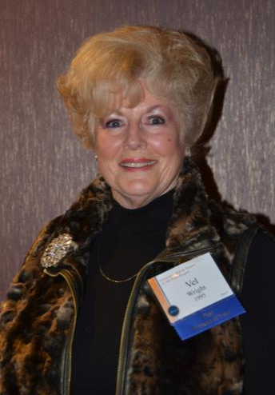
Woman of the Year 1995
Vel Wright

Slide 42
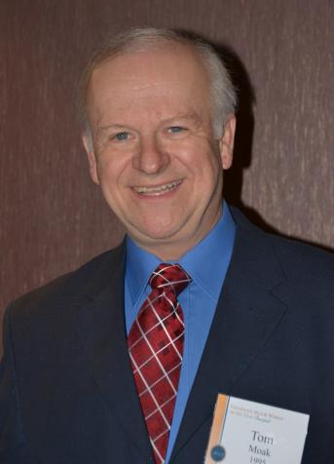
Man of the Year 1995
Tom Moak

Slide 43
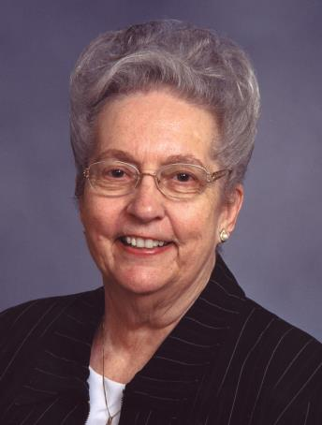
In Memoriam Woman of the Year 1994
Shirley Painter

Slide 44
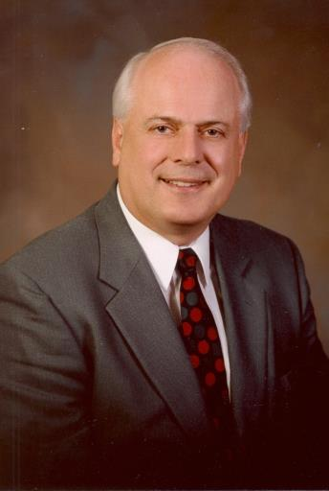
In Memoriam Man of the Year 1994
Diehl Rettig

Slide 45
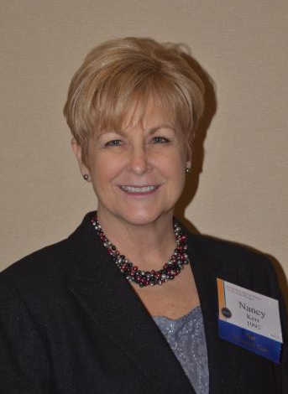
Woman of the Year 1993
Nancy Kerr

Slide 46
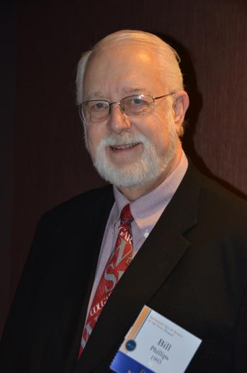
Man of the Year 1993
Rev. Bill Phillips

Slide 47
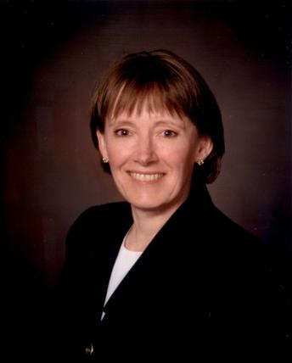
Woman of the Year 1992
Sandra Matheson

Slide 48
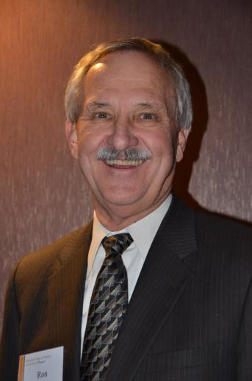
Man of the Year 1992
Ron Hue

Slide 49
In Memoriam
Dorothea Olsen
Woman of the Year 1991

Slide 50
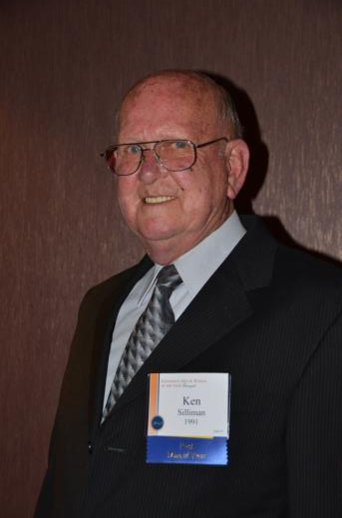
Man of the Year 1991
Ken Silliman

Slide 51
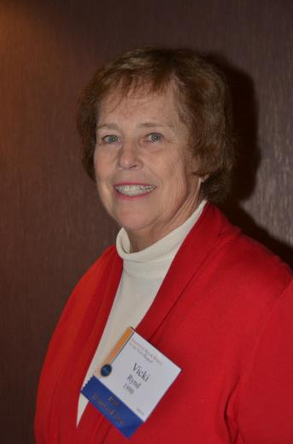
Woman of the Year 1990
Vicki Rynd

Slide 52
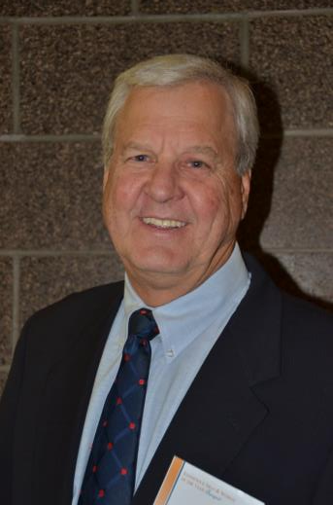
Man of the Year 1990
Bill Lampson

Slide 53
Kennewick Man & Woman of the Year Banquet
Title Sponsor:
Presented by:
Soroptimist International of Pasco-Kennewick
and the
Kennewick Past Men of the Year Club

Slide 54
In Memoriam Woman of the Year 1989
Melva Mabry

Slide 55
Man of the Year 1989
Marv Kinney

Slide 56
Woman of the Year 1988
Jacque Sonderman

Slide 57
In Memoriam Woman of the Year 1988
Carol Voss

Slide 58
Man of the Year 1988
Rick Reil

Slide 59
Woman of the Year 1987
Linda Garner

Slide 60
Man of the Year 1987
Coke Roth

Slide 61
Woman of the Year 1986
Cynthia Kittson

Slide 62
In Memoriam
Ray Elmgren
Man of the Year 1986

Slide 63
Woman of the Year 1985
Danielle Friar

Slide 64
Man of the Year 1985
Rev. Bob Waller

Slide 65
Woman of the Year 1984
Louise Gustafson

Slide 66
In Memoriam Man of the Year 1984
Don Anderson

Slide 67
Woman of the Year 1983
Inie Pepiot

Slide 68
In Memoriam
Jack Barnes
Man of the Year 1983

Slide 69
In Memoriam Man of the Year 1983
Dave Dickerson

Slide 70
Woman of the Year 1982
Geneva Davidson

Slide 71
In Memoriam Man of the Year 1982
Gene Spaulding

Slide 72
In Memoriam
Marie Tatro
Woman of the Year 1981

Slide 73
In Memoriam Man of the Year 1981
Neil F. Lampson

Slide 74
Woman of the Year 1980
Jane Foreman

Slide 75
Man of the Year 1980
Dean Mitchell

Slide 76
In Memoriam Woman of the Year 1979
Florence Starkebaum

Slide 77
Man of the Year 1979
Dr. Rod Coler

Slide 78
Woman of the Year 1978
Pat Turner

Slide 79
Man of the Year 1978
George Jones

Slide 80
In Memoriam Woman of the Year 1977
Velta Belba

Slide 81
In Memoriam Man of the Year 1977
Duane Pepiot

Slide 82
Woman of the Year 1976
Judi Clark

Slide 83
In Memoriam Man of the Year 1976
Clif LaHue

Slide 84
In Memoriam Woman of the Year 1975
Fran Spooner

Slide 85
In Memoriam Man of the Year 1975
Dr. Ralph DeBit

Slide 86
Woman of the Year 1974
Blanche Shane

Slide 87
In Memoriam Man of the Year 1974
Jerry Eerkes

Slide 88
In Memoriam
Joy Burke
Woman of the Year
1973

Slide 89
In Memoriam Man of the Year 1973
Rev. Ron Yates

Slide 90
Woman of the Year 1972
Kathy Paine

Slide 91
In Memoriam Man of the Year 1972
Joe Osborne

Slide 92
In Memoriam
Mary Fenstermacher
Woman of the Year
1971

Slide 93
Man of the Year 1971
Daniel Hurson

Slide 94
In Memoriam
Patricia McMahon
Woman of the Year
1970

Slide 95
In Memoriam Man of the Year 1970
O.C. “Dutch” Lincoln

Slide 96
Women of the Year 1960s
1960 Marilla Oliver
1961 Mildred Jordan
1962 Dorothy Eby
1963 Neva Bequette
1964 Mabel Richmond
1965 Marie Abken Elliott
Mary Louise Chapman
Margaret Shaw
Shirley Atwood
Iris Lohman

Slide 97
Men of the Year 1960s
1960 Clement Cejka
R. M. “Cork” Simmelink
John Gravenslund, Sr.
Alfred Amon
F. P. Meverden
B. Amon Mueller
James Magnuson
James French
Lyle Beavers
Kenneth Serier

Slide 98
Women of the Year 1950s
1950 Beatrice Behrman
1951 Margaret Thompson
Marion Robbins
Ruth Simmelink
Annie Sutton
Minnie Strawhun
Eula Spurgeon
Lottie Lampson
Irene Hughes
Glenna Taylor

Slide 99
Men of the Year 1950s
Frank Maupin
Glenn Felton
Paul Richmond
Edward Hopkins
J. Carrol Pratt, Sr.
Herbert Malchow
John Neuman
Manley Corderman
John Vibber
Robert Graves

Slide 100
Women of the Year 1940s
1948 Blanche Pratt
1949 Lena McCamish

Slide 101
Men of the Year 1940s
1946 Lawrence Scott
Brick Oliver
Frank Lampson
Charles Powell

