Slide 1
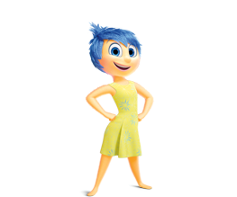
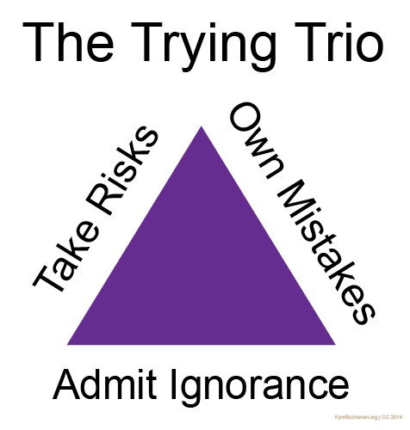
Joy, Creativity, & Play
Kym Buchanan
February 9, 2018
Joy: http://bkfk.com/insideout/Test%20your%20Memory_files/joy.png

Slide 2
As we prepare for take off…
In a moment, you'll need a Post-it note and a pen or pencil (you could also use scrap paper)
FYI: There's a takeaway handout in the #WSRA18 app (you don't need it today)
This slideshow is available at KymBuchanan.org under "SPEAKER"
Post-it notes: https://pixabay.com/p-1726554/?no_redirect

Slide 3
As an adolescent I aspired to lasting fame, I craved
factual certainty, and I thirsted for a meaningful
vision of human life
so I became a scientist.
This is like becoming an archbishop
so you can meet girls.
-Matt Cartmill

Slide 4
As a scientist I aspire to find simple, clear
uses of psychology in everyday life
so I study happiness.
This is like studying grammar
so you can tell better jokes.
-Kym Buchanan

Slide 5
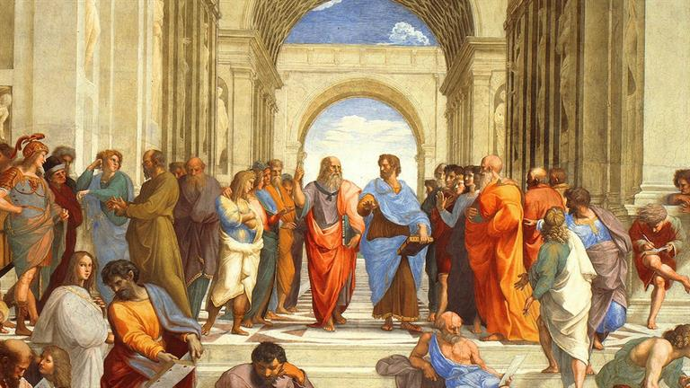
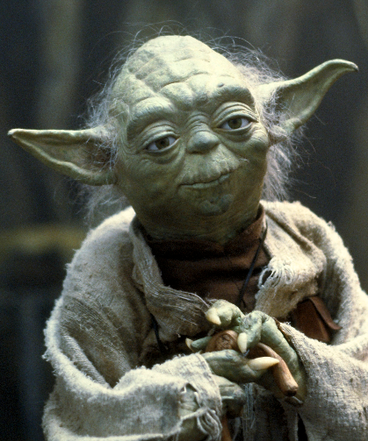
Want to be happy?
1. Think about happiness
2. But don't overthink it
Aristotle: https://pilosopiskosclcv.files.wordpress.com/2014/10/o-raphael-rooms-facebook.jpg

Slide 6
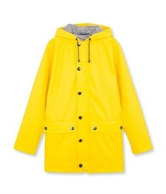
Happiness
John had
Great Big
Waterproof
Boots on;
John had a
Great Big
Waterproof
Hat;
John had a
Great Big
Waterproof
Mackintosh --
And that
(Said John)
Is
That.
jacket
http://static1.squarespace.com/static/54cbf96ce4b0d313c375636f/560046c9e4b04aa016709eb4/560046cae4b069c8e3a691ad/1442858727413/1458968_PRI.jpg?format=1000w
-A.A. Milne
(rhymes with "kiln")

Slide 7
Introductions
My story: high school teacher, psychologist, professor, administrator
My roles: educator, leader, life partner, father
My joy: family, games, psychology, cooking
What does being a "good listener" look like, sound like, & feel like?
What is your story, role, and/or joy?

Slide 8
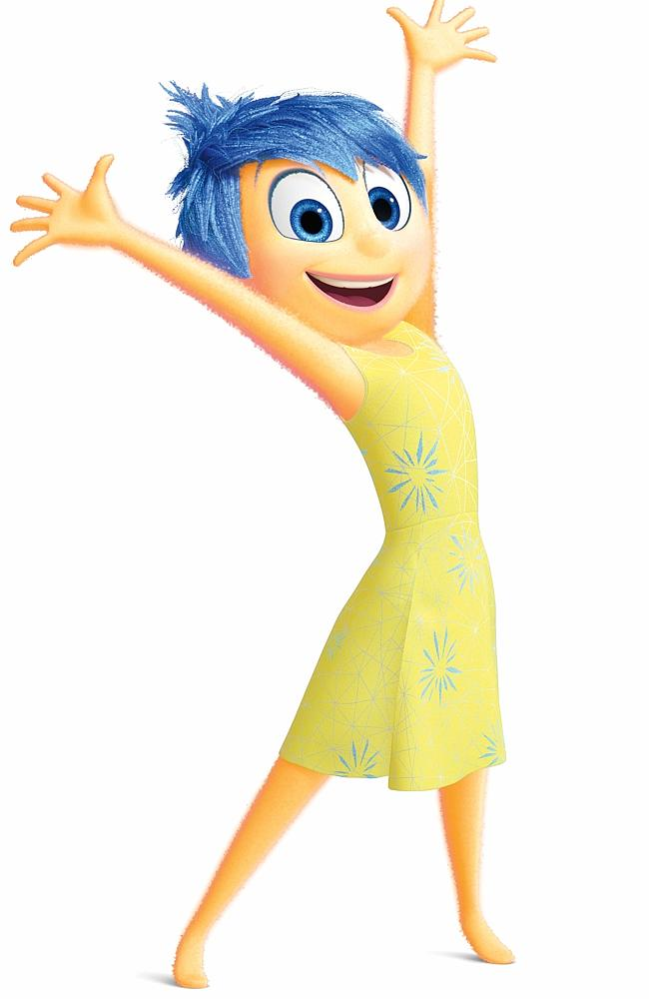
What is joy?
Joy is doing.
Joy is productive struggle.
Joy is knowing who you are.
Joy is serious business.
Joy is closeness.
http://wallpapersafari.com/w/b6CAag/

Slide 9
How often do you feel your bliss?
"I don't have time for happiness
because
I need to _________________."

Slide 10
(Heavy) Things We Carry
You won't have to share with anyone
What is one current anxiety, challenge, or goal in this area? (don't overthink this)
Personal/Family: left pocket
School/Work: right pocket
Kym's answers:
Be present with my daughters
Give this talk 5 times

Slide 11
Are the things we carry obstacles to joy,
or opportunities for joy, or what?

Slide 12
Let's get some Science! in here
First question for Science! : What are you?
Careful, systematic, intentional exploration & experimentation
Social construct that aims for objectivity
Is Science! just common sense?
Yes & No (Science! answers many questions with paradoxes)

Slide 13
Intuition
Psychology
Positive
Psychology
Happiness
Food Science
Spirituality
Ethics
Cooking

Slide 14
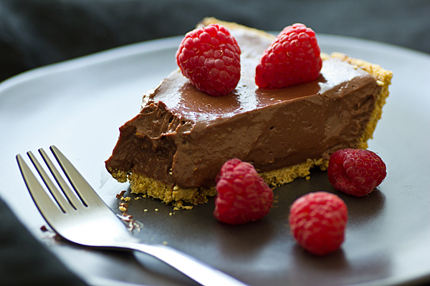
Joy often includes paradoxes
paradox: an apparent contradiction that hides a deeper truth
Kym's chocolate cream pie
Think about it, but don't overthink it
It's the journey, not the destination
The opposite of happiness isn't sadness
http://ohmyveggies.com/wp-content/uploads/2013/01/chocolate_raspberry_tofu_pie.jpg
It's fear

Slide 15
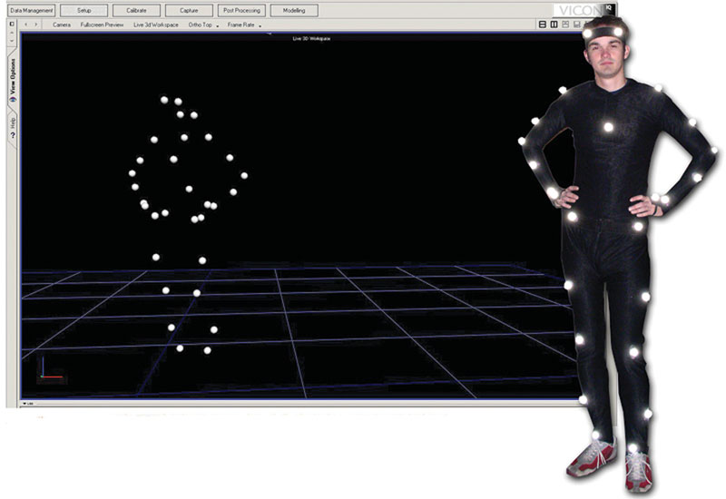
Gait Analysis
http://www.digitalstudiome.com/pictures/gallery/Pre%20and%20Post%20Production/MOCAP-2.jpg

Slide 16
Stand Like a Superhero
pixabay

Slide 17
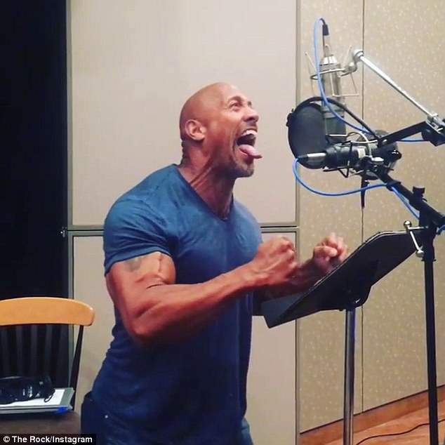
Fake it 'til you make it
Mind-body connection
See also:
Pacing to think
Gestures during a speech
Moving meditation (e.g., yoga, tai chi, qigong)
Haka (e.g., the New Zealand All Blacks)
The Rock / Instagram

Slide 18
What is joy?
Joy is doing.
Joy is productive struggle.
Joy is knowing who you are.
Joy is serious business.
Joy is closeness.

Slide 19
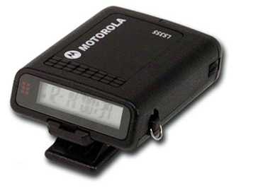
Challenge Leads to Joy
(Mihaly Csikszentmihalyi)
About the research: experience sampling
flow: a state of sustained optimal challenge; a natural high
We can teach other people what flow is and why it's desirable.
http://3.bp.blogspot.com/_j8AAWt2lEDk/SeNklUX0MhI/AAAAAAAABo0/2Smo3MBqd1Q/s400/motorola%2Bpager.png
pager

Slide 20
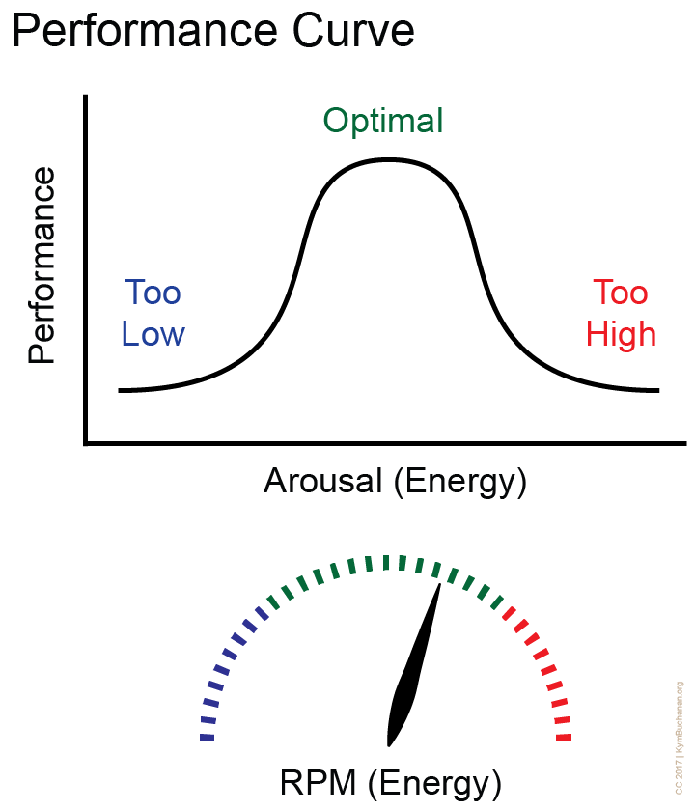

Slide 21
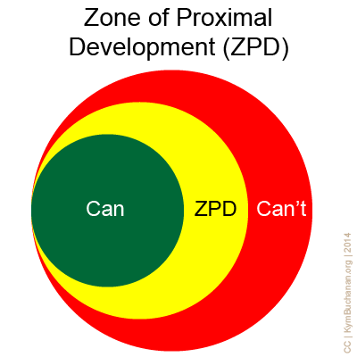
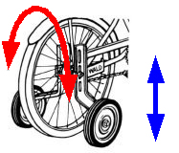
Challenge

Slide 22
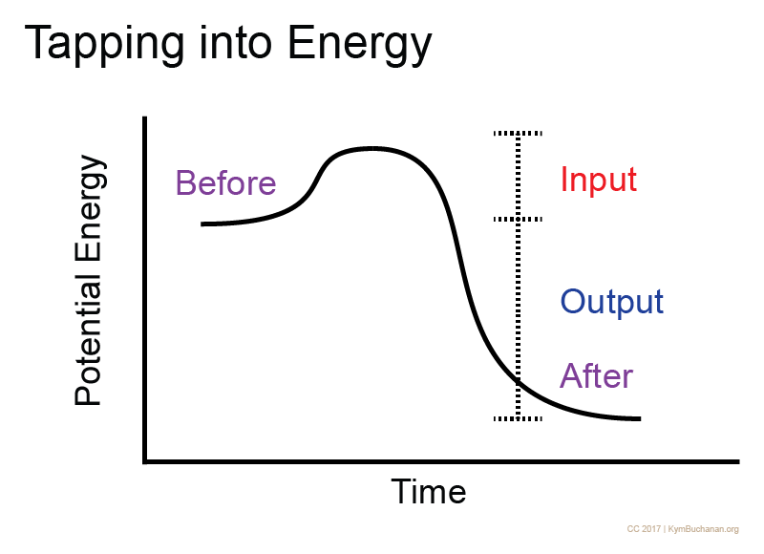
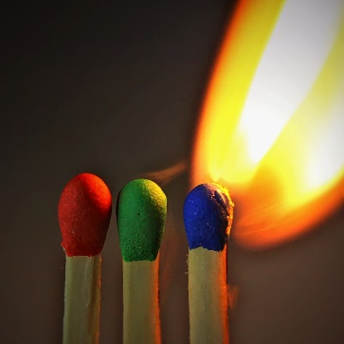
{
Grit

Slide 23
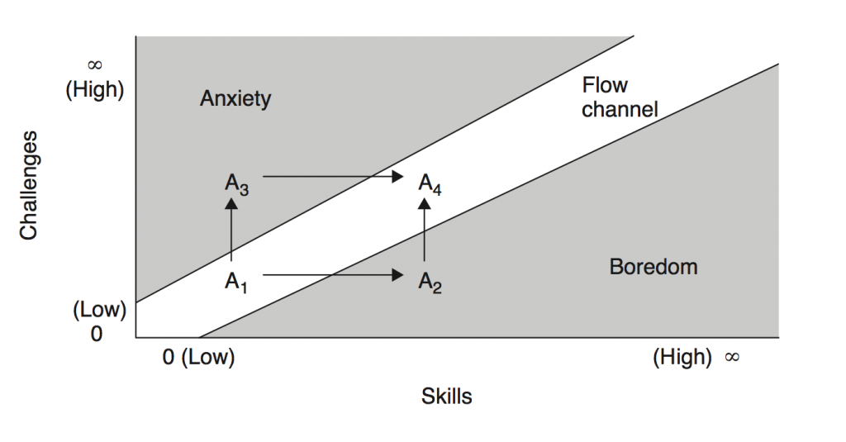
In the Groove
Too High
Too Low
What does Too High or Too Low look like?
from The Art of Game Design, by Jesse Schell

Slide 24
These behaviors are desirable because they catalyze learning. Learners who confront their ignorance and actively experiment with answers and strategies will learn faster than learners who conceal their ignorance and only passively observe.
Buchanan, K., & Cook, P. (Winter 2011-2012). Playing the Believing Game with Dr. Seuss and reluctant learners. The Journal of the Assembly for Expanded Perspectives on Learning, 17: 31-41.

Slide 25
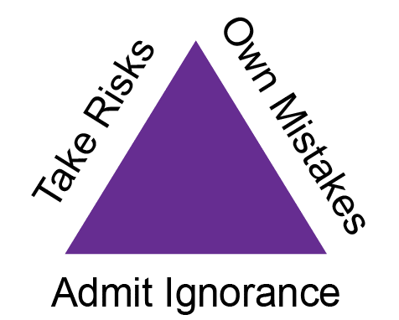
Courage
Grit (Resilience)
Ignorant
≠ Stupid
https://4.imimg.com/data4/NB/CU/NSDMERP-21369731/paperbag-250x250.png
How can you foster Trying Trio behaviors in your classroom?

Slide 26
What is joy?
Joy is doing.
Joy is productive struggle.
Joy is knowing who you are.
Joy is serious business.
Joy is closeness.

Slide 27
Basic Needs
self-determination: wanting to feel in control of your life, to feel competent
affiliation: wanting to belong, to be part of something bigger than yourself
approval: wanting the support & recognition of people you trust & admire
relatedness (i.e., intimacy): wanting close, deep, dependable relationships with others
vulnerable yet safe

Slide 28
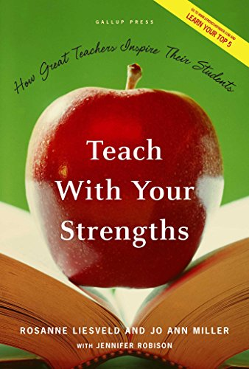
Know Your Strengths
Remind yourself
Remind others
Own them
"As a psychologist…"
"As a gamer…"
Listen to how you talk
about youself

Slide 29
Find strategies at the overlap:
Meet Your
Needs
Use Your
Strengths
Joy

Slide 30
Storytime!
Look for...
Elizabeth's strengths, and how she uses them to meet her needs
Elizabeth's self-knowledge, and how this leads her to joy

Slide 32
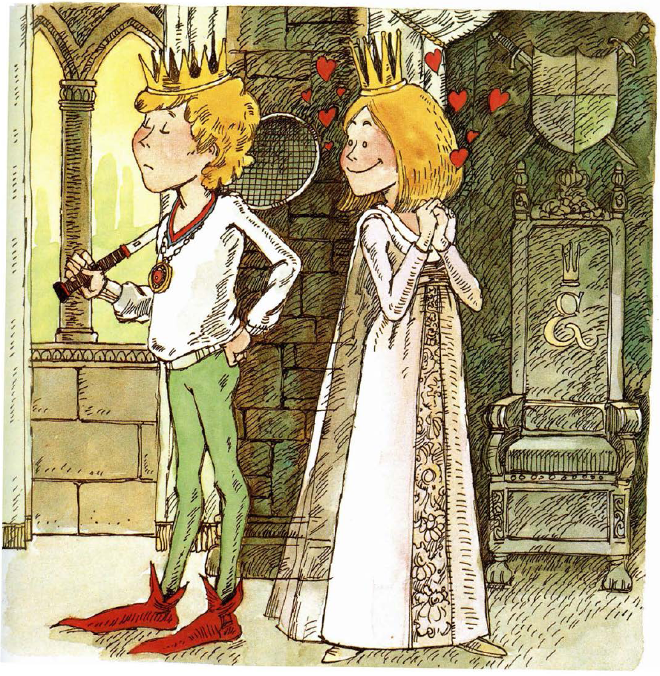

Slide 33
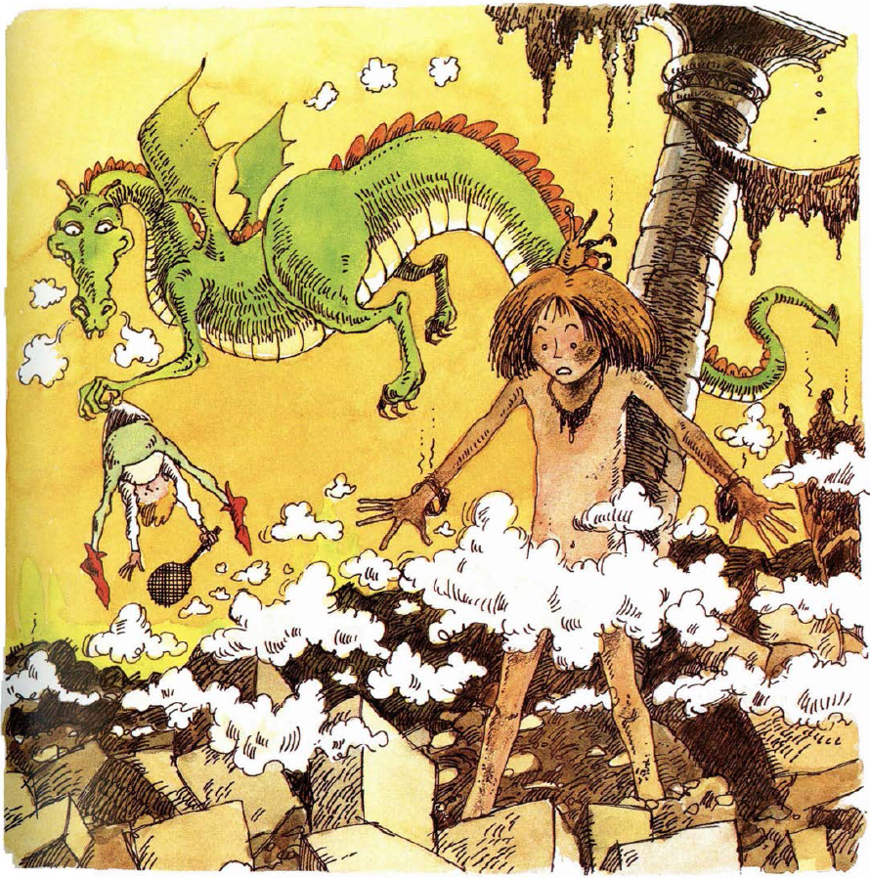

Slide 34
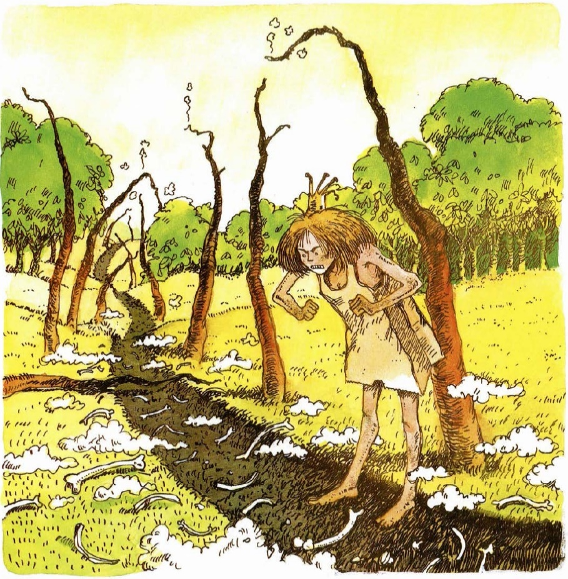

Slide 35
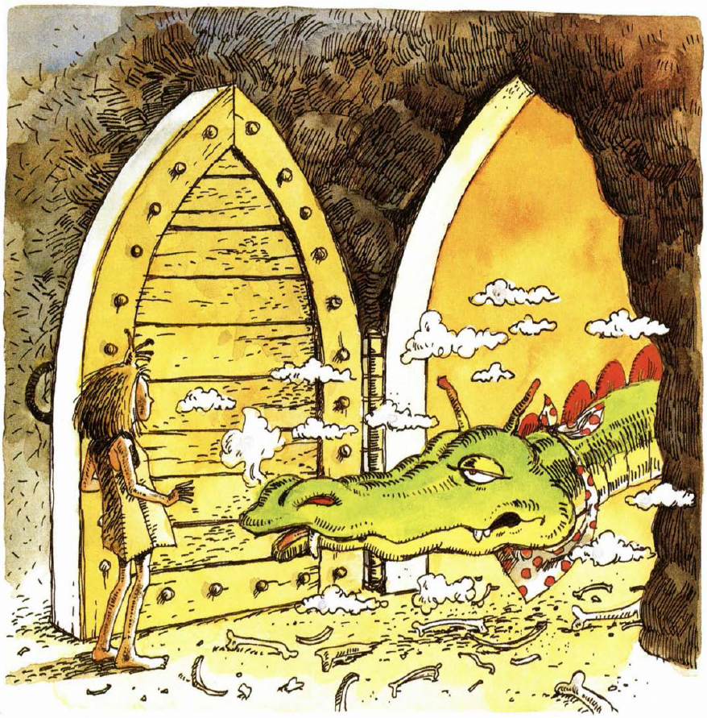

Slide 36
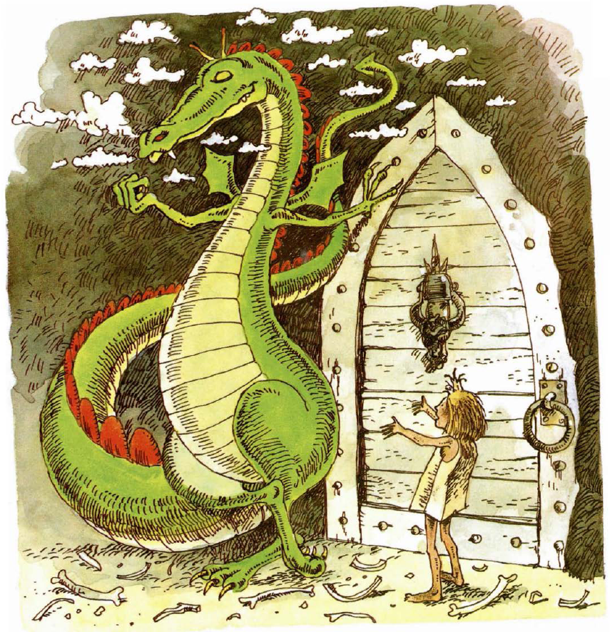

Slide 37
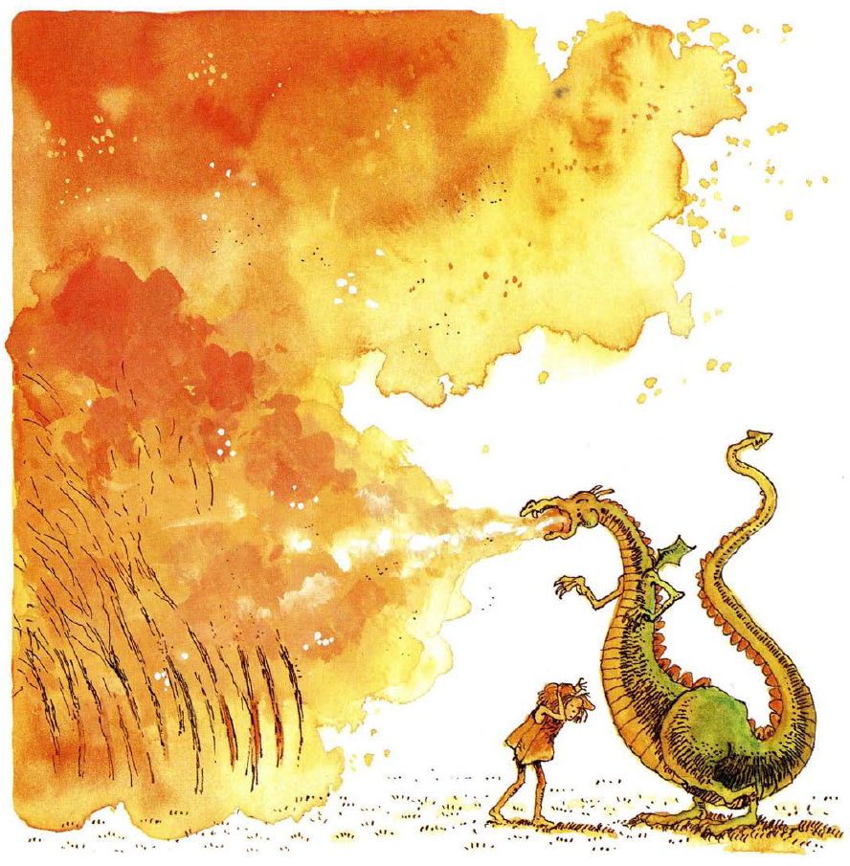

Slide 38
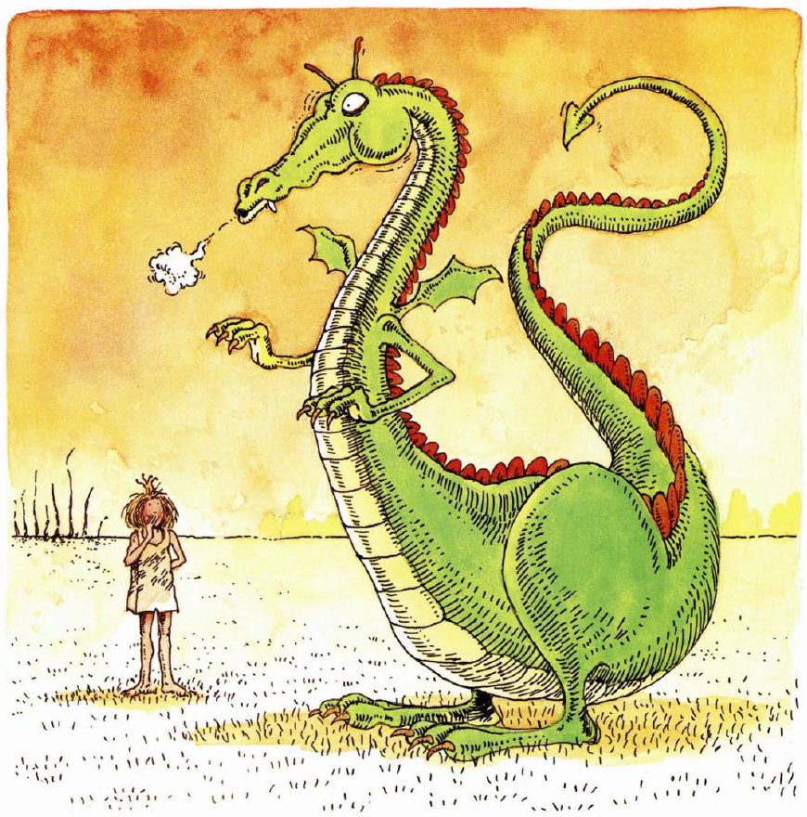

Slide 40
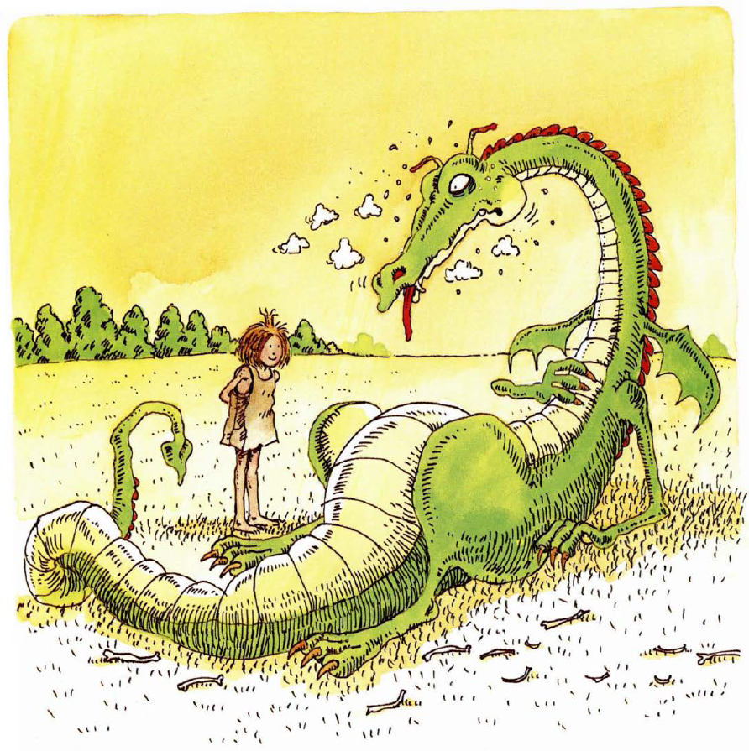

Slide 41
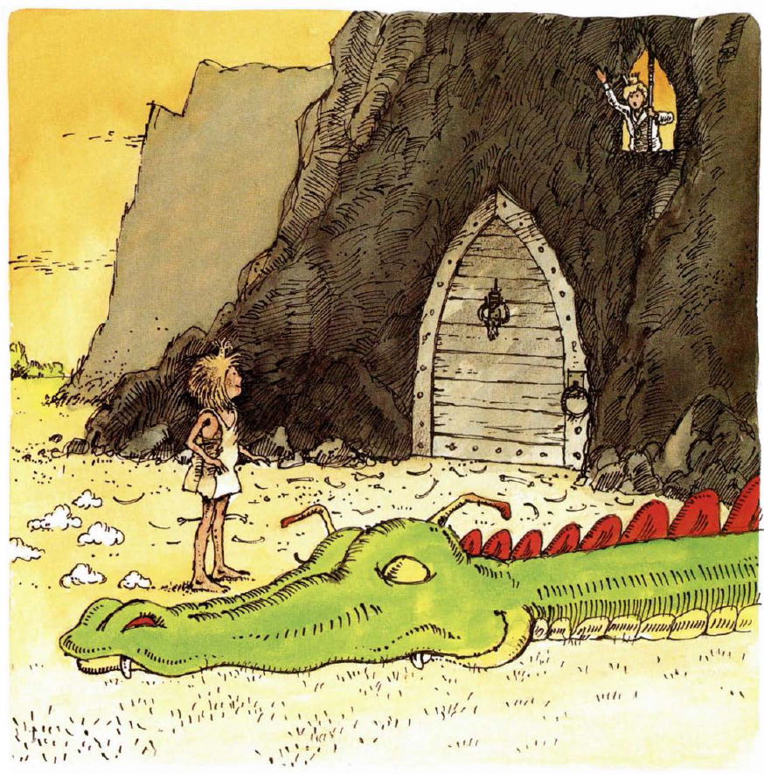

Slide 42
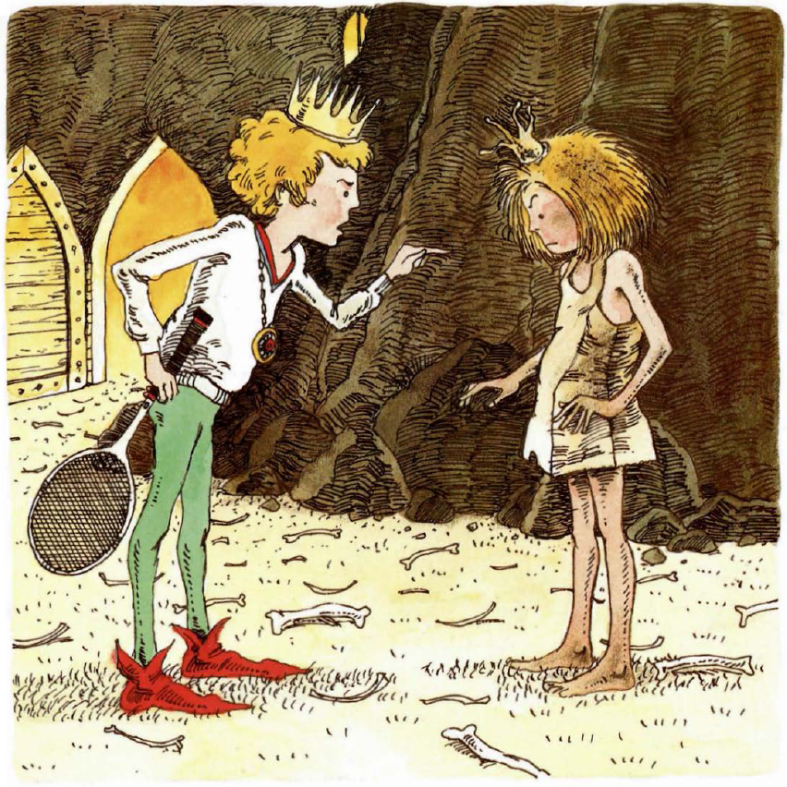

Slide 44
Paper Bag Self-Determination
Notice Elizabeth's strengths, and how she uses them to meet her needs
How does Elizabeth's self-knowledge lead her to joy?

Slide 45
Find strategies at the overlap:
Meet Your
Needs
Use Your
Strengths
Joy
this presentation has one of
Kym’s overlaps:
playful teaching

Slide 47
Know what makes you happy
Exercise
Relaxing
Eating healthy
Indulgence
Prayer/meditation
Music & dance
Thrills
Relationships
Family
Friendship
Romance
Intimacy
Alone time ("me" time)
Escapism
Charity/volunteering
…more
notice the
paradoxes

Slide 48
What is joy?
Joy is doing.
Joy is productive struggle.
Joy is knowing who you are.
Joy is serious business.
Joy is closeness.

Slide 49
Intuition
Psychology
Imagination
Creativity
Happiness
Spirituality
Ethics
Empathy
Safety

Slide 50
What's at Stake
Knowing who you are
+ Productive struggle
+ (something else)
Realizing your full potential
Joy can be the sunlight that grows imagination, creativity, collaboration, problem-solving, innovation, invention, resilience, & sustainability.

Slide 51
How often do you feel your bliss?
"I don't have time for happiness
because
I need to _________________."
deal with conflict

Slide 52
Let's look at conflict
Conflict can douse joy. It can also fan joy.
While resolving a conflict, we can validate priorities, anxieties, and fears.
"Just" being a good listener can be a powerful gift.

Slide 53
Conflict Resolution
Create a space for resolution (e.g., remove audience, remove distractions)
Check in (e.g., small talk about how each person's day is going)
Commit to resolution, with consensus if possible, but with authority if necessary
Share perceptions of conflict, taking turns to talk and really listen

Slide 54
Conflict Resolution
Validate priorities, anxieties, and fears
Clear up any confusion or ignorance
Identify options, including costs and benefits
Find a compromise that everyone can support
Commit to action
Revisit and revise, as needed

Slide 55
My favorite step
Validate priorities, anxieties, and fears
We fear…
Looking stupid
Looking incompetent
Not having control
Not being able to change things
The opposite of happiness isn't sadness. It's fear.

Slide 56
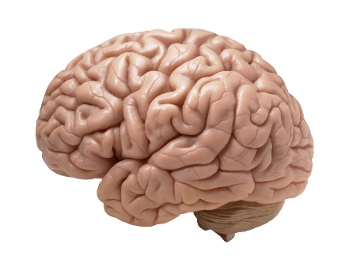
Brain: https://c1.staticflickr.com/9/8055/8376271918_0ca57957fa_b.jpg

Slide 57
Mindset is Magic
(Carol Dweck)
fixed mindset: my abilities can't be changed "It's easy for you. You're creative."
growth mindset: my abilities can be changed "I can't do this yet."
powerful word!

Slide 58
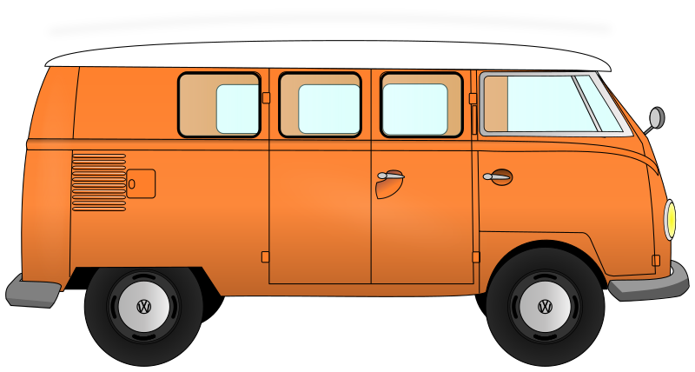
1000 Words
For each image, immediately share the first word, words, or short phrases that come to mind
Try to avoid literal descriptions
Consider symbolism or associations
Example: My mom taking me to Grateful Dead concerts as a child

Slide 60
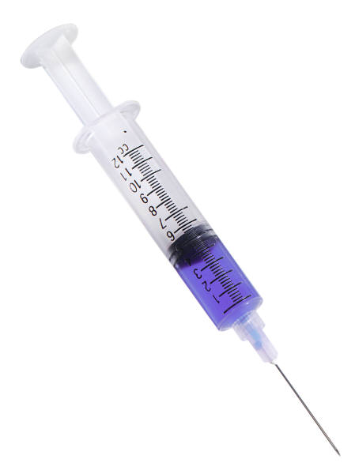

Slide 61
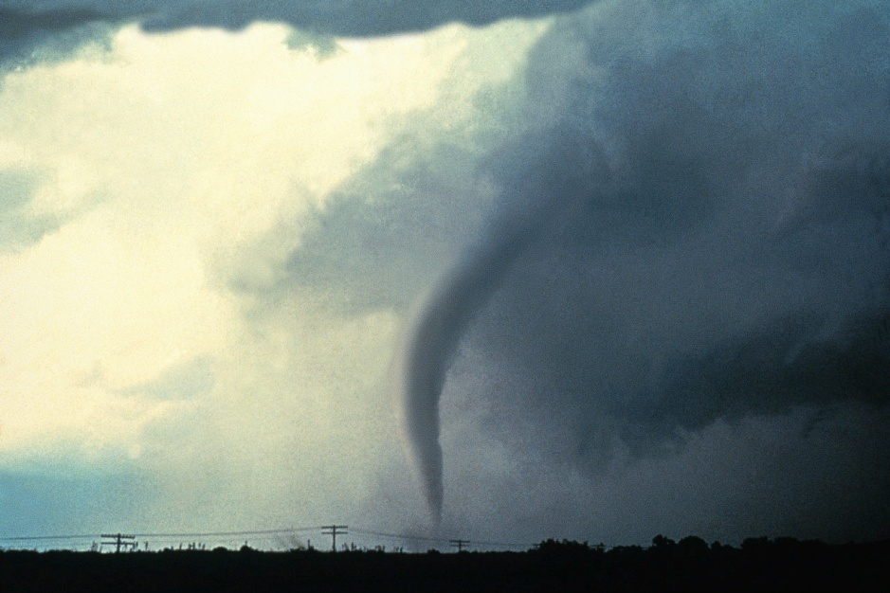
Which is more powerful?

Slide 62
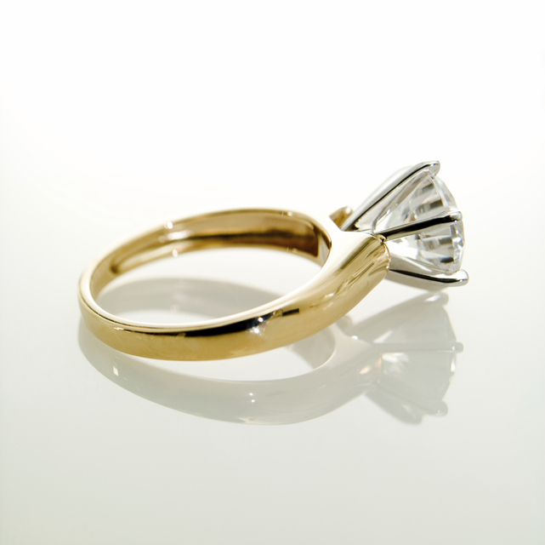
Which is more beautiful?

Slide 63
Which is more dangerous?

Slide 64
Variations
More images
Switch sides
More categories (e.g., Valuable? Amazing? Permanent?)
Image scavenger hunt (e.g., books, magazines, Google Images)
Random images, then tell or write a story that uses them as illustrations

Slide 65
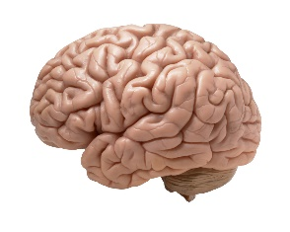
You can become more creative through activities just like that.
Brain: https://c1.staticflickr.com/9/8055/8376271918_0ca57957fa_b.jpg

Slide 66
What is joy?
Joy is doing.
Joy is productive struggle.
Joy is knowing who you are.
Joy is serious business.
Joy is closeness.

Slide 67
7 Dimensions of Wellness
Meeting our needs is good. Feeling well is better.
Social
Physical
Emotional
Career
Intellectual
Environmental
Spiritual

Slide 68
Closeness
Our needs include:
Affiliation
Approval
Relatedness
The opposite of happiness isn't sadness. It's fear.
Knowing who you are
+ Productive struggle
+
Realizing your full potential
Safety & Inclusivity
What goes here?

Slide 69
Want happiness? The place to start (or restart) may be reflecting on the climate we create for our clients, our colleagues, and ourselves.
"I don't have time for happiness
because
I need to _________________."
not make
waves
work twice as hard
for half the respect
keep my
head down

Slide 70
No Difference
Small as a peanut,
Big as a giant,
We're all the same size
When we turn off the light.
Rich as a sultan,
Poor as a mite,
We're all worth the same
When we turn off the light.
Red, black or orange,
Yellow or white,
We all look the same
When we turn off the light.
So maybe the way
To make everything right
Is for God to just reach out
And turn off the light!
-Shel Silverstein

Slide 71
"I don't see color."
"We're all worth the same."

Slide 72
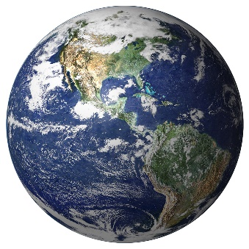
Closeness = Healthy Relationships
Deep relationships don't just happen. They require listening, talking, honoring different points of view, being vulnerable, and earning trust.
This hard work pays off: if people feel heard and valued, then they share their best ideas and they take ownership of problems.

Slide 73
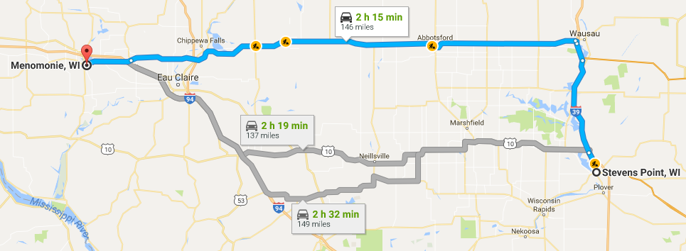
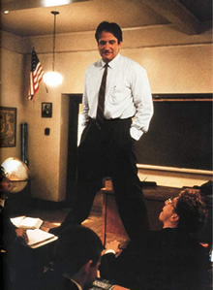
The moment that created this talk
you know these people
be open
and authentic
go big or
go home

Slide 74
The Power of Mindset
That kind of moment can happen every day.
The opportunities are there, if we create the right spaces and we’re brave enough take risks.
It’s OK to start small (e.g., talking about D&D).
How can you bring your joy into work on Monday?

Slide 75
Closure
Joy is doing.
Joy is productive struggle.
Joy is knowing who you are.
Joy is serious business.
Joy is closeness.
Stand like a superhero.
Embrace the Trying Trio.
Know your strengths and use them to kill defeat your dragons.
Nurture a growth mindset.
Value others and their diversity.

Slide 76
Questions & Sharing
Kym.Buchanan@uwsp.edu
KymBuchanan.org
@reach2grow
this is on
the sticker
Bones mend. Regret stays with you forever.
-Patrick Rothfuss, The Name of the Wind
Thank you for participating.
I highly value feedback on this talk.

Slide 77
