Slide 1
Way to improve your chances of being hired

Slide 2
Way to improve your chances of being hired
Let’s be clear starting off the big factors that go into a hiring decision in “most” companies and organizations are:
Does the person have the skills that we are looking for?
Does the person fit the culture of the organization or group?
Will the person add value and not destroy value?
Do the plusses the individual has outweigh the minuses.

Slide 3
Way to improve your chances of being hired
However there are some key things that you can do to improve your chances. We will explore the following in the next few slides:
Due Diligence
Be on time
Dress for success
Know what it means to add value in that company and organization
Be prepared to discuss how you are a fit to that company or organizations culture
Know your personality

Slide 4
Due Diligence
Due diligence is an investigation of a business or person prior to signing a contract, or an act with a certain standard of care. We believe that one should do due diligence when seeking an opportunity with a company or organization. You need understand what the company, organization and job are truly about. Understanding the company culture is a critical part of the process. No one wants to be in the dark. There have been many interviews where the person being interviewed knew nothing about the company or the job. That can get you an instant rejection.

Slide 5
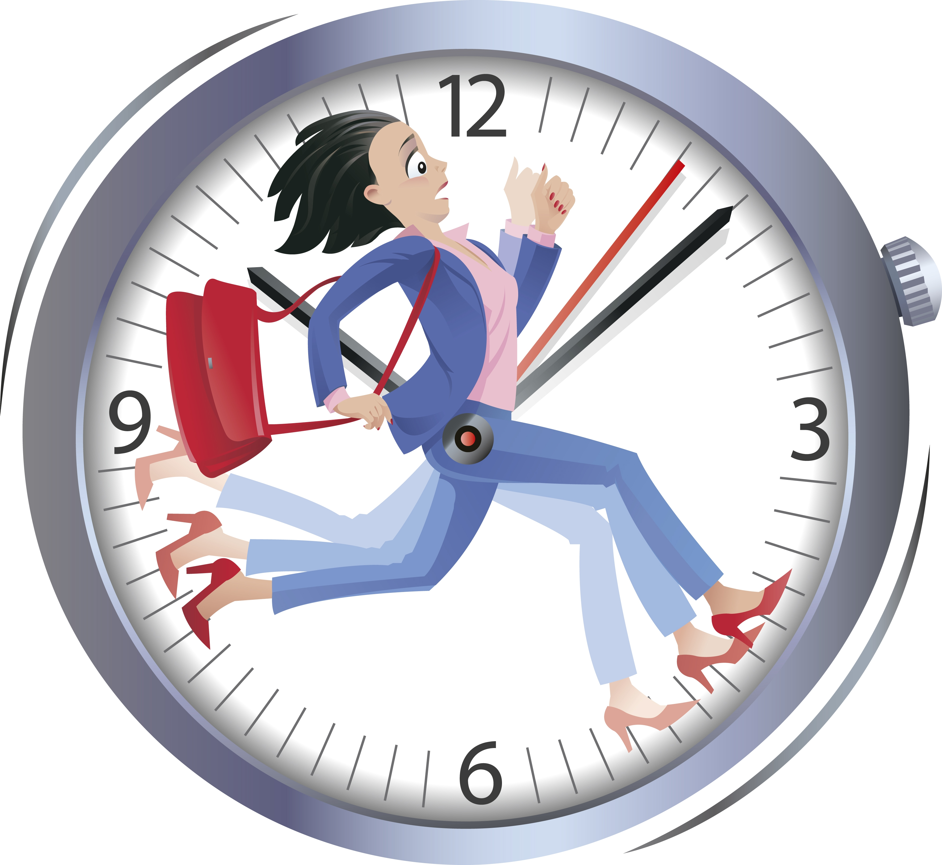
Be on time
One of the most annoying and often times deal breakers is when a person is late for an interview. This goes towards a person’s character and it reflects bad on the interviewee. Even when it may not be your fault, the interviewers may still question your ability to properly plan. I prefer that individuals do several dry runs of getting to the designated location. Then think about all the possible things that can go wrong and add the appropriate time to overcome those things in your travel time. There is nothing wrong with sitting in the parking lot 30 to 45 minutes ahead of time to ensure you are on time.

Slide 6
Dress for success
As part of your due diligence, you need to understand what the proper attire is for the interview. I always says one need to dress in a manner that respects that process. If I am going into interview for a mechanic role I would not wear a three piece suit but I would wear something business casual to show respect to the process. When in doubt always ask the recruiter or the key person whom has called you in for the interview prior to the interview.

Slide 7
Know what it means to add value in that company and organization
You will began to see a reoccurring theme. When you do your due diligence you are looking to see what the company or organization believes about adding value and what it means to add value in that job. It never hurts find others who are in similar jobs and ask them. Now once you have that information prepare example to use in the interview on how you have added value of a similar nature in your past or how you would look to add value within the company or organization once your are hired.

Slide 8
Be prepared to discuss how you are a fit to that company or organizations culture
This is a carbon copy of adding value but for most companies and organization this is critical. In doing your due diligence you want to find out about the company or organizational culture. The company or organizations culture is their values and beliefs. Most interviews now are behavioral based interviews. These interviews not only tell the interviewer(s) how you would behave in certain situations but they can pierce into your character. Being able to speak on how your values and belief align with that company or organization is a MAJOR plus.

Slide 9
Know your personality
That old saying of no one knows you better than you is true. You know the pleasant thing about you and the not so pleasant. You know if you smile automatically or if you only smile when you are engaged. Understand your tendencies and adjust accordingly so no one reads or interpret something about you that is not necessarily the case. Remember the interview process starts the moment you make contact: visual and verbal. So if you have a tendency to sit around with angry look on your face then become self aware make sure you are not doing that. Practice, practice, practice in the mirror and verbally all aspects of the process.

Slide 10
bbv2m-brothersbrooksvision2missionllc.com

