Slide 1
Lesson 5: The Self and Socialization
Robert Wonser
Introduction to Sociology

Slide 2
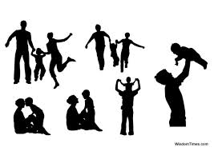
How Do We Become Who we Are?
We are who we are because of those around us.
Our interactions with others, with groups, with institutions, and ultimately society shape us.
Socialization into the ways of those around us, our culture.

Slide 3
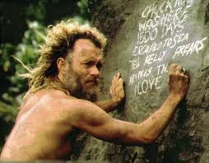
How does the Self fit in to Society?
The Self doesn’t exist without society.
The self is an internalization of society’s expectations.
To that end, the self, socialization and interaction with others are forms of social control.
Specifically, the self = self control

Slide 4
Maine’s ‘Last True Hermit’
"But you must have thought about things," I said. "About your life, about the human condition."
Chris became surprisingly introspective. "I did examine myself," he said. "Solitude did increase my perception. But here's the tricky thing—when I applied my increased perception to myself, I lost my identity. With no audience, no one to perform for, I was just there. There was no need to define myself; I became irrelevant. The moon was the minute hand, the seasons the hour hand. I didn't even have a name. I never felt lonely. To put it romantically: I was completely free."
Notes:
http://www.gq.com/news-politics/newsmakers/201409/the-last-true-hermit?printable=true

Slide 5
The Self and Socialization
The self is one of the most basic features of human beings and society.
The self is our experience of a distinct, real, personal identity that is separate and different from all other people.
Sociologists look at both the individual and society to gain a sense of where the self comes from.
The self is created and modified through interaction over the course of a lifetime.

Slide 6
Reality is created, negotiated and agreed upon (that is, constructed) socially, through social interaction.
The world exists before we’re born but we help (re)create the world by interacting with others.
Socialization teaches us about reality

Slide 7
Socialization
Socialization is the process of learning and internalizing the values, beliefs, and norms of our social group and by which we become functioning members of society.
The socialization process begins in infancy and is especially productive once a child begins to understand and use language.
Socialization is a lifelong process.

Slide 8
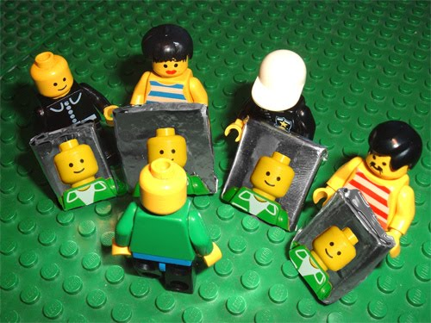
How Does the Self Develop? Looking Glass Self
Charles Cooley believed that one’s sense of self depends on seeing one’s self reflected in interactions with others.
The looking-glass self refers to the notion that the self develops through our perception of others’ evaluations and appraisals of us.

Slide 9
The Self is Developed
George Herbert Mead expanded Cooley’s ideas about the development of the self.
Mead also believed that the self was created through social interaction and that this process started in childhood (that children began to develop a sense of self at about the same time that they began to learn language).

Slide 10
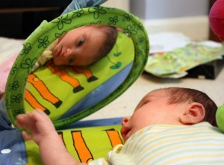
The acquisition of language skills coincides with the growth of mental capacities, including the ability to think of ourselves as separate and distinct, and to see ourselves in relationship to others.

Slide 11
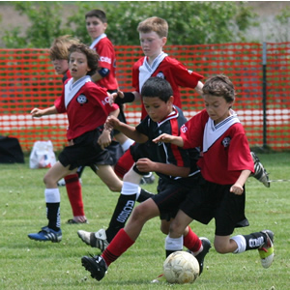
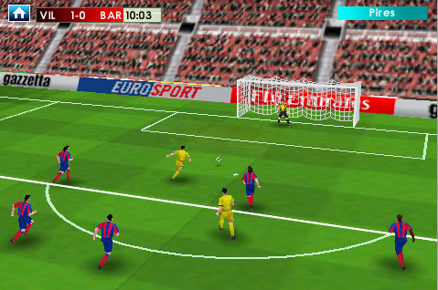
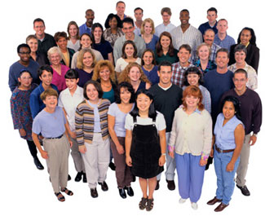
Development of Self in Children: Mead’s Three Stages
Play
1 significant other at a time
Game
several significant others
Generalized Other
a whole community of attitudes

Slide 12
Phases of the Self: The ‘I’ and the ‘Me’
“I” (the self in action)
Self in process, in the moment
The impulsive, spontaneous, and indeterminate part of the self
Non-reflective
Part of the self that produces individuality
“Me” (the self as an object in the world)
The structured and determinate part of the self
A product of interaction and conscious reflection
We know the “I” only through the “me”
Society’s expectations internalized

Slide 13
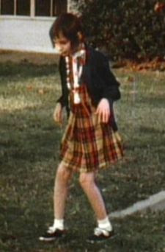
Self without People?
What would a self look like without the social interaction required to create and maintain it?

Slide 14
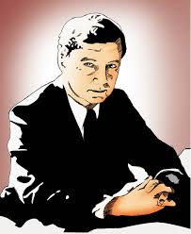
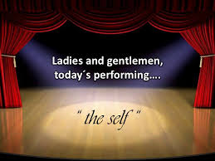
Goffman and Dramaturgy
Goffman was less concerned about where the self comes from and more with what we do with once we have it. He believed meaning was constructed through interaction.
His approach, dramaturgy, compares social interaction to the theater, where individuals take on roles and act them out to present a favorable impression to their “audience.”

Slide 15
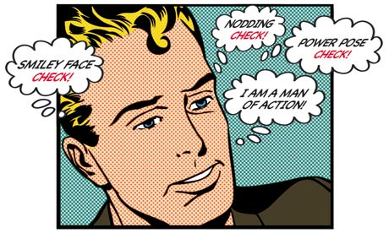
Impression Management and the Presentation of Self in Everyday Life
Goffman sees social life as a sort of game, where we work to control the impressions others have of us, a process he called impression management.
Where we attempt to manage the impressions others have of us.

Slide 16
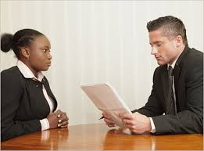
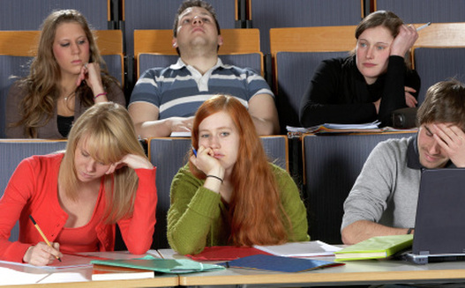
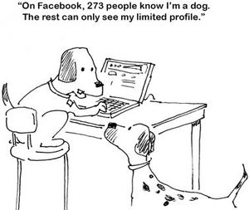
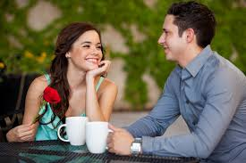
Presentation of Self
Besides everyday life and social interaction, where else do we present ourselves (our ‘selfs’) for others to get a controlled impression of our self?

Slide 17
Society and its Agents of Socialization
Society is a social construction so it doesn’t socialize us but instead has agents who work on its behalf.
Agents of socialization are the social groups, institutions, and individuals that provide structured situations in which socialization takes place.
The four predominant agents of socialization are the family, schools, peers, and the mass media.

Slide 18
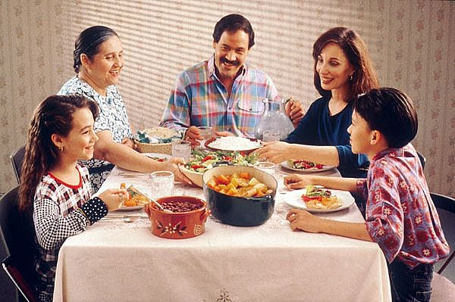
Family
The family is the single most significant agent of socialization in all societies and teaches us the basic values and norms that shape our identity.

Slide 19
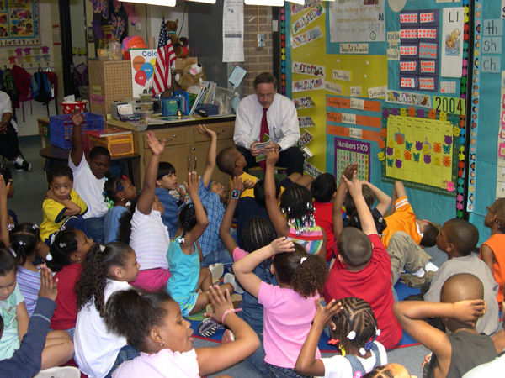
Agents of Socialization: Schools
Schools provide education and socialize us through a hidden curriculum (a set of behavioral traits such as punctuality, neatness, discipline, hard work, competition, and obedience) that teaches many of the behaviors that will be important later in life.

Slide 20
Agents of Socialization: Peers
Peers provide very different social skills and often become more immediately significant than the family, especially as children move through adolescence.
Peer group socialization has been increasing over the past century because young people are attending school for longer periods of time.

Slide 21
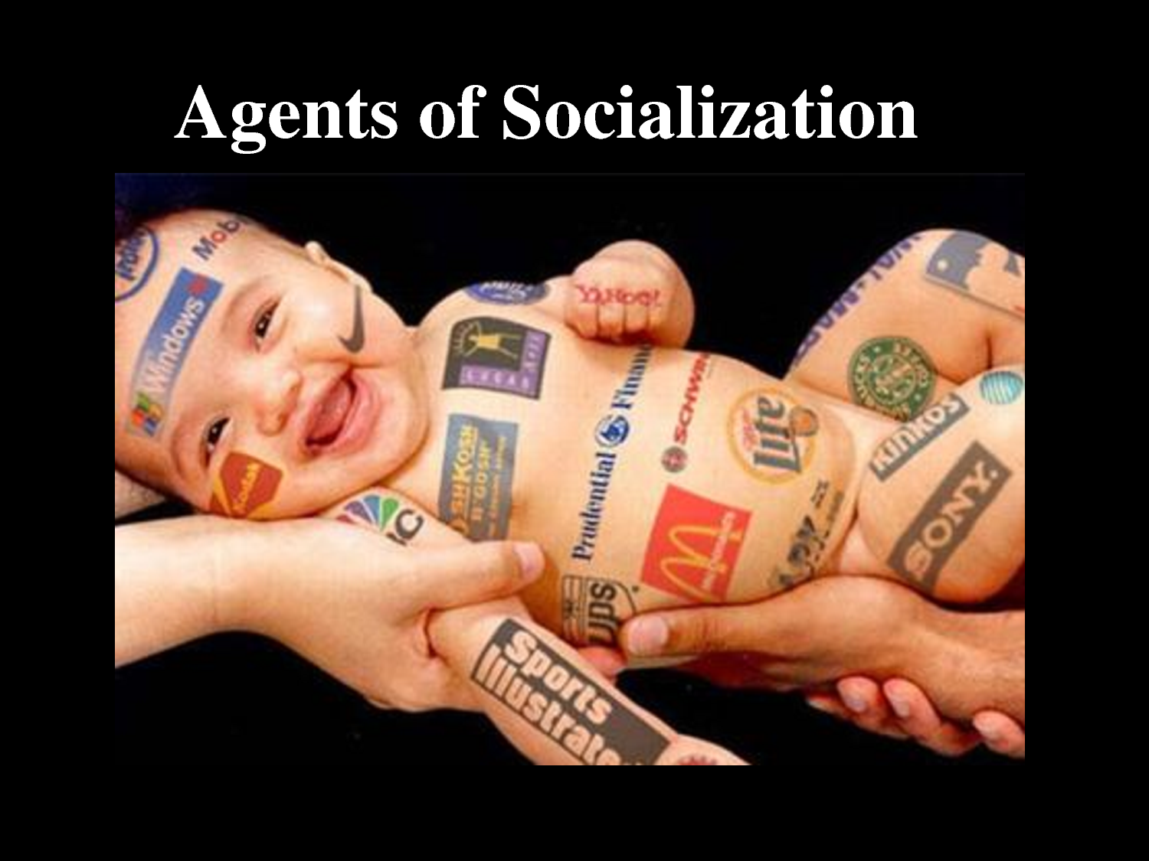
Agents of Socialization: Mass Media
The mass media has become an important agent of socialization, often overriding the family and other institutions in instilling values and norms.
The American mass media plays a major role in teaching Americans to buy and consume goods and other values.

Slide 22
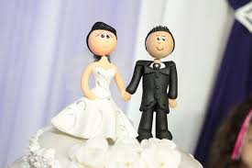
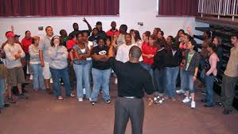
Socialization Never Ends…
Resocialization is the process of replacing previously learned norms and values with new ones as a part of a transition in life.
Learn how to be a husband/wife, employee, etc.

Slide 23
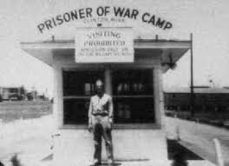
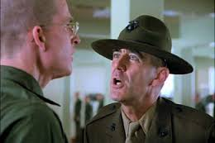
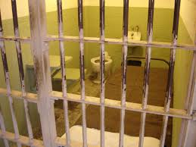
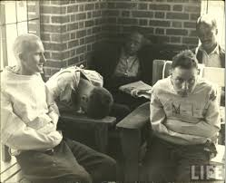
Resocialization: Total Institution
A dramatic form of resocialization takes place in a total institution, which is an institution in which individuals are cut off from the rest of society so that their lives can be controlled and regulated for the purpose of systematically stripping away previous roles and identities in order to create a new one.

Slide 24
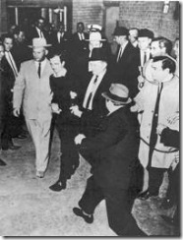
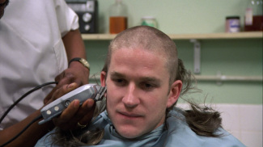
Entrance into Total Institutions: the Start of Resocialization
Mortification of self, the most dramatic type of resocialization, occurs in such institutions as the military, POW camps, and mental hospitals.
Often involves “degradation ceremonies”

Slide 25
Statuses and Roles
A status is a position in society that comes with a set of expectations.
An ascribed status is one we are born with that is unlikely to change.
An achieved status is one we have earned through individual effort or that is imposed by others.
One’s master status is a status that seems to override all others and affects all other statuses that one possesses.

Slide 26
Statuses and Roles
Roles are the behaviors expected from a particular status.
Role conflict occurs when the roles associated with one status clash with the roles associated with a different status.
Role strain occurs when roles associated with a single status clash.
Either of these may lead to role exit.

Slide 27
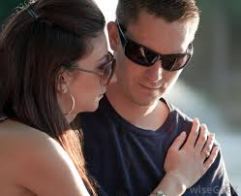
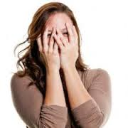
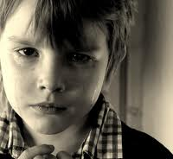
Everything about us. Socialized.
Role-taking emotions are emotions like sympathy, embarrassment, or shame, which require that we assume the perspective of another person and respond from that person’s point of view.
Which are guided by:
Feeling rules are socially constructed norms regarding the expression and display of emotions and include expectations about the acceptable or desirable feelings in a given situation.

Slide 28
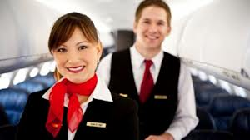
Emotion Work
Emotion work refers to the process of evoking, suppressing, or otherwise managing feelings to create a publicly observable display of emotion.

Slide 29
Some Important Realizations
Human beings are unfinished at birth.
Socialization makes us human.
We are socialized into the ways of the people around us (our culture).
The self is created and maintained through social interaction.

Slide 30
Lesson Quiz
1. The process of learning and internalizing the values, beliefs, and norms of a social group is called:
a. culturization.
b. nature.
c. socialization.
d. social isolation.

Slide 31
Lesson Quiz
2. An individual’s conscious, reflexive experience of a personal identity separate and distinct from others is called the:
a. self.
b. id.
c. ego.
d. superego.

Slide 32
Lesson Quiz
3. The way that a professor dresses and carries herself would be considered a part of her attempts at:
a. expressions given.
b. dramaturgy.
c. a generalized other.
d. impression management.

Slide 33
Lesson Quiz
4. The fact that schools teach children to obey authority would be considered a part of:
a. a total institution.
b. the agents of socialization.
c. the hidden curriculum.
d. resocialization.

Slide 34
Lesson Quiz
5. A person who is asked to come in to work overtime on the same night that he has to study for a sociology exam is experiencing:
a. role envy.
b. role strain.
c. role conflict.
d. role status.

Slide 35
Lesson Quiz
6. “Boys don’t cry” and “Don’t laugh during a funeral” would be examples of:
a. emotion work.
b. feeling rules.
c. resocialization.
d. role-taking emotions.

