Slide 1
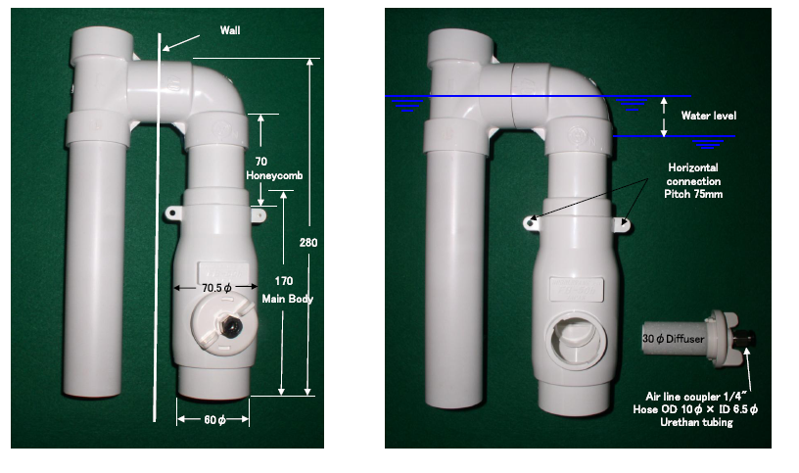
FB-50h Dimensions
2.8
3”
9.8
2.8
6.7
2.4
3/8 air supply tubing

