Slide 1
Rich Paul President & CIO of Potomac Advisors
EVO IN THE TANK
Presented By
May 3rd, 2017

Slide 2
Rich Paul
INTRODUCING
Career Highlights:
31-year tenure as a registered investment advisor. Founder of Potomac Fund Management in 1987 – grew AUM to over $100m.
Co-founding member of National Association of Active Investment Managers (NAAIM) in 1990 - authored NAAIM’s first performance measurement standards while serving as Chairman of the committee.
Conceived and co-authored a landmark 1992 Journal of Portfolio Manangement article: “Market Timing Works, Where it Matters Most… In the Real World.”
Since competing in 2015 Shark Tank:
Began licensing EVO to other RIAs, growing assets from $1m to $253m.
EVO at a Glance:
Beat every single one of over 30,000 mutual funds, ETFs and world wide market indexes tracked by Steele Systems based on
Morningstar data over the last ten years through 12/31/2016
35.4%
20.97%
18.66%
#1
$1000M
$1000M
Since Shark Tank Debut
5 year annualized
10 year annualized
10 year Rank
May 31, 2002 through March 31,2017. Gross of Fees

Slide 3
ABOUT EVO
EVO Basics
EVO is a mechanical system that generates buy, sell and short signals based on algorithmic rules using quantitative analysis.
Incepted in May, 2002: 15-year track record, with 162 total round trips.
Trades are executed in Rydex funds: 1.5x leveraged S&P 500 index fund, a 1.0x inverse S&P 500 index fund, and a money market fund. Signals are for next-day execution.
“All In,” i.e. 100% invested on each trade.

Slide 4
ABOUT US
ev·o·lu·tion-ary (ĕv′ə-lo͞o′shə-nĕr′ē):
A gradual process in which
something changes into a different and usually
more complex or better form.
EVO:
AN EVOLUTIONARY MONEY MANAGEMENT SYSTEM

Slide 5
ABOUT US
THE KEY
TO EVO’S STRATEGY
DESIGN
“Academic research indicates that
when multiple trading systems are aggregated the noise and errors will tend to diversify away, while the signal remains, and is more robust.”

Slide 6
ABOUT EVO
How it works
#1
In 2002, EVO selected from a universe of ~40 trading systems.
Systems use a myriad of quantitative indicators based on historic and raw stock market data.
EX: momentum, volatility measures, overbought / oversold oscillators, moving averages, seasonality and many more.
40 Systems

Slide 7
ABOUT EVO
How it works
#1
Today, EVO selects from a universe of over 120 trading systems.
Each system is evaluated for risk & return.
Example:
What’s the probability the system generates a winning trade?
120 Systems

Slide 8
ABOUT EVO
How it works
#1
EVO selects from a universe of 120 trading systems.
#2
8 systems originally selected,
resulting in being invested
37% of the time.

Slide 9
ABOUT EVO
How it works
#1
EVO selects from a universe of 120 trading systems.
#2
EVO originally had 8 systems, invested 37% of the time.
#3
Today, EVO has evolved to
include over 20 systems,
capturing more missed opportunities increasing % invested to over 50%

Slide 10
ABOUT EVO
How it works
#1
EVO selects from a universe of 120 trading systems.
#2
EVO originally had 8 systems, invested 37% of the time.
#3
Today, EVO has over 20 systems -
% invested increased to >50%
#4
When multiple systems generate a buy signal at the same time, they
create a combination.
20+ systems create
>15k Combinations!!!
(Here are just a few)

Slide 11
ABOUT EVO
How it works
⁺
^{Performance}
#1
EVO selects from a universe of 120 trading systems.
#2
EVO originally had 8 systems, invested 37% of the time.
#3
Today, EVO has over 20 systems -
% invested increased to >50%
#4
20+ Systems creates thousands of combinations.
#5
⁻
^{Risk}
Each combination is tested to determine if it will improve the EVO Composite.

Slide 12
ABOUT EVO
How it works
#1
EVO selects from a universe of 120 trading systems.
#2
EVO originally had 8 systems, invested 37% of the time.
#3
Today, EVO has over 20 systems -
% invested increased to >50%
#4
20+ Systems creates thousands of combinations.
#5
Combinations are analyzed for impact on EVO composite.
#6
Validated Combinations are added to the
EVO Composite.

Slide 13
ABOUT EVO
How it works
#1
EVO selects from a universe of 120 trading systems.
#2
EVO originally had 8 systems, invested 37% of the time.
#3
Today, EVO has over 20 systems –
% invested increased to >50%
#4
20+ systems create thousands of combinations.
#5
Combinations are analyzed for impact on EVO Composite.
#6
Validated combinations are added to the
EVO Composite.
#7
New Combinations
Continually Reviewed for Inclusion

Slide 14
=
ABOUT EVO
EVO’s evolution: May 2002 – March 2015. (gross of fees)
THE ORIGINAL 8 SYSTEMS
18 SYSTEMS (MARCH 2015)
By using forward-testing, we can see how the original 8 system would have performed if never changed.
As EVO evolved from 8 to 18 systems, we see performance improve with little change to risk & volatility.
Forward-tested
Actual Results
ANNUALIZED
RATE OF
RETURN
13.22%
17.30%
VS
ULCER INDEX
6.20%
5.40%

Slide 15
EVO’s Performance
“no BS*”
*(no Backtesting Strategies)

Slide 16
PERFORMANCE
EVO’S
PERFORMANCE
PHILOSOPHY
Compound short-term gains into superior
long-term growth
Consistently provide near absolute returns
Mininize downside risk – capture upside
Notes:
Lastly, our performance philosophy is twofold: First, by taking short-term market gains, and compounding them over time, this leads to superior market growth. And second, we want to consistently provide positive returns.

Slide 17
Goal: Compound short-term gains into superior long-term growth
PERFORMANCE
61% WINNERS / 3.86% AVERAGE GAIN
922% CUMULATIVE RETURN
(16.97% CAGR)
39% LOSERS / -2.17% AVERAGE LOSS
EVO’S
PERFORMANCE
RESULTS
MAY 31, 2002 –
March 31, 2017
Gross of FEES

Slide 18
PERFORMANCE
Historical Performance
June 1, 2002 through March 31st, 2017. (Gross of Fees)
Year | EVO1 | S&P500
YTD | 3.67% | 6.12%
2016 | 13.84% | 11.96%
2015 | 12.18% | 1.38%
2014 | 23.61% | 13.69%
2013 | 50.90% | 32.39%
2012 | 24.78% | 16.00%
2011 | 5.24% | 2.11%
2010 | -0.08% | 15.06%
2009 | 20.05% | 26.46%
2008 | 19.88% | -37.00%
2007 | 19.17% | 5.49%
2006 | 15.59% | 15.79%
2005 | -1.04% | 4.91%
2004 | 19.10% | 10.88%
2003 | 35.49% | 28.68%
2002* | -0.34% | -16.69%
Goal:
Consistently provide near absolute returns.
In it’s 15-year history, EVO has only had
three miniscule down years, after fees.
EVO’s Worst Year = -1%
S&P Worst Year = -37%.
*beginning June 1, 2002

Slide 19
Goal: Minimize downside risk – capture upside
METRIC | EVO | S&P 500
CAGR Since Inception | 16.97% | 7.68%
Max Drawdown | -23.9% | -51%
Worst Year | -1.04% (2005) | -37% (2008)
Downside Standard Deviation / annual | 7.5% | 8.9%
Sortino Ratio | 2.12 | 0.73
Beta | 0.39 | 1.0
Up / Down Capture | 89.6% / 34.1% | 100%
PERFORMANCE
EVO’S
PERFORMANCE
MAY 31, 2002 –
MARCH 31, 2017
GROSS OF FEES

Slide 20
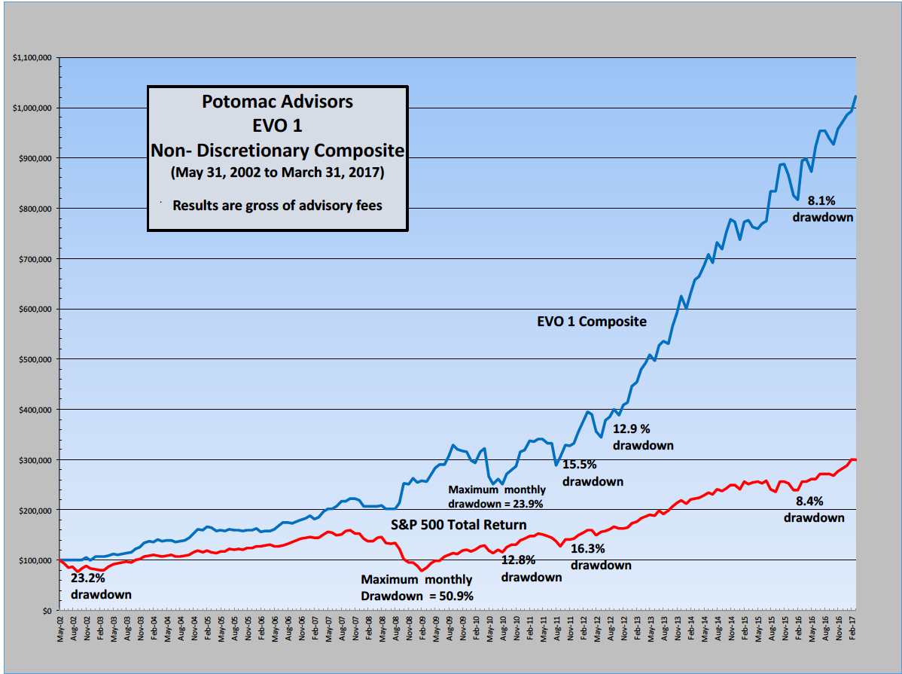
YOUR MONEY
Growth of a Hypothetical $100,000 Investment
Bottom Line:
$1 invested in 2002
=
$10.22 Today

Slide 21
CLOSING THOUGHTS
The EVO competitive advantage
Real-time
Stellar
1
6
All results are actual. No hypotheticals or back-tested results.
Superior performance, beats on risk and return.
2
History
7
Consistency
EVO went live May 31, 2002, almost
15-years ago.
The only strategy ranked in the top four in performance in all seven time periods from one to 10 years as tracked by Theta Research as of
(July 2016)
Ranking Highlights:
Three #1 rankings
Three #2 rankings
Ranked #1 or #2 on a risk adjusted basis for all time periods from three to 10 years. (Theta’s Ulcers Performance Index)
3
Verified
GIPS verified track record through June 2014. Theta Research provides ongoing verification.

Slide 22
Thank You!
For more information, contact us at:
1.877.RICHPAUL
info@potomacadvisorsinc.com

Slide 23
GIPS VERIFICATION

Slide 24
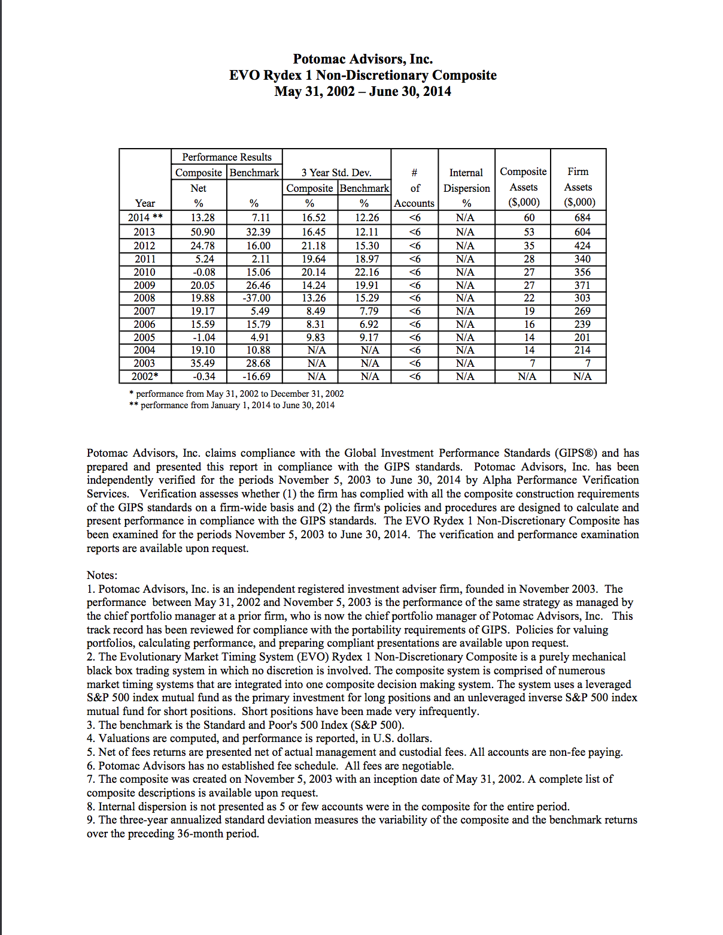
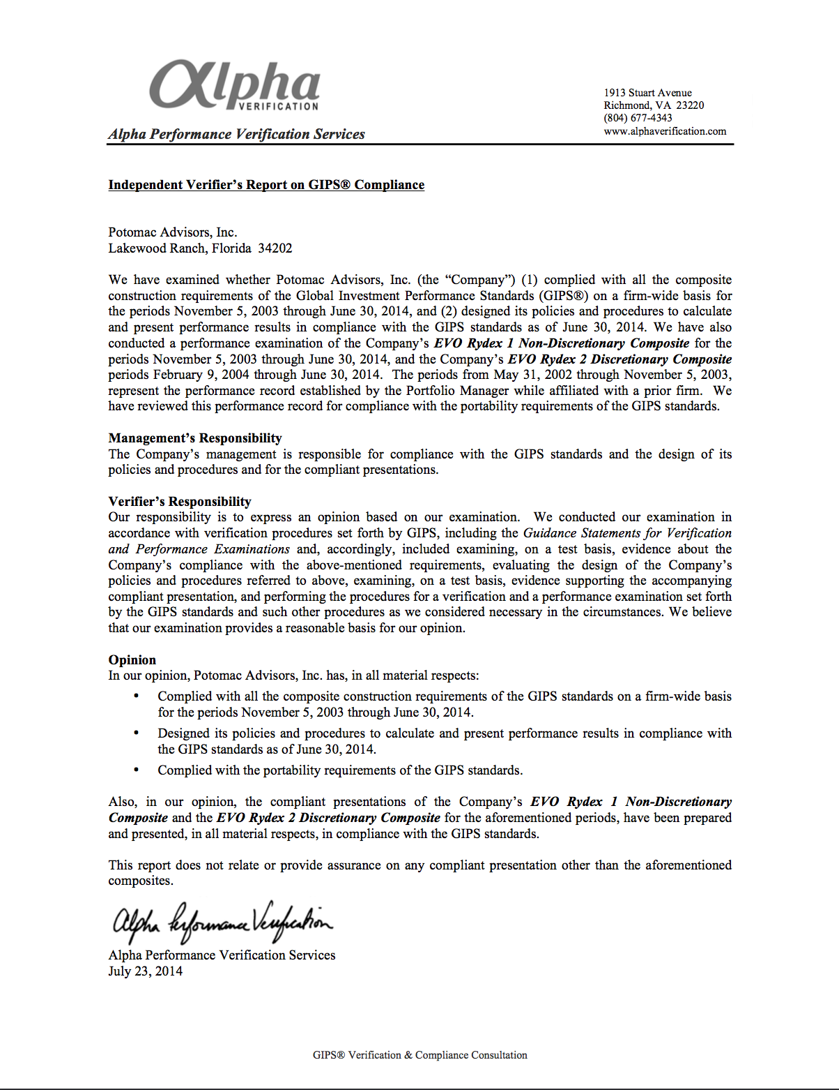

Slide 25
Potomac Advisors Performance Disclosure
EVO 1 performance is based on the oldest actual account using the EVO 1 strategy and is considered representative of all accounts within the EVO 1 composite strategy since all accounts with few exceptions are traded the same in an omnibus group account. Occasionally, specific investor instructions, or fund restrictions, or the time at which an account is opened or additions are made may result in different trades and returns for a specific account from the composite. Composite performance has been verified to be in compliance with GIPS® for the period from inception on May 31, 2002 through June 30, 2014 by Alpha Performance Verification Services. The oldest account in the composite has been verified for performance since inception by Theta Research and is continuously monitored daily by Theta Research. Composite returns are time-weighted total returns that reflect the reinvestment of dividends and capital gain distributions. Composite returns are net of the underlying mutual fund management fees, other fund (administrative) expenses.
The performance results shown here reflect the use of the Guggenheim Rydex Investor class funds. Other classes of Rydex funds that may be used by investment advisers who license the EVO 1 strategy may include funds with marketing and distribution fees (12b1 fees). Use of these funds by other investment advisors would reduce the performance shown here. Results presented here are gross of fees and are for presentation for evaluation of the EVO strategy before fees. Presentation to retail prospects or clients must include performance based on actual or the maximum fees charged by Potomac Advisors, prorated and deducted quarterly in advance. Fees charged by licensees for this strategy may be higher or lower than the fees charged by Potomac Advisors.
No adjustments have been made for potential income tax consequences. Performance for other composite investment programs may differ materially (more or less) from the performance of this composite. It should not be assumed that future recommendations will be profitable or equal past performance. The investment return and principal value of an investment will fluctuate so that an investor's shares, when sold or redeemed, may be worth more or less than their original cost and current performance may be lower or higher than the performance quoted.
The benchmark returns of the S&P 500 are total returns and reflect the reinvestment of dividends. The S&P 500 Index is a capital weighted index composed of 500 widely held common stocks varying in composition, and is not available for direct investment. Benchmark returns are provided exclusively for comparison purposes only so as to provide general comparative information to assist an individual client or prospective client in determining whether the performance of a Potomac Advisors, Inc. meets, or continues to meet, his/her investment objective(s).
It should not be assumed that any of Potomac Advisors, Inc. programs will correspond directly to any such comparative index. The volatility of the market indices may materially differ (more or less) from that of the actual portfolios. Since individuals cannot invest directly into any index, deductions for management fees or other custodial or transaction charges are not taken into account. These charges, if applicable, would reduce the overall return of the S&P 500 index. The strategies shown involve investing in mutual funds. Mutual fund shares are not insured by the FDIC or any other agency, are not guaranteed by any financial institution, are not obligations of any financial institution, and involve investment risk, including possible loss of principal.
The data presented has been collected from sources believed to be reliable; however, Potomac Advisors, Inc. does not guarantee or warrant the accuracy, timeliness, or completeness of the information. Past performance is no guarantee of future results. This material is for informational purposes only and does not constitute an offer to sell or a solicitation of an offer to buy any security. Such offers can only be made where lawful under applicable law.
Potomac Advisors is registered as an investment adviser under various state laws. Such registration does not imply a certain skill or training and no inference to the contrary should be made. Information pertaining to Potomac Advisors’ advisory operations, services, and fees is set forth in Potomac Advisors’ current Form ADV Part II, a copy of which is available from Potomac Advisors upon request. Information pertaining to any mutual fund that is used in Potomac Advisors’ EVO strategy is set forth in each respective mutual fund's prospectus, a copy of which is also available from Potomac Advisors upon request.
GIPS Disclosure Statement
Potomac Advisors Inc. is an independent registered investment advisor. EVO 1 performance has been verified to be in compliance with the Global Investment Performance Standards (GIPS®) from 5.31.2002 through 6.30.2014 by Alpha Performance Verification Services who retain a CFA Institute CIPM (Certificate in Investment Performance Measurement). Valuations are computed, and performance is reported, in U.S. dollars. Composite returns are net of the underlying mutual fund management fees, custodial fees and other fund (administrative) expenses. All accounts in the composite are non-fee paying and as such returns are presented gross of Potomac Advisors' fees. The benchmark is the Standard and Poor's 500 Index (S&P 500.) To obtain a Compliant Presentation or a list of the Composite Descriptions visit our website at www.potomacadvisorsinc.com
The Evolutionary Market Timing System (EVO 1) Non-Discretionary Composite is a purely mechanical black box trading system in which no discretion is involved. The composite system is comprised of numerous long and intermediate-term market timing systems (filters) and quantitative short-term trading systems (triggers) that are integrated into one composite decision-making system. The system uses a leveraged S&P 500 index mutual fund as the primary investment for long positions in seeking to magnify the index’s exposure 150% on a daily basis to increase the potential return of an investment. Conversely, leverage can magnify the losses of an investment during a down market. The fund’s use of derivatives, such as futures, options and swap agreements, may expose the fund’s shareholders to additional risks that they would not be subject to if they invested directly in the securities underlying those derivatives. The trading system also may employ an unleveraged inverse S&P 500 index mutual fund for short positions. Short positions have been made very infrequently. Given the potential risks involved, strategies employing leverage and shorting may not be suitable for conservative investors.
Theta Research Disclosure
Charts, graphs, statistics and other content and material presented herein identified as prepared by Theta Research is copyrighted by Theta Research and may not be reproduced, copied, duplicated or distributed withoutthe express prior written permission of Theta. Data, statistics and reports prepared by Theta as contained on theirweb site are prepared from data believed to be reliable, but no representation is made by Theta as to its accuracyor completeness. Potomac Advisors, Inc. has received express prior written permission from Theta Research to use reports generated from their web site for downloading and/or publishing for general distribution. The reports maybe used without restriction by the manager in individual presentation to clients and prospects. Theta makes no warranty or representation as to whether any of its reports and printable material meets any compliance and regulatory requirements for any manager or firm. The manager accepts responsibility for use of such reports and material in a manner which meets all compliance and regulatory requirements for its state and/or jurisdiction anddemnifies Theta from any and all actions resulting from use of said reports in any way.

