Slide 1
College Search Best Practices
Notes:
Check in where everyone is from weather Temp
Wait a little while

Slide 2
Housekeeping
College Search Best Practices
This webinar is being recorded and will be made available after.
Problems with connections please refresh or reload ZOOM link provided
Questions can be posted in the chat
Full Screen can be accomplished by double clicking your zoom window
Notes:
.

Slide 3
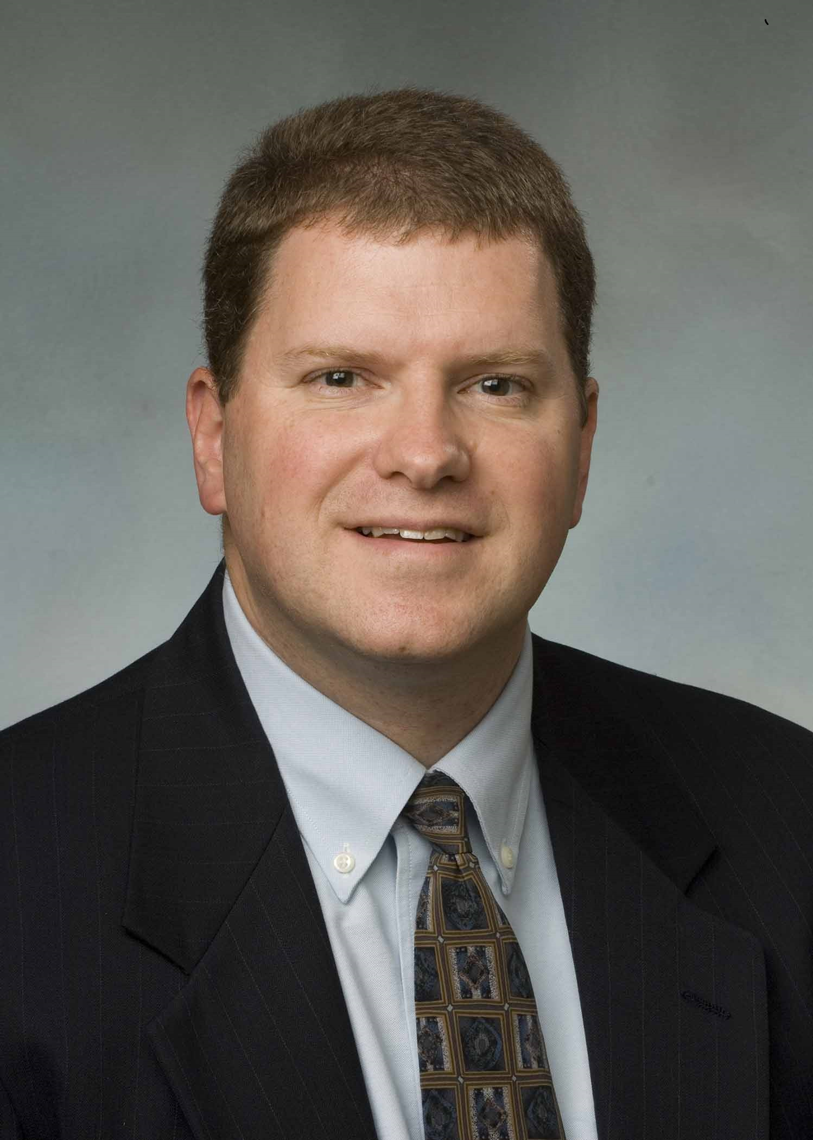
Presenters
Mark Yacavone, Assistant Vice President Enrollment Management
SUNY Cortland Mark.Yacavone@cortland.edu
Dean Reinhart, Ph.D. Associate Director Undergraduate Admissions
Buffalo State College Reinhadj@buffalostate.edu
Notes:
33 Years
6 campuses
25 years in SUNY
15 years at Buffalo State College

Slide 4
Finding the right fit begins with your help. In a year of paradigm shifts – from NACAC code of ethics changes, remote learning, and suspension of exams to reduced AP exam times and ever-increasing announcements of test optional policy rollouts – your role is even more important. These new changes, combined with the traditional college search challenges, can be overwhelming. Our goal is to provide solid resources, websites, and action plans that you can use and implement.
Notes:
Thank you to who introduces us,
Welcome,
Appreciate you taking the time,
Very much the same team here though on both sides of search process,
SUNY is here to Help, Please call on us,
To Varying degrees everyone of you is involved with the search process,
We hope to provide you with a lot of food for thought on the college search

Slide 5
Topics
Changes
Philosophy
Critical Thinking
Information
Campus Visit
Application Process
Grades/Transcripts
Recommendations
Extracurricular/ Essay
Final Thoughts
Questions
Notes:
Overview
About 605 million results for College Search Best practices
About 1.7 Billion results for college planning
Here are the definitive answers
Borrowed from lots of places and people

Slide 6
Changes: NACAC Code of Ethics and Professional Practices (CEPP)
voted to remove sections of the Code of Ethics and Professional Practices (CEPP) as it may violate antitrust laws and to institute a moratorium on enforcement of the entire document. (Summary)
Colleges must not offer incentive exclusive to students applying or admitted under an Early Decision application plan.
Once students have committed themselves to a college, other colleges must respect that choice and cease recruiting them.
Colleges will not knowingly recruit or offer enrollment incentives to students who have already enrolled, registered, have declared their intent, or submitted contractual deposits to other institutions. May 1 is the point at which commitments to enroll become final, and colleges must respect that
Colleges must not solicit transfer applications from a previous year’s applicant or prospect pool unless the students themselves initiated a transfer inquiry or the college has verified prior to contacting the student that they are either enrolled at a college that allows transfer recruitment from other colleges or are not currently enrolled in college.
Notes:
NACAC changes beginning to be subtle seen
Review the four changes briefly
Final results are yet to be known

Slide 7
Changes: Operation Varsity Blues
Parents, test administrators and college coaches were involved in a widespread effort to rig the college admissions process for children
More than 50 people in two sets of schemes: standardized test cheating and college acceptance bribery.
Entrance Exam cheating and Posing as athletic recruits
School counselors were among the first to identify the scandal
School Counselors and Admissions Professionals have not been identified as being involved.
Notes:
All over the news, and it does not help a process that is already seen as something not very transparent.
Reinforces beliefs that there are secrets and tricks

Slide 8
Changes: COVID
Remote Learning
Suspension of all Exams (Regents)
Deadline changing/moving
Creative grading from March 2020 on
AP moving online. IB exams not held
Visiting – Virtual tours and virtual information sessions
Open Houses
Standardized test
Notes:
The impact will be felt for years, likely going to see a lot of essays around this and we need to take this once in a hundred years pandemic in to consideration.

Slide 9
Changes: Standardized Test Scores
Notes:
The display considers the 868 institutions that were members in both 2019 and 2020 of Common Application.
55% of this group of institutions “always” required standardized test scores in 2019, while in 2020 only 17% of members will “always” require them.
The percentages of those “never” requiring standardized test scores increased from 11% in 2019 to 36% in 2020.
What About scholarships??
No Blanket statement/ tension of testing/ Kahn Academy

Slide 10
Philosophy - Truth
Anyone can go to college
Colleges need students
Lots of excellent schools and many very happy students
What varies is setting, size and location
2/3 get in to first choice, 93% get in first or second choice
Reality
Not objective, but subjective
Where, when and how do I start
Process
USE YOU SCHOOL COUNSELORS
Do not have to pay for help
Notes:
Reality = Ivy League numbers
2.9 million hs grads, 14,000 Ivy Leagus slots, 1600 Harvard
Against 38,000 valedictorians, saludatorians and class presidents
Only 59 schools have less than a 25% accept rate

Slide 11
Philosophy - Advice
Be Creative
Match to be made
Pick more than one first choice
Be Honest
Communication is key
Dialogue
Take a Risk
Relate to the Campus
Tell Their Story - Qualities; character and personality should show
Proofread, edit, rewrite
Don’t save the essay for last
Notes:
The display considers the 868 institutions that were members in both 2019 and 2020 of Common Application.
55% of this group of institutions “always” required standardized test scores in 2019, while in 2020 only 17% of members will “always” require them.
The percentages of those “never” requiring standardized test scores increased from 11% in 2019 to 36% in 2020.

Slide 12
Critical Thinking
Emergency Room Visit or Surgery?
Where you go to college matters less than, if you go to college
Make college a big deal not a particular college a big deal
Over 4,500 schools
Mail from almost all of them
Marketing
Business
Smiling Faces
Notes:
The display considers the 868 institutions that were members in both 2019 and 2020 of Common Application.
55% of this group of institutions “always” required standardized test scores in 2019, while in 2020 only 17% of members will “always” require them.
The percentages of those “never” requiring standardized test scores increased from 11% in 2019 to 36% in 2020.

Slide 13
Critically Think – Image and Branding
Notes:
Sample Brochure critically think
What emotion are they trying to invoke?
AWWWWWWW
“I want to hold a Bear, I am going there”
8,700 students likely not getting to hold a bear

Slide 14
Notes:
We can make fun of ourselves
Uchicago of the nations top schools
As you can imagine we secret shop and I just love Uchicago advertising

Slide 15
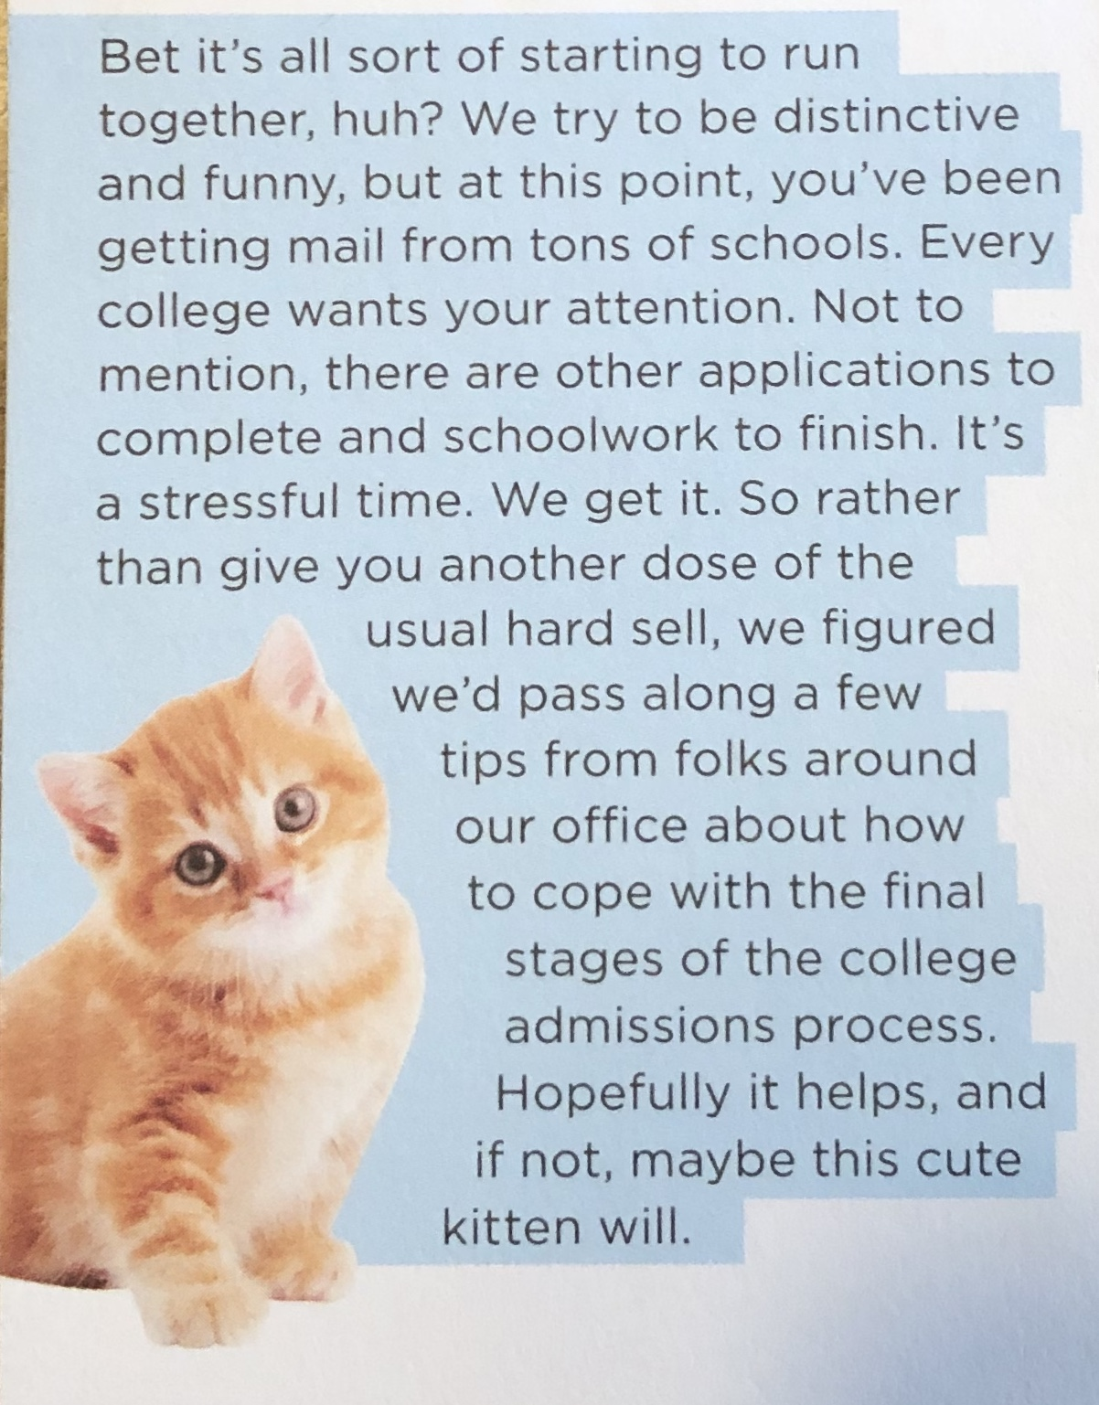
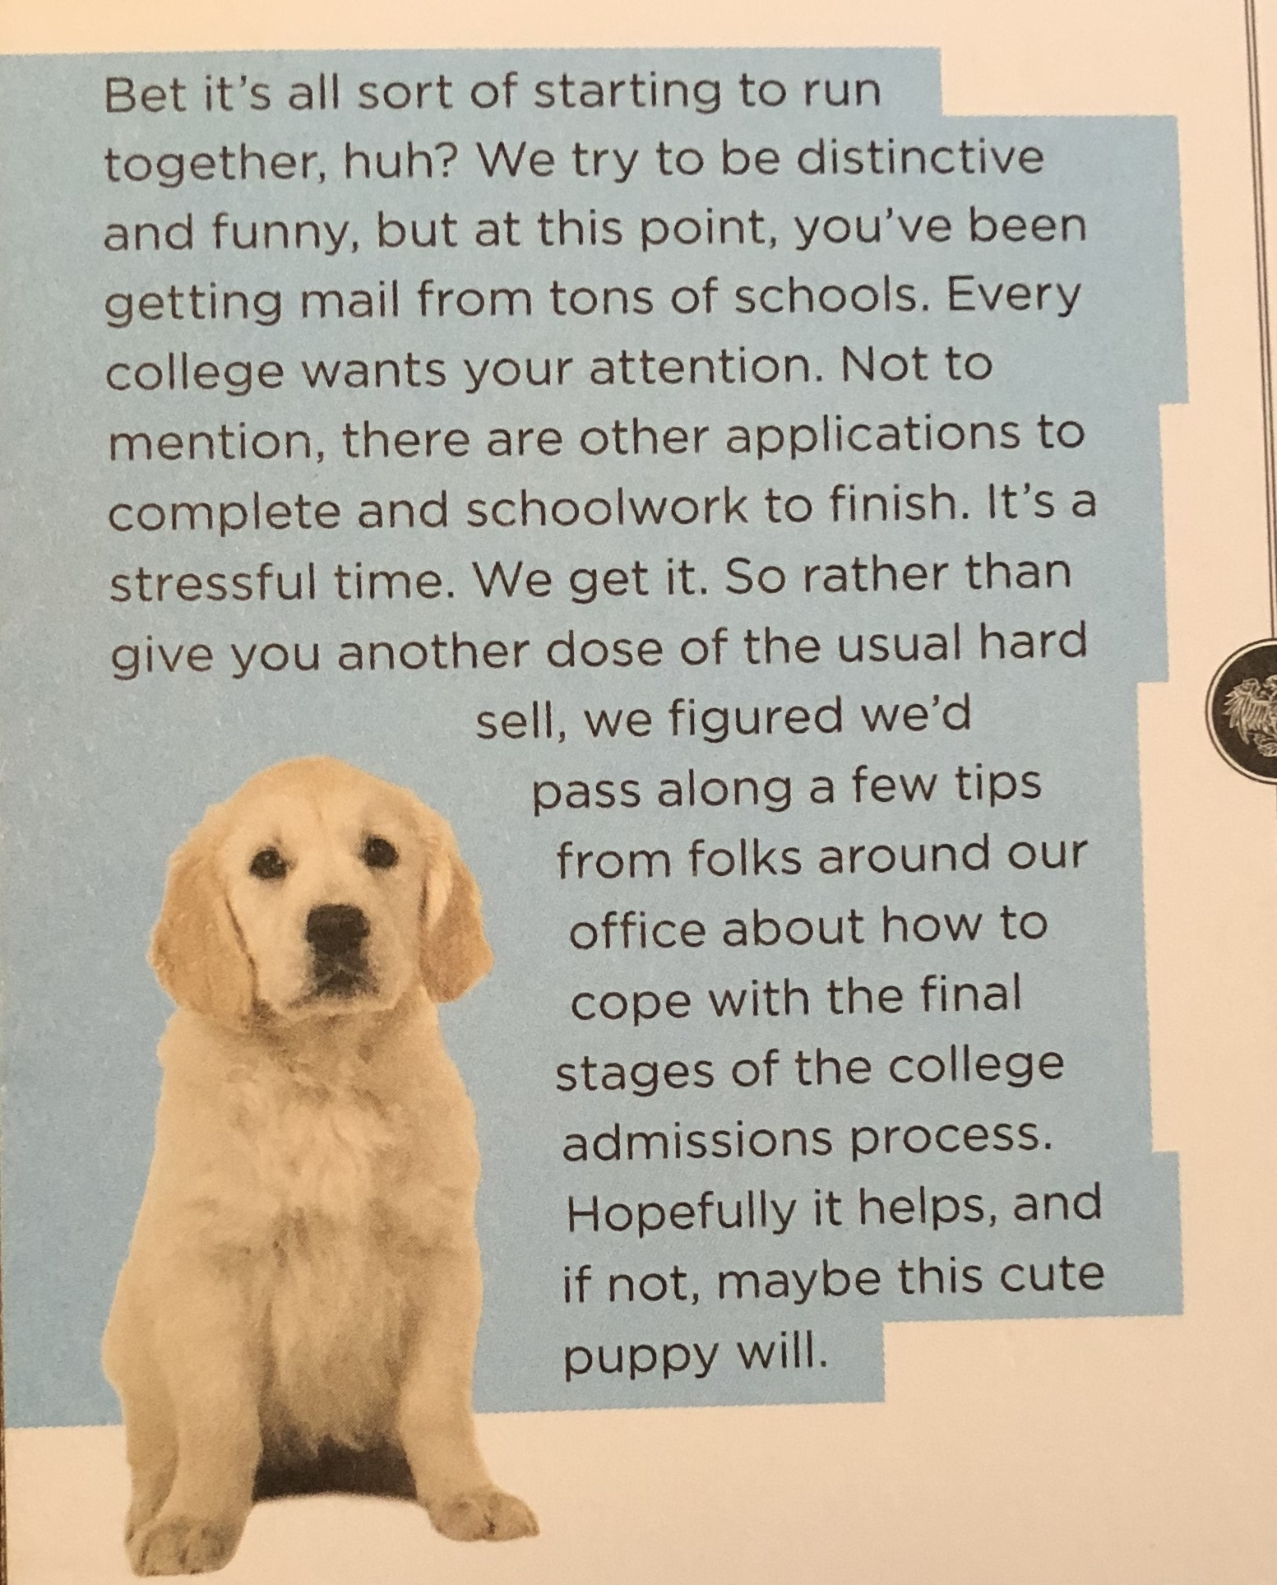
Critically Think – Image and Branding
Notes:
This a temporary suspension of testing requirements in light of the fact that students may have limited opportunities to take a standardized test this year.

Slide 16
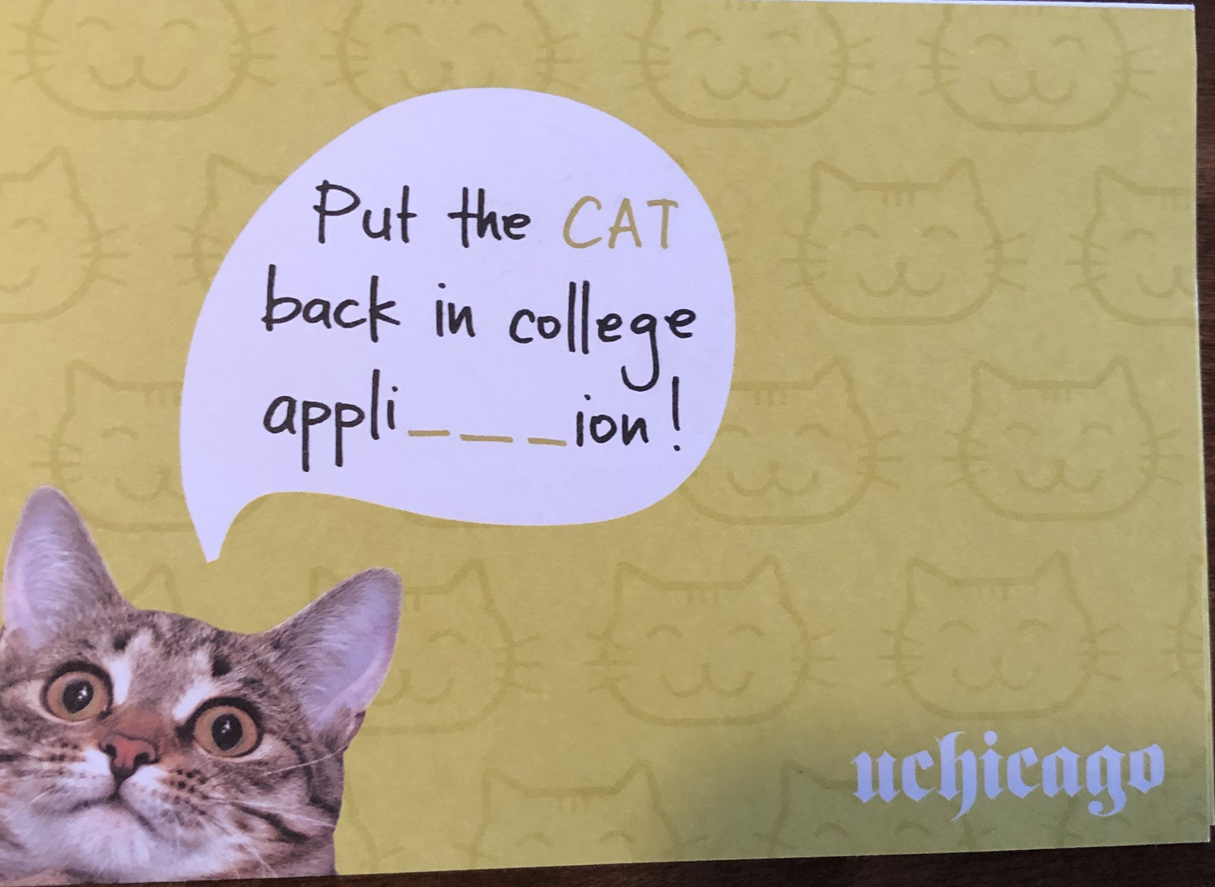
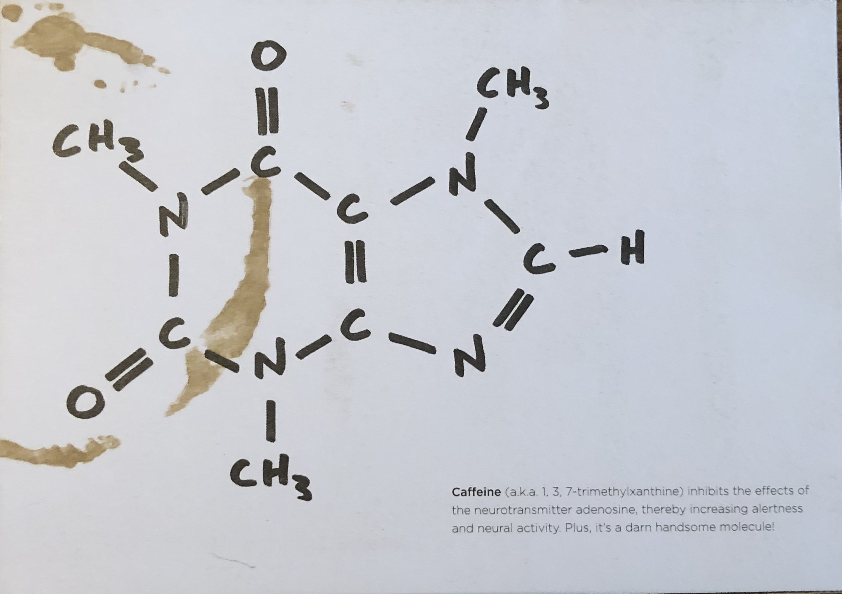
Critically Think – Image and Branding
Notes:
This a temporary suspension of testing requirements in light of the fact that students may have limited opportunities to take a standardized test this year.

Slide 17
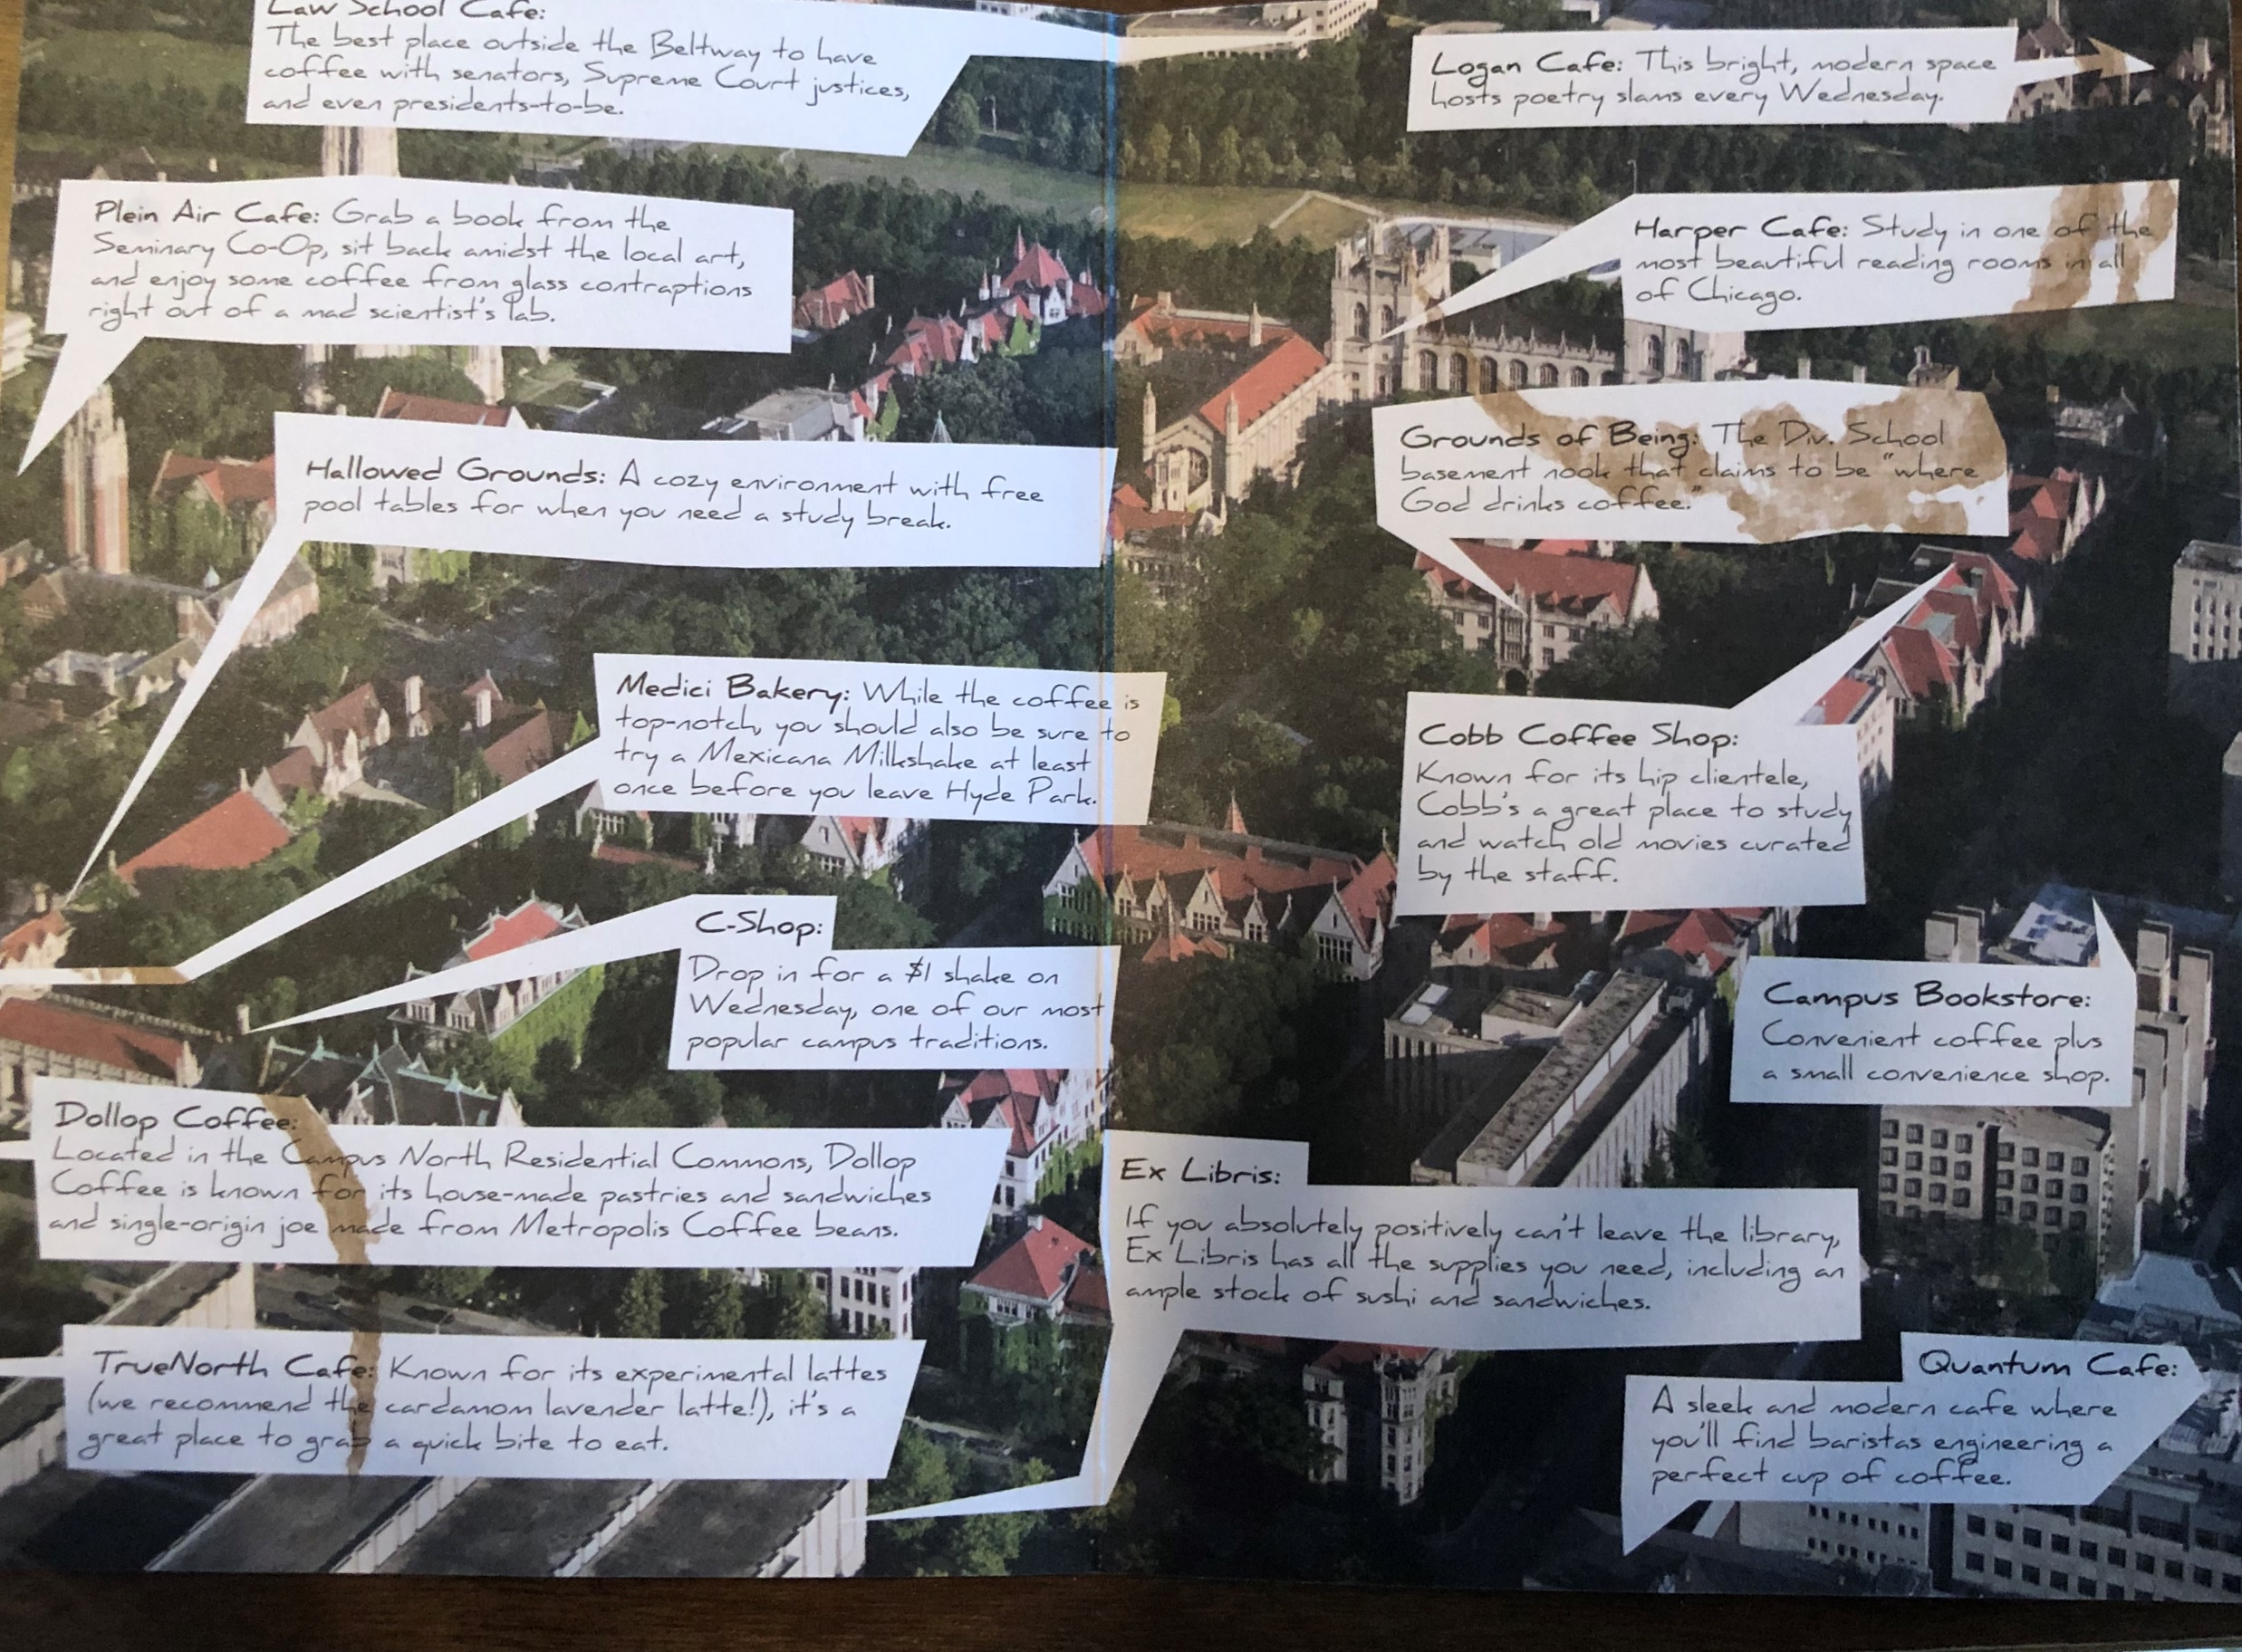
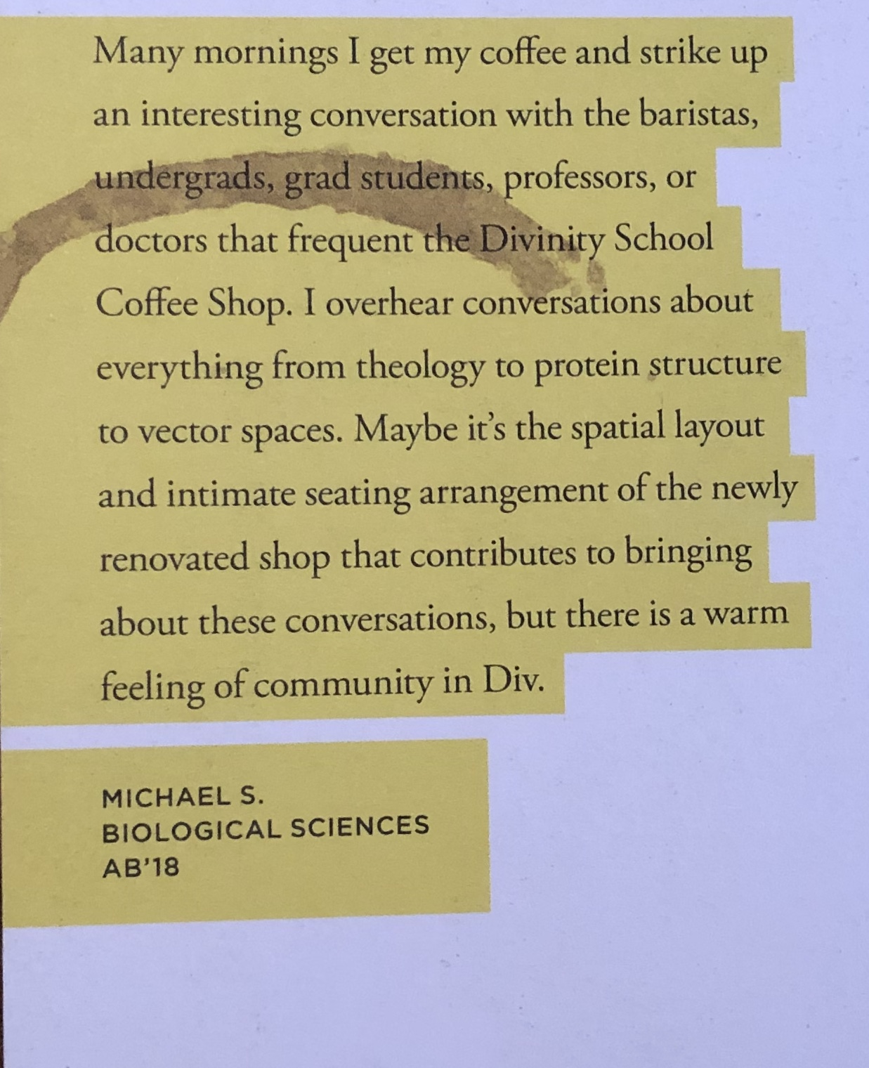
Notes:
This a temporary suspension of testing requirements in light of the fact that students may have limited opportunities to take a standardized test this year.

Slide 18
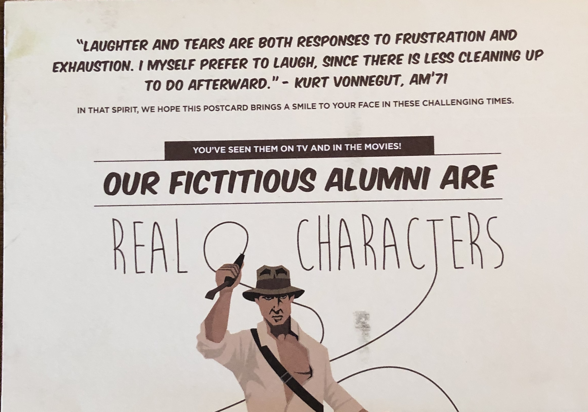
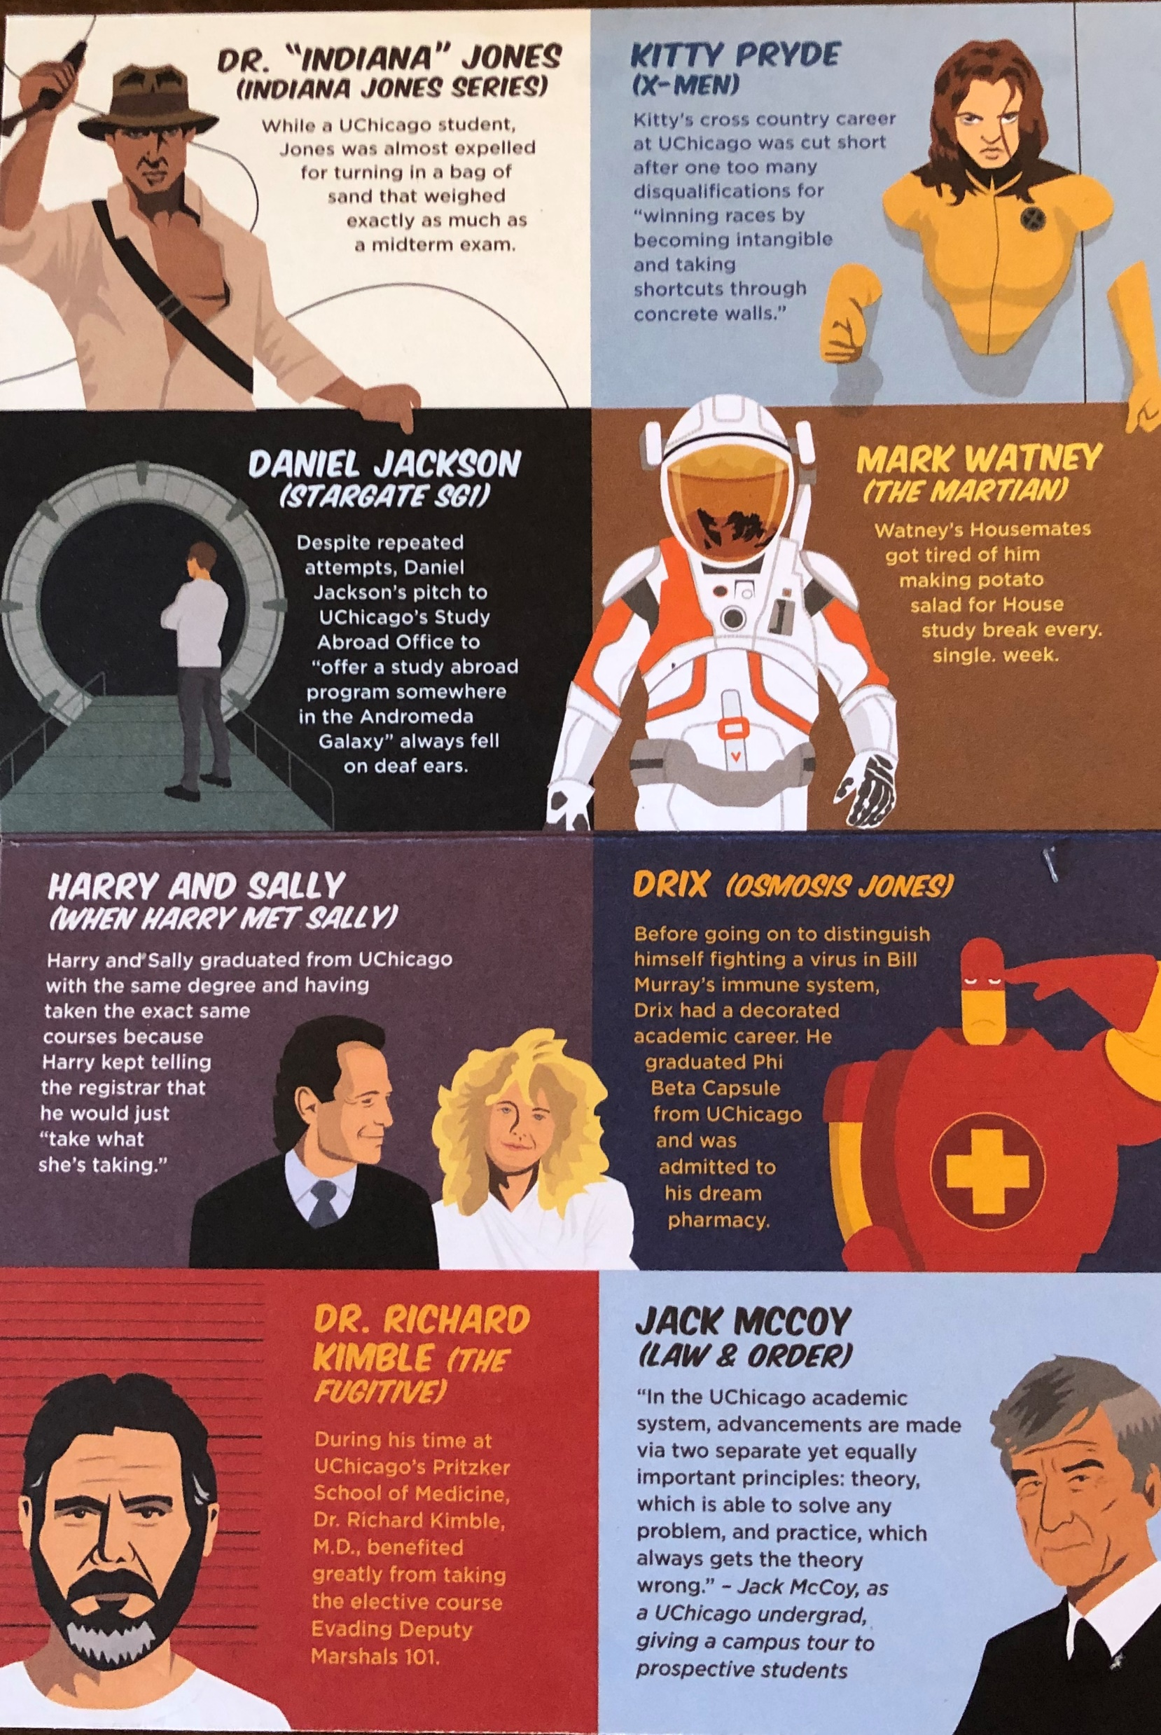
Notes:
This a temporary suspension of testing requirements in light of the fact that students may have limited opportunities to take a standardized test this year.

Slide 19
Information
Finding answers
Essential and accurate Info
Guidance from counselors, teachers, parents, family members, friends
Marketing fatigue
College websites, college fairs, visits, inbox and mail
Collegescorecard.ed.gov
Common Data Set _Insert college name
College Navigator (National Center for Education Statistics)
Sources often paid vendors
College finders need to be looked at critically
Software in schools
College Board - Big Future, Petersons, Naviance, Collegestats, Cappex, College Insight, College Confidential, Niche, Unigo, College Simply, College Xpress
Rankings
Notes:
It used to be VHS video mailed

Slide 20
RANKING FACTOR | NATIONAL | REGIONAL
GRADUATION AND RETENTION RATES | 22% | 22%
AVERAGE SIX-YEAR GRADUATION RATE | 17.6% | 17.6%
AVERAGE FIRST-YEAR STUDENT RETENTION RATE | 4.4% | 4.4%
SOCIAL MOBILITY | 5% | 5%
PELL GRANT GRADUATION RATES | 2.5% | 2.5%
PELL GRANT GRADUATION RATE PERFORMANCE | 2.5% | 2.5%
GRADUATION RATE PERFORMANCE | 8% | 8%
UNDERGRADUATE ACADEMIC REPUTATION | 20% | 20%
PEER ASSESSMENT SURVEY | 20% | 20%
FACULTY RESOURCES FOR 2019-2020 ACADEMIC YEAR | 20% | 20%
CLASS SIZE INDEX | 8% | 8%
FACULTY COMPENSATION | 7% | 7%
PERCENT FACULTY WITH TERMINAL DEGREE IN THEIR FIELD | 3% | 3%
PERCENT FACULTY THAT IS FULL TIME | 1% | 1%
STUDENT-FACULTY RATIO | 1% | 1%
STUDENT SELECTIVITY FOR THE FALL 2019 ENTERING CLASS | 7% | 7%
MATH AND EBRWOF THE SAT AND THE COMPOSITE ACT SCORES | 5% | 5%
HIGH SCHOOL CLASS STANDING IN TOP 10% | 2% | 0%
HIGH SCHOOL CLASS STANDING IN TOP 25% | 0% | 2%
ACCEPTANCE RATE | 0% | 0%
FINANCIAL RESOURCES PER STUDENT | 10% | 10%
AVERAGE ALUMNI GIVING RATE | 3% | 3%
GRADUATE INDEBTEDNESS | 5% | 5%
GRADUATE INDEBTEDNESS TOTAL | 3% | 3%
GRADUATE INDEBTEDNESS PROPORTION WITH DEBT | 2% | 2%
TOTAL | 100% | 100%
2020 USNEWS ranking-criteria-and-weights
https://www.usnews.com/education/best-colleges/articles/ranking-criteria-and-weights
Notes:
This a temporary suspension of testing requirements in light of the fact that students may have limited opportunities to take a standardized test this year.

Slide 21
Information Points
Subjective Tier: reach, target, safety Status: rejected, gather [more info], consider [applying], apply, applied, denied, accepted Reason: reason for the status
School Data Name, location, 25th and 75th percentile SAT, admission rate, cost, graduation rate (6 yr) size, number of undergrads, majors, first year % living on campus, undergrad % living on campus, % of in-state students, residence halls and dining,
Applications Deadline, aid deadline, teacher recommendations, and essay writing;Test scores: optional, self report, official; subject tests: no, recommended, required;Essays: N/A, ignored, optional, recommended, required, supplemental, honors;Teachers Recommendations: min–max [+ counselor recommendation]; Other Recommendations: min–max (coaches, employers, etc.) Applications: Common, Coalition, school's own (when required)
Miscellaneous Affiliation: public, private, religious Nickname; Distance; Mascot; school colors
Notes:
It used to be VHS video mailed

Slide 22
Campus Visits
Reservations required
Summer gives broad overview –
Don’t visit too many or they blur
Go with set of questions you want answered
Campus tour / admissions presentations / interviews
More focused tour in fall of top schools
Ask for specific tour/Dept meet
Outside of classroom is important
Virtual options?
Notes:
Visit lots of campuses over time not all at once
Stomach check
Make an appointment/walk around on own
15 hours
Positive/Negative where it ranks – (get contact)
Look for things that matter to you
Major 70% change/ 50% again undecided is OK – General Education
Clubs/organizations/athletics/intramurals/housing/ study abroad/ honors program
E-mail, phone messages be careful (Eric the situation) (Touch me back) (Music)
Apply to schools who you want to go to
Find a fit
In college you can reinvent self (no one knows you)
Realistically find a good fit, not one others say is a good fit.
A lot transfer back to western NY (Wegmans and Target, same jacket)
Go with what they want, be independent

Slide 23
Application Process
SUNY Application
Common Application
Coalition Application
Local Application (mainly community colleges)
Processing time
Downloads/Mailing
Confirmation/Reminders
Student communication/Counselor communication

Slide 24
Information Provided by Counselor
High School Transcript
Letter of Recommendation
School Profile
Individual email/phone call
Notes:
Transcript Review
Strength of Schedule as compared to what is offered at your school
Rigor and taking 4-years of subjects
Late arrivals and early dismissals
Avoiding Senioritis
LOR- Bullets are okay, most impactful for borderline students
Three piles
80% of time on 20% of the applicants
Look for reasons to admit but don’t feel guilty saying not yet

Slide 25
Information Provided by Student
Application
Resume
Essay
SAT/ACT Scores
Personal Statement
Interview/Audition
Demonstrated Interest (some campuses)
Notes:
Application seeks to put everyone on equal footing
But we want to get to know individuals
We use the Resume, and essay to get to know the student individually
Likelihood of enrollment is a value added (Fish where fish are)

Slide 26
What Matters?
demonstrated
interest
community service
personal statement
extracurriculars
talent
diversity
EVERYTHING
rigor
opportunity
passion
high school
performance
grit
academics
letters of
recommendation
Notes:
Each college has its own specific way of reviewing applicants but the general process of most SUNY schools is remarkably similar. What is the difference between a first read and committee review? What stands out on a transcript? What non-quantitative factors are considered and how? During this interactive presentation, SUNY Admissions representatives will provide counselors with tangible examples and screen shares of how we review an applicant.

Slide 27
Colleges Consider:
Academic performance
Standardized tests
Activities and involvement
Letters of recommendation
College essay/personal statement
Personal interview
Demonstrated interest
Notes:
Transcript Review
Strength of Schedule as compared to what is offered at your school
Rigor and taking 4-years of subjects
Late arrivals and early dismissals
Avoiding Senioritis
LOR- Bullets are okay, most impactful for borderline students
Three piles
80% of time on 20% of the applicants
Look for reasons to admit but don’t feel guilty saying not yet

Slide 28
Grades / Transcripts
Strength of schedule
Coursework
Sequence
Subjects
Academic performance (GPA and class rank)
Test scores
Notes:
Early Decision / Early Action
Looking to admit / Don’t rule yourself out
Academic record (AP and Honors)
4 years English / Social Studies
3 years Science / Math / Second Language
Strength in one area

Slide 29
Restricted Programs
Restricted programs tend to be more quantitative-based
Nursing
Engineering
Sound Recording Technology
Accounting
Hard sciences
Focused on student success
Admitting students who will be successful with current levels of support
Rigorous majors

Slide 30
Recommendations
Submit 1 – 3 letters, even if not required
Value of selection
Offers different perspective on a student
Give time and instructions and format of required letter
Provide an activities resume and transcript
Write a thank you note

Slide 31
Recommendations
Avoid form letters that simply replace name and pronouns
Bullets are ok to use
Include student’s name and date of birth
Use letterhead to identify where it is from
Letters are very beneficial especially for students on the “bubble”
Letters give additional insight to tie together the other pieces on the application
Provide additional insight instead of restating application details
Work ethic, response to adversity, overcoming obstacles
OpInform 2017

Slide 32
COLLEGE ESSAY/PERSONAL STATEMENT
student’s personal introduction to the admissions committee
The essay is the student’s voice and opportunity to share who they are
Provides non-cognitive variables to relate to the student
Opportunity to share personal values and story
Choose your topic carefully
Essays should be unique, but not weird
Follow the directions
Proofread, edit, rewrite
Don’t save it for last!

Slide 33
Activities and Involvement
Meaningful, sustained community service
- Immersed in the experience
- Emotional awareness
- Develops a sense of responsibility
Leadership positions
- In school or within the community
Continuous commitment
- Dedication demonstrated, not just one time event
Employment vs. activities
- Demonstrates responsibility
Quality not quantity of activities
Service/Volunteerism
Involvement leads to opportunity

Slide 34
Final Thoughts
Students
Parent/ Guardian
Questions
Extra’s
College Search Organizer
College Cost Organizer
Notes:
Dialogue with students,
Need to lead this process
Set up time to discuss schedule an appointment
We talk with more parents than students
Nerve racking process
Parents job is to love their child and that is where they are coming from
Be able to explain the choice you make

