Slide 1
Student Membership and Attendance Procedures Manual http://tn.gov/assets/entities/education/attachments/331958_membership_attendance_manual.pdf
What is it?
why use it?
Who needs it?
Angela Hargrave
Director of Attendance and Discipline

Slide 2
Rules are Necessary
https://www.youtube.com/watch?v=Lju4BweO7zQ&list=PLANVMX4PIUhVGNMHLSj8iNV-Sm6v3VxmZ

Slide 3
What Is It?
With the adoption of the Education Improvement Act of 1992, school systems moved into a more precise era of budgeting and accountability practices.
Special procedures and legislative requirements have been put in place to ensure accuracy and equity among school systems’ data and the distribution of funds for educational purposes. With the conversion to the EIS system and SSMS, it is even more important that the principles of attendance record-keeping are known and utilized so that all systems receive the monies they earn.

Slide 4
What Is It?
The purpose of this Student Membership and Attendance Procedures Manual is to provide local education agencies a clear and concise method of obtaining student counts for budget purposes, as well as a standardized method of reporting for school accountability.
The minimum standards found in this manual apply to all school systems in Tennessee. The manual includes a number of membership/attendance accounting procedural changes either required by legislative action, or recommended by attendance supervisors and user technicians.

Slide 5
Why Use It?
Documentation, Record Keeping, and Reporting
School Year and Day
Enrollment and Membership
Attendance
Enrollment and Attendance Coding
Alternative Education Programs
Transportation
Definitions and Abbreviations
Options of Special Education Services
Migrant and Homeless Students
Legal Appendix

Slide 6
Useful Information
The State minimum attendance day for 1st -12th grade is 6.5 hours.
The State minimum day for Kindergarten is 4 hours.
Every student has the right to have the opportunity to attend 180 days of school.
All attendance records must be kept for five years.
Provide attendance information from student attendance records for cumulative folder at the end of the year.

Slide 7
Student Record Sharing
Pursuant to T.C.A. §49-6-3401 and the Federal Family Educational Rights and Privacy Act (FERPA), if a student transfers from a school to another school in the same LEA or to another LEA, the LEA shall remit copies of the student’s records, including disciplinary records, to the school to which the student transfers.
All records shall be remitted in accordance with FERPA, compiled in U.S.C. § 1232g.

Slide 8
Documentation, Record Keeping and Reporting
This section defines what must be done in order to document, maintain and report attendance. (Pg. 5)
Every school system must have the following documentation on file at the central office or individual school:
Board approved attendance policies which comply with Procedures Manual (Central Office)
Daily absentee sheets with sign-in/out rosters attached indicating present or absent students for at least half of the state minimum day (Individual School)
Documentation indicating procedures for notifying parents and/or the attendance supervisor of students’ absences (Central Office)

Slide 9
Documentation, Record Keeping and Reporting
For withdrawals, sufficient documentation of a student’s reason for withdrawal. This may include documentation provided by relatives, court documents, record requests, etc. This documentation should be kept in the student’s permanent record. (Individual School)
Documentation that the names of students between the ages of 15 and 17, (inclusive) who do not have satisfactory academic progress or do not meet attendance standards as stated in T.C.A. § 49-6-3017 have been submitted to the Department of Safety. (Individual School)

Slide 10
Documentation, Record Keeping and Reporting
Attendance records (teacher’s attendance records, sign-in/out rosters, absentee lists)
If conflicts between teacher records and other records relating to excused or unexcused absences occur, the information recorded in the school office data file shall prevail.
Excused or unexcused absences are a matter or local board as long as the local policy is not in conflict with state law.
Teachers must document attendance daily during the 1st two weeks to maintain accurate records

Slide 11
Documentation, Record Keeping and Reporting
In-school suspension students, homebound, homebound pregnant, alternative school or program students and students participating in school sponsored events are not counted absent and their attendance is used to calculate ADA and ADM.

Slide 12
Documentation, Record Keeping and Reporting
Temporary records may be kept during the first two weeks of school; however, attendance must be marked daily beginning with the first day of school.
Absentees are posted to the computer daily.
Schools should print and distribute absentee list.

Slide 13
Retention of Records
You must keep these documents for five (5) years:
District’s Monthly Student Membership/Attendance Report
District’s Annual Student Membership/Attendance Report
Principal’s Monthly Membership/Attendance Report or equivalent
Monthly Attendance Detail

Slide 14
ATTENDANCE FLOW CHART FOR SCHOOLS

Slide 15
Scenario
This is the ADA and ADM for a Pre-K student enrolled for the entire calendar year.
Since Pre-K is not mandatory, it is not important to report attendance and membership for Pre-K.
Notes:
Collecting data for Pre-K is not mandatory for the State of TN.

Slide 16
Scenario
All pre-k programs receiving state, federal or local funds in any way, including but not limited to: Pilot, lottery, voluntary expansion, local, Title I, and special education are required to collect and report pre-k data to the Tennessee Department of Education. This information is vital for reports submitted to the Governor, General Assembly and other state and federal agencies. To capture the necessary data, local education agencies (LEAs) and offsite pre-k locations are required to:
a) Enroll all pre-k students (including students receiving special education services or offsite related special education services only)
b) Create school calendars
c) Set up staff data
d) Schedule classes and assign students and staff to each class
e) Capture and maintain accurate attendance information
Notes:
Collecting data for Pre-K is not mandatory for the State of TN.

Slide 17
School Year and Day
For reporting purposes, the school year is defined as the period of time between August 1 and June 30.
Membership and Attendance accounting for each student will be on the basis of the amount of time a student is enrolled for an instructional day.
School Systems may schedule any three of the 180 instructional days as abbreviated days. These dates shall be specified on the 200 Day Accountability. The dates of these abbreviated days must be approved by the local school board.

Slide 18
School Year and Day
Since the state minimum day is six-and-one half hours and four hours for kindergarten students, any time less is considered abbreviated day.
Students not in school on any day for at least half the time of which they are enrolled should be considered absent for state reporting.
A system that has a school day exceeding six-and-one half hours by at least 30 minutes throughout the entire school year and notifies the State at the beginning of the school year via its District Calendar in EIS that the system is stockpiling.

Slide 19
Stockpiling Days
In computing the excess time, only those 30 minutes above the usual six-and-one half hour day may be accumulated.
The system will have to account for 180 instructional days even though up to 13 of these 180 days may be excess time days.
The term instructional day includes lunch period, activities period, assembly period, recess period, etc.
Each monthly membership/attendance report must be a 20-day period, with the exception of the ninth month.

Slide 20
School Year and Day
School emergencies may result in schools closing early. In order to protect 180 days of instructional time, the following are options:
Reduce time scheduled for Spring break
Extend the school year ( the school year can legally be extended to June 30).
Schedule classes on Saturdays
Increase the length of school day by a minimum of 30 minutes for a period adequate to accumulate the equivalent of the days lost.

Slide 21
School Year and Day
School systems may elect to use staggered (flexible) scheduling for kindergarten classes by policy of the local board of education.
Systems may establish policies that include opportunities for students to attend make-up sessions outside the regular school day in order to regain credit/time lost due to absence from school. However, if a student is absent from school, he/she is considered absent for ADA purposes. To direct teachers to change attendance reports when a student was actually absent is a violation of T.C.A. § 49-5-201 which states that teachers shall record accurately the number of pupils present and the number absent each day.

Slide 22
Scenario
Your LEA’s bell times are 7, 8 and 9 am. It starts to flurry at 9:15am, however classes are scheduled for dismissal at 10:30am, 11:30am and 12:30pm. A parent arrives to check out a student at 10:00 am from the 8:00 am school. Is this student counted present or absent for the day?

Slide 23
Scenario
If students are dismissed from school, determination of whether the day can be counted as a full instructional day is based on the earliest class in session within your system.
Example: School is in session and the students are released due to snow at 10:30. The earliest class started at 7:00 AM at the high school. Therefore the entire system is credited for an instructional day because some students were in class for the minimum 3.5 hours.

Slide 24
Enrollment and Membership
For the purposes of recording and coding student absences from school because of disciplinary action, the following definitions shall apply:
In-School Detention- removed from regular classroom but not from the school.
Suspension- dismissed from attendance at school for any reason for not more than ten (10) consecutive days.
Remand- assignment to an alternative school or program.
Expulsion- removal from attendance for more than ten (10) consecutive days or more than 15 days in a month of school attendance. The school district shall not be eligible to receive funding for an expelled student.

Slide 25
Enrollment and Membership
Students who qualify for services under the Individuals with disabilities Education Act may be suspended only within the provisions of said Act.

Slide 26
Scenario
The state of Tennessee educates children between the ages of 6-17. There are several undocumented immigrants trying to enroll at one of your high schools. The school is requesting that these students provide a birth certificate. Can they require this document?
Notes:
No……pg. 24 c-106

Slide 27
Scenario
No. Page 24 addresses immigrant students.
This also encompasses undocumented and refugee students.
Notes:
No……pg. 24 c-106

Slide 28
Enrollment and Membership
All students in Tennessee regardless of their immigrant status, are entitled to a free public school education as determined by a U. S. Supreme Court ruling (Plyer v. Doe, 1982)
In 1982, the Supreme Court rules in Plyler v. Doe , 457 U.S. 202 (1982), that public schools were prohibited from denying immigrant students access to a public education. The Court stated that undocumented children have the same right to a free public education as U.S. citizens and permanent residents. Undocumented immigrant students are obligated, as are all other students, to attend school until they reach the age mandated by state law.

Slide 29
Enrollment and Membership
A dropout is an individual who:
Was enrolled in school at some time during the previous school year;
Was not enrolled at the beginning of the current school year.
Has not graduated from high school or completed a state-approved educational program;
Withdrawal codes may be found on page 41 of the manual. A pre-k student may be deleted when the student leaves pre-k within six weeks of initial enrollment and waits until the next school year to begin school or when the child was pre- registered (pre-enrolled) for pre-k and never showed up. When the child has attended school or after the initial six week period, withdrawal code 10 should be used (homeschool)

Slide 30
Attendance
Each school system shall maintain a term of not less than 180 days for classroom instruction.
All students must have the opportunity to attend school for 180 days of classroom instruction. Failure to comply will result in penalties against the school system
Attendance must be marked daily
The local School board shall adopt a procedure for attendance accounting, including symbols to be used.

Slide 31
Attendance
Parents or guardians must be given written notice each time a student misses five unexcused days (this means an aggregate or five days during the school year and not necessarily five consecutive days).
Dismissal of students for parent conferences may not occur during any of the 180 instructional days, unless it is maintained in the school’s master calendar and provided that the classroom instruction time is made up in full.

Slide 32
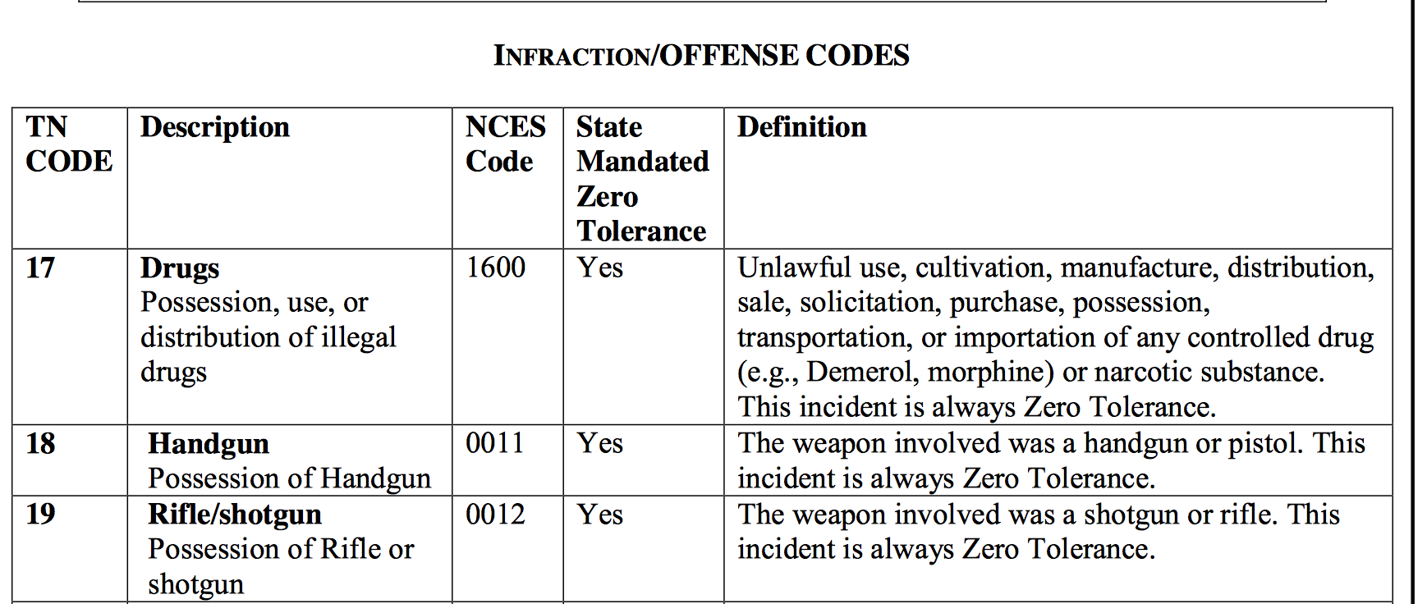
Infraction/Offense Codes
Infraction/Offense Codes can be found on pages 38-41 of the Procedures Manual.
These pages include the TN Codes, Descriptions, and Definitions of all State Reported Offenses
Example:

Slide 33
Who Needs It?
School Attendance Clericals
School Administrators
District Administrators
Transportation Coordinators
Alternative School Staff
Pre-K Staff
Special Education staff
Anyone responsible for student data

Slide 34
Where to Find
Student Membership and Attendance Procedures Manual can be found at:
http://tn.gov/assets/entities/education/attachments/331958_membership_attendance_manual.pdf

