Slide 1
Southeast New Mexico STEPS Network

Slide 2
Southeast New Mexico STEPS Network - Board Members
Dave Small – Pres.
Danny Owens – VP
Scott Ford – Sec.
Judy Goodwin – Tres.
Advisory Members
Charlie Vannatta – At Large
Terry Colwell – Sponsors
Andy Francis – IT
Darrell Martinez, David Long – Outreach
Steve Sauceda – Speakers/NMJC
Jeff Walker – DOT
Melissa Barker – NM OSHA

Slide 3
Thank you Ron Todd

Slide 5
Southeast New Mexico STEPS Network
Next Meeting
^{July 16}
Artesia – Devon (tentative)

Slide 6
Southeast New Mexico STEPS Network
2015 Elections
Nominations for:
President
Vice-President
Secretary

Slide 7
Southeast New Mexico STEPS Network
NM MTP
Mike Weatherly
Bryan Credeur
Chris Mydock

Slide 8
Southeast New Mexico STEPS Network
Keith Vital
Road Transport Field Guide
Shell

Slide 14
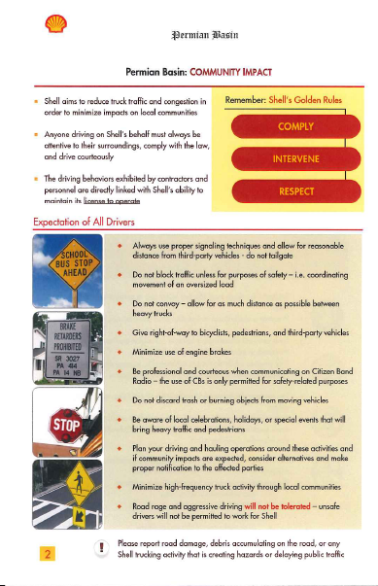
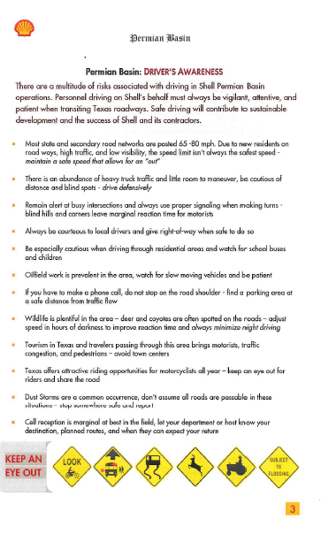

Slide 15
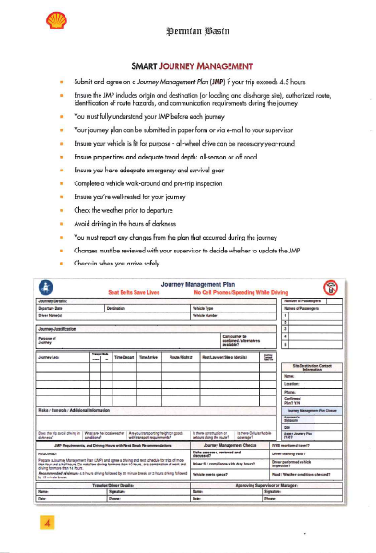

Slide 16
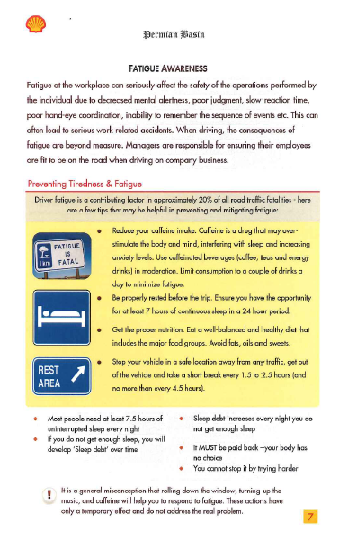

Slide 17
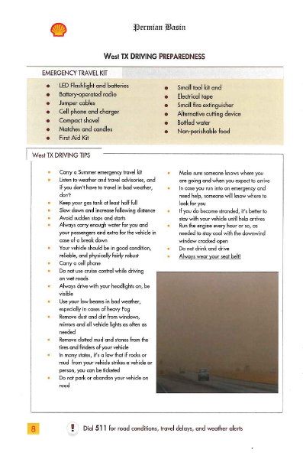
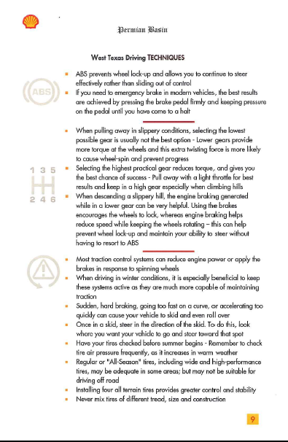

Slide 18
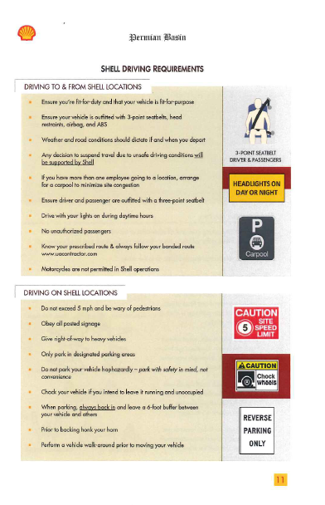

Slide 20
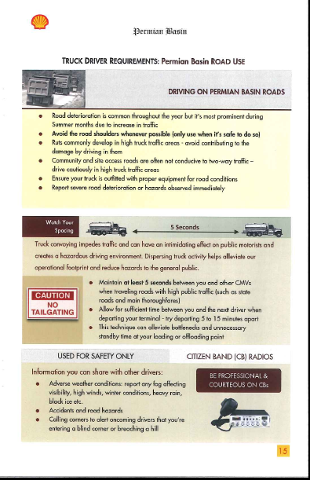

Slide 21
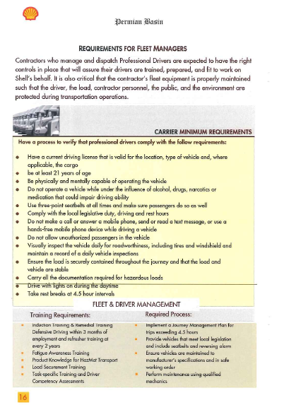
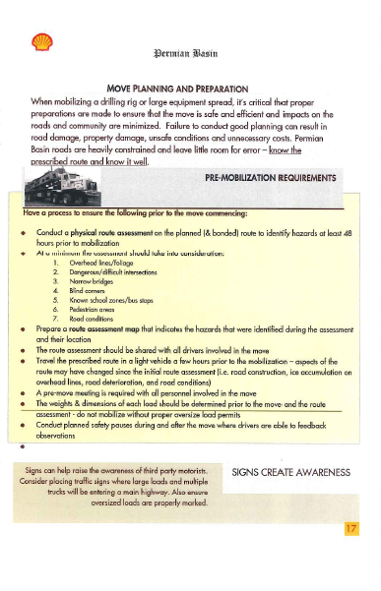

Slide 22
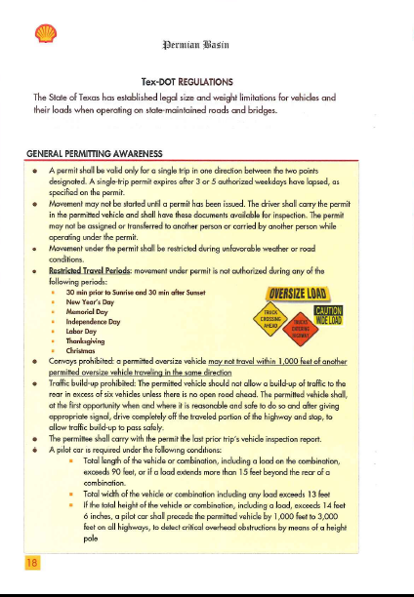
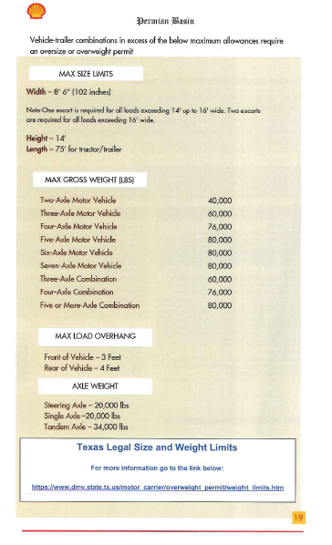

Slide 23
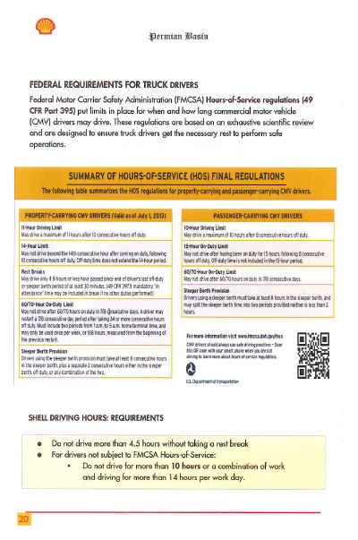
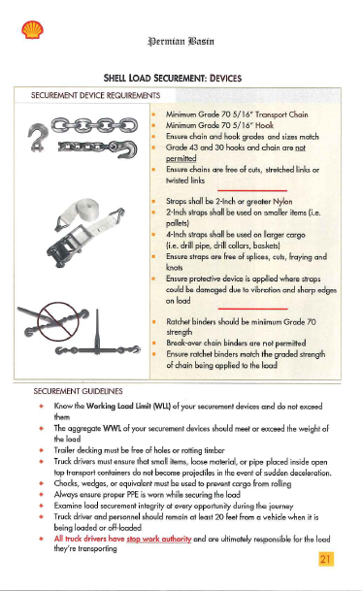

Slide 24
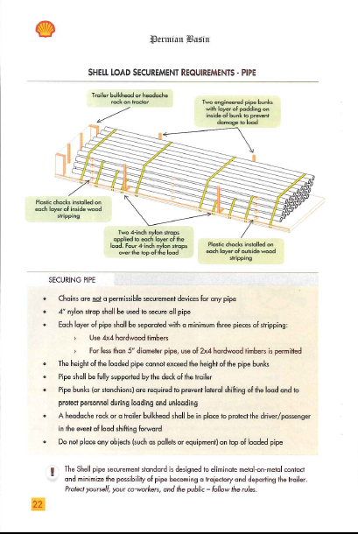
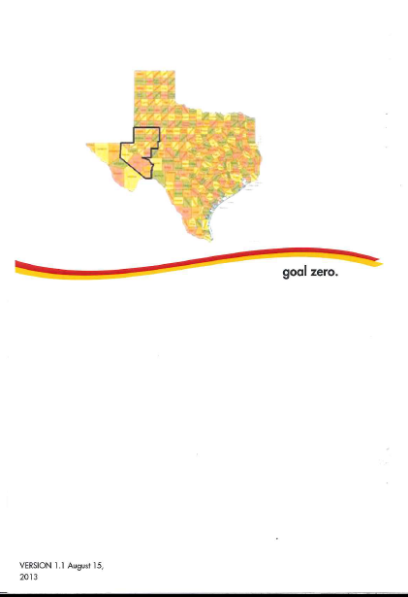

Slide 26
Southeast New Mexico STEPS Network
Table Top Discussions
Near Misses

Slide 27
Southeast New Mexico STEPS Network
Table Top Discussions
Near Misses
Table Presentations

Slide 28
Southeast New Mexico STEPS Network
NM OSHA
Melissa Barker

Slide 29
Rig/Heavy Equipment Move Task Force
SENM oil and gas industry, local utility companies and NM OSHA have joined together to establish a Rig/Heavy Equipment Move Task Force.
The task force will focus on prevention of injuries and electrocutions associated with equipment moves by developing and communicating best practices for the oil and gas industry in SENM.
The first meeting took place on April 15, 2014 in Artesia.
The next meeting will take place in July – date, time and location TBA.
For more information contact Melissa Barker with NM OSHA at (505)222-9595 or melissa.barker@state.nm.us

Slide 30
Southeast New Mexico STEPS Network
2015 Elections
Nominations for:
President
Vice-President
Secretary

Slide 32
Thank you Ron Todd

Slide 33
Southeast New Mexico STEPS Network
Closing Prayer
Steve Sauceda

Slide 34
Southeast New Mexico STEPS Network
Next Meeting
July 16
Artesia – Devon (tentative)

