Slide 1
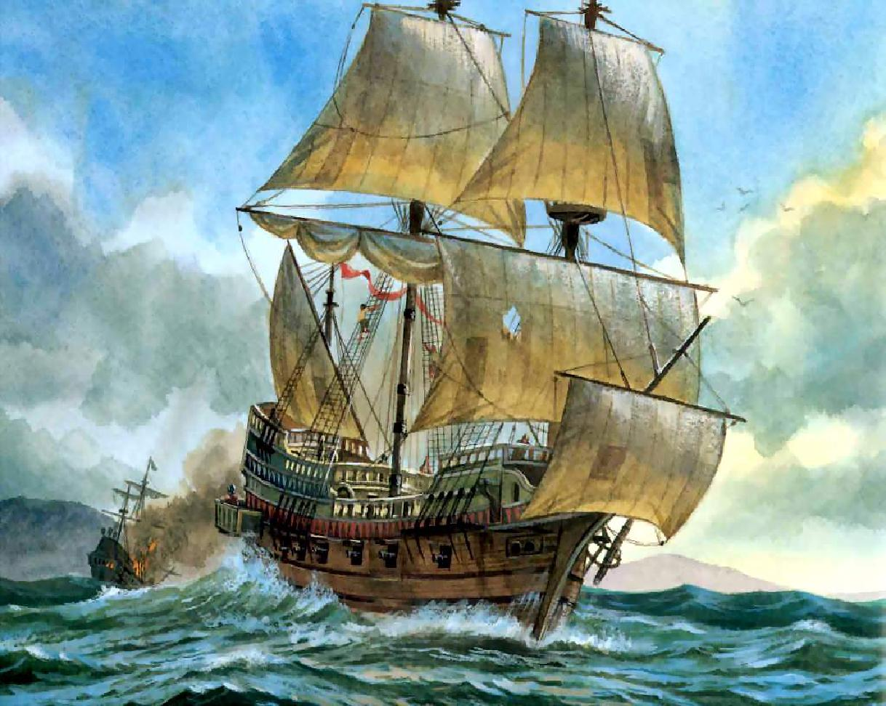
Age of Exploration

Slide 2
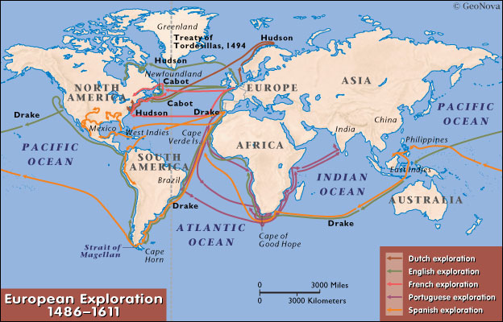
What Was The Age of Exploration?
A time period when Europeans explored the globe.
Portugal
Spain
England
France
Began in the early 15th century and lasted until the 17th century

Slide 3
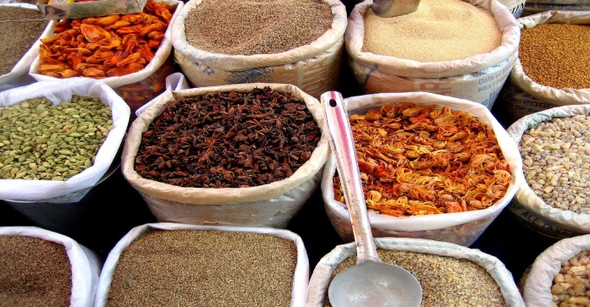
What Motivated Europeans to Explore?
Wanted to expand trade by:
Finding New Goods
Raw materials (gold, silver, spices, etc.)
Creating New Markets
(new people to trade with)
Establishing New Trade Routes
Faster/more efficient routes to Asia
Spice and silk trade
More Trade=More Wealth=More Power!!!!

Slide 4
What made exploration possible?
New Technology
Compass – navigation tool for finding direction on the ocean
Gunpowder – military advantage for subduing native peoples
Astrolabe – navigation tool using the stars to locate ones’ position in the ocean
Caravel (ship) – hull design and sails allowed ships to sail the oceans
Cartography – map making improved

Slide 5
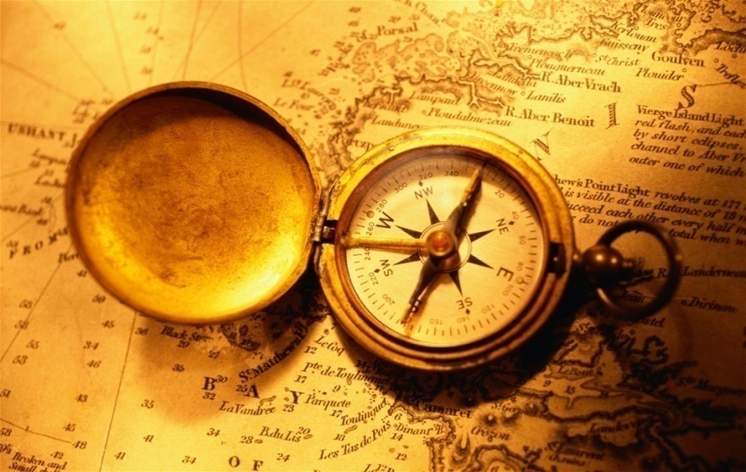
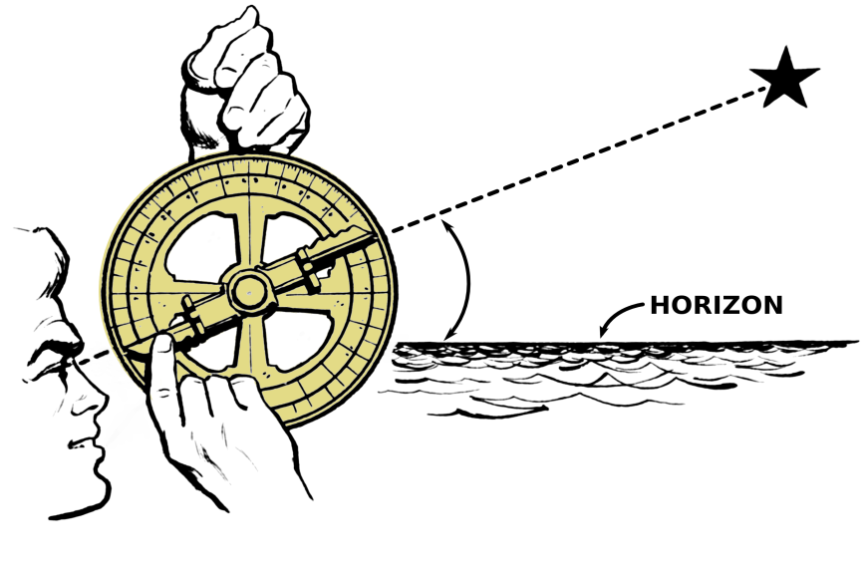
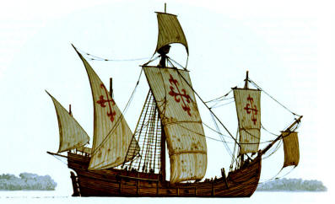
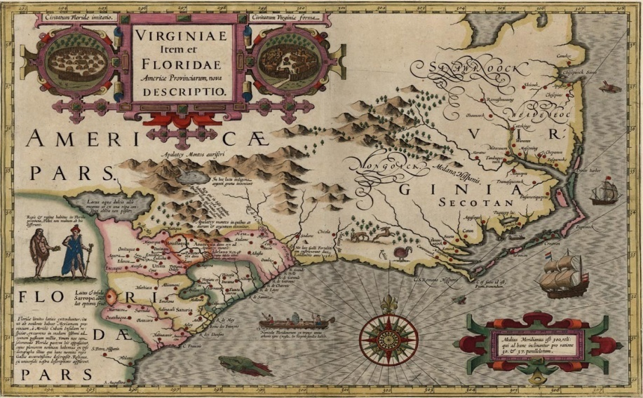

Slide 6
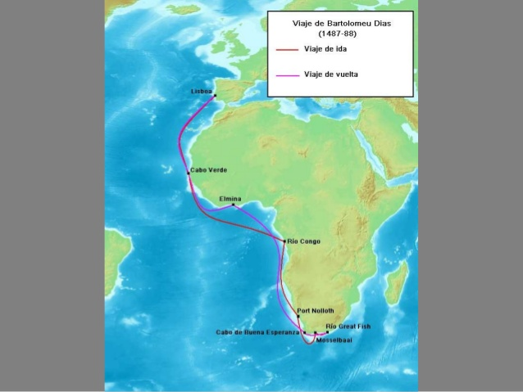
Famous Explorers
Bartolommeo Dias
Sailed around Good Hope at Southern Tip of Africa
Found route to Indian Ocean
Opened up trade from Europe to Asia

Slide 7
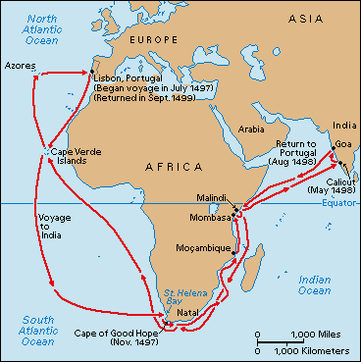
Famous Explorers
Vasco De Gama
He was the first European to reach India by sea
Linked Europe and Asia by ocean route for the first time

Slide 8
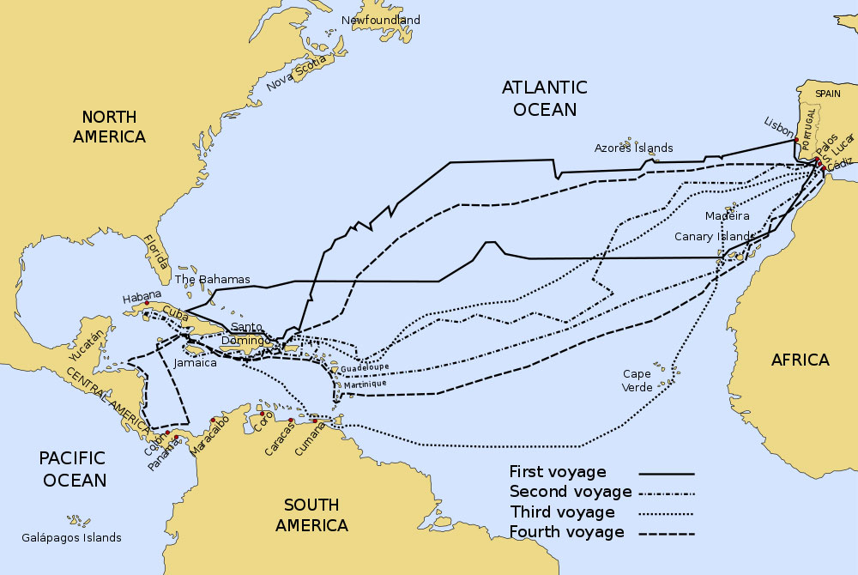
Famous Explorers
Christopher Columbus
Believed a shorter route to Asia existed if you sailed West rather than east.
Bumped into the island of Hispaniola . (present day Dominican Republic)
Reported wealth and “Indians” to Spain.
Resulted in the invasion of the Americas by Spain.

Slide 9
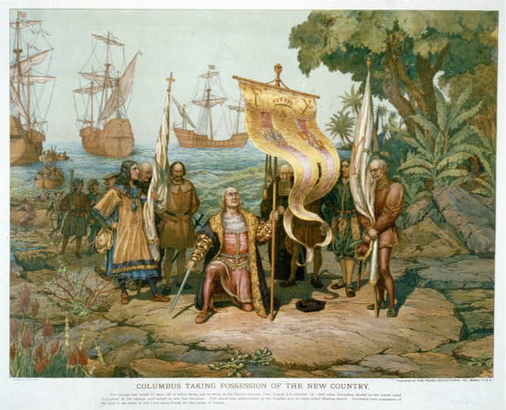

Slide 10
S.P.A.M
S - Symbol
P – People
A – Action
M – Message

Slide 11
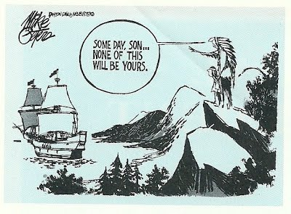

Slide 12
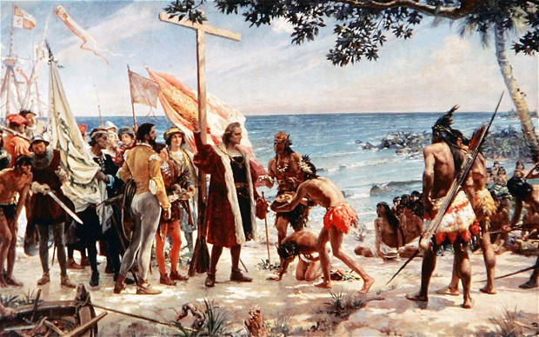

Slide 13
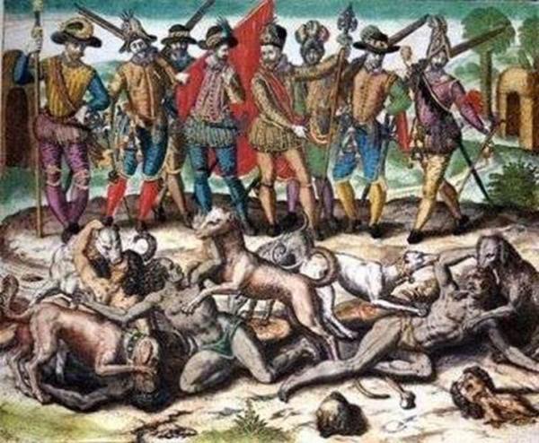

Slide 14
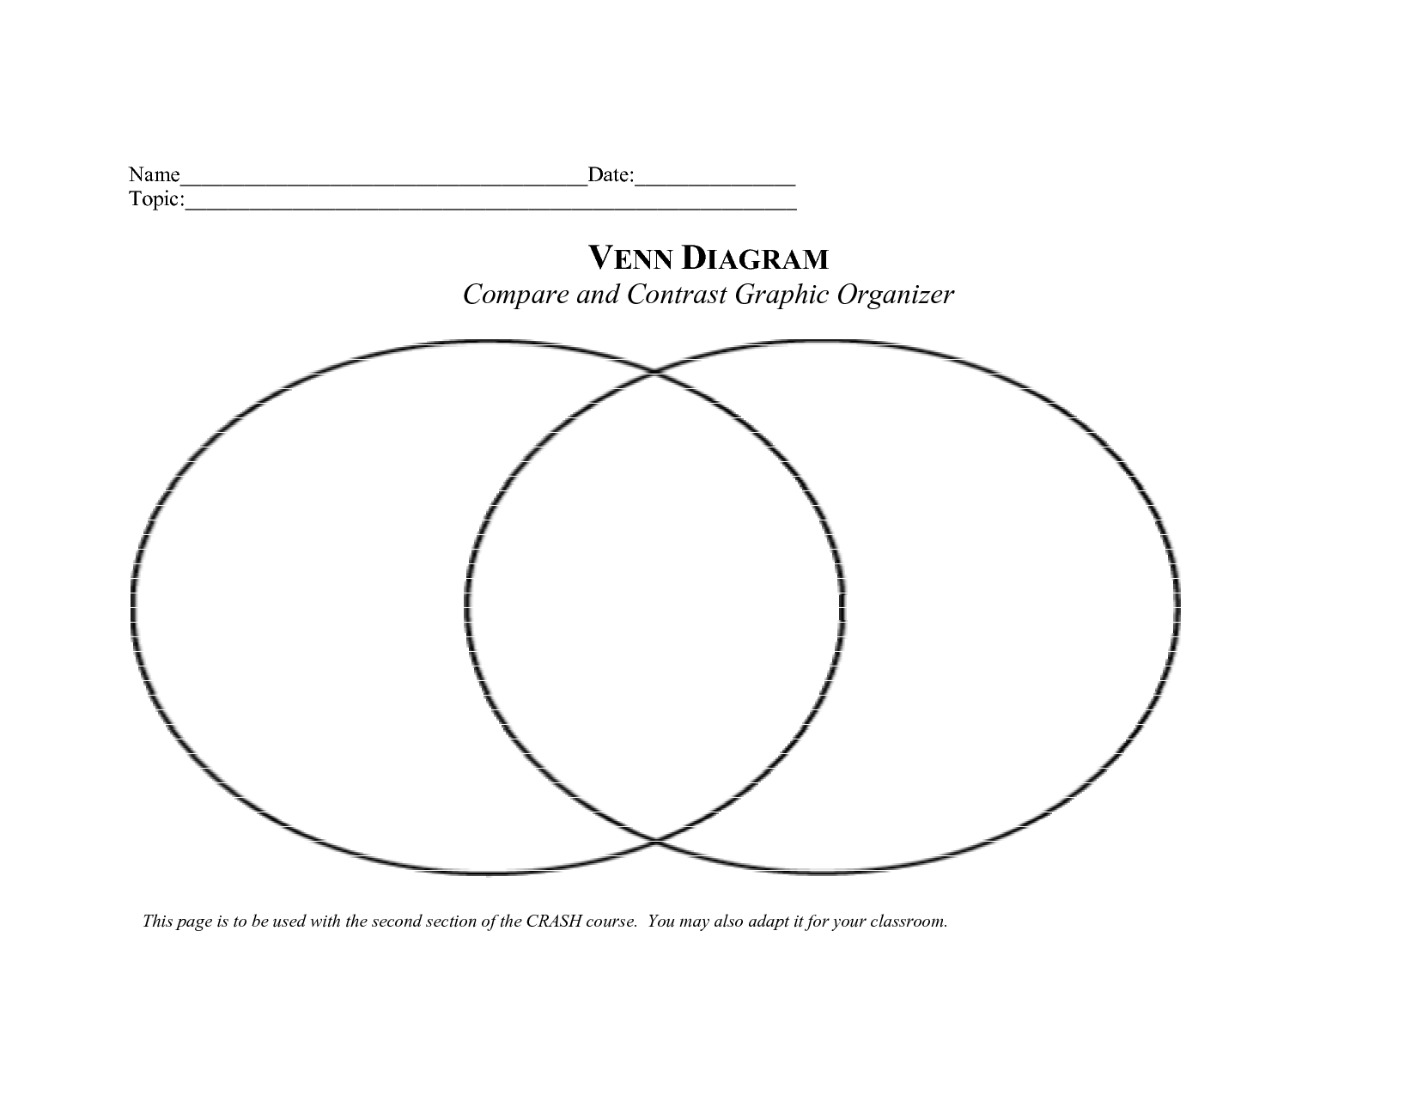

Slide 15
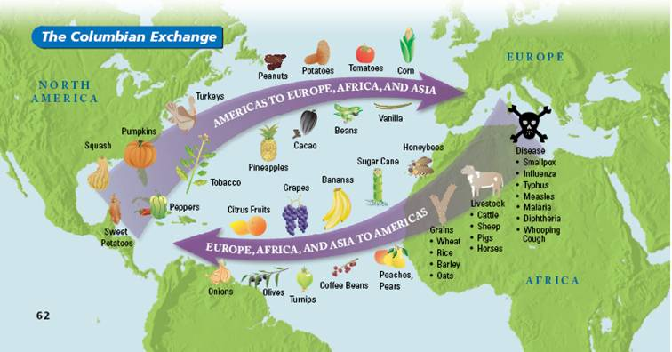
Columbian Exchange

Slide 16
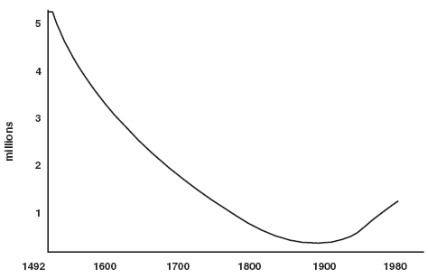

Slide 17
From Exploration to Colonization
Spain becomes first to establish colonies in the Americas
Colony- a nation or territory ruled by another country.
New Spain= Middle America +Western South America+ Southwest of US and Florida
Sets the trend for European colonization of the Americas
European countries race to establish colonies in the “New World”
Spain
Portugal
France
England
Netherlands

Slide 18
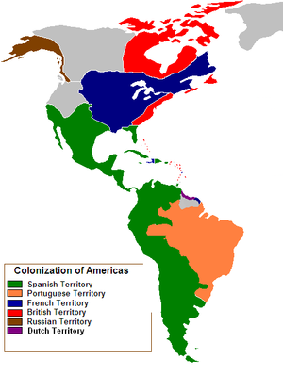

Slide 19
British Colonization of North America
England wanted to assert their influence in North America.
Saw colonization as a means to:
Expand their Economy
Increase their political influence
Alleviate social problems at home (over crowding, crime, poverty, etc.)

Slide 20
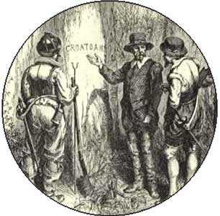
British Settlements in North America
Roanoke 1585
Failed first attempt by England to establish permanent settlement in New World
Led by Sir Walter Raleigh
Located on an island off the coast of NC
117 colonists led by John White
Within 3 years colony disappears without a trace
The word “Croatoan” was carved into a tree on the island
Remains a mystery to historians

Slide 21
British Settlements of North America
Jamestown Colony, Virginia 1607
1st permanent British settlement in North America
Chartered by King James I
Funded by the Virginia Company (Joint Stock Company)
Purpose of the Colony:
Make Profits!!!! (expected to find silver, gold, precious resources)
Counterbalance expansion of other European nations
Company sends 109 colonists to Virginia in 1607
Men
Soldiers/upperclass
Captain John Smith
John Rofle

Slide 22
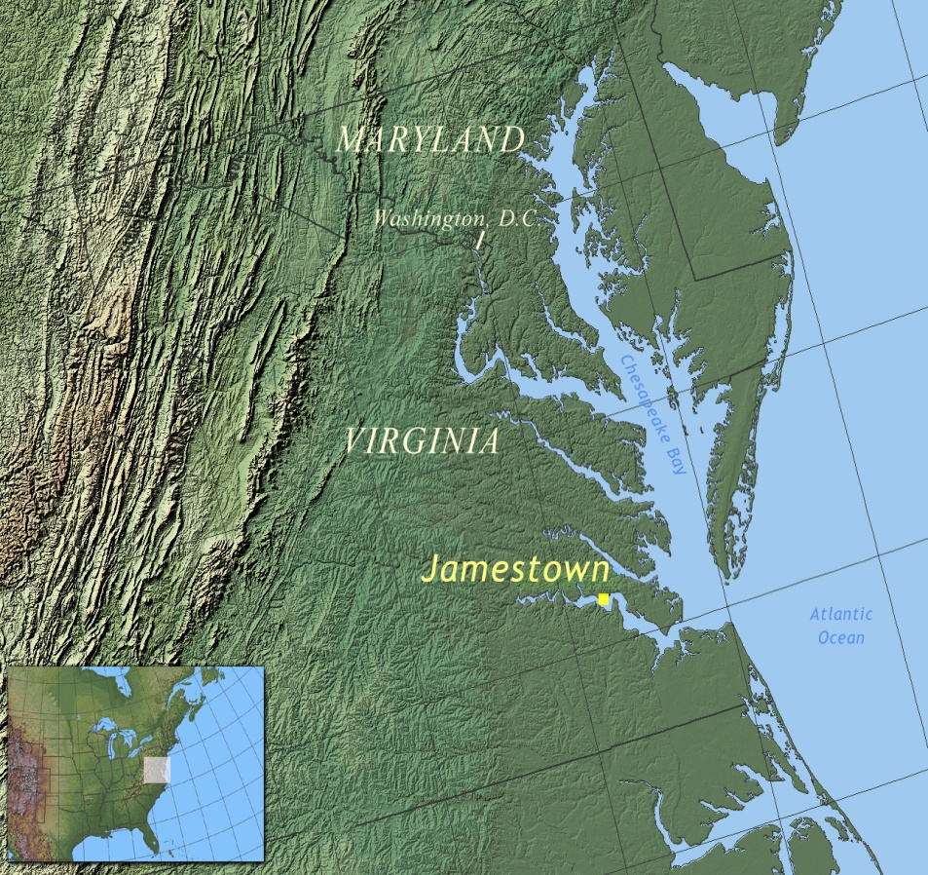
Jamestown Continued…
April 1607 land in Virginia
Settle on the James river in Virginia.
Deep water
Good defensive position

Slide 23
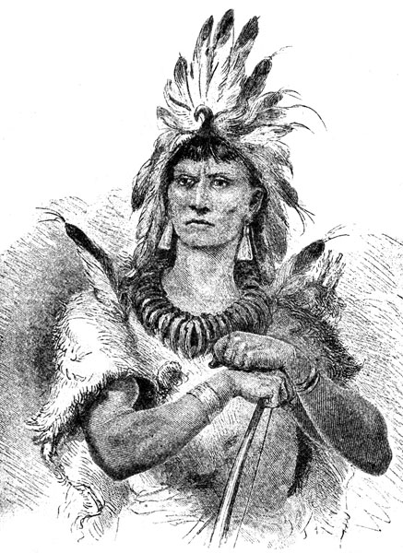
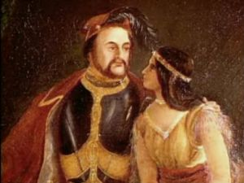
Jamestown Continuted…
Colony experienced serious problems!!
1. Located in the midst of the powerful Powhatan Confederacy-
large native American nation (approx 14,000) led by Chief Powhatan
Pocahontas was the daughter of Powhatan
Marries John Rolfe

Slide 24
Jamestown Continued…
2. Unfamiliar Environment/Climate
Much hotter than England
High Humidity
Brackish Waters
Disease
Malaria, scurvy, typhoid, diphtheria, dysentery
3. Lack of skilled laborers and food supply

Slide 25
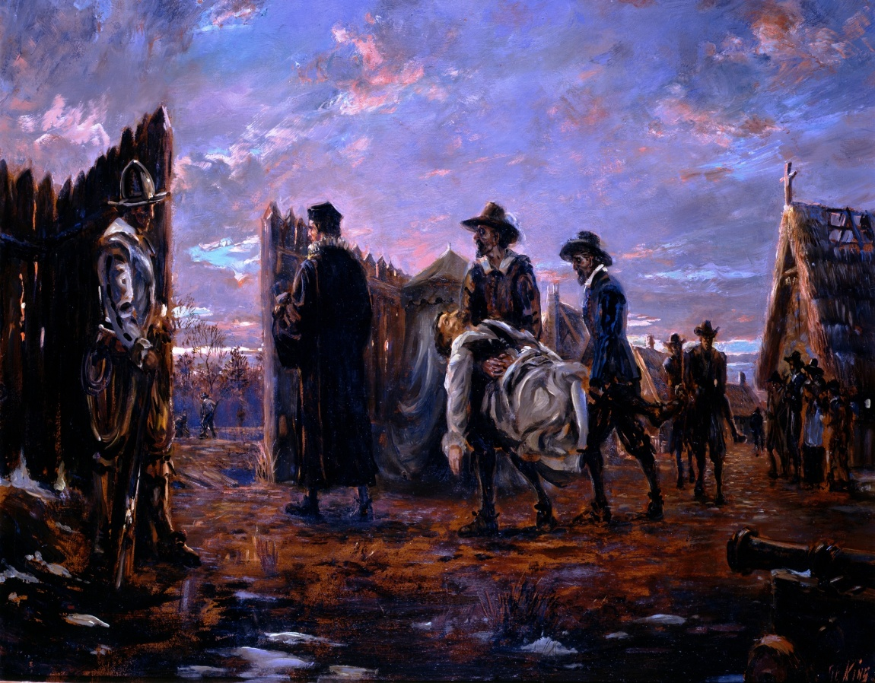
Jamestown Continued
Starving Time- 1609-1610
period of famine, death and disease in Jamestown
Decimated 90% of colony’s population.
(60 survivors out of 600)
Several reports written by captain John Smith speak of murder and cannibalism!!!

Slide 26
Jamestown Continued…
King James issues a 2nd charter, 1610
More colonists arrive but fail to make a profit for the Virginia Company
1613- tobacco is introduced in colony
Reinvents Virginia !!!!!!!
Tobacco becomes incredibly profitable crop!!!!!!
Labor demands increase
Indentured servitude becomes main source of labor

Slide 27
British Settlements in North America
Plymouth
Established in 1621
Founded by the Puritans
group of religious dissenters who were granted a charter to begin a colony
Sought religious freedom
Sought to permanently relocate with family to practice their religion free from discrimination
Colonists were men, women and children

Slide 28
Plymouth Continued…
Climate was similar to England’s
Less disease
Cooler climates are less prone to than warmer climates.
No large Native American population
Had been decimate d by disease prior to the arrival of the Puritan colonists.
Less fertile soil than in South
Subsistence farming

Slide 29
Expansion of British Colonies
British America expands to 13 colonies.
Southern Colonies :
NC, SC, GA, VA
Middle Colonies
PA, NJ, DE, NY, MD
New England Colonies
RI, MA, NH, CT

Slide 30
Southern Colonies
Economies relied on agriculture
The south’s warm climate, rich fertile soil, and broad deep rivers allowed for crop production and easy exportation of goods
Produced Cash Crops
Cash crop- readily salable crop produced primarily for market
Highly profitable !!!!!!!
What were the main cash crops of the southern and middle colonies ?

Slide 31
Southern Colonies Continued…
Cash crop production was extremely labor intensive and required many field hands.
Therefore, large land owners began importing slaves from Africa via the Slave Trade
Slave trade- transatlantic slave system which imported slaves from Africa to the Americas.
Resulted in the Plantation System
Plantation system- economy based on specialized agricultural production of a few crops.
Relies on Slavery and export of cash crops

Slide 32
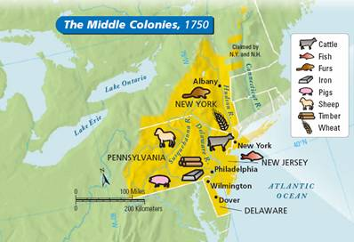
Middle Colonies
Very Diverse Region
Many different ethnicities and religions
Ethnicities: English, Swedes, Dutch, Germans, Scots-Irish, French, African Americans, Algonkian and Iroquois , etc.
Religions: Quakers, Mennonites, Lutherans, Dutch Calvinists, and Presbyterians
Hybrid of New England and Southern Colonies

Slide 33
Middle Colonies
Cities were important distribution centers in the English mercantile system.
Central Location
Broad/deep harbors
Farming
Shipbuilding
Lumbering

Slide 34
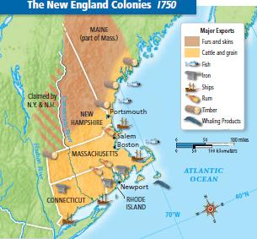
New England Colonies
New England developed a very different economy from south.
Cooler temperature, less fertile soil, different resources.
New England has an abundance of game, lumber, and fish.
They developed sophisticated trading networks with other Native Americans, England, and other countries.
Required large Merchant and trade smith classes.
Produced textiles
Textiles- production of manufactured yarn, twine, thread fabric, etc.

Slide 35
Mercantilism
England governed the economies of the 13 colonies according to the economic system of Mercantilism
Mercantilism
an economic system developed to increase a nation by imposing government regulations and trade policies.
Navigation Acts of 1660s
Series of laws that restricted the colonies use of foreign shipping with any other country than England

Slide 36
Mercantalism

Slide 37
S
P
A
M

