Slide 1
Absenteeism in Tennessee schools
Mary Batiwalla
Office of Research and Policy

Slide 2
Agenda
Absenteeism definitions
Absenteeism in the state
Chronically absent students
Lost instructional time due to disciplinary action
The relationship between attendance and student outcomes

Slide 3
Absenteeism definitions

Slide 4
Definitions of terms
Absent: Student is marked not present at school, for either unexcused or excused reasons. According to the state attendance policy, a student who is absent for half of the school day should be marked absent.
Excused absent: A student is absent due to excused reasons. This usually requires documentation. However, what constitutes an excused absence is determined by district policy*.
Unexcused absent: A student is absent due to unexcused reasons. District policy defines an unexcused absence*.
Chronic absenteeism: absence rate greater than 10%.
  In a 180-day school year, a student is missing more than 18 days.

Slide 5
Absenteeism in the state

Slide 6
On average, Tennessee students missed 8 days of school last year.
Each bar represents a grade level.

Slide 7
Attendance has been stable across the last six school years.

Slide 8
However, the attendance rate hides the fact that some students are missing a lot of school.
Each bar represents a grade level.

Slide 9
Chronically absent students

Slide 10
Some student subgroups are overrepresented in the chronically absent student population.

Slide 11
About half of chronically absent students in the 3rd and 9th grades have been chronically absent for multiple years in a row.

Slide 12
Students missing two or more days in August are five times as likely as their peers to be chronically absent.

Slide 13
The percent of chronically absent students differs substantially across districts.
Each bar represents a district.

Slide 14
Lost instructional time due to disciplinary action

Slide 15
Disciplinary actions are actions that result in the removal of a student for more than half of an instructional day.
In school suspension: The student was removed from his or her regular classroom and assigned to an in-school suspension program for 10 or fewer days.
Out of school suspension: The student was removed from his or her regular classroom and barred from school grounds for 10 or fewer days and did not receive educational services.
Expulsion: The student was expelled from all school district settings, for more than 10 days, with total cessation of educational services.
Change of Placement: The student was assigned to another school facility or program (for more than 10 days) that allowed him/her to continue to participate in the general curriculum at a school setting.

Slide 16
On an average school day, about 5,000 Tennessee students are absent from their classroom due to a disciplinary action.

Slide 17
The vast majority of students receive disciplinary actions due to violation of school rules.

Slide 18
The type of disciplinary action differs by the disciplinary reason.

Slide 19
The number of instructional days missed varies by the disciplinary reason.

Slide 20
In 2013, one in four 9th graders experienced at least one disciplinary action.
Each bar represents a grade level.

Slide 21
The relationship between attendance and student outcomes

Slide 22
As absences increase in freshman year, the likelihood that a student will graduate on time decreases.

Slide 23
Students are less likely to score a
21 or higher on the ACT if they are chronically absent.

Slide 24
Even when we control for prior achievement, chronically absent students are less likely to score a 21 or higher on the ACT.

Slide 25
Students who are chronically absent score proficient or advanced on math TCAP at much lower rates than their peers.

Slide 26
Takeaways
Students are missing lots of instructional time, especially in P4 and high school.
Attendance rates mask the issues the state and some districts are having with chronic absenteeism.
About half of chronically absent students are chronically absent for two or more years in a row.
Students who miss school early in the year are very likely to chronically absent.
Students lose considerable amounts of instructional time due to disciplinary actions.
Absenteeism has a negative relationship with student success on achievement measures.

Slide 27
Appendix

Slide 28
Disciplinary action disparities across student groups
Note: The following slides focus only on 9th graders.
However, these trends are similar across all grades.

Slide 29
Some student subgroups are overrepresented in student population with at least one disciplinary action.

Slide 30
Black students make up 25% of the 9th grade student body across the state but more than 80% of expulsions.

Slide 31
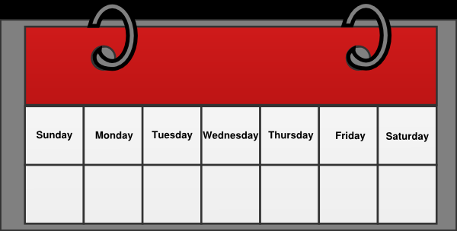
Black females receive about one more day of out of school suspension for fighting compared to white males.
Suspension
Non-black
males
Non-black
females
Black males
Black females

