Slide 1
Navigating through Requisitions and Disbursements in the State’s Educational Materials and Administrative Technology ordering system- otherwise known as EMAT
11/03/2015
Nick Gleicher- Irving ISD

Slide 2
Presentation Outline
Instructional Materials Allotment -IMA
Requesting a user ID so you can order through EMAT
Logging in to EMAT
Completing the IMA & TEKS Certification
Accessing your State Allotment
IMA Rollover from one year to the next
Delayed Payment Option
Requisitions
Creating them,
Opening detail pages for specific items
Adding lines to order additional items within an SLC
Shipping Errors on requisitions- What do you do?
Disbursements
Creating them
Building in funding to cover shipping
Lots of information to gather prior
Instructional Materials Disbursement
Technological Equipment Disbursement
Technology Services Disbursement
Documenting your Disbursements
Leftover Disbursement Funds
Wrap Up

Slide 3
IMA
EMAT is an ordering system funded by Instructional Materials Allotments. These allotments come from the state, for instructional materials and Administrative Technology acquisitions/ expenses made/incurred by Public School Districts as well as Charter Schools. The Allotments are based on your enrollment and determine your district’s share of state funds dedicated to education.
Notes:
Your district enrollment is the basis of your allotment. Bigger districts get more funding.
Since we routinely get new members who have just assumed the role of Instructional Materials Coordinator or Manager for their district, this presentation will incorporate some basic information that many of you are already familiar with, but could always use a refresher.
Ask if anyone does not have access to EMAT. If answer is no, SKIP TO SLIDE #9

Slide 4
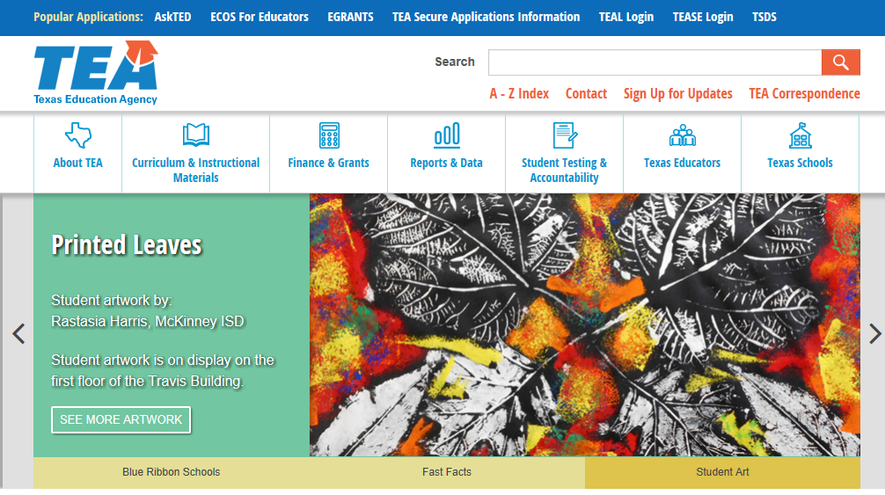
To request a user ID for EMAT take the following steps:
Open the TEA Website and click on the TEA Secure Applications Information Link at the top of the page.
For EMAT access, the superintendent of each district or open-enrollment charter school verifies the roles of personnel for the EMAT system. The EMAT system allows for two different roles – ‘ordering’ access and ‘view only’ access. You will likely be the designee for ordering.
Notes:
Your screen may look a bit different, but focus on what I am advising you to select in the dark blue header bar at the top of the screen

Slide 5
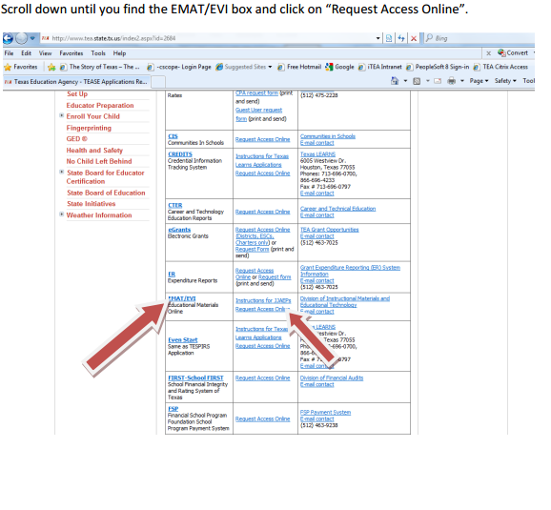

Slide 6
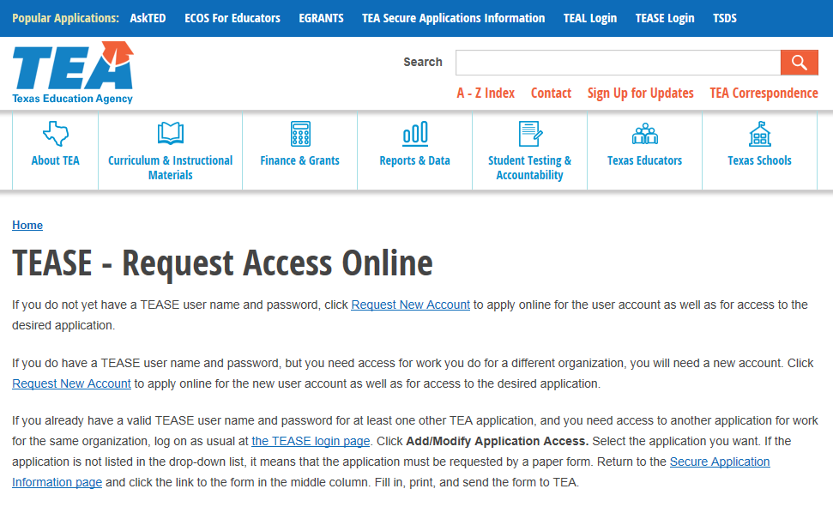
Notes:
Click on the hyperlink to request a new account.

Slide 7
You need to click the drop-down box arrow and scroll down to EMAT and EVI Order Materials

Slide 8
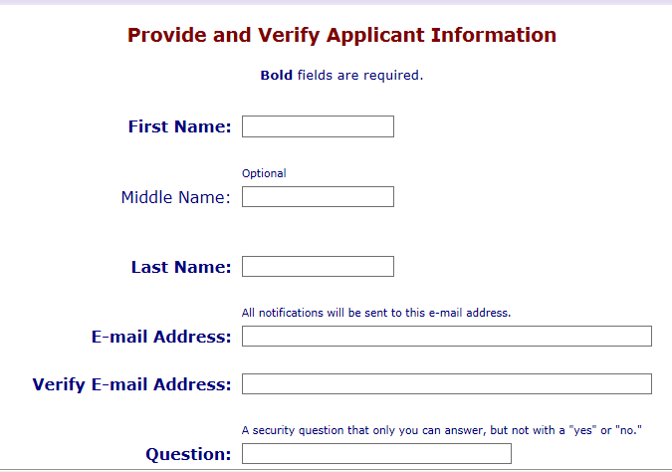
Notes:
There are of course additional fields which require data entry, but you get the idea.

Slide 9
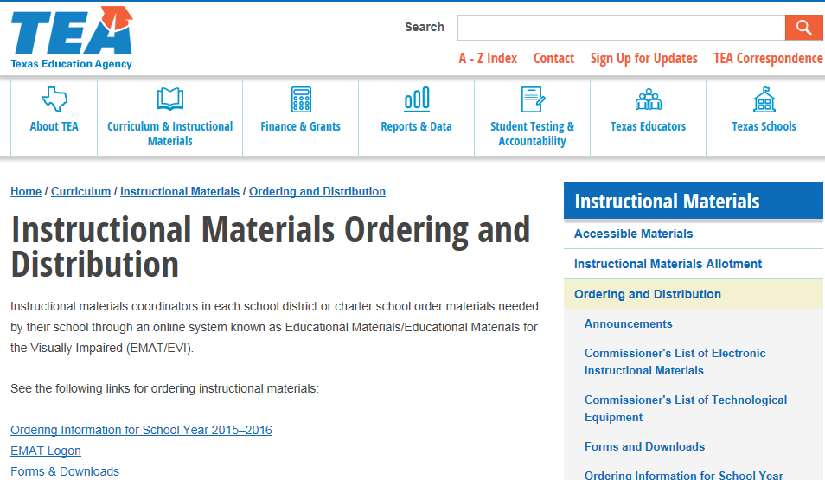
Once you have an account, you can use the TEA Website to access the EMAT LOGON Screen, but I strongly recommend that you bookmark it to your favorites bar.
Notes:
Click on the EMAT LOGON Hyperlink

Slide 10
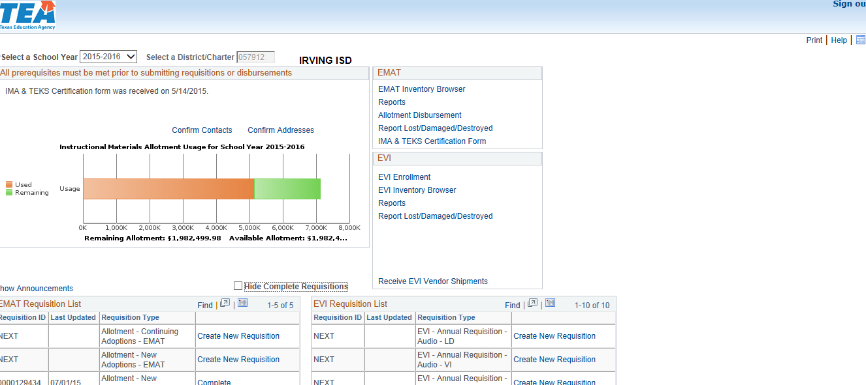
One
Two
Three
Four
Seven
Eight
Nine
Five
Six
Notes:
This is your EMAT Home Screen . Sometimes you have to click through various announcements to get to it.
There are a bunch of numbered red arrows to call your attention to key areas. On this “Home” screen
1) You can choose to see information pertaining to 5 prior years of activity.
2) Your district’s ID is always available on your home screen;
3 & 4) You are reminded that before you can do anything you have to confirm
our district’s approved contacts and shipping address “s”
5&6 ) You can always see at a glance how much you have left in your account and how
much you can actually access;
7) You can always pull an allotment report among others to document what you are doing
for the district;
8) You can and should report shipping errors ( The TEX-013 report;)
9) You HAVE TO submit the TEKS CERTIFICATION FORM prior to ordering anything each year. It is a
form that has to be signed off on by your Superintendent as well as your school board
President and Secretary.

Slide 11
IMA & TEKS Certification
The District Superintendent, Along with the Local Board of Trustees are required to Certify that the District has Instructional Materials that cover all elements of the essential knowledge and skills of the required curriculum, other than physical education as required in the Texas Education Code, Section 28.002.
NOTHING can be processed through EMAT until this form is completed and submitted by the District to the TEA.
It can be emailed to instructional.materials@tea.texas.gov.
Notes:
Before you continue, ask the audience if anyone is unfamiliar with this process. If all are good, SKIP TO slide 14

Slide 12
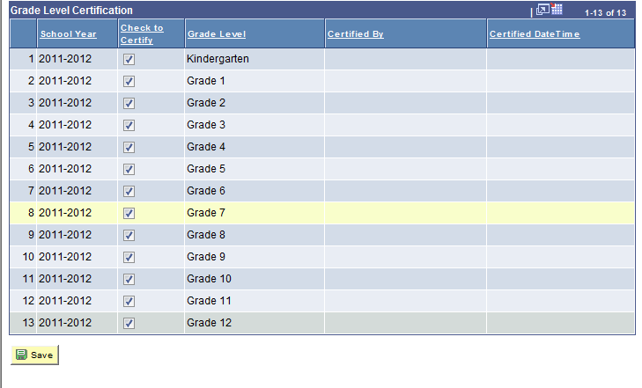
Notes:
Remember that you need to check off the grade levels your district educates. This is more applicable to charter schools that may not be set up to teach K-12.

Slide 13
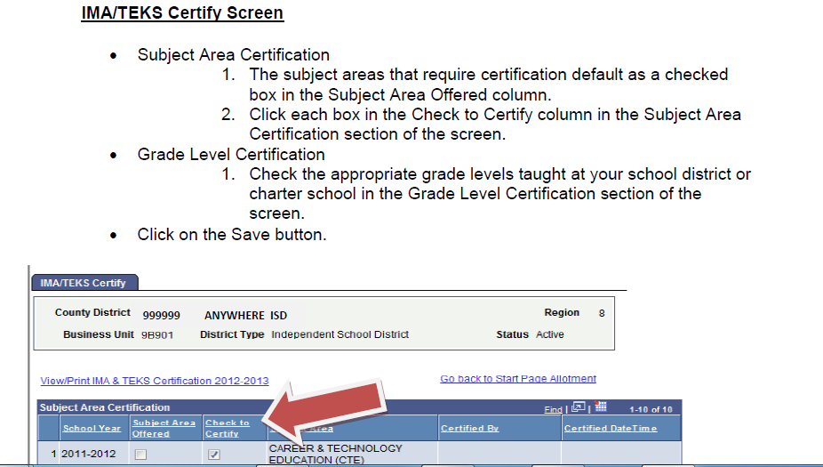
Notes:
Once you click on the link next to Arrow #9, the form will open as a web page. You fill out online, save and then print. The Certified Date Time column will update when you have successfully saved. Your name also gets recorded on the form.
Once printed, it needs to be placed on the agenda of your next school board meeting. Get the signed copy in hand as soon as possible so you can scan and then email it to the TEA. No need for “snail mail”
This will be a key action you must follow up on during the spring of 2016-17 when you are preparing to receive your next allotment for 2017-18 and 2018-19

Slide 14
Accessing your State Allotment
There are two distinctly different methods available to utilize your state funding:
REQUISITIONS: The TEA Pays publishers on your behalf.
2) DISBURSEMENTS: Your District issues payments for materials directly to the Publishers, once funds are received from the state.
Notes:
Requisitions are like going to the candy store at summer camp. You ask for candy bar X and the credits in your account are reduced accordingly- you never see real money.
Disbursements on the other hand are like an advance of your allowance.
The stipulation being that you have to wait until you get the advance before you can buy what you want with the real money. Keep in mind that the state is not obligated to approve a disbursement request. If you submit one and then turn around and send a PO to the publisher, you may run the risk of getting billed when you have no incoming funds to offset the expense. Unlikely, but a possibility nevertheless.

Slide 15
If you have unused funds at the end of a school year, the TEA will roll them forward to the next year
Notes:
In the event that your district manages to save a portion of its allotment for the next year,
it WILL rollover.
Many districts, including mine, purposefully saved funds from the 2013-14 Allotment to
provide additional resources for the purchase of materials during the subsequent proclamation.

Slide 16
The snippet below shows that Irving had a whopping $1.11 to carry forward from 2014-15 to 2015-16
Notes:
We had saved $2.7 milion from our 2013-14 Allotment. We spent those funds and our entire 2014-15 allotment leaving the minute sum of $1.11 to carry over..

Slide 17
At this point I want to segway the issue of delayed payments.
(a) A school district or an open-enrollment charter school may requisition and receive state-adopted instructional materials before instructional materials allotment (IMA) funds for those materials are available.
(b) The total cost of materials included in a district's or charter school's requisition(s) pursuant to this section may not exceed 80% of a school district's or open-enrollment charter school's expected IMA for the subsequent fiscal year.
(c) When a district or charter school submits a requisition for instructional materials under this section, the Texas Education Agency (TEA) will expend a district's or charter school's existing IMA balance before applying the delayed payment option.
(d) The TEA will make payment for any remaining balance for a district's or charter school's order under this section as the IMA funds become available.
(e) The TEA will prioritize payment for requisitions under this section over reimbursement of purchases made directly by a school district or an open-enrollment charter school.
(f) Publishers may decline orders for which payments could be delayed. A publisher's decision to decline an order under this section shall affect all of that publisher's orders for which payments could be delayed. Publishers may not selectively decline orders from individual districts or charter schools.
© Texas Education Agency. All rights reserved.
Authorized under Texas Education Code §31.0215
19 Texas Administrative Code §66.1327
Notes:
This slide is derived from the TEA’s Powerpoint presentation. It pertains to both requisitions and disbursements.
It is vital that you understand this option. In essence, for a district that heads into an adoption cycle with no funds leftover from the previous cycle, this option will make it possible to requisition and receive materials prior to September first of the looming school year. Normally the state funds are not truly yours until September . When Publishers agree to the delayed payment option- they are agreeing to accept payment from the state on your behalf after September 1st and at the same time agreeing to release the materials you have ordered prior to September 1st.
It is imperative that you make arrangements with your publishers for a similiar billing plan in regard to disbursement purchases. Otherwise, the publisher’s accounting staff will hound your district’s accounting staff for the payments before you get the cash from the state.
You can expect to see several different statuses for disburements ranging from pending (submitted ) to pre-approved and finally to allotment disbursement once the payment has been sent (ours get wire transferred, which may be the norm).

Slide 18
REQUISITIONS
If EMAT requisitions had already been created for the year by your predecessor, you are good to go. Otherwise, you would need to start a requisition for a continuing adoption. I don’t think you actually have to submit it, though during my first year I did.
Notes:
Click on CREATE A NEW REQUISITION on the Allotment- New Adoptions Line if you have already opened the spigot.

Slide 19
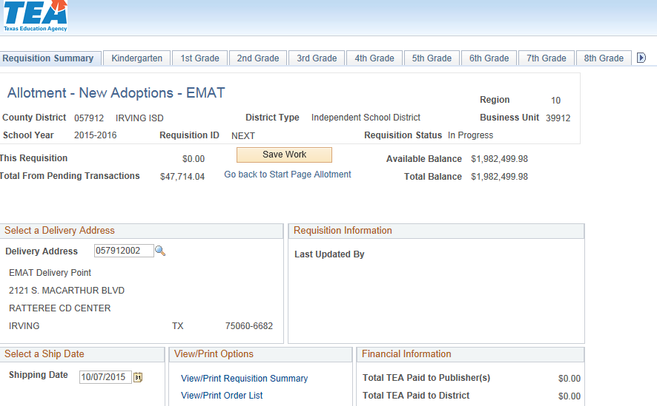
This is the first screen you will see when you create a requisition..
This is where you will see a running balance of what you have left.
dates can be changed
Notes:
When you are working on a requisition, the SAVE button ( two red arrows) is your constant companion.
Organize your materials into groups by grade level- note that at the top of the page ( it also appears on the bottom, but I didn’t show it) you can select grade levels through MS and subjects for High School.
2) Start by clicking on a grade level. If you don’t see the one you need, click on the arrow.
The cloud comment in the lower left hand corner pertains to shipping dates.
If one order’s delivery gets delayed and the revised shipment date overlaps with the date you chose for another requisition don’t fret: just email the TEA staffer you are most familiar with, they can fix it in a jiffy.

Slide 20
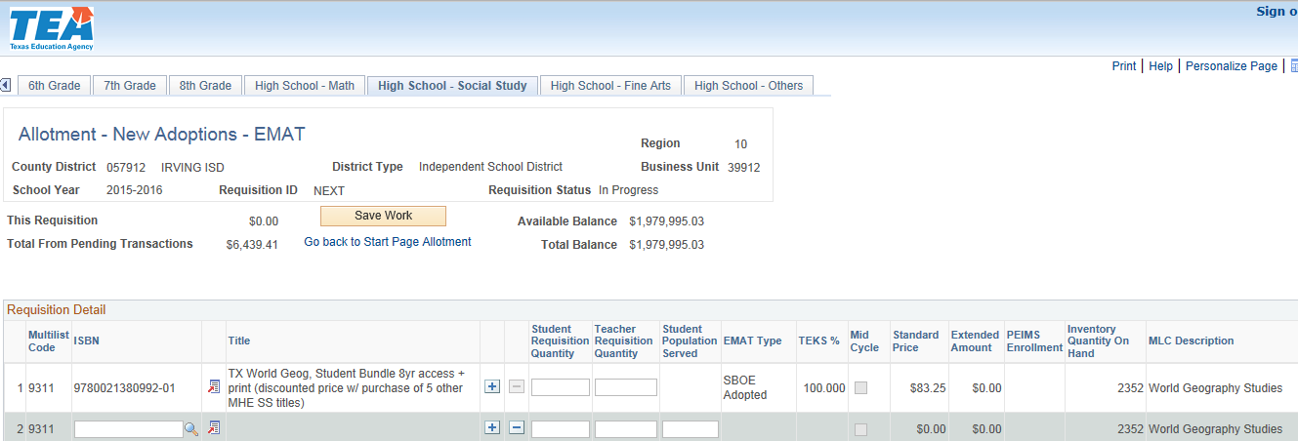
Let’s take a look at Irving’s requisition for World Geography
Notes:
When you start out, you will see what has already been ordered so far as the new adoption is concerned. The tab marked by the dark red arrow is High School Social Studies, By clicking on the TAB you can see all of the materials you have ordered for that grouping of subjects. I am only showing Irving ISD’s selection for World Geography from the top line. By clicking on the symbol of a page marked with the bright red arrow, you can sneak a peek at what the state thinks is included with this particular ISBN. This will give you an idea of what you are getting, but you need to talk with your sales rep to nail down the specifics.

Slide 21
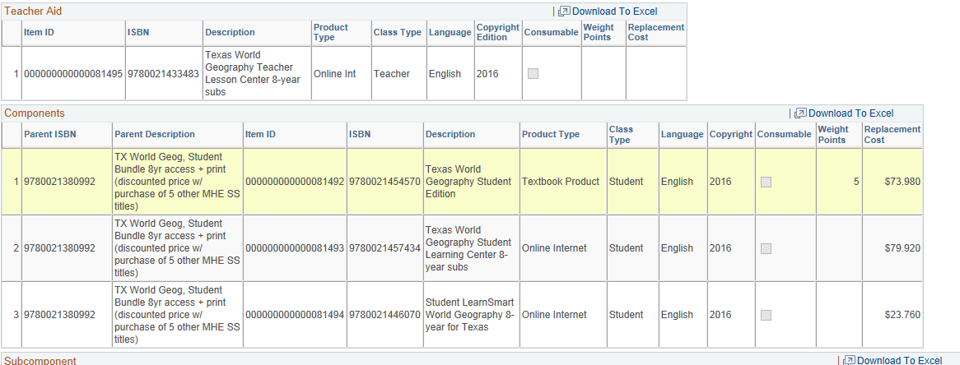
Notes:
As I said before double check with your rep. to determine how many different ISBNs you will receive with your selection. Our package came with a print TE ( Not listed here) along with an ExamView CD-Rom and a text with Chapter Tests and lesson Quizzes, also not listed. Expect the state’s listing should provide a slightly blurred image as opposed to a crisp blueprint.

Slide 22
Let’s assume that after the first wave of EMAT orders, IISD detects an enrollment surge in World Geography. What can we do? Start by clicking the + sign below the green arrow on slide 20. This will open a window like the one below.
Notes:
Here is a small section of the titles and publishers on the state adopted list for World Geography 9311 from which we selected McGraw-Hill. ( The state organizes materials by their Multilist Code- TIPWeb calls these SLCs or State List Codes.)
We could choose to employ a digital only approach instead of the 1-1 plan hard-copy/online one we started with
Notice that MHE offers online only packages for 1,2,4 and 8 years. Work with your district’s academic coordinators to decide which variant of the product your district chose to adopt fits your district’s needs best.

Slide 23
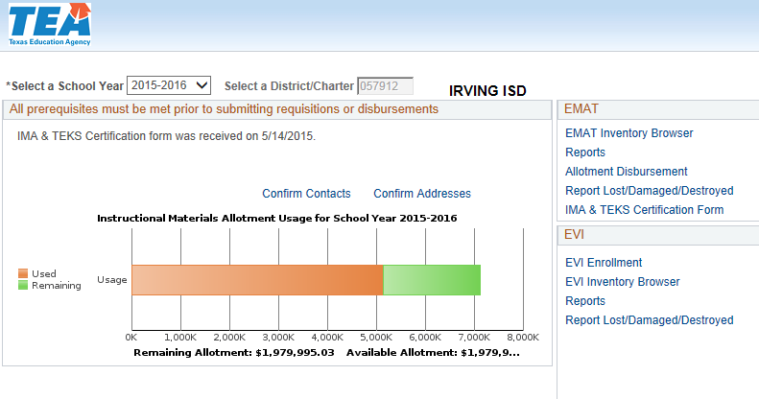
Shipping Errors on requisitions- What do you do?
Materials will come to you either directly from the publishers or instead from what the state describes as depositories located in a variety of Texas cities..
When the quantities you receive do not match the quantities noted on the packing lists, you have to fill out a state form TEX-013 which can be found on the EMAT page below.:
Notes:
Shortages and damage will happen.
Ask the participants if any of them are unfamiliar with the use TEX-013 If none, SKIP TO SLIDE 26
KEEP ALL OF YOUR STATE ORDER PACKING LISTS- YOU NEED THEM to fill out your TEX-013 forms, which you can get to by selecting Report Lost/Damaged/Destroyed next to the arrow.

Slide 24
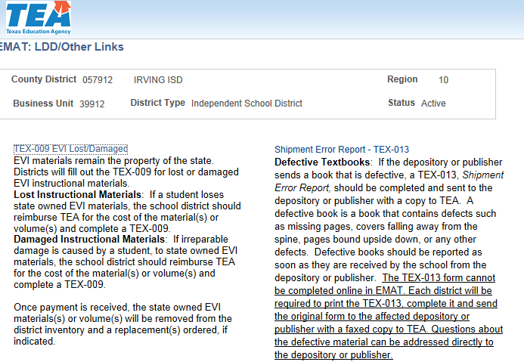
When you click that link, you will see this page and select The Shipment Error Report- TEX- 013 next to the arrow.
Notes:
A word document will appear, if you choose the option to open it. Instructions are on page #2 that apply to handling state related shipments as well as to reporting errors or damages like a box being skewered by a forklift. Fill out the form to the best of your ability. Keep in mind that you will be sending a copy of the packing list with it, so if you can’t figure out what goes on every line, you don’t have to worry. You can use email instead of the fax to send it to the TEA.

Slide 25
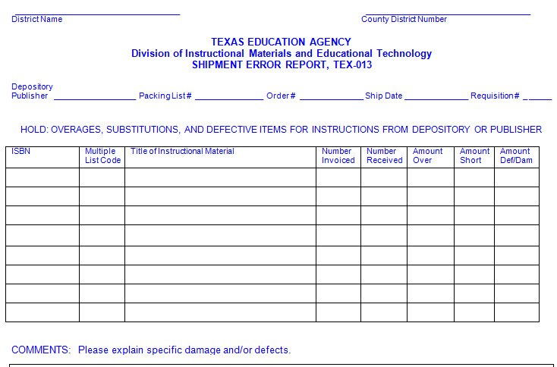
I have shrunk the form down a bit and excluded the fields for your signature etc.
Notes:
If you don’t know your county District number by heart, remember that it always appears on your EMAT home screen

Slide 26
DISBURSEMENTS
The Allotment Disbursement option in EMAT makes it possible for School Districts and Charter Schools to Order the following:
Non-State Adopted Instructional Materials
State Adopted Instructional materials not reflected on the state list from the Instructional Materials Allotment ( IMA.)
Administrative Technology Equipment
Technology Services specifically related to the use of that equipment.
What the disbursement option CANNOT be used for are the costs of upgrading District Wireless infrastructure in order to use the equipment targeted for purchase.
Notes:
An example of state adopted materials that simply are not included on the list, is the Spanish variant of McGraw Hill’s iScience for Middle School.
You can create disbursement requests to access the 20% that the state holds back till Sept 1, but be sure to discuss deferred billing before you execute a POl. If you have no prior year IMA to access, an approved disbursement will not be sent to your district until September 1st . In fact, it is possible you won’t get payments until Dec 1. The state processes the payments in correlation to when the requests were submitted.

Slide 27
If you work out a deal with a publisher for a special package of state adopted materials that is not listed by the state, you cannot place a requisition for it. However, you can enter a request for a disbursement.
Notes:
To start a disbursement request, click on Allotment Disbursement next to the red arrow above.
Take note of the comment to the right of the arrow. If you select an adopted item but work out some special package deal, you can no loger process a requisition for it.
However, you CAN place a disburement request.

Slide 28
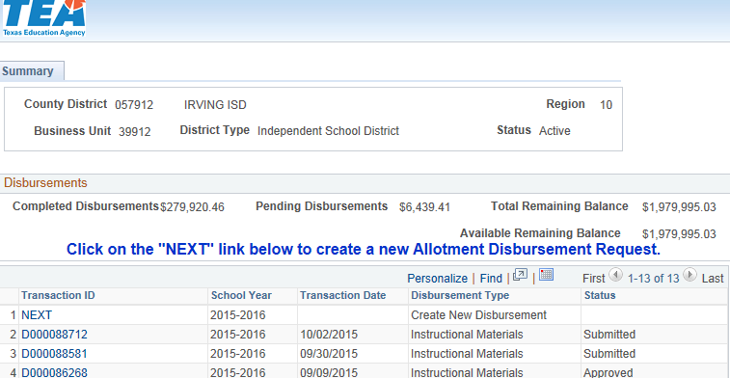
Instructional Materials Disbursement
Notes:
When you click on Allotment Disbursement, this window will open up. You can see that Irving still has two disbursements worth $6,439.41 that have been submitted but not approved. Above them is the word NEXT which is what you need to click to create a new request .

Slide 29
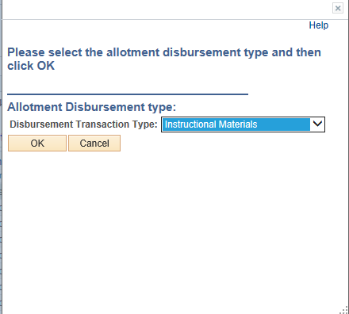
Notes:
You start by defining what the entire disbursement relates to. Remember that I said this spending method can be used for instructional materials, Administrative technology equipment for instruction or technology services related to that equipment.

Slide 30
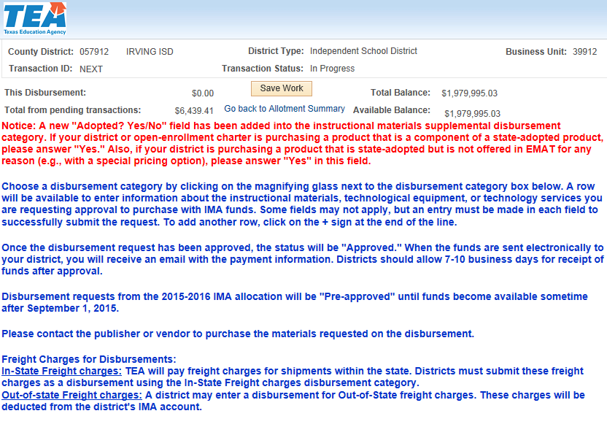
Notes:
You are looking at one section of one of our submitted disbursement requests. Take note of the text in red. Remember what I said about McGraw Hill’s Spanish variant of iScience? It is a variant of a state adopted item. If I were to buy more of that item using a disbursement request, would I answer Yes or No in the Adopted field?
Note that the TEA will pay freight charges for In-State shipments as well as for Out-of-State. For both types of shipping charges, you can use your IMA Funds, You need to create a line item for the shipping charges separate and distinct from the instructional materials

Slide 31
To add a request for Out-of-State Shipping Charges...
Click on the magnifying glass beneath the red arrow to select shipping
Enter 1 for the quantity
Enter the publisher’s shipping cost from the quote
Click the TAB button to move on to EXTENDED Amount
Notes:
Either in or out of state

Slide 32
Notes:
I pulled the figure of $185.55 right off the quote I requested for the materials referenced in this disbursement request.

Slide 33
Now you can add a line for the instructional materials you want to order. Click the green plus sign next to the green arrow on slide #31 to open another opportunity to select a disbursement category.
Notes:
The arrow is actually on slide #31

Slide 34
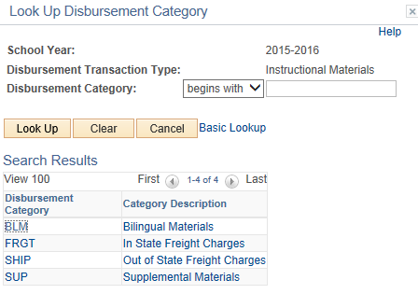
Notes:
This time, instead of choosing shipping, you will choose instructional materials. Warning, if your intention is to buy Bilingual materials, create separate disbursement requests for them and specifically choose BLM as your Disbursement Category.

Slide 35
Information you will need before you enter a disbursement request
Once you click on the disbursement category within the request, you can select instructional materials in two ways:
Bilingual Materials or Supplemental Materials.
No matter which one you choose, you will need to provide answers in the following fields:
Publisher Title SBN Language Subject
Course name Grade # of Students Copyright
TEKS % Quantity Unit Price Material Type Media Format
Notes:
Take note of the grey sliding bar at the bottom of the screen. just below the word “Refresh ”You can’t see every field that requires data entry at once.

Slide 36
Disbursements
Select Save Work to create a new Transaction ID. You will find it at the top of the page
Once you have all of the fields filled in, you can click the Certify and Submit button just above the word “Refresh”,

Slide 37
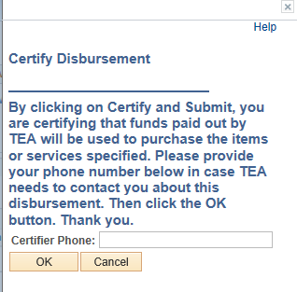
Disbursements
When you submit, you are required to relay your phone number to certify the transaction. Do so and click on “OK”

Slide 38
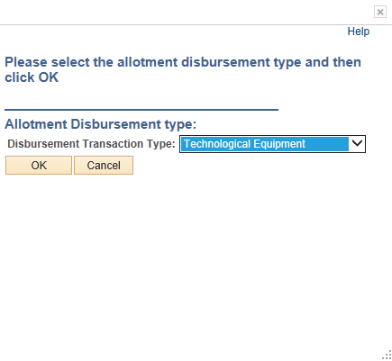
Technological Equipment Disbursement
Notes:
Just as you were instructed to do on slide 40, you use the drop down arrow to select the type of request you are making. This time, select technological equipment.and follow the steps to complete certify and submit.

Slide 39
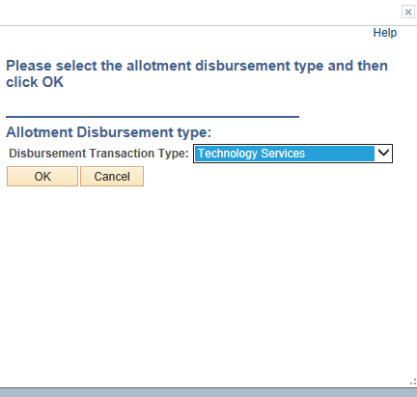
Technology Services Disbursement
Notes:
Same steps as before only this time, select technology services. Complete/ certify/ and submit. There are a few differences, however.

Slide 40
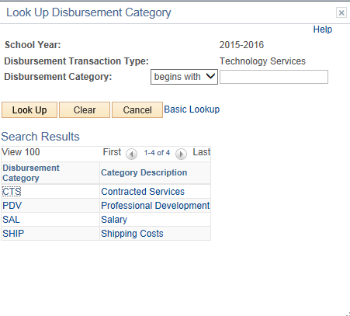
Technology Services Disbursement
Notes:
When you click on the magnifying glass next to disbursement Category, you will see this screen.

Slide 41
Technology Services Disbursement
There are different fields that you are required to fill out including:
Service Description
Service Audience
Quantity
Unit Price
Once you have entered everything, Certify and Submit as before.

Slide 42
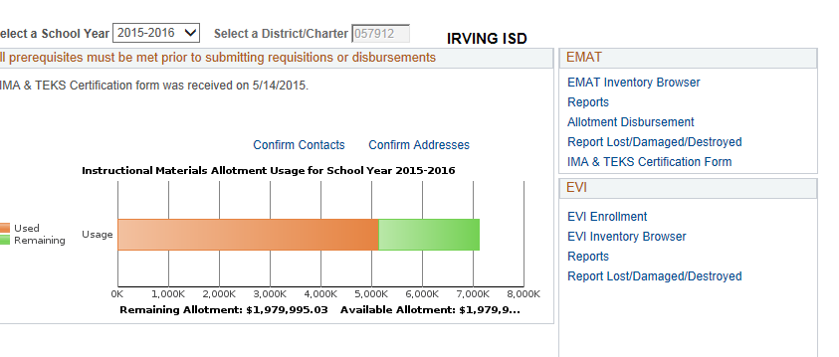
Documenting your Disbursements
Once you have created and submitted disbursement requests, you can create PDF reports for each one by clicking on Allotment Disbursement again like you did at the beginning.
Notes:
Keep Hard Copies in a binder along with your requisitions

Slide 43
Documenting your Disbursements
Click on the ID of a submitted, pre-approved or approved request
Notes:
Your Finance department will likely ask you for something to document your disbursement purchases- Here is what you do.

Slide 44
Documenting your Disbursements
Click
Click on VIEW DISBURSEMENT REQUEST

Slide 45
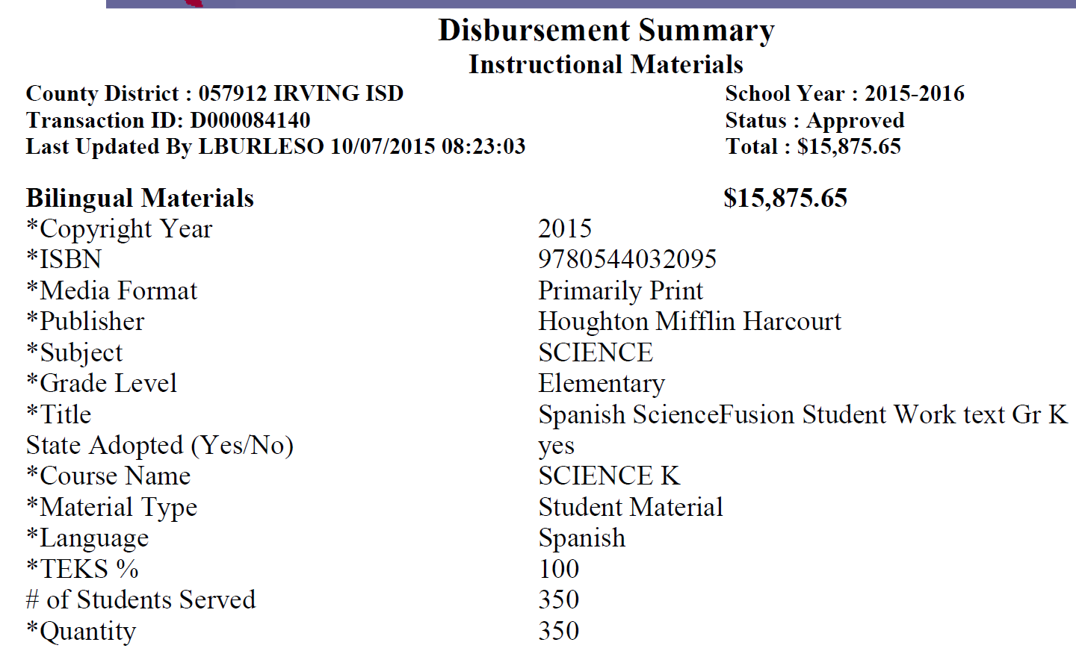
Documenting your Disbursements
Click
Notes:
This request was for a Spanish variant of HMH’s ScienceFusion texts for K-5 which are not listed for ordering.. Since the English version was state approved, I answered YES in that field and indicated the TEKS % at 100 because that was the % for the English version.

Slide 46
Excess funds occur when you encounter
Changes in shipping costs
Items you requested are no longer available- like specific IPAD chargers
A vendor could not provide the quantity you requested.
Leftover Disbursement Funds

Slide 47
If, for one of the reasons I just listed, you have $2,000 left over. Do you have to send it back to the TEA?
NO! The TEA doesn’t WANT it back!
In situations like this TEA staffers have repeatedly advised those of us in the field to apply the remaining funds to the next disbursement purchase.
For example, you need 28 copies of an AP text that costs $125 each. Instead of requesting $3,500 from the state, you would use the $2,000 leftover noted above and request only $1500 to cover the balance.
Leftover Disbursement Funds
Notes:
All the TEA really wants is to be assured that the funds you requested are in fact used to acquire instructional materials, administrative technology or technological services in to aid in the use of the technology. They don’t want you to send money back.
Rather, reduce your next disbursement accordingly to reflect the application of leftover funds.
That’s about it. I am open to questions at this point.

