Slide 1
Gaydos Hydro Services
Anything Water!

Slide 2
Introduction
Dana J. Gaydos
15 yrs experience
Permitting
Monitoring & Reporting
Water Quality Assessment
Chuck Burnite
20 yrs experience
Wetland Monitoring & Reporting
Wetland Design & Maintenance
Aquatic Site Management
Doug Crowson, PG
30 yrs experience
Groundwater/Surface Water Investigations
Well Design & Construction
John Dumeyer, PG/PE
45 yrs experience
Groundwater Modeling
Stormwater Inspections
Peggy Mathews
25 yrs experience
Government Relations
Environmental Management
Grants and Funding Sources
Julie Earls
16 yrs experience
GIS/Mapping
Data Analysis/Statistics
Kevin Hector– Field Services Manager
Renee Lindquist – Admin

Slide 3
Professional Services
Monitoring & Reporting
Data Analysis
Sampling
Compliance
Design & Permitting
Feasibility
Testing
Permits
Modeling
& Studies
Environmental
Water Quality
Wetlands
MFLs
Groundwater Modeling
Lakes & Ponds

Slide 4
Typical Clients
Duke Energy
Ryland Homes
Benderson Development
Northern Trust
Baycare Hospitals
Gladstone Land
DMS
American Watercraft Association
Fischbach Land Development
Southeastern Construction
Florida Hospitals
Southeast Land Advisors
Rizzetta & Company
City of New Port Richey

Slide 5
Current Projects
St Joseph’s Hospital North
WUP, RW Services Contract & County Variance
Water Quality Monitoring & Reporting
Knight Family Trust
Hydrologic Monitoring
Water Supply Planning and Testing
Crystal River Energy Complex
Water Quality Analysis & Saltwater Intrusion Investigation
Recently asked for Hydrological Monitoring & Reporting
Ryland Homes
WUP & ERP Permitting
Data Management, Compliance

Slide 6
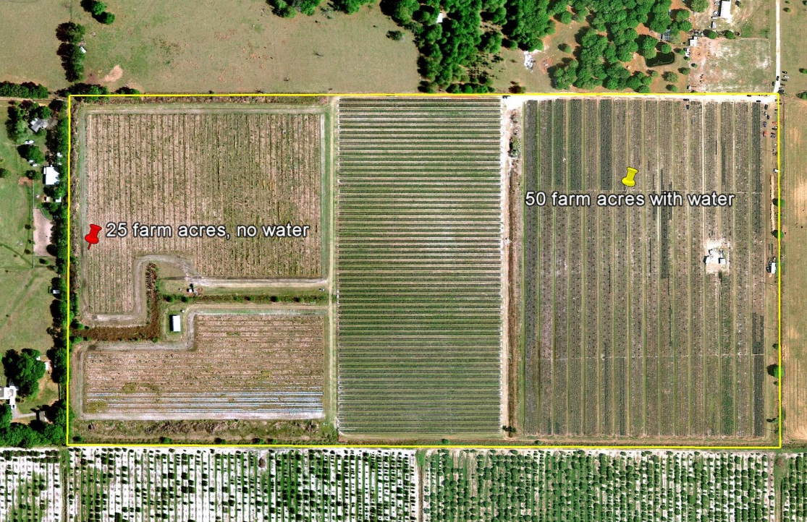
Agriculture
Gladstone Land
Fischbach Land Development
Southeast Land Advisors
WUP Modifications
Crop Conversions
Quantity & Impact Evaluation
AGSWM’s

Slide 7
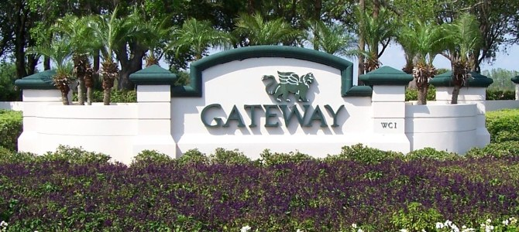
HOA’s & Community Development Districts
DMS
Rizzetta & Company
Lennar Homes
Ryland Homes

Slide 8
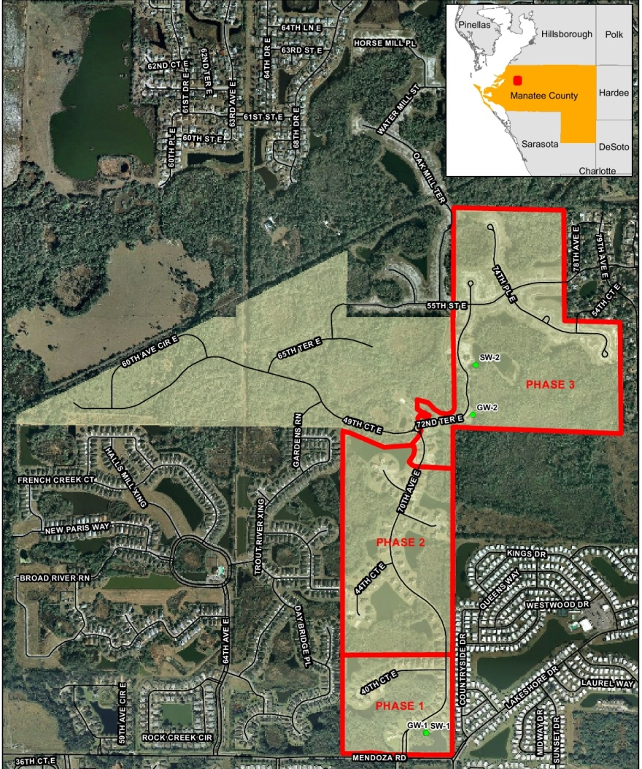
Development
Ryland Homes
Benderson Development
Lennar Homes
ERP & WUP Permitting
Water & Resource Planning
Site Utilization & Design
Wetland Assessments & Mitigation Design

Slide 9
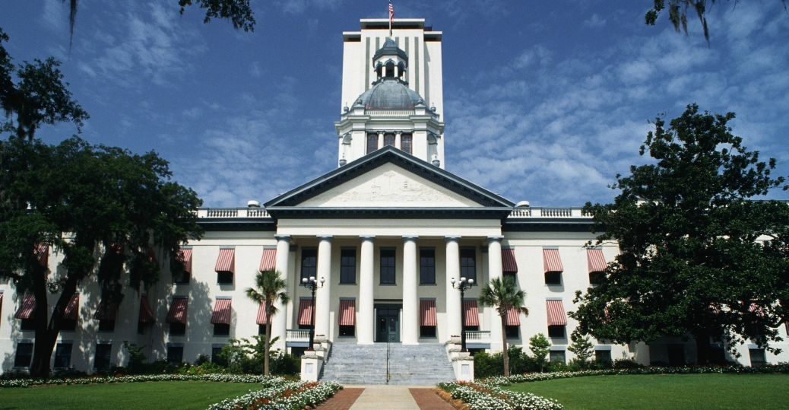
Government Relations
State Legislature, State and Federal Agencies
Local Governments
Environmental management
Laws and Regulations
Areas of practice
Marine & coastal resources
Boating issues
Funding, BP oil spill
Grants

Slide 10
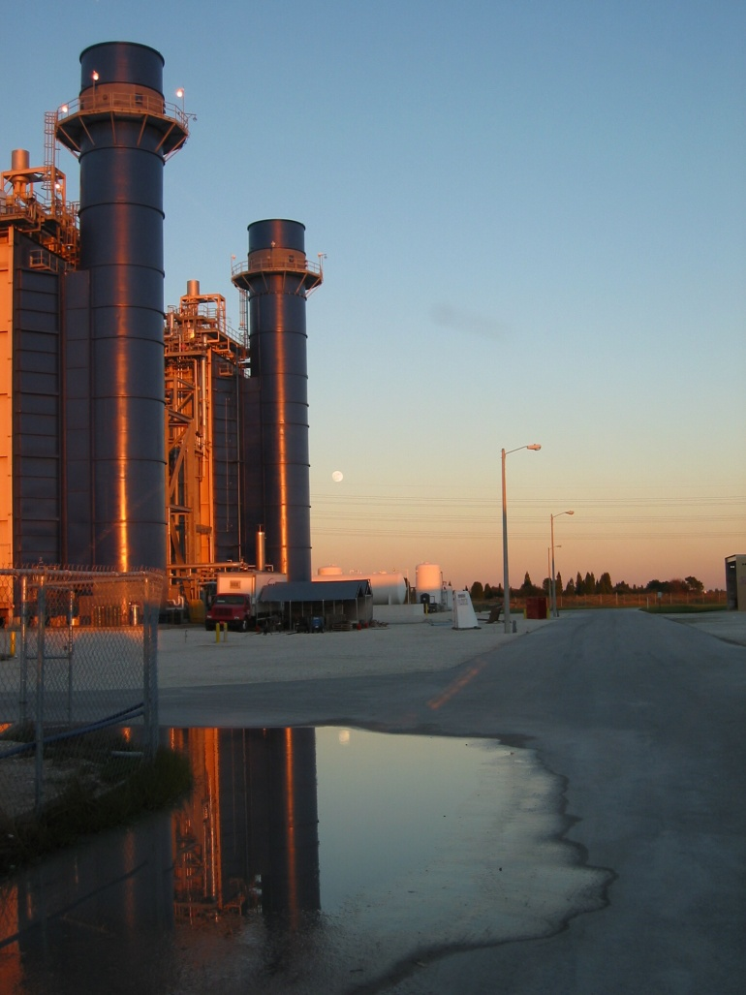
Industrial & Commercial
Duke Energy
Southeast Construction
Baycare & FL Hospitals
Water Resource Development
Water Use Impact Assessment
SWPPP’s, NPDES, & SPCC’s

Slide 11
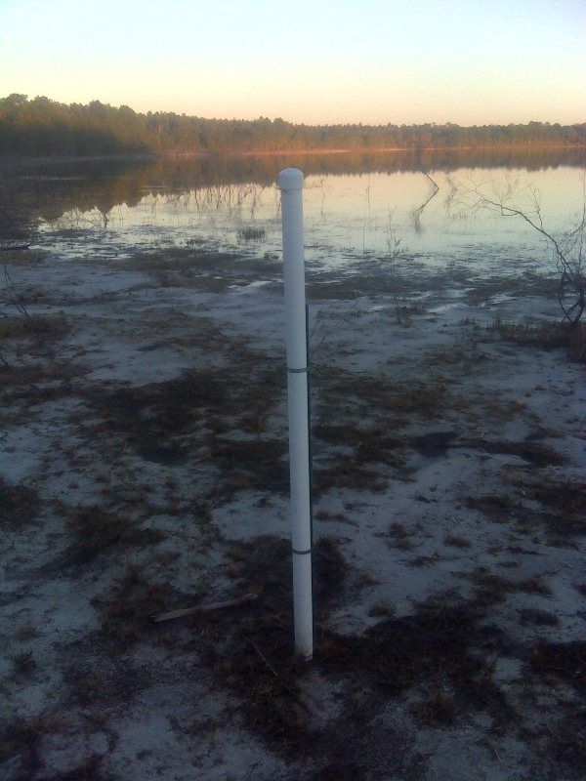
Environmental Monitoring
Water Level Studies
Surface Water & Groundwater Flow Studies
Wetland Monitoring
Groundwater Withdrawal Modeling
APT’s
Stream Flow & Site Discharge Monitoring

Slide 12
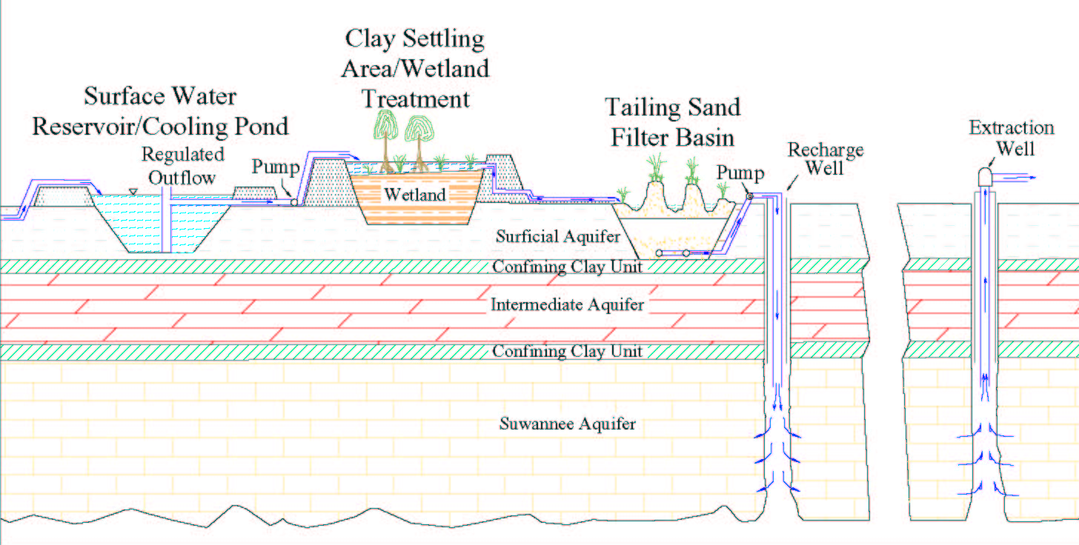
PEF Hines Energy Complex ARR System UIC Permitting

Slide 13
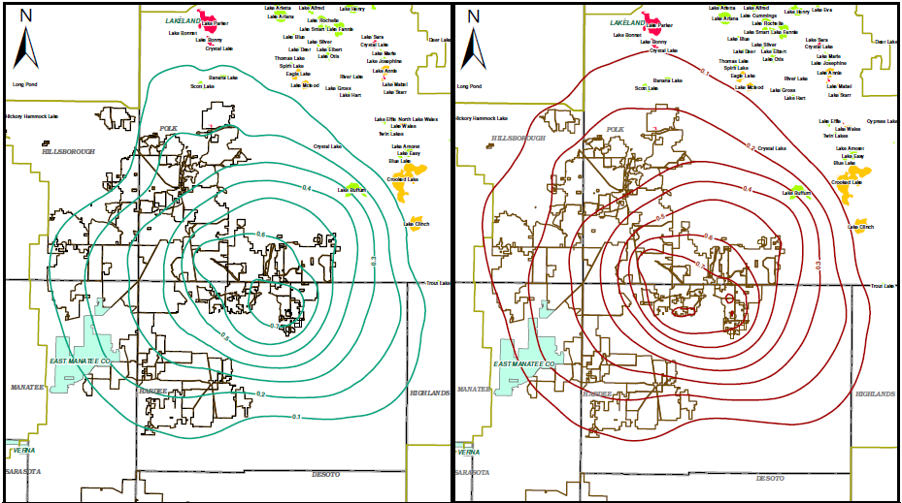
Modeling

Slide 14
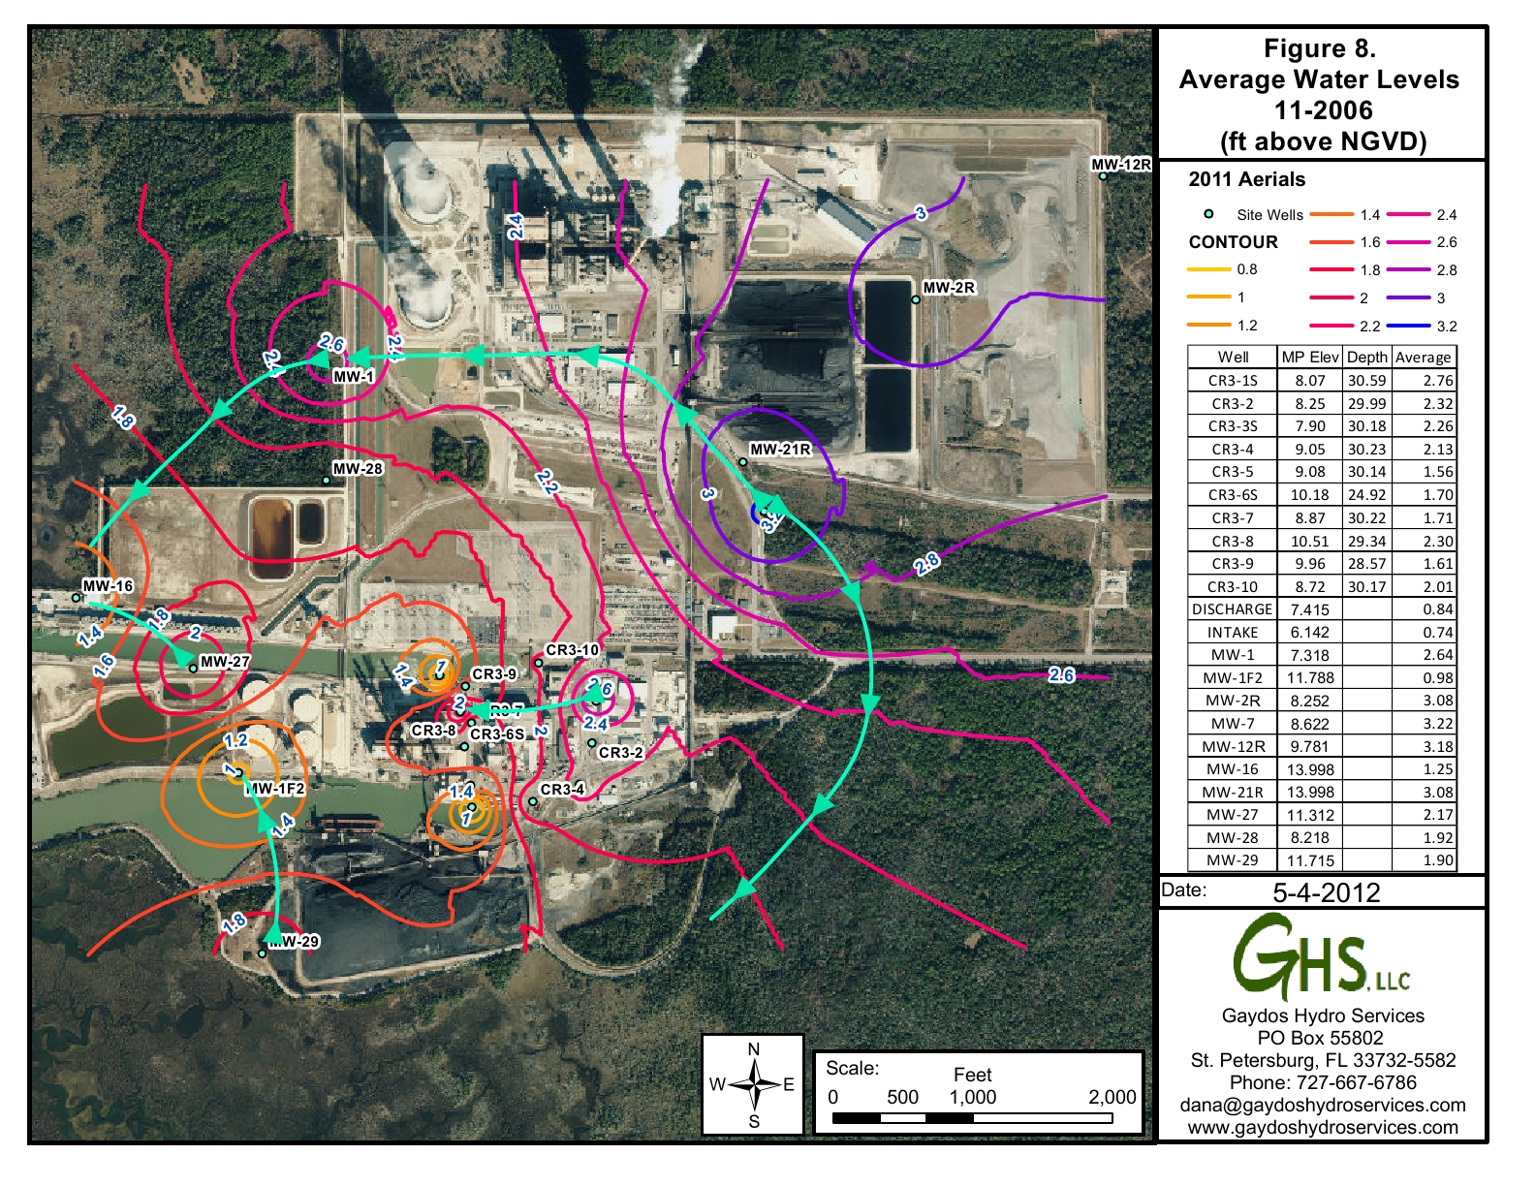
Hydrologic Monitoring

Slide 15
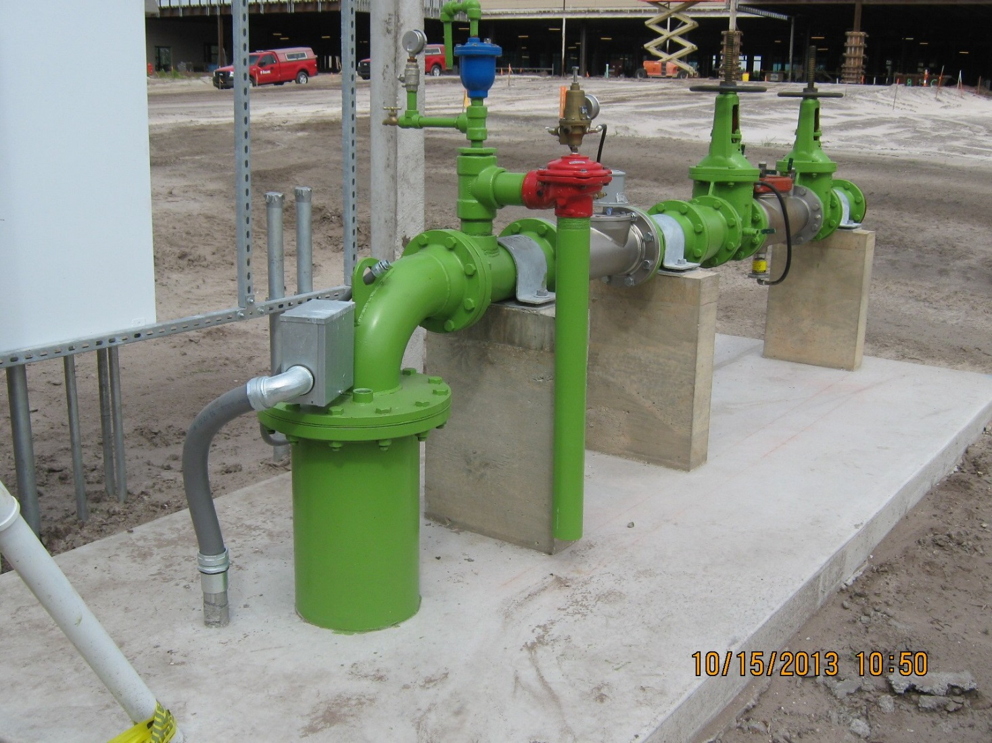
Well Design/Installation

Slide 16
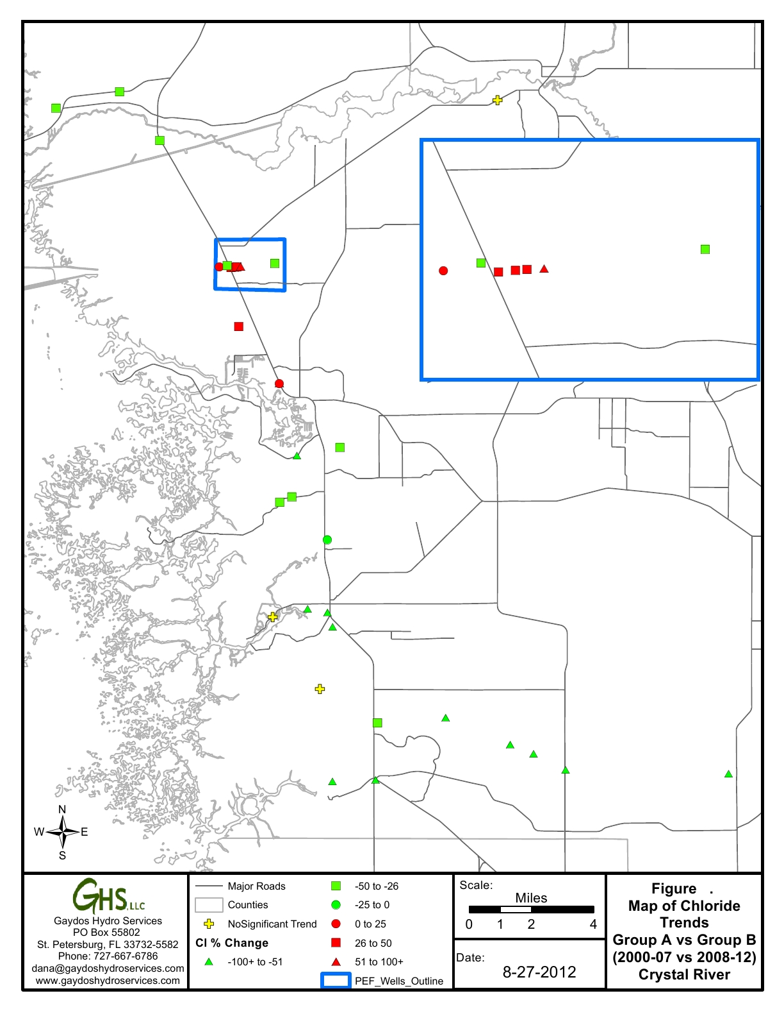
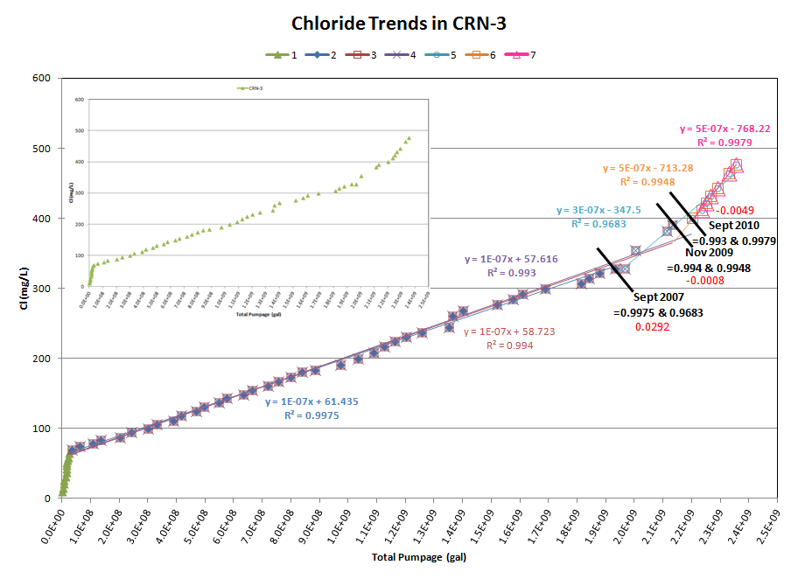
Impact Analysis

Slide 17
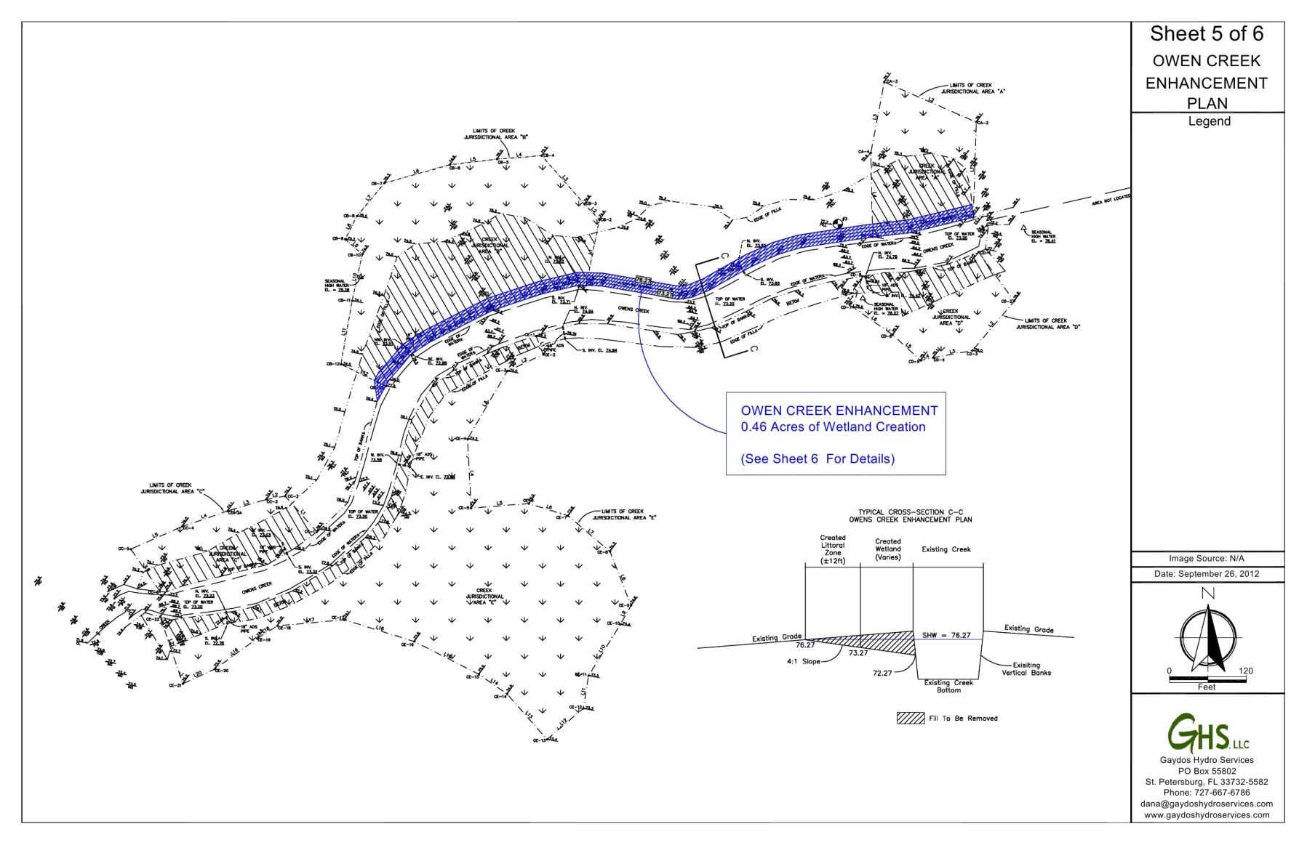
Mitigation Design/Wetland Assessment

Slide 18
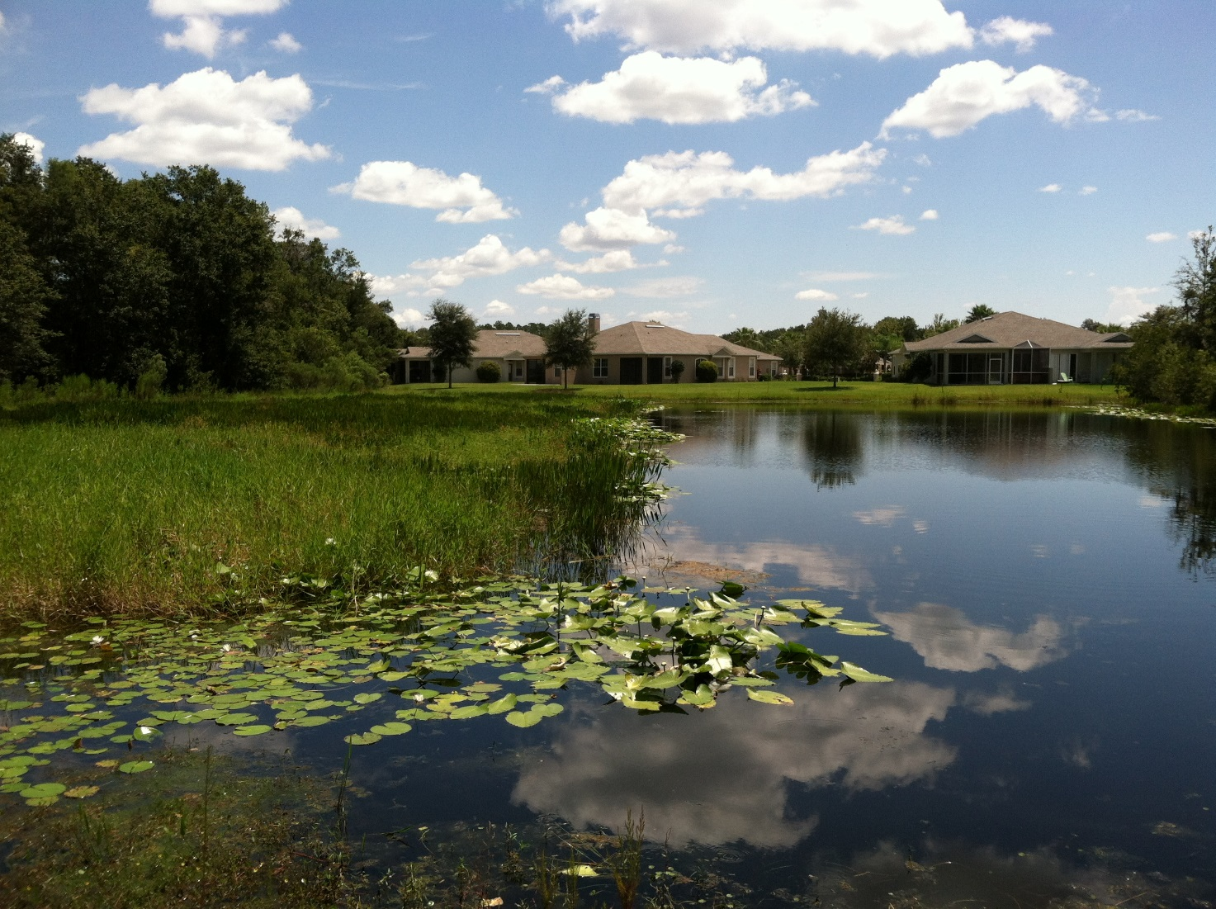
Pond Evaluation/Maintenance

Slide 19
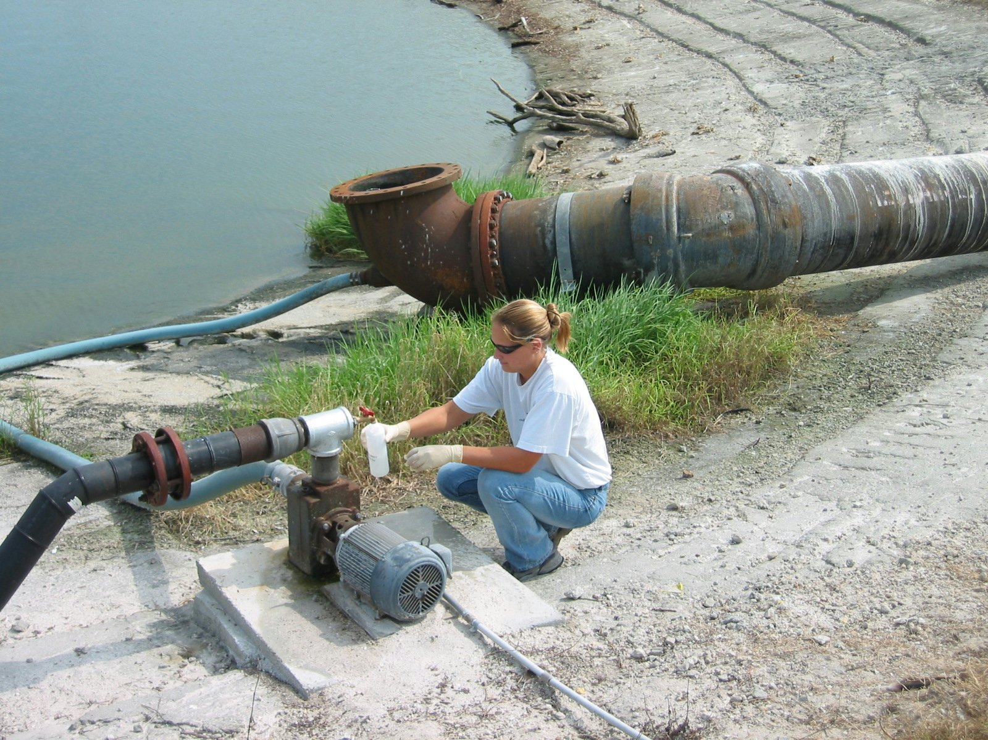
Sampling & Compliance

