Slide 1
Update on Chronic Absenteeism and Related Issues
2016 Fall Tennessee Data & Attendance Supervisors Conference
Mike Herrmann – Executive Director – Healthy, Safe & Supportive Schools

Slide 2
Current initiatives
All Means All – Chronic absenteeism/discipline
Public Safety Subcabinet
RTI2B
Adverse Childhood Experiences (ACEs)
ESSA Planning

Slide 3
Setting the Stage for Learning
Using available data and resources to identify challenges and opportunities.
Pat Conner – Mike Herrmann – Lori Paisley
Office of Healthy, Safe and Supportive Schools

Slide 4
Workshop objectives
To identify readily available sources of data and other tools that can be used to improve attendance, assess school climate, and identify barriers to learning.
To provide directors with specific examples of how these tools can and are being used in Tennessee schools.

Slide 5
Attendance defined
Average Daily Attendance: How many students show up to school every day?
The percent of enrolled students who attend school each day.
Truancy: Who is missing school without permission?
Typically refers only to unexcused absences.
Chronic Absence: Which students are missing so much school they are academically at risk?
Broadly means missing school for any reason – excused, unexcused, suspended/expelled. Commonly defined as missing 10 percent or more of instructional days.

Slide 6
Why is chronic absenteeism rate important?
Multiple research studies link poor attendance with reduced academic outcomes.
Harmful effects of poor attendance are cumulative.
Only looking at average daily attendance rate tends to mask attendance problems, particularly within subgroups.
Most districts and schools have access to rich attendance data that can be accessed throughout the school year.

Slide 8
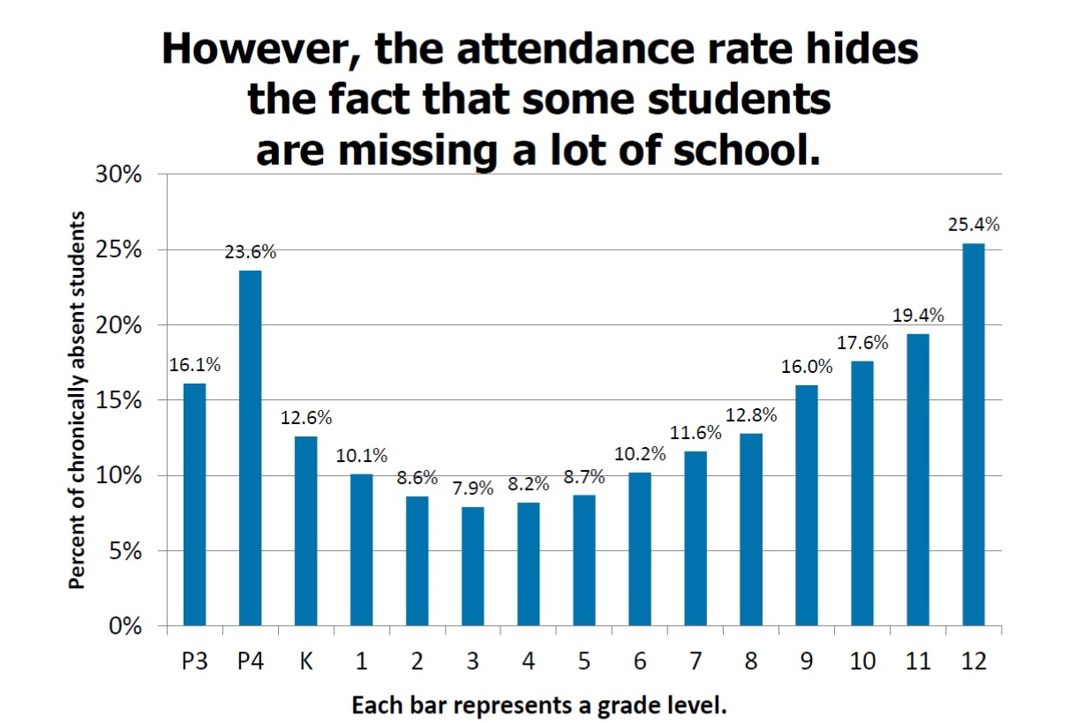

Slide 9
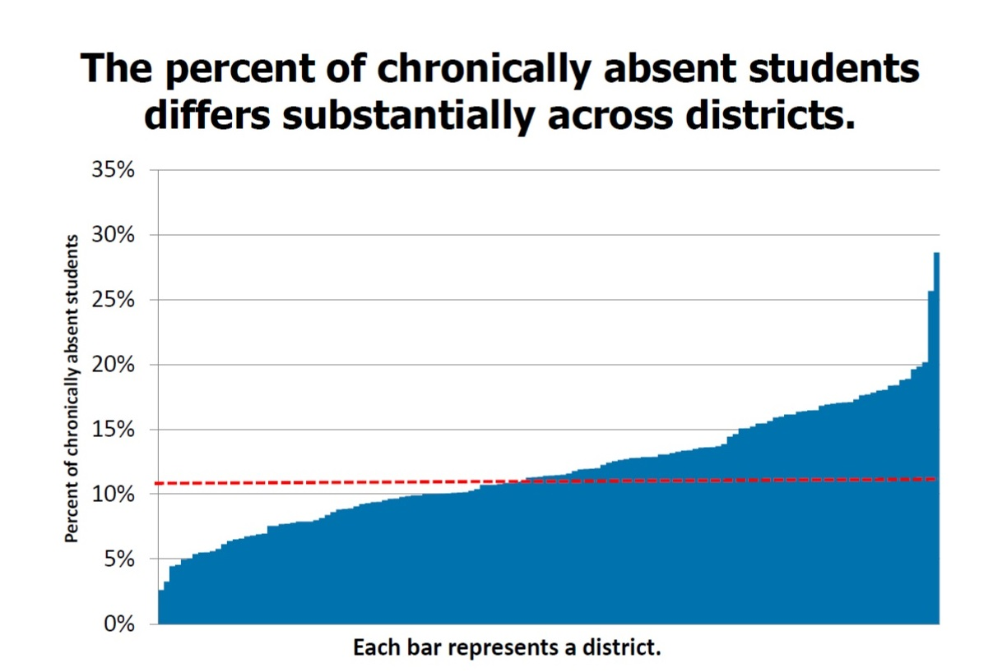

Slide 10
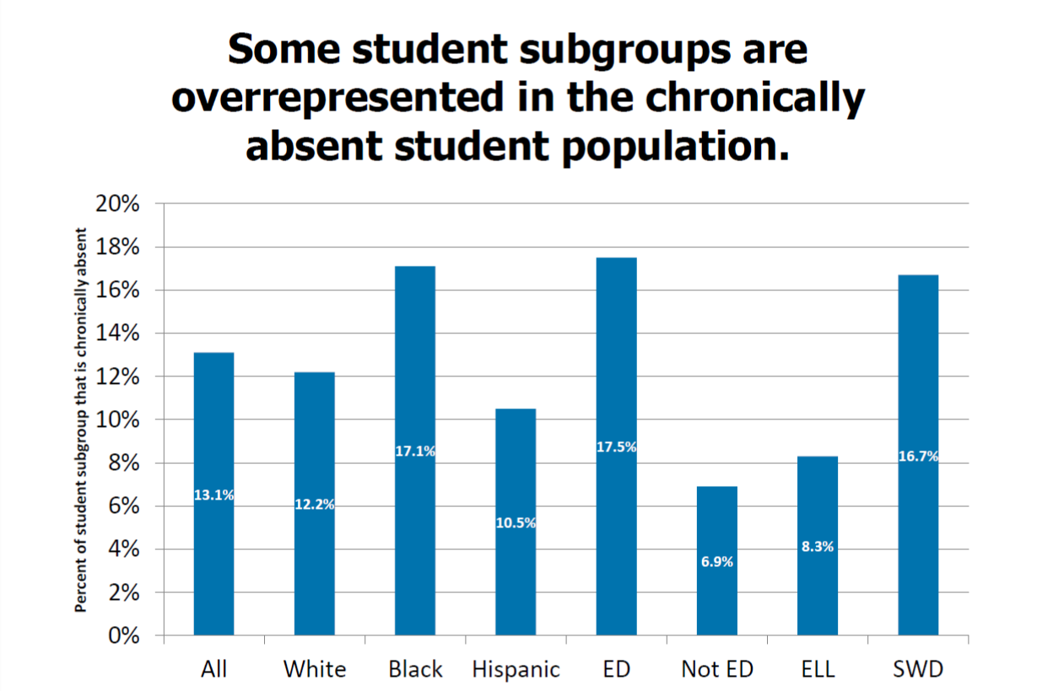

Slide 11
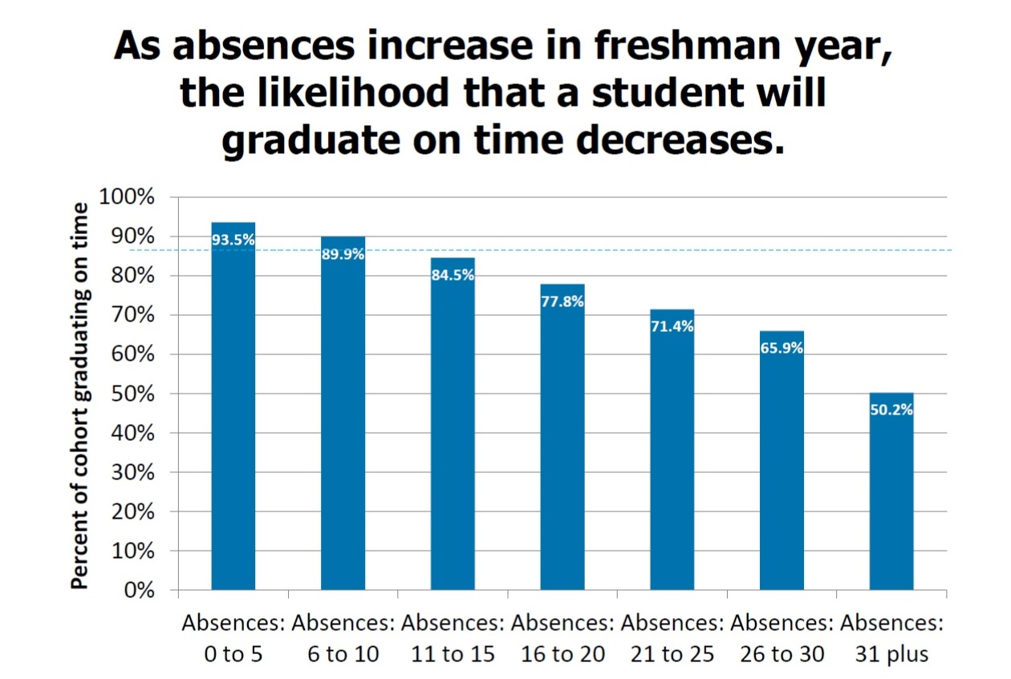

Slide 12
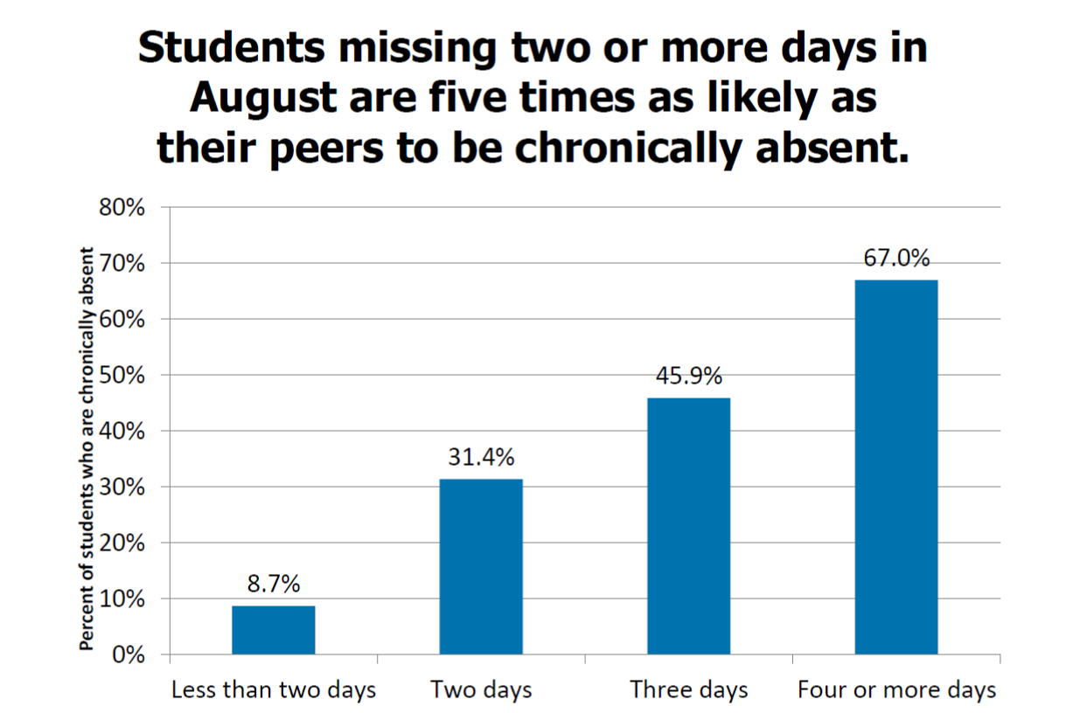

Slide 13
Chronic absence in ninth grade is a significant predictor of high school graduation
Notes:
Just over 15 percent of ninth grade students are chronically absent. Chronic absence, along with grades in ninth grade, according to many researchers are the biggest predictors of ninth grade success. In Tennessee, the patterns are clear. The patterns of disengagement that lead to drop out tend to be present in ninth grade. Over half of the dropouts in the 2011 cohort were chronically absent in ninth grade.

Slide 14
Unpack factors related to attendance
Myths
Aversion
Disengagement
Barriers
Absences are only a problem if they are unexcused
Sporadic versus consecutive absences are not a problem
Attendance only matters in older grades
Lack of access to dental and health care
Poor transportation
No safe path to school
Trauma
Homelessness
Child struggles academically and socially
Bullying
Ineffective school discipline
Family had negative school experience
Undiagnosed disability
Lack of engaging and relevant instruction
Few meaningful relationships with adults in school
Poor school climate

Slide 15
Tiered intervention systems provide both a clear framework and the flexibility to adapt
Notes:
Are any districts beginning to implement RTI2-B statewide?

Slide 16
Successfully addressing chronic absenteeism will require a paradigm shift.
Truancy/Legal
Looks only at unexcused absences
Adversarial/punitive approach
Emphasizes compliance with school rules
Applied generally after the damage is done
Student/Family support
Looks at all absences and focuses on reducing lost instructional time
Supportive/shared approach
Emphasizes impact on academic and personal outcomes
Is preventive and positive in nature.

Slide 17
Discipline Data

Slide 18
One in five ninth graders received some disciplinary action in 2014-15

Slide 19
Number of exclusionary disciplinary incidents in the early elementary grades is low, but still troubling

Slide 20
Majority of disciplinary incidents due to “violating school rules”

Slide 21
Between sixth and ninth grade, two out of three of black students have been disciplined whereas just under half of Hispanic students and one out of three white students have been disciplined

Slide 22
Economically disadvantaged students make up over 80 percent of all exclusionary disciplinary incidents

Slide 23
Nearly one in ten ninth graders misses a week of school due to instances of exclusionary discipline

Slide 24
Similarly, students who start behind academically are more likely to lose instructional time.

Slide 25
Looking at discipline data
What does the discipline data look like across schools in your district?
What grade level(s) have the greatest number of suspensions?
Are students in grades K-3 being suspended or expelled?
How many students are being removed for non-violent behaviors (e.g. violation of school rules, conduct prejudicial to good order).
Are African American, economically disadvantaged, and low-performing students disproportionately disciplined?
How do suspensions compute to lost instructional time for students?
ePlans school improvement data this year will include a more robust look at discipline.

Slide 26
Responding to discipline data
What are some alternatives to suspension and expulsion?
Restorative justice
Multi-tiered systems of support
Saturday school
Community service (within school community)
What kind of training do our teachers need to keep students in class?
TEAM evaluation rubric points to classroom management as one of the highest indicators.
What kinds of supports can the state provide to certain schools in order to change culture/practices?

Slide 27
Assessing School Climate

Slide 28
Safe and Supportive Schools Climate Model

Slide 29
Safe and Supportive Schools Survey Instruments
Student Surveys
Elementary School Student Survey (grades 3-8)
Middle School Student Survey (grades 5-8)
High School Student Survey (grades 9-12)
Teacher Surveys (K-12)
Parent Surveys (K-12)

Slide 30
Student Focus Groups
Conduct student focus groups to solicit student’s perceptions on the climate of their school.
Focus groups should be made up of a diverse group of students representing all factions in the school.
Focus groups should nurture discussion in an open and spontaneous format. Time to set aside for a focus group is anywhere from 45 to 90 minutes.
Focus groups are structured around a set of carefully predetermined questions.
It takes more than one focus group to produce valid results – usually three or four.

Slide 31
Coordinated School Health Data

Slide 32
Coordinated School Health Data
Addressing health-related chronic absenteeism:
Annual Health Services Survey
Number of students with a chronic health condition:
2016 State Total = 205,254 (22%)
Chronic Health Conditions: Asthma, Seizures/Diastat,
Severe Allergies/Epi Pens, Diabetes/Glucagon
Return to Class Rate:
Total # of clinic visits this year; How many of
those student visits resulted in a return to class?
Number of medical provider and mental health provider
referrals made because of clinic visit

Slide 33
Return to Class Rates by Region

Slide 34
Contact information
Pat Conner
Pat.Conner@tn.gov
Lori Paisley
Lori.Paisley@tn.gov
Mike Herrmann
Mike.Herrmann@tn.gov
Healthy, Safe & Supportive Schools
615-741-3248

Slide 35
What should you expect?
Continued focus on all aspects of attendance
Requests for deeper dives into data (subgroups, grade-levels, reasons)
More of a focus on real-time data
Greater transparency

Slide 36
How can you help us?
Help school leaders access/use available data
Identify/develop effective strategies for improving attendance
Share your successes and challenges

