Slide 1
Timing and Location Beluga Whale Hunting Northern Alaska
Alaska Beluga Whale Committee

Slide 2
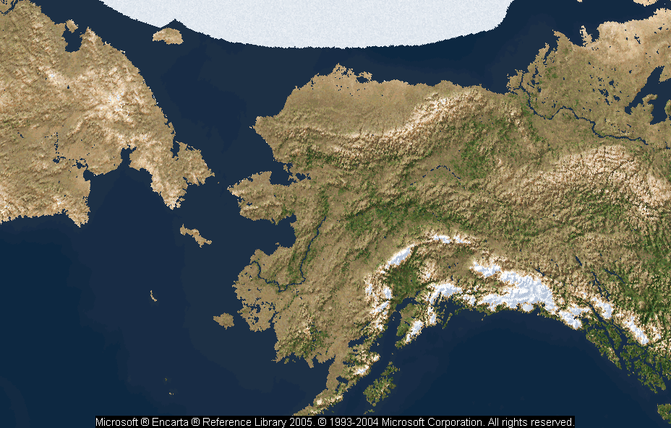
Summer and Winter Concentration Areas: Beluga Stocks in Alaska
Beaufort Sea
Chukchi Sea
Kotzebue Sound
Eastern Bering Sea
Cook Inlet
Wintering Locations
Bristol Bay
G. O’Corry-Crowe, HBOI

Slide 3
April and May—Harvests
`

Slide 4
June to early August—Chukchi Stock

