Slide 1
Bromsgrove Safer Neighbourhoods Team Command Structure
Supt Mark Colquhoun
Ch Insp Edward Hancox
Insp Lee Page
Sgt Steve O’Neill
Sgt Ian Heeks
SNT Bromsgrove North & Rural
SNT Alvechurch & Wythall
SNT St. Johns
SNT Bromsgrove South & Rural
SNT Hagley & Rubery

Slide 2
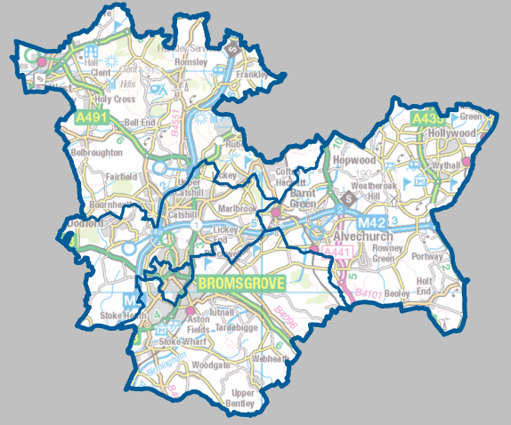
Bromsgrove North & Rural
PC Barney Kelso
PC Lloyd Stone
PCSO Simon Cadwallader
Hagley & Rubery
PC Marc Ginder
PCSO Stuart Taylor
PCSO Susan White
Bromsgrove St. Johns
PC Anna Harding
PCSO Eleanor Batty
Alvechurch & Wythall
PC Simon Albutt
PC Stuart Head
PCSO Katie Hearnden-Fellows
PCSO Mark Hyder
SC Steve Lloyd
Bromsgrove South & Rural
PC Chris Burns
PC Jasmine Hutton
PCSO Jane Brothers
PCSO Scott Halward-Smith

Slide 3
Contact Information
Supervision
Insp Lee Page 07773043360
Sgt Steve O’Neill 07970544522
Sgt Ian Heeks 07811973864
Bromsgrove North & Rural
bnr.snt@westmercia.pnn.police.uk
PC Barney Kelso 07976936406
PC Lloyd Stone 07773042166
PCSO Simon Cadwallader 07773044333
Hagley & rubery
hr.snt@westmercia.pnn.police.uk
PC Marc Ginder 07773043548
PCSO Stuart Taylor 07773045855
PCSO Susan White 07773044188
Bromsgrove St. Johns
bromsgrovesj.snt@westmercia.pnn.police.ukPC Anna Harding 07773047445
PCSO Eleanor Batty 07970543671
Alvechurch & Wythall
aw.snt@westmercia.pnn.police.uk
PC Simon Albutt 07816236638
PCSO Katie Hearnden-Fellows 07811760894
PCSO Mark Hyder 07816236001
SC Steve Lloyd 078104944303
PC Stuart Head 07773043048
Bromsgrove South & Rural
bsr.snt@westmercia.pnn.police.uk
PC Chris Burns 07773050890
PC Jasmine Hutton 07929783259
PCSO Jane Brothers 07773046472
PCSO Scott Halward-Smith 07811759651

