Slide 1
WHY ISAGENIX
AND WHY?
AND WHY

Slide 2
THE COMPANY
In operation since 2002
Sold billions of products
Paid out billions in commissions
Privately owned & profitable company
Backed by industry investors
425+ Legacy Members
Operating in 25 markets globally
AND WHY?
Australia
Austria
Belgium
Bulgaria
Canada
Denmark
Finland
France
Germany
10. Ireland
Italy
Japan
Mexico
Netherlands
New Zealand
Norway
Poland
Portugal
Puerto Rico
Romania
Spain
Sweden
Switzerland
United Kingdom
United States

Slide 3
OPPORTUNITY AWAITS
2023 2033
Savings Rate Needed for Retirement - 15%
AND WHY?
Wellness- $4.7 T
$12.9 T
Beauty- $723.7 M
$10.2 B
Bio-Hacking- $4.6 B
$7.5 B
Vitamins- $57.6 B
$133.9 B
Savings Rate Needed for Retirement- 15%
40%

Slide 4
SIMPLE PROVEN NATURAL
TARGETED SOLUTIONS
AND WHY?

Slide 5
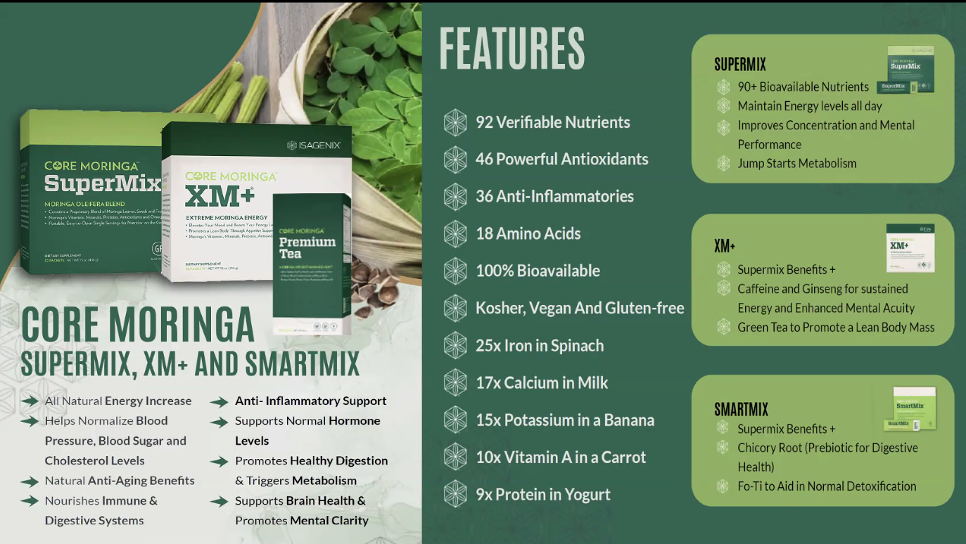
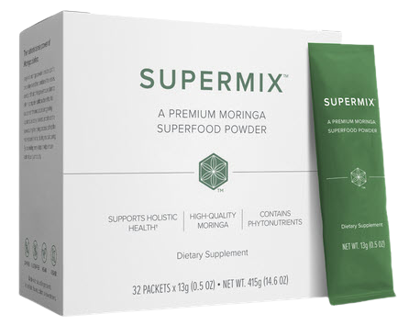
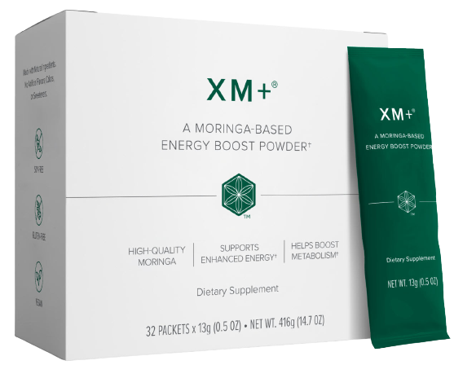
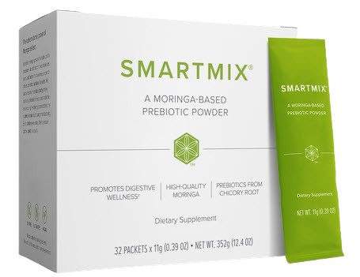
AND WHY?

Slide 6
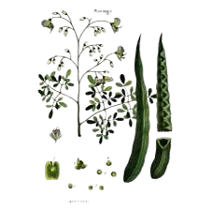
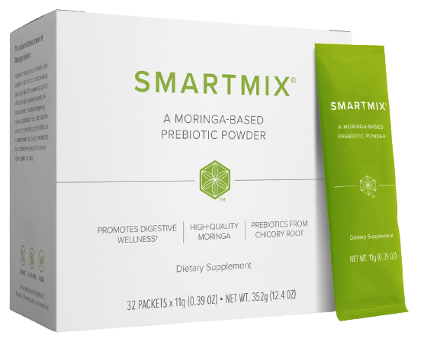
“Natures Miracle Tree”
Gram for Gram
Fresh Moringa Leaves Contain:
9X
More Protein than yogurt
10X
More Vitamin A than carrots
7X
More Vitamin C than oranges
15X
More Potassium than bananas
17X
More Calcium than milk
25X
Iron in Spinach
AND WHY?
Moringa Oleifera
46 Antioxidants
36 Anti-Inflammatories
Omegas 3,6, and 9
20 Amino Acids including 9 essential
amino acids our bodies don’t produce
Over 92 nutrients and health benefits
100% Bioavailable
Kosher, Vegan and Gluten-free
*2100+ Mg of Moringa Oleifera
*(Leaves Seeds And Fruits) *
+Energy of Green Tea,
Ginseng & *Brigham Tea

Slide 7
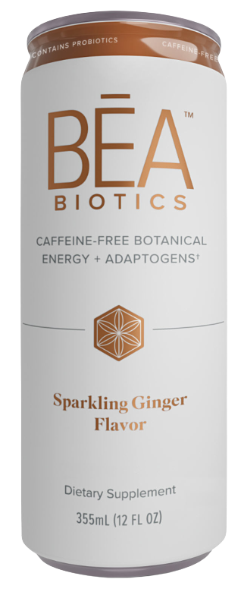
GUT HEALTH
AND WHY?

Slide 8
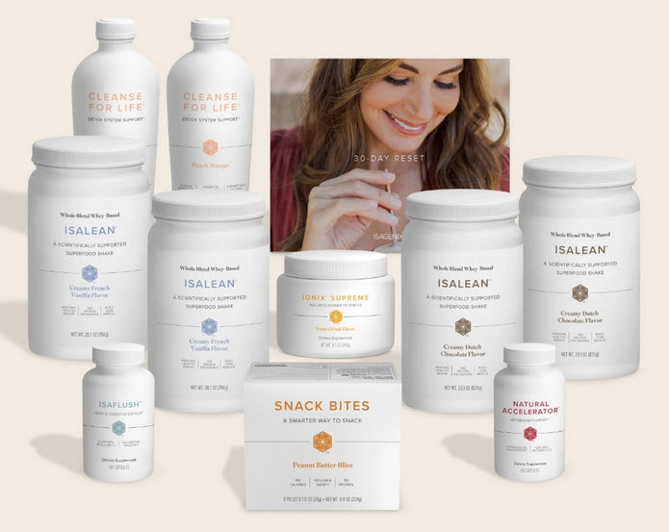
Nutrition & Weight Management
30 DAY RESET
Scientifically
Studied & Result
Proven System
AND WHY?

Slide 9
Moringa Oleifera- Nature’s Miracle Tree
Vitamins
Vitamin A (Alpha and Beta Carotene), B, B1, B2, B3, B5, B6, B12, C, D,
E, K, Dietary Folate, Biotin and many more.
Minerals
Calcium, Chloride, Chromium, Copper, Florine, Iron, Manganese, Magnesium, Molybdenum, Phosphorous, Potassium, Threonine, Tryptophan, Valine
All 9 Essential Amino Acids
Histidine, Isoleucine, Leucine, Lysine, Methionine, Phenylelenine, Threonine, Tryptophan, Valine
10 Additional Amino Acids
Alanine, Arginine, Aspartic Acid, Cystine, Glutamine, Glycine, Histidine, Proline, Serine, Tyrosine
Other Beneficial Nutrients
Chlorophyll,Cytokines Carotenoids, Flavonoids, Omega (3,6,9) oils, Plant Sterols, Polyphenois, Lutein, Xanthins, Rutin and more
AND WHY?
Gram for gram, fresh Moringa leaves contain
17x the Calcium of Milk
10x the Vitamin A of Carrots
9x the Protein of Yogurt
15x the Potassium of Bananas
7x the Vitamin C of Oranges
25 x the Iron in Spinach

Slide 10
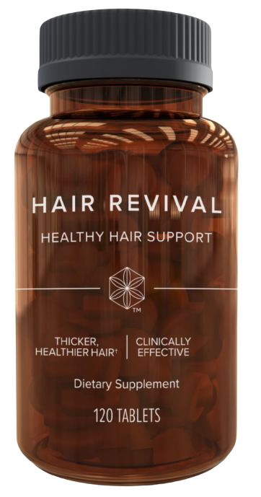
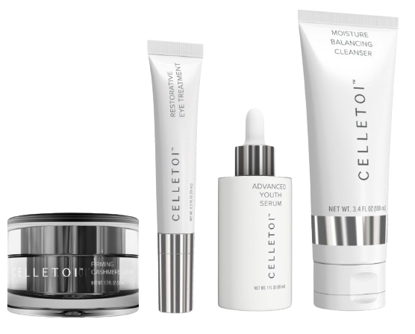
NATURAL BEAUTY
AND WHY?

Slide 11
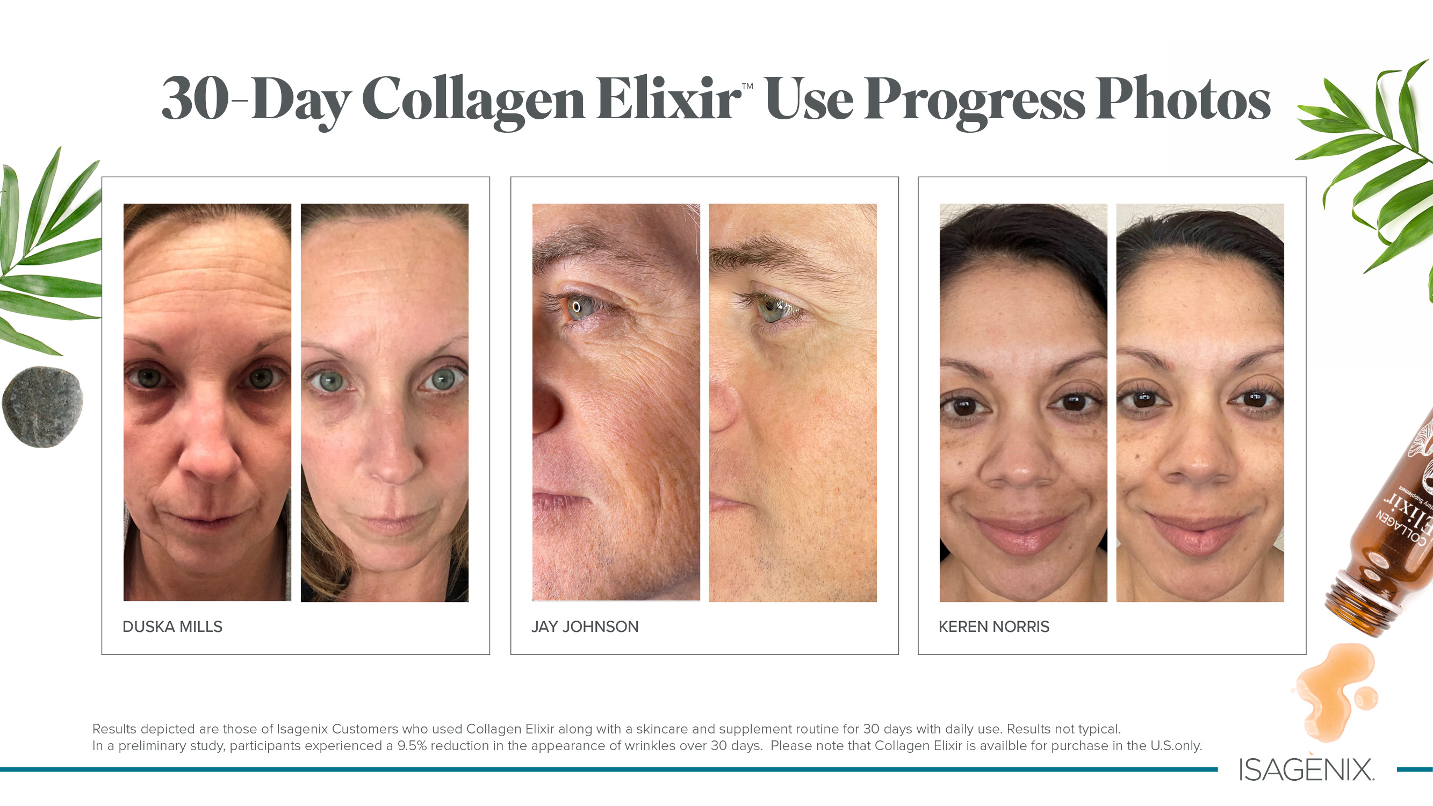

Slide 12
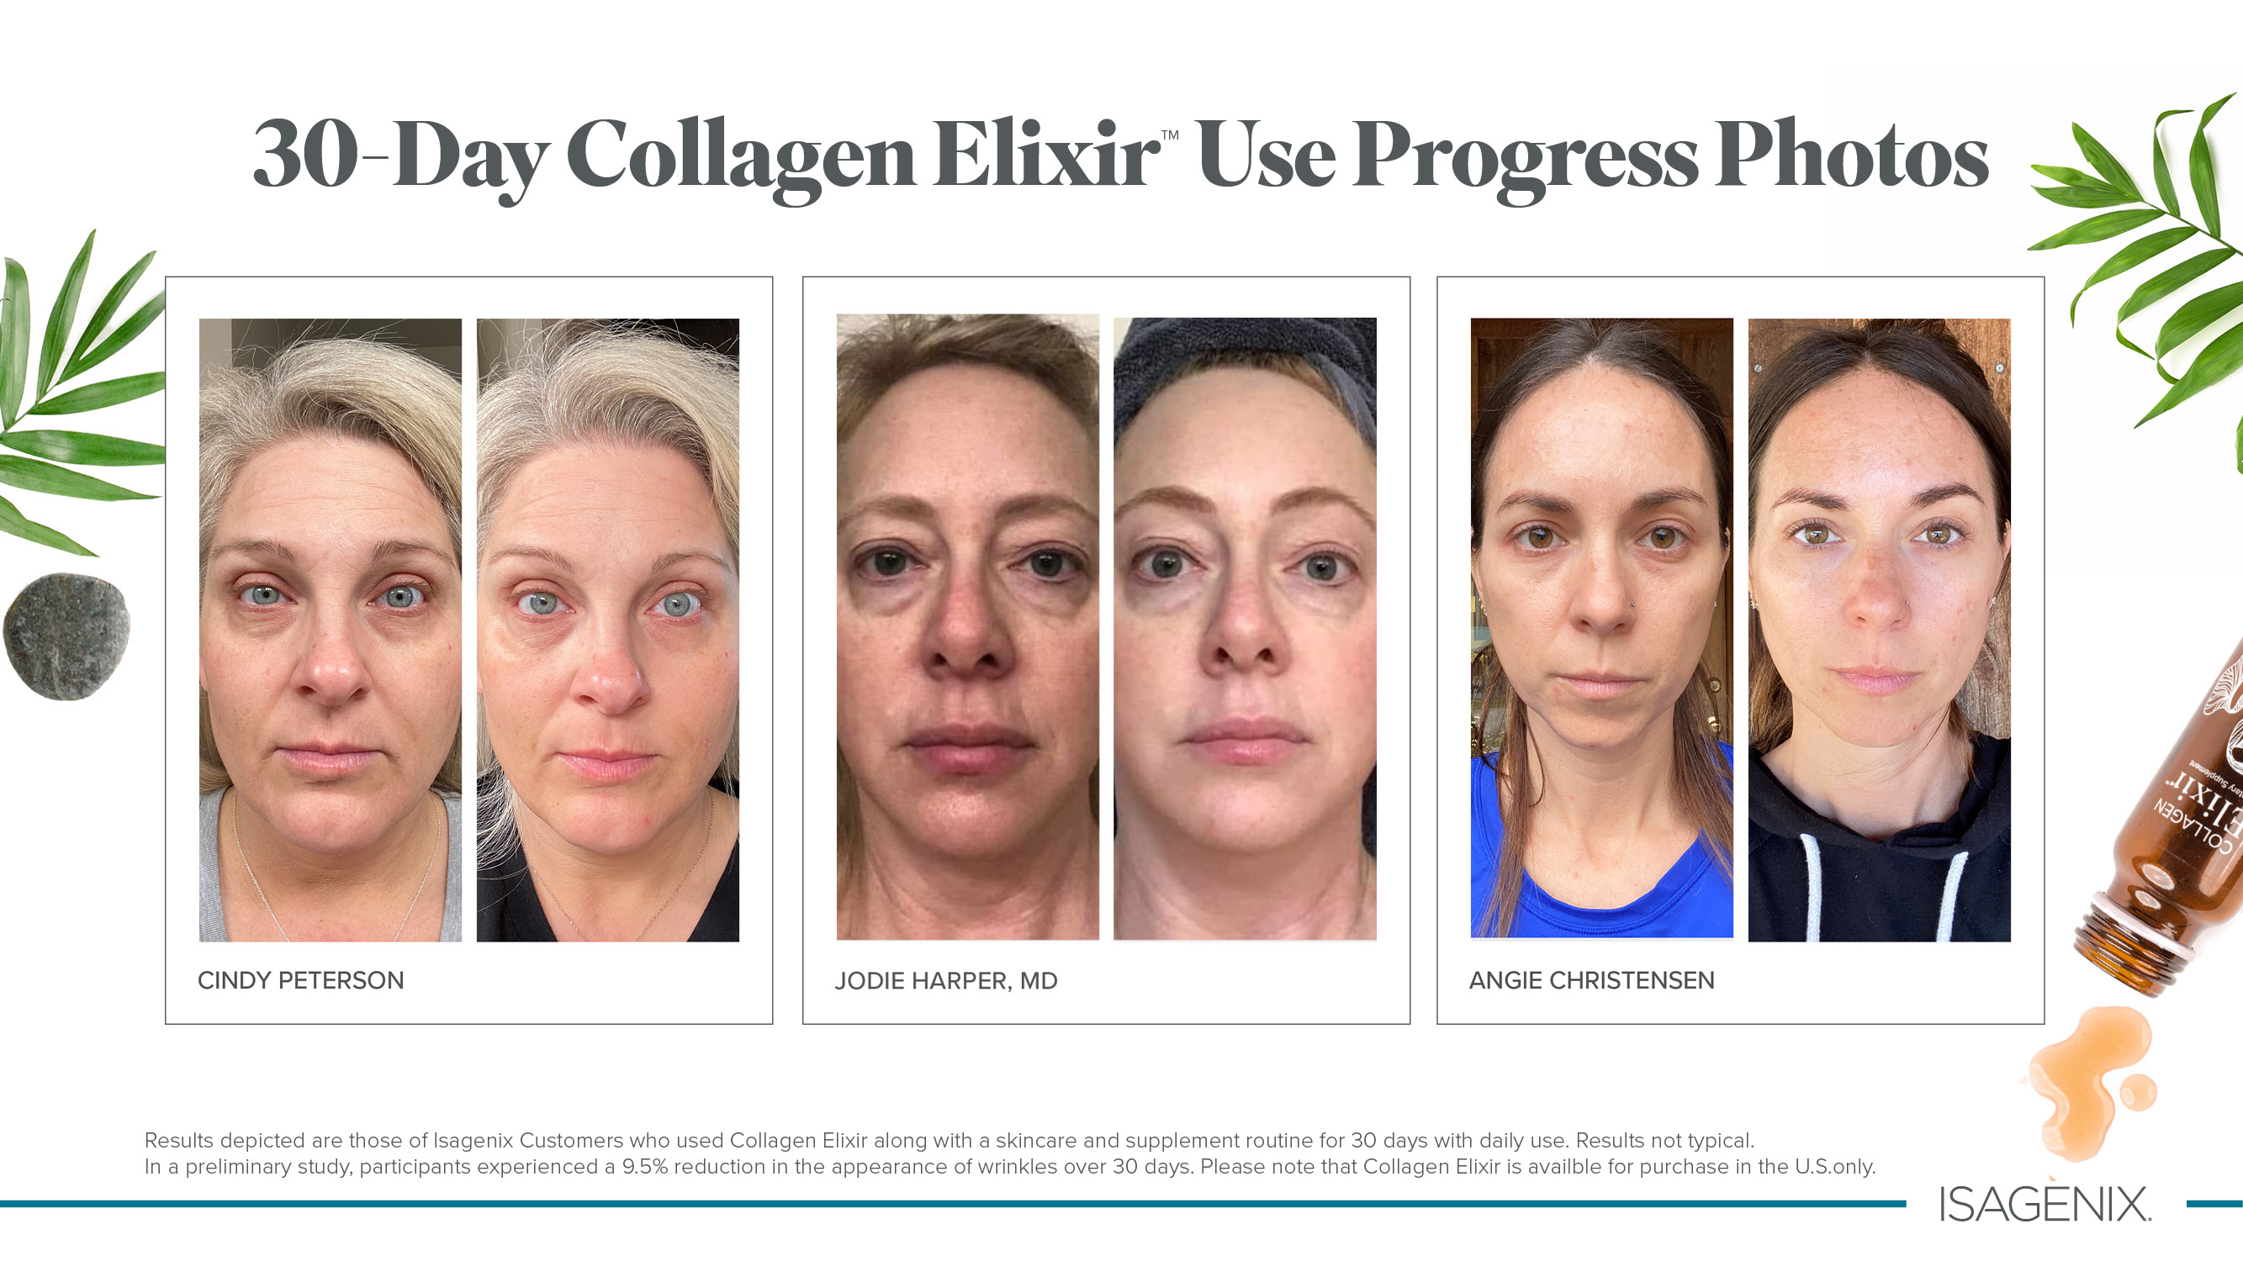

Slide 13
Notes:
Look at the difference here! Do you think this has changed these ladies’ lives?
And guys—it’s for you too!

Slide 14
STRESS & SLEEP
AND WHY?

Slide 15
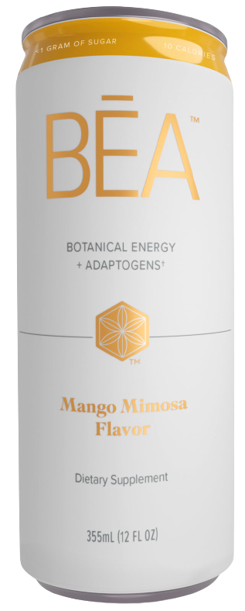
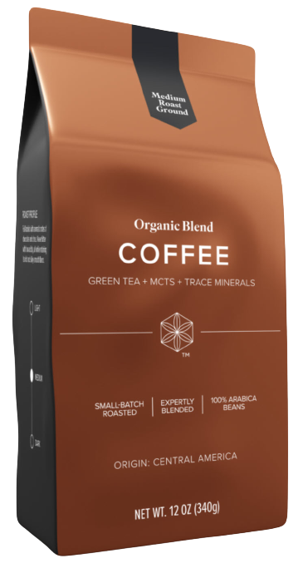
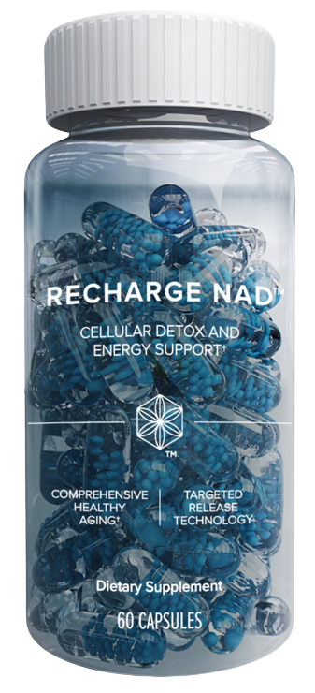
ENERGY & FOCUS
AND WHY?

Slide 16
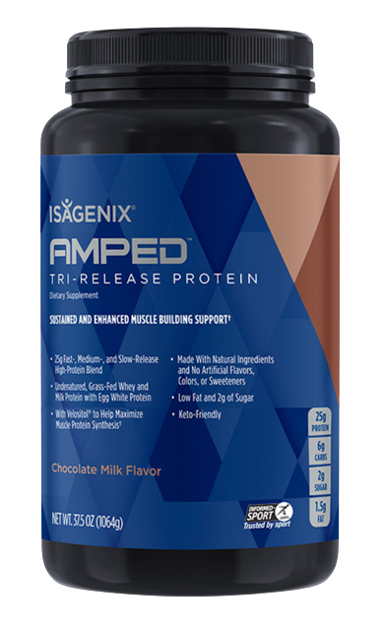
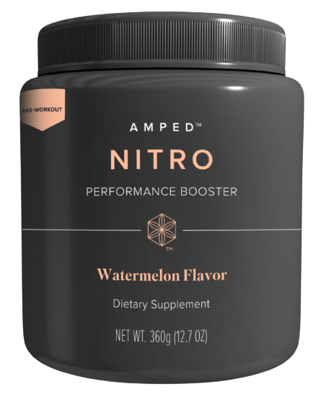
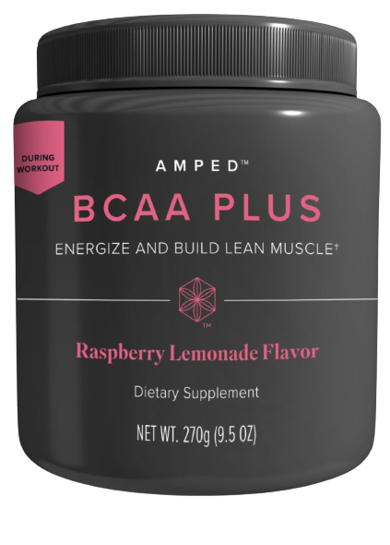
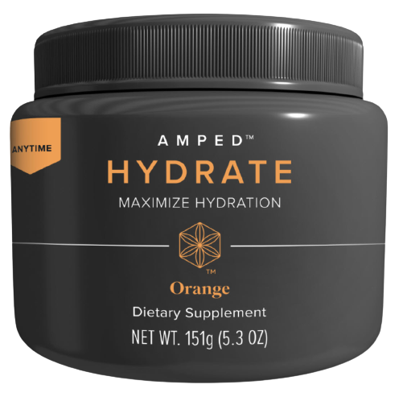
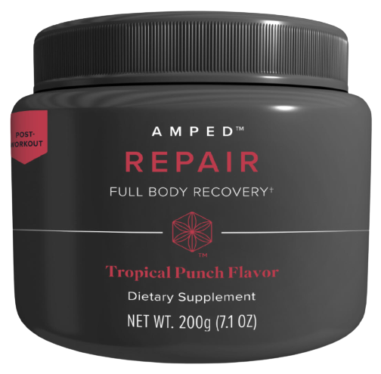
FITNESS
AND WHY?

Slide 17
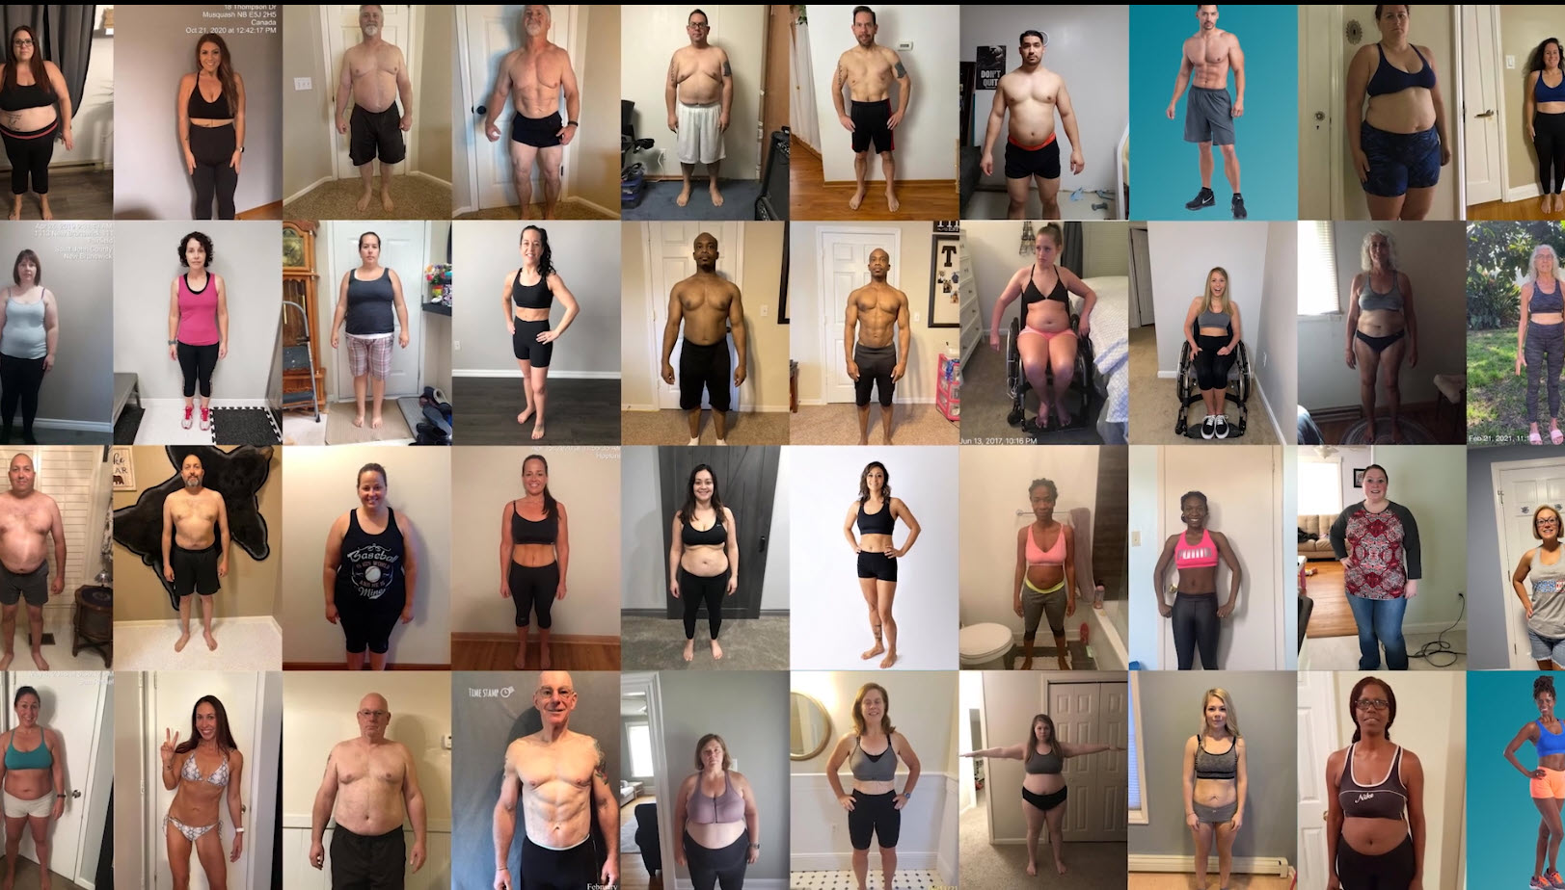
Imagine Your Ideal Life
If you want to feel better,
Isagenix can help with that.
1
YOUR OWN VIRTUAL STORE
AND WHY?
No Storefront necessary
No Employees
Minimal Investment (other than reclaiming your health)
Proven system with:
Trainings
Events
Marketing
Social media support
Real Individuals,
Real results.

Slide 18
Imagine Your Ideal Life
Your own virtual store
AND WHY?
No Storefront Necessary
No Employees
Minimal Investment (other than reclaiming your health)
Proven system with
Trainings
Events
Marketing
Social Media Support

Slide 19
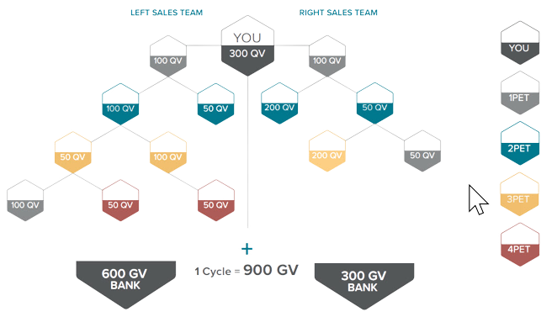
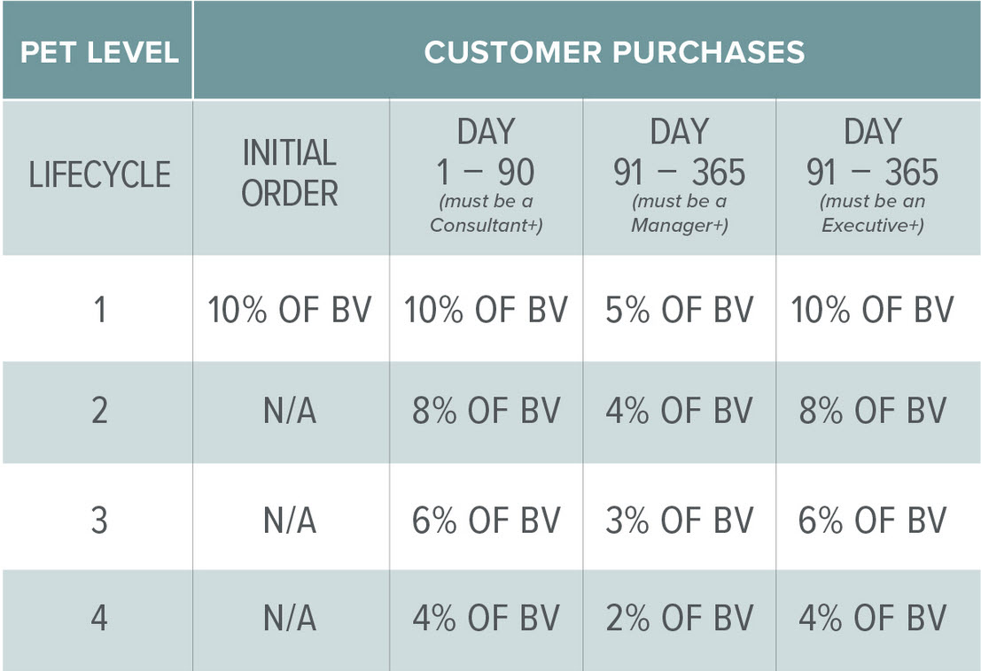
BUILD & LEVERAGE COMMUNITY
You have the potential to earn recurring leveraged income on the product purchases of your entire group, as well as paid on your organizational re-orders.
AND WHY?
900 BV = 1 Cycle
1 Cycle = $54
Up to 250 Cycles/week
1 Cycle = $54
1 Cycle/week = $54
5 Cycles/week = $270
10 Cycles/week = $540
20 Cycles/week = $1,080
40 Cycles/week = $2,160
100 Cycles/week = $5,400
5 Cycles/week = $270
20 Cycles/week = $1,080
100 Cycles/week = $5,400

Slide 20
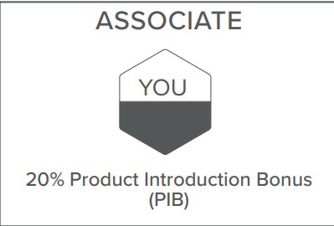
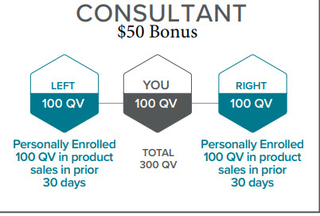
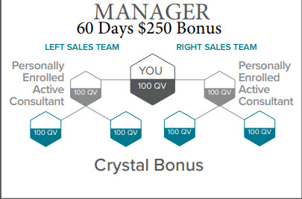
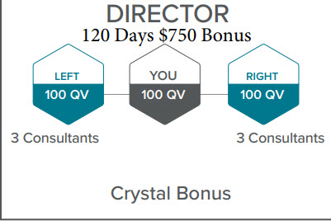
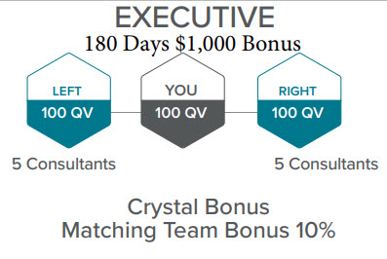
HOW TO EARN INCOME
WHERE DO YOU SEE YOURSELF?
AND WHY?

Slide 21
GETTING STARTED
How do you see yourself starting?
AND WHY?
CUSTOMER:
Use the products. 2. Get results. 3. Let us know who else might like these products.
ASSOCIATE: $29
1. Use the products. 2. Get results. 3. Share with people you know or people you haven’t met yet to earn a side income and grow your business.

Slide 22
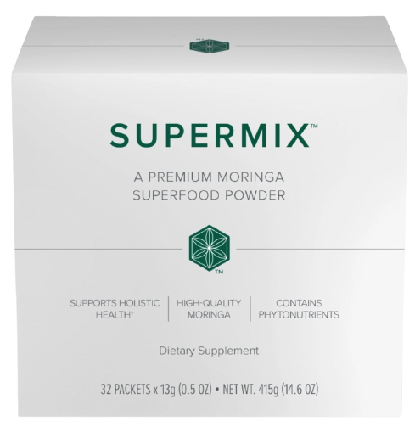
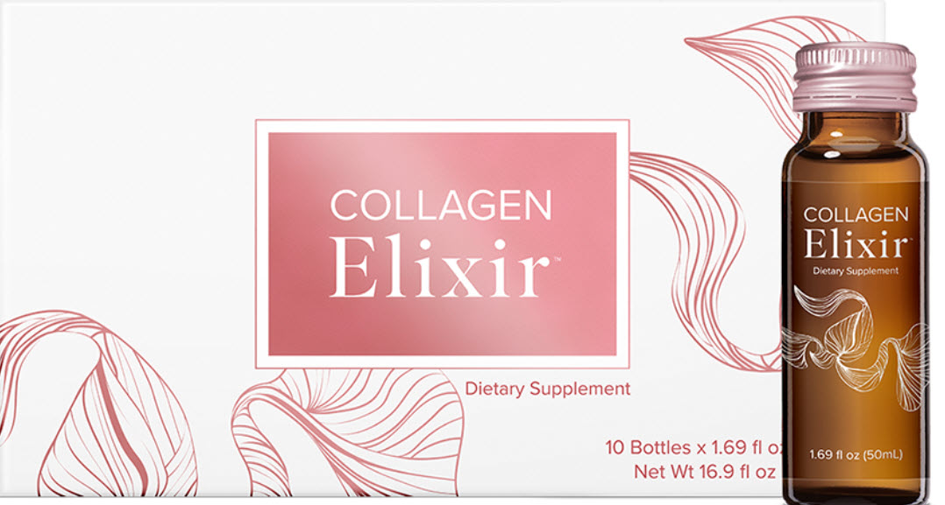
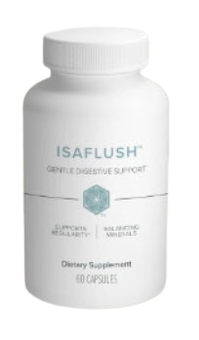
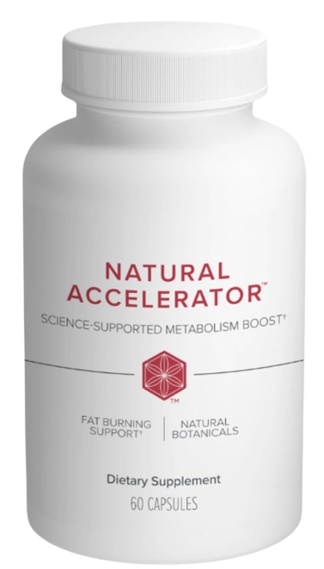
AND WHY?
1 Supermix
1 Premium Tea
Total $158.00
+ Tax-- 101 BV
1 Supermix
30 Bottles of Collagen
1 Supermix
1 Natural Accelerator
1 Isa Flush
Total $161.00
+ Tax-- 100 BV
Total $253.00
+ Tax—159 BV
All Packages are priced with a subscription.

Slide 23
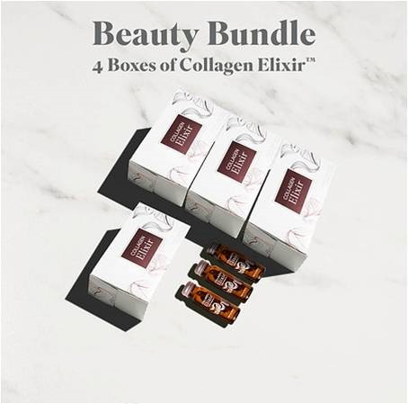
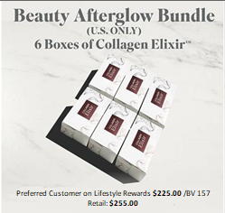
$179.00 BV 110 (with Subscription)
$240.00 BV 157 (with Subscription)

Slide 24
$$
“STAGES OF GROWTH”
AND WHY?
Global Multibillion $
Legacy Wellness Corporation
Revenue - $800 Million
2018
2020
STABILIZED
2024 * NOW
Spent Millions on Rebranding.
Product development & Strengthened
Customer & associate programs.
Hired #1 PHD Harvard Medical Dr. Plant
Hired top I.T. industry Expert
Company Founded
Acquired Zija International
Shakes & Weight loss
2002
Pioneered Intermittent Fasting
& Cleansing

Slide 25
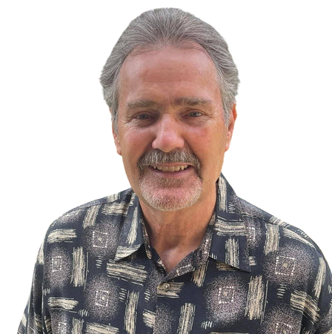
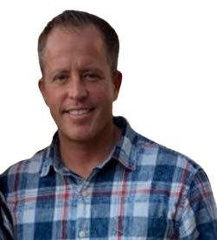
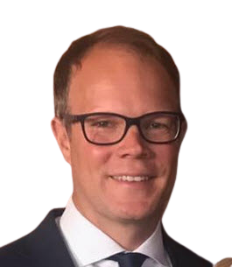
FOUNDERS
Dr. Jerry Brown
Tommy Chapa
Ruth Claybrooks
Tom Waggoner
Rich Miller
THE LEGACY DEVELOPMENT GROUP
We are a collective of top earning individuals
in the direct selling industry, some of which have been together for 30 years.
Founding members have all earned millions, some tens of millions of dollars
and have helped people all over the world with building residual income. It
is important to note that none of these people have ever quit a direct
selling company ever! They have now found themselves in a unique position. United as
one group to build at their final company, Isagenix International. They are going to help people
all over the world build and secure substantial walk away incomes for their family and leave
a LEGACY.
JoAnne McMahon
Mike Chorost
Bob DeCant
Carrie Kimball Chorost
Joel McNinch
Landon Weaver

Slide 28
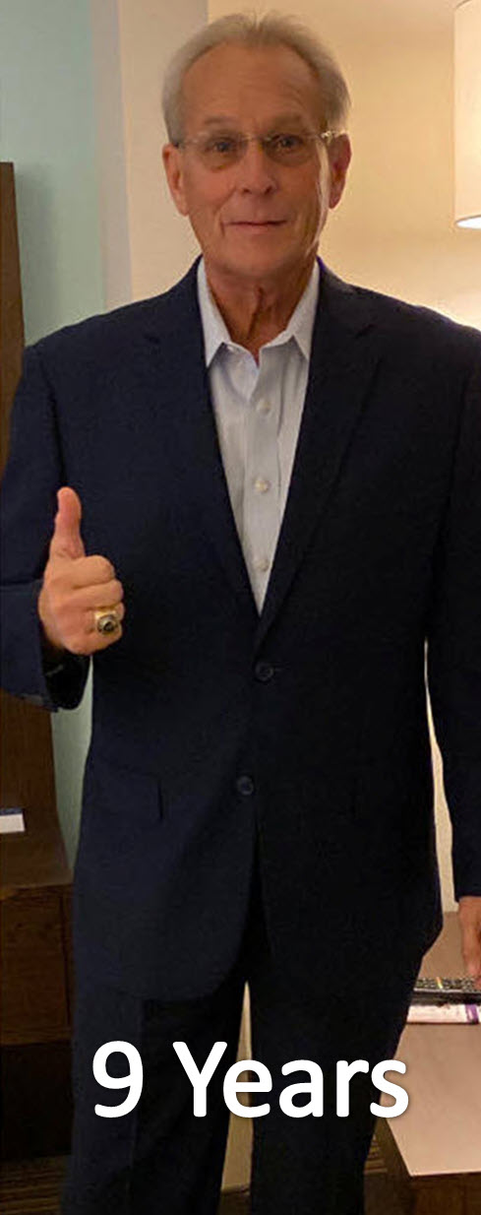
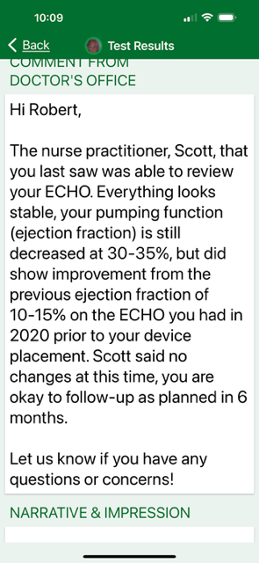
Date 05/05/2022
6 Months

Slide 29
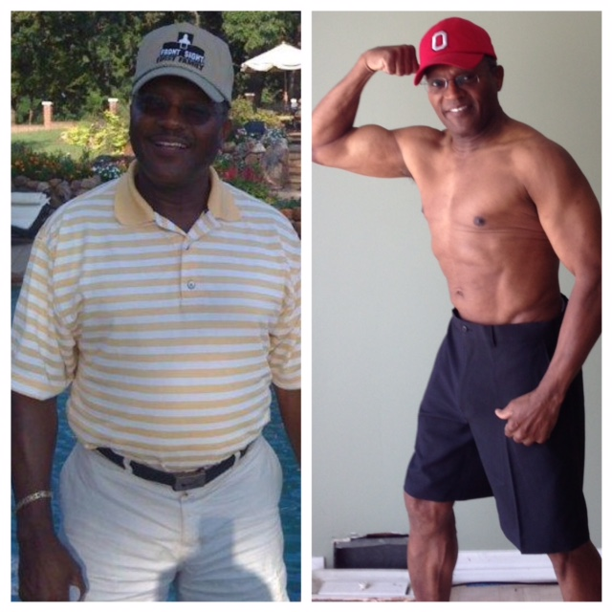

Slide 30
