Slide 1
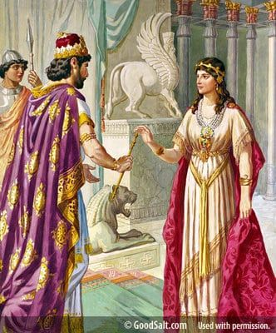
Esther
Lesson # 2
God’s Care
for a
Careless People

Slide 2
God’s Promises to Israel
Three Unconditional Covenants with Israel
Abrahamic Covenant – Gen. 12:1-3 - God promised – Land, Seed (nation) and Blessing
Davidic Covenant - 2 Samuel 7:12-16 – God Promised everlasting kingdom and throne.
New Covenant - Jeremiah 31:31- God promised transformation of the heart by the Holy Spirit through the death of Jesus Christ. Ezek. 36:25-27

Slide 3
Take Aways
God is actively engaged in history and is working all things toward His purpose and design.
God is faithful to his promises and keeps his covenants.
God is always working behind the scenes especially in times of chaos and confusion.
God uses imperfect and weak people to carry out his plans.
Christians have to constantly evaluate how much we have assimilated into our societal norms and weigh that against what scripture requires.

Slide 4
The Historical Setting of Esther

Slide 5
Esther
God’s Care for a Careless People
Rise
Of
Esther
Rise
Of
Haman
Courage
Of
Esther
Plan
Of
Esther
Feast
Of
Purim
1:1 2:23 3:1 3:15 4:1 7:10 8:1 9:19 9:20 10:3
Party Power Purpose Protection Provision
King’s Favor
Haman’s Position
Mordecai’s Refusal
Mordecai’s Identity
Haman’s Disdain
Haman’s Complaint
Haman’s Plot
King’s Decree
Haman’s Bounty
City in Confusion
Mordecai’s Wailing
Jews Mourning
Jews fasting
Esther’s Anguish
Esther’s Inquiry
Esther’s Crisis
Esther’s Request
Haman’s Gallows
King’s Dream
Mordecai Honored
Haman Humiliated
Haman Caught
Haman hanged
King’s Gift to Esther
Mordecai Revealed
Esther’s Request
Decree Unchanged
King’s Response
Jews Armed
Mordecai’s News
Jews Rejoice
Jews Defense
Haman’s Sons Hanged
Jews Victory
Mordecai’s Report
Casting of the Pur
Feast of Purim
Esther’s Letter
Purim Established
Mordecai Elevated
Mordecai’s Legacy
King’s Request
Queen’s Refusal
King’s Counsel
Queen’s Demise
Beauty Pageant
Esther Taken
Hegai’s Kindness
Esther Chosen
Esther’s Secret
Mordecai’s Word
Esther’s Report
Assassins Killed
Issues
God not mentioned
Not Quoted in NT
No Law/Sacrifices
Fasting Mentioned
Prayer not mentioned
No Supernatural

Slide 6
The Great Banquet
Ahasuerus commonly known as Xerxes the Great, was the fourth King of the Persian Empire, ruling from 486 to 465 BC. He was the son and successor of Darius the Great and his mother was Atossa, a daughter of Cyrus the Great, the founder of the Achaemenid empire.
This king Ahasuerus is well known to history, though more commonly under the name Xerxes. He inherited the vast Persian Empire from his father, Darius I (who is mentioned in passages such as Ez. 4:24; 5:5-7; 6:1-15; Dan. 6:1; 6:25; Hag. 1:15; 2:10).

Slide 7
The Great Banquet
1:1 - Now it came to pass in the days of Ahasuerus (this was the Ahasuerus who reigned over one hundred and twenty-seven provinces, from India to Ethiopia.) The author wanted us to notice the historical setting of the book.
At this time, the Persian Empire was the largest the world had ever seen. It covered what we call today Turkey, Iraq, Iran, Pakistan, Jordan, Lebanon, and Israel; and also, parts of modern-day Egypt, Sudan, Libya, and Arabia.

Slide 8
127 Provinces
Largest Kingdom in History
(Esther’s Palace)
(Sushan)

Slide 9
(Esther’s Palace)
(Sushan)
Persepolis

Slide 10
Palace in Susa/Shushan

Slide 11
Palace in Susa/Shushan
The ceiling of the Banquet Hall would have been 70 feet high.

Slide 12
Xerxes’ Persepolis

Slide 13
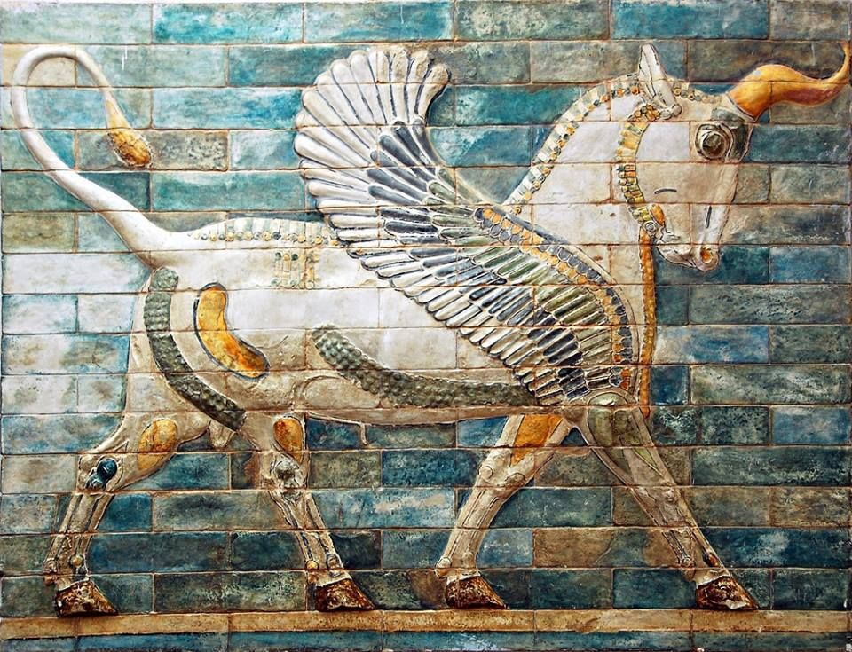
Xerxes’ Persepolis

Slide 14
The Great Banquet
1:2 -In those days when King Ahasuerus sat on the throne of his kingdom:
At this time (approximately 483 B.C.), Ahasuerus was planning an invasion of Greece, which would take place several years later. At this time the city of Athens was in its classical glory and in Greece they were celebrating the 79th Olympic games. Greece’s military might was well known in the world.
Ahasuerus was about to take in hand the expedition against Athens, called together an assembly of the noblest Persians, to learn their opinions, and to lay before them his battle strategies.

Slide 15
The Great Banquet
Notice to focus on outward beauty by the author.
1:6 “There were white cotton curtains and violet hangings fastened with cords of fine linen and purple to silver rods and marble pillars, and also couches of gold and silver on a mosaic pavement of porphyry, marble, mother-of-pearl, and precious stones. Drinks were served in golden vessels, vessels of different kinds, and the royal wine was lavished according to the bounty of the king.

Slide 16
The Great Banquet
God never uses one’s outward physical appearance to determine beauty. When the prophet Samuel examined Jesse’s sons in search of the next king of Israel, he was impressed with Eliab’s appearance. God told Samuel: “Do not consider his appearance or his height, for I have rejected him. The LORD does not look at the things man looks at. Man looks at the outward appearance, but the LORD looks at the heart” (1 Samuel 16:7). Nothing in a person’s outward appearance impresses God. God looks upon the inner beauty, the beauty of one’s heart.

Slide 17
The Great Banquet
What is beautiful in God’s eyes? Recognizing the qualities God has cherished in the lives of other people is one way to determine His concept of beauty. Noah’s implicit trust in God led him to construct a gigantic boat miles from water. Abraham trusted God’s promise so implicitly that he would have sacrificed his son of promise without hesitation. Moses yielded total control of his life to God and became the man of meekness. David gave his whole being to doing the will of God. No consequence or shameful treatment could keep Daniel from reverencing his God. Peter, Paul, Barnabas, and Timothy were ruled by God in every consideration and decision. They were totally focused upon Jesus’ will as they shared the gospel with all. In all these qualities God saw great beauty. (Gotquestions.org)

Slide 18
The Great Banquet
While all these people were beautiful to God, virtually nothing is known about their physical appearance. It was not their physique or stateliness but their faith and service that made them beautiful.
The same was true of God’s beautiful women: Rahab, Hannah, Ruth, Deborah, and Mary of Bethany. Those noted for physical beauty were often great spiritual disappointments. Rebekah was “very beautiful” (Genesis 26:7), but she was also a deceiver and manipulator.

Slide 19
The Great Banquet
Beauty in Christianity:
Some theologians argue that beauty constitutes the core of religious life. Beauty is an experience of the good, which can be associated with God, creation, faith, truth, harmony, or numerous other notions.
For some thinkers, beauty begins with God. God is that which is ultimately beautiful—and God’s nature, God’s very being, or who God is, is beauty.
In Christian thought, God is beautiful because God is holy and transcendent or above all things. In Christianity, everything exists by God’s power and divine will. God is the source and reason for everything that exists, including love and benevolence. Conceived as such, God is beautiful. (Gotquestions.org)

Slide 20
The Great Banquet
Some Christian thinkers maintain that all human beings are beautiful by virtue of being created by God and in God’s image. Since God is beautiful, they argue, human beings are beautiful because they reflect God’s creative work, and they have within them an aspect of the Divine image.
On the other hand, while human beings are created in the image of God, they are corrupted by sin, which has separated God and humans. This corruption, theologians contend, can be transformed into that which is beautiful and good through the redemptive work of Jesus Christ, who died so that human beings can be reconciled to God. Through Jesus, sin no longer separates humans from God—this relationship with God is what constitutes beauty.

Slide 21
The Foolish Decision
Drunkenness is never a good thing. Men get bragging and as a result challenges are made. In this case it might have been which country or province had the most beautiful women.
Ahasuerus being drunk decides to call Vashti who is described as very beautiful to the banquet hall to settle the argument. This foolish decision creates a crisis. Her refusal puts in jeopardy the role of men and women in the kingdom. The fear of rebellion of the wives of the drunken attendees ends in the banishment of Queen Vashti.

Slide 22
The Courageous Decision
Vashti demonstrated courage in her decision not to appear before the King’s banquet. Just think of her options:
She could have gone along with the request and avoided any problems.
She could have said she was ill or fled to another part of the palace.
She could have pretended she never got the message or forgot and not shown up.
She stood by her values and would not let the king humiliate her and so she refused.

Slide 23
The Counsel
When fear guides our decisions, it usually leads to unjust results.
Instead of recognizing the humiliating consequences of the request the men focus on the response of the queen.
The fear of how her actions would be perceived became the basis for the decision
The fear of losing control or power resulted in the banishing of a righteous person.

Slide 24
The Counsel
When wealth, beauty and power are not tempered by Godly values they become destructive and corruptive in any culture.
Wealth - 1 Timothy 6:6-10; 17-19 provides guidance in how to manage wealth in a Godly way. The result is that we store up treasure in heaven and find contentment.
Beauty - 1 Peter. 3:3-5 Do not let your adorning be external—the braiding of hair and the putting on of gold jewelry, or the clothing you wear 4 but let your adorning be the hidden person of the heart with the imperishable beauty of a gentle and quiet spirit, which in God’s sight is very precious

Slide 25
The Counsel
Power - Mark 10:42-45 And Jesus called them to him and said to them, “You know that those who are considered rulers of the Gentiles lord it over them, and their great ones exercise authority over them. But it shall not be so among you. But whoever would be great among you must be your servant, and whoever would be first among you must be slave of all. For even the Son of Man came not to be served but to serve, and to give his life as a ransom for many.”

Slide 26
The Plot
2:1 After these things: This is broader than just the events of the previous chapter. Est. 2:1 indicates that there was a four-year span between chapters one and two. During that time King Ahasuerus made his great, unsuccessful invasion of Greece and he came home a defeated man, wanting to cheer his heart through sensual diversions.
Josephus a historian mentions that over 400 women where were gathered from the various provinces.

Slide 27
The Plot
Mordecai: The writer gives us a detailed summary of the background of Mordecai and Esther. They are part of the diaspora of the Jews under the rule of Babylonians and now the Persians. We have a full lineage and historical verification of the main characters in this story.
The position at the gate was a place of prominence where the elders or decision makers were gathered. This means that Mordecai had become a leading citizen in the culture of Persia and was one whose counsel was sought in matters pertaining to Persian law and customs.

Slide 28
The Plot
Mordecai uncovers a plot to kill the king. Two of the eunuchs who guarded the king’s door were going to betray the king and allow assassins to enter and kill the king. Mordecai reveals the plot, and the assassins are apprehended and hung.
This shows that Mordecai had fully assimilated into the Persian culture and was committed to protecting the king. Ahasuerus was eventually killed by his own Prime Minister. Little did Mordecai realize how this deed would come to play in saving the Jews in Persia.

Slide 29
The Prophecy
Could Mordecai have been following the counsel of Jeremiah the prophet.
Jer. 29:4-7 - 4 This is what the Lord Almighty, the God of Israel, says to all those I carried into exile from Jerusalem to Babylon: 5 “Build houses and settle down; plant gardens and eat what they produce. 6 Marry and have sons and daughters; find wives for your sons and give your daughters in marriage, so that they too may have sons and daughters. Increase in number there; do not decrease. 7 Also, seek the peace and prosperity of the city to which I have carried you into exile. Pray to the Lord for it, because if it prospers, you too will prosper.”

Slide 30
The Harem
Many commentaries state that Esther entered this beauty pageant, but this is not true. The young virgins were gathered by the king’s emissaries and had little choice to refuse. There is no indication that Mordecai could have hidden Esther from this process. The most he could do is take up a position by the women’s court and coach Esther from outside.
We see here the love that Mordecai had for Esther and his protective care.

Slide 31
The Harem
Hegai - In the harem Esther won Hegai’s favor. He treated her differently than other virgins in four ways.
First, Hegai started Esther’s year of beauty treatments immediately; expediting her introduction to King Xerxes.
Second Hegai gave Esther special food.
Third, he assigned her seven maids.
Fourth, Hegai moved Esther and her maids into the best suite of rooms in the harem. During her year-long preparation, Esther won the favor of everyone who saw her.
Fifth, Hegai coached her on the night she went into the King.

Slide 32
The Harem
The Bible doesn’t identify why Hegai gave Esther such unmerited preferential treatment. Perhaps he selfishly hoped that if Esther became queen she would give him special favors. Maybe Hegai was even a Jew. When he saw Mordecai walk outside the harem each day to check on Esther, he recognized Mordecai’s nationality; thus promoted Esther.
Finally and more reasonably, God ordained Hegai’s actions on Esther’s behalf. Whatever Hegai’s nationality or sexuality, God has ultimate control of each life on earth. He can harden or soften a heart toward an individual, as he softened Hegai’s heart toward Esther. God ordained for Esther to be in place to save the lives of the Jewish when Haman planned to have all of them killed.

Slide 33
The Harem
Esther obtained favor in the sight of all who saw her: This was because of both Esther’s inner and outer beauty. Inner beauty often gains people (especially women) favor with others. This is a fact that Christians must accept, wisely teaching their children what really matters, and refusing to rely too much on beauty for our judgment of people.
The word for “favor” means grace, charm, elegance, etc. It reflects both the inner and outer beauty of Esther.

Slide 34
Take Aways
The thirst for power often leads to destruction because it inflates one’s ego which leads to foolish decisions.
The use of wealth to lay up treasure in heaven outweighs the use of money for selfish desires.
The cultivation of inward beauty allows God’s glory to be manifested to those around you.
Doing the right thing at the right time brings reward to the soul even if no one recognizes it. It may bring reward in the future and it will surely bring reward before the Lord.
No matter what our station in life, if we allow God to guide is we will contribute to His plan and purpose.

