Slide 1
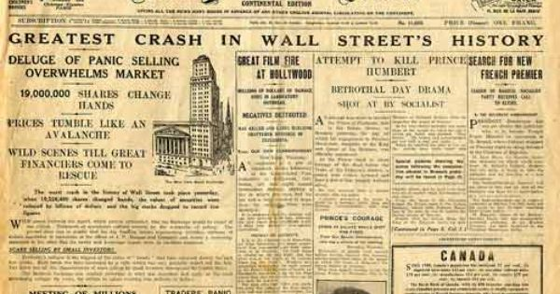
Lubbock and the Great Depression
1929-1939
https://ourunveilsecrets.wordpress.com/category/vintage-newsreels/

Slide 2
Credits
Sponsored by The Knowledge Center, Inc. – Lubbock, Texas
This project was made possible through the generous support of:
South Plains Foundation
The Knowledge Center, Inc. The Lubbock Christian University School of Education Lubbock Independent School District
The CH Foundation
All photographs are printed with permission from: Southwest Collection/Special Collections Library at Texas Tech University Lubbock Independent School District
Prepared by Kasey Porr, Britni Cantu, and Samuel J. Ayers, Ed. D.
Copyright 2016

Slide 3
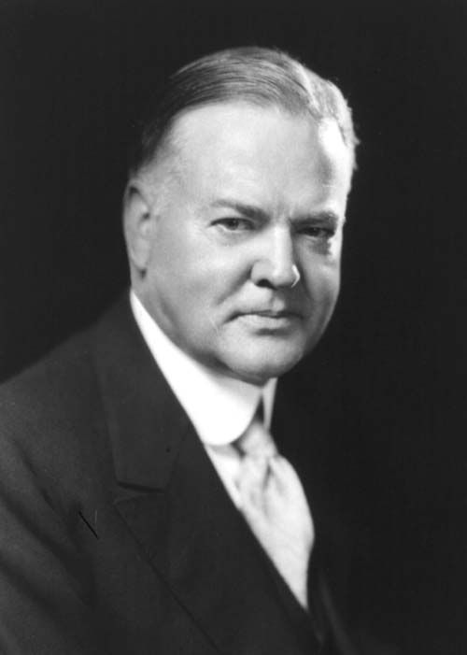
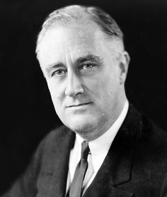
U.S. Presidents
Herbert Hoover (1929-1933)
(https://en.wikipedia.org/wiki/Herbert_Hoover)
Franklin D. Roosevelt (1933-1945)
(https://en.wikipedia.org/wiki/United_States_presidential_election,_1932)

Slide 4
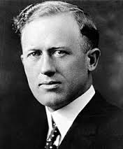
Governors of Texas
Dan Moody (1927-1931)
(http://www.wikitree.com/wiki/Moody-2757)
Ross S. Sterling (1931-1933)
(https://www.tsl.texas.gov/governors/personality/page2.html)

Slide 5
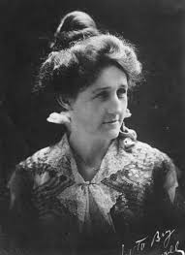
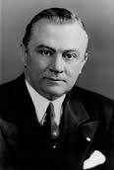
Governors of Texas
Miriam A. “Ma” Ferguson
(1933-1935)
(https://en.wikipedia.org/wiki/Miriam_A._Ferguson)
James V. Allred
(1935-1939)
(https://tshaonline.org/handbook/online/articles/fal42)
W. Lee O’Daniel
(1939-1941)
(https://fr.wikipedia.org/wiki/Wilbert_Lee_O%27Daniel)

Slide 6
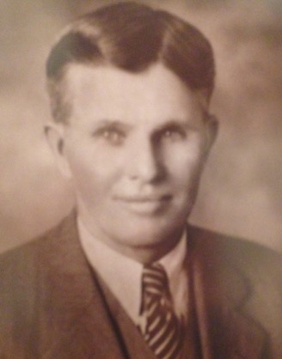
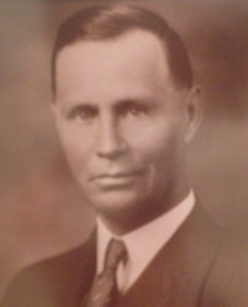
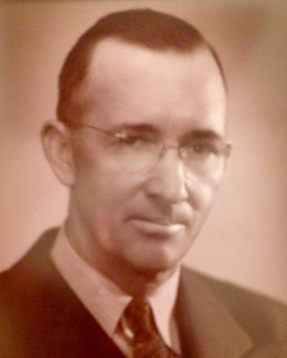
Mayors of Lubbock
JJ Clements
(1930-1934)
Ross Edwards
(1938-1944)
C.E. Slaton
(1938-1944)

Slide 7
U.S. History

Slide 8
The Great Depression (1929-1939)
Stock Market Crash-Black Tuesday
The Wall Street Crash of 1929, also known as Black Tuesday (October 29), the Great Crash, or the Stock Market Crash of 1929, began on October 24, 1929 ("Black Thursday"). The crash signaled the beginning of the 10-year Great Depression that affected all Western industrialized countries.
Causes
Investors borrowed heavily in credit while relying on the stock value boom
The overproduction of agricultural produce
“Buying on the margin” became a widespread practice - Buying stock with money borrowed (loan) from a bank
Effects
Severe macroeconomic difficulties
contraction of credit
business closures
firing of workers
bank failures
decline of the money supply

Slide 9
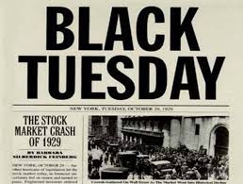
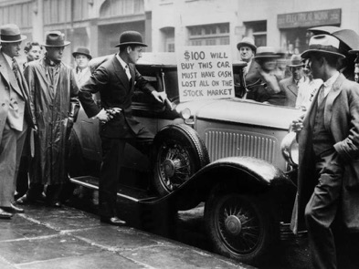
The Great Depression (1929-1939)
http://laborhistoryin2.podbean.com/e/october-29-black-tuesday/
In the 1920’s the stock markets growth caused many to invest.
Reckless spending characterized the stock market of the 1920’s.
The stock market then sharply fell throughout 1929 but on October 21 the stock market took a major dive and by Thursday investors were in a frenzy over their losses.
People began selling their stocks due to their loss of confidence in the market. Bankers tried to put more money in the system and buy the stocks but it did little to improve the situation.
By October 29th the crash could no longer be denied and the day became known as Black Tuesday.
Most people did not own stocks but the effects were felt across the country. Factories all over the country closed and countless banks also closed.
http://static3.businessinsider.com/image/5245cf4d69bedd2d708f0407-960/stock-market-crash-1929.jpg

Slide 10
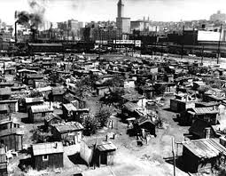
The Great Depression (1929-1939)
People around the country lost their jobs or had major cuts to their salary causing many to become homeless and hungry. One out of four men were unemployed.
People began to spend less and save more only buying what was absolutely needed and refused to put their money in banks due to a lack of trust.
The stock market crash was not the only factor to play a role in the Great Depression. The agriculture sector struggled and many families lost their farms to the bank. The lumber, textile, and other industries were beginning to slow.
Some larger cities were shut down for periods of time due to worker marches.
In New York, Chicago, and Denver the homeless came together to form communities called Hooverville's after President Herbert Hoover whom they blamed for the problems the countries problems.
http://depts.washington.edu/depress/hooverville.shtml

Slide 11
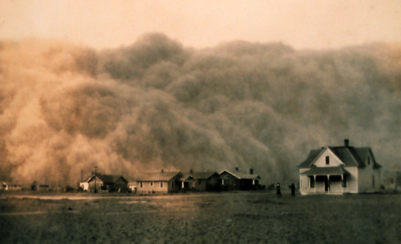
The Great Depression (1929-1939)
The Bonus Army made up of World War I veterans marched on Washington D.C. demanding their military pensions but were driven out by the U.S. Army.
In rural areas, farming areas, many families lost their farms and those that did not looked for financial assistance from the government.
During the 1930’s a major drought settled in in the Dakotas, Montana, Oklahoma, Kansas, Colorado, and Texas. In these areas farmers had farmed the land loosening the soil to plant their crops. Once the drought set in and the winds picked up the dirt blowing it across the prairies. Nothing grew in this area. Many families picked up and moved west towards California in hopes that their would be agricultural work but it was scarce.
https://en.wikipedia.org/wiki/Dust_Bowl

Slide 12
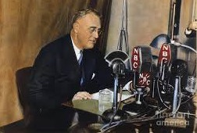
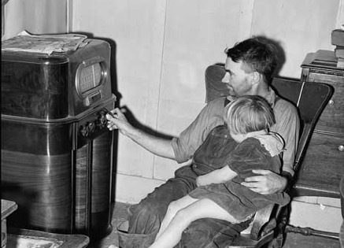
The Great Depression (1929-1939)
www.keyword-suggestions.com
President Franklin D. Roosevelt was inaugurated into office in March 1933.
In the First Hundred Days of being in office, Roosevelt proactively pushed through legislation to help stabilize the economy even going so far as to shut down banks in the country and summon congress for a special session.
Throughout the remainder of the Great Depression Roosevelt held what became known as Fireside Chats. He spoke directly from the White House over the radio directly to the people calming their fears and promising a New Deal and change.
The New Deal became a program centered on fixing the U.S. Economy and bringing the U.S. back to normal. He created a program based on Relief, Reform, and Recovery brought together by what was known as Roosevelts “Brain Trust”, a group of leaders designed to create these programs.
http://www.winslowpress.com/dearmrpresident/dmp4/prompts.cfm?ID=51

Slide 13
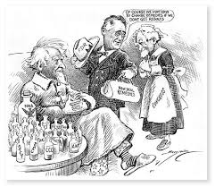
The Great Depression (1929-1939)
Roosevelt’s reforms became known as the Alphabet Soup because of the countless acronyms that came from his policies. Some of these included the Agricultural Adjustment Administration (AAA), the National Industrial Recovery Act (NRA), and the Federal Emergency Relief Administration (FERA).
The New Deal also worked to help minorities and women by creating programs to help them find and keep their jobs.
There was opposition to the New Deal. Because it favored the poor, the wealthy felt like they had much to lose.
Opposition also came from the Supreme Court where they deemed many of the New Deal acts were unconstitutional.
Other opposition came from those who were initially pro-New Deal. People such as Huey Long, Father Coughlin, and Gerald L. K. Smith all became critical of the New Deal after first supporting it.
https://www.pinterest.com/pin/426012445974426538/

Slide 14
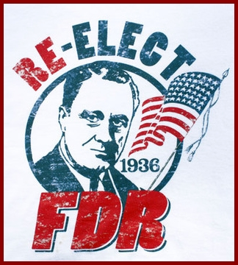
The Great Depression(1929-1939)
The New Deal programs were not without their problems. Although they were not to discriminate, many still did discriminate against women and minorities. Despite various problems, the New Deal still provided hope for many Americans.
In 1936, Roosevelt was re-elected to the White House and by 1938 the New Deal was coming to an end. Roosevelt turned his attention to World War II. Massive government spending would help bring an end to the Great Depression.
http://law.rwu.edu/story/goldstein-compares-1936-2012-elections

Slide 15
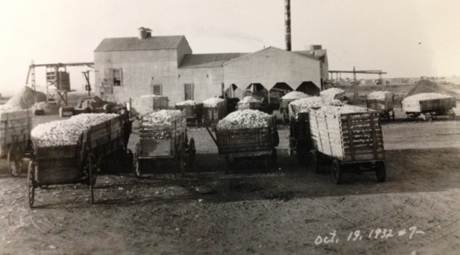
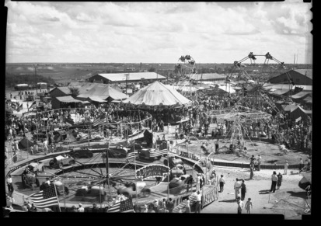
Lubbock During the Great Depression
Lubbock Fair Grounds 1930’s

Slide 16
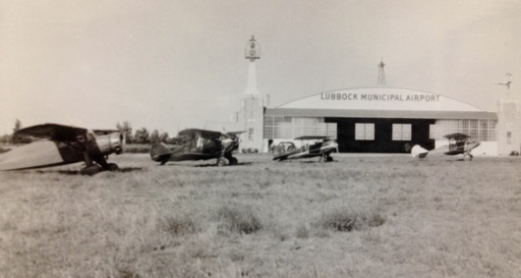
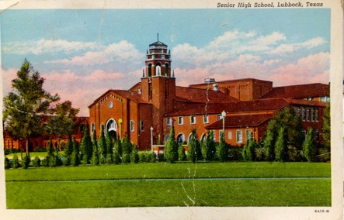
Life in Lubbock During The Great Depression
1930 – Lubbock’s population increases to 20,520
1930 – Lubbock Municipal Airport opened north of town (original hanger is now occupied by WesTex Aviation)
1930 – New Guadalupe School for Hispanics was built
1930 – Cotton Exchange Building was constructed (became Carlock Building, now offices for Glasheen, Valles, Inderman LLP)
1931 – The present Lubbock High School was completed (listed on the National Register of Historic Places and is a Recorded Texas Historic Landmark)

Slide 17
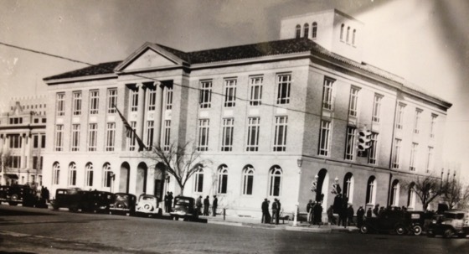
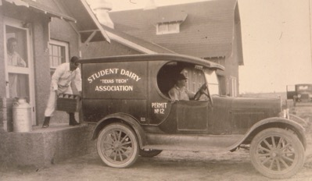
Life in Lubbock During The Great Depression
Federal Building & Post Office
1931 – The old Lubbock High School became Carroll Thompson Junior High (later demolished, now site of Pete Ragus Aquatic Center)
1931 – Art Deco Style Lubbock County Jail built on Main Street
1931 – Classical Revival Style Federal Building and Post Office constructed on the north side of Broadway near the County Courthouse (utilized until 1968, now privately owned)
1932 – Lubbock’s first commercial radio station, KFYO, began broadcasting
1932 - City of Lubbock applied for RCF funds for street paving and storm sewer extensions
Texas Tech student loading milk for delivery

Slide 18
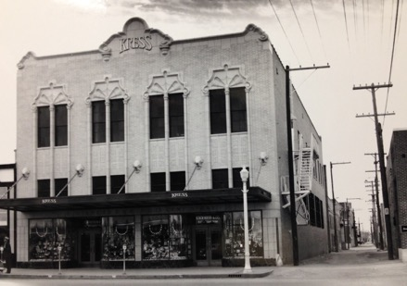
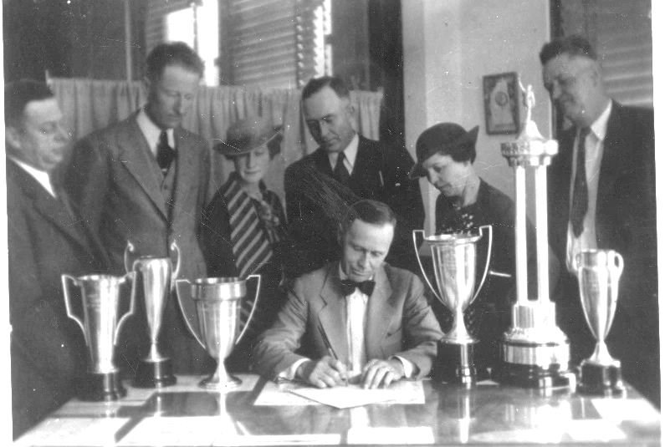
Life in Lubbock During The Great Depression
Kress Store
1932 – The mission style Kress retail store building was constructed at 1109 Broadway
1933 - Governor “Ma” Ferguson called for a ‘bank holiday” on March 2 and closed all state banks. Days later, President Roosevelt declared a four-day national banking holiday
Lubbock citizens were without banking services for nearly two weeks
There were no “runs” on Lubbock banks
1934- George H. Mahon elected the first United States Representative from the new Nineteenth Congressional District, which included Lubbock County
1935 – Under Mayor Ross Edwards, Lubbock applied to Works Progress Administration (WPA) program to dig and refill Lubbock Lake
Mayor Ross Edwards signs proclamation for annual clean-up campaign

Slide 19
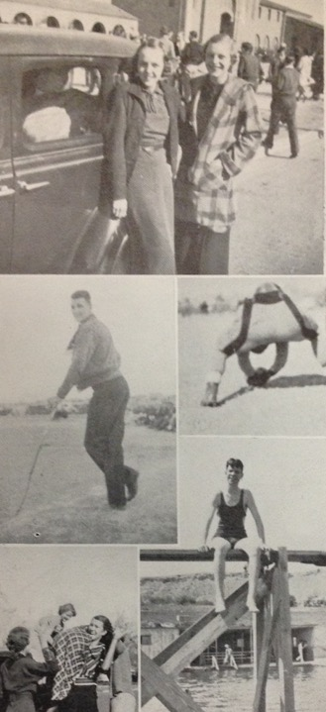
Life in Lubbock During The Great Depression
1935- Mackenzie State Park established, combining existing city and country parks with additional acreage under state ownership
Mayor Ross Edwards worked to designate Mackenzie Park as a State Park, P.F. Brown and Mollie Abernathy assisted in purchasing additional land to enlarge the park before deeding the property to the State (reverted back to city in 1993)
Civilian Conservation Corps (CCC) camp established in Mackenzie Park. Workers constructed golf course, tennis courts, picnic areas, and swimming pool
Lubbock High students, 1935

Slide 20
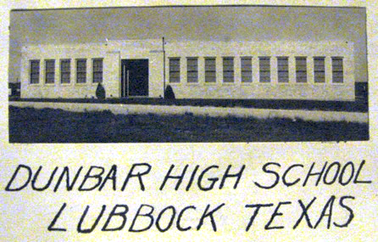
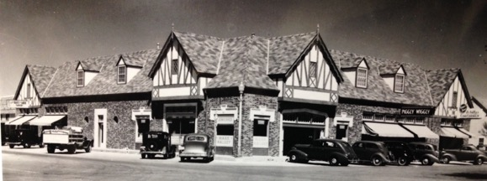
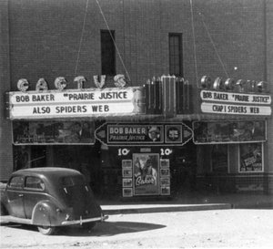
Life in Lubbock During The Great Depression
1936 – Dunbar Junior Senior High School constructed on Date Avenue with four classrooms, study hall (became part of Ella Iles Elementary School, now vacant)
1937 – Tudor Revival style shops were constructed at corner of Broadway and College Avenue-now University
1938 – The Cactus Theatre opened at 1812 Buddy Holly
1939 – Spanish Colonial style elementary schools George Bean (3001 Ave N) and Roscoe Wilson constructed (2807 25th Street)
http://cactustheater.com/about/

Slide 21
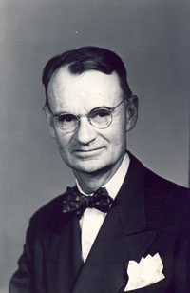
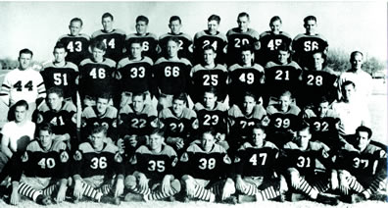
Life in Lubbock During The Great Depression
Professor William Curry Holden
1939 – Professor William Curry Holden received WPA grant for excavations at Lubbock Lake archaeology site
1939- On January 1, Texas Tech College defeated by St. Mary’s in Tech’s first Cotton Bowl appearance
1939- Lubbock High School won the city’s first state football championship, defeating Waco High School
1939- Roscoe Wilson Elementary opened at 2801 25th Street-Mr. Wilson was an early settler and attorney in the City of Lubbock
http://longlivethematadors.tumblr.com/post/100674217723/40-years-at-texas-tech
1939 Lubbock High State Champions
http://lisd.schoolfusion.us/modules/cms/pages.phtml?pageid=209613&sessionid=8f2abc731ff52ac888f7513ad8e1a553

Slide 22
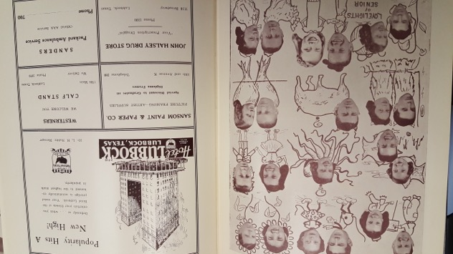
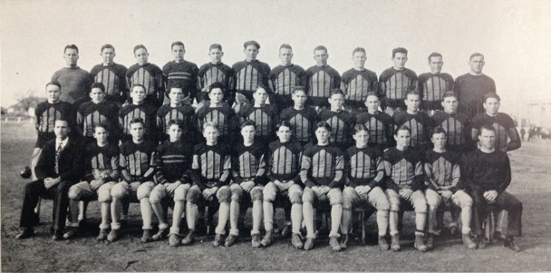
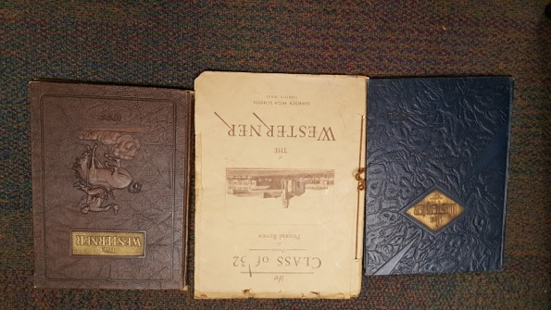
Meet the People of Lubbock
1929 Lubbock High School Football Team

Slide 23
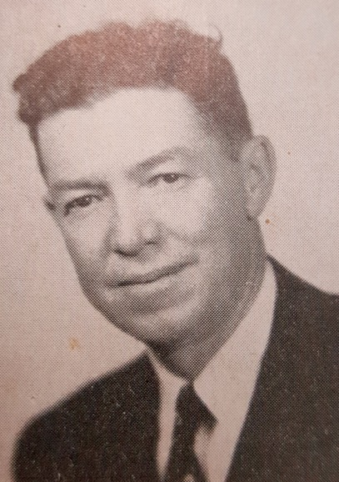
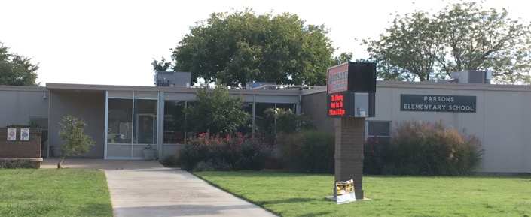
Ellsworth Jack “EJ” Parsons (1892-68)
Served as Sargent in U. S. Army during World War I
Moved to Arizona as a clothing salesman
Moved to Lubbock to open and manage J.C. Penney store on Broadway & Texas, 1925-52
Served as Lubbock ISD Trustee, 1934-49
Parsons Elementary School was named in his honor, 1958

Slide 24
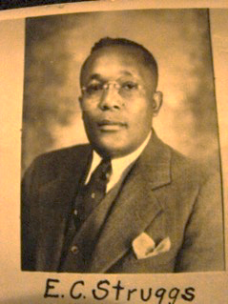
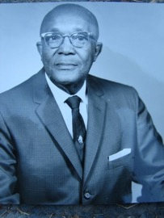
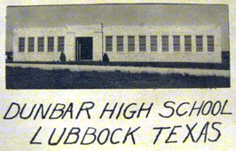
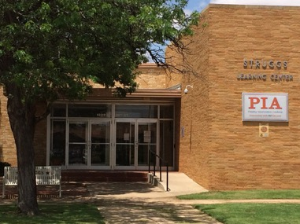
Edward Cecil Struggs (1900-79)
Paul Quinn College
Prairie View State Normal and Industrial College (Prairie View A&M University)
University of Michigan, master’s Degree
Teacher/Principal-Minerva, 1920-25
Teacher/Principal-Dunbar Junior-Senior High School, 1930-65
Struggs Junior High School named in his honor, 1965
Closed as a junior high in 1979
Building used as part of Dunbar-Struggs High School, 1979-93
Building served as home to New Directions and LISD-TV, 1993-98
Building began serving Project Intercept, 1998

Slide 25
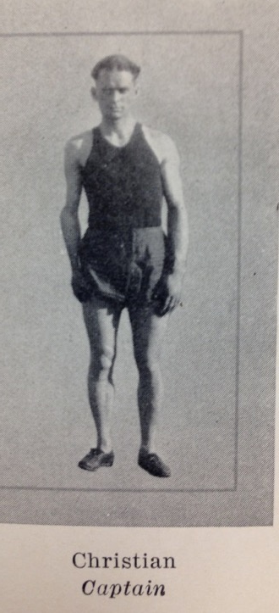
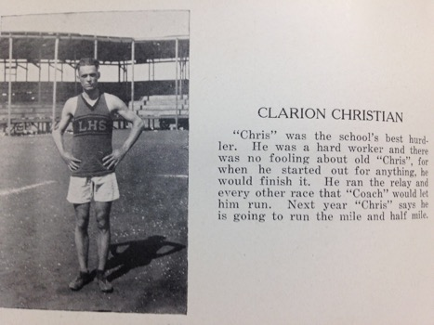
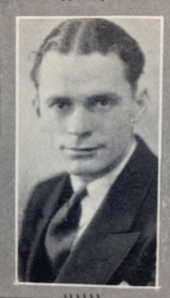
Clarion “Chris” Christian (1904-66)
Lubbock High School, Class of 1924
State Qualifier-Broad Jump, High Jump, High Hurdles
Texas Technological College (now Texas Tech University), Class of 1929
First Texas Tech Track Captain-1927
First Undefeated Texas Tech Track Team, 1929
Worked in Abilene

Slide 26
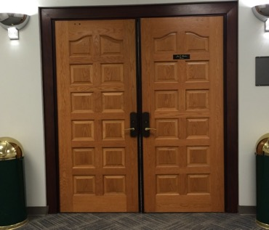
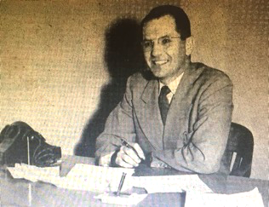
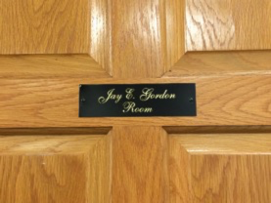
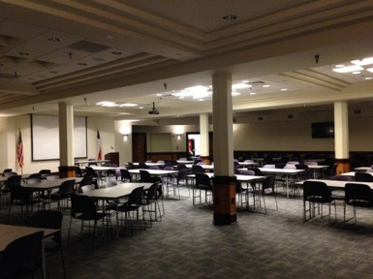
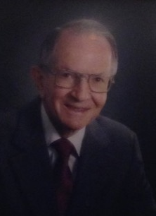
Jay Edmond Gordon (1913-2008)
Lubbock High School, Class of 1929
Texas Technological College (now Texas Tech University), Class of 1933
Teacher-Robertson and Lubbock schools
Special Agent-Army Counter Intelligence Corps-World War II
Assistant Principal-Lubbock Junior High School
Principal-K. Carter Elementary School
Principal-J. T. Hutchinson Junior High School
Principal, Lubbock High School
LISD Curriculum Director
LISD Assistant Superintendent for Curriculum
The Jay E. Gordon Room was dedicated in his honor and is located at the Lubbock Independent School District Central Office.

Slide 27
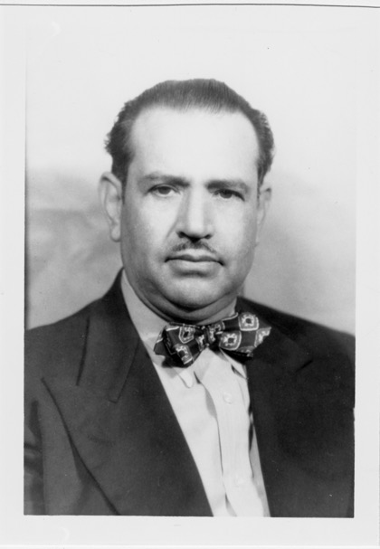
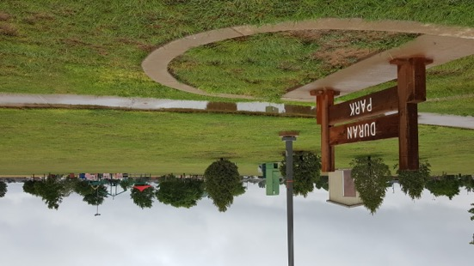
Dr. Armando Cabajal Duran (1897-1986)
During migrant season of the early 1930’s, Dr. Duran and Dr. Pescatello opened a Lubbock downtown office
In the mid 1930’s, he became a permanent resident and served Spanish speaking patients for over 35 years
Dr. Armando Duran Park is named in his honor (26th and Kewanee Ave.)

Slide 28
Charles Maedgen (1882-1964)
Texas Agricultural and Mechanical College (now Texas A&M University), Class of 1904
Banker in Troy & Temple
Organized Security State Bank and Trust Company,1917
After expanding it was later known as Lubbock National Bank in 1925
Served as LISD Trustee, 1922-32
President of the Lubbock Chamber of Commerce, 1931
Helped form the Lubbock Symphony Orchestra
Maedgen Elementary School named in his honor, 1955

Slide 29
Eugene V. “Gene” Barnett (1913-1979)
Lubbock High School, Class of 1932
LHS Football & Basketball Letterman & All-District
1939 (10-0) Texas Tech Cotton Bowl Team & Honorable Mention All-American
1987 Texas Tech Hall of Fame

Slide 30
H. Eugene Brown, Sr. (1914-1981)
Lubbock High School, Class of 1932
LHS Basketball and Football: District and Bi-District Football Champions (1931), Outstanding Basketball Center (1930-31 & 1931-32), Captain Basketball Team
Earned Law Degree at Cumberland College in Tennessee, Class of 1935
He was a Justice of the Peace (Megargel, TX), Founding Partner- RR Electronics (Lubbock & Amarillo), Provided first instant replay technology to Texas Tech Football Program in the 1950’s

Slide 31
Dorothy Lomax (1897-1995)
Baylor University
Teacher-Killeen, Meridian, Big Spring
English Teacher/LHS Newspaper Advisor-Lubbock High School, 1925-37
Texas Technological College (now Texas Tech University), Master’s Degree
LISD Curriculum Director, Secondary Curriculum Director and Director of Secondary Language Arts
The Lomax Center was constructed as the YMCA building. LISD acquired and remodeled the building in 1987 for outreach programs and classes from Lubbock High School, O.L. Slaton Middle School and Hutchinson Middle School – The Lomax Center is named in her honor

Slide 32
Lonnie Dean “Primo” McCurry (1919-2010)
Lubbock High School, Class of 1936
LHS Football Letterman
Texas Technological College (Texas Tech University) Graduated in 1941
Three-time Texas Tech Letterman (1938-1940), 1938 Cotton Bowl, 1940 All-American, Drafted into the NFL Brooklyn Dodgers
U.S. Marines Corp during WWII - Purple Heart at Guam
1960 Retired as Lieutenant Colonel and became a Real Estate Broker
2000 Texas Tech Hall of Fame

Slide 33
Dixie White (1917-1990)
Lubbock High School, Class of 1936
LHS Football Letterman & Co-Captain
Texas Technological College (now Texas Tech University) Class of 1940
Three-time Texas Tech Letterman 1937-1939, 1938 Cotton Bowl, 1939 Captain
Assistant Coach at Midwestern State University 1951-1952, Idaho 1952- 53, Arkansas 1955-1961, and LSU 1962-1963; Head coach at Northeast Louisiana 1964-1971, Assistant Coach at NFL New Orleans Saints 1971-1973

Slide 34
William Murl “Babe” Ritchie (1918-1997)
Lubbock High School, Class of 1938
LHS Football Letterman & Captain
Golden Gloves in 1937-1938, 1937 Texas Golden Gloves Champion
Professional heavyweight boxer from 1938-1946 & Boxed former Heavyweight Champion Max Baer at Fair Park Stadium in Lubbock on September 18,1939
Babe Ritchie in the White
Max Baer in the Dark

Slide 35
Preston Smith (1912-2003)
Lamesa High School, Class of 1930
Worked his way through college at a Lubbock gas station
Texas Technological College (now Texas Tech University) class of 1934
Owned and operated a chain of Lubbock movie theaters
Elected to the Texas House of Representatives, 1945-49, the Texas Senate 1957-963, Lieutenant Governor 1963-69, and Governor 1969-73
Governor Smith was instrumental in establishing the Texas Tech School of Law and Texas Tech University Medical School
Smith Elementary School named in his honor, 1987

Slide 36
Ross Ayers (1910-2001)
Cuero High School, Class of 1928
Texas Technological College [now Texas Tech University], Class of 1934
Texas Tech Football Letterman & Captain
Served in National Guard as Master Sergeant in Artillery Unit, 1931-39
Served as Teacher/Assistant Coach at Lubbock High School, 1930s
Served in U.S. Army during World War II, 1939-45, awarded Silver Star for Gallantry in Action, Legion of Merit and Bronze Star
Served as Principal at Harwell Elementary School Principal, 1945-46
University of Texas, Class of 1946 (Master’s Degree)
Served as Lt. Colonel and Commander of reserve artillery unit, 1946-65
Worked as farmer and served as a counselor to Disabled Veterans at the Veterans Administration
Appointed by Texas Governor Preston Smith as Adjunct General for the Texas National Guard and Commander of the Texas National Guard, 1969-73
http://www.texasmilitaryforcesmuseum.org/hallofhonor/ayers.htm

Slide 37
Damon Hill, Sr. (1913-1982)
Booker T. Washington High School in Houston, Class of 1932
Prairie View State Normal and Industrial College (Now Prairie View A&M University), Class of 1937
PVSNIC Football and Track Letterman
Served as Teacher/Head Coach for Dunbar High School 1937-42
Served in U.S. Navy during World War II, 1942-45
Served as Teacher/Head Coach for Dunbar High School, 1945-50
Served as Teacher at Mackenzie JHS and OL Slaton JHS until 1974

Slide 38
W.B. Chapman (1902-1939)
Independent Order of Odd Fellows State School- (for orphans) - Corsicana, Class of 1918
Austin College, class of 1922
Served as Teacher/Head Football Coach at Cisco High School 1922-30: named CHS team “Loboes”, District Champions 1924 & 1925.
Served as Teacher/Head Football Coach at Lubbock High School 1931-38: District Champions 1931 & 1938, 1938 State Runner- Up
Chapman died during the 1939 Season- Lubbock finished as 1939 State Champions
Chapman Career Record 148-38-11, Lubbock HS Chapman Field named in his honor, Texas High School Coaches Association Hall of Honor in 1961.

Slide 39
Berl Huffman (1907-1990)
Grapevine High School-near Dallas, Class of 1924
Trinity University, Class of 1928
Served as Teacher/Head Basketball and Assistant Football coach for Lubbock High School 1932-1935
Served as Assistant Football Coach & Head Basketball Coach at Texas Tech 1936-42, 1942 NAIA Tournament
Served in U.S. Army Air Corps during World War II, 1942-46
Served as Head Basketball Coach at Texas Tech, 1946-47
Served as Head Football Coach at University of New Mexico, 1947-49
Served as Head Basketball Coach at University of New Mexico, 1951-52
Served as Head Baseball Coach at Texas Tech, 1961-67
Berl Huffman Athletic Complex in northwest Lubbock named in his honor

Slide 40
Pete Cawthon (1898-1962)
Central High School-Houston, Class of 1917
Southwestern University in Georgetown (near Austin), Class of 1919
As a coach he changed the Texas Tech mascot from the Matadors to the Red Raiders, took the team to the Cotton Bowl in 1938, Tech record 76-32-6
Served as Head Football and/or Basketball Coach at Beaumont High School, Rice University, Terrell Prep High School & Austin College 1919-29
Served as Head Football Coach at Texas Tech 1930-40, 1937 Conference Champions, Texas Tech played in 1937 Sun Bowl and 1938 Cotton Bowl
Served as Assistant Coach at University of Alabama 1942, NFL Brooklyn Tigers 1943-44 & NFL Detroit Lions 1945-46
Served as Athletic Director at University of Alabama 1952-53
1961 Texas Tech Hall of Honor in 1961
1978 Texas Sports Hall of Fame in 1978

Slide 41
George Herman Mahon (1900-1985)
Loraine High School-Loraine
Hardin Simmons University, Class of 1924
University of Texas School of Law, Class of 1925
Served as a U.S. Representative in the newly formed Nineteenth Congressional District which included Lubbock, 1934-78
Mahon School named in his honor, 1972
Mahon Public Library named in his honor, 1974
Smithsonian Regent, 1964-78

Slide 42
J. G. “Goober” Keyes (1904-1985)
Cisco High School, Class of 1924
Abilene Christian College (now Abilene Christian University), Class of 1932
ACC Four-time Letterman
Lubbock High School-Teacher/Assistant Football Coach/Head Track Coach, 1935-39
Lubbock High School-Teacher/Head Football Coach, 1939-42
Lieutenant-U.S. Army Air Corps-World War II, 1942-45
Owner-Sports Center, Inc. (sporting goods store), later partnered with John Cardinal of Cardinal Sports

Slide 43
Sammy West (1904-1985)
Rule High School-Rule, Class of 1924
Began playing Semi-Pro Baseball while in high school – Rule (Tx), Roswell, New Mexico & Biloxi, Mississippi, 1922-24
Played Minor League Baseball for Monroe Drillers-Louisiana & Birmingham Barons-Alabama, 1924-1926
Played MLB Washington Senators 1926-33, St. Louis Browns 1933-38 & Washington Senators 1938-41; Four-time All Stars 1933, 1934, 1935 & 1937; Four-time American League MVP Finalist
Served as Sergeant in U.S. Army Air Corps at Reese Air Base during World War II, 1942-45
Played MLB Chicago White Sox, 1942
Served as Coach for MLB Washington Senators, 1945-47
Part Owner of Lubbock West Drug Store 1933-47, Owner of Sports Center Inc. 1947-69, this would eventually become Cardinal’s Sport Center

Slide 44
Carlisle A. “Cobby” Tubbs (1904-1980)
Lubbock High School, Class of 1922
LHS four-year Letterman in football & baseball, Football Captain, 1921
Texas Technological College ( Texas Tech University), Class of 1929
Carlisle A. “Cobby” Tubbs Memorial Scholarship in Engineering established by Hugo Reed and Associates.
Served as Engineer/Surveyor for Texas Highway Department, 1930-45
Owner/Engineer/Surveyor of the C.A. Tubbs Engineer, 1945-75
Served as Engineer/Draftsman of Hugo Reed and Associates, 1976-80

Slide 45
Resources
Ayers, Samuel J. (2009). E.C. Struggs Dunbar’s Visionary Leader. Lubbock, Texas: The Knowledge Center, Inc. ISBN 0-9772850-4-9
Ayers, Samuel J. (2012), Lubbock School’s Namesakes. Lubbock, Texas: The Knowledge Center, Inc. ISBN 0-9772850-5-7
Ayers, Samuel J. (2015). Lubbock Sports Heroes. Lubbock, Texas: The Knowledge Center, Inc. ISBN 978-0-9909126-0-6
Carlson, Paul H. (2008). The Centennial History of Lubbock: Hub of the Plains. Virginia Beach, VA: Donning Company Publishers.
Michael Stewart, Lubbock High School
Randy Vance, Southwest Collection/Special Collections Library, Texas Tech University
Douglas Young, Lubbock High School

Slide 46
Cactus Theatre - 2010 Cesar E. Chavez Blvd.
Operated as a movie theatre, 1938-58
Served as Greer Iron Works storage area for scrap iron
Renovated and opened as a live performance theatre, 1995

Slide 47
George H. Mahon Elementary School - 2010 Cesar E. Chavez Blvd.
George H. Mahon Elementary School named in his honor, 1972
Mahon Elementary School served as elementary campus, 1972-96
Repurposed as LISD Central Office Annex during renovations to building on Avenue Q
Repurposed as Mahon Early Childhood Center, 2001-10
Repurposed as LISD Materials Production and Print Shop , 2010-

Slide 48
http://lubbockeda.org/real-estate/airport/
Lubbock Municipal Airport – Lubbock Preston Smith International Airport
5401 N. Martin Luther King Blvd.
1930 – Lubbock Municipal Airport opened north of town (original hanger is now occupied by WesTex Aviation)
1966 – First jet service to Lubbock with Continental Airlines, Braniff Airlines soon followed
1966 – New Lubbock Municipal Airport passenger terminal dedicated
1980’s – Renamed Lubbock International Airport
2004 – Renamed Lubbock Preston Smith International Airport

Slide 49
Lubbock High School – Lubbock JHS – Carroll Thompson JHS – Pete Ragus Aquatic Center (14th Street and Avenue T)
1931 – The old Lubbock High School became Lubbock Junior high School
1947 – Campus renamed Carroll Thompson Junior High in honor of principal (1932-47)
1980 – Campus closed
1996 – Building demolished
1998 – Present site of Pete Ragus Aquatic Center and Lubbock High School Tennis Courts

Slide 50
Lubbock County Jail
1931 – Art Deco Style Lubbock County Jail built (three stories) on Main Street
1951 – Two additional floors added to Jail
2010 – New Lubbock County Detention Center opened on N. Holly, old jail empty
2016 – Jail building for sale to interested buyers

Slide 51
Federal Building & Post Office – 800 Broadway
1931 – Classical Revival Style Federal Building and Post Office constructed on the north side of Broadway near the County Courthouse, utilized until 1968 with new Post office building located at 1515 Avenue G
2001 – Last of occupants, building left empty
2014 – Purchased by developer for condominiums and other uses
2016 – Renovation of building started

