Slide 1
Overview of a Rapidly Changing Telephony Services Environment by Gerry Means-DIT
Annual IIPS Conference: January 22,2017

Slide 2

Part One
The TDM Sunset
“The transition is not just an abstract plan, it is being “forced” by old equipment reaching end-of-life, and by large numbers of customers migrating away from traditional wireline voice communications and substituting mobile, VoIP and other alternatives. As the subscriber base declines, but the costs of maintaining the old network stay level (or increase), the cost per customer rises and profitability decreases, creating a traditional voice “death spiral”. Ignoring the situation is not an option. The major telecommunications carriers are already rapidly distancing themselves from the “old” service and moving to IP”
Prof. Richard Taylor
Co-Director Emeritus, Institute for Information Policy
The Pennsylvania State University

Slide 3
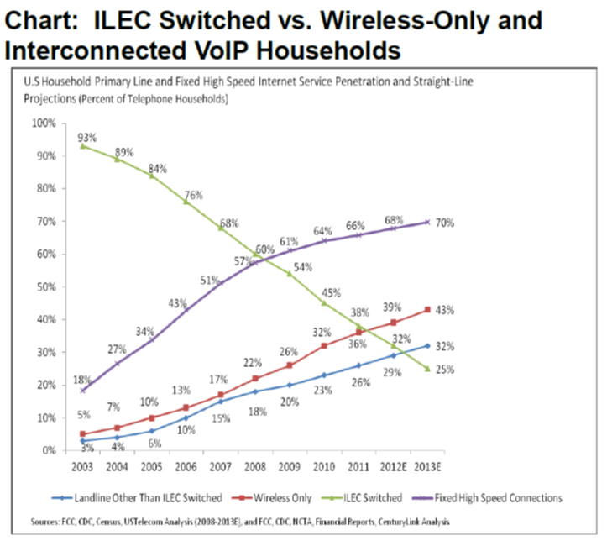
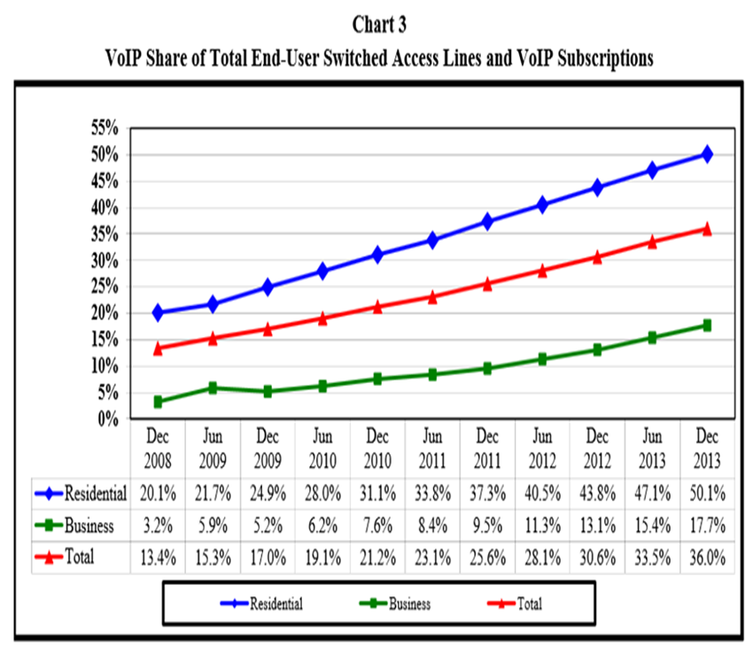
What is driving change?
Telecom service providers experiencing rapid declines in the TDM customer base as lines are lost to IP based services and wireless.
Cost to maintain TDM infrastructure is a drain on capital that could be used to enhance IP based services and increase broadband capacity, coverage, and bandwidth.
The FCC USF/ICC Transformation ruling of August 2011 is a natural result of the trend
The rapid decline of TDM based services in the residential market leaves the commercial market with a cost burden that the carriers cannot pass on per the terms of the ruling.

Slide 4
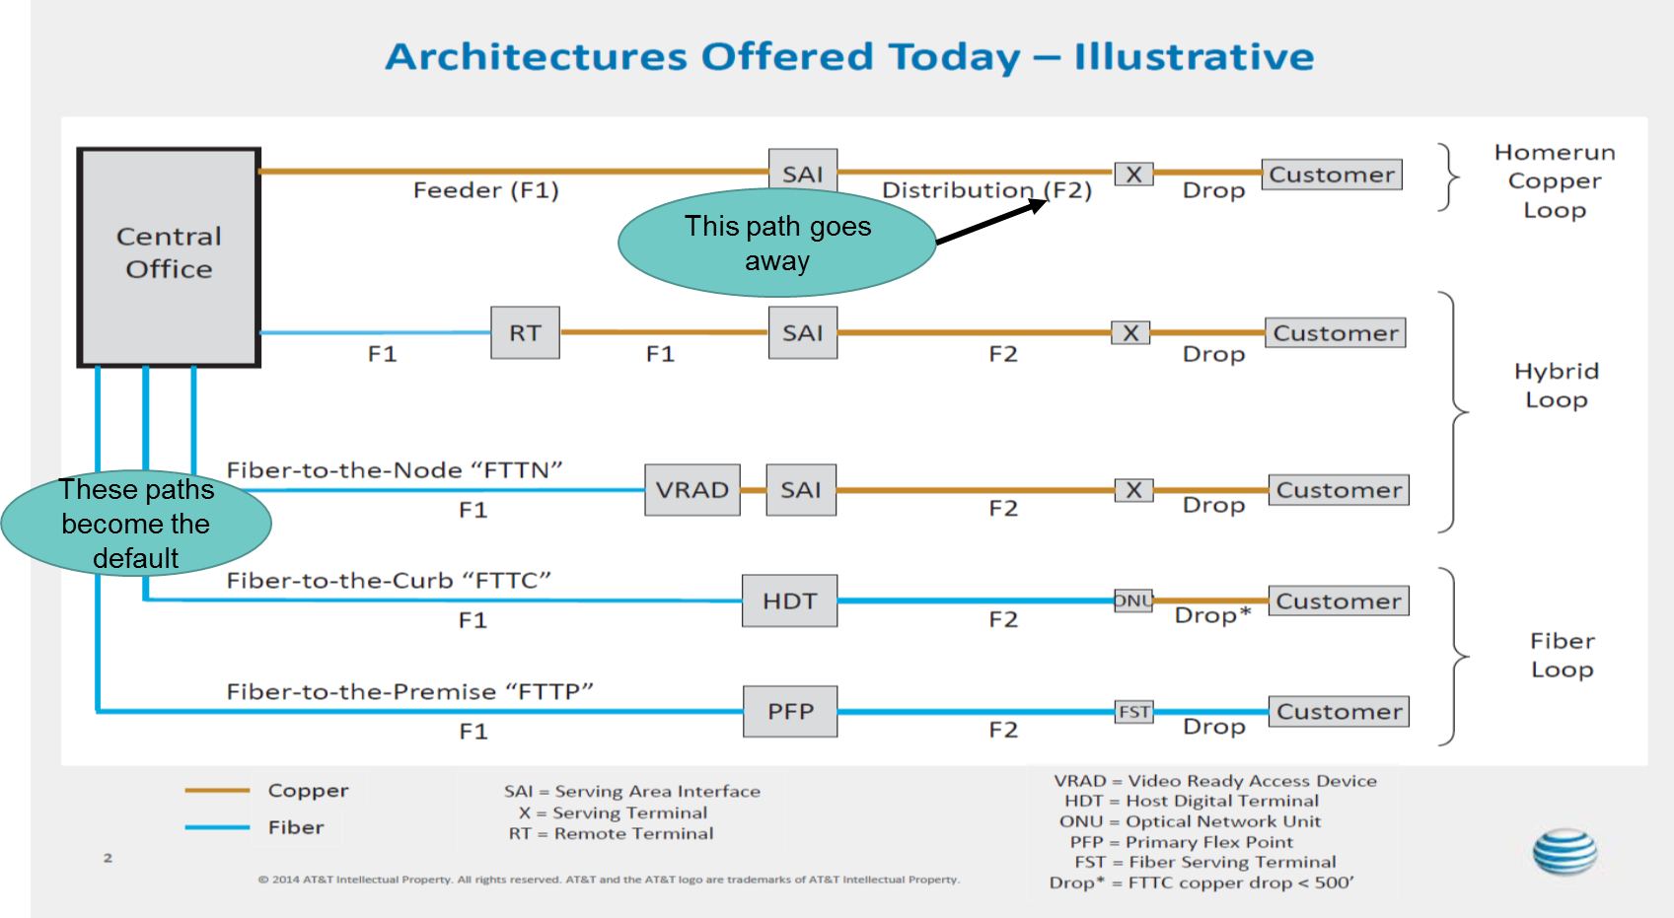
What happens to the remaining TDM plant?
Carriers are looking to drive more service delivery to higher capacity infrastructure and abandon site specific copper plant. Broadband access becomes the key element for the delivery of any and all forms of digital media including voice.
Users should see this as a motivation to aggregate voice at as application served across L2/L3 infrastructure

Slide 5
FCC rulings on “IP Trials” have begun in response to major carrier petitions and the debate on Net Neutrality
Regulatory environment: Federal level-There are numerous filings with the FCC to allow for changing technologies.
Regulatory environment: State level-ILECs have been given some choice by the NC PUC at the State level to choose their competitive status.
  Carriers are petitioning to be allowed to discontinue TDM services over the next few years and to shift virtually all network infrastructure investment to IP based services.
  Carriers are requesting that the FCC not regulate next-gen IP services
  Major carriers are petitioning that legacy ILEC rules not be burdened with the requirement to provide last mile services to CLECS for IP services.
  CLECS are petitioning the FCC to continue to regulate this market, at least to guarantee access to all services, to insure Universal Service Access. This is in the interest of self-preservation of their business model.
  Those that choose to be regulated, will continue to have a guaranteed rate of return.
  AT&T, the largest ILEC, and others have elected to totally forgo any guaranteed rate of return, and in turn, gain much more freedom to determine what services to provide and at what rates.
  FCC could use the ubiquitous nature of IP based services (traffic not defined within state borders and essentially all interstate) to negate the ability of State’s to regulate service fees and availability in the new post TDM environment.
  Availability of IP based services can be a major influence on a State’s ability to attract new industry and to maintain economic growth. Example: the impact of Google fiber as a business incubation factor in TX and MS

Slide 6
Major vendor Strategies: ATT & CenturyLink
Stated Plans
  AT&T to discontinue all PSTN TDM services by 2023*.
  Some services e.g. PRIs, POTS, long distance will occur sooner
  No new PSTN TDM services beginning in 2020, with some of the phase-out beginning in 2018.
  AT&T is two years in on all IP trials in two cites
  CenturyLink has one trial in Las Vegas
  Both asking that the FCC NOT regulate any new IP networks and services.
  CenturyLink does not want ILECs be required to provide CLEC access to current and emerging IP services.
*As stated to DIT. This data applies only to Centrex.
Notes:
T&T has filed numerous petitions with the FCC, requesting permission discontinue all PSTN TDM services by 2023*. AT&T has recently amended these requests with the FCC with a less aggressive timeframe on Centrex
AT&T has approach large enterprise accounts to inform them of their plan to start discontinuing provisioning of new PSTN TDM services earlier than 2020, with some of the phase-out beginning in 2018.
CenturyLink has requested an experiment status in one area (Las Vegas, NV) as a trial but has not been aggressive in its filings.
CenturyLink has petitioned the FCC, asking that the FCC NOT regulate any new IP networks and services, and NOT require that the ILECs be required to provide CLEC access to those emerging IP services

Slide 7
Ramifications of ILEC plans
Impact to Contracts
  AT&T’s current accelerated transition from TDM-to-IP, and associated early discontinuance of TDM circuits will have major implications for those having long term contracts (post 2018).
  CenturyLink has not made a formal declaration although Account teams have been directed to focus on non-traditional services such as Ethernet access services and hosted VOIP
  The TDM-to-IP acceleration plan will force a significant acceleration in DIT’s IP migration plans and contract negotiations as we try to comply with carrier and FCC new deadlines.
  DIT will seek to renew the DIT 4759 local service contract and the DIT 4457 Centrex contracts before the June 2018 expiration for at least two additional years.
  DIT customers need to be well on their way to an IP telephony migration by EOY 2018, therefore technology and fiscal planning for the TDM sunset must begin now.

Slide 8
Major Takeaways: The business climate…
AT&T presents the case to the FCC that beginning now, support of vendor transition plans is the only way to promote the extensive level of private investment needed to make the transition to an all IP voice network. AT&T hopes to be completely out of the out of the TDM business EOY 2023.
Following the lead of the ILEC community, DIT can also make the argument that investing in additional TDM hardware only serves to divert resources from the primary goal of getting to an all IP environment. If we don’t act now, the rising cost to maintain and support TDM services by every element of government will impact government’s ability to meet the evolving needs of the citizens of the SONC.
Citizens will increasingly rely on new and better technology that blurs the lines of technology separation between voice and data. Data infrastructure must grow and evolve and voice becomes one of many applications that the data infrastructure must support.

Slide 9
Major Takeaways: The challenges…
As a primary governing authority, the SONC also faces the challenge of exercising careful oversight on the ILEC, CLEC, and non-traditional service providers.
  This is necessary to ensure that the SONC does not impugn their willingness to invest in newer IP backbone infrastructure in the SONC. As we are competing for private investment against other States, we must and therefore must be sensitive to the creation of unnecessarily burdensome regulations, contracts, etc.
  State PUC regulatory rules that apply to definition of transport services such as intrastate versus interstate and dialing parity are particularly blurred given the nature of IP based services. Therefore emphasis on them should be reduced.
A TDM-to-IP transition will require all State, County, and Local government entities to update technology spending plans to adjust to this industry wide technological advance. Hence we the technical community, cannot see this change as a hindrance but as an opportunity to show leadership by providing well thought out plans backed by appropriate contracts, services, and expertise to carry out the transition.

Slide 10
Part Two
DIT Contract Structure Supporting the Migration to IP
First objective is to provide contract structure for existing TDM services through 2020
  Will negotiate with vendors for the combining of the two primary TDM telephony service contracts and renewal extension to 2020
Second objective is expand the use of State Term contracts (STCs) for new and emerging VOIP based telephony services
  Will continue to promote premise based VOIP via the 725A manufacturer specific contract that provides access to all major premise system manufacturers. Also has provisions for vendor management of on prem systems
  Will promote hosted VoIP and SIP trunking services with STC 725T that provides IP services from AT&T, CenturyLink, and Level3. Contract “open enrollment ‘ period in November will seek to add additional qualified vendors.
Third objective is to explore options for operating agreements to allow the expanded use of the DIT EIPT managed VOIP services portfolio across multiple SONC networks.

Slide 11
DIT Telephony Contract Support
TDM PSTN Access Contracts
  DIT 4729 Local Services: POTS, PRI, Long Distance, Toll Free, misc. services
    Vendors: AT&T, CenturyLink, Windstream
    Terms: Expires 6/30/2018
  DIT 4457 Centrex: Centrex only
    Vendors AT&T, CenturyLink, Frontier
    Terms: Expires 6/30/2018
IP Access, Equipment, and Services Contracts
  STC 725A: Purchasing vehicle for premise based systems, professional services, maintenance
    Vendors: Avaya, Cisco, NEC, Unify, Toshiba*, Mitel*, ShoreTel
    Terms: Expires 12/31/2017
    Options: Open enrollment provisions; renewal provisions
  STC 725T: SIP trunking and Hosted (cloud based) VOIP
    Vendors: AT&T, CenturyLink, Level3
    Terms: Expires 11/5/2017
    Options: Open enrollment provisions; renewal provisions
*Vendors approved to provide vendor hosted equipment services

Slide 12
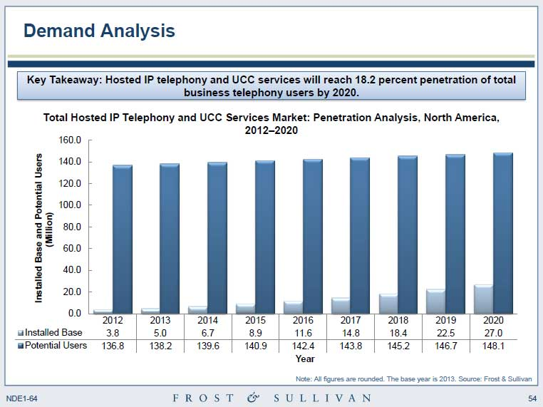
Industry Predictions of VOIP Penetration
This projection is very conservative considering the other market forces now in play

Slide 13
IP based telephony is a topology shift in service delivery
IP telephony Introduces a different acquisition and support cost model vs. the historical telecom model.
Site Model
Subscriber Model
CENTREX & AGENCY OWNED KEY SYSTEMS
VENDOR or DIT HOSTED
VoIP SERVICE
TDM Access
IP Access
Key systems
LAN/WAN based systems
PBX systems
Centrex Lines

Slide 14
Pre-Cursor Elements for Site vs. Subscriber Telephony Contracting
Site Model
Degree of expertise required for system management.
L2/L3 network readiness assessment and results (VOIP).
Identification of method for PSTN access as a part of the design requirements-TDM or IP must be defined.
Requirements for needed updates, patches, and upgrades over the life of the system and projected cost and effort.
Method of acquisition, one-time purchase and/or financed.
Clear definition of what constitutes customer acceptance.
Security compliance aspects of the system that must be managed internally.
Subscriber (Hosted) Model
Engineering analysis of voice traffic stated as IP traffic.
L2/L3 network readiness assessment and results.
Degree of user participation desired re: phone and features setup and support.
Budget impact of ongoing operational cost of internal vs. external vendor provided.
For hosted services transfer of budget from one-time capital (Capex) to ongoing monthly (Opex) and what's the impact.
Clear definition of what constitutes customer acceptance.
Security aspects of external management of the service.

Slide 15
Key Contacts for Contract Info
DIT Shared Services-Service Administration
Lloyd Taylor-Service Management Specialist
lloyd.taylor@nc.gov
919-754-6745
Todd Russ-Service Management Director
todd.russ@nc.gov
919-754-6784
DIT Shared Services-Product Management and Engineering
Gerry Means-Voice Engineering
gerry.means@nc.gov
919-754-6781
DIT Strategic Sourcing-Contracts Management
Jessie S. (Scott) McKaig-Contracts Manager
scott.mckaig@nc.gov
919-754-6550

Slide 16
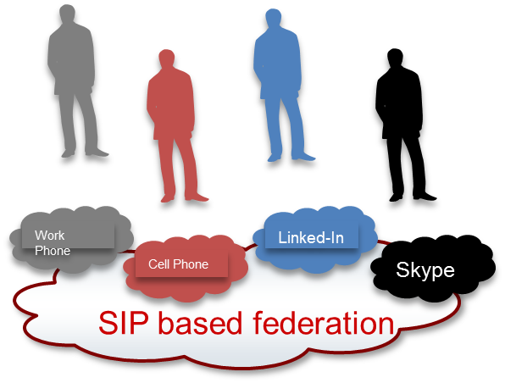

Next Generation Telephony Service Architecture
Part 3: SIP based services and advent of WebRTC
Federation: To cause to join into a similar association is the distinct advantage of SIP based solutions. SBC’s provide the security elements to enable enterprises and service providers to form “federations” in a SIP environment
Every person has a different identity based on each device they use. They can have additional identities based on the services they subscribe to. Examples include: Cell Phone, Home Phone, email, IM, Facebook, Twitter, Linked-In, …
A flexible framework allowing each provider to peer with other providers allowing secure controlled access based on provider level policy and user level opt-in control, allows for compelling context and information to follow a user on all of their devices and services that the user wishes to have this information on.
The power of federated collaboration will greatly increase information worker productivity and will transform the customer service market.

Slide 17
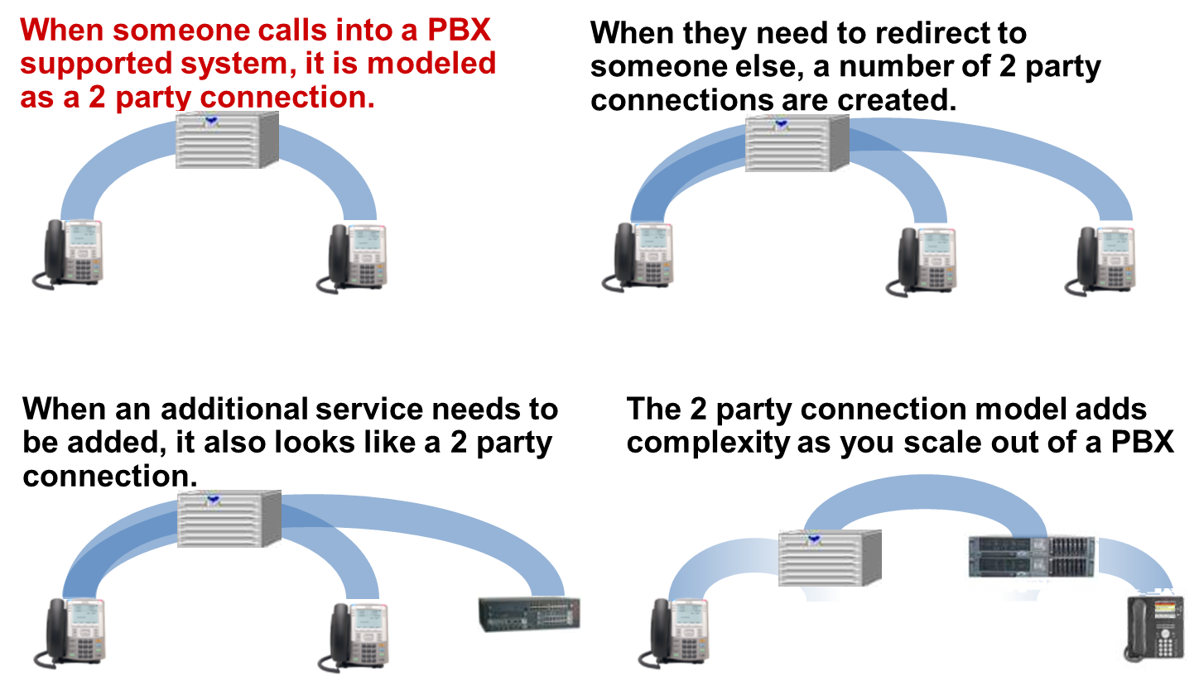
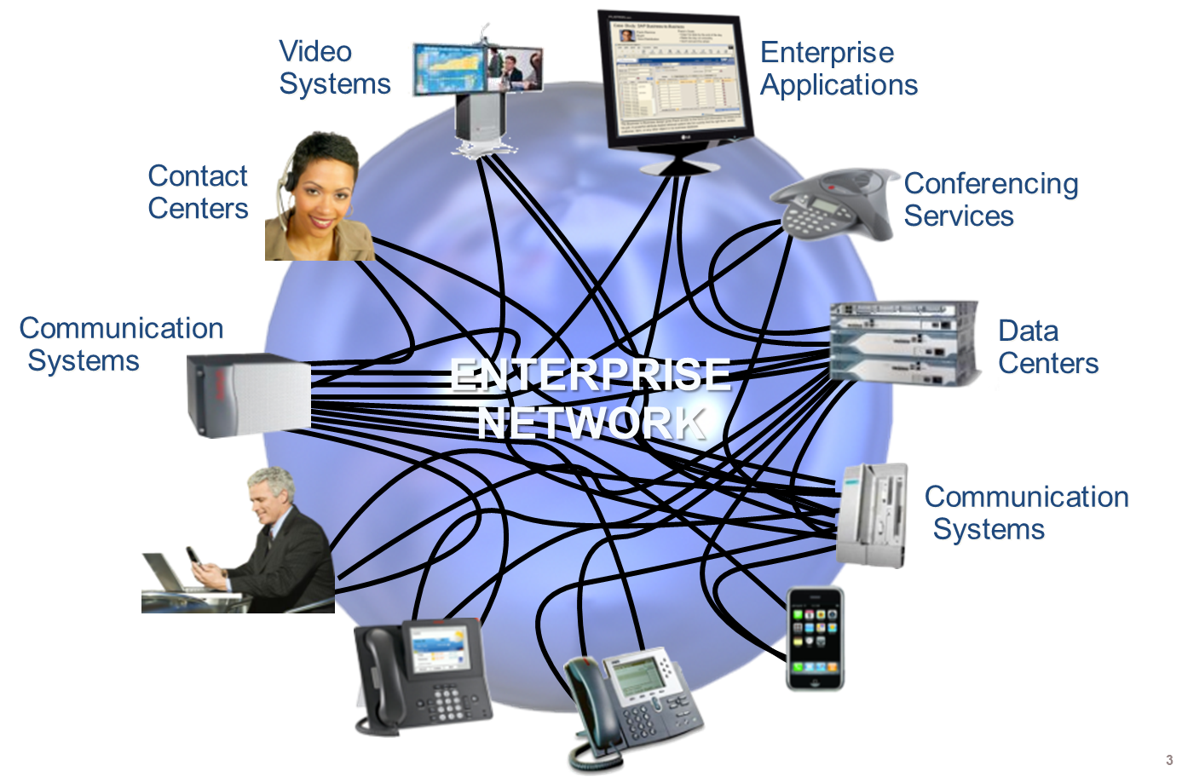
Next Generation Telephony Service Architecture
Before SIP
1
2
3
4

Slide 18
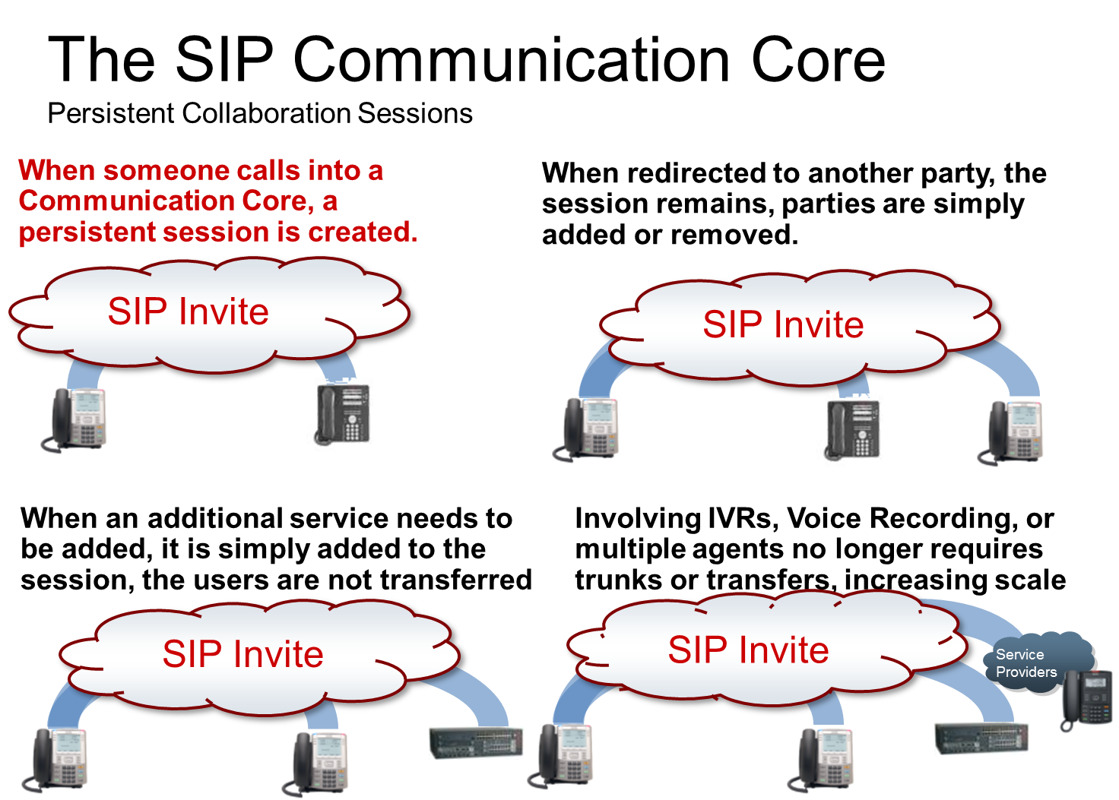
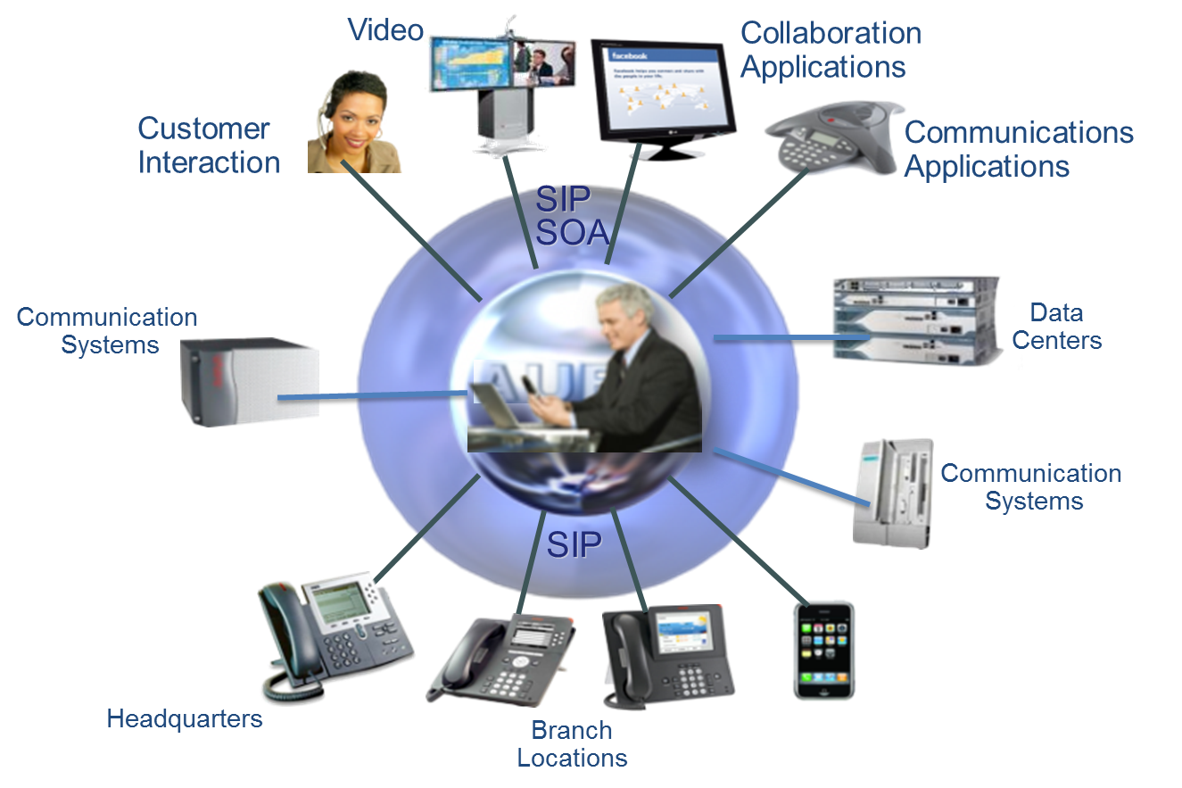
Next Generation Telephony Service Architecture
1
2
3
4
SIP is a HTTP like protocol specified in RFC 3261 and runs similarly to email as all IP.

Slide 19
Next Generation Telephony Service Architecture
SIP: The Opportunity To Do More with What We Have
$
Rapid deployment of new applications
Strategic Investments
$
Strategic Investments
Maximize Multi-Vendor Assets
Centralized
Administration
Increased Cost Savings
Unrealized Benefits
Optimized Network Routing
SIP SERVICES
Converged
Network
Reduced Trunking

Slide 20



Next Generation Telephony Service Architecture
SIP enables treating of voice and video as just other applications on the data network. Architecturally following an IP Internet model where all external Internet connectivity comes into the data center and then is forwarded out to the sites after it has been integrated with data (Unified Communications) has been the most commonly used model.
However, deployment can follow different models…
Design A
Design B
Design C
SP
SIP Trunk Service
SP
SIP Trunk Service
SP
SIP Trunk Service
PSTN
PSTN
PSTN
SP SIP Trunking
To Central HQ Site;
Private SIP Trunking
Between HQ & Branch
SP SIP Trunking
To Central HQ Site;
Private SIP Trunking
Between HQ & Branch
Internet
SP SIP Trunking
To Each Site
L2/L3
HQ &
Main Campus
Offices
HQ &
Main Campus
Offices
WAN
HQ &
Main Campus
Offices
Branch and/or Regional Offices
Branch and/or Regional Offices
Branch and/or Regional Offices
HQ site has MPLS SIP trunking to SP
Other sites trunk back to HQ via VPN
Share SP trunk across all sites
All sites have SP MPLS SIP trunk
Less efficient vs. centralized model
HQ site has MPLSSIP trunking to SP
Other sites trunk back to private net
Share SP trunk across all sites

Slide 21
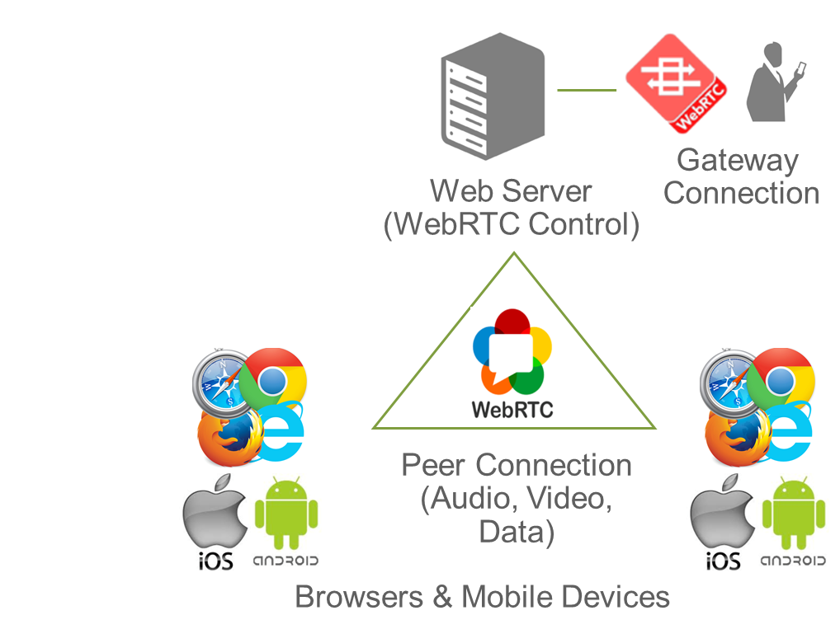
Next Generation Telephony Service Architecture:
What is WebRTC?
Essentially….
Take the guts out of an audio/video phone app like MS Skype, Cisco Jabber, Avaya One-X
Stuff it into a browser
Wrap it with a programming interface that any website can use
A built-in API for browsers & native mobile apps that enables:
  Voice & video directly embedded in browser & native mobile app
  Peer-to-peer data (screen / file / whiteboard sharing)
Powerful tool for internal and external collaboration
Easier development and deployment for IT staff

Slide 22
Next Generation Telephony Service Architecture:
How to Think About WebRTC
Technology
  It’s a technology that enable voice, video, and data sharing in a
  peer to peer fashion between applications running in a browser
Peer 2 Peer
  Traditionally browsers only sent data in client server fashion,
  now they can talk browser to browser
Big Eco System
  SIP makes it interoperable with modern UC systems
  Accessible to many developers
Zero Install
  It’s part of the web browser and does not require installing any
  extra plugins

Slide 23
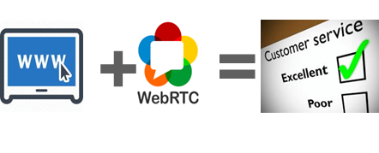
Next Generation Telephony Service Architecture:
Enterprise Real-time Communications Trends
How Enterprises are leveraging WebRTC & related enterprise communications innovations
Increasing usage of WebRTC technology for these important use cases:
  Enhance CX¹ by adding voice / video / co-browsing to websites
  Enable voice & video from native mobile app (iOS/Android)
  Support contact center agent & remote worker connectivity
Migration of premises elements & features to Cloud (cPaaS², UCaaS, CCaaS)
Usage of “Communications Middleware” to help integrate apps with UC/CC
  Leverage APIs on communications assets to make business processes more efficient
¹ Customer and/or client experience ² CPaaS stands for Communications Platform as a Service

Slide 24
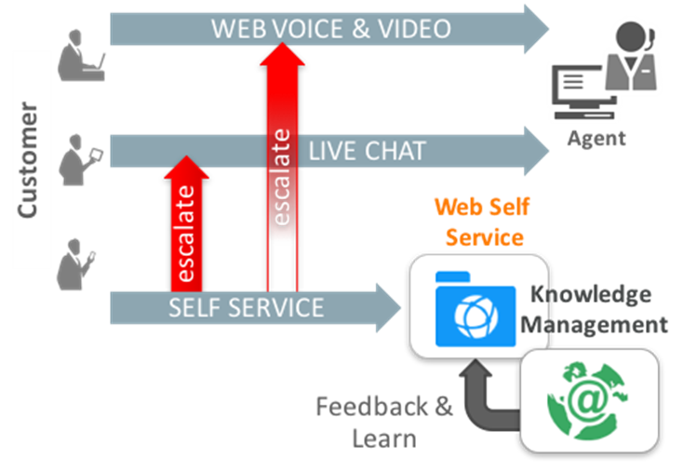
Next Generation Telephony Service Architecture:
WebRTC Use Case Example:
Providing voice, video, & data sharing access via website pages
Value Summary
  Organizations want to offer new collaboration channels (voice, video, data sharing) to their clientele
  Help increase revenue and/or reduce cost; resolve problems
Business Case
  Deflect more customer issues to self-service
  Lower cost of problem resolution
Enhancing the Client Experience By Adding
Voice & Video to Websites

Slide 25
Next Generation Telephony Service Architecture:
WebRTC Impact On State Government Communications
WebRTC makes it easier to embed real-time communications (voice, video, various forms of file sharing) directly into webpages & mobile apps
  Users can speak to agents/personnel without dialing a number
  Agent can see the web screen/application in use by the caller
  Caller doesn’t have explain the issue thereby improving communication
Much easier to implement than previous SIP & proprietary UC apps
  Generally requires only basic Java and HTML development skills
  Multiple vendors offer SDKs and gateway platforms to facilitate development
Telco cost savings can result from moving away from PSTN usage
Capital savings by reducing the need for hardware and other infrastructure costs

Slide 26
WebRTC: Not Just an Opportunity for Telephony Enhancement
WebRTC affords an opportunity for the development of skill sets within the local community to foster new business models and provide pools of talent for existing businesses to better meet changing consumer requirements

Slide 27
WebRTC in the Marketplace
200+ firms in this space

Slide 28
Presentation Wrap-up
What are the key takeaways?
TDM telephony sunset is real and will be here before we know it
  Get prepared for the retirement of POTS, Centrex, PRIs, etc.
  At minimum get to VOIP as your primary telephony infrastructure
  With VOIP look to design around a user/subscriber model vs. a site specific model
  Make maximum use of modern L2/L3 design techniques
  Ramp up skill sets in the IP telephony space
  Consider all your options including cloud based hosting
DIT has contracts and support personnel that can help in the transition
  DIT is making the effort to keep TDM contracts in place long enough to ease the transition
  DIT highly encourages the use of STCs 725A and 725T to facilitate services acquisition
  DIT STCs have Ts&Cs to protect you if things don’t go as planned
SIP is the way to go and WebRTC has huge potential
  SIP facilitates better use of you data network for voice traffic
  SIP has tremendous cost saving potential
  SIP knowledge transfers to WebRTC that puts IP telephony into a whole new realm

Slide 29
Back Up Information

Slide 30

Back-Up Information
Real-time interactive IP communications is different
Can’t rely on data-centric security solutions
End-to-end interoperability/connectivity is problematic
Assuring service quality is a critical requirement
Session-based traffic flows need to be routed intelligently
Must comply with regulations (e.g., E911, lawful intercept)

Slide 31

Back-Up Information
IP communications deployment challenges
Heterogeneous IP addressing and user identity schemes
Multiplicity of audio and video codecs
Many SIP protocol variants (plus other signaling protocols)
Bandwidth is a limited resource
Some sessions are more important than others
Regulatory compliance is a fact of life
IP networks are inherently insecure
Tower of Babel

Slide 32














Back-Up Information
SIP trunking border
Hosted services border
Role of the session border controller
Contact center,
audio/video conferencing,
IP Centrex, etc.
IP
subscribers
PSTN
Session – Real-time, interactive IP communications
Border – Between IP networks
Control
– Security
– Service reach maximization
– SLA assurance
– Cost management
– Regulatory compliance
Service
providers
Data
centers
IP PBX
UC
Private network
Internet
H.323
SIP
SIP
Regional
site
Remote
site
HQ/
campus
Nomadic/
mobile user
Tele-
worker
Remote
site
Private network border
Internet border

Slide 33





Back-up Information
Examples of UC Vendors Working With WebRTC
Oracle: WebRTC Session Controller &
WebRTC Cloud Services
Cisco: Spark is 100% WebRTC based
Avaya: Some capabilities in Breeze platform
Microsoft: Edge browser will support WebRTC;
Skype for Business also adopting

Slide 34







Back-Up information
Examples of Endpoint & App Vendors Working with WebRTC
Oracle: Service Cloud video chat
Salesforce: SOS video chat
Amazon: Mayday Video Chat
American Express: Customer video chat
Google Android & Hangouts
Apple iOS: WebRTC supported via vendor apps; native support coming

Slide 35
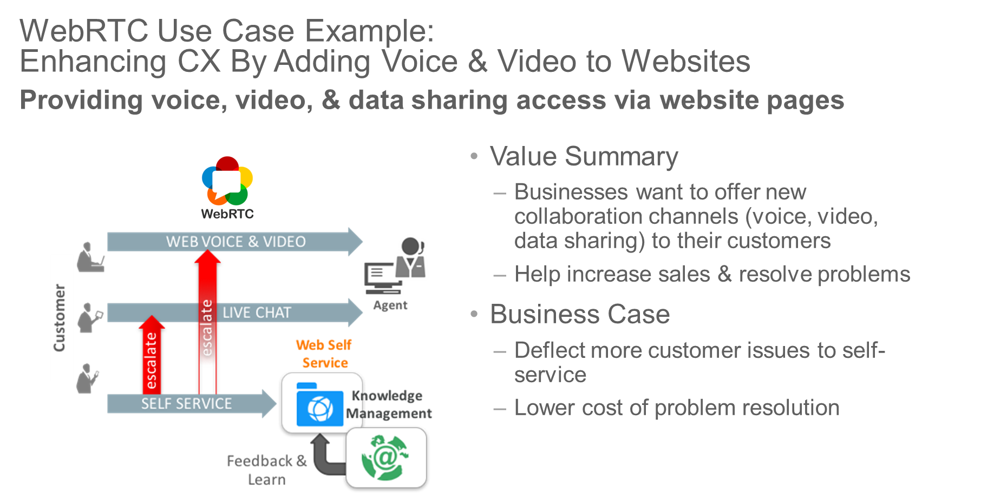
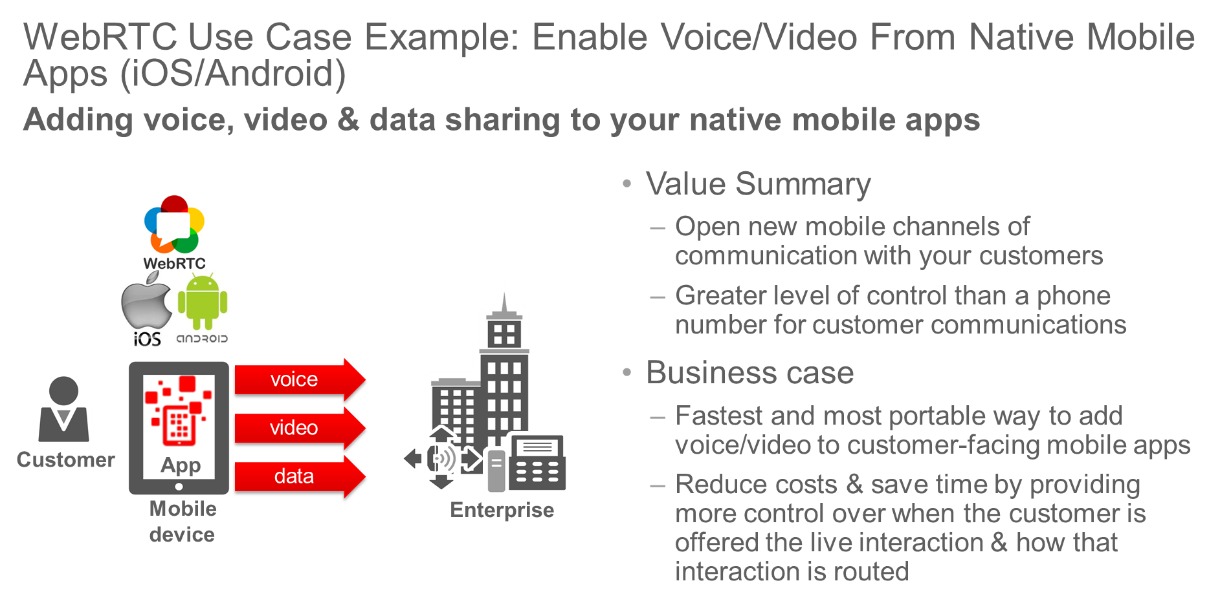
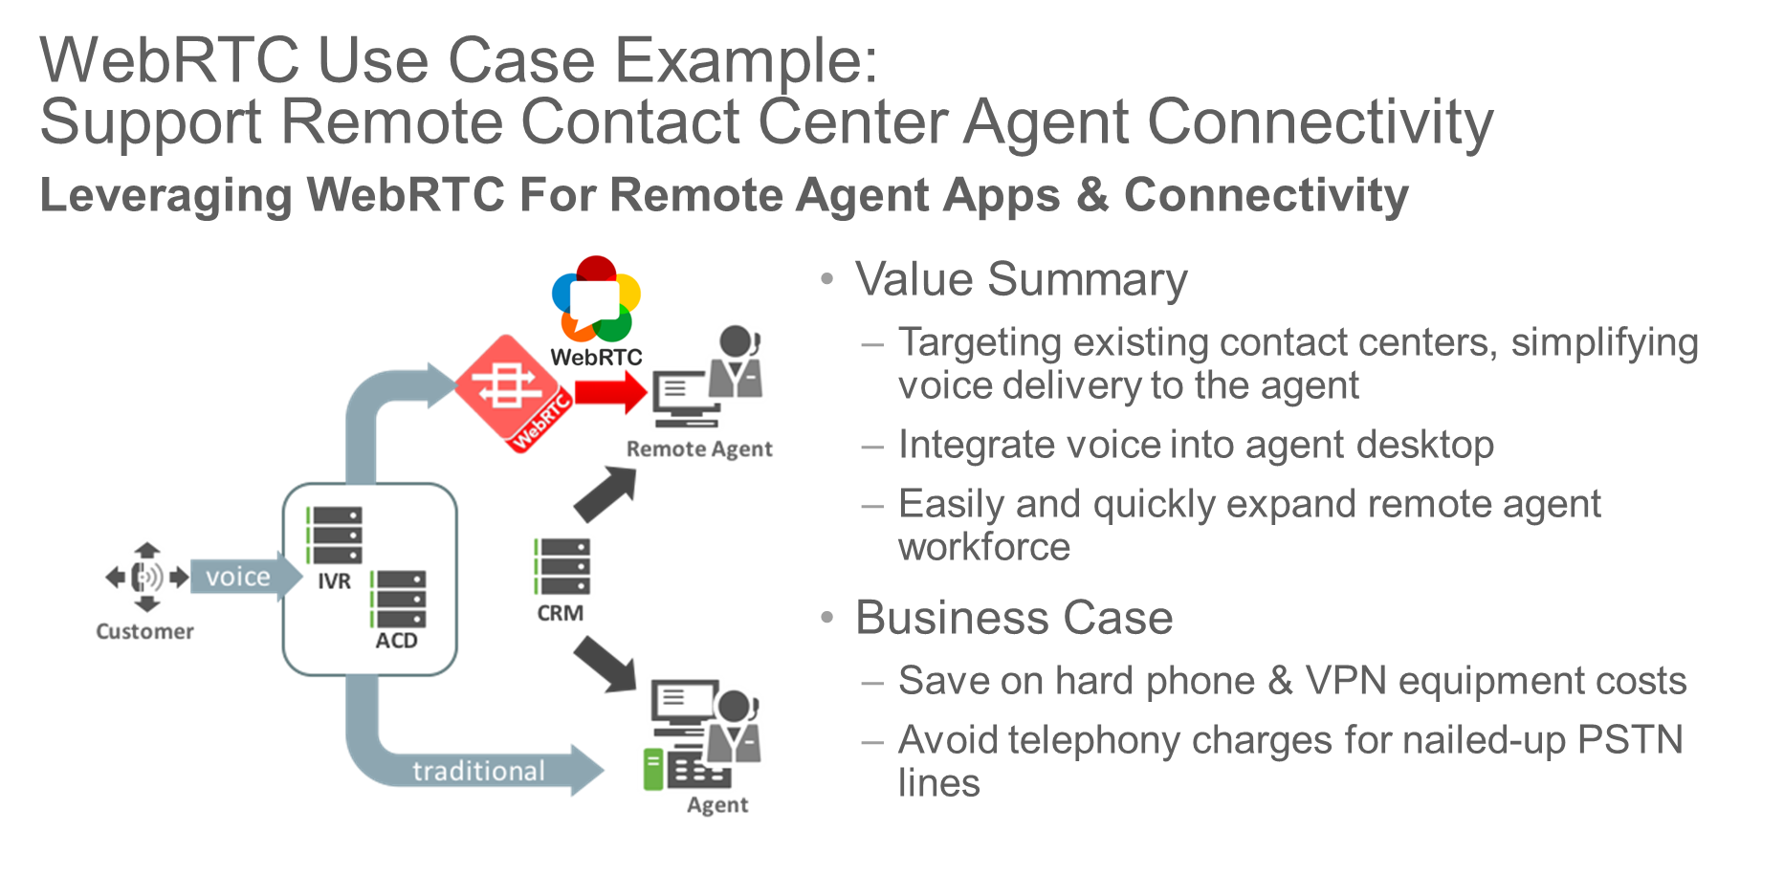
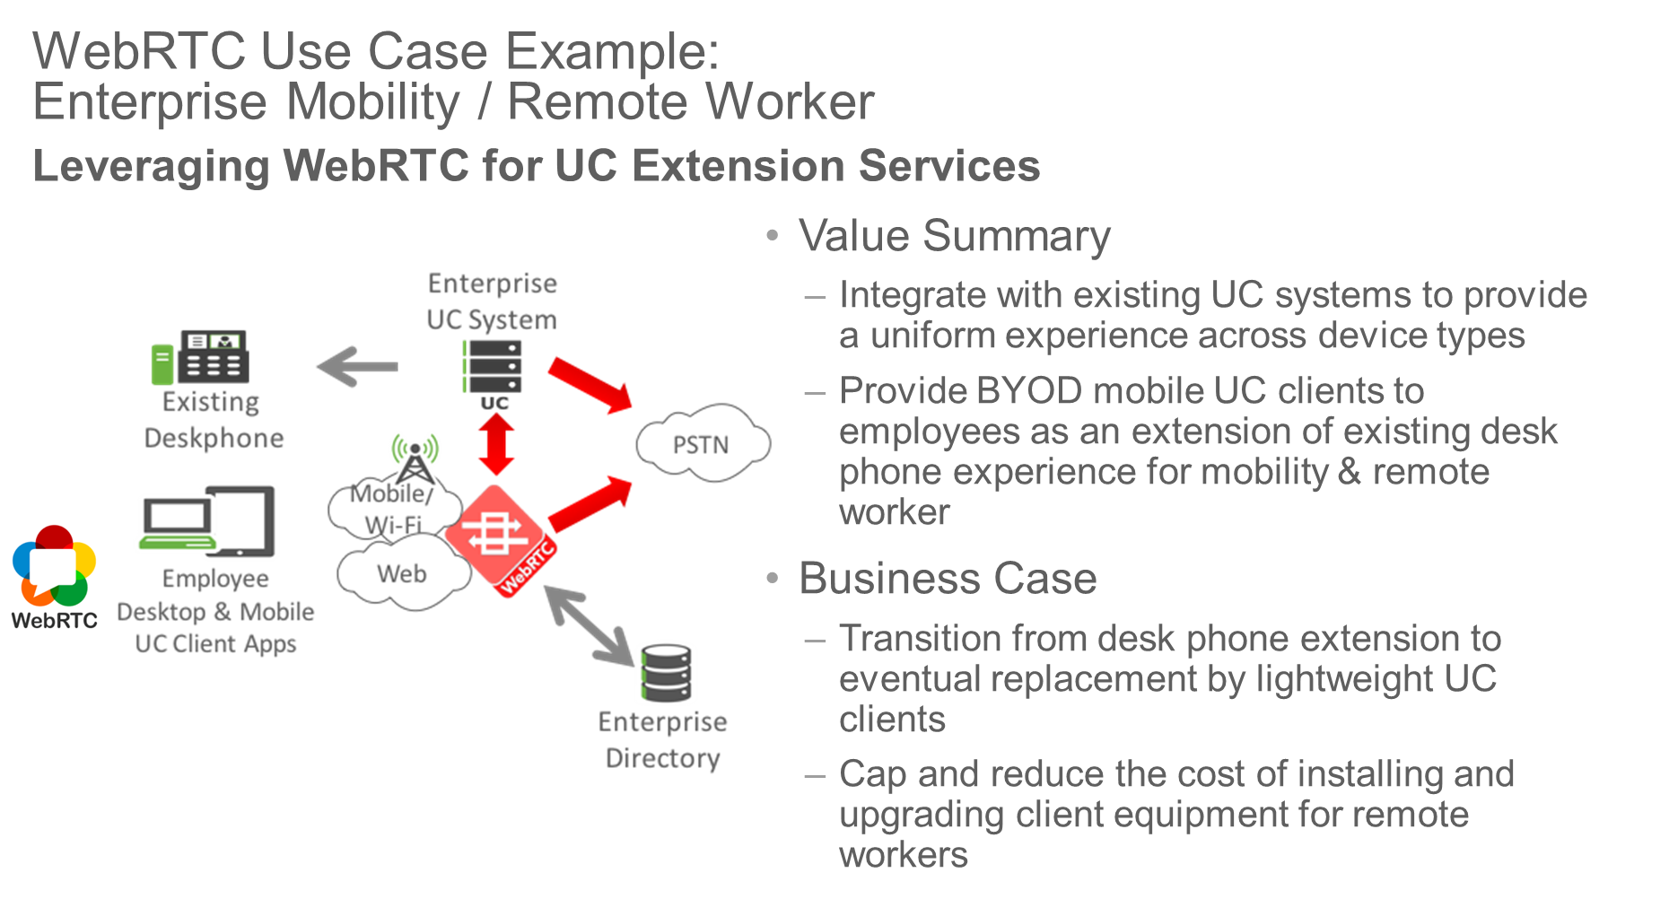
Back-Up Information

