Slide 1
Lakewood Forest Fund Dick Taylor Pond Park Erosion Point 8 Post Project Summarization

Slide 2
Dick Taylor Pond Park – Erosion Point 8
This presentation provides photos and remarks, after the completion of LWF Fund’s Erosion Point 8 (EP 8) project at Dick Taylor Pond Park. EP 8’s estimated cost was $3,000 to $5,000.
The purpose of the EP 8 project was to address severe erosion which the Lakewood Forest Perimeter wall, located at Dick Taylor Pond Park, incurred during Hurricane Harvey.
This end goal of this work is to repair and maximize the life of this section of our Lakewood Forest Fund perimeter wall.

Slide 3
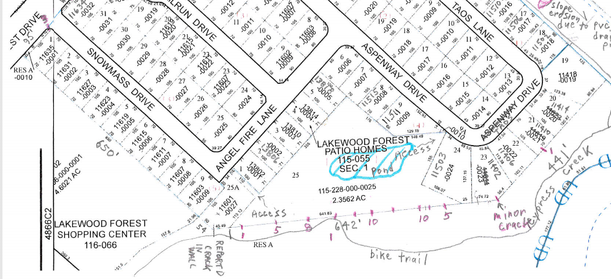
Dick Taylor Pond Park – Erosion Point 8
This plan view shows the location of Erosion Point 8 (EP 8), with the Cypress Creek side of the wall being accessible by a Bobcat via the off road bicycle trail located between the Lakewood Forest Shopping Center (11710 Grant Rd), and Cypress Creek.
The access way to the Dick Taylor Pond (DTP) Park side of the wall is indicated in red font.
Accessway
to DTP
EP8

Slide 4
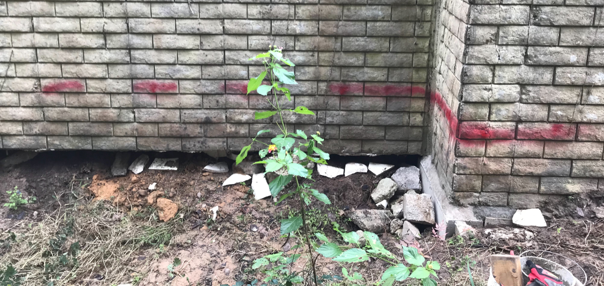
DTP – Erosion Point 8 – Nov 2018
This is a northwest looking view of Erosion Point 8 from the Cypress Creek side of the wall. The red line indicates the ground level on the other side of the wall.
The scope of work consists of the following items:
Place and compact 21 cubic yards of backfill soil (common fill) up to the red line on the wall.
Place 300 SF of Geo Textile fabric on top of the backfilled soil.
Place 291 each Articulated Concrete Blocks (ACBs) on top of the fabric.

Slide 5
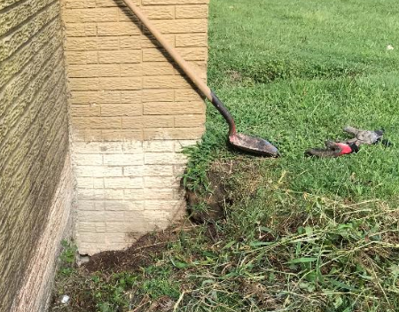
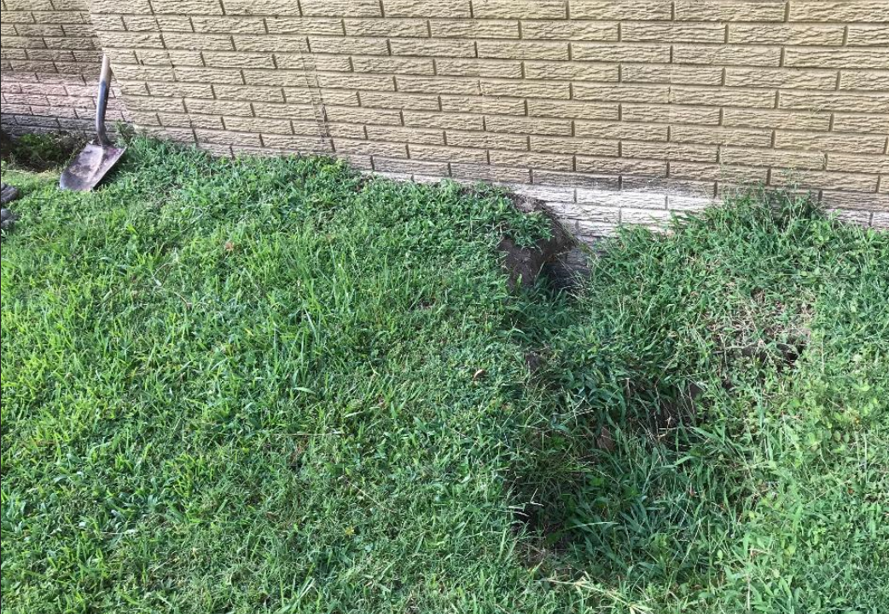
DTP – Erosion Point 8 – Nov 2018
These views (south and east) are of Erosion Point 8 from the Dick Taylor Pond Park side of the perimeter wall. Note the two sink holes, and the paint line which indicates the soil level on this side of the wall before Hurricane Harvey. The estimated backfill for filling these two sink holes is 2 CY.

Slide 6
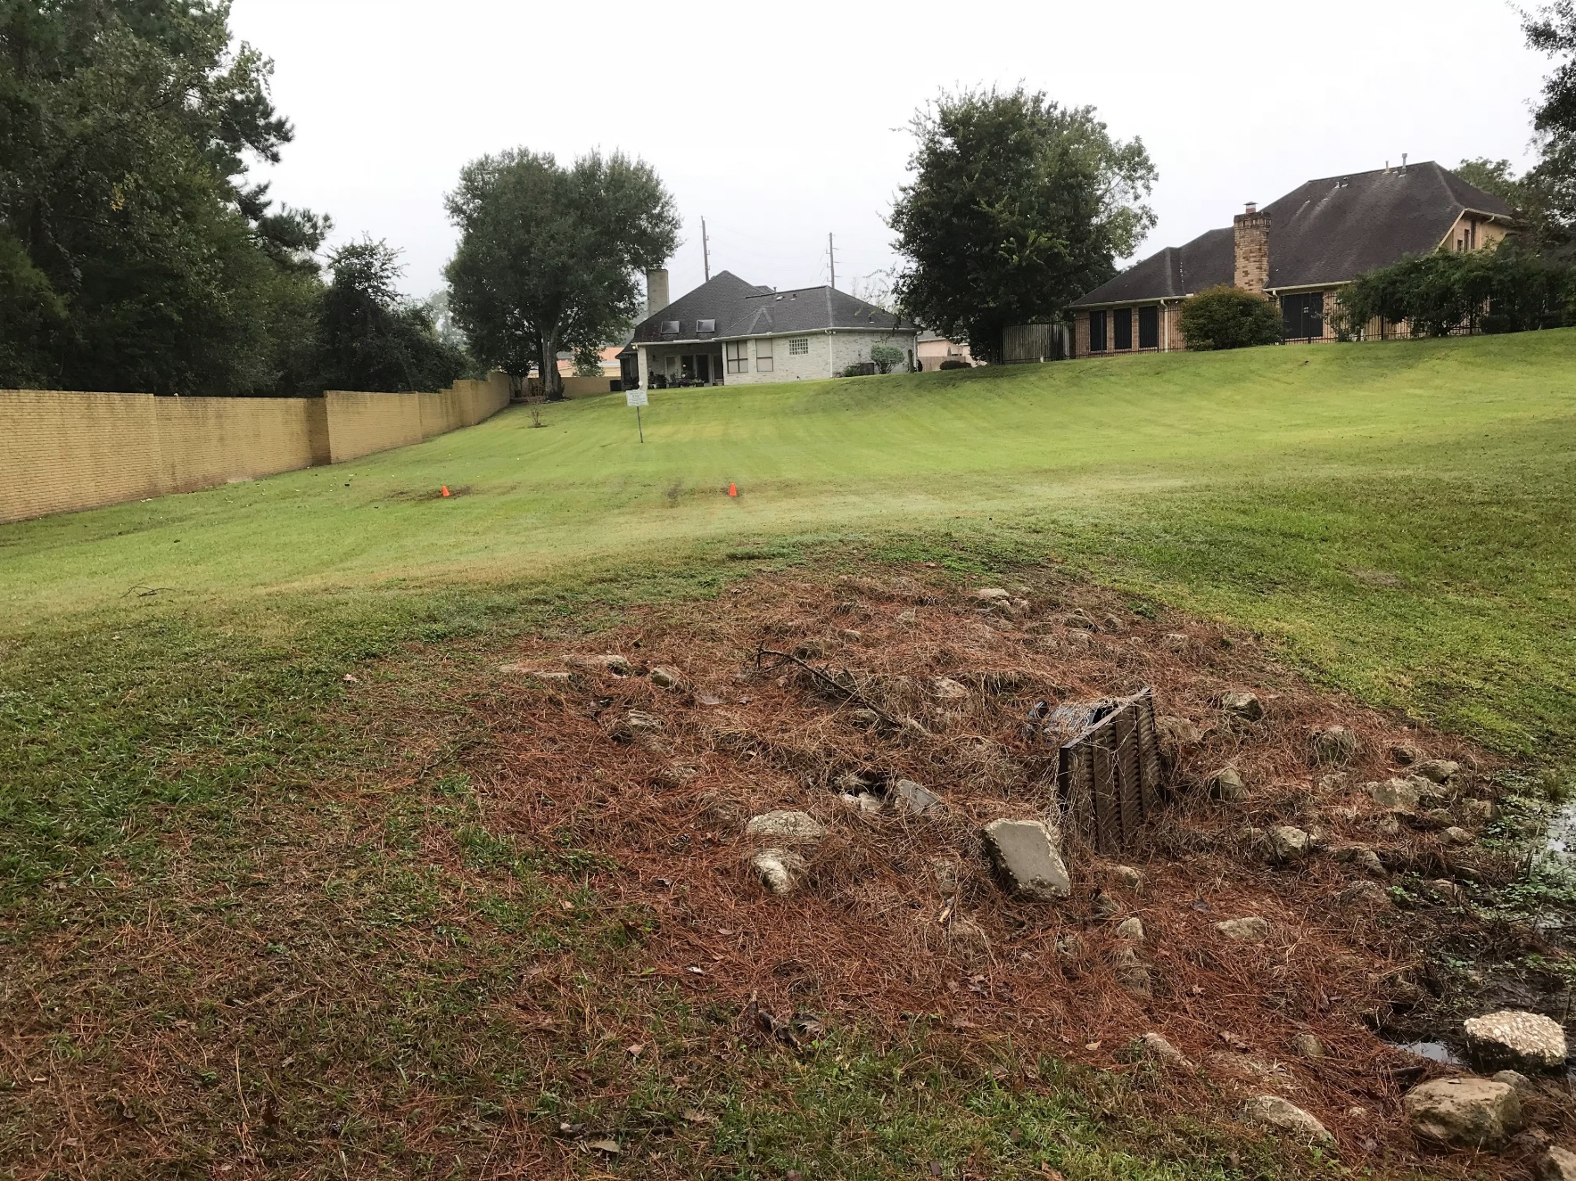
Dick Taylor Pond park – Nov 2018
Spread 1.5 cubic yards of clay based soil (six inches high) in the two low areas of Dick Taylor Pond Park (indicated by orange cones).
These low areas are located about 30 feet south east of the pond’s outlet culvert pipe.
Water pools in these low areas, after a moderate, ground saturating rain.

Slide 7
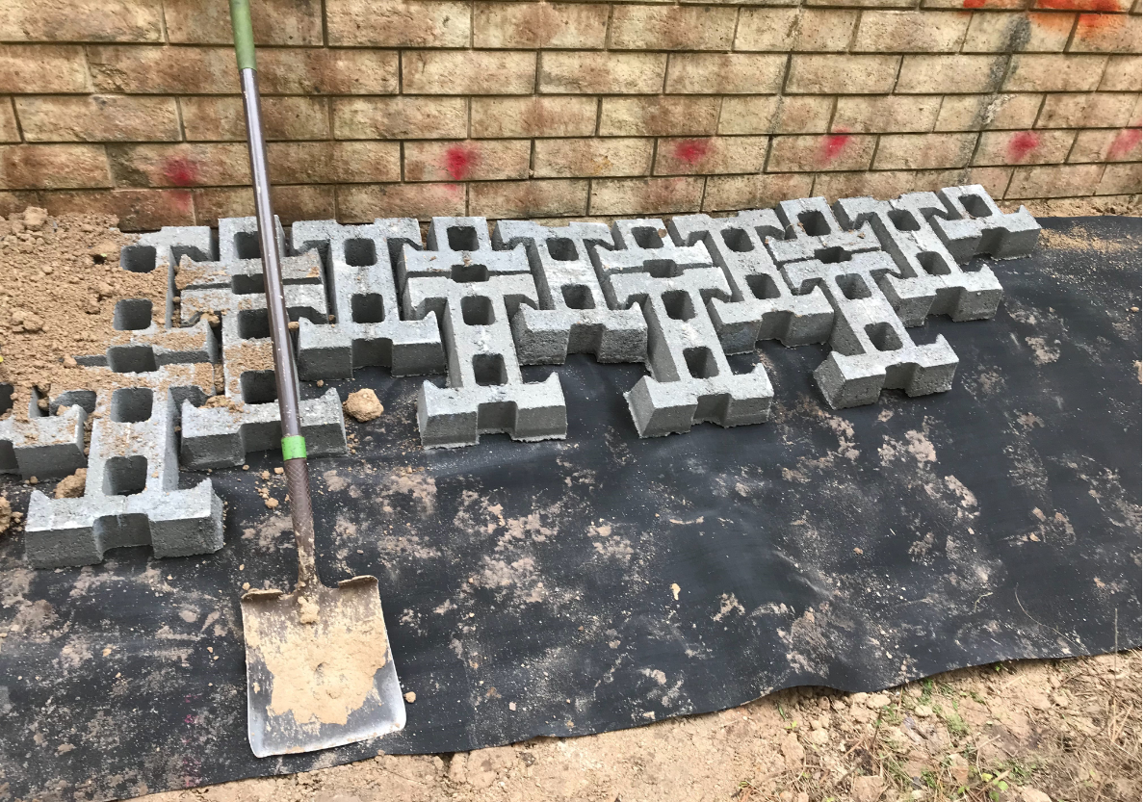
DTP – Erosion Point 8 – Saturday 23Feb2019
This photo shows the Cypress Creek side of the wall. Notice the interlocked Articulated Concrete Blocks (ACBs) placed on top of the black Geo Textile Fabric, which in turn is sitting on top of the newly placed “Common Fill” (i.e. – backfilled soil). These interlocking ACBs are designed to collectively withstand a Cypress Creek flood force 20 times greater than the force which a single ACB can withstand.

Slide 8
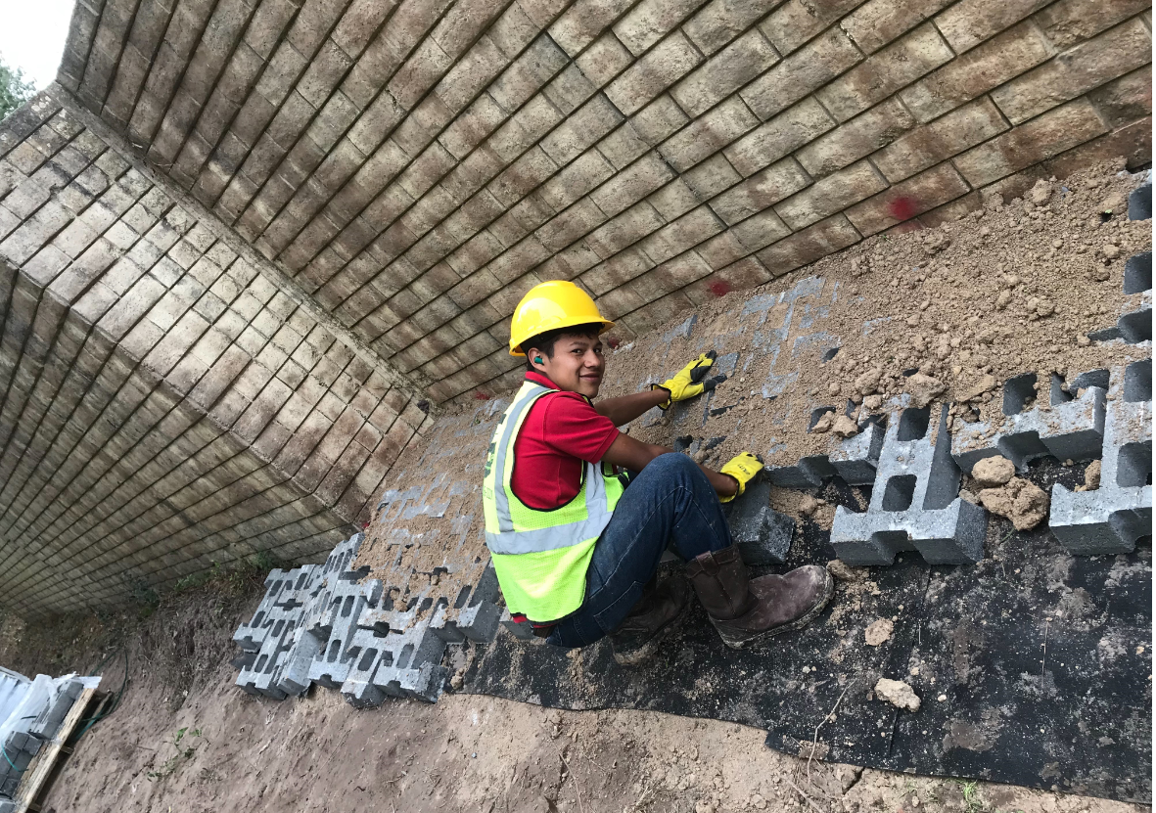
DTP – Erosion Point 8 – Saturday 23Feb2019
This photo shows the ACBs with backfilled soil filling in the voids within and between the ACBs.
Eventually, vegetation will grow into these soil filled voids.

Slide 9
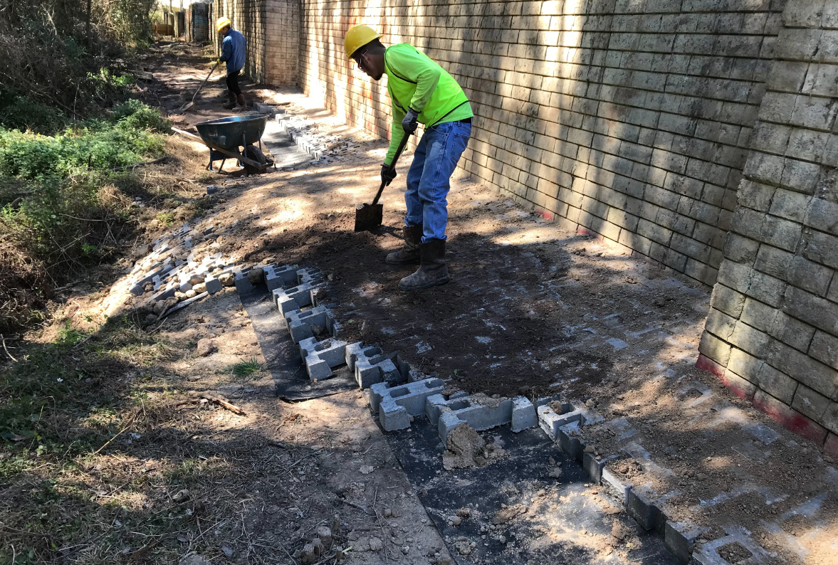
DTP – Erosion Point 8 – Sunday 24Feb2019
This photo shows all of the ACBs in place, and the backfill soil being applied to fill in the voids between and within the ACBs.
Notice that the top of the blocks are at the height of the red line indicated on the wall. In other words, our objective of the ground level being the same on both sides of the wall has been achieved.
Lastly, notice some of the the ACBs extending down the hill; this is the area which experienced the most severe erosion.

Slide 10
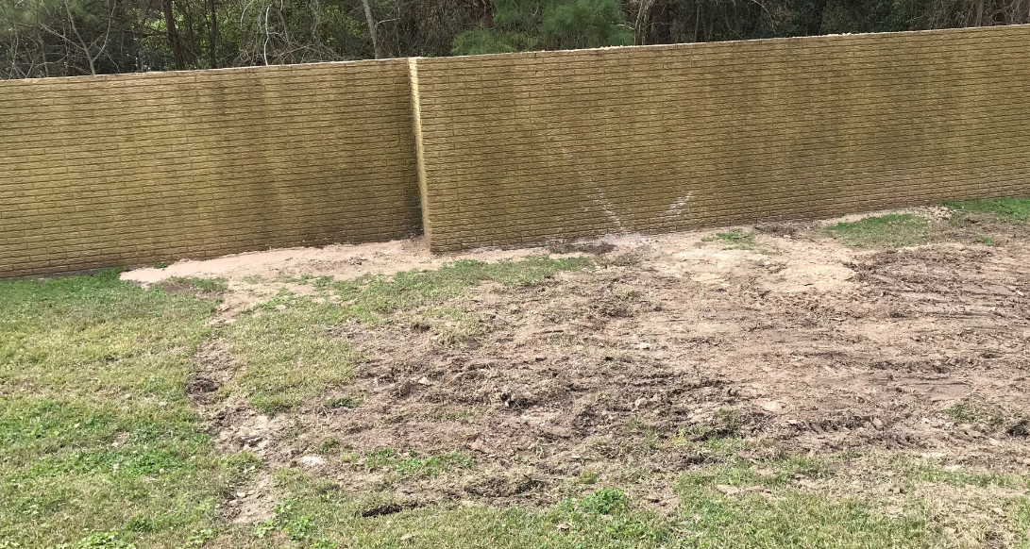
DTP – Erosion Point 8 – 24Feb2019
This photo shows the DTP Park side of the wall. Notice that the two sink holes, previously shown on slide 5, have been backfilled with soil, and the soil compacted.

Slide 11
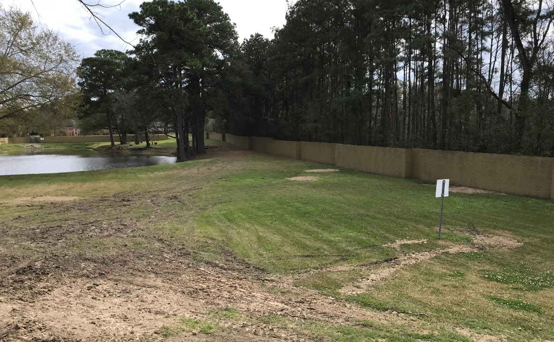
DTP – Erosion Point 8 – 24Feb2019
This photo shows the DTP Park low areas, previously shown on slide 6, backfilled with common fill.
The white arrows indicate the five low areas which received common fill dirt.

Slide 12
DTP – Erosion Point 8 – 24Feb2019
Any questions?

