Slide 1
SPEAK OUT OUTREACH (OUR HOME OF HOPE FOR MANKIND.) a 51c(3) Organization. AMERICAN, AFRICAN AND YOUNG ADULT, EMPOWERMENT. 2021.

Slide 2
EMPOWERMENT TOOLS
1.) SCHOOL OF KNOWLEDGE
Knowledge represents facts, information, and skills acquired through experience or education; the theoretical or practical understanding of a subject.

Slide 3
EMPOWERMENT TOOLS
VOCATIONAL TRAINING contd.
CARPENTRY
PLUMBING
AUTOMOBILE REPAIRS
ELECTRICAL WIRING
PHOTOGRAPHY
DRESS MAKING
OIL AND GS TECHNICIANS

Slide 4
EMPOWERMENT TOOLS
2.) VOCATIONAL TRAINING
We engage African youth in vocational training in in areas such as
PAINT PRODUCTION,
TIE AND DYE,
SHOE AND
BAG MAKING.

Slide 5
EMPOWERMENT TOOLS
OUR TRAINING GRAPHICS
BELOW ARE SOME OF OUR TRAINING GRAPHICS

Slide 8
EMPOWERMENT TOOLS
3.) EMPOWERMENT THROUGH INVESTMENT
We provide jobs through our investment in
AGRICULTURE
SOLAR PANELS INSTALLATION
CASHEW NUT PLANT.
FROZEN CHICKEN
CHICKEN FARM
WATER PLANT
HOUSING .

Slide 9
EMPOWERMENT TOOLS
3.) EMPOWERMENT THROUGH INVESTMENT
SOLAR PANELS INSTALLATION
CASHEW NUT PLANT.
FROZEN CHICKEN
CHICKEN FARM
WATER PLANT
HOUSING .

Slide 10
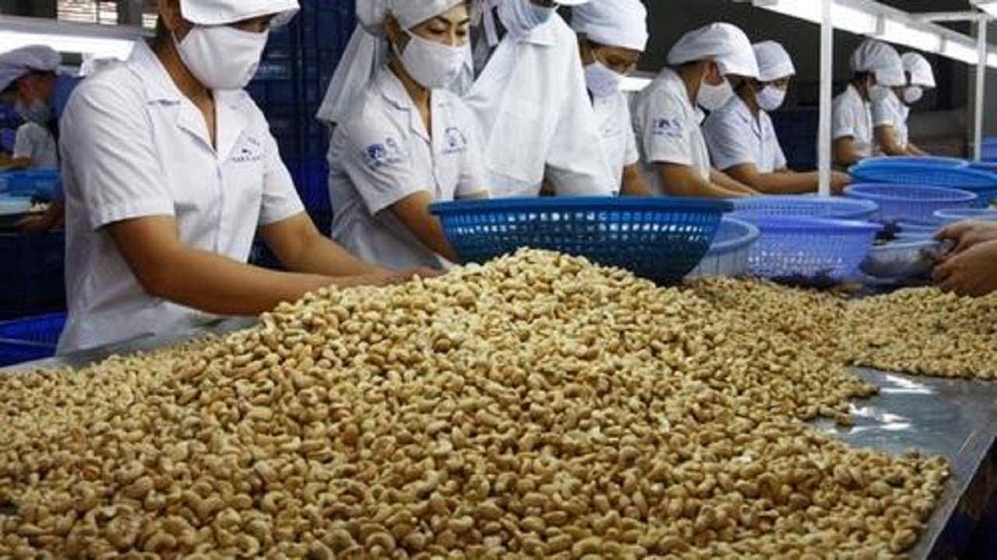
EMPOWERMENT TOOLS
3.) EMPOWERMENT THROUGH INVESTMENT
CASHEW NUT PLANT.
FROZEN CHICKEN
POULTRY
WATER PLANT
HOUSING .

Slide 11
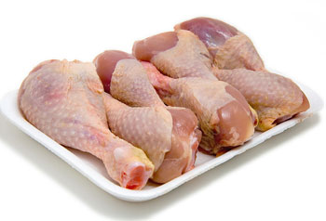
EMPOWERMENT TOOLS
3.) EMPOWERMENT THROUGH INVESTMENT
We provide jobs through our investment in
FROZEN CHICKEN
POULTRY
WATER PLANT
HOUSING .

Slide 12
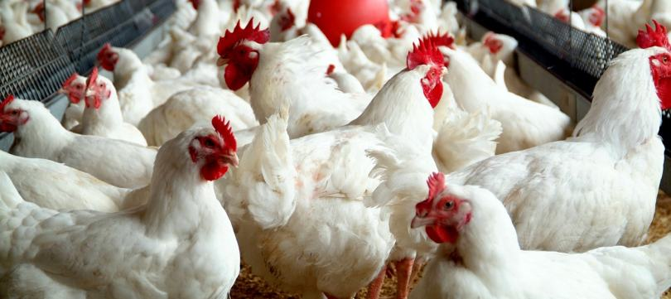
EMPOWERMENT TOOLS
3.) EMPOWERMENT THROUGH INVESTMENT
We provide jobs through our investment in
POULTRY
WATER PLANT
HOUSING .

Slide 13
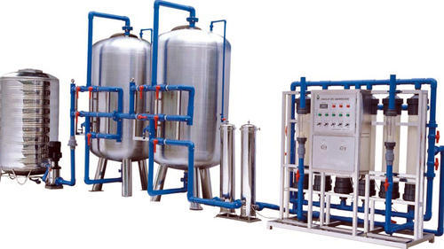
EMPOWERMENT TOOLS
3.) EMPOWERMENT THROUGH INVESTMENT
We provide jobs through our investment in
WATER PLANT
.

Slide 14
EMPOWERMENT TOOLS
4.) EMPOWERMENT THROUGH HOUSING
We also aim to support governments and private entities in the provision of the basic human need of housing through a project called.
AMERICAN CITY IN NIGERIA (NAMERICA)
FROZEN CHICKEN
POULTRY
WATER PLANT
HOUSING .

Slide 15
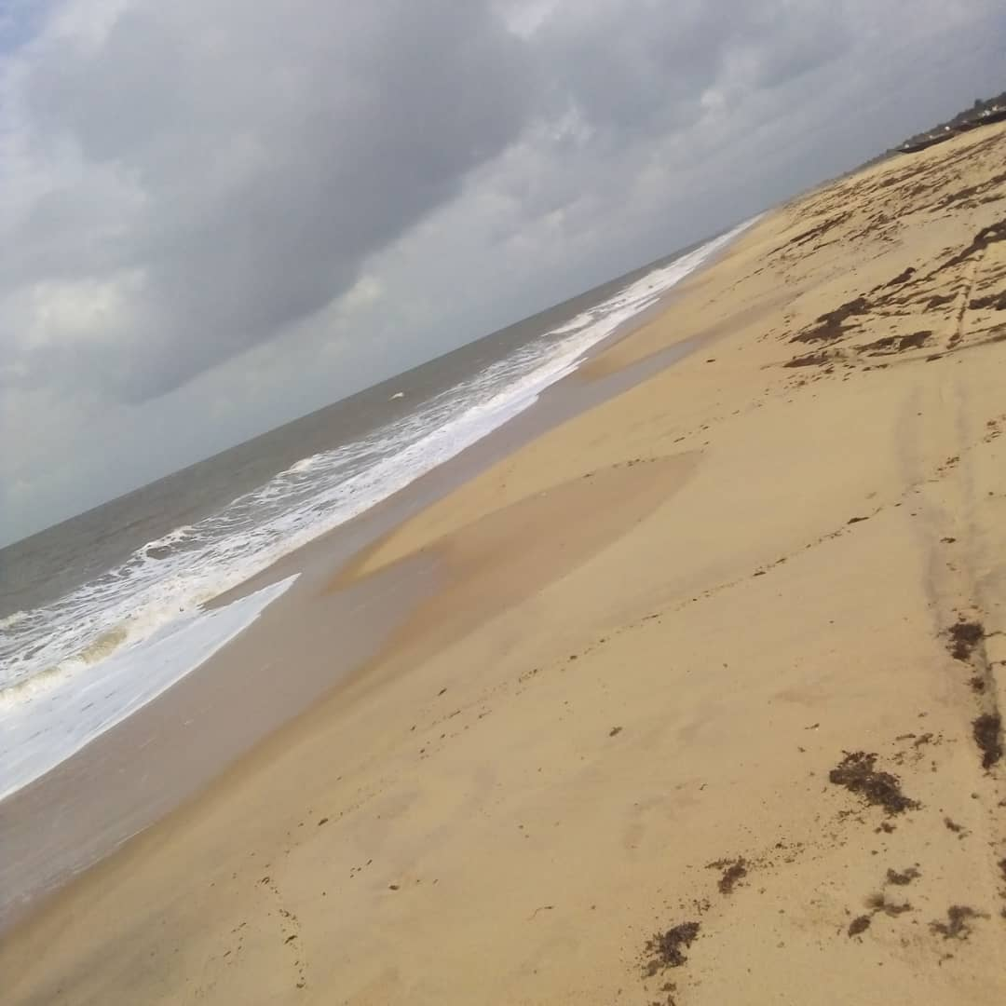
EMPOWERMENT TOOLS
4.) EMPOWERMENT THROUGH HOUSING
FROZEN CHICKEN
POULTRY
WATER PLANT
HOUSING .

Slide 16
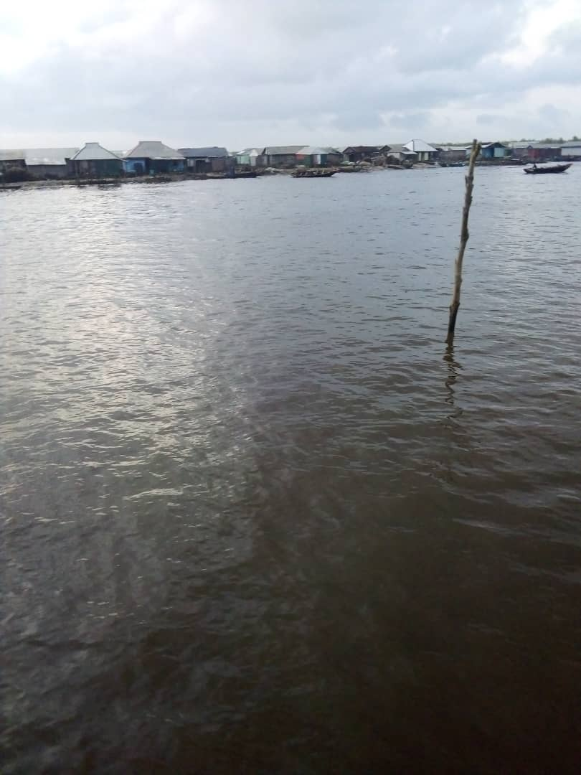
EMPOWERMENT TOOLS
4.) EMPOWERMENT THROUGH HOUSING
FROZEN CHICKEN
POULTRY
WATER PLANT
HOUSING .

Slide 17
CONCLUSION
We require your support to continue our strides towards the empowerment of our teeming youth and reducing the unemployment burden in Africa.

Slide 18
THANK YOU FOR LISTENING

