Slide 1
Sheila Theodorou
Bureau Director
Community Services
Office of Developmental Programs

Slide 2
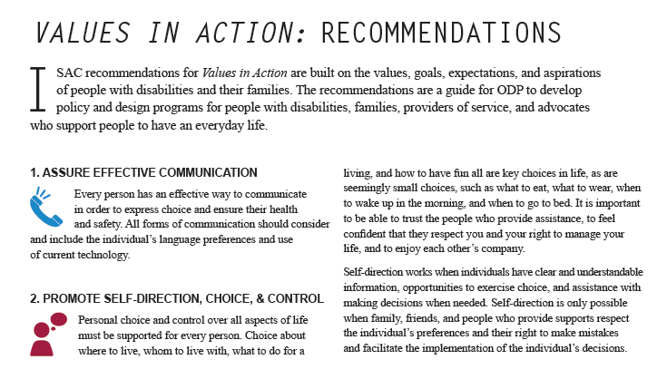

Slide 3
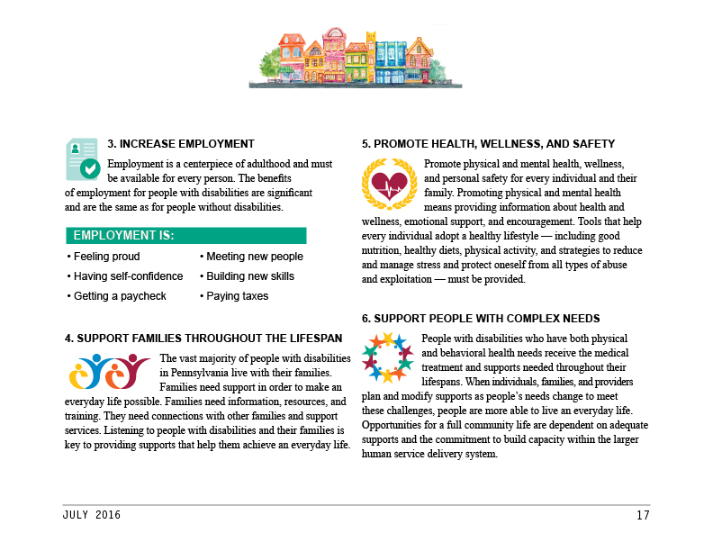

Slide 4
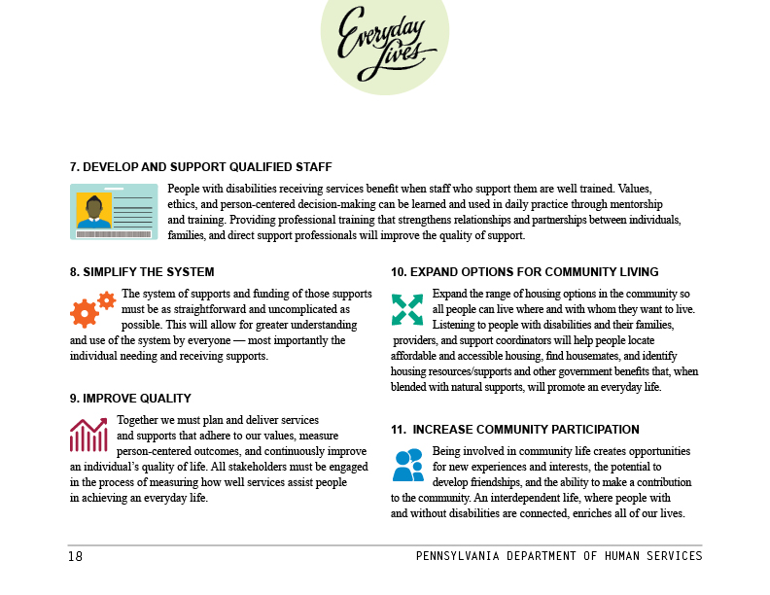

Slide 6
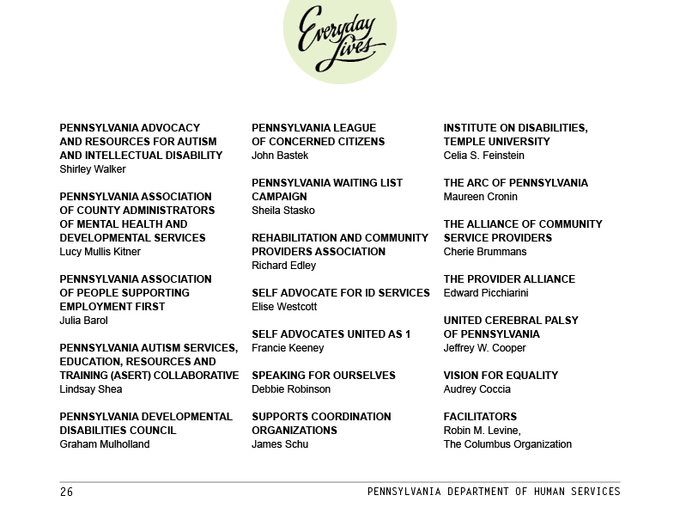

Slide 7
The Next Steps
Implement ISAC Recommendations
Renewing Our Waivers *
Incentivize employment
Promote full inclusion in the community
Greater supports for families
More independent living options
New Service Rates*
Implement New Federal HCBS Rule
Employment; inclusion and rights
Training
New 6100 Regulations *
Promote full inclusion
Reflect the HCBS Rule
Rollout Supporting Families Community of Practice
ISAC serve as Quality Council and measure progress on Everyday Lives
* Will be issued for public comment

Slide 8
PFDS and Consolidated Waiver Renewal Development Time Line
Waiver Renewal
6100 Regs
Rates Setting
Key Dates
Oct - Dec ‘15
Jan – ‘16
June – ‘16
July – ‘16
Aug – Sept ‘16
Oct – Nov ‘16
Dec ‘16 – Jan ‘17
Feb-Mar ‘17
July ‘17
Oct‘17
Jan ‘18
ODP Research and internal work on application
PA Bulletin notice A-H
Waiver public comm period
MAAC
Develop App. I & J
PA Bulletin notice I & J
Publish response to public comments for A-H
Revisions based on comments
Review and Appendix J comments and revise
Community Engagement Work group
Waiver app finalized Appendix
A - H
Publish
response to
public
comments
for I-J
6100 regs
Promulgation
in PA Bulletin.
5 Public Forums
& Webinars to
hear stakeholder input
Provider fiscal work group mtngs. and recommendations
Service
definitions finalized
Internal DHS review of A-H
Waivers Effective
Residential provider survey
Residential rate simulation begins
Webinars on Waivers for Stakeholders
Provider
Meetings on Waiver changes
6100 regs
Proposed
in PA Bulletin.
Sept. 2016
45 day comment period
Implement Residential Rates
Rate development
Waivers Submitted to CMS
ISAC work Everyday Lives
Values and Recommendations

