Slide 1
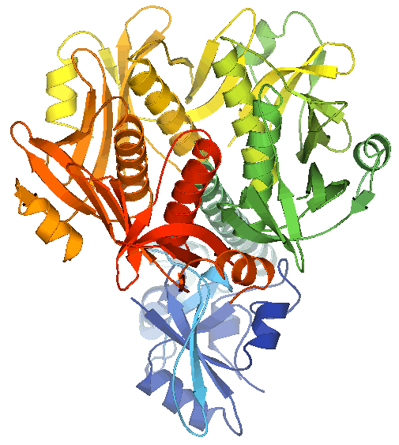
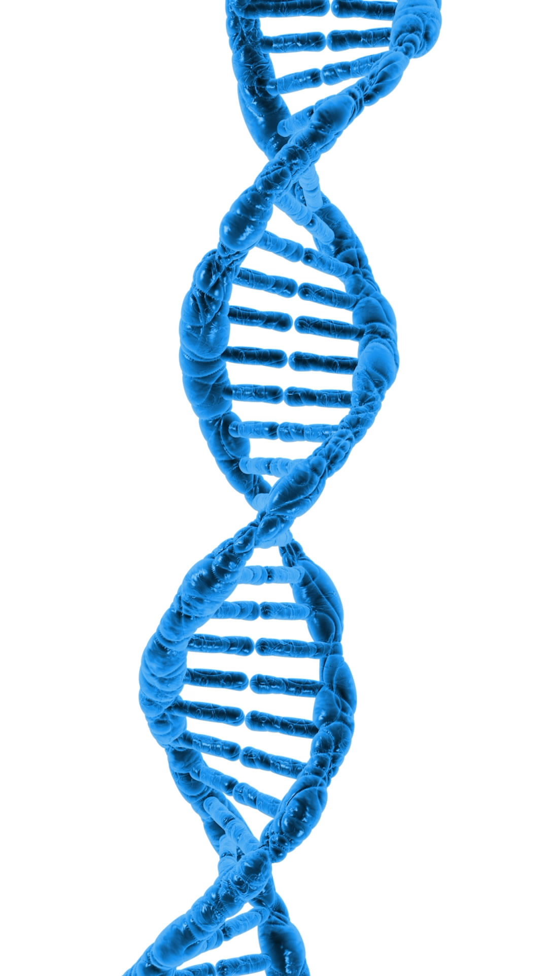
Gel Electrophoresis
Purpose: separate molecules by size and/or charge
In molecular biology these are usually DNA/RNA or proteins
Requires:
a matrix (gel) for molecules to travel through
(usually agarose or polyacrylamide)
2) A constant electrical current forcing molecules to move
Exhibit: home made agar gel electrophoresis
Separate food coloring by size in an agar matrix
Agar – agar agar from Li Ming Global Mart
Power supply – 9 V batteries
Paper clips
gel box – lid from pipette tip container
Gel comb – 3D printed
Running buffer – borax; loading buffer – corn syrup
Primary colors are
red, blue, yellow
Question is:
What colors are green and
purple made from?

Slide 2
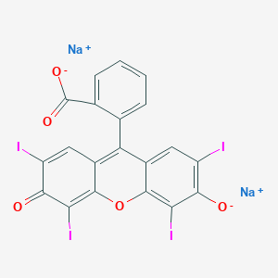
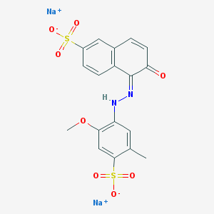
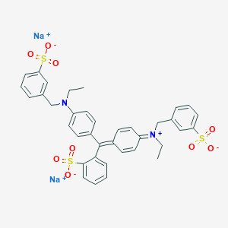
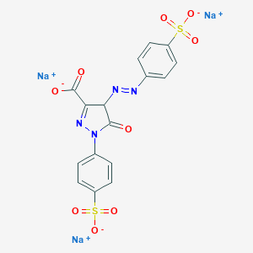
Food Dye Electrophoresis
Gel matrix separates molecules by size and charge
Red 3
Red 40
McCormick Food dyes are
a composition of the four dyes
to the left
Red = Red 3 + Red 40
Yellow = Yellow 5 + Red 40
Blue = Blue 1 + Red 40
Green = Yellow 5 + Blue 1
MW: 879.86, charge -2
Absorbance max 530 nm
MW: 496.42, charge -2
Absorbance max 504 nm
Blue 1
Yellow 5
Purple = mix Red + Blue 1:1
Questions:
Which electrode will the dyes migrate to,
the anode (+) or cathode (-)?
Which color/dye will move faster?
Can you tell the composition of green and
purple from the migration patterns?
MW: 792.84, charge -2
Absorbance max 628 nm
MW: 534.36, charge -3
Absorbance max 470 nm
North Carolina Essential Standards Bio.3.3.1
Summarize the process of gel electrophoresis as a technique to separate molecules based on size

