Slide 1
New Administrator Workshop Agenda
Welcome Kathleen Taylor
What’s a Framework Eric Owens
Basic Skills Kathleen Taylor
Essential Components to CTE Stefany Deckard
Questions and Answers Group

Slide 2
Curriculum and Programmatic Overview
Eric Owens
Director, CTE Programs

Slide 3
Career and Technical Education
Middle school A.S./A.A.S. degrees
Prepare for occupations requiring less than a 4-year degree
Aligned with the 17 national career clusters and Enterprise Florida’s target industry sectors
“Based on the needs of business and industry”
Program standards developed by business and industry

Slide 4
Career Clusters
Agriculture, Food &
Natural Resources
Architecture &
Construction
Arts, A/V Technology &
Communication
Business, Management
& Administration
Education & Training
Energy
Engineering & Technology
Education
Financial Services
Government & Public
Administration
Health Science
Hospitality & Tourism
Human Services
Information
Technology
Law, Public Safety &
Security
Manufacturing
Marketing, Sales &
Service
Transportation,
Distribution & Logistics

Slide 5
CTE Programs
Each program has a curriculum framework
Secondary and district PSAV programs are comprised of a sequence of courses defined in the curriculum frameworks and the Course Code Directory
College program (credit and PSAV) courses are defined by the offering institution

Slide 6
Curriculum Frameworks
Curriculum Frameworks are reviewed and revised on a three year rotation
With business and industry representatives and classroom teachers
Approved by the State Board of Education

Slide 7
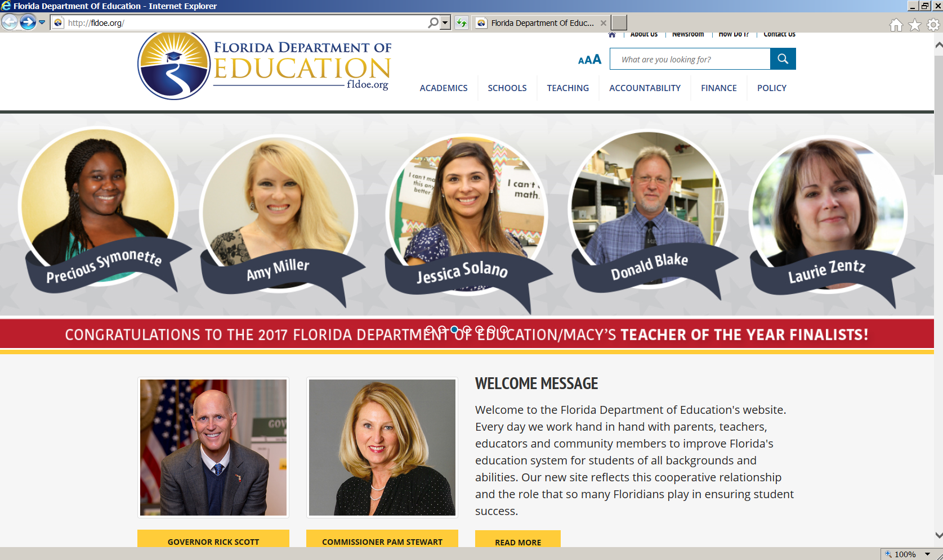
TWO ways to access the Career and Adult Education webpage…
Notes:
DCAE webpage can be found by going to fldoe.org. There are two ways to access the DCAE webage from homepage.
Click on the Academics Tab, then select Career and Adult Education
Go to fldoe.org, then scroll down to the Career and Adult Education section

Slide 9
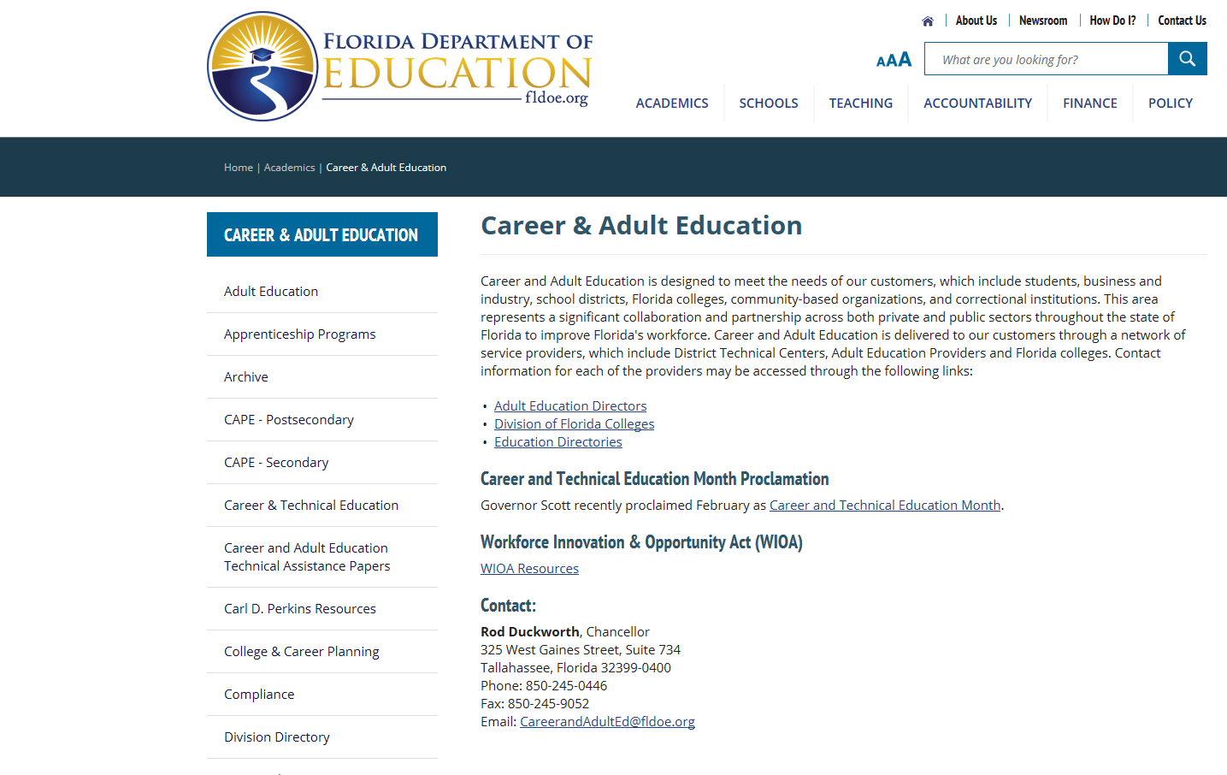
Select Career and Technical Education from left margin to locate Curriculum Frameworks

Slide 10
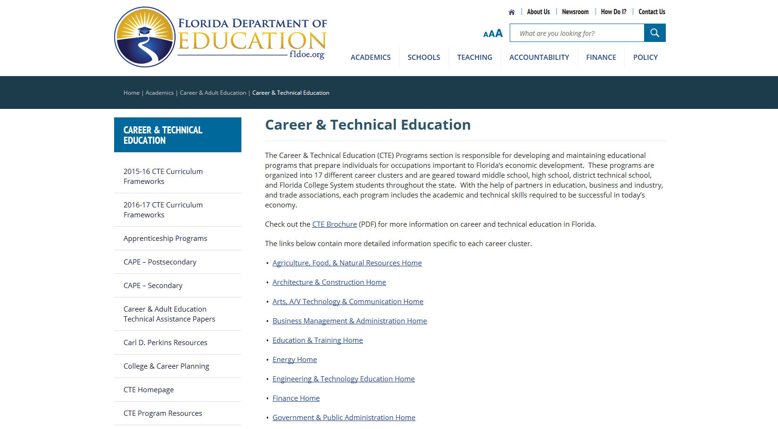

Slide 11
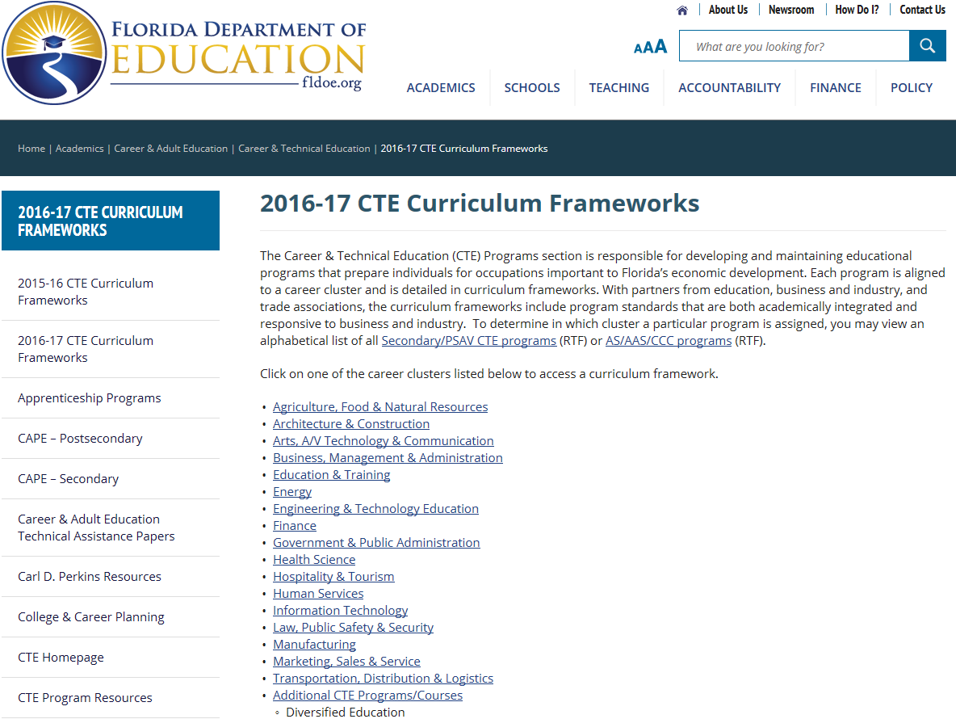
Listed alphabetically by career cluster

Slide 12
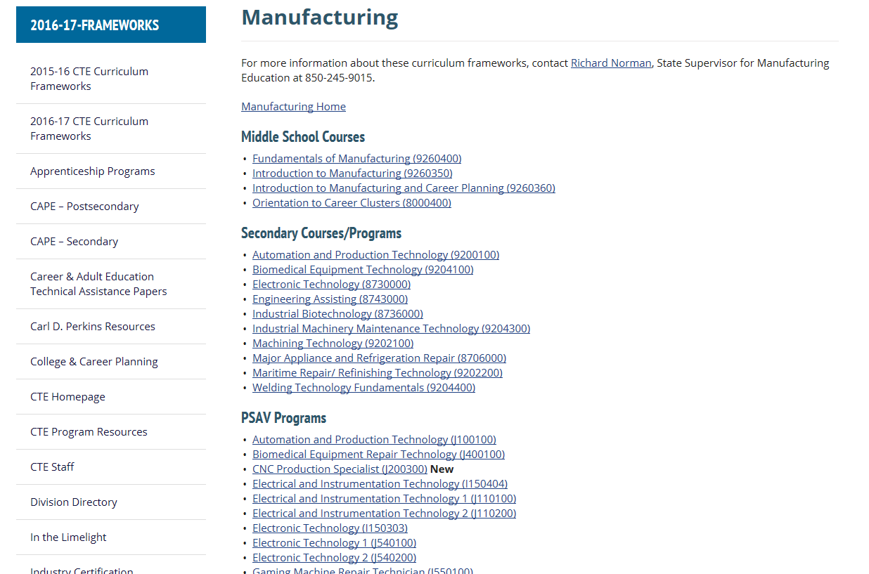

Slide 13
What's in a Framework
Everything you need to know about a CTE program!!!

Slide 14
Secondary Postsecondary ------------------------------------------------------------------------

Slide 15
Teacher Certification
Teacher Certification | METAL WORK 7G WELDING @7 7G

Slide 16
Standard Occupational Classification System (SOC)
SOC Codes (all applicable) | 51-9198 – Helpers-Production Workers 51-4121 – Welders, Cutters, Solderers, and Brazers
51-9198 – Helpers-Production Workers
51-4121 – Welders, Cutters, Solderers, and Brazers
http://www.onetonline.org/

Slide 17
Basic Skills
Basic Skills Level | Mathematics: 9 Language: 9 Reading: 9
Basic Skills
In PSAV programs offered for 450 hours or more, in accordance with Rule 6A-10.040, F.A.C., the minimum basic skills grade levels required for postsecondary adult career and technical students to complete this program are: Mathematics 9, Language 9, and Reading 9. These grade level numbers correspond to a grade equivalent score obtained on a state designated basic skills examination.
Exemptions are listed in Statutes included in the framework

Slide 18
Program Structure

Slide 19
Academic Alignment Table (Secondary only)

Slide 20
Standards Secondary Postsecondary

Slide 21
Benchmarks Secondary Postsecondary

Slide 22
Additional Information

Slide 23
CTE Program Resources

Slide 24
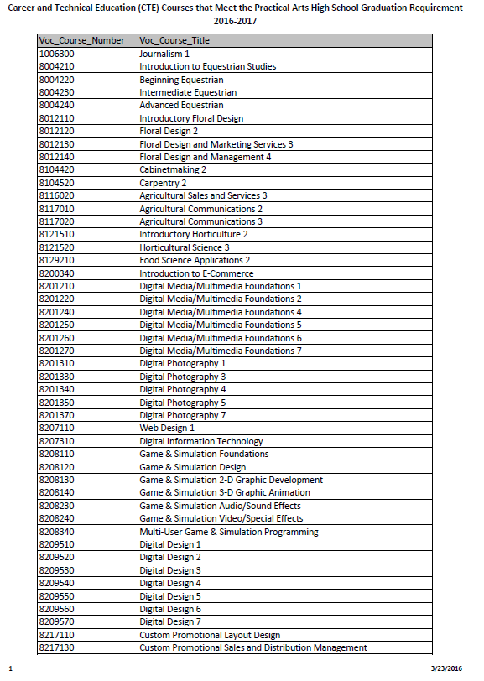

Slide 25
CTE Program Resources

Slide 26
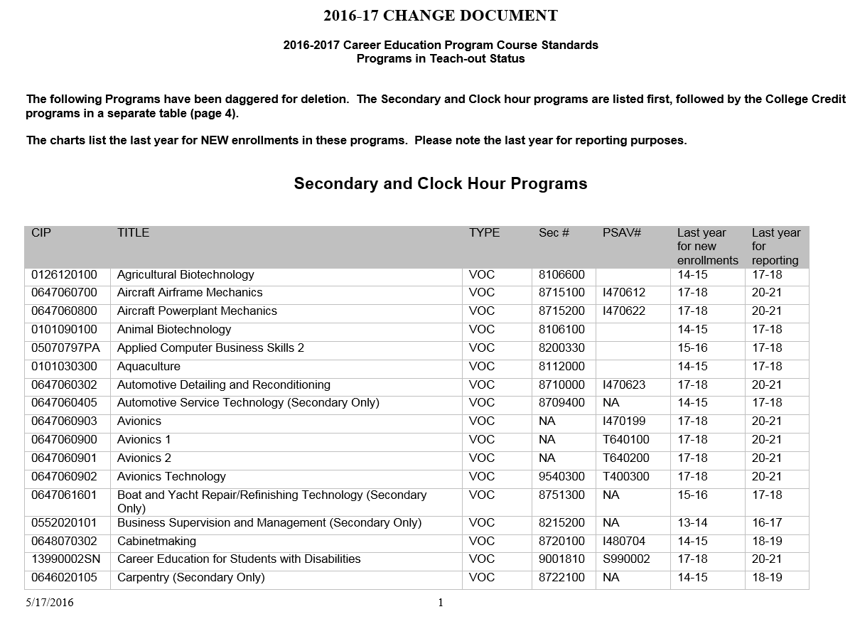

Slide 27
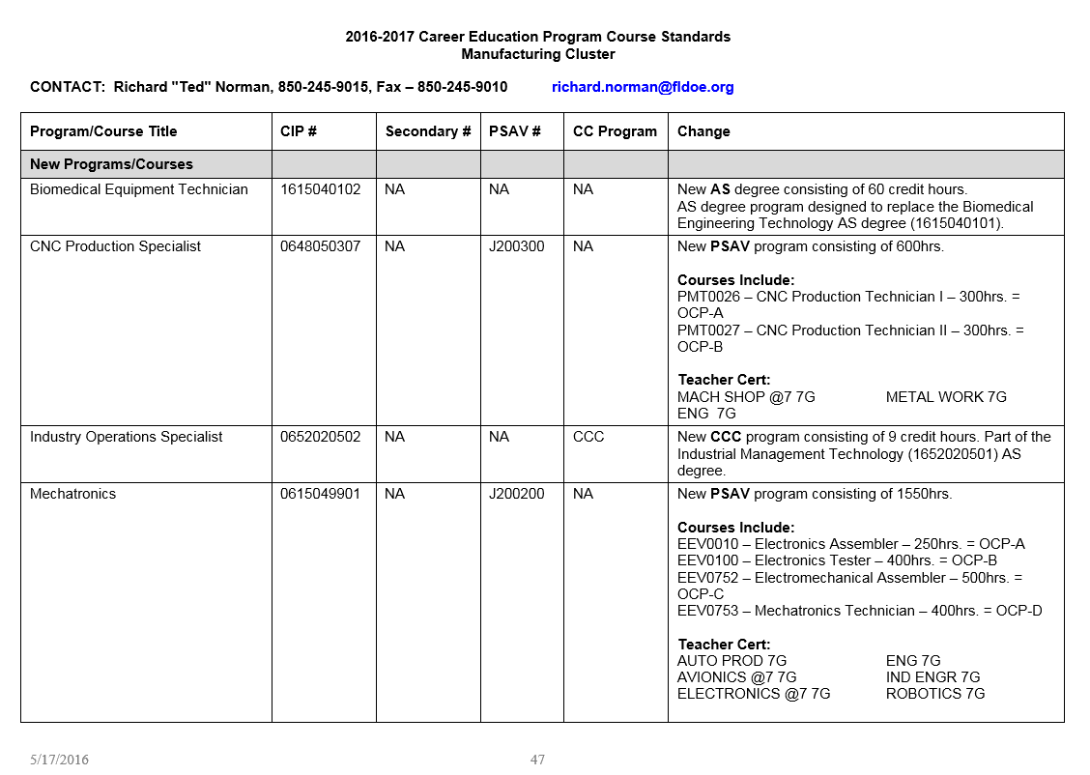

Slide 28
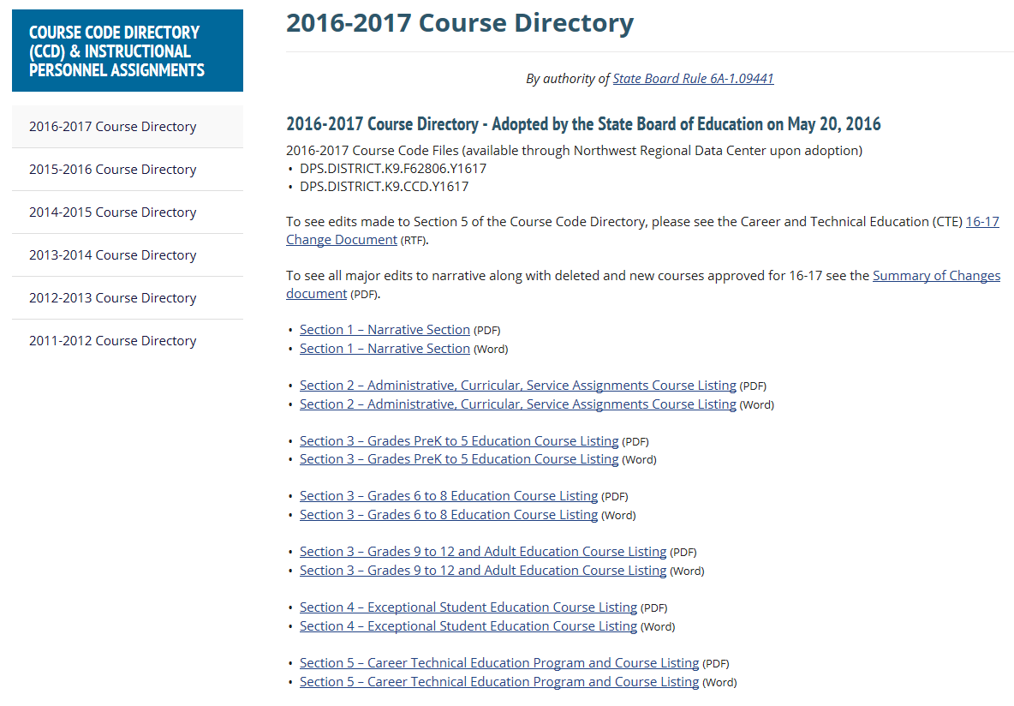

Slide 29
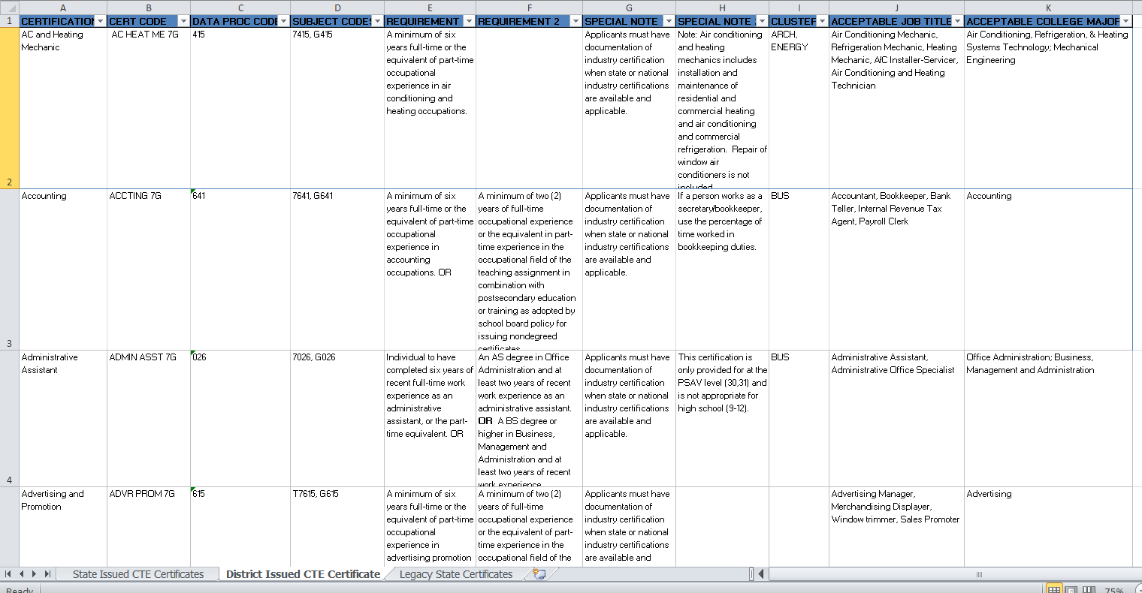

Slide 30
CTE Program Resources

Slide 31
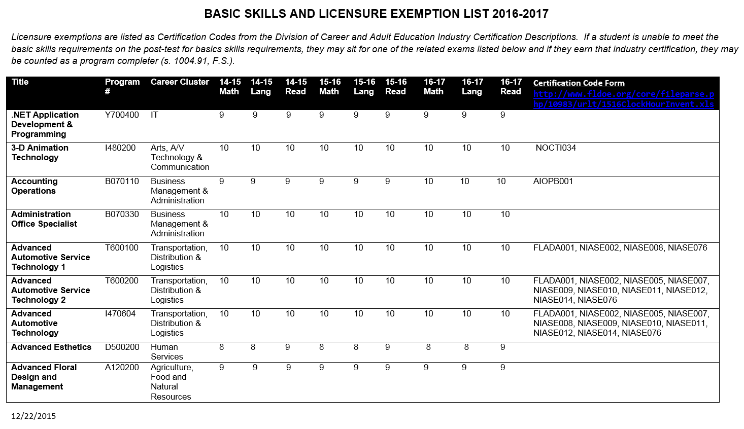

Slide 32
Future Additions
Course level teacher certifications rather than program level
Link to “My Career Shines”, an interactive resource to assist students in identifying their ideal career and to enhance their preparation for employment.
Are there enhancements which would assist you that we should consider?

Slide 33
Postsecondary Basic Skills Exit Requirements for Career Certificate Programs
Kathleen Taylor

Slide 34
Authority
Section 1004.91, Florida Statute
6A-10.040, Florida Administrative Code
Office of Civil Rights
Guidelines for Eliminating Discrimination and Denial of Services on the Basis of Race, Color, National Origin, Sex, and Handicap
FEDERAL REGISTER
WEDNESDAY, MARCH 21, 1979
Notes:
Both Florida Statute and Florida Administrative Code require assessment of CTE students within the first six weeks AFTER admission in a CTE program. Basic skills requirements listed in the curriculum frameworks for programs 450 hours or longer are EXIT requirements and may NOT be used to deny entry into a program.
The Office of Civil rights guidelines prohibit discrimination into CTE programs based on national origin, gender, disability, race, or color.
This is nothing NEW, the guidelines are from 1979 and are still valid today.

Slide 35
Section 1004.91, F.S. Requirements for career education program basic skills
Students who enroll in a program offered for career credit of 450 hours or more shall complete an entry-level examination within the first 6 weeks after admission into the program.
Each school district and Florida College System institution that conducts programs that confer career and technical certificates shall provide applied academics instruction through which students receive the basic skills instruction required pursuant to this section.
Notes:
A student may be tested prior to admission as long as the test scores are not used to deny entry.
This would include dual enrolled secondary students.

Slide 36
Section 1004.91, F.S. Requirements for career education program basic skills
(3)(a) An adult student with a disability may be exempted from this section.
(b) The following students are exempt from this section:
1. A student who possesses a college degree at the associate in applied science level or higher.
2. A student who demonstrates readiness for public postsecondary education pursuant to s. 1008.30 and applicable rules adopted by the State Board of Education.
3. A student who passes a state or national industry certification or licensure examination that is identified in State Board of Education rules and aligned to the career education program in which the student is enrolled.
4. An adult student who is enrolled in an apprenticeship program that is registered with the Department of Education in accordance with chapter 446.
Notes:
Rule 6A-10.0315
If a student cannot reach the requirements on a basic skills test, they may sit for a related examination. If they pass that exam, they may be counted as a completer. The school may allow the student to sit for an exam is they have successfully completed all the requirements except the basic skills.

Slide 37
Essential Components to CTE
Stefany Deckard

Slide 38
Florida’s Career and Technical Student Organizations

Slide 39
Career and Technical Student Organizations
Florida Business Professionals of America (BPA)
Florida Collegiate DECA (Delta Epsilon Chi)
Florida DECA (DECA)
Florida Family, Career and Community Leaders of America (FCCLA)
Florida FBLA Association.
Florida FFA Association
Florida Health Occupations Students of America (HOSA)
Florida Phi Beta Lambda
Florida Public Service Association (FPSA)
Florida SkillsUSA
Florida Technology Association (TSA)

Slide 40
Purpose of CTSOs
To function as an integral part of the curriculum
Extra-curricular--NO
Intercurricular—YES
Co-curricular –YES
To provide opportunities for students to develop
Technical skills
Leadership skills
Personal skills
To provide for active student participation
Local, state and national levels
Notes:
.

Slide 41
State Leadership

Slide 42
Division of Career and Adult Education
Office of the Chancellor
Rod Duckworth
K12 Liaison
Stefany Deckard
Budget, Accountability and Assessment
Tara Goodman
Grants Administration
Gloria Spradley-Brown
Standards, Benchmarks and Frameworks
Kathleen Taylor
Educational Initiatives
Belinda Chason
FCS Liaison
Wendy Sikora

Slide 43
Division of Career and Adult Education
Budget Accountability, and Assessment
Tara Goodman, Chief
Research and Evaluation
Tara McLarnon
CAPE Industry Certification Manager
Sean Friend
GED Testing Manager
Diane Vaccari

Slide 44
Division of Career and Adult Education
Grants Administration and Compliance
Gloria Spradley-Brown
Compliance
Tashi Williams
Grants Administration
Marcy Sieg
Farmworker Jobs and Education Programs
Mario Zuniga

Slide 45
Division of Career and Adult Education
Standards, Benchmarks, and Frameworks
Kathleen Taylor
Career and Technical Education
Eric Owens
Adult Education
Zelda Rogers
Apprenticeship
Ken Olsen
Federal and State Initiatives
Amy Albee-Levine
State Supervisors
Staff

Slide 46
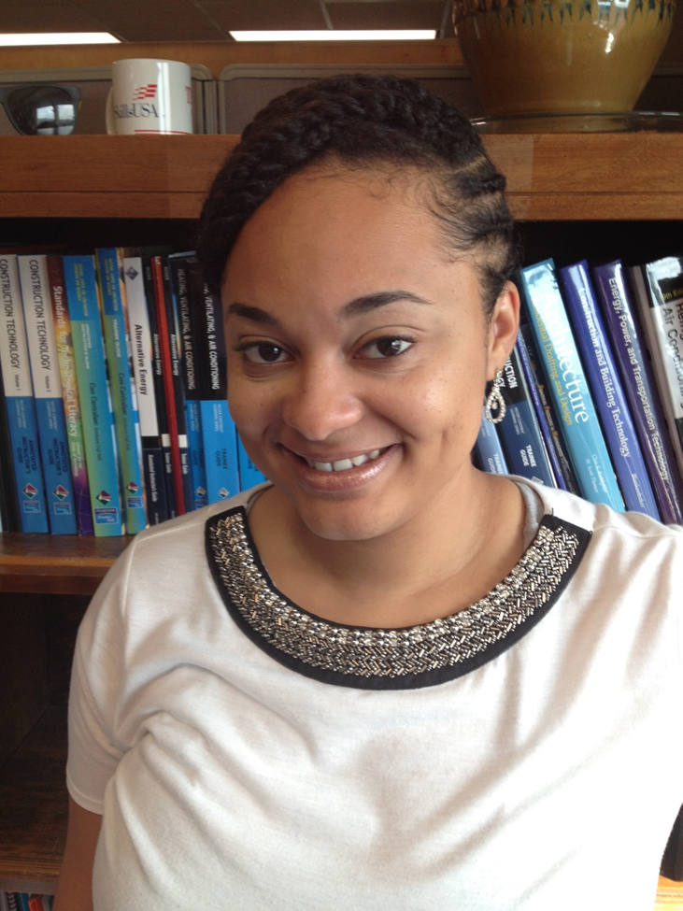
CTE STATE SUPERVISORS
Alicia Alexander
(850) 245-9900
Alicia.Alexander@fldoe.org
Business Management & Administration Finance

Slide 47
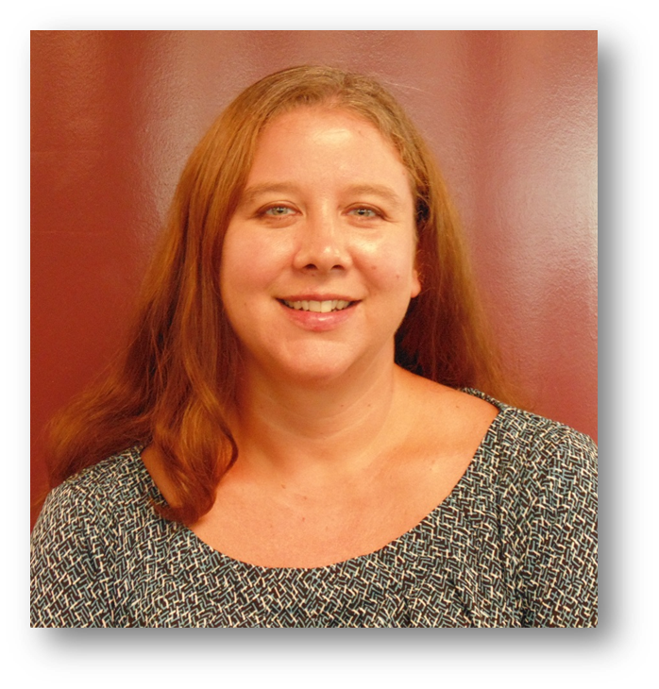
CTE STATE SUPERVISORS
Jerris Cross
(850) 245-9013
Jerris.Cross@fldoe.org
Arts, A/V Technology & Communication
Marketing, Sales & Service
Diversified Education
Florida DECA, Collegiate DECA, and Career Education Clubs of FL (CECF) grants manager
FFA Grant Manager

Slide 48
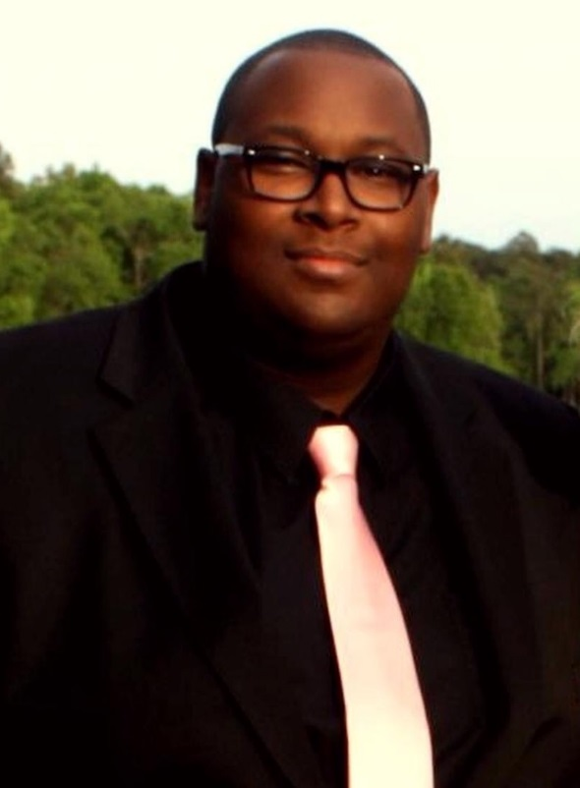
CTE STATE SUPERVISORS
Vaughn Hendriex
(850) 245-0663
Vaughn.Hendriex@fldoe.org
Human Services
Government & Public Admin.
Law, Public Safety & Security
FPSA Grant Manager

Slide 49
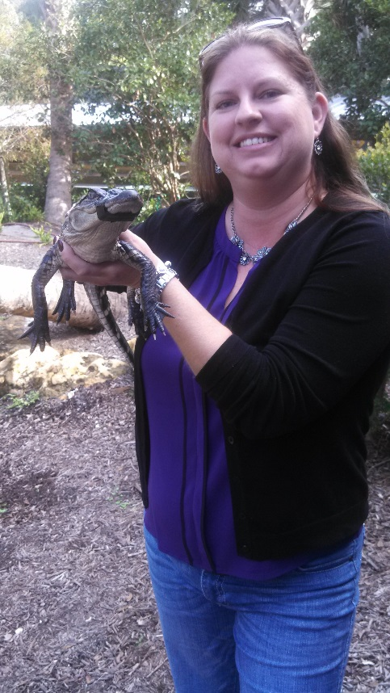
CTE STATE SUPERVISORS
Amy McAllister
(850) 245-9017
Amy.McAllister@fldoe.org
Agriculture, Food & Natural Resources
FFA Grant Manager

Slide 50
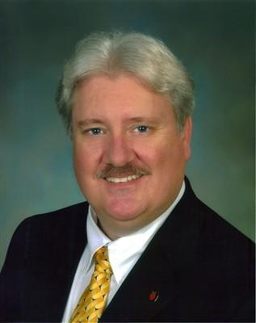
CTE STATE SUPERVISORS
Ted Norman
(850) 245-9015
Richard.Norman@fldoe.org
Manufacturing
Transportation, Distribution & Logistics
Engineering & Technology Education
TSA Grant Manager

Slide 51
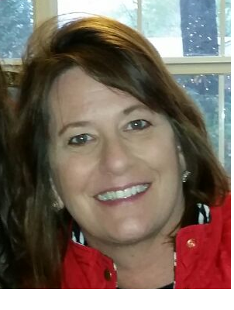
CTE STATE SUPERVISORS
Anne Nyman
(850) 245-9900
Anne.nyman@fldoe.org
Education and Training
Hospitality, Travel & Tourism
FCCLA CTSO Grant Manager

Slide 52
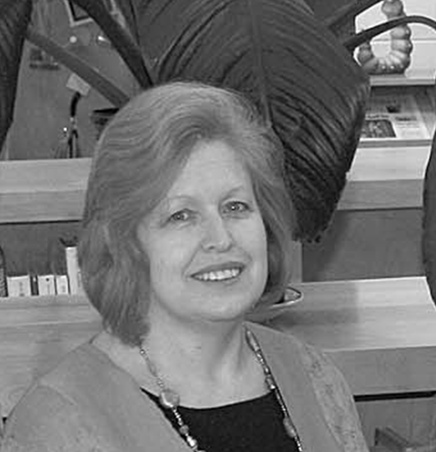
CTE STATE SUPERVISORS
Debbie Perdue
(850) 245-9003
Debra.Perdue@fldoe.org
Information Technology
FBLA Grant Manager

Slide 53
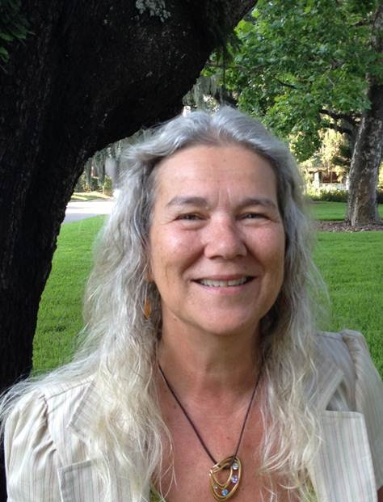
CTE STATE SUPERVISORS
Jane Silveria
(850) 245-9022
Jane.Silveria@fldoe.org
Special Populations
Equity
CTE Assessment

Slide 54
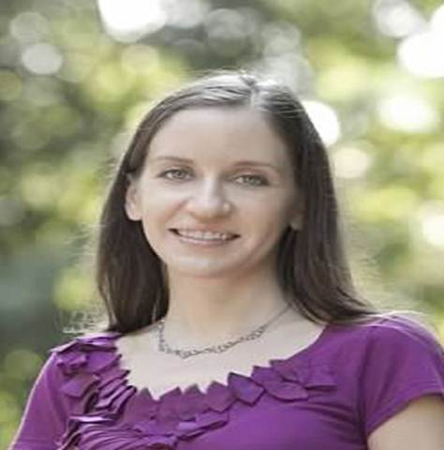
CTE STATE SUPERVISORS
Kathryn Frederick Wheeler
(850) 245-9016
Kathryn.Frederick@fldoe.org
Architecture & Construction
Energy
SkillsUSA Grant Manager

Slide 55
CTE STATE SUPERVISORS
Tracy Yacobellis
(850) 245-9018
Tracy.Yacobellis1@fldoe.org
Health Science
HOSA Grant Manager

Slide 56
Advisory Boards

Slide 57
Why are Program Advisory Boards Essential?
Essential Functions
Discussion
Focus on Improvement
Building Relationships
Provide Expertise
Required by Perkins!
ACTIVITIES
Curriculum development
Public relations
Job placement
Recruiting
In service training
Leadership
Legislative
Program evaluation

Slide 58
Who should I contact with concerns about:
Perkins – Kathleen Taylor (850/245-9062)
Industry Certification/CAPE Funding - Sean Friend
(850/245-9030)
ESSA (Every Student Succeeds Act) – Stefany Deckard (850/245-9439)

Slide 59
Who should I contact with concerns about:
Perkins – Kathleen Taylor (850/245-9062) or
Amy Albee (850/245-0949
Industry Certification/CAPE Funding - Sean Friend
(850/245-9030)
ESSA (Every Student Succeeds Act) – Stefany Deckard (850/245-9439)

